Slide 1

Learning to Localize and Anonymize Objects with Indirect Supervision
Yong Jae Lee
University of California, Davis

Slide 2
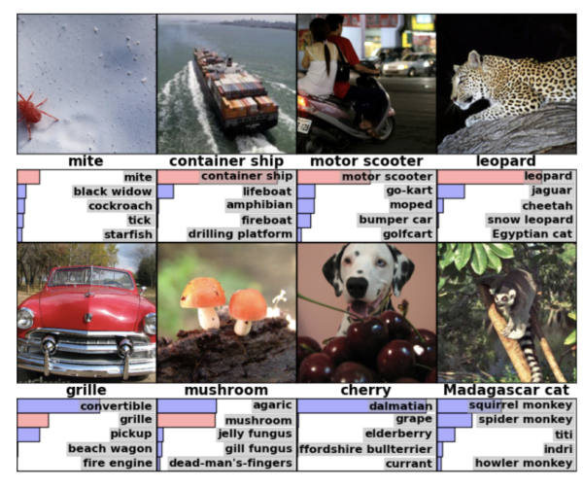
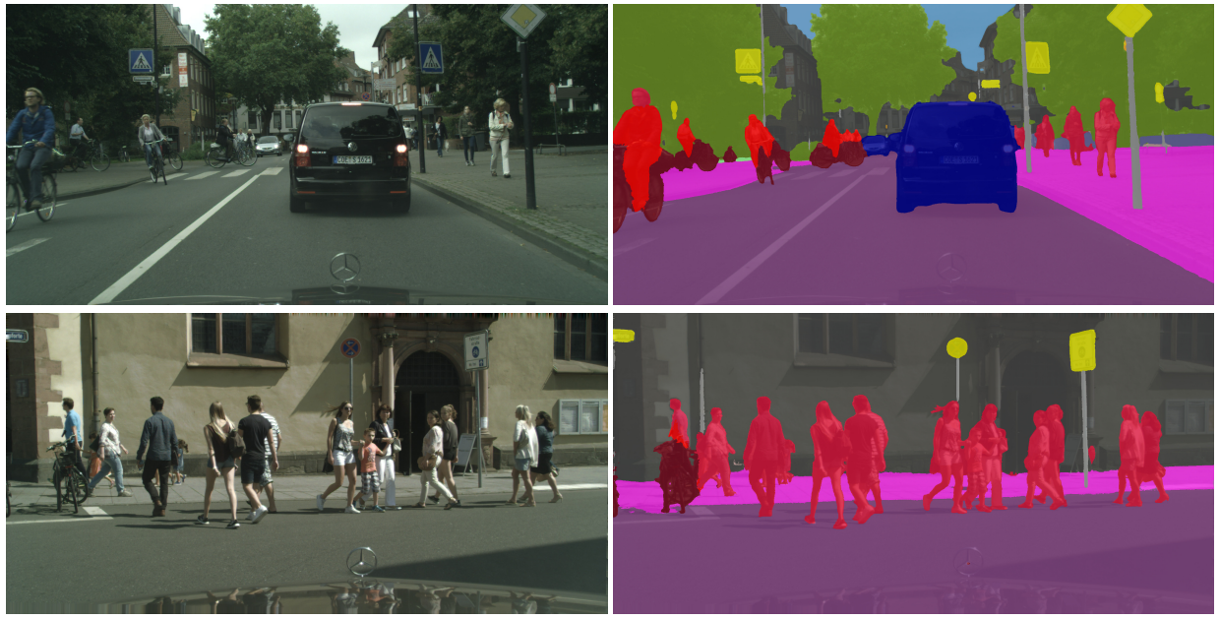
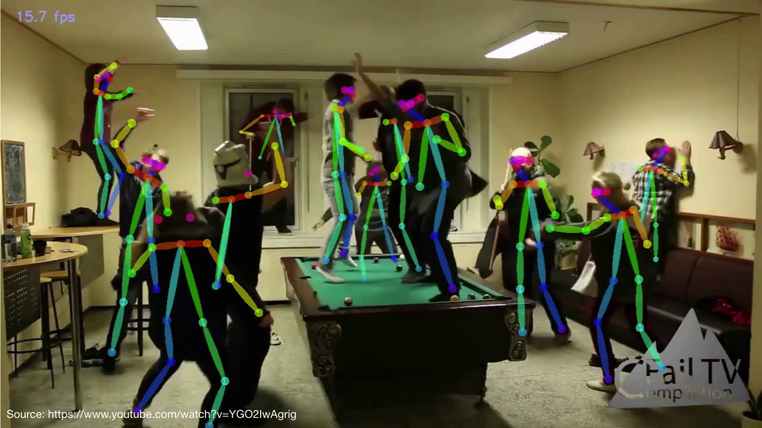
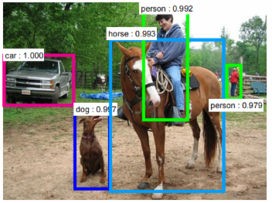
Success in modern visual recognition research
Image classification
Semantic segmentation
… and many more
Pose recognition
Object detection
Notes:
Visual recognition research has had tremendous success in recent years on a variety of problems including image classification, semantic segmentation, pose recognition, object detection and many others..

Slide 3
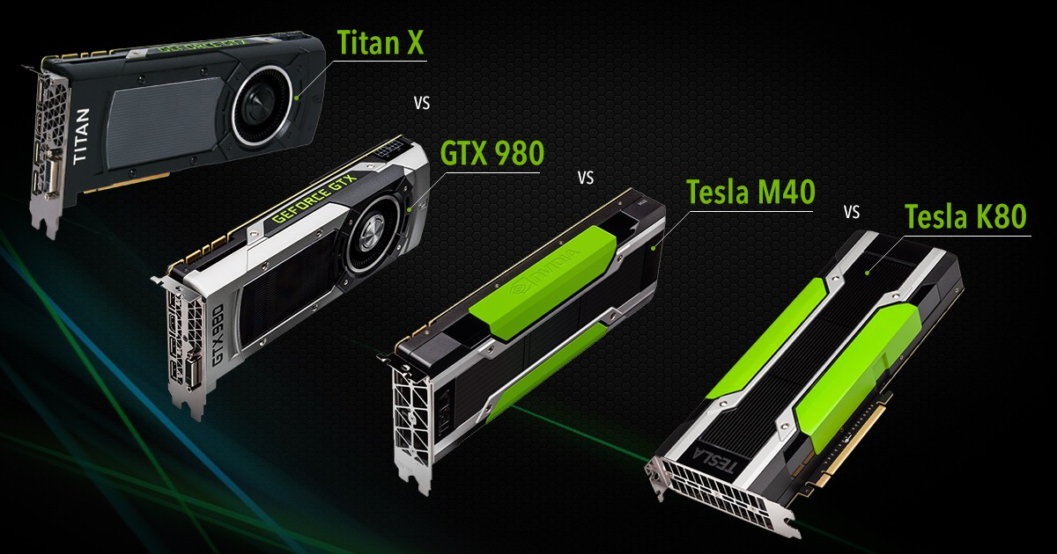
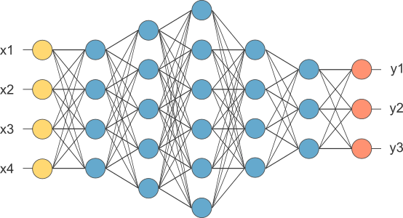
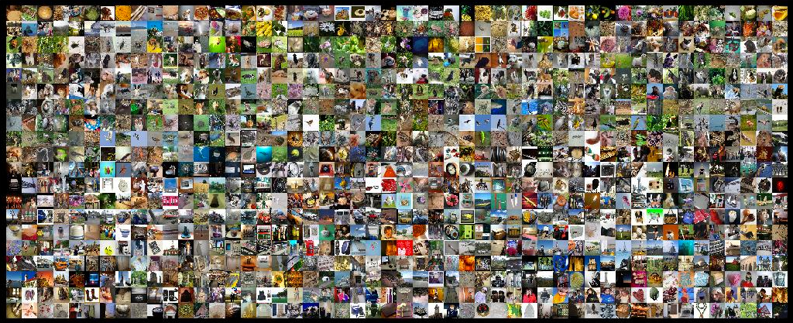
Ingredients for success today
1. Fast computation (GPUs)
3. Algorithm
Which ingredient will be the bottleneck for
tomorrow’s success?
2. Large labeled image dataset

Slide 4
Ingredients for success today
1. Fast computation (GPUs)
3. Algorithm
2. Large labeled image dataset
Requires expensive direct
human supervision

Slide 5
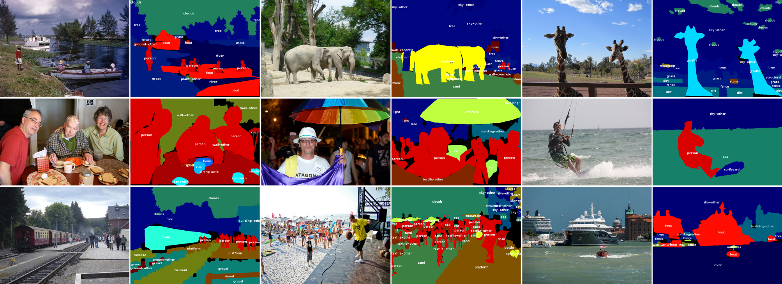
Direct supervision can be costly
70,000+ annotation hours for 328K images but only 80 object categories (MS COCO)
Requires pixel-level semantic labels

Slide 6
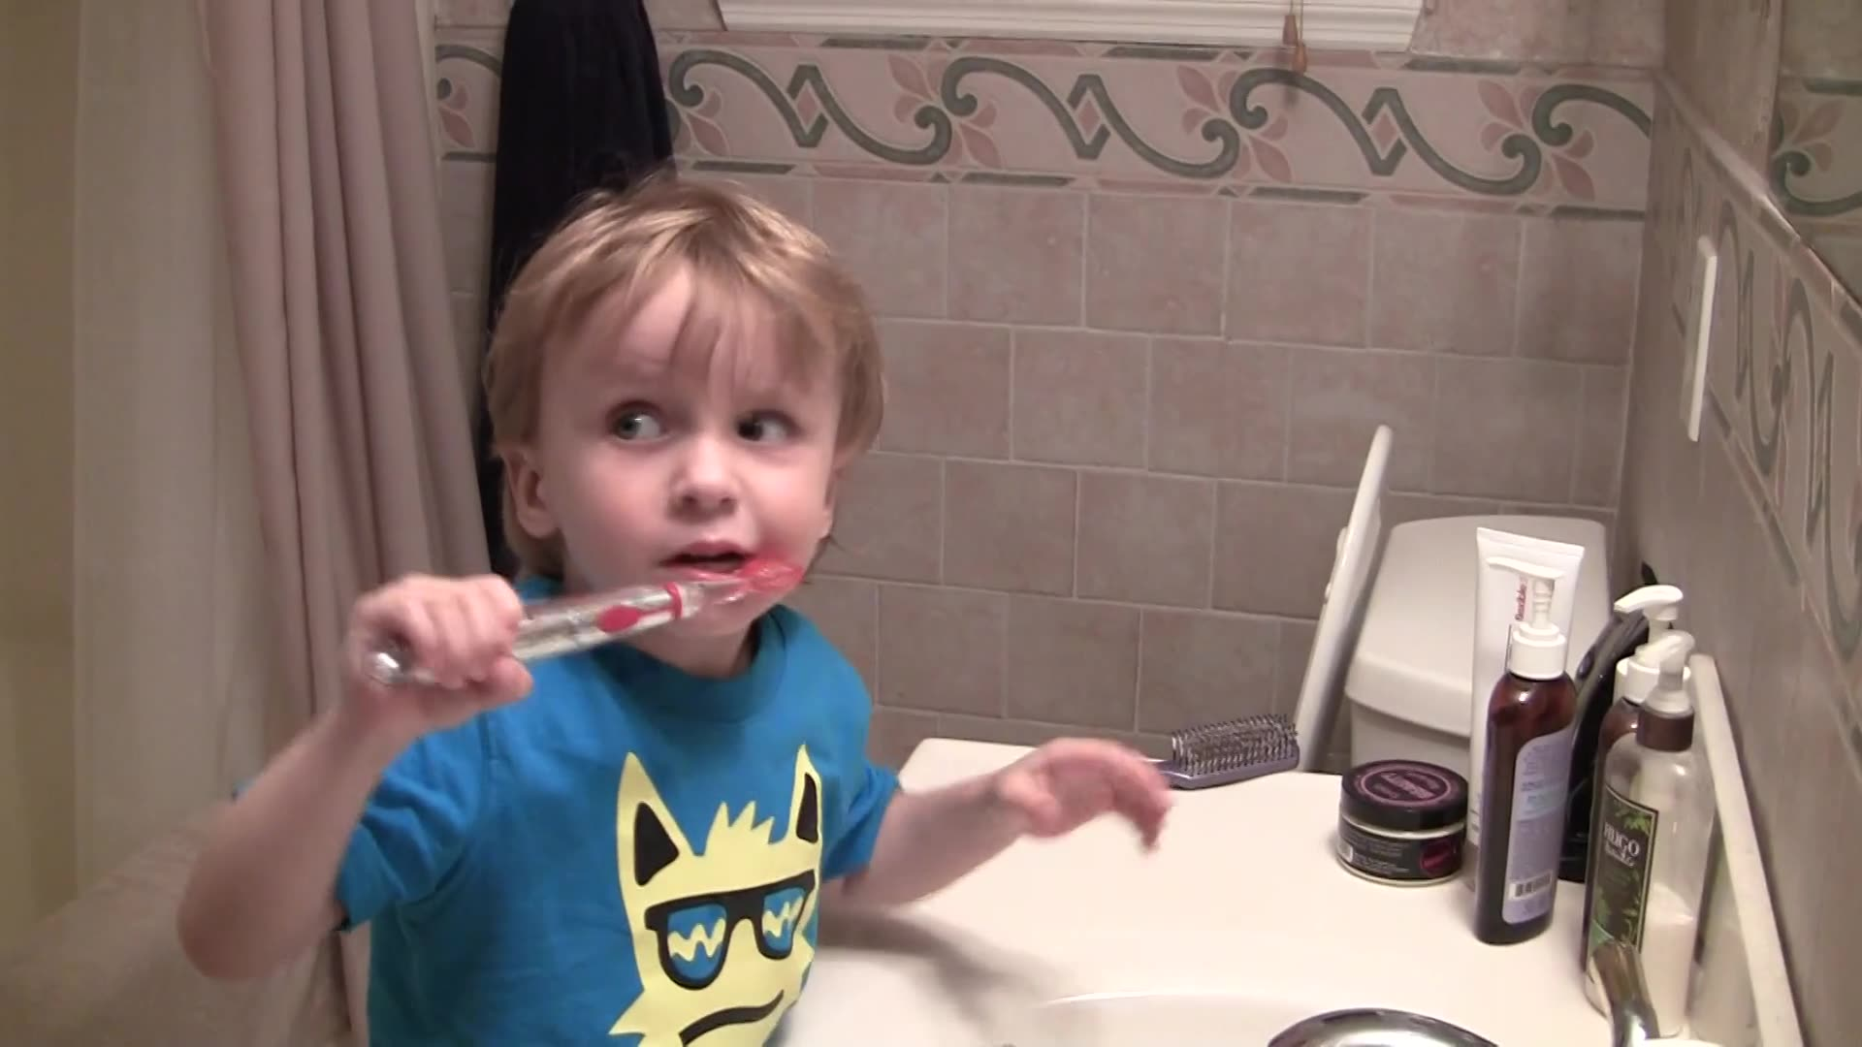
Direct supervision can be challenging
Ambiguity in what to label
Goal: Anonymization for privacy while preserving action information

Slide 7
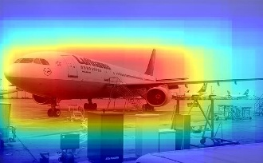
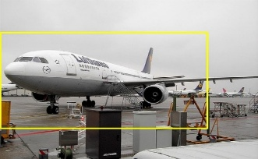
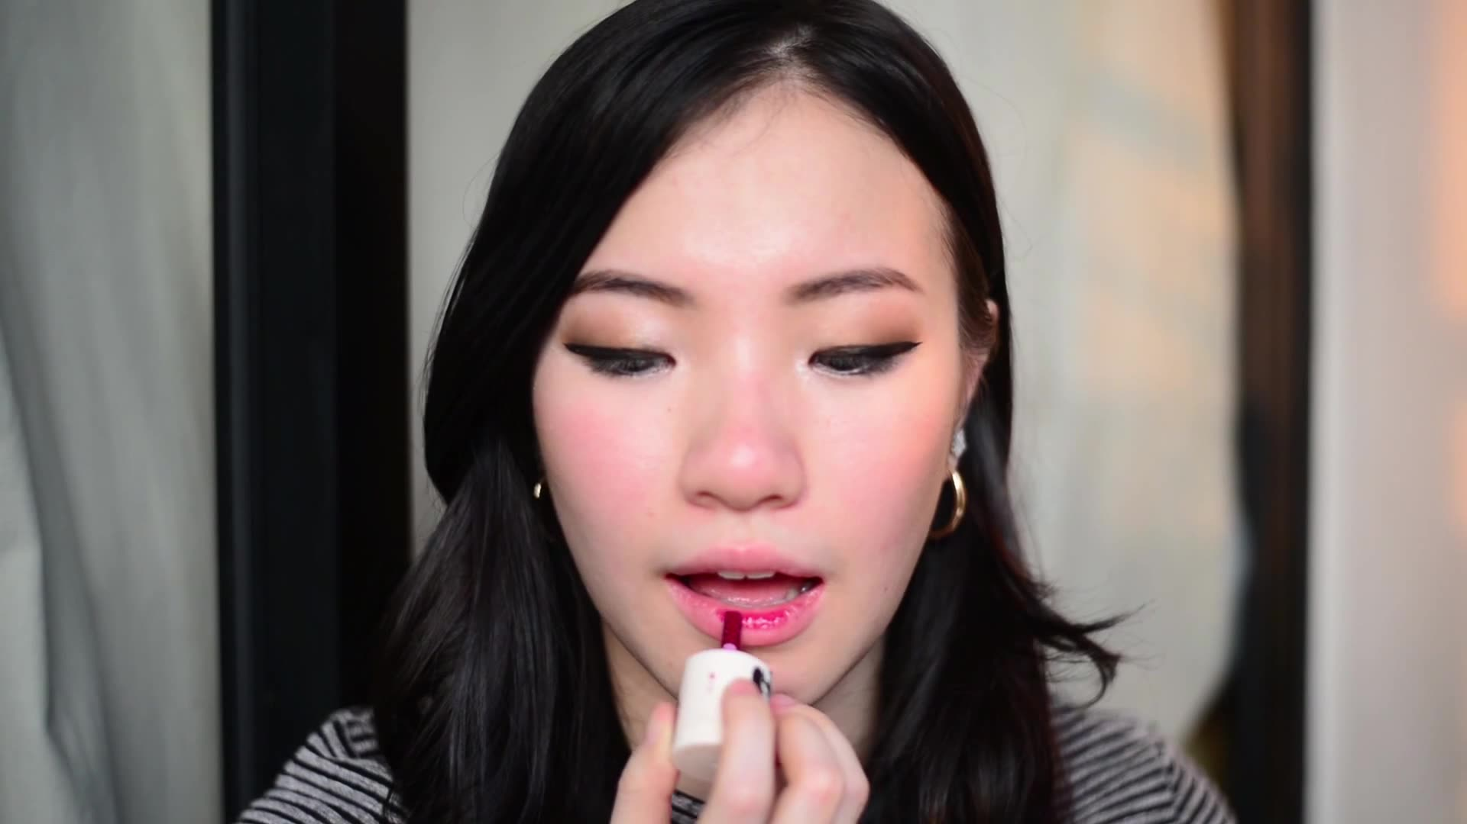
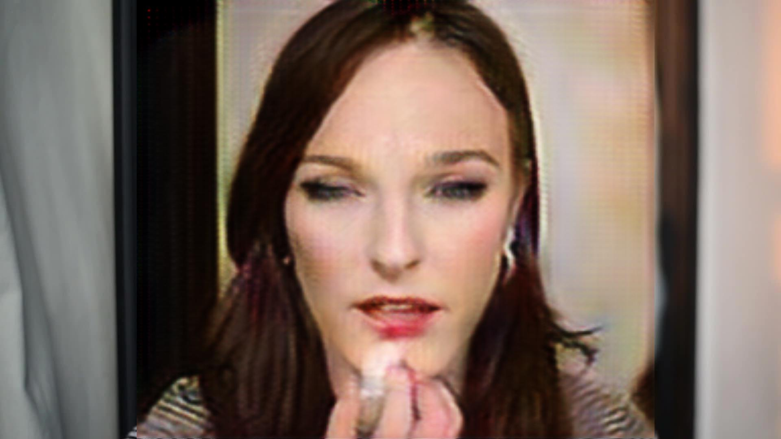
Outline: Visual understanding with indirect supervision
Learning to localize objects with image-level tag annotations [Singh & Lee, ICCV 2017]
Learning to anonymize videos for privacy-preserving action detection [Ren, Lee, Ryoo, ECCV 2018]
plane

Slide 8
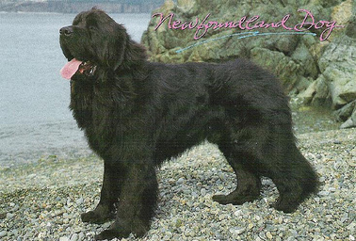
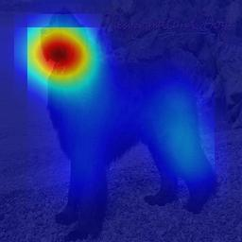
Learning to localize with image-label supervision
Training image
‘dog’
Image classification network
Global Average Pooling [Zhou et al. 2016]
Model focuses only on the most discriminative part (i.e. dog’s face) for image classification
[Weber et al. 2000, Pandey & Lazebnik 2011, Deselaers et al. 2012, Song et al. 2014, …]

Slide 9
Our idea: Hide and Seek (HaS)
Training image
‘dog’
[K. Singh and Y. J. Lee, “Hide-and-Seek: Forcing a Network to be meticulous for weakly-supervised object and action localization”, ICCV 2017]

Slide 10
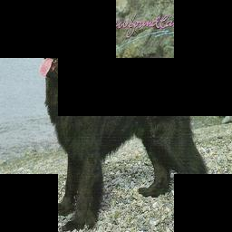
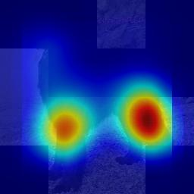
Our idea: Hide and Seek (HaS)
Training image
‘dog’
Image classification network
Global Average Pooling [Zhou et al. 2016]
Hide patches to force the network to seek other relevant parts
[K. Singh and Y. J. Lee, “Hide-and-Seek: Forcing a Network to be meticulous for weakly-supervised object and action localization”, ICCV 2017]

Slide 11
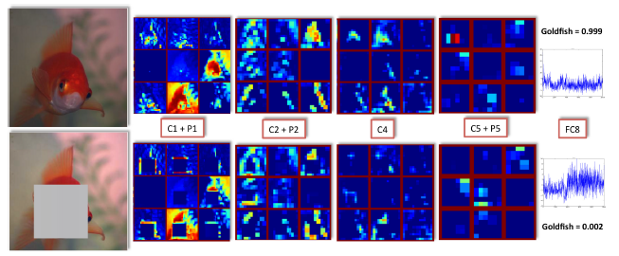
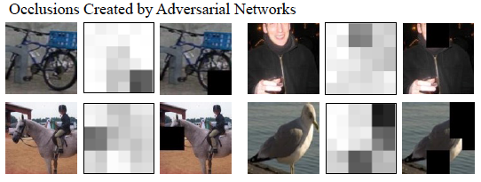
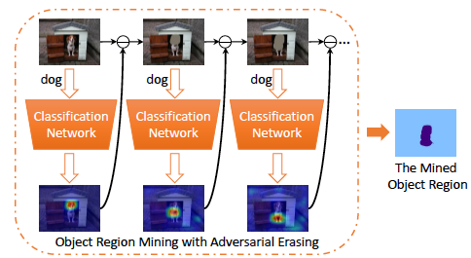
Related contemporary work on masking pixels
Identifies class-relevant patches via hiding during testing [Bazzani et al., WACV 2016]
Adversarial learning to generate hard occluded examples [Wang et al., CVPR 2017]
Iterative hiding for weak semantic segmentation [Wei et al., CVPR 2017]
Notes:
Key distinction of our work: random hiding works well

Slide 12
Approach

Slide 13
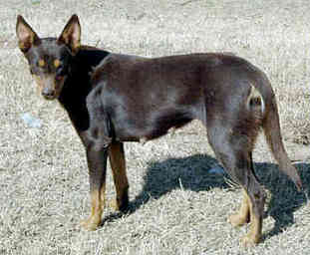
Divide the training image into a grid of patch size S x S
Training image with label ‘dog’

Slide 14
Divide the training image into a grid of patch size S x S
S
S
Training image with label ‘dog’

Slide 15
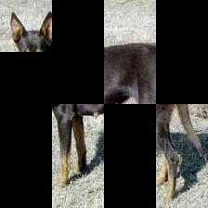
Randomly hide patches
S
S
Epoch 1
Training image with label ‘dog’

Slide 16
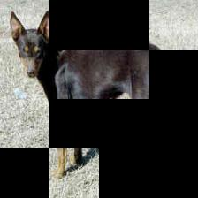
Randomly hide patches
S
S
Epoch 1
Epoch 2
Training image with label ‘dog’

Slide 17
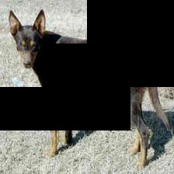
Randomly hide patches
S
S
Epoch 1
Epoch 2
Training image with label ‘dog’
Epoch N

Slide 18
Feed each hidden image to image classification CNN
S
S
Epoch 1
Epoch 2
CNN
Training image with label ‘dog’
Epoch N

Slide 19
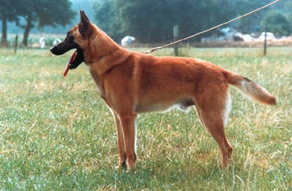
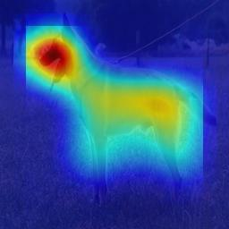
During testing feed full image into trained network
Trained CNN
Test image
Class Activation Map (CAM)
[Zhou et al. 2016]
Predicted label: ‘dog’

Slide 20
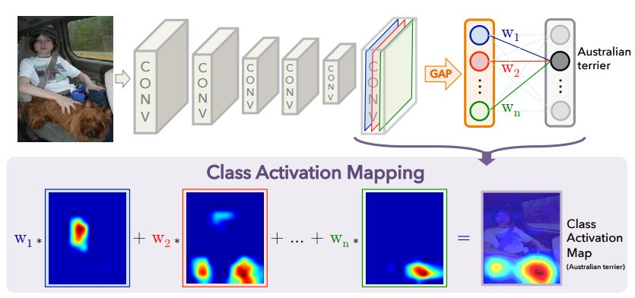
Generating a Class Activation Map (CAM)
[Zhou et al. “Learning Deep Features for Discriminative Localization” CVPR 2016]
Notes:
Global average pooling

Slide 21
Setting the hidden pixel values
Patches are hidden only during training; during testing full image is given as input
Activations of 1st conv layer will have different distribution during training and testing
Inside visible patch
Inside hidden patch
Partially in hidden patch
Notes:
There are three possible activations as shown in left.
Assigning mean RGB value to the pixels ensure activation remain same during training and testing for all the three cases.

Slide 22
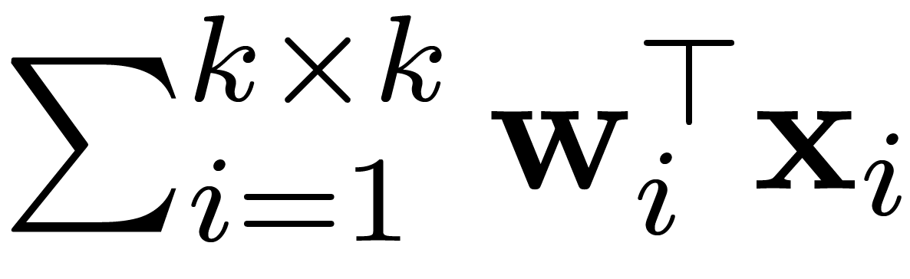
Setting the hidden pixel values
Let conv filter of size k x k with weights W = {w₁, w₂, …, w_{kxk}} applied on patch X = {x₁, x₂, …, x_{kxk}}, then output is:
which is same during training and testing in expectation
Inside visible patch
Inside hidden patch
Partially in hidden patch
Notes:
Convolutional filter is completely Inside the visible patch

Slide 23

Setting the hidden pixel values
Assigning µ (mean RGB value) to hidden pixels ensures same activation in expectation during training and testing:
i.e. expected output of a patch is equal to output of an average-valued patch
Inside visible patch
Inside hidden patch
Partially in hidden patch
Notes:
Convolutional filter is either completely or partially inside the hidden patch.

Slide 24
Results

Slide 25
Dataset
ILSVRC 2016 for localization
1000 categories
1.2 million training images, 50 thousand validation and test images

Slide 26
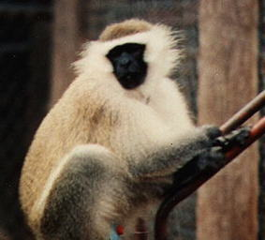
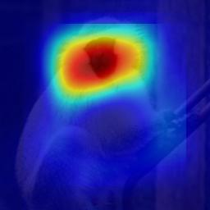
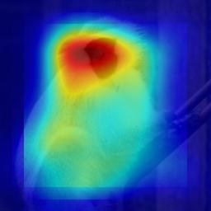
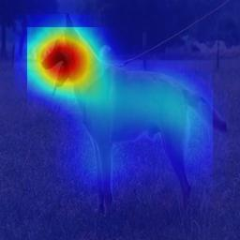
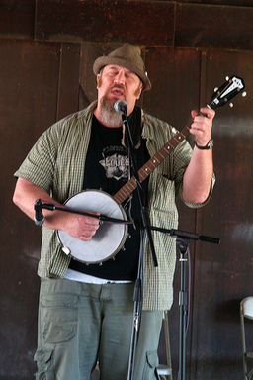
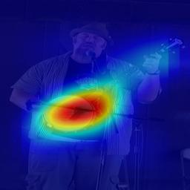
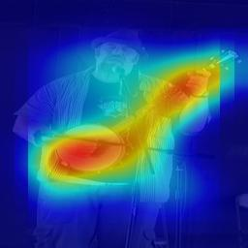
Our approach localizes the object more fully
AlexNet-GAP
[Zhou et al.’16]
Ours

Slide 27
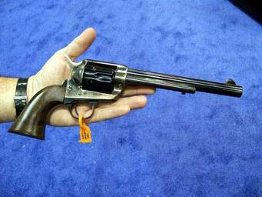
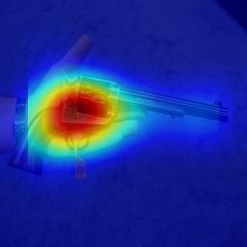
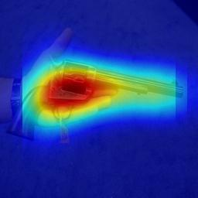
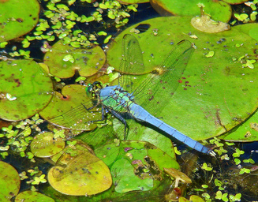
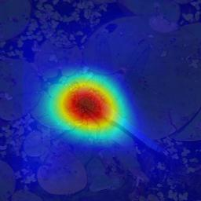
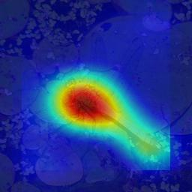
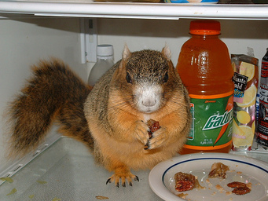
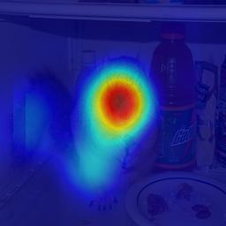
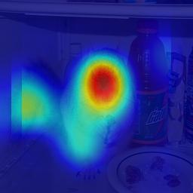
Our approach localizes the object more fully
AlexNet-GAP
[Zhou et al.’16]
Ours

Slide 28
Our approach localizes the object more fully
Top-1 Loc: Predicted label is correct and predicted box > 50% IoU w/ GT
Notes:
Since we only change the input image, our approach works with any image classification network
Two main differences:
Dropout is designed to prevent overfitting while our work is designed to improve localization
In Dropout, units in a layer are dropped randomly, while in our work, contiguous image regions are dropped

Slide 29
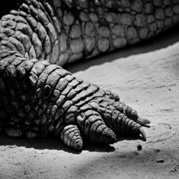

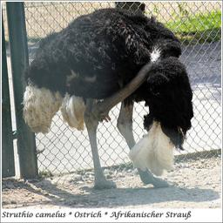
Our approach improves image classification when objects are partially-visible
AlexNet-GAP: Trilobite
Ours: African Crocodile
AlexNet-GAP: Waffle Iron
Ours: Notebook
AlexNet-GAP: Border Collie
Ours: Ostrich

Slide 30
Hide-and-Seek for semantic segmentation
Fully-supervised
FCNs AlexNet [Long, Shelhamer, Darrell, CVPR 2015]
PASCAL VOC 2011
+1.3% mIOU w/ Hide-and-Seek ImageNet pre-training
Weakly-supervised
DCSP VGG [Chaudhry, Dokania, Torr, BMVC 2017]
PASCAL VOC 2012
+0.6% mIOU w/ Hide-and-Seek CAM initialization (rather than GAP)

Slide 31
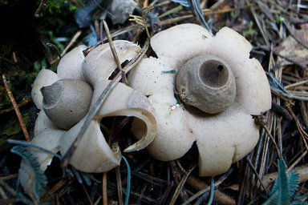
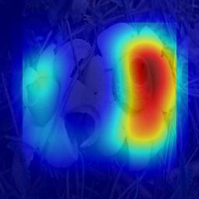
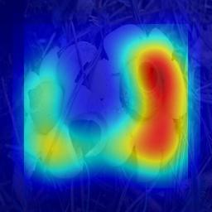
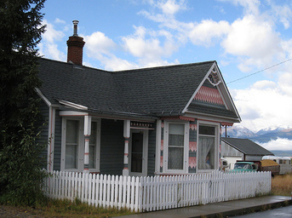


Failure cases
AlexNet-GAP
[Zhou et al.’16]
Ours
Merging spatially-close instances together
Localizing co-occurring context

Slide 32
Outline: Visual understanding with indirect supervision
Learning to localize objects with image-level tag annotations [Singh & Lee, ICCV 2017]
Learning to anonymize videos for privacy-preserving action detection [Ren, Lee, Ryoo, ECCV 2018]
plane

Slide 33

Anonymize videos while preserving activity information
Identity: Jessica
Action: Applying Make-up on Lips
Identity: ???
Action: Applying Make-up on Lips

Slide 34



Motivation
Quality-of-life, intelligent resource allocation, service robots
Privacy concerns
Existing anonymization approaches are hand-crafted e.g., extreme blurring [Butler et al.’15, Ryoo et al.’17, …]
Do not consider effects on action detection
Notes:
Difficult to label exactly how someone should be anonymized.

Slide 35
Our key idea: Adversarial learning of the privacy-preserving action detector
A fight between two competing systems:
(1) a video anonymizer that removes identify information while preserving activity recognition performance
(2) a face classifier that tries to extract identity information from the anonymized videos

Slide 36
Approach

Slide 37


Network for privacy-preserving action detection
Action
detector A
L_{A}
Modifier
M
Face classifier D
L_{D}
L_{l1}
: Faster-RCNN detection loss [Ren et al. NIPS‘15]
: Angular softmax face classifier loss [Liu et al., CVPR‘17]
Notes:
L1 loss encourages the modified image to preserve the basic structure (pose, brightness, etc.) of the original picture.
Differentiable grid generator and sampler [STNs]

Slide 38
Adversarial training
Action
detector A
L_{A}
Modifier
M
Face classifier D
L_{D}
L_{l1}
Notes:
Optimize minimax objective
Modifier gets better at modifying the face to fool the face classifier while preserving action information, while the face classifier gets better at recognizing the face despite the modifications.

Slide 39
Requires both face identity and action labels
Action
detector A
L_{A}
Modifier
M
Face classifier D
L_{D}
L_{l1}
Solution:
Use videos to train action detector
Use celebrity images to train face classifier
Modifier affects both

Slide 40


Requires both face identity and action labels
Action
detector A
L_{A}
Modifier
M
Face classifier D
L_{D}
L_{l1}
Modifier
M

Slide 41
Results

Slide 42

[Z. Ren, Y. J. Lee, M. S. Ryoo “Learning to Anonymize Faces for Privacy Preserving Action Detection”, ECCV 2018]

Slide 43



Face verification vs. action detection accuracy
Baselines
Mask
Blur
Noise
Daily Action Localization in YouTube videos (DALY) [Weinzaepfel et al. ’16]
Labeled Faces in the Wild (LFW) [Huang et al., 2007]

Slide 44


Guess that celebrity
Ans: Hilary Clinton

Slide 45


Guess that celebrity
Ans: Yao Ming

Slide 46


Guess that celebrity
Ans: Jackie Chan

Slide 47






Guess that celebrity

Slide 48
Further analysis
User study (10 subjects)
Correctly name only 19.75% of modified faces (out of 16 celebrities that they know)
Face classifier remains accurate
94.75%/66.95% verification accuracy on original/modified faces
Modified face still remains a face, but with some artifacts
Easier to stay on face manifold
Could add “realism” GAN loss

Slide 49



Conclusions
Indirect learning for
scalable object localization
anonymization while preserving action information
Code, additional results available:
http://krsingh.cs.ucdavis.edu/krishna_files/papers/hide_and_seek/hide_seek.html
https://jason718.github.io/project/privacy/main.html (code coming soon)
Krishna Kumar Singh
Zhongzheng Ren
Michael Ryoo

Slide 50
Thank you!

Slide 52
All the patch sizes perform better than the baseline
Methods | GT-known Loc | Top-1 Loc
AlexNet-GAP | 54.99 | 36.25
AlexNet-HaS-16 | 58.00 | 36.89
AlexNet-HaS-32 | 58.92 | 37.46
AlexNet-HaS-44 | 58.74 | 37.71
AlexNet-HaS-56 | 58.62 | 37.50
AlexNet-HaS-mixed | 59.36 | 37.64
AlexNet-HaS-mixed: Patch sizes are chosen randomly between 16, 32, 44 and 56
Gives best GT-known Loc accuracy

Slide 53
Our approach of Hide-and-Seek can also boost the performance after convolutional layers
Methods | GT-known Loc | Top-1 Loc
AlexNet-GAP | 54.99 | 35.70
AlexNet-HaS-Conv1-5 | 57.49 | 37.02
AlexNet-HaS-Conv1-11 | 58.49 | 37.52
Increasing hiding probability decreases Top-1 Loc accuracy
Decreasing hiding probability decreases GT-known Loc accuracy
Methods | GT-known Loc | Top-1 Loc
AlexNet-HaS-25% | 57.64 | 37.89
AlexNet-HaS-33% | 58.27 | 38.19
AlexNet-HaS-50% | 58.62 | 37.38
AlexNet-HaS-66% | 58.76 | 35.90
AlexNet-HaS-75% | 58.52 | 34.38

