Slide 1


Algorithmic self-assembly with DNA tiles
Tutorial
David Doty (UC-Davis)
23rd International Meeting on DNA Computing and Molecular Programming
University of Texas–Austin
September 2017

Slide 2
DNA tile self-assembly
monomers (“tiles” made from DNA) bind into a crystal lattice
tile
lattice
Source: Programmable disorder in random DNA tilings. Tikhomirov, Petersen, Qian, Nature Nanotechnology 2017
Notes:
What does it mean to say that a physical system “does computation via molecular binding”? Well, it could mean a lot of things, but there’s two popular lines of experimental research, with associated theoretical models, that make this idea specific.
One is DNA tile self-assembly. DNA complexes called tiles---each could be just one strand, could be 4 or 5 strands, this one here is actually made from hundreds of strands---bind to each other in a lattice to form a crystal. Here’s an AFM image of a 2D square lattice crystal made of DNA tiles. It’s not clear how “computation” could happen here, but we’ll get to that.
Another popular nanoscale technology is DNA strand displacement. Here, DNA complexes are more “dynamic”, they can bind, but they can also exchange individual DNA strands with each other and break apart.
I’ll give just enough details of these two methods to justify that they can “compute”, and as I warned, after that we’re going to stop talking about them. →

Slide 3
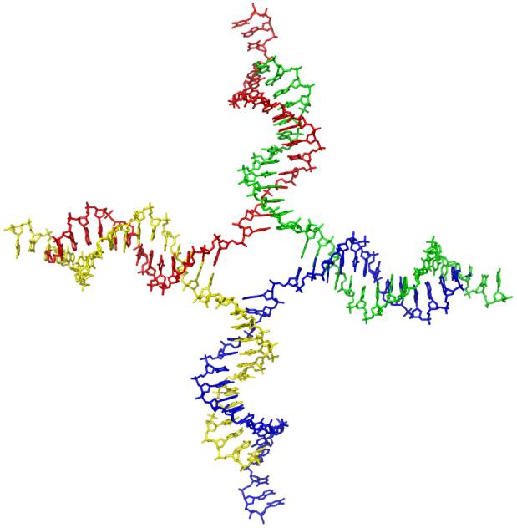
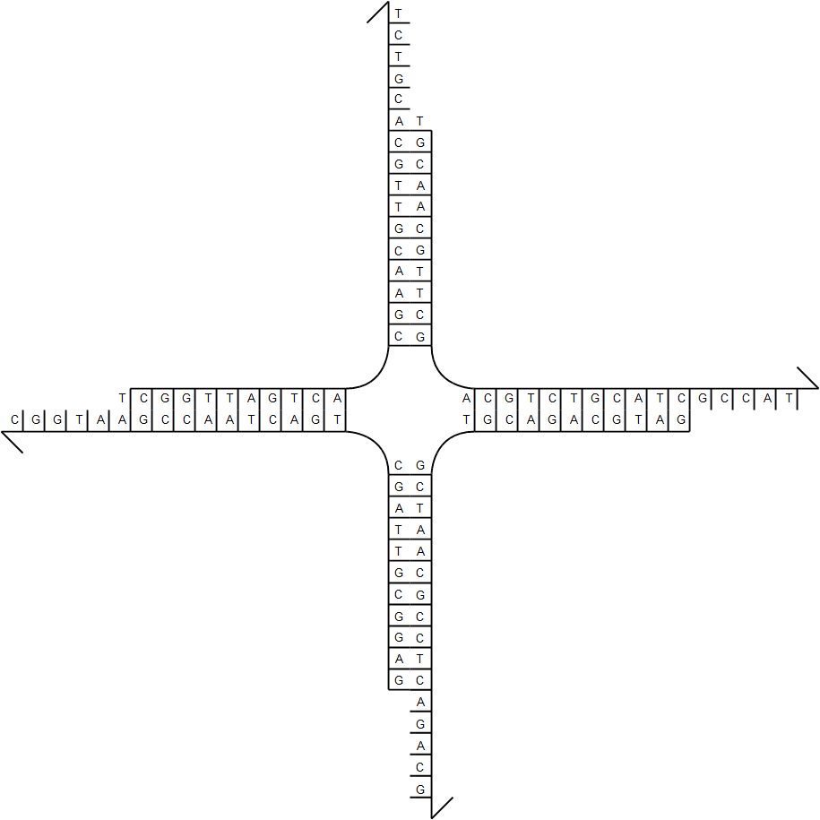
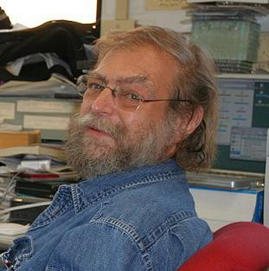
Practice of DNA tile self-assembly
Source:en.wikipedia; Author: Zephyris at en.wikipedia; Permission: PDB; Released under the GNU Free Documentation License.
DNA tile
Ned Seeman, Journal of Theoretical Biology 1982
sticky end
Notes:
DNA tile assembly was pioneered by Ned Seeman, whose first idea used something called a “branched junction” molecule. By synthesizing four strands of DNA as shown, they form this “tile” which has
four “sticky ends”, meaning single strands that are “sticky” because they want to bind to their Watson-Crick complement.
In this case, west is complementary to east, and north is complementary to south, →

Slide 4
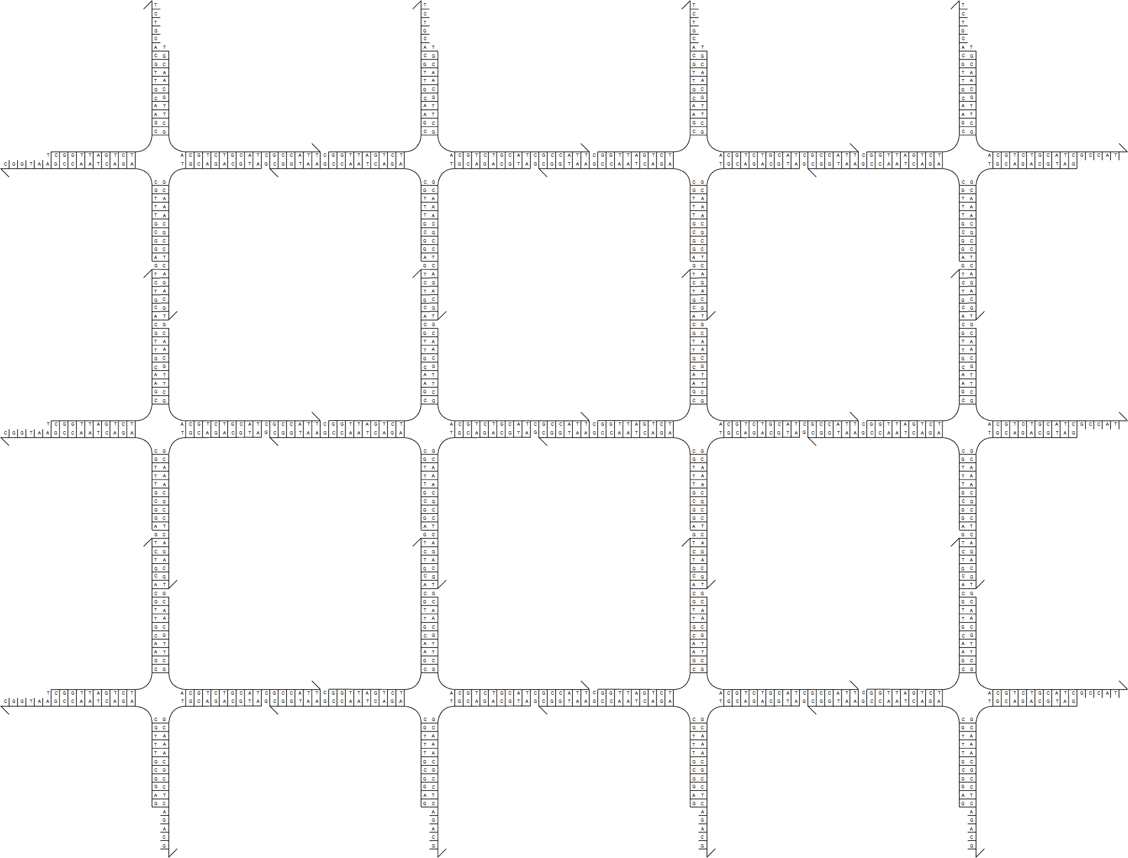
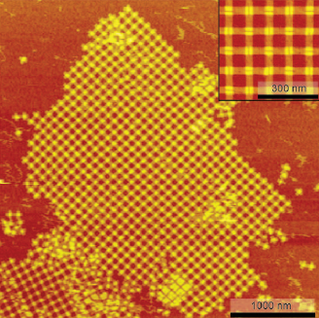
Practice of DNA tile self-assembly
Place many copies of DNA tile in solution…
(not the same tile motif in this image)
Liu, Zhong, Wang, Seeman, Angewandte Chemie 2011
Notes:
so mixed in solution, they self-assemble a regular grid like this. The right image is actually a different tile motif closer to the one you saw a few slides ago, the one on the left doesn’t actually work so well, but it illustrates the idea nicely. →

Slide 5
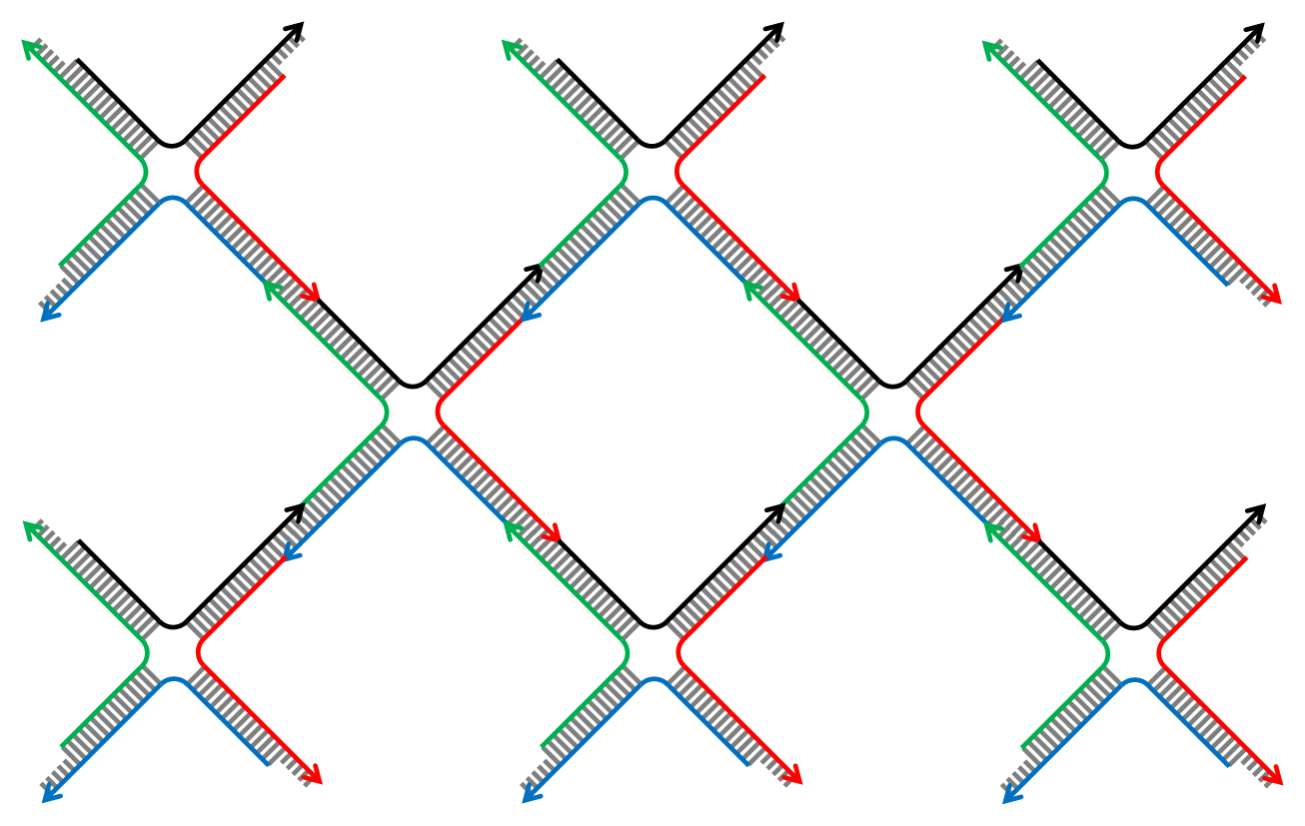
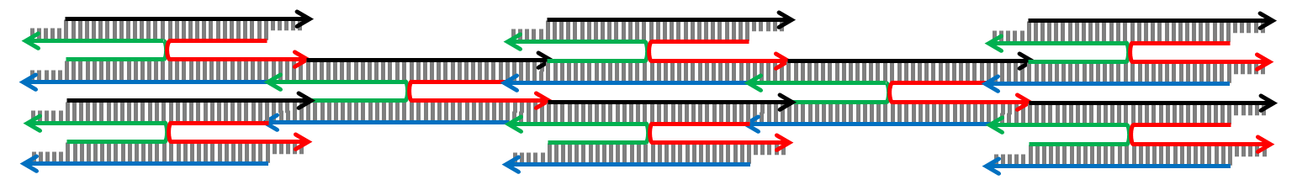
Practice of DNA tile self-assembly
What really happens in practice to Holliday junction (“base stacking”)
Notes:
Now in reality, a phenomenon called “base stacking” implies the tile is more likely to be → shaped like this, → or like this. If we could ensure that the tile always folds consistently, → then the shape of the grid would → flatten, but its connectivity would not change. So how to ensure they all fold the same way? →

Slide 6
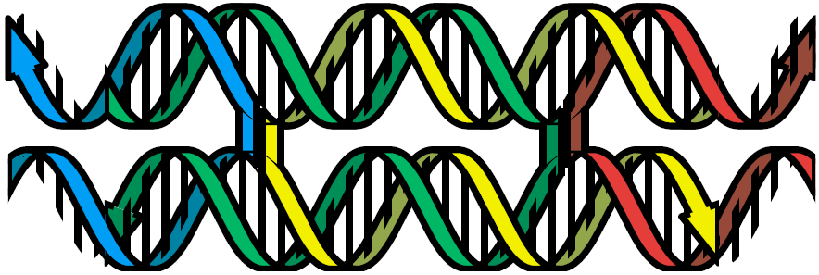
Practice of DNA tile self-assembly
single crossover
Figure from Schulman, Winfree, PNAS 2009
double crossover
Notes:
In this configuration, → the tile consists of two DNA helices in parallel, with a single crossover point where they exchange single strands. → If instead we have two crossovers, then the tile always orients the same way. So does this work? →

Slide 7
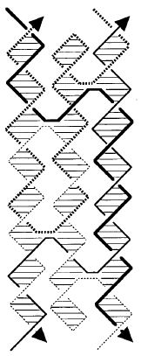
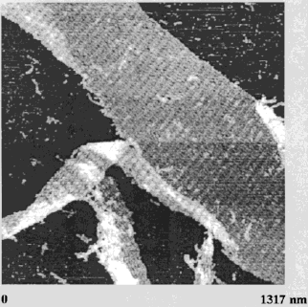
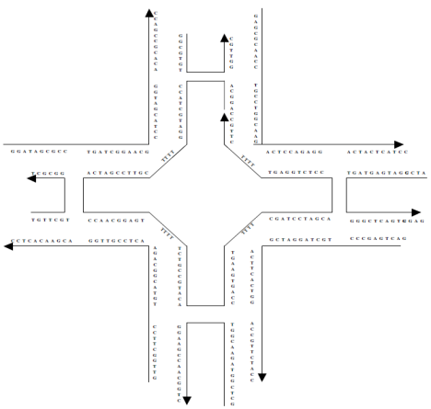
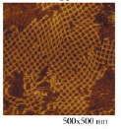

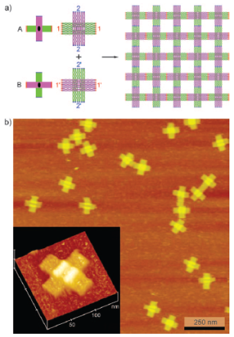
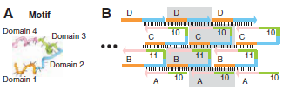



Practice of DNA tile self-assembly
other tile motifs
4x4 tile (Yan, Park, Finkelstein, Reif, LaBean, Science 2003)
triple-crossover tile (LaBean, Yan, Kopatsch, Liu, Winfree, Reif, Seeman, JACS 2000)
single-stranded tile (Yin, Hariadi, Sahu, Choi, Park, LaBean, Reif, Science 2008)
DNA origami tile (Liu, Zhong, Wang, Seeman, Angewandte Chemie 2011)
Tikhomirov, Petersen, Qian, Nature Nanotechnology 2017
150 nm
Notes:
There’s no shortage of other experimental designs for making DNA tiles, but this video is about a fascinating theory inspired by these tiles that is independent of the underlying DNA architecture. →

Slide 8

Theory of algorithmic self-assembly
What if…
… there is more than one tile type?
… some sticky ends are “weak”?
Erik Winfree
Notes:
So what’s so “algorithmic” about tiles forming a crystal? Erik Winfree asked two questions, “What if there is more than one tile type?” And “What if some sticky ends are ‘weak’?” →

Slide 9
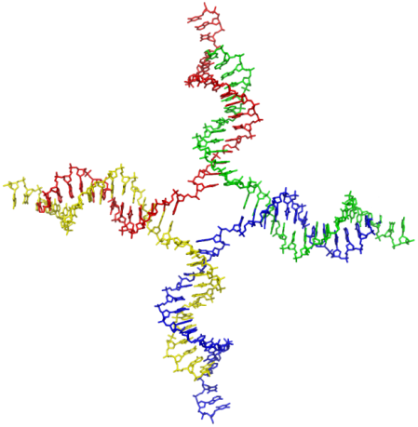
Abstract Tile Assembly Model
Erik Winfree, Ph.D. thesis, Caltech 1998
tile type = unit square
each side has a glue with a label and strength (0, 1, or 2)
tiles cannot rotate
finitely many tile types
infinitely many tiles: copies of each type
assembly starts as a single copy of a special seed tile
tile can bind to the assembly if total binding strength ≥ 2 (two weak glues or one strong glue)
north glue label
west glue label
south glue label
strength 0
strength 1 (weak)
strength 2 (strong)
Notes:
Let’s formalize those ideas.
We model the tile as a square.
Each side has a “glue” with a label and an integer strength, strength 1 is weak, and strength 2 is strong .
The tiles cannot rotate. Obviously, real tiles will rotate; what we mean is that we’ll design glues so that they cannot match between two tiles rotated relative to each other.
There are finitely many types of tiles but an infinite number of tiles of each type available, ∞ serving as a useful approximation of 50 billion, which is about how many will be in a test tube at one time.
Assembly starts from a single copy of a specially designated “seed” tile type, and
the key rule that makes it all work, a tile can only bind to an assembly if it binds with total strength at least 2; that means either two weak glues, or one strong glue. →

Slide 10
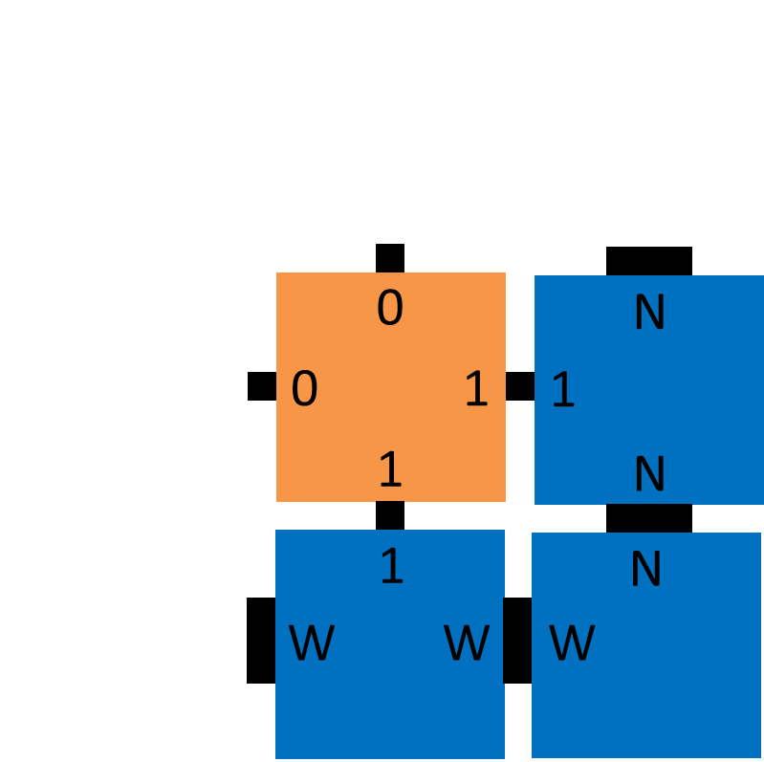




Example tile set
seed
“cooperative binding”
N
N
W
W
XOR
N
1
1
W
W
N
1
1
1
0
1
1
1
0
0
0
0
0
0
1
0
1
Notes:
Let’s see an example. I said we have a finite set of tile types; there’s 7 of them.
We start with a single copy of the seed. Tiles bind asynchronously and nondeterministically whenever there is a way to attach with strength 2,
so the first few attachments might involve these strong bonds.
More interesting is when a tile binds using two weak bonds; this is known as cooperative binding. Because both the bottom and right glues have to match for the orange tile to attach, we think of the tile as computing a
function of two inputs, which are the bits representing each glue.
If you examine these four tile types, you’ll see that the bottom and right glues enumerate every pair of bits, and that the logical XOR of these bits
is then “advertised” on the top and left glues.
If we allow growth to continue, a pattern emerges, →

Slide 11
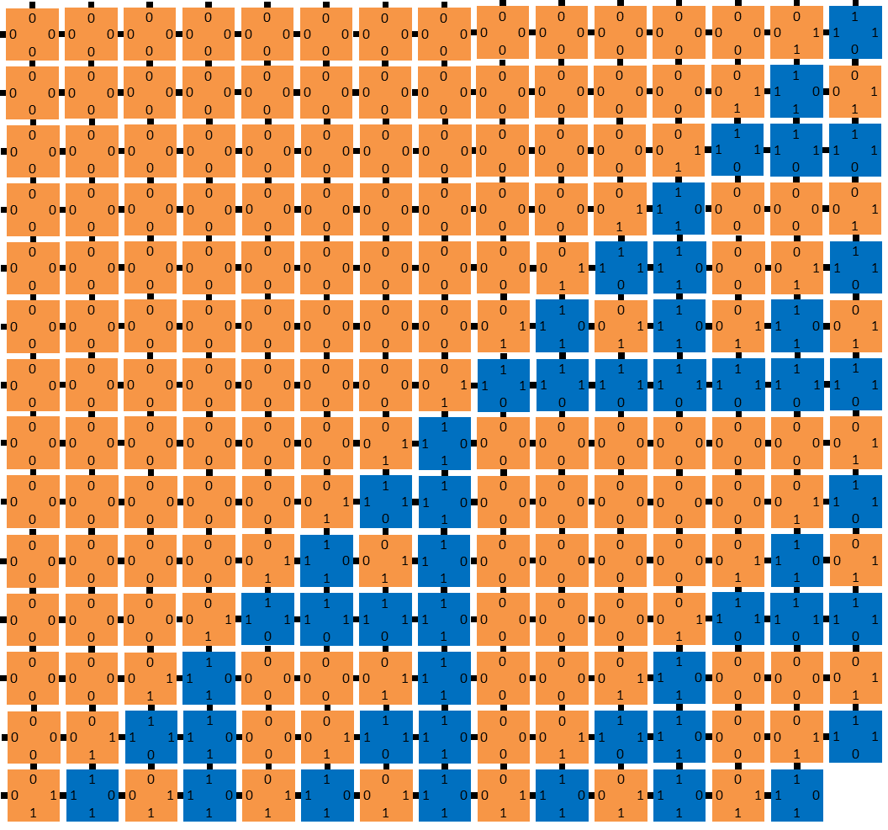
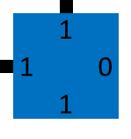
Example tile set
seed
N
W
N
1
1
W
W
N
1
1
1
0
1
1
1
0
0
0
0
0
0
1
0
1
Notes:
→ this pattern that we call the discrete Sierpinski triangle, painted onto the entire second quadrant. Not terribly complex, but not what you would expect to see from random crystal formation, although that’s precisely what this is. I said that the tile types compute a function; we could change that function. XOR is sum modulo 2, in other words, add the bits and throw away the most significant bit of the result. →

Slide 12
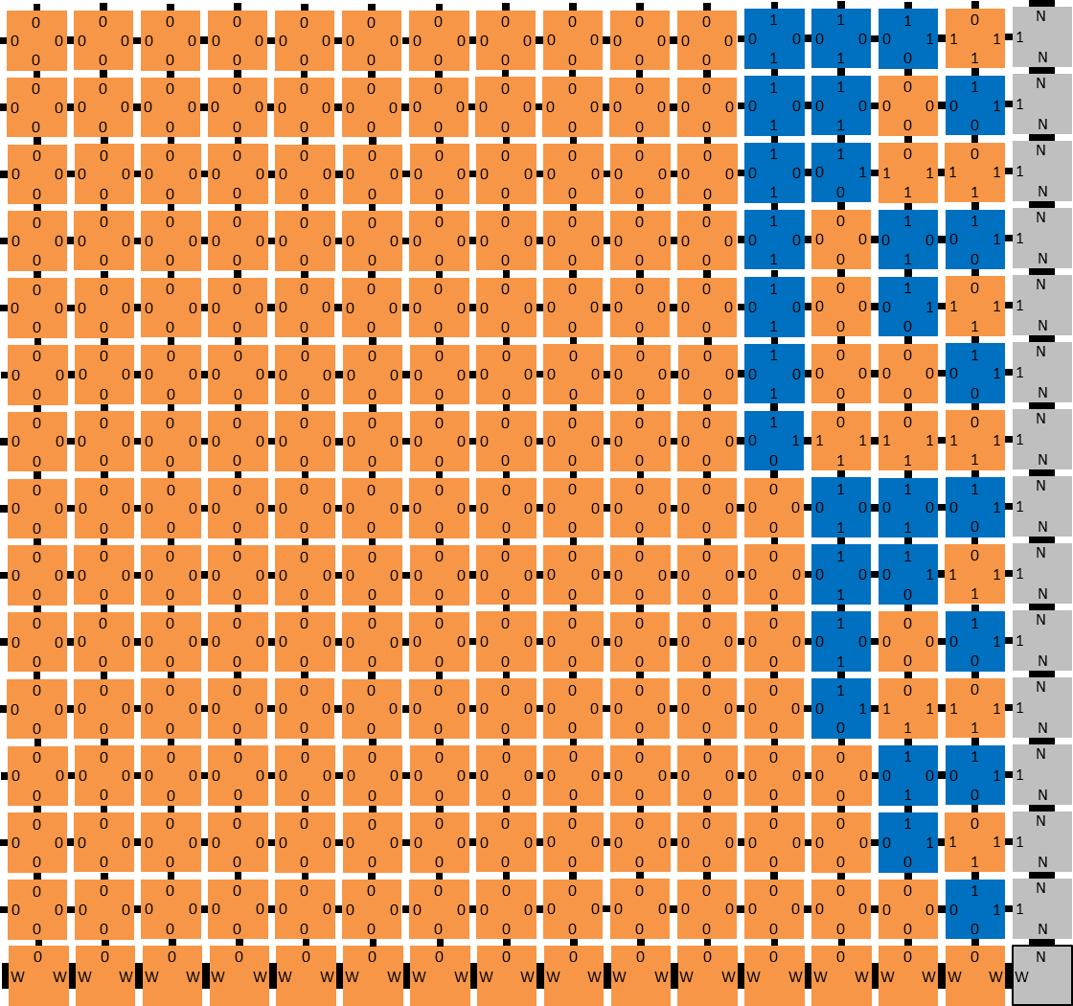
14
13
12
11
seed
10
N
9
N
W
W
8
7
N
0
6
1
W
W
N
5
4
1
1
0
c
Σ
0
0
c
Σ
1
3
HA
HA
1
0
2
change function to half-adder
1
0
0
0
c
Σ
0
1
c
Σ
1
HA
HA
0
0
1
Notes:
Well, instead of throwing it away, we could put it on the left side. Now the tiles compute a different logical function called a “half-adder”. And if we let these grow, they form a different pattern,
familiar to computer scientists; a binary counter. The n’th row of this assembly represents n in binary, with a lot of leading 0s. →

Slide 13





Algorithmic self-assembly in action
Track B talk by Damien Woods at 11:30am tomorrow!
simulation
sheared image
AFM image
raw AFM image
sorting
w
100 nm
shearing
parity
cellular automaton
rule 110
80 nm
[Crystals that count! Physical principles and experimental investigations of DNA tile self-assembly, Constantine Evans, Ph.D. thesis, Caltech, 2014]
[Iterated Boolean circuit computation via a programmable DNA tile array. Woods, Doty, Myhrvold, Hui, Wu, Yin, Winfree, in preparation]
Notes:
And here’s some lab results. These tiles aren’t square shaped, they’re elongated so the rows of the counter aren’t rectilinear, but I sheared the image to make it look like a rectangle.
On the right is some unpublished experimental research showing many more varied computations being done by tiles. And if you’re just starting to get comfortable with Tile Assembly, well now we’re going to stop talking about it. →

Slide 14
How computationally powerful are self-assembling tiles?

Slide 15
Turing machines
state ≈ line of code
current symbol
next symbol
initial state = s
current state
next state
next move
s
q
t
q
s,0: q,0,→
s
u
q,0: t,1,←
q,1: s,0,→
…
0
1
1
_
_
_
0
1
0
0
1
1
t,0: u,1,→
u,1: HALT
transitions
(instructions)
tape ≈ memory

Slide 16
Tile assembly is Turing-universal
time
HALT
halt
0
0
1
u 1
1
1
_
_
_
_
_
_
0
0
1
halt
1
1
_
_
_
_
_
_^
→
→
→
→
u
→
u
→
←
←
←
←
←
←
←
←
←
←
←
←
←
←
*
*
0
0
t 0
1
1
1
_
_
_
_
_^
0
0
t 0
1
1
1
_
_
_
_
_
0
0
t 0
1
1
1
_
_
_
_
_^
→
→
→
→
t
←
t
←
←
←
←
←
←
←
←
←
←
←
←
←
*
*
0
0
0
q 0
1
1
_
_
_
_^
0
0
0
q 0
1
1
_
_
_
_
0
0
0
q 0
1
1
_
_
_
_^
→
→
→
→
q
→
q
→
←
←
←
←
←
←
←
←
←
←
*
*
0
0
s 0
0
1
1
_
_
_^
0
0
s 0
0
1
1
_
_
_
s,0: q,0,→
0
0
s 0
0
1
1
_
_
_^
→
→
s
→
s
→
←
←
←
←
←
←
←
←
←
←
*
*
0
q 1
0
0
1
1
_
_^
q,0: t,1,←
0
q 1
0
0
1
1
_
_
0
q 1
0
0
1
1
_
_^
q
→
q
→
←
←
←
←
←
←
←
←
←
←
*
*
q,1: s,0,→
s 0
1
0
0
1
1
_^
s 0
1
0
0
1
1
_
t,0: u,1,→
s 0
1
0
0
1
1
_^
1
1
2
2
3
3
4
4
5
5
6
6
u,1: HALT
space
Notes:
The model is Turing-universal, which means that it can simulate any algorithm, in a straightforward manner. We can define “algorithm” to mean “single-tape Turing machine”, which is defined by → rules like this, which stipulate that if the machine is in a → state s and reading the → bit 0, then it changes to → state q, writes a → bit 0 (in other words, leaves the bit alone), and → moves to the right. → A finite list of such rules define a Turing machine. We can represent this machine in its initial state s by a → tile that encodes the state s, and → some tiles that immediately bind to the right to represent the initial input bit string, with a blank symbol just to the right. The orange tile represents where the tape head is. → This means the first rule applies, and on the → next tile to attach, we represent the written bit on the → top glue and the next state and tape move → on the right glue. The → next attachment crucially uses cooperative binding to combine the → new state with the symbol on the new tape cell. → Some tiles bind to copy the rest of the bits to the next row. We also design the tiles at the edge to expand the number of tape cells by one each time, → which ensures that the Turing machine has an arbitrary amount of tape space available, should it be needed. Now that we’ve simulated a step of the Turing machine, → a new transition rules applies. → We apply it as before. → And again. → And again. → And again. Finally, → the computation is done. What we’ve assembled is a → space → time configuration history of the Turing machine. What this means is that self-assembling tiles can do any computation that is possible that is possible to do by any algorithm, and therefore that computation can be used to control the assembly of the tiles. It’s essentially a → crystal that thinks about how it’s growing. And this is the reason that computer science has had so much to say about the possibilities, and limitations, of molecular self-assembly. →

Slide 17
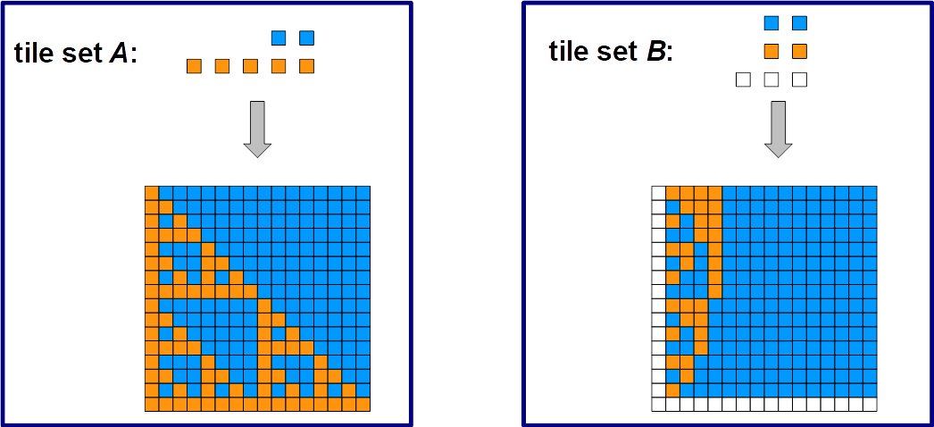
Putting the algorithm in algorithmic self-assembly
set of tile types is like a program
shape it creates, or pattern it paints, is like the output of the program

Slide 18
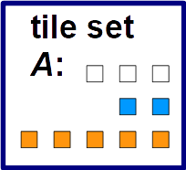
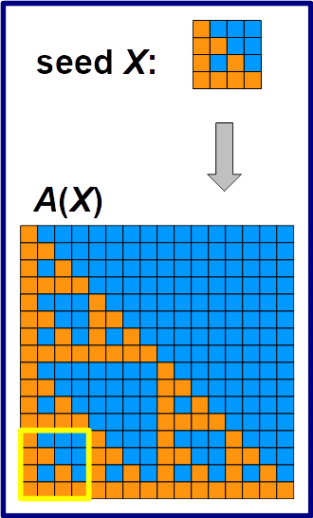
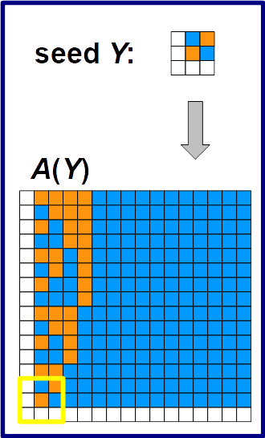
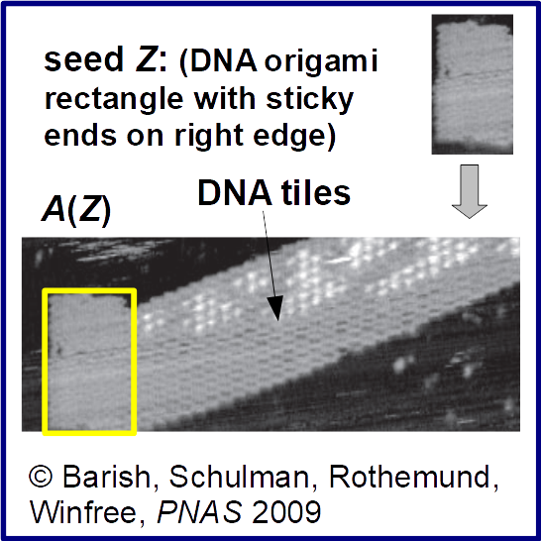
Putting the algorithm in algorithmic self-assembly
How is a set of tile types not like a program?
  Where’s the input to the program?
  One perspective: pre-assembled seed encodes the input

Slide 19
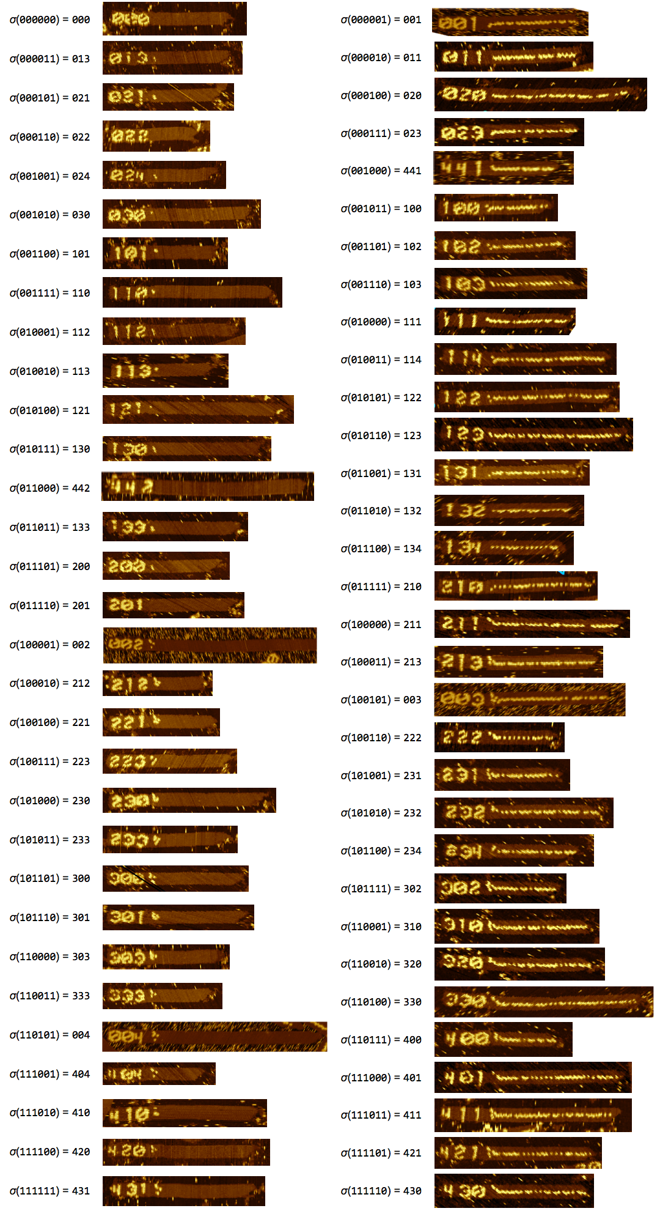
Calculating parity of 6-bit string:
1 algorithm, 2⁶ inputs
seed encoding 100101
single set of tiles computing parity
2⁶ seeds:
seed encoding 110101
[Iterated Boolean circuit computation via a programmable DNA tile array. Woods, Doty, Myhrvold, Hui, Wu, Yin, Winfree, in preparation,
work presented in DNA 23 talk tomrrow by Damien Woods]

Slide 20
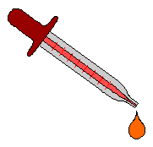
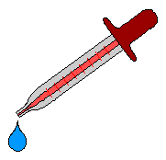
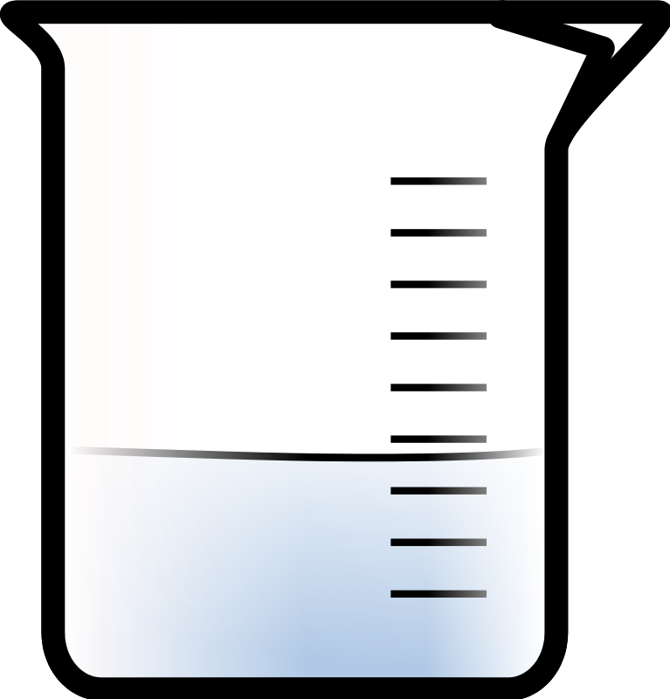


So tiles can compute… what’s that good for?
Theorem: There is a single set T of tile types, so that, for any finite shape S, from an appropriately chosen seed σ_{S} “encoding” S, T self-assembles S.
σ_{smiley_face}
σ_{Eiffel_tower}
These tiles are universally programmable for building any shape.
[Complexity of Self-Assembled Shapes. Soloveichik and Winfree, SIAM Journal on Computing 2007]

Slide 21
Active self-assembly
tiles are passive: they bind based on glue identity, and do little else
active self-assembly: monomers with a “state”:
  state can change after binding
  monomer can communicate with neighbors
  possibly, monomer can move

Slide 22
Active self-assembly at DNA 23
Marta Andrés Arroyo, Sarah Cannon, Joshua J. Daymude, Dana Randall, and Andréa W. Richa. A Stochastic Approach to Shortcut Bridging in Programmable Matter
Yen-Ru Chin, Jui-Ting Tsai and Ho-Lin Chen. A Minimal Requirement for Self-Assembly of Lines in Polylogarithmic Time

Slide 23
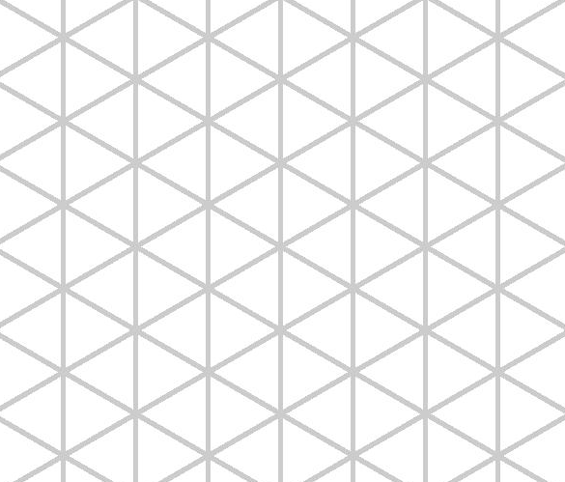
A Stochastic Approach to Shortcut Bridging in Programmable Matter
Marta Andrés Arroyo, Sarah Cannon, Joshua J. Daymude, Dana Randall, Andréa W. Richa
Abstraction of Programmable Matter: Self-organizing Particle Systems
A collection of simple computational elements that self-organize to solve system-wide problems of movement, configuration, and coordination via fully distributed, local algorithms.
Geometric Amoebot Model: Particles move on the triangular lattice.
Asynchronous,
Each has constant-size memory,
Each can communicate only with neighboring particles,
There is no common orientation, only common chirality,
Often desirable that the system stays connected.
(Mostly) deterministic algorithms exist for: Leader election, Shape formation (triangle, hexagon, etc.), Infinite object coating. (See sops.engineering.asu.edu).
Stochastic algorithms exist for:
Compression: gathering a particle system together as tightly as possible.
  Often found in natural systems.
  Approach is decentralized, self-stabilizing, and oblivious (no leader necessary).
  Uses a Markov chain to derive a local algorithm.
Shortcut bridging (DNA23): Generalizes the stochastic approach.

Slide 24
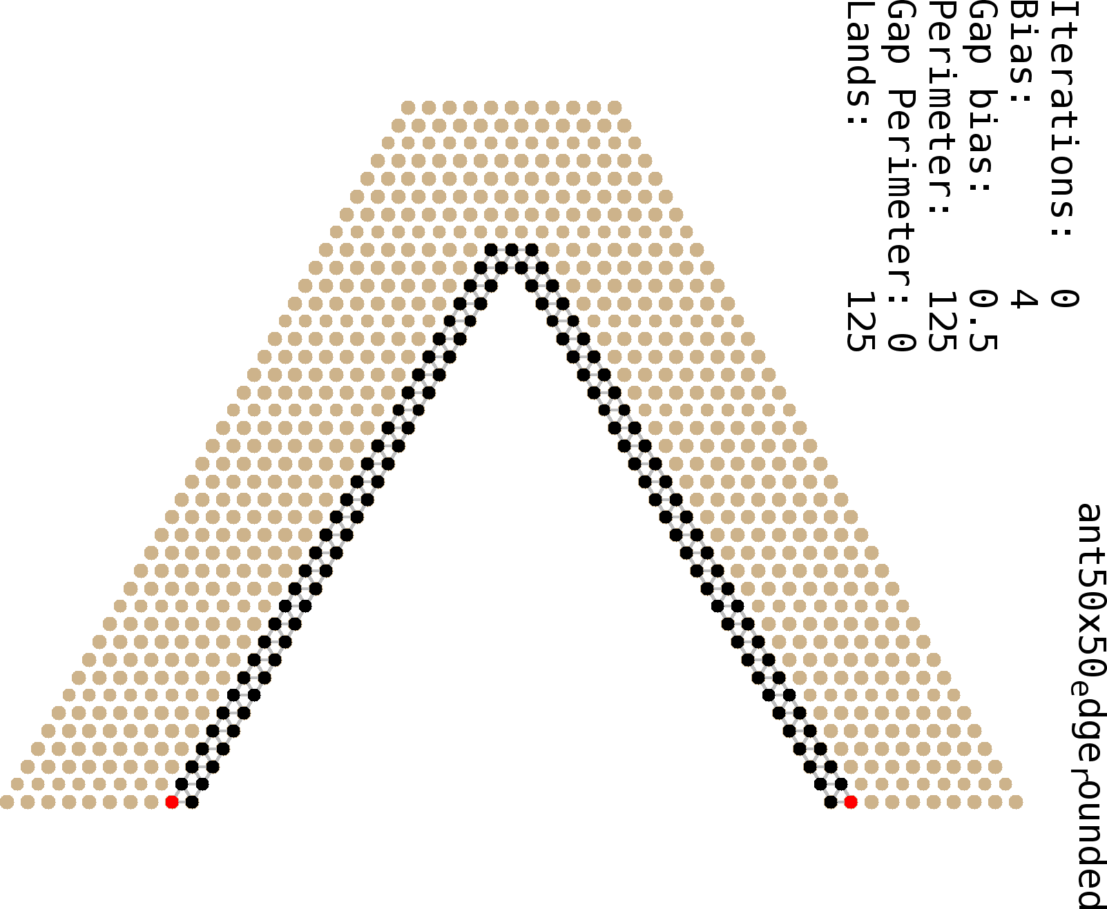
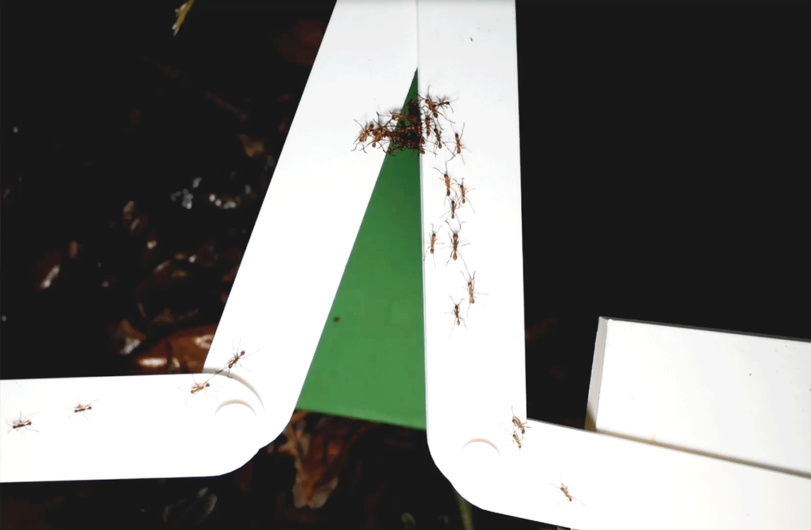
A Stochastic Approach to Shortcut Bridging in Programmable Matter
Marta Andrés Arroyo, Sarah Cannon, Joshua J. Daymude, Dana Randall, Andréa W. Richa
A framework for transforming Markov chains into local, asynchronous distributed algorithms:
Markov chain algorithm:
Starting at any configuration, repeat:
Pick a random particle.
Choose a random direction.
If certain properties hold, move in that direction with probability […..] .
Otherwise, do nothing.
Distributed algorithm:
Each particle continuously executes:
Particle proceeds at its own processing speed (possibly variable).
Choose a random direction.
If certain properties hold, move in that direction with probability […..] .
Otherwise, do nothing.
Poisson clock with
individual rate
Depends on application
Depends on application
Shortcut Bridging: Bridge across a V-shaped gap in a way that balances minimizing paths between endpoints with cost of bridge.
Chris R. Reid, Matthew J. Lutz, Scott Powell, Albert B. Kao, Iain D. Couzin, and Simon Garnier. Army ants dynamically adjust living bridges in response to a cost-benefit trade-off. Proceedings of the National Academy of Sciences, 112(49):15113-15118, 2015.
Inspired by ants (Reid et al. 2015)
Our algorithm

Slide 25
Theorem:
With only one supplementary layer,
Supplementary layer
Main layer
if each nubot can only perform one state change, then
the main layer can only grow linearly.
[Yen-Ru Chin, Jui-Ting Tsai and Ho-Lin Chen. A Minimal Requirement for Self-Assembly of Lines in Polylogarithmic Time, DNA 23]
25

Slide 26
Theorem:
Simple extensions allow exponential growth:
Two supplementary layers
or
Disappearance does not require a state change
[Yen-Ru Chin, Jui-Ting Tsai and Ho-Lin Chen. A Minimal Requirement for Self-Assembly of Lines in Polylogarithmic Time, DNA 23]
26

Slide 27

Non-cooperative binding
Conjecture: Non-cooperative tiles can only self-assemble “periodic” patterns like this. (formally, semilinear sets)
repeated
tile type

Slide 28
Non-cooperative binding at DNA 23
Pierre-Étienne Meunier and Damien Woods, The non-cooperative tile assembly model is not intrinsically universal or capable of bounded Turing machine simulation

Slide 30
Hierarchical self-assembly

Slide 31
Hierarchical self-assembly

Slide 32
Hierarchical self-assembly

Slide 33
Hierarchical self-assembly at DNA 23
Robert Schweller, Andrew Winslow, and Tim Wylie, Complexities for high temperature two-handed tile self-assembly

Slide 34
Thank you!
Questions?

