Slide 1
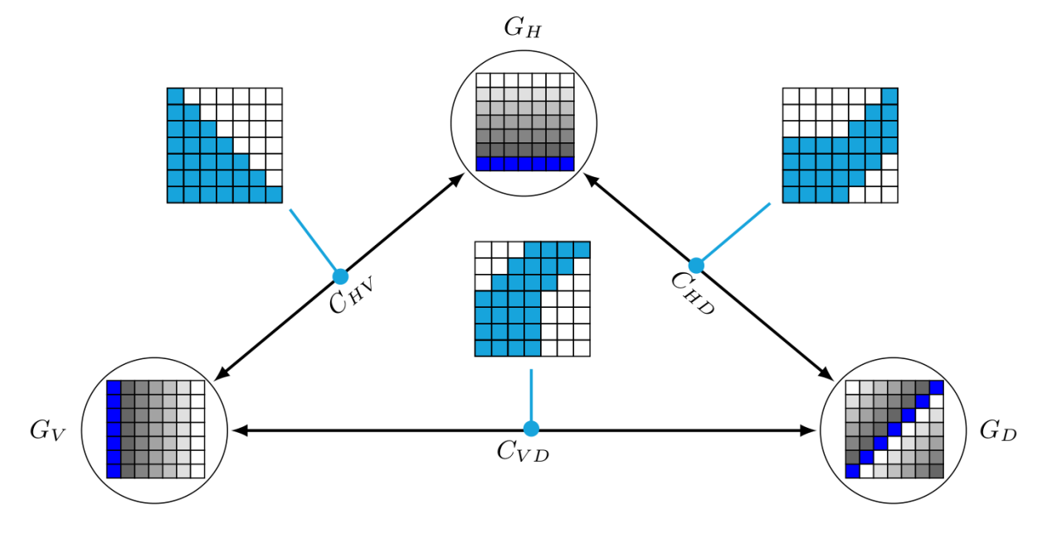
Digging (energy) wells for unknown substances: Programming substrate-independent energy barriers in catalytic chemical reactions
David Doty
Maynooth University CS Colloquium, May 8th, 2019
Slides credit: David Haley
Joint work with: Keenan Breik, Cameron Chalk, David Haley, David Soloveichik

Slide 2
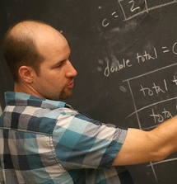
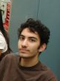






Acknowledgements
David Haley
Keenan Breik
Cameron Chalk
David Soloveichik

Slide 3
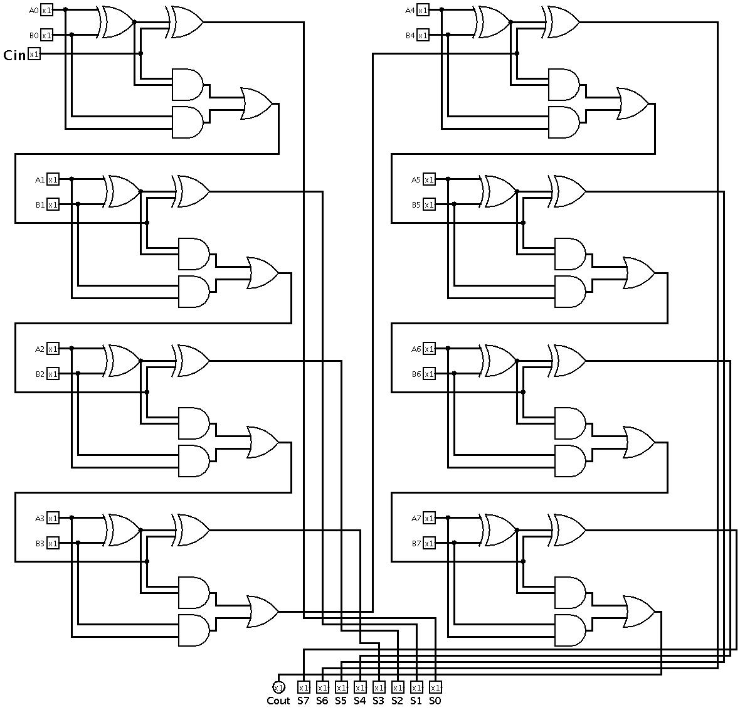

Goal
Build molecular computing systems that are reliable
?
?
?!?
(often DNA)

Slide 4
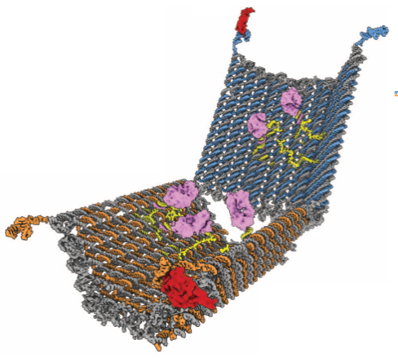
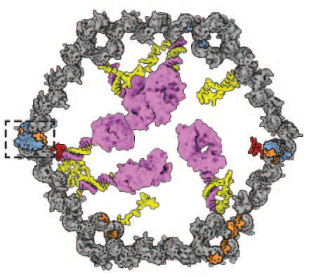
DNA nanotechnology applications
nonbiological:
example
art
nanoscale resolution surface placement
X-ray crystallization scaffolding
molecular motors
super-resolution imaging
molecular circuits
DNA origami opens to deliver antibody only in presence of two protein antigens
antibody Fab’ fragments
open
41t-specific latch
biological:
smart drugs
mRNA detection
cell surface marker detection
genetically encoded structures
TE17-specific latch
Shawn Douglas, Ido Bachelet, George Church, A logic-gated nanorobot for targeted transport of molecular payloads, Science 2012
Ashwin Gopinath, Evan Miyazono, Andrei Faraon, Paul Rothemund, Engineering and mapping nanocavity emission via precision placement of DNA origami, Nature 2016
Grigory Tikhomirov, Philip Petersen, and Lulu Qian. Fractal assembly of micrometre-scale DNA origami arrays with arbitrary patterns. Nature 2017.

Slide 5
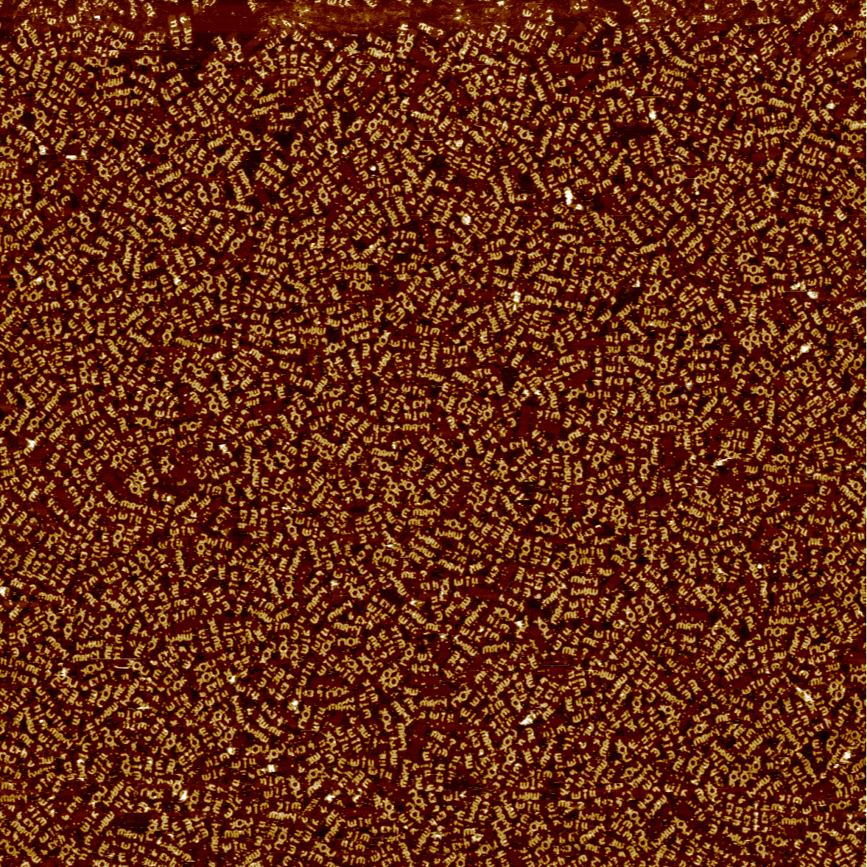
Other applications of DNA nanotechnology
4 μm wide scan
zoom in

Slide 6

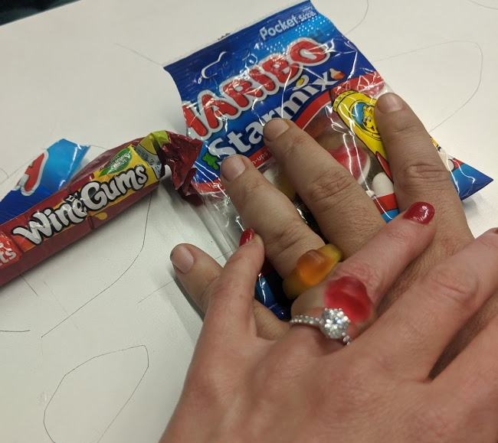
Cherry-picked samples
Beth Yim

Slide 7
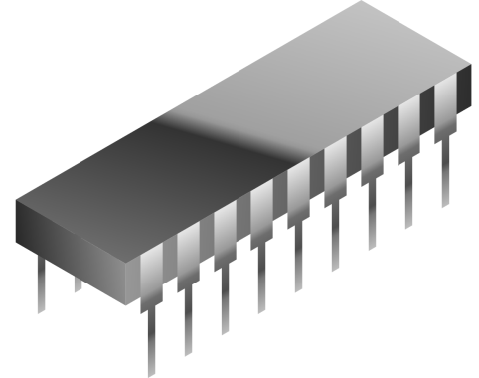
Representing Information with Molecules
Concentration
Voltage
1
0
Time
In a well-mixed solution,
concentration can represent Boolean input
In an electronic circuit,
voltage can represent Boolean input

Slide 8
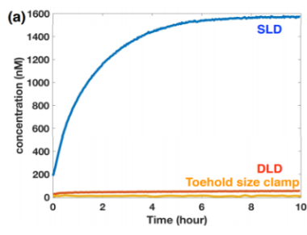
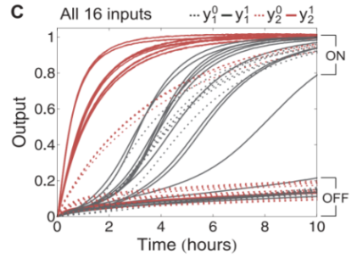
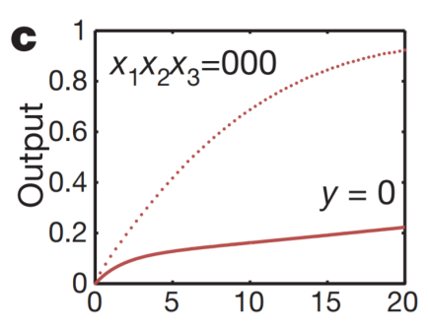
Chemical Identity Gate: Idealized vs. Actual Behavior
Experimental Implementation of Chemical Logic
Input
Output
Output
Input Present
1
Wang et al. DNA 23, 2017
Qian et al. Science 332, 2011
Leak
No Input (Ideal)
0
Qian et al. Nature 475, 2011
Time
(Don’t worry about the details in the pictures above)

Slide 9
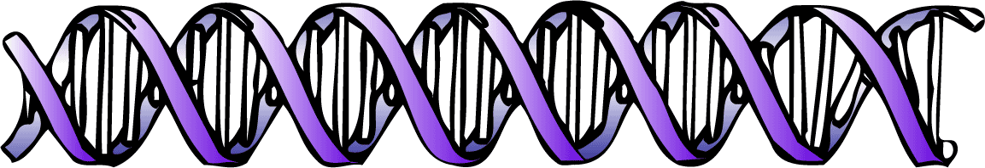

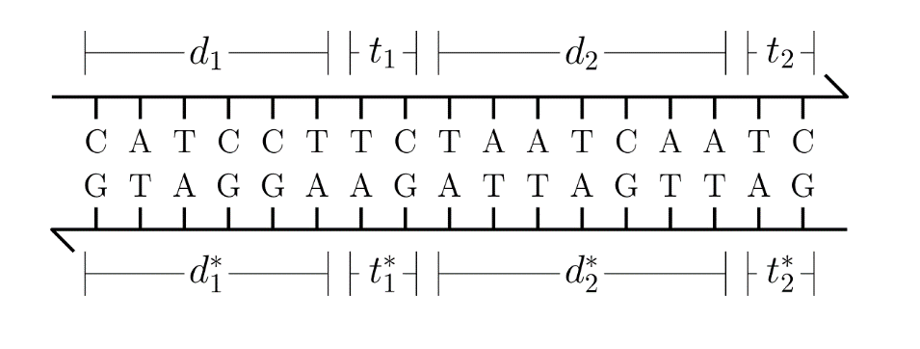
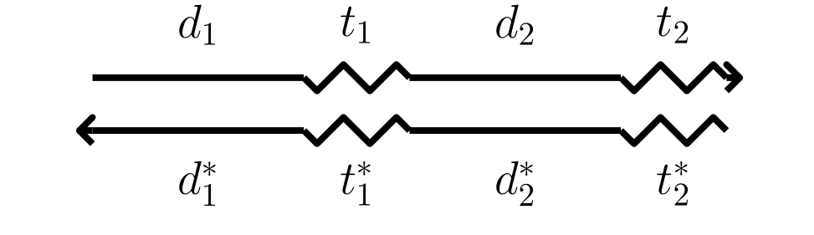
Levels of Abstraction
DNA
Base Pairs
Strands
long
short

Slide 10
DNA strand displacement
t₁
Bind
a
a
Displace
a
t₂
a
a
Release
t₁*
a*
t₂*

Slide 11
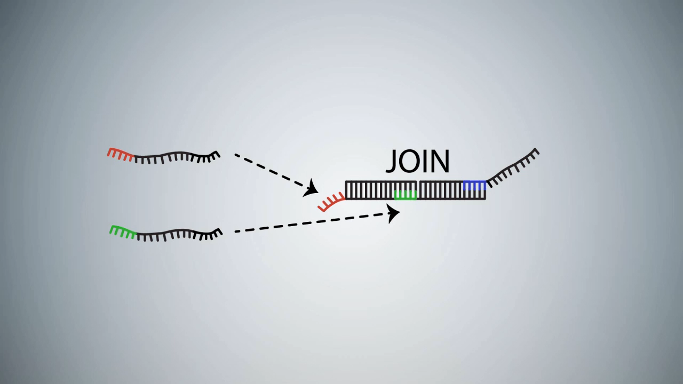
DNA strand displacement implementing A+B→C
video: Microsoft Research Cambridge

Slide 12
X ⟶ Y + Z
X
h_{x}
t₁
x
t₂
h_{y}
t₃
y
t₄
x
t₂
h_{y}
t₃
h_{z}
t₅
t₁*
x*
t₂*
Y
Z
y
t₄
h_{y}
t₃
h_{z}
t₅
z
t₆
t₂*
h_{y}*
t₃*
h_{z}*
t₅*

Slide 13
Ø ⟶ Y + Z
Leak: A Source of Error
X ⟶ Y + Z
h_{x}
t₁
x
t₂
h_{y}
t₃
y
t₄
x
t₂
h_{y}
t₃
h_{z}
t₅
t₁*
x*
t₂*
t₄
y
t₄
y
t₃
h_{y}
t₃
t₅
h_{y}
h_{z}
z
t₆
t₂*
h_{y}*
t₃*
h_{z}*
t₅*
t₂*

Slide 14
more favorable
A Driving Force for Leak
Before:
After:
h_{y}
t₃
y
t₄
x
t₂
h_{y}
t₃
h_{z}
t₅
slow
t₁*
x*
t₂*
h_{z}
t₅
z
t₆
y
t₄
very slow
h_{y}
t₃
h_{z}
t₅
z
t₆
x
t₂
h_{y}
t₃
h_{z}
t₅
t₂*
h_{y}*
t₃*
h_{z}*
t₅*
t₁*
x*
t₂*
h_{y}*
t₃*
h_{z}*
t₅*
less favorable

Slide 15
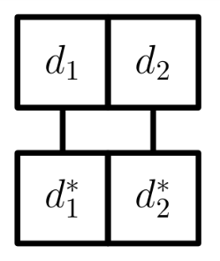
Levels of Abstraction
DNA
Base Pairs
Strands
Thermodynamic
Binding Network

Slide 16
Thermodynamic Binding Networks
a
b
b
Geometry-Free Model:
The domains within a monomer are unordered
a
a*
a*
b*
Monomer = collection of domains
Configuration = how monomers are bound

Slide 17
Thermodynamic Binding Networks
saturated = all starred domains are bound
Saturated
stable = most components while saturated
a
b
a
b
a
b
a
b
a
b
a*
b*
a*
b*
a*
b*
a*
b*
a*
b*
a
b
a
b
a
b
a
b
a
b
a
b
a
b
a
b
a
b
Stable
a*
b*
a*
b*
a*
b*
a*
b*
a
b
a
b
a
b
a
b

Slide 18
Pathways
Thermodynamics: Which configurations are energetically favorable
Kinetics: How a system moves between configurations over time
a
b
a
b
a
b
a*
b*
a*
b*
a*
b*
a
b
a
b
a
b

Slide 19
X ⟶ Y + Z
h_{x}
t₁
x
t₂
x
t₂
h_{y}
t₃
h_{z}
t₅
t₁*
x*
t₂*
y
t₄
h_{y}
t₃
h_{z}
t₅
z
t₆
t₂*
h_{y}*
t₃*
h_{z}*
t₅*

Slide 20
X ⟶ Y + Z
X
h_{x}
x
x
h_{y}
h_{z}
x*
x*
Y
Z
Energy
h_{y}
y
h_{z}
z
Merge
(less favorable)
Split
(more favorable)
h_{y}*
h_{z}*
h_{y}*
h_{z}*
progress

Slide 21
Ø ⟶ Y + Z
Leak: A Source of Error
x
h_{y}
h_{z}
x*
Energy
h_{y}
y
h_{z}
z
Merge
(less favorable)
Split
(more favorable)
h_{y}*
h_{z}*
h_{y}*
h_{z}*
progress

Slide 22
Kinetic Binding Networks
Favorability is a combination of bond count and component count
Weighted average:
Energy := – w_{H}(# bonds) – (# components)
Define pathways to consist of merges and splits
But for w_{H} ≥ 2, only saturated pathways need be considered²
Since all saturated configurations have an equal number of bonds, we can focus solely on the number of components
²Keenan Breik, Cameron Chalk, David Doty, David Haley, David Soloveichik. Programming Substrate-Independent Kinetic Barriers with Thermodynamic Binding Networks. CMSB 2018

Slide 23
Large Energy Barriers
Energy
Reaction Pathway
Merge
(less favorable)
Barrier
Split
(more favorable)
α
β
Configuration space

Slide 24
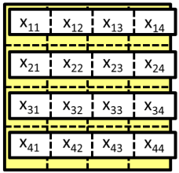
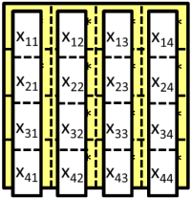
A Network with a Programmable Energy Barrier
x₁₁
x₁₂
x₁₃
x₁₄
x₁₁*
x₁₂*
x₁₃*
x₁₄*
x₁₁
x₁₂
x₁₃
x₁₄
x₂₁
x₂₂
x₂₃
x₂₄
x₂₁*
x₂₂*
x₂₃*
x₂₄*
x₂₁
x₂₂
x₂₃
x₂₄
x₃₁
x₃₂
x₃₃
x₃₄
x₃₁*
x₃₂*
x₃₃*
x₃₄*
x₃₁
x₃₂
x₃₃
x₃₄
x₄₁
x₄₂
x₄₃
x₄₄
x₄₁*
x₄₂*
x₄₃*
x₄₄*
x₄₁
x₄₂
x₄₃
x₄₄
Energy
Merge
(less favorable)
Split
(more favorable)
progress

Slide 25
Catalysis
x₁₁
x₁₁
+
x₂₁
x₂₂
+
x₂₁
x₂₂
x₃₁
x₃₂
x₃₃
x₃₁
x₃₂
x₃₃
x₄₁
x₄₂
x₄₃
x₄₄
x₄₁
x₄₂
x₄₃
x₄₄
x₁₁
x₁₁*
x₁₂*
x₁₃*
x₁₁
x₁₂
x₁₃
x₁₄*
x₁₁
x₁₃
x₁₄
x₁₂
x₁₄
x₂₁
x₂₂
x₂₁*
x₂₂*
x₂₃*
x₂₁
x₂₂
x₂₃
x₂₄*
x₂₁
x₂₃
x₂₄
x₂₂
x₂₄
x₃₁
x₃₂
x₃₃
x₃₁*
x₃₂*
x₃₃*
x₃₄*
x₃₁
x₃₂
x₃₃
x₃₄
x₃₁
x₃₂
x₃₃
x₃₄
x₄₁
x₄₂
x₄₃
x₄₄
x₄₁*
x₄₂*
x₄₃*
x₄₄*
x₄₁
x₄₂
x₄₃
x₄₄
x₄₁
x₄₂
x₄₃
x₄₄
Energy
Merge
(less favorable)
Split
(more favorable)
progress

Slide 26
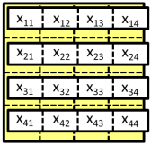
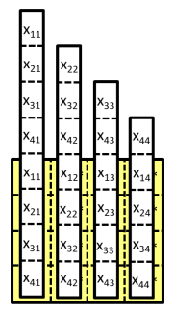
Autocatalysis
x₁₁
+
x₂₁
x₂₂
x₃₁
x₃₂
x₃₃
x₄₁
x₄₂
x₄₃
x₄₄
x₁₁
x₂₁
x₂₂
x₁₁
+
x₂₁
x₂₂
x₃₁
x₃₂
x₃₃
x₃₁
x₃₂
x₃₃
x₄₁
x₄₂
x₄₃
x₄₄
x₄₁
x₄₂
x₄₃
x₄₄
+
x₁₁*
x₁₁
x₁₂
x₁₃
x₁₄
x₁₁
x₁₂*
x₁₃*
x₁₂
x₁₃
x₁₄*
x₁₁
x₁₄
x₂₁*
x₂₁
x₂₂
x₂₃
x₂₄
x₂₁
x₂₂*
x₂₃*
x₂₂
x₂₃
x₂₄*
x₂₁
x₂₂
x₂₄
x₃₁*
x₃₁
x₃₂
x₃₃
x₃₄
x₃₁
x₃₂*
x₃₃*
x₃₂
x₃₃
x₃₄*
x₃₃
x₃₄
x₃₁
x₃₂
+
x₄₁*
x₄₁
x₄₂
x₄₃
x₄₄
x₄₁
x₄₂*
x₄₃*
x₄₂
x₄₃
x₄₄*
x₄₄
x₄₁
x₄₂
x₄₃
x₄₄

Slide 27
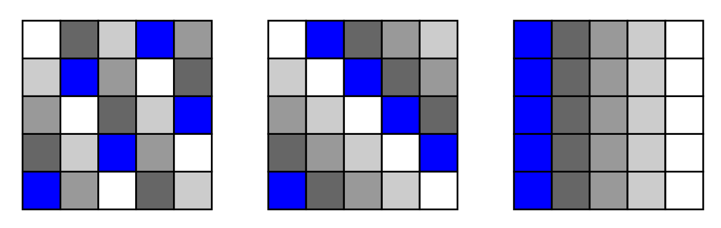
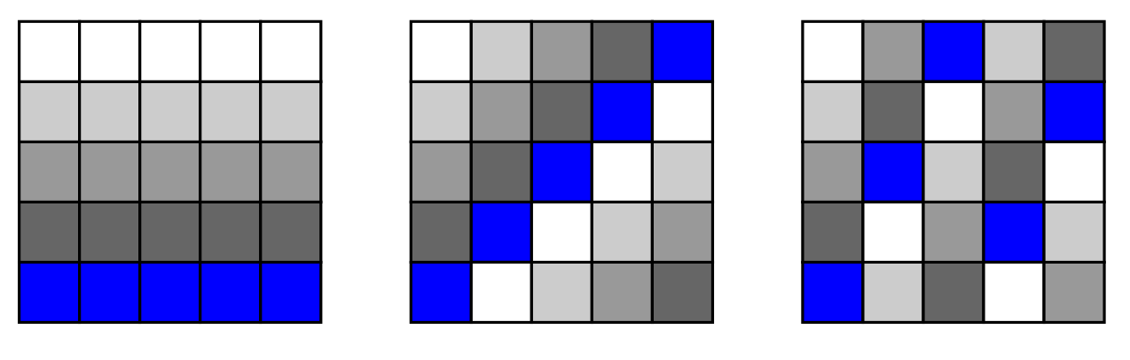
Multiple Stable Configurations
For a grid of size n x n, there can be at most n+1 different stable configurations with barrier n to pass between any of them

Slide 28
Social Golfer Problem
Can 25 (n²) golfers play in 5-somes (n-somes) for 6 (n+1) days, so that no two golfers play together more than once?
First studied by Euler.
True if n is a prime power (2,3,4,5,7,8,9,11,13,…)
False for smallest prime power n=6: can only play for 3 days! [Gaston Tarry (1901). "Le Probléme des 36 Officiers". Compte Rendu de l'Association Française pour l'Avancement des Sciences. Secrétariat de l'Association. 2: 170–203.]
Unknown for next prime power n=10:
trivial upper bound is 11 days
best known lower bound is 3

Slide 29

Directed Catalysis
Along a catalyzed pathway, the barrier is 1
Otherwise the barrier is n/2

Slide 30
Allowing more than one catalyst at once
∪
=
displaces

Slide 31
Allowing more than one catalyst at once
∪
∪
displaces 3 diagonal monomers from D complex
=

Slide 32
Allowing more than one catalyst at once
∪
∪
Not sure how to prove that all properties we want of system are preserved.
=

Slide 33
Allowing more than one catalyst at once
To have d stable states, set of domains is discrete d-dimensional hypercube.
Each monomer is (d-1)-dimensional hyperplane
Maintains energy barrier n, not just Ω(n).

Slide 34
Future directions
Simultaneous presence of multiple directed catalysts (without exponential blowup)
Minimum number of domain types to be robust to varying relative amounts of the monomers
Constrained catalytic networks using overhangs

Slide 35
Thank you!

Slide 36
Feasible DNA implementation

