Slide 1


“No we can’t”
Impossibility of fast leader election in chemical reaction networks
David Doty
Workshop on Advances in Numerical and Analytic Approaches for the Study of Non-Spatial Stochastic Dynamical Systems in Molecular Biology
WoAiNaAAftSoNSSDSiMB 2016!
Isaac Newton Institute of Mathematical Sciences, University of Cambridge
April 5, 2016
Notes:
4/26/2016
1
1

Slide 2


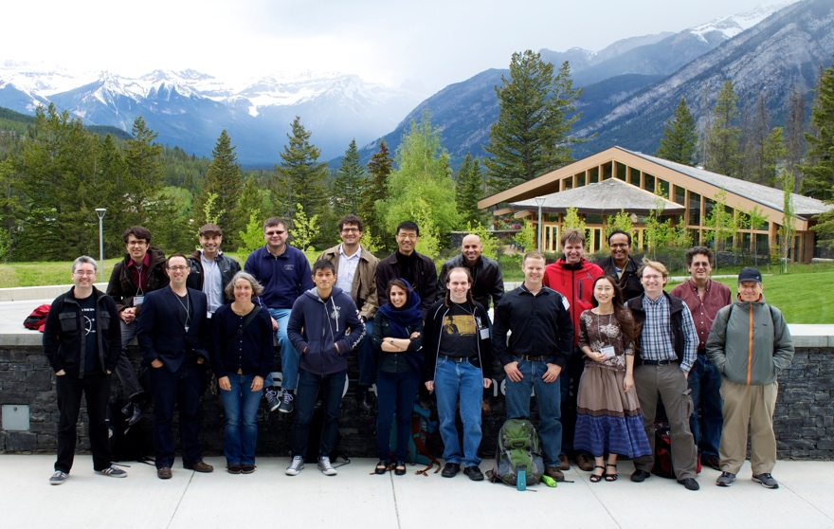


Acknowledgments
co-author
David Soloveichik
University of Texas, Austin
Monir Hajiaghayi
Anne Condon
David Anderson
Notes:
4/26/2016
2
2
Doty here!
Initial ideas at workshop

Slide 3
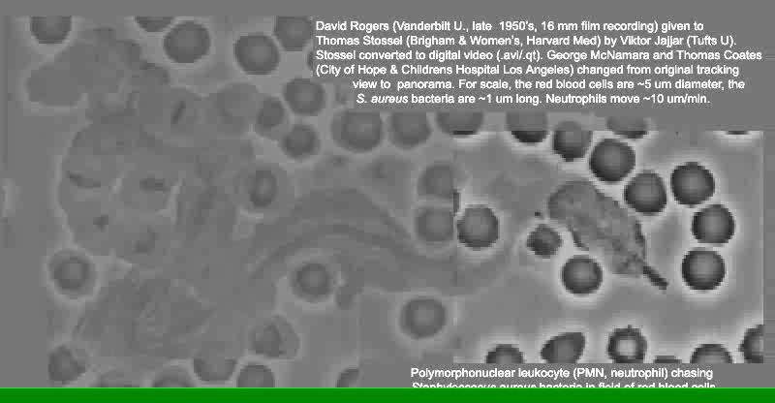
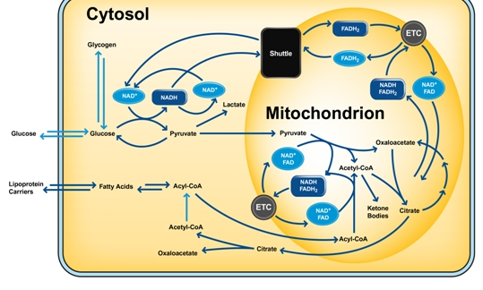
The Software of Life
How does a cell compute?
What is possible to compute using
chemistry / geometry
?
Notes:
What molecules actually do!
Fundamental mathematical structure: it comes up over and over again in different contexts: vector addition systems, Petri nets, commutative semigroups, bounded context-free languages, uniform recurrence equations

Slide 4
Chemical Reaction Network (CRN)
R→P₁+P₂
M₁+M₂→D
C+X→C+Y
Traditionally a descriptive modeling language…
Let’s instead use it as a prescriptive programming language
Notes:
What molecules actually do!
Fundamental mathematical structure: it comes up over and over again in different contexts: vector addition systems, Petri nets, commutative semigroups, bounded context-free languages, uniform recurrence equations

Slide 5













Can we compute with chemistry?
“Not every CRN describes real chemicals!”, i.e. “where’s the compiler?”
Response: Soloveichik et al. [PNAS 2011] showed how to physically implement any CRN using DNA strand displacement
X₁+X₂→X₃
↔
+
+
→
+
+
+
→
+
Notes:
What molecules actually do!
Fundamental mathematical structure: it comes up over and over again in different contexts: vector addition systems, Petri nets, commutative semigroups, bounded context-free languages, uniform recurrence equations

Slide 6
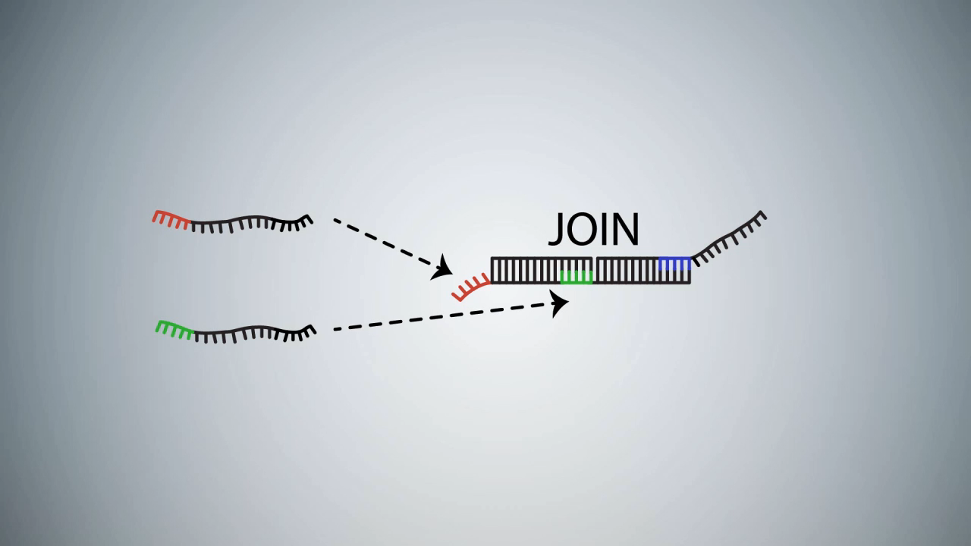
DNA strand displacement implementing A+B→C
video courtesy Microsoft Research Cambridge

Slide 7
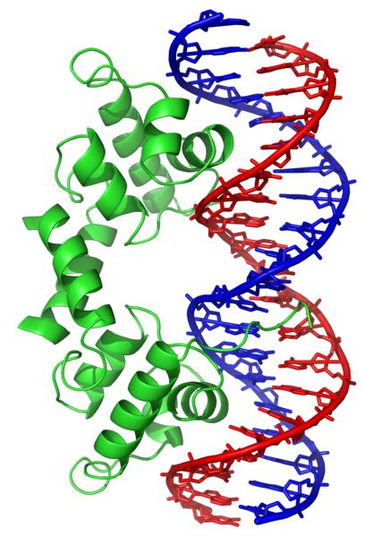
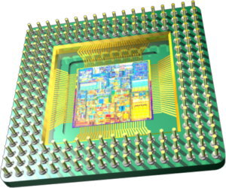
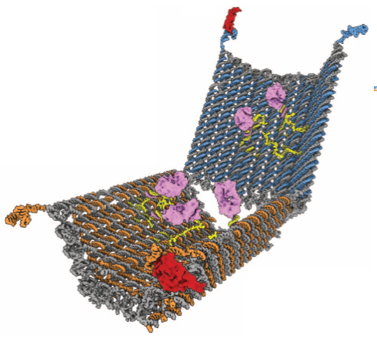
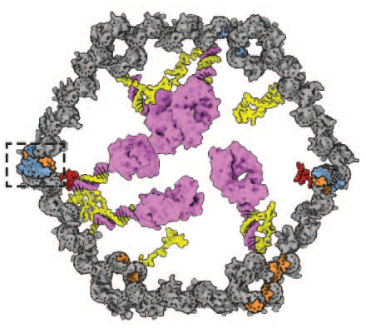


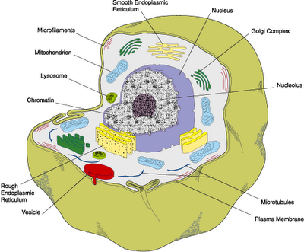
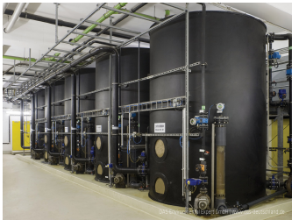
Why compute with chemistry?
opens to deliver only in presence of two protein antigens
versus
antibody Fab’ fragments
slow
speed?
fast
open
10-100nm
component size?
10-100nm
yes
compatible with biological or other “wet” environments?
not easily
41t-specific latch
TE17-specific latch
Douglas et al, Science 2012
cells
bioreactors
“smart” drug released only in certain cellular conditions
“chemical controller” to optimize yield of metabolically produced biofuels/drugs
Notes:
What molecules actually do!
Fundamental mathematical structure: it comes up over and over again in different contexts: vector addition systems, Petri nets, commutative semigroups, bounded context-free languages, uniform recurrence equations

Slide 8

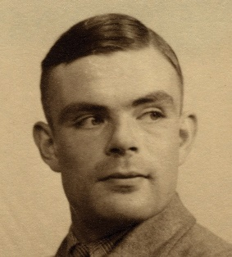

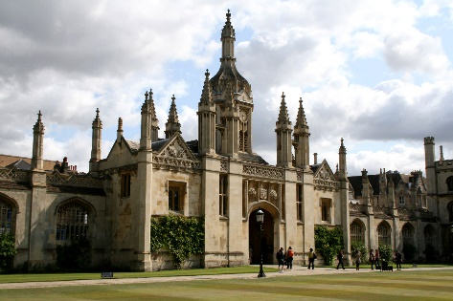
Theoretical Computer Science Approach
What computations necessarily take a long time and what can be done quickly?
(Computational complexity)
What computation is possible and what is not?

Slide 9
Outline
(Stochastic, discrete) chemical reaction networks
Time lower bound on one computational task: leader election
Open questions

Slide 10
Chemical Reaction Networks (CRNs)
finite set of d species { A, B, C, D, ... }
configuration x∈ℕ^{d}: molecular counts of each species
finite set of reactions: e.g.
k₁
A+B→A+C
C→A+A
C+B→C
k₂
k₃
Notes:
[d stands for dimension]
[Transition to next slide:] Unless otherwise noted, we’ll say that the rate constants are 1. So suppose we have this set of reactions... and we start in this state...

Slide 11
Example reaction sequence
A B C
α:
A+B→A+C
C→A+A
x =
(2, 2, 0)
β:
α
⟹
(2, 1, 1)
α
β
⟹
...
⟹
(4, 1, 0)
α
⟹
(4, 0, 1)
...
Notes:
...

Slide 12

Stochastic kinetic model of CRNs
Solution volume v
System evolves via a continuous time Markov process:
time until next reaction is exponentially distributed with rate ∑propi
Pr[next reaction is rxnj] = propj/∑propi
reaction type
prop_{i}
k
k⋅ #A
k⋅ #A⋅ #B / v
k⋅ #A⋅(#A-1) / v
A → …
k
A+B → …
k
A+A → …
McQuarrie 1967, van Kampen, Gillespie 1977, etc

Slide 13
Main result (informally)
“Leader election” (getting to count 1 of a species) requires Ω(n) expected time
L+L→L+F
Doty, Soloveichik, “Stable leader election in population protocols requires linear time” DISC 2015: International Symposium on Distributed Computing

Slide 14
Leader election: what’s the point?
First step towards establishing full theory of time complexity in CRN computation (“in-house” result)
Getting “precise” quantities of species (e.g. exactly 1 L) from “uncontrolled” initial conditions (e.g. a lot of A).
easy to add billions of molecules to test tube
difficult to add 1
Other kinds of computation require an initial leader.
Versions of “leader election” in biology: centriole number, choice of olfactory receptor expression, ...
Notes:
2: Explains why leader election can be slow even though it is semilinear!!!
[biology: if the components are identical, how can the cell degrade one but not the other ]

Slide 15
Defining stable leader election
∀
∃
∀
i
x
o
o’
reaction sequence
reaction sequence
reaction sequence
uniform initial
configuration
any reachable
configuration
single L
single L
o is stable
If number of reachable configurations is finite, CRN will reach such a configuration with probability 1
Notes:
-This is the appropriate notion of determinism here
-Say “such that” when talk about there not existing a path to o’

Slide 16
Speed of stable computation
How to fairly assess speed?
Like any respectable computer scientist…
1) as a function of input size n (how required time grows with n)
2) ignoring constant factors
rate constants k_{i} bounded by 1
n = total molecular count
volume v = Θ(n)
i.e., require bounded concentration (finite density constraint)

Slide 17
An exponential time difference
n molecules
volume v=Θ(n)
B
X
B
X
X
B
B
B
X
B
X
X
B
X
B
X
B
X
B
B
X
X
B
B
X
B
X
B
X
X
B
X
B
B
X
A
X
B
X
X
B
B
X
X
B
B
B+X→B+B
A+B→Y+B
A+B→Y+B
propensity: #A·#B / v = Θ(1/n)
expected time to
produce Y:
Θ(n)
Θ(log n)
Notes:
-Suppose you want A to know there is a B, or in other words for Y to get produced if both A and B are present.
-B recruits X’s to become B, which can in turn recruit other X’s...
-Exponential amplification!
-n is large (Avogadro scale)

Slide 18
Speed of naïve stable leader election
initial configuration: uniform (all n molecules of the same species)
output: stable configuration with #L = 1
Naïve algorithm:
Θ(n) time
initial config = {n L}
L+L→L+F
...
Fast leader elimination
L+F→F+F
“2-bottleneck” reaction
Θ(log n) time
one of these is always count ≥ n/2
Notes:
4/26/2016
18
18

Slide 19
Main theorem
Any “reasonable” CRN stably electing a leader requires Ω(n) time to reach a stable configuration. (L+L→L+F is optimal)
“reasonable” ≈ from initial configuration with n molecules, at most O(n) additional molecules produced in initial O(1) time… implies probably all species eventually produced
Holds for dense initial configurations: all species present have count Ω(n)
notion of denseness is compatible with “mass action limit”
a.k.a. “mean field approximation”
Notes:
4/26/2016
19
19

Slide 20
Entire proof?
Sublinear time implies ∃ reaction sequence resulting in 1 L with no O(1)-bottleneck reactions
when L=2 and L+B→C+D occurs, B≫1 since it's not a bottleneck
This configuration might not be stable!
(CRN could produce a new leader)
C
B
L
C
B
B
B
C
D
B
B
B
D
D
B
C
B
L
B
C
C
B
C
Notes:
4/26/2016
20
20
Natural tendency is to start thinking about the last reaction that affects the leader.
Trying to develop the intuition for the proof, suppose the last reaction is bimolecular.

Slide 21
Proof must reason about initial configuration
Sublinear time leader election from non-uniform initial configurations is possible!
#R = n^{1/4}
#X = n–n^{1/4}
#L = 0
K
X
K
X
X
K
K
X
K
K
R
X
k
X
X
R+R→L+K
// produce L O(n^{1/2}) time
K
X
K
K
R
R
L
R+K→K+K
// stop 2nd L from being produced
K
K
R
X+K→K+K
R
L
// O(log n) time to complete
R
K
K
X
K
X
L+L→L+K
// just in case 2nd L produced
X
X
K
K
X
// O(n) time if needed (likely not)
K
K
X
X
K
K
X
k
K
X
K
X
X
total expected time O(n^{1/2} log n) (proof not shown)

Slide 22
Large counts lemma
From uniform initial configuration i = {n A}, with probability > 99%, after O(1) time, all species reach count Ω(n)
1 sec
[Doty, SODA 2014: Symposium on Discrete Algorithms]

Slide 23
Main lemma
hypothesis of lemma
(i_{n}): uniform initial configurations (i.e., all n molecules are A)
probably
(x_{n}): i_{n} ⇒ x_{n} where x_{n}(S) ≥ 0.01n for all species S (large counts lemma)
fast
(y_{n}): x_{n} ⇒ y_{n} no bottleneck (fast), y_{n} has stable leader (correct)
Definition. Δ = species with bounded counts in (y_{n}) as n→∞
i₂₀₀
x₂₀₀
y₂₀₀
≥
v₂₀₀
y₃₀₀
fast
probably
⇒
⇒
Lemma: x_{n} ⇒ v_{n} where v_{n}(Δ) = 0
Δ
stable!
Δ
y_{n}(L) = 1 so L ∈ Δ
Get from x_{n} to v_{n} using transitions from Reaction Ordering Lemma:
so v_{n}(L) = 0
There is an order on Δ = { D₁, D₂, …, D_{k} }, and reactions D_{j}+R→P+P' where R,P,P' ∉ { D₁, D₂,…, D_{j} }.
i.e., leader not elected with probability 1
[Chen, Cummings, Doty, Soloveichik, DISC 2014: Symposium on Distributed Computing]

Slide 24
Summary
Every (reasonable) CRN that stably elects a leader from a uniform initial configuration (all molecules are same species) requires time Ω(n).
More generally, negative result holds even if:
  initial configuration nonuniform but dense (each species present has count Ω(n))
  goal is any positive number of leaders under some constant
  there are multiple leader species L₁,L₂, …,L_{k} and goal is to stabilize to ∑#L_{i} = 1

Slide 25
Open questions
Convergence versus stabilization
#
L
=2
#
L
=1
#
L
=1
#
L
=1 stable
...
...
initial
convergence
stabilization
Leader election takes Ω(n) time to stabilize; what about convergence?
What initial configurations allow sublinear leader election?
    dense configurations like { n/2 A, n/4 B, n/4 C }: NO
    non-dense configurations like { n-n^{1/4} X, n^{1/4} R }: YES

Slide 26
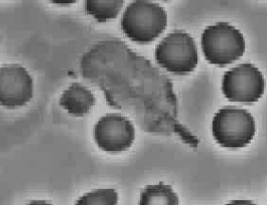
Take-home message
(engineer’s perspective)
Ask not what nature does
Ask what nature could do…

Slide 27
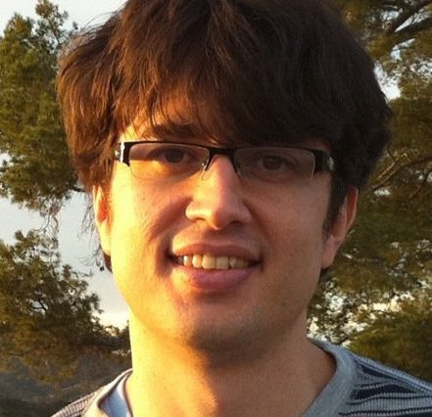
Recruiting Ph.D. Students
David Soloveichik
David Doty

