Slide 1
Slow Molecule Revolution Time lower bounds for computation with chemical reaction networks
David Doty
Laboratoire de Recherche en Informatique
Université Paris-Sud
July 5, 2017
Notes:
7/5/2017
1
1

Slide 2
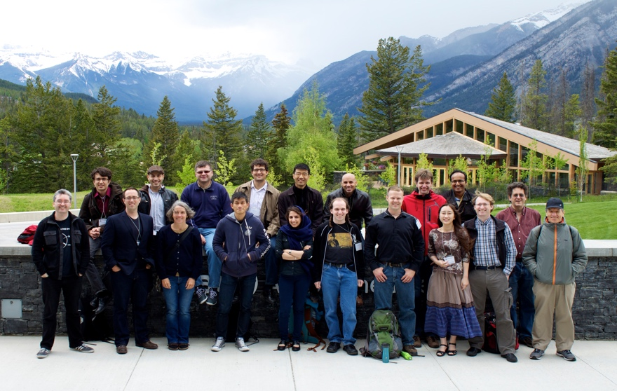
Acknowledgments
co-author
David Soloveichik
University of Texas, Austin
Monir Hajiaghayi
Anne Condon
Notes:
7/5/2017
2
2
Doty here!
Initial ideas at workshop

Slide 3
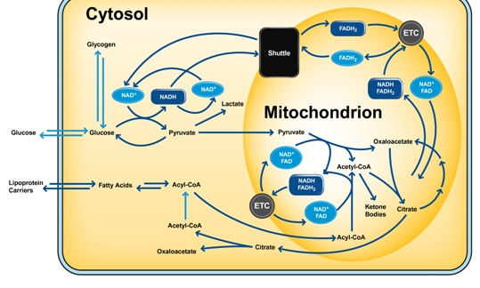
The Software of Life
How does a cell compute?
What is possible to compute using
chemistry / geometry
?
Notes:
What molecules actually do!
Fundamental mathematical structure: it comes up over and over again in different contexts: vector addition systems, Petri nets, commutative semigroups, bounded context-free languages, uniform recurrence equations

Slide 4
Chemical Reaction Network
R→P₁+P₂
M₁+M₂→D
C+X→C+Y
Traditionally a descriptive modeling language…
Let’s instead use it as a prescriptive programming language
Notes:
What molecules actually do!
Fundamental mathematical structure: it comes up over and over again in different contexts: vector addition systems, Petri nets, commutative semigroups, bounded context-free languages, uniform recurrence equations

Slide 5
Can we compute with chemistry?
“Not every CRN describes real chemicals!”, i.e. “where’s the compiler?”
Response: Soloveichik et al. [PNAS 2011] showed how to physically implement any CRN using DNA strand displacement
X₁+X₂→X₃
↔
+
+
→
+
+
+
→
+
Notes:
What molecules actually do!
Fundamental mathematical structure: it comes up over and over again in different contexts: vector addition systems, Petri nets, commutative semigroups, bounded context-free languages, uniform recurrence equations

Slide 6
DNA strand displacement implementing A+B→C
video courtesy Microsoft Research Cambridge

Slide 7
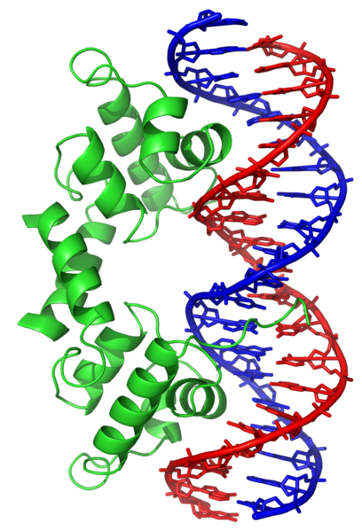
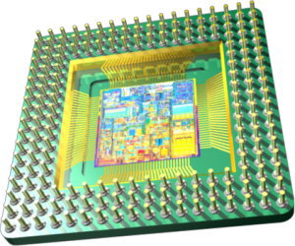
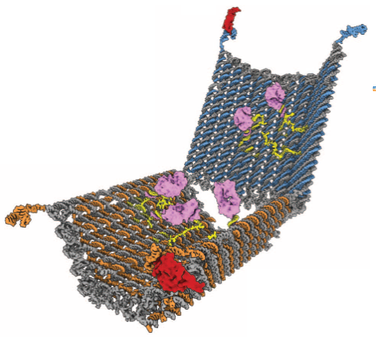
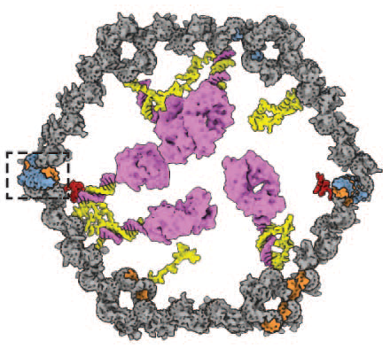
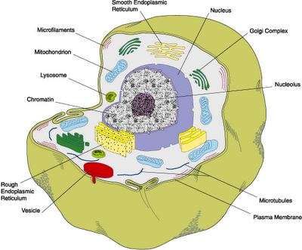
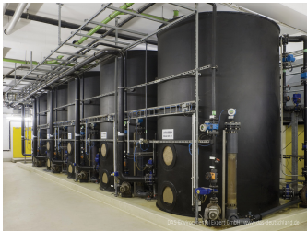
Why compute with chemistry?
opens to deliver antibody only in presence of two protein antigens
versus
antibody Fab’ fragments
slow
speed?
fast
open
10-100nm
component size?
10-100nm
yes
compatible with biological or other “wet” environments?
not easily
41t-specific latch
TE17-specific latch
Douglas et al, Science 2012
cells
bioreactors
“smart” drug released only in certain cellular conditions
“chemical controller” to optimize yield of metabolically produced biofuels/drugs
Notes:
What molecules actually do!
Fundamental mathematical structure: it comes up over and over again in different contexts: vector addition systems, Petri nets, commutative semigroups, bounded context-free languages, uniform recurrence equations

Slide 8
Theoretical Computer Science Approach
What computations necessarily take a long time and what can be done quickly?
(Computational complexity)
What computation is possible and what is not?

Slide 9
Outline
(Stochastic, discrete) chemical reaction networks
Relationship to population protocols (i.e., why is chemical computation a kind of distributed computing?)
Time lower bound on one computational task: leader election
Open questions

Slide 10
Chemical Reaction Networks (formal definition)
finite set of d species { A, B, C, D, ... }
configuration x∈ℕ^{d}: molecular counts of each species
finite set of reactions: e.g.
k₁
A+B→A+C
C→A+A
C+B→C
k₂
k₃
Notes:
[d stands for dimension]
[Transition to next slide:] Unless otherwise noted, we’ll say that the rate constants are 1. So suppose we have this set of reactions... and we start in this state...

Slide 11
Example reaction sequence
A B C
α:
A+B→A+C
C→A+A
x =
(2, 2, 0)
β:
α
⟹
(2, 1, 1)
α
β
⟹
⟹
...
(4, 1, 0)
α
⟹
(4, 0, 1)
...
Notes:
...

Slide 12
Stochastic kinetic model of chemical reaction networks
Solution volume v
reaction type
prop_{i}
k
k⋅ #A
k⋅ #A⋅ #B / v
k⋅ #A⋅(#A-1) / v
A → …
k
A+B → …
k
A+A → …
System evolves via a continuous time Markov process:
time until next reaction is exponentially distributed with rate ∑propi
Pr[next reaction is rxnj] = propj / ∑propi
McQuarrie 1967, van Kampen, Gillespie 1977, etc

Slide 13
population protocols ⊊ chemical reactions
population protocol = list of transitions such as
X,Y → X,X A,B → C,D A,A → A,A (null transition)
This is a chemical reaction network with
two reactants, two products per reaction
unit rate constants
volume = n = number of agents

Slide 14
population protocols ⊊ chemical reactions
time analysis
parallel time = number of interactions / n
each interaction rolls a (n choose 2)–sided die (pick pair of agents to interact)
# interactions until a non-null interaction (A,B) → (C,D) is a geometric random variable (discrete version of exponential random variable) with success probability p = (# non-null interactions possible) / (n choose 2)
expected time: Θ(n) / (# non-null interactions possible) = Θ(n)/(#A∙#B) = same expected time as chemical reaction time model
recall reaction rate is #A∙#B/volume = #A∙#B/n, and expected time = 1/rate

Slide 15
Main result (informally)
“Leader election” (getting to count 1 of a species) requires Ω(n) expected time.
Therefore, this network is optimal:
We’ll see later it takes O(n) time.
L+L→L+F
Doty, Soloveichik, “Stable leader election in population protocols requires linear time” DISC 2015: International Symposium on Distributed Computing

Slide 16
Leader election: what’s the point?
First step towards establishing full theory of time complexity in CRN computation (“in-house” result)
Getting “precise” quantities of species (e.g. exactly 1 L) from “uncontrolled” initial conditions (e.g. a lot of A).
easy to add billions of molecules to test tube
difficult to add 1
Other kinds of computation require an initial leader.
Versions of “leader election” in biology: centriole number, choice of olfactory receptor expression, ...
Notes:
2: Explains why leader election can be slow even though it is semilinear!!!
[biology: if the components are identical, how can the cell degrade one but not the other ]

Slide 17
Defining stable leader election
∀
∃
∀
i
x
o
o’
reaction sequence
reaction sequence
reaction sequence
uniform initial
configuration
any reachable
configuration
single L
single L
o is stable
If number of reachable configurations is finite, network will reach such a configuration with probability 1
Notes:
-This is the appropriate notion of determinism here
-Say “such that” when talk about there not existing a path to o’

Slide 18
Speed of stable computation
How to fairly assess speed?
Like any respectable computer scientist…
1) as a function of input size n (how required time grows with n)
2) ignoring constant factors
rate constants k_{i} bounded by 1
n = total molecular count volume v = Θ(n)
i.e., require bounded concentration (finite density constraint)

Slide 19
An exponential time difference
n molecules
volume v=Θ(n)
B
X
B
X
X
B
B
B
X
B
X
X
B
X
B
X
B
X
B
B
X
X
B
B
X
B
X
B
X
X
B
X
B
B
X
A
Y
X
B
X
X
B
B
X
X
B
B
B+X→B+B
A+B→Y+B
A+B→Y+B
propensity: #A·#B / v = Θ(1/n)
expected time to
produce Y:
Θ(n)
Θ(log n)
Notes:
-Suppose you want A to know there is a B, or in other words for Y to get produced if both A and B are present.
-B recruits X’s to become B, which can in turn recruit other X’s...
-Exponential amplification!
-n is large (Avogadro scale)

Slide 20
Speed of naïve stable leader election
initial configuration: uniform (all n molecules are same species, volume = n)
output: stable configuration with #L = 1
Naïve algorithm:
Θ(n) time
initial config = {n L}
L+L→L+F
...
Fast leader elimination
L+F→F+F
“2-bottleneck” reaction
Θ(log n) time
one of these is always count ≥ n/2
Notes:
7/5/2017
20
20

Slide 21
Main theorem
Any “reasonable” chemical reaction network stably electing a leader requires Ω(n) time to reach a stable configuration. (L+L→L+F is optimal)
“reasonable” ≈ from initial configuration with n molecules, at most O(n) additional molecules produced in initial O(1) time… implies probably all species eventually produced
Holds for dense initial configurations: all species present have count Ω(n)
notion of denseness is compatible with “mass action limit” a.k.a. “mean field approximation”
Notes:
7/5/2017
21
21

Slide 22
Entire proof?
Sublinear time implies ∃ reaction sequence resulting in 1 L with no O(1)-bottleneck reactions
when L=2 and L+B→C+D occurs, B≫1 since it's not a bottleneck
This configuration might not be stable!
(network could produce a new leader)
C
B
L
C
B
B
B
C
D
B
B
B
D
D
B
C
B
L
B
C
C
B
C
Notes:
7/5/2017
22
22
Natural tendency is to start thinking about the last reaction that affects the leader.
Trying to develop the intuition for the proof, suppose the last reaction is bimolecular.

Slide 23
Proof must reason about initial configuration
Sublinear time leader election from non-dense initial configurations is possible!
#R = n^{1/4}
#X = n – n^{1/4}
#L = 0
K
X
K
X
X
K
K
X
K
K
R
X
k
X
X
R+R→L+K
// produce L O(n^{1/2}) time
K
X
K
K
R
R
L
R+K→K+K
// stop 2nd L from being produced
K
K
R
X+K→K+K
R
L
// O(log n) time to complete
R
K
K
X
K
X
L+L→L+K
// just in case 2nd L produced
X
X
K
K
X
// O(n) time if needed (likely not)
K
K
X
X
K
K
X
k
K
X
K
X
X
total expected time O(n^{1/2} log n) (proof not shown)

Slide 24
Large counts lemma
From uniform initial configuration i = {n A}, with probability > 99%, after O(1) time, all species reach count Ω(n)
1 sec
[Doty, SODA 2014: Symposium on Discrete Algorithms]

Slide 25
Main lemma
want to show: if network quickly elects a leader, then it has positive probability of failure
(i_{n}): uniform initial configurations (i.e., all n molecules are A)
probably
(x_{n}): i_{n} ⇒ x_{n} where x_{n}(S) ≥ 0.01n for all species S (large counts lemma)
hypothesis of lemma
fast
(y_{n}): x_{n} ⇒ y_{n} no bottleneck (fast), y_{n} has stable leader (correct)
Definition. Δ = species with bounded counts in (y_{n}) as n→∞
i₂₀₀
x₂₀₀
y₂₀₀
v₂₀₀
y₃₀₀
≥
fast
probably
⇒
⇒
Lemma: x_{n} ⇒ v_{n} where v_{n}(Δ) = 0
Δ
Δ
y_{n}(L) = 1 so L ∈ Δ
stable!
Get from x_{n} to v_{n} using reactions from Reaction Ordering Lemma:
so v_{n}(L) = 0
There is an order on Δ = { D₁, D₂, …, D_{k} }, and for each 1 ≤ j ≤ k,
reactions D_{j}+R→P+P' where R,P,P' ∉ { D₁, D₂,…, D_{j} }.
[Chen, Cummings, Doty, Soloveichik, DISC 2014: Symposium on Distributed Computing]
i.e., leader not elected with probability 1

Slide 26
Summary
Every (reasonable) chemical reaction network that stably elects a leader from a uniform initial configuration (all molecules are same species) requires time Ω(n).
More generally, negative result holds even if:
initial configuration nonuniform but dense (each species present has count Ω(n))
goal is any positive number of leaders under some constant
there are multiple leader species L₁,L₂, …,L_{k} and goal is to stabilize to ∑#L_{i} = 1

Slide 27
Open questions
Convergence versus stabilization
#
L
=2
#
L
=1
#
L
=1
#
L
=1 stable
...
...
initial
convergence
stabilization
Leader election takes Ω(n) time to stabilize; what about convergence?
What initial configurations allow sublinear leader election?
dense configurations like { n/2 A, n/4 B, n/4 C }: NO
non-dense configurations like { n^{1/4} R, n – n^{1/4} X }: YES

Slide 28
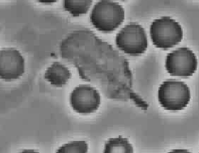
Take-home message (engineer’s perspective)
Ask not what nature does
Ask what nature could do…

