Slide 1


Thermodynamic binding networks
How to self-assemble molecules reliably without knowing too much about them (substrate-independent self-assembly)
David Doty (UC-Davis)
Joint work with Trent Rogers (UArk), David Soloveichik (UT-Austin), Chris Thachuk (Caltech), Damien Woods (Inria)
Self-Assembly, Geometry, and Computation Workshop at UCNC
IUT Sénart-Fontainebleau, June 2018

Slide 2









Acknowledgements
co-authors
Trent Rogers
David Soloveichik
Chris Thachuk
Damien Woods
paper in proceedings of DNA 23:
23rd International Meeting on DNA Computing and Molecular Programming
Notes:
I normally have a policy with alphabetically authored papers of stating that all authors contributed equally, and if you want any more information, good luck beating it out of me. But in this case I feel obligated to thank David Soloveichik especially for conceiving of this model and working out the initial ideas. We all contributed a lot to this paper over the past 3 years, but it’s really David’s vision, and I feel a bit guilty to be the first one of us to talk about it extensively in public. But David will talk about it a month from now at the DNA computing conference. →

Slide 3
Outline
Part 1: Computation via molecular binding (kinetically)
Part 2: Computation via molecular binding (thermodynamically)
Part 3: Thermodynamic self-assembly
Notes:
I’m now about to violate a second rule of mine, which is not to introduce too many tricky concepts in one talk. But we conceived the model while thinking about some other models, so to motivate our work, I’m going to present some other rather involved models, and after I’m done presenting them, we’re not going to talk about them any more. Sorry. →

Slide 4
Computation via molecular binding: Two models
DNA tile self-assembly
DNA strand displacement
monomers (DNA “tiles”) bind into a crystal lattice
DNA complexes exchange strands with each other by displacing binding domains
domains
tile
=
=
bind
unbind
lattice
displace
Source: Programmable disorder in random DNA tilings. Tikhomirov, Petersen, Qian, Nature Nanotechnology 2017
Notes:
What does it mean to say that a physical system “does computation via molecular binding”? Well, it could mean a lot of things, but there’s two popular lines of experimental research, with associated theoretical models, that make this idea specific.
One is DNA tile self-assembly. DNA complexes called tiles---each could be just one strand, could be 4 or 5 strands, this one here is actually made from hundreds of strands---bind to each other in a lattice to form a crystal. Here’s an AFM image of a 2D square lattice crystal made of DNA tiles. It’s not clear how “computation” could happen here, but we’ll get to that.
Another popular nanoscale technology is DNA strand displacement. Here, DNA complexes are more “dynamic”, they can bind, but they can also exchange individual DNA strands with each other and break apart.
I’ll give just enough details of these two methods to justify that they can “compute”, and as I warned, after that we’re going to stop talking about them. →

Slide 5
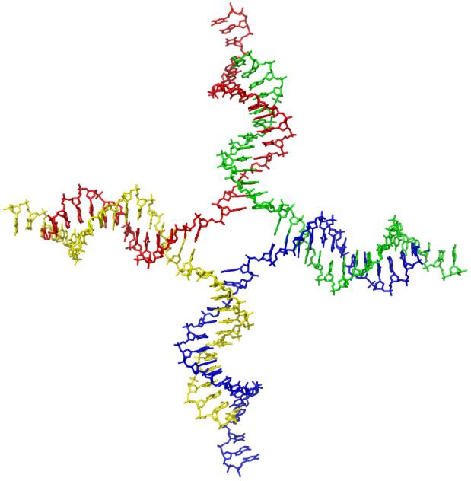
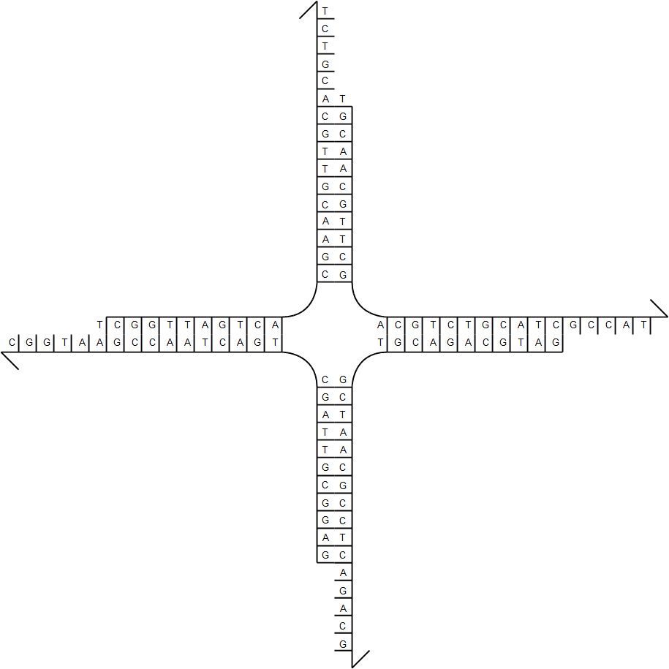
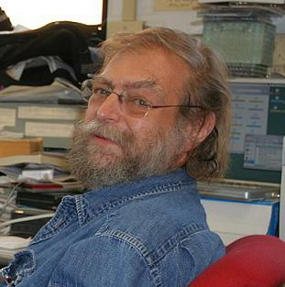
Practice of DNA tile self-assembly
Source:en.wikipedia; Author: Zephyris at en.wikipedia; Permission: PDB; Released under the GNU Free Documentation License.
DNA tile
Ned Seeman, Journal of Theoretical Biology 1982
sticky end
Notes:
DNA tile assembly was pioneered by Ned Seeman, whose first idea used something called a “branched junction” molecule. By synthesizing four strands of DNA as shown, they form this “tile” which has
four “sticky ends”, meaning single strands that are “sticky” because they want to bind to their Watson-Crick complement.
In this case, west is complementary to east, and north is complementary to south, →

Slide 6
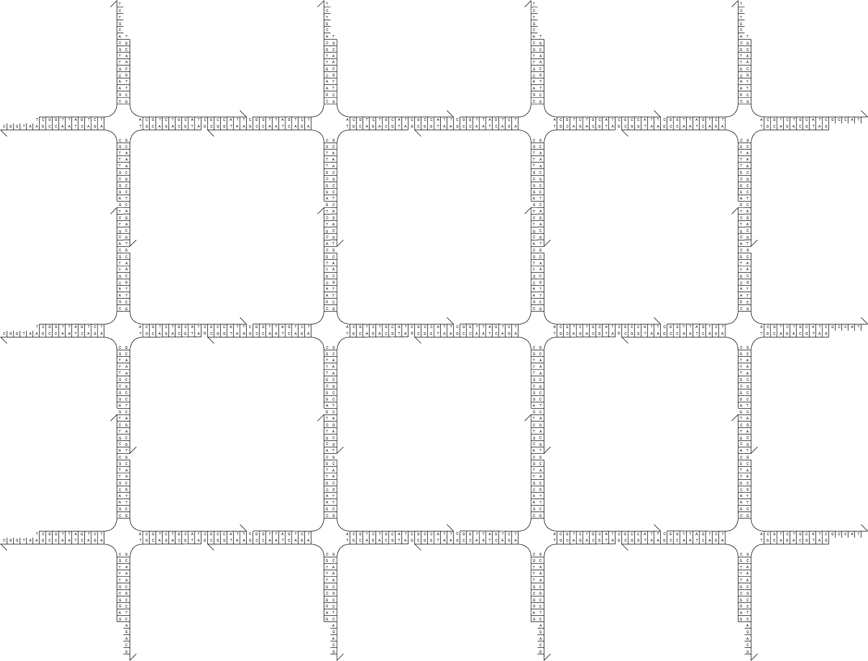
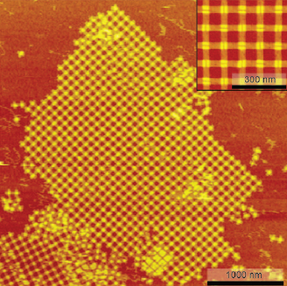
Practice of DNA tile self-assembly
Place many copies of DNA tile in solution…
(not the same tile motif in this image)
Liu, Zhong, Wang, Seeman, Angewandte Chemie 2011
Notes:
so mixed in solution, they self-assemble a regular grid like this. The right image is actually a different tile motif closer to the one you saw a few slides ago, the one on the left doesn’t actually work so well, but it illustrates the idea nicely. →

Slide 7

Theory of algorithmic self-assembly
What if…
… there is more than one tile type?
… some sticky ends are “weak”?
Erik Winfree
Notes:
So what’s so “algorithmic” about tiles forming a crystal? Erik Winfree asked two questions, “What if there is more than one tile type?” And “What if some sticky ends are ‘weak’?” →

Slide 8
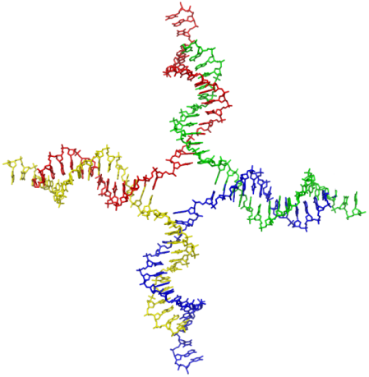
Abstract Tile Assembly Model
Erik Winfree, Ph.D. thesis, Caltech 1998
tile type = unit square
each side has a glue with a label and strength (0, 1, or 2)
tiles cannot rotate
finitely many tile types
infinitely many tiles: copies of each type
assembly starts as a single copy of a special seed tile
tile can bind to the assembly if total binding strength ≥ 2 (two weak glues or one strong glue)
north glue label
west glue label
south glue label
strength 0
strength 1 (weak)
strength 2 (strong)
Notes:
Let’s formalize those ideas.
We model the tile as a square.
Each side has a “glue” with a label and an integer strength, strength 1 is weak, and strength 2 is strong .
The tiles cannot rotate. Obviously, real tiles will rotate; what we mean is that we’ll design glues so that they cannot match between two tiles rotated relative to each other.
There are finitely many types of tiles but an infinite number of tiles of each type available, ∞ serving as a useful approximation of 50 billion, which is about how many will be in a test tube at one time.
Assembly starts from a single copy of a specially designated “seed” tile type, and
the key rule that makes it all work, a tile can only bind to an assembly if it binds with total strength at least 2; that means either two weak glues, or one strong glue. →

Slide 9
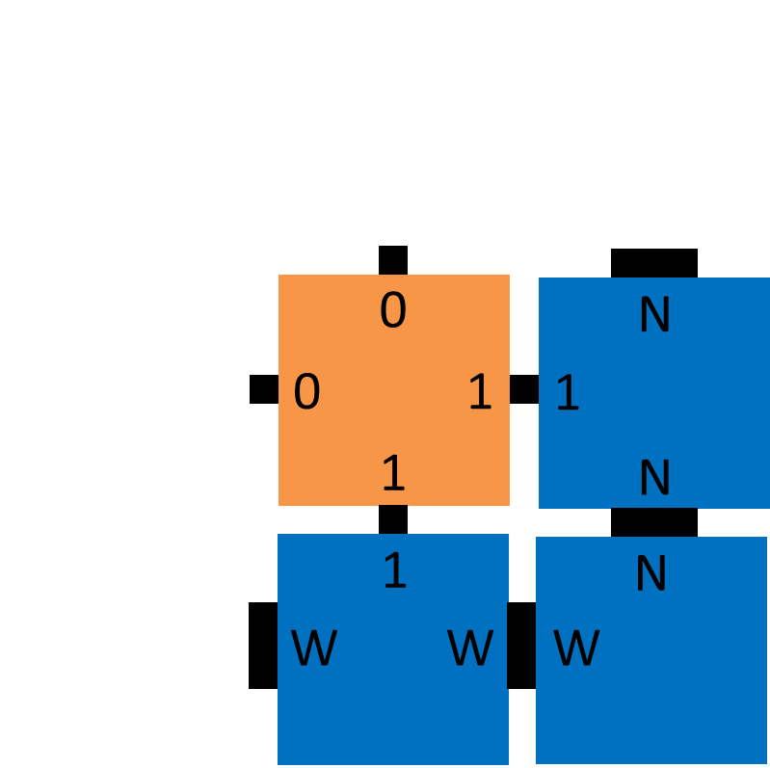




Example tile set
seed
“cooperative binding”
N
N
W
W
XOR
N
1
1
W
W
N
1
1
1
0
1
1
1
0
0
0
0
0
0
1
0
1
Notes:
Let’s see an example. I said we have a finite set of tile types; there’s 7 of them.
We start with a single copy of the seed. Tiles bind asynchronously and nondeterministically whenever there is a way to attach with strength 2,
so the first few attachments might involve these strong bonds.
More interesting is when a tile binds using two weak bonds; this is known as cooperative binding. Because both the bottom and right glues have to match for the orange tile to attach, we think of the tile as computing a
function of two inputs, which are the bits representing each glue.
If you examine these four tile types, you’ll see that the bottom and right glues enumerate every pair of bits, and that the logical XOR of these bits
is then “advertised” on the top and left glues.
If we allow growth to continue, a pattern emerges, →

Slide 10
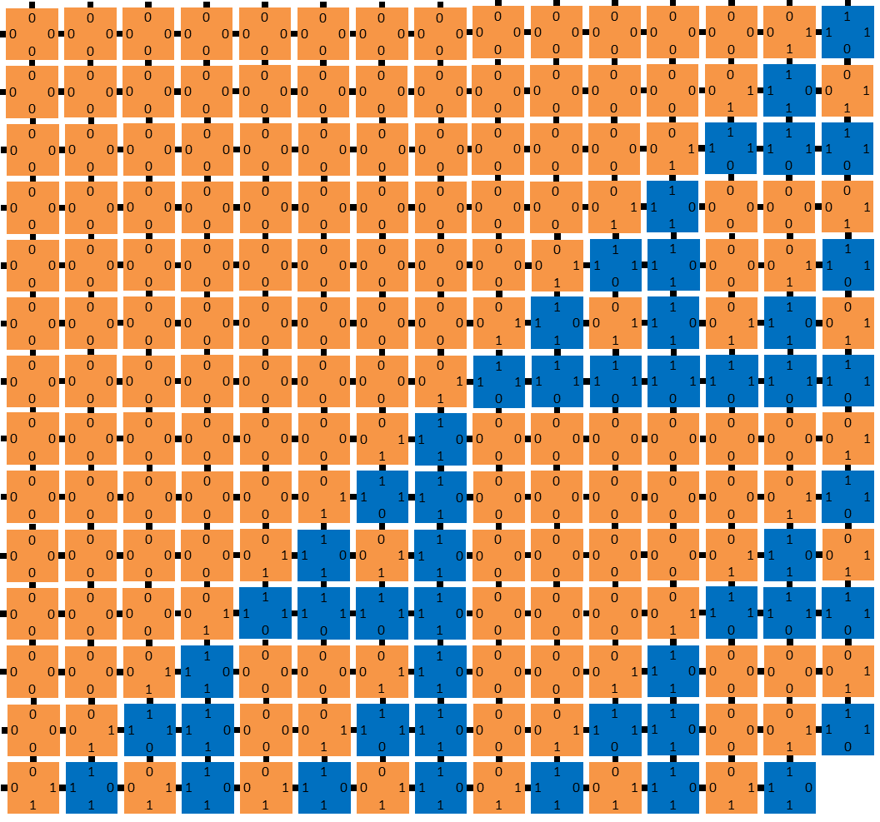
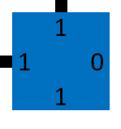
Example tile set
seed
N
W
N
1
1
W
W
N
1
1
1
0
1
1
1
0
0
0
0
0
0
1
0
1
Notes:
→ this pattern that we call the discrete Sierpinski triangle, painted onto the entire second quadrant. Not terribly complex, but not what you would expect to see from random crystal formation, although that’s precisely what this is. I said that the tile types compute a function; we could change that function. XOR is sum modulo 2, in other words, add the bits and throw away the most significant bit of the result. →

Slide 11
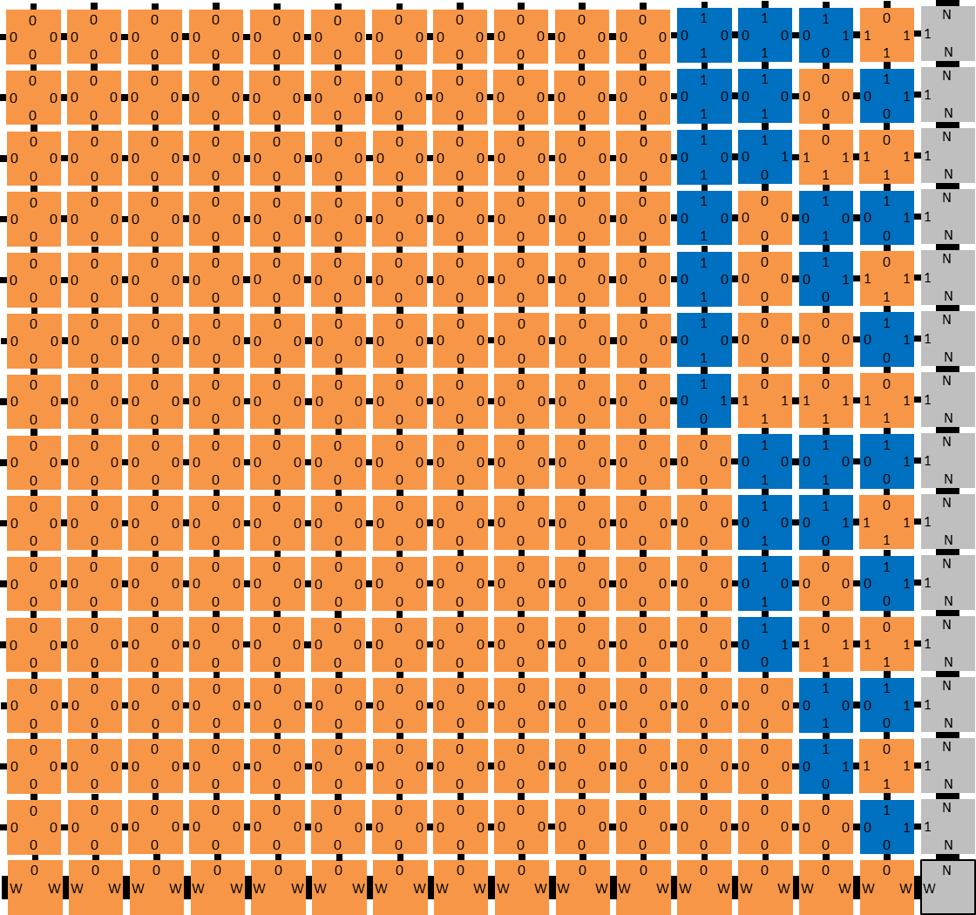
14
13
12
11
seed
10
N
9
N
W
W
8
7
N
0
6
1
W
W
N
5
4
1
1
0
c
Σ
0
0
c
Σ
1
3
HA
HA
1
0
2
change function to half-adder
1
0
0
0
c
Σ
0
1
c
Σ
1
HA
HA
0
0
1
Notes:
Well, instead of throwing it away, we could put it on the left side. Now the tiles compute a different logical function called a “half-adder”. And if we let these grow, they form a different pattern,
familiar to computer scientists; a binary counter. The n’th row of this assembly represents n in binary, with a lot of leading 0s. →

Slide 12

Algorithmic self-assembly in action
See Damien Woods’ talk on Thursday!
simulation
raw AFM image
sheared image
sorting
AFM image
w
150 nm
shearing
parity
Rule 110
80 nm
[Crystals that count! Physical principles and experimental investigations of DNA tile self-assembly, Constantine Evans, Ph.D. thesis, Caltech, 2014]
[Iterated Boolean circuit computation via a programmable DNA tile array. Woods, Doty, Myhrvold, Hui, Wu, Yin, Winfree, submitted]
Notes:
And here’s some lab results. These tiles aren’t square shaped, they’re elongated so the rows of the counter aren’t rectilinear, but I sheared the image to make it look like a rectangle.
On the right is some unpublished experimental research showing many more varied computations being done by tiles. And if you’re just starting to get comfortable with Tile Assembly, well now we’re going to stop talking about it. →

Slide 13
DNA strand displacement
3 basic steps:
bind
displace
unbind
t
a
=
a
s
t*
a*
s*
Notes:
The other technology I mentioned is DNA strand displacement. In this model we get into a bit more detail about the DNA, representing strands as arrows indicating 5’-3’ orientation, and logically sectioning the strand into “binding domains”.
The top-middle strand here has a short domain t called a toehold and a long domain a, and the complex on the bottom has complements of both, but a* is bound to another strand. There’s also a second double-stranded short domain s on the bottom complex.
There’s 3 basic operations: two complementary single stranded domains can bind, → and if they are short, they can unbind as well.
A single strand can displace → its counterpart in a complementary double stranded domain, and this can go both ways, and
a short domain can unbind. →

Slide 14
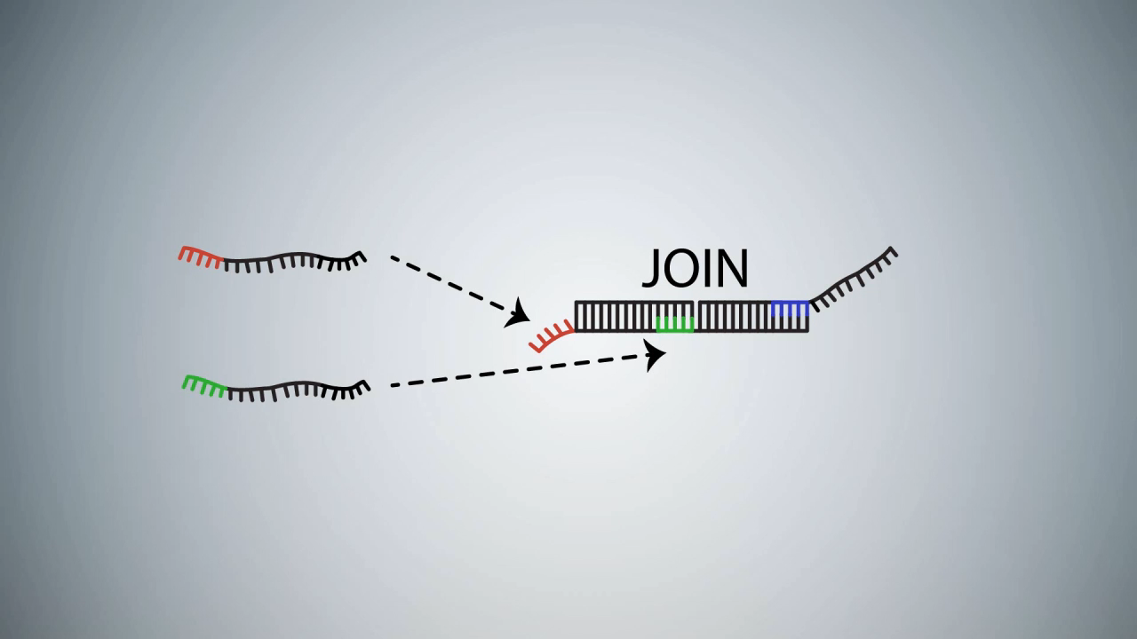
DNA strand displacement implementing C = A AND B
Notes:
Here’s a video showing a cartoon animation of this in action on a simple DNA circuit computing the AND function: the C strand is released if and only if the A and B strands are both present.
The video also shows a common readout technology: once free, C displaces another strand containing a fluorophore molecule, separating it from a quencher that absorbs photons, so the light intensity is a proxy for the concentration of C in solution. →

Slide 15
Computation with DNA strand displacement
Boolean circuit computation
Analog majority computation
[Scaling up digital circuit computation with DNA strand displacement cascades. Qian and Winfree, Science 2011]
[Programmable chemical controllers made from DNA. Chen, Dalchau, Srinivas, Phillips, Cardelli, Soloveichik, Seelig, Nature Nanotechnology 2013.]
Classification with Hopfield associative networks
Chemical oscillator
[Neural network computation with DNA strand displacement cascades. Qian, Winfree, Bruck. Nature 2011]
[Enzyme-free nucleic acid dynamical systems. Srinivas, Parkin, Seelig, Winfree, Soloveichik, Science 2017.]
Notes:
Now, ideas like this can and have been pushed in ingenious directions (by some of the people in this room, but not me), using strand displacement to implement all kinds of computation in vitro. And we aren’t going to talk about any of it, or think about it again, sorry. →

Slide 16
Outline
Part 1: Computation via molecular binding (kinetically)
Part 2: Computation via molecular binding (thermodynamically)
Part 3: Thermodynamic self-assembly
Notes:
Now I want to make the claim that the models I just discussed are “kinetic” in nature, to contrast to the “thermodynamic” model that is the subject of this talk.

Slide 17
Kinetic models
kinetic ≈ predicts possible/probable paths from initial configuration to others
tile assembly
initial configuration = seed
other configurations = assemblies containing seed
transition = attachment of tile
strand displacement
initial configuration = initial binding of domains on DNA strands
other configurations = other ways of binding domains
transition = bind|displace|unbind
1
N
N
W
N
N
N
1
W
N
W
1
W
W
N
W
1
W
W
N
bind
displace
Source: Scaling up digital circuit computation with DNA strand displacement cascades. Qian and Winfree, Science 2011.
unbind
Notes:
By “kinetic” model, I mean one that predicts possible or probable paths followed through time from some initial configuration, to other possible configurations.
In the case of tile assembly, the initial configuration is the seed tile, the other configurations are other assemblies that have other tiles attached to the seed, and transitions between configurations correspond to tile attachment.
In the case of strand displacement, there’s a similar initial preparation of complexes, configurations are other ways the strands could be bound, and the three bind | displace | unbind rules are the transitions moving between these configurations. →

Slide 18

Thermodynamic models
thermodynamic ≈ defines free energy G(α) of each possible configuration α and predicts that Pr[observing α] ∝ e^{–G(α)/kT}
minimum free energy configuration = most probable configuration
How to find energy of a configuration of DNA strands?
Why, it’s elementary:
Source: Thermodynamic Analysis of Interacting Nucleic Acid Strands. Dirks, Bois, Schaeffer, Winfree, Pierce, SIAM Review 2011.
Notes:
In contrast, a “thermodynamic“ model is one that has configurations, but no notion of initial configuration or transitions. Instead, it assigns a so-called free energy to each configuration α, and it predicts that the probability of observing the system in configuration α is proportional to something like e^{- the energy of α}, with a really important constant up there in the exponent that I’m not going to dwell on.
The important thing is that the so-called minimum free energy configuration (which generally means “maximum absolute value of energy” since it tends to be a negative quantity) is the most probable configuration.
So how is the free energy defined for binding configurations of DNA strands? How can we compute it? Well…
it’s a very well-studied problem, and a very important one, and there are good models and algorithms for it, but our goal here is a NOT a detailed definition of free energy accounting for every intricate detail of DNA biophysics →

Slide 19
Simplified model: Thermodynamic binding networks
Goal 1: Isolate the contribution of thermodynamics alone to the correctness of a molecular binding system
no notion of “initial configuration” or “transitions”
Goal 2: Abstract away DNA-specific details and model arbitrary molecules with specific binding domains
no “geometry”
can “graft onto” kinetic models
Notes:
I’ll define the model in a few slides, but first I want to say a few things about our goals.
The first goal is to isolate the contribution of thermodynamics alone to the correctness of a system. Now, by itself this wouldn’t be very innovative; physicists have been doing this on system after system since the late 1800s.
The second goal is to abstract away DNA-specific details, and get a model simplified and abstract enough to apply to any system of molecules with specific binding domains. In particular, there’s no geometry, the molecules aren’t embedded in a square lattice, if you think of it like DNA, for instance, pseudoknots are permitted. The idea is that the model is general enough to “graft onto” existing kinetic and geometric models like the ones I presented earlier. →

Slide 20
Simplified model: Thermodynamic binding networks
Not a goal: be a predictive model telling us what the system will do
It’s an adversarial model constraining the system’s misbehavior when it violates assumptions of a more detailed molecular model.
Errors in practice take “illegal” transitions in kinetic model
tile binds with strength 1 instead of 2
strand A displaces B despite lack of toehold
Can we design systems so that the desired final configuration is also the thermodynamically most stable?
Notes:
I really want to emphasize this point, because the rest of the talk won’t make much sense otherwise. The model’s goal is emphatically not to precisely predict what the system will do. Such models exist for DNA systems, such as the so-called nearest-neighbor energy model I let you glimpse earlier.
Instead, the model is more like those that computer scientists and electrical engineers employ when we want to engineer systems that behave well, subject to uncertainty about what will happen: it’s an adversarial model.
In practice, errors tend to mean that in the kinetic model, some illegal transition has occurred; there was no path to some configuration, but we ended up there anyway, for example, a tile binding with strength 1 instead of 2, or a strand displacement occurring despite the lack of adjacent toehold to initiate it.
What we want to know is, can we design a system so that, even in the face of arbitrary bad transitions taking place, if we wait long enough for the system to reach thermodynamic equilibrium, will the system do what we want anyway? Can we make the desired final configuration be also the thermodynamically most stable? →

Slide 21
Thermodynamic binding networks: Definition
monomer type = collection of domains
e.g., { a, b, b, c, d*} or {d, a*}
configuration = matching of complementary domains (how domains are bound)
enthalpy of configuration = # bonds
entropy of configuration = # free complexes (a.k.a. polymers)
energy of configuration = weighted sum of enthalpy and entropy
enthalpy = 2
a
b
enthalpy = 2
a
b
b
a
b
entropy = 2
a
entropy = 2
a*
b*
a*
b*
enthalpy = 1
a
b
a
b
enthalpy = 2
a
b
entropy = 3
a
b
entropy = 3
a*
b*
a*
b*
Notes:
Finally, here’s the definition of the model. A monomer type is a collection or multiset of domains, domains here are single letters, with a star indicating complementarity, so a binds to a*, and to no other domain.
If you have some collection of monomers, a configuration is a matching between complementary domains indicating how they are bound, here’s an example with 4 monomers.
Now is when we start co-opting physics words. The enthalpy of a configuration is the number of bonds in it. All else being equal a configuration with more bonds is more stable. Note we’re implicitly assuming all bonds are equal strength; you could obviously extend the model to generalize this, but let’s assume they’re all “strength 1” for now. This configuration here has enthalpy 2.
The entropy of a configuration is the number of free complexes in it, also known as polymers. This example has entropy 2, one polymer on the left consisting of just a single monomer with two domains a and b, and the polymer on the right consisting of 3 monomers. Now I want to plant a flag here and say, we’re well aware that this is an abuse of terms. We’re ignoring rotational degrees of freedom, for example, since there’s no geometry. So “entropy” is a bit of a metaphorical term here.
Now it’s common to say the energy of a configuration is a weighted sum of the enthalpy and entropy. I’m not going to get into specifics about the precise relative weights, for reasons that will become obvious in a little bit. Also note that all the energies here are positive, so greater energy corresponds to “more stable”. If you prefer to think about minimum energy configurations, just throw a negative sign in front of everything, but I have trouble keeping track of negative signs.
Here’s some other example configurations. This one breaks a bond and creates an extra polymer, so it has enthalpy 1 and entropy 3.
This is a different configuration than the first, but also has enthalpy and entropy 2.
Finally, this has enthalpy 2 and entropy 3, which is the largest those values can be when there’s at least one bond. →

Slide 22
Tradeoff favoring enthalpy infinitely over entropy
monomer collection = vector c ∈ ℕ^{M} indicating counts of M monomer types
configuration of c is saturated if enthalpy is maximal (no pair of unbound complementary domains)
configuration of c is stable if saturated and entropy is maximal (no saturated config. of c has more polymers)
saturated
not saturated
stable
a
b
a
b
a
b
a
b
a
b
a*
b*
a*
b*
a*
b*
a*
b*
a*
b*
a
b
a
b
a
b
a
b
a
b
a
b
a
b
a
b
a
b
a*
b*
a*
b*
a*
b*
a*
b*
a
b
a
b
a
b
a
b
Notes:
A few more terms… a monomer collection, if we have M monomer types, is a vector over ℕ^{M} indicating their counts, the examples before had one of each type, but you could have more. One monomer collection can have many configurations depending on the choice of domain binding.
A configuration is saturated if it has maximal enthalpy. In all the examples I show, the unstarred domains will be in excess, so saturated will mean “all the starred domains are bound”.
A configuration is stable if, among all the saturated configurations, it has maximal entropy, in other words the greatest number of polymers. In other words, we favor enthalpy infinitely over entropy, using entropy only as a tie-breaker.
Here’s all the configurations of this monomer collection. You can imagine achieving this limit in a real molecular system, for instance, by decreasing concentrations, and increasing bond strengths (for example by decreasing temperature), but at a relative rate such that the limiting ratio of bond energy to entropic gain from breaking a bond goes to infinity.
Another way to think about it is that bonds are so strong they cannot be broken, so all observed configurations are saturated, but bonds can be exchanged between two pairs of bound domains. If this exchange breaks one polymer into two, then they float apart, and with such low concentrations, we expect them to spend much more time freely floating as separate polymers than together as a single polymer exchanging domains. →

Slide 23
Outline
Part 1: Computation via molecular binding (kinetically)
Part 2: Computation via molecular binding (thermodynamically)
Part 3: Thermodynamic self-assembly
Notes:
I’ll now present an initial result applying this model to self-assembly. If I have time later we’ll get to Boolean logic. →

Slide 24
A modest goal
Informal: Design monomers that self-assemble arbitrarily large polymers.
size of a polymer = # monomers in the polymer
Formal: Design a set of monomer types so that, for all S ∈ ℕ, there is a stable polymer of size at least S.
Easy to do in Abstract Tile Assembly Model:
size-8 polymer (assembly) formed
with 8 copies of monomer
set of monomer types:
a
a*
a
a*
a
a*
a
a*
a
a*
a
a*
a
a*
a
a*
a
a*
Notes:
I showed some quite sophisticated computation done by self-assembling DNA tiles using the Abstract Tile Assembly Model, but in this new model, let’s back off from those ambitions and attempt a rather modest goal: keep growing.
What exactly do I mean by this? Let’s formalize it this way. Design a thermodynamic binding network, a set of monomer types, that with enough copies of each monomer type, grows arbitrarily large polymers, in other words for all integers S, there is a stable polymer (by that I mean a stable configuration consisting of a single polymer) of size at least S.
Now, in our first model, the Tile Assembly Model, this is trivial. Here’s a monomer, in other words, a tile, that with S copies, grows a polymer of size S. →

Slide 25
Difficulty of self-assembling large polymers
not stable! (or even saturated)
more complexes ⇒ higher entropy ⇒ more stable
a
a*
a
a*
a
a*
a
a*
a
a*
a
a*
a
a*
a
a*
a
a*
a
a*
a
a*
a
a*
a
a*
a
a*
a
a*
a
a*
These have more polymers, and each is self-saturating (every domain can be bound within the polymer)
attempt 2:
not stable!
…
w
x*
y
z*
w
x*
y
z*
w
x*
y
z*
w
x*
y
z*
x
y*
z
w*
x
y*
z
w*
x
y*
z
w*
x
y*
z
w*
Notes:
Here’s a way of depicting this as a Thermodynamic Binding Network. Does that look stable? … It’s not, first of all, it’s not even saturated, because the final a* is unbound, but that’s not the worst of it.
This is a saturated configuration, each a* is bound, but every polymer is size 1. Sort of the opposite of what we wanted. So you might think, well, the lesson here is don’t put a domain and its complement on the same monomer, they can always just bind to each other, and there’s no sense paying the entropy cost to bring two monomers together to form that bond when you can always form that bond within one monomer.
So maybe we should try to add some new domains and monomer types like so: w, x, y, z, and after a while, add a w*
and then we can expect copies of this polymer to bind to each other and form a long chain. Does that fix the problem?
Nope. This makes bigger polymers than the previous example, but as soon as we repeat a domain, it’s more favorable for each group of four monomers to “wrap up on themselves” like this and form polymers of size 4.
Observe what happened in each case: these configurations on the right are possible because each small polymer is “self-saturating”: it’s possible to bind all starred domains with only “intra-polymer bonds”. →

Slide 26
An even more modest goal
Original goal: Design a set of monomer types so that, for all S ∈ ℕ, there is a stable polymer of size at least S.
and O(1) domains per monomer
Re-
Revised goal: For all S ∈ ℕ, design a set of M monomer types using D domain types with a stable polymer of size at least S.
^
How large can we make S relative to D and M?
S ≈ D²
D,M = O(1), S = arbitrarily large
c₃*
c₃*
c₃*
c₃*
S ≈ D
c₃
c₃
c₃
c₃
d*
d*
d*
d*
d*
d*
d*
d*
c₂*
c₂*
c₂*
c₂*
d₁*
d₁
d₂*
d₂
d₃*
d₃
d₄*
d₄
d
d
d
d
d
d
d
d
c₂
c₂
c₂
c₂
c₁*
c₁*
c₁*
c₁*
c₁
d₁*
d₁
c₁
d₂*
d₂
c₁
d₃*
d₃
c₁
Notes:
So as I said, this goal is modest, but maybe it’s still too ambitious. I also want to take a moment to observe that, a priori, this difficulty is a bit surprising. This model favors enthalpy infinitely over entropy: in other words, it would seem that in a model with infinitely strong bonds that cannot be broken, it would be easy to make monomers clump together into large polymers.
So let’s lower our expectations even further and revise the goal. Instead of designing a single system that grows arbitrarily large polymers, let’s first specify a size of polymer we want, and then design a system to form it. So we fix a size bound S, then ask for M monomer types, using D domain types, that has some stable polymer of size at least S.
Now the interesting question is, how large can we make S relative to D and M?
Well, as phrased, pretty large. Here’s two domain types, and two monomer types, with many copies of the d monomer, and they make as big a polymer as you want, but of course this isn’t really what we are trying to get at with this question. We want to capture the idea that with a little work to create some small monomers, the monomers themselves do the rest of the work and self-assemble, but this huge monomer here with all the d* domains requires lots of work to create.
So let’s revise the question again to try to get at the issue: let’s stipulate that we want a constant number of domains per monomer, it can be a large constant, but it cannot depend on the target size S itself.
What if we ask for S to be approximately equal to D? Anyone see how to do that?
We can have each monomer type appear exactly once, each with unique domains to connect to the next monomer.
So if we want S to be larger, we have to reuse monomer types, and have different copies appear more than once. Could we achieve S equals something like D²?
Here’s a way to do it. Start with a chain of unique monomers like before but note they each share a c₁ domain.
That can be used to bind a similar chain of polymers, each polymer is a copy of the others, so the length of each polymer is something like O(D), but there’s O(D) of them, so the polymer has total size O(D²). →

Slide 27
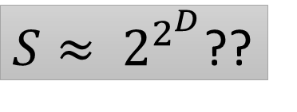
How large can we make S relative to D and M?
S ≈ 2^{D}?
$S≈ 2^{2^{D}}$??
d₁
d₁
d₂
d₁*
d₂
d₂
d₁*
d₂
d₃
d₂*
d₃
d₃
d₂*
d₃
d₃
d₂*
d₃
d₃
d₂*
d₃
d₄
d₃*
d₄
d₄
d₃*
d₄
d₄
d₃*
d₄
d₄
d₃*
d₄
d₄
d₃*
d₄
d₄
d₃*
d₄
d₄
d₃*
d₄
d₄
d₃*
d₄
d₄*
d₄*
d₄*
d₄*
d₄*
d₄*
d₄*
d₄*
d₄*
d₄*
d₄*
d₄*
d₄*
d₄*
d₄*
d₄*
Notes:
Let’s step up our ambitions. Can we make S exponentially larger than D?
Yes we can. We can have a tree of monomers, each level consisting of several monomers of the same type, twice the number in the previous level.
Can we get more ambitious still? How about a doubly-exponential size polymer?
→ It turns out no, that’s too ambitious. It can’t be done. →

Slide 28
Stable polymers have at most exponential size
Theorem: Any thermodynamic binding network with
D domain types,
M monomer types,
≤ A domains per monomer type (note D/A ≤ M ≤ A^{D+1})
has polymers of size ≤ 2(M+D)(AD)^{2D+3} = poly(D^{D}) if A = O(1)
Notes:
So we arrive at our first theorem (and close to last that I will cover in this talk), which states that stable polymers have at most “exponential size“.
The exact bound is in red here, it’s a bit messy, and involves this number A, the maximum number of domains on any monomer, but if you assume that’s constant with respect to D, then this bound is polynomial in D^{D}, which I’m simply calling “exponential in D”. →

Slide 29
Easy proof if binding graph is acyclic (tree)
Since monomers have O(1) domains, binding graph is bounded degree
# nodes of tree is at most exponential in depth (longest path length ≤ 2∙depth)
If some path has > 2D edges, it must repeat some ordered pair (d_{i},d_{i}*) or (d_{i}*,d_{i})
Break into two saturated polymers as shown.
not stable
Notes:
Let’s start with proving an easy special case. Note that all of the examples so far have been trees, in other words the binding graph of the polymer was acyclic. This special case is easy to show.
Since we assume each monomer has O(1) domains, the binding graph is bounded degree.
Now, the tree isn’t rooted, but I’ll pretend like it is to make the terminology and drawing simpler. If we have a bounded-degree tree of some depth, its total size is at most exponential in the depth. And the longest path is at most twice the depth, you start from a leaf, go up to the root, and back down to another leaf.
Note each edge on a path corresponds to an ordered pair of complementary domains: you exit one monomer through d_{i} and enter the next through d_{i}*, or vice versa. By the Pigeonhole Principle, any path longer than 2D must repeat an ordered pair. In this example, we follow this red path from left to right and encounter d₂, then d₂*, in that order, twice, where the two arrows are.
It turns out, if that happens, then we can re-bind those pairs of domains, and it will provably separate the polymer into two. So if it was saturated before, it still is, we didn’t lose any bonds, but now it’s two polymers instead of one, so the original was not stable. →

Slide 30
A digression into computational complexity
Integer-Programming problem
Given: integer matrix A, integer vector b
Question: is there a nonnegative integer vector x such that Ax = b?
0/1-Integer-Programming is NP-complete (Karp 1972).
Non-obvious fact: Integer-Programming is in NP. (independently due to [Borosh and Treybig 1976], [Gathen and Sieveking 1978], [Kannan and Monma 1978])
If Ax = b has a solution, it has a “small” solution… max_{i} x_{i} ≤ exp(max_{ij}(A_{ij},b_{j}))
Papadimitriou’s proof:
If x is a large enough solution, there is 0 < y < x, y ∈ ℕ^{m}, such that Ay = 0.
Defining z = x – y, Az = A(x – y) = Ax – Ay = Ax – 0 = b.
So z is a strictly smaller solution than x: x cannot be the smallest solution.
[On the complexity of integer programming. Papadimitriou, JACM 1981]
Notes:
Before we show the more general theorem for cyclic binding graphs, we’re going to take a brief detour through an interesting result in computational complexity theory. There’s this problem, called Integer-Programming, and it essentially asks us to solve a linear system of equations, but only to accept nonnegative integer solutions.
Solving linear equations over the reals (or really, the rationals) is easy as we all know, but every computer scientist learns on mother’s knee that one of the first known NP-complete problems is 0/1-Integer-Programming, where we restrict the solution entries to be 0 or 1.
Here’s a fact that’s not as obvious as it might seem: Integer-Programming is contained in NP. You might think it’s obvious, if the system has a solution, the solution is the NP-witness, right? But note I didn’t say “0/1”, I just said “Integer”. The solution is a witness, but who’s to say it’s a polynomial-size witness?
If you want to show this, you have to show that if Ax=b has a solution, then it has a polynomial-size solution, in other words the number of bits to represent x is polynomial in the number of bits to represent A and b. This amounts to showing that each integer entry in x is at most exponential in the entries of A and b.
Now, this was shown independently by several authors, but the nicest proof comes from an old paper of Papadimitriou, it’s a 4-page paper with a very nice geometric proof of this fact: that if a solution x is larger than a certain exponential bound, then there is a nonzero vector y componentwise at most x, and smaller than x on at least one component, and Ay is ZERO. That’s what he proves.
To see that this helps, note that if you look at the difference x – y, call it z, then Az is simply Ax – Ay, which is Ax – 0, which is simply b.
So z is also a solution, but it’s smaller than x. So x couldn’t be the smallest solution. →

Slide 31
Monomers as vectors
monomer {a, b*,b*, d,d,d,d,d*, e,e*} represented as (1,-2,0,3,0)
sum of many monomers gives the number of excess domains in a fully bound (saturated) polymer with those monomers
i.e., 2 copies of above monomer 2∙(1,-2,0,3,0) = (2,-4,0,6,0) have an excess of 2 a’s, 4 b*’s, 0 c’s, 6 d’s, 0 e’s

Slide 32
Farkas’ Lemma
Given vectors m₁, m₂, … , they obey one of two constraints:
a) are directions of balanced forces
b) lie on one side of some hyperplane
m₁
∃c
(counts of monomers)
(m₁ m₂ m₃)c = 0
m₂
h
m₂
(hyperplane orthogonal vector)
m₁
∃h
h∙m_{i} ≥ 1
m₃
m₃

Slide 33
How to prove exponential polymer size bound for polymers with cycles in binding graph?
A = d x m matrix: A_{ij} = monomer m_{j}‘s excess of domain d_{i} over d_{i}*
If Ac = b, then b_{i} = total # unbound d_{i} in any saturated configuration of x
If |c| > exponential in D, Papadimtriou’s proof gives us subcollection y < c such that Ay = 0, (Farkas’ Lemma says that if this fails, then monomer vectors all lie on one side of a hyperplane, see next slide)
i.e., #d_{i} in y = #d_{i}* in y, so y is self-saturating.
So whatever bonds were broken to separate y can be re-bound within y.
By symmetry, the same bonds in z = c – y can be re-bound within z.
monomer collection c ∈ ℕ^{M}
a
b
c
Ac = (2,1,0)
z
a
b
c*
y
a
b*
a*
a
c*
c*
a*
c*
a
a*
b*
c
a*
c
b
b
b
a
a
b
b*
a
b*
a*
Notes:
Okay, so how’s that supposed to help us prove we can’t grow big polymers? Imagine we have a monomer collection x; remember that’s a vector of M integers telling us how many of each monomer type we have, and suppose it forms a saturated polymer like so. We’re going to show we can find another saturated configuration with two polymers, so this one can’t be stable.
There’s a matrix A we can define, and each column represents a monomer type in the following way: A_{ij} represents the i’th monomer’s excess of unstarred j’th domains. So for example this monomer with a and two c*’s would be +1 on a and -2 on c, and 0 on b. This one with a, b, and b* is also 0 on b, because the b and b* cancel.
So if you define this matrix, and multiply it by x, then the output vector has D components, one per domain pair, and it tells you the total number of unbound unstarred domains.
In this example, across all of x, we have ONE excess b and TWO excess a domains, so Ax = the vector (2,1,0). Remember we assume unstarred domains are in excess, so this is going to be nonnegative.
Now, if |x| is too large (exponential in D), then Papadimitriou’s proof (modified a bit) tells us there is a subcollection y of x such that Ay = 0.
Let’s think about what that means: for each domain d, there are exactly the same number of d* domains in y. So y is self-saturating, it’s possible to bind every single domain of y just within y.
So if we imagine ripping y out of the larger polymer of x, then whatever bonds were broken to separate y, can be re-bound within y. In this example, we broke an a, but also an a*, and we broke a b, but also a b*.
And by symmetry, the bonds broken in z, the remaining part of x, can also be re-bound just within z, because they’re the same bonds, just on the other side. So we get two saturated polymers, so the original was not stable. →

Slide 34
If all monomer types lie on one side of hyperplane h…
Consider “slack monomers” {d₁*}, {d₂*},…, adding just enough to bind to all the excess d_{i} domains, so saturated (fully bound) == all domains bound
If c is count of all monomers including slack monomers (c(i) = count of m_{i}), then Ac = 0, where each column of A represents a monomer (counts of domains).
dot-product h on both sides: h∙Ac = h∙0 = 0, distribute through: ∑_{i}(h∙m_{i})c(i) = 0
Let S be set of monomers with “small” counts, move them to one side:
– ∑_{i∈S}(h∙m_{i})c(i) = ∑_{i∉S}(h∙m_{i})c(i)
Then “small”₂ ≥ – ∑_{i∈S}(h∙m_{i})c(i) = ∑_{i∉S}(h∙m_{i})c(i) ≥ ∑_{i∉S}c(i)
c(i) (count of i’th monomer) is small by definition, and h∙m_{i} = O(1)
above
since h∙m_{i} ≥ 1

Slide 35
Applying thermodynamic model to tile assembly
Let’s incorporate the thermodynamic binding network model into the abstract tile assembly model.
How can we create a large assembly from a small number of tile types?
Notes:
I said one interest we have is “grafting” these thermodynamic ideas onto existing kinetic models. Let’s give it a try with tile assembly. How can we create a large assembly from a small number of tile types? In particular, can we do it in a way where the Tile Assembly Model has a desired final assembly, but also, that assembly is thermodynamically stable when interpreted within our Thermodynamic Binding Network model? →

Slide 36
A thermodynamically unstable tile assembly counter
0
0
0
0
0
0
0
1
1
1
0
1
Notes:
I have to apologize that this part of the talk is for Tile Assembly experts. There is a well-known way to make a large structure in tile assembly, creating something called a counter of size about 2^{n} from only n tile types. It’s a modification of the infinite counter I showed earlier, and it counts from 1 up to some power of 2, then stops. The idea is that each vertical column of tiles represents a binary string with the least significant bit on the bottom.
Now, to see this is not stable in the geometry-free thermodynamic model, observe that one of the tiles in the middle has a 0 domain and a 0* domain, and an n domain (n stands for “no carry”) and an n* domain. So if we rip that tile out of the assembly, and really bend it around to bind those domains within the tile, it’s saturated, and we can do the same thing in the gap where we ripped it out. Now there are some rather bendy tile motifs, they don’t all look like rigid squares like the kind I showed. The motif I’ve worked with, the whole tile is just a single strand, so it’s not outrageous to assume this could happen. But it means the original assembly was not stable, because we can separate it into two saturated polymers. →

Slide 37
A thermodynamically stable tile assembly counter
Difference is that each row (corresponding to bits of the same significance) has glues labeled with the row number
Notes:
So one little result we show in the paper is that we can overcome this and make a counter that works in both models. Essentially, the trick is to encode the significance of the bits in each glue, so that glue 0 in the 2’s place, for example, is different from glue 0 in the 8’s place. And you still get an assembly exponentially larger than the number of monomer types, but it’s more geometrically feasible than than big branching tree I showed a while ago.

Slide 38
Thermodynamic self-assembly at UCNC 2018
Thermodynamically Favorable Computation via Tile Self-assembly, Cameron Chalk, Jacob Hendricks, Matthew Patitz, and Michael Sharp (talk on Friday!)

Slide 39
Conclusions
Strong bonds (surprisingly) aren’t sufficient to self-assemble large thermodynamically stable structures. Geometry helps!
Kinetically self-assembling a thermodynamically stable structure has very strong guarantees on errors:
target structure eventually results despite arbitrary kinetic errors.
If it’s the only stable structure, and free energy of other structures is much less, then it’s the only result you’ll see.
Bad news: NP-complete to tell if a given configuration is unstable… even NP-hard to approximate entropy of stable configuration:
[Breik, Thachuk, Heule, Soloveichik, Computing properties of stable configurations of thermodynamic binding networks]
Notes:
Strong bonds, surprisingly, aren’t enough to self-assemble large thermodynamically stable structures.
You also need geometric constraints, such as those assumed in models such as Tile Assembly and DNA Strand Displacement.
If you can self-assemble a thermodynamically stable structure in the abstract Tile Assembly Model, then you have very strong guarantees on errors: Arbitrary errors in binding cannot stop the thermodynamic equilibrium from containing the target structure.
If furthermore it’s the only stable structure, and the free energy of other structures is much less, then you don’t expect to see much of anything else at equilibrium. Of course, these are some strong assumptions, but they can be studied within the model, or generalizations of it.

Slide 40
Merci!
Questions?

