Slide 1
TouchLogger: Inferring Keystrokes on Touch Screen from Smartphone Motion
Liang Cai and Hao Chen
UC Davis

Slide 2
Security Problems on Smartphones
Old problems
Malware
Software bugs
Information leak
…
New problems
How can attackers exploit sensors?

Slide 3
Sensors on Smartphones
Privacy-sensitive sensors
Microphones
Cameras
GPS
Are motion sensors privacy-sensitive?
Accelerometers
Gyroscopes

Slide 4
Traditional Keyloggers
Intercepting key events
E.g., Trojan programs
Using out of channels
Acoustic frequency signatures of keys
Timing between keystrokes
Electromagnetic emanations of keystrokes
Work well on physical keyboards
But not on software keyboards

Slide 5
Keylogger for Soft Keyboard
New out of band channel on smartphones
Accelerometers
Gyroscopes
Insight: motion sensor data can infer keystrokes

Slide 6
Threat Model
Keylogger can read motion sensor
Most users do NOT regard motion sensors as sensitive data source
W3C’s DeviceOrientation Event Specification allows web applications to read motion sensors via JavaScript
supported by both Android 3.0 and iOS 4.2
User does NOT place phone on fixed surface

Slide 7
Modeling Typing-Induced Motion
Shift is affected by
Striking force of the typing finger
Resistance force of the supporting hand
Rotation is affected by
Landing location of the typing finger
Location of the supporting hand on the phone
We observe
Shift is more likely user dependent
Rotation is more likely user independent

Slide 8
Device Orientation
Device orientation event consists of
α: Device rotates along z-axis (perpendicular to the screen plane)
β: Device rotates along x-axis (parallel to the shorter side of screen)
γ: Device rotates along y-axis (parallel to the longer side of screen)
We use only β and γ

Slide 9
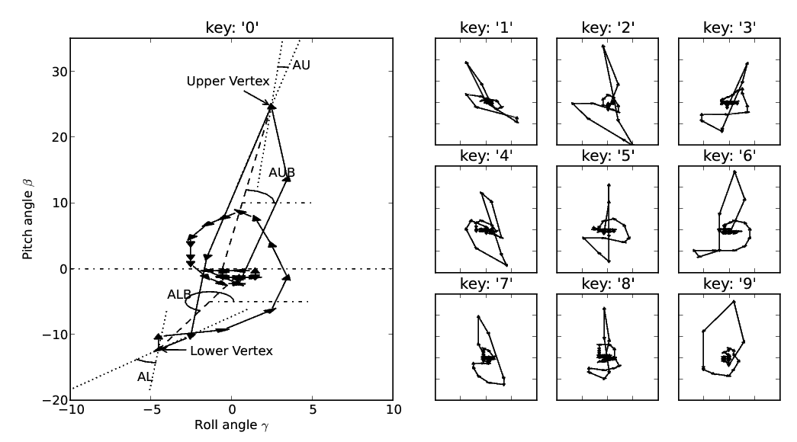
Feature Extraction

Slide 10
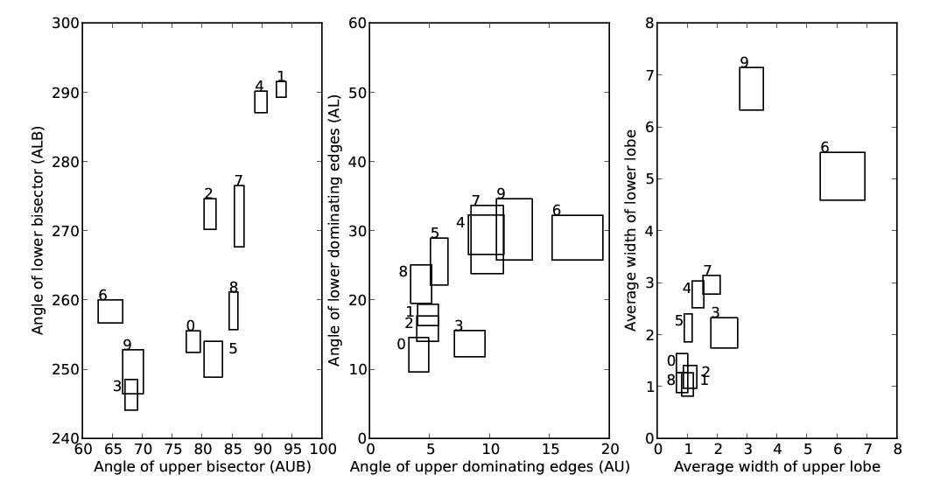
Feature Extraction

Slide 11
Evaluation
HTC Evo 4G smartphone
Digits 0 … 9 on number-only soft keyboard

Slide 12
Results
Collected 3 datasets
2 smaller datasets for training
The largest dataset (449 keystrokes) for testing
Correctly inferred 321 out of 449 (71.5%) keystrokes.

Slide 13
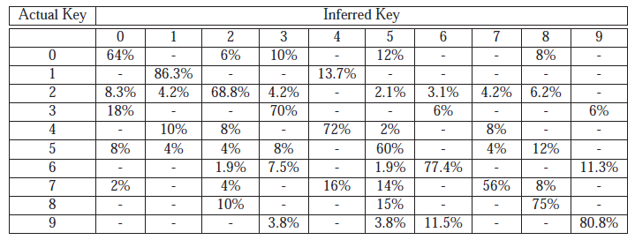
Detailed Inference Results

Slide 14
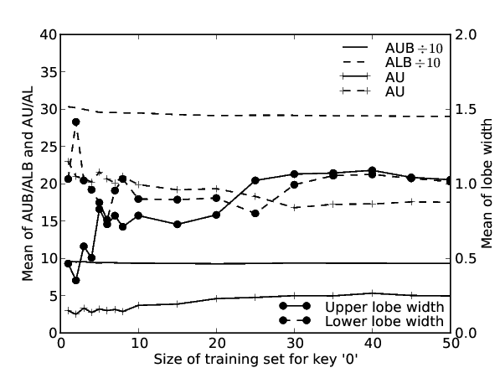
Training Set Size

Slide 15
Conclusion
Motion sensors on smart phones may reveal keystrokes
Need to protect motion sensors as diligently as other sensors

