Slide 1
Why Compare Surfaces?
1. Every object we see is a surface (almost).
2. Cell phone software can already digitize surfaces.
Scanners soon to be built in.
3. Can we recognize this digitized data?
4. Countless applications:
Diagnose disease or fracture Radiologists
Drug design Pharmaceutical costs
Recognize bones and fossils Anthropologists

Slide 2
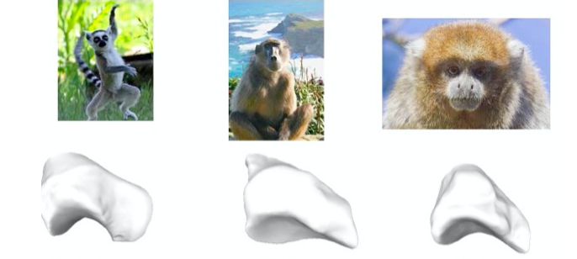
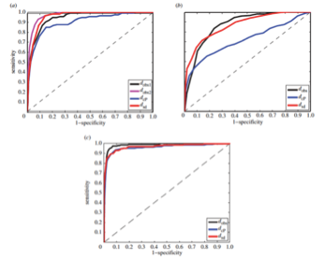
Today
1. Look at one surface comparison algorithm.
2. Apply it to some biological data.
3. Analyze how well it does compared to human
experts.

Slide 3
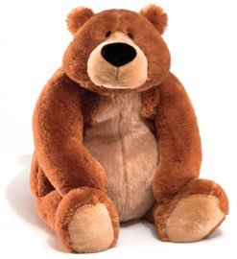
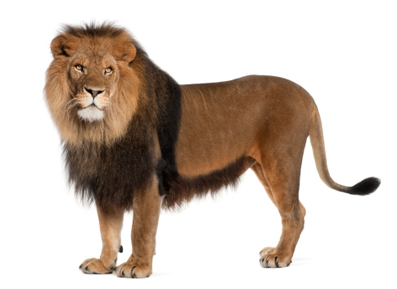
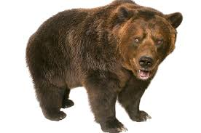
Comparing Surfaces
Problem: How to compare two surfaces?
What is the distance between a pair of surfaces?
2. What is a good alignment between two surfaces?
Find a good diffeomorphism f:S1 S2

Slide 4
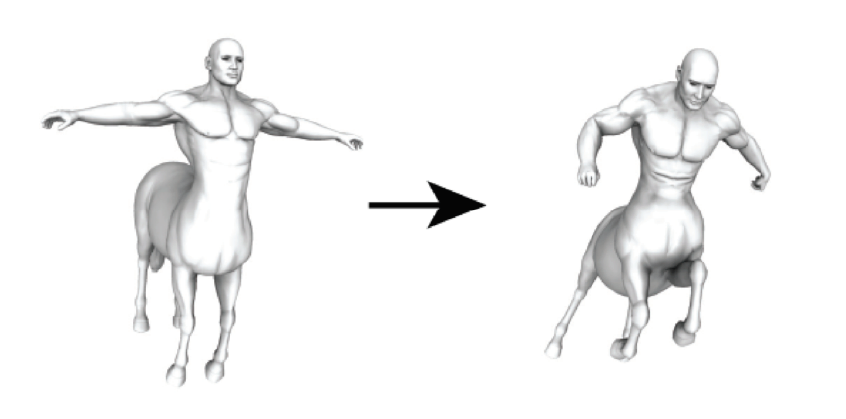
Optimal Diffeomorphisms
We want to compare two surfaces by finding an
optimal diffeomorphism between them.
If the surfaces have identical geometry
then the optimal diffeomorphism is given by
an isometry.
But what if they have different geometries?
What map is closest to being an isometry?

Slide 5
Optimal Diffeomorphisms
Optimal diffeomorphisms do more than give
a distance. They also give a correspondence.

Slide 6
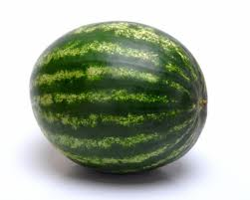
Riemannian metrics
In the smooth setting, a geometry on a surface
S is described by a Riemannian metric g.
This is an inner product on vectors at each
point of S. The inner product is used to
describe lengths of paths, angles between
vectors, and distance between points.
g: TS x TS
R
is a Riemannian metric
v
<v, w> = g(v,w)
w

Slide 7
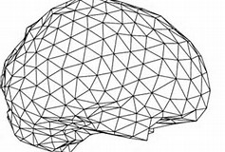
Discrete metrics
In the PL setting, a geometry on a surface
S is described by a triangulation with an edge
length function. A PL metric assigns lengths
to each edge of a triangulation.
l : {Edges} R⁺
k
l(ejk)
l(eik)
j
l(eij)
i

Slide 8
Isometries
Two surfaces are “the same” if there is an isometry
between them.
f
f is an isometry
How can we find a good correspondence when the
surfaces are not isometric?
h
h is not an isometry

Slide 9
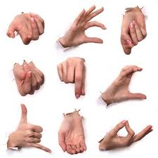
Intrinsic versus Extrinsic
Isometries preserve intrinsic geometry
These 9 surfaces have the same intrinsic geometry.

Slide 10
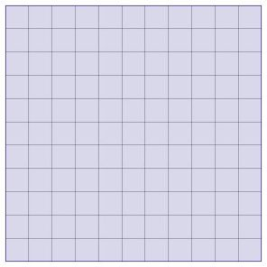
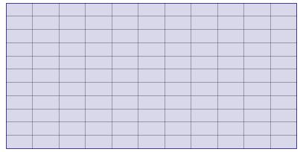
Approximating Isometries
Neither of these maps is an isometry.
Can we deform them to become isometries?
f
g
If not, can we deform them to something having
some properties of an isometry?

Slide 11
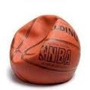
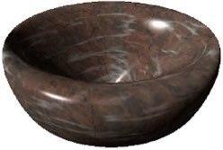
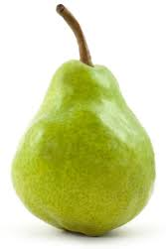
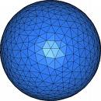
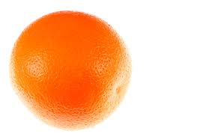
Diffeomorphisms
Diffeomorphisms are maps f such that f and f ⁻¹ are smooth.
Each of these surfaces is diffeomorphic to a sphere.
Four of these five surfaces are isometric.
To align or compare surfaces, we search for a near isometry in the space of diffeomorphisms.
“Near” refers to how much stretching is needed to
fit one surface over another.

Slide 12
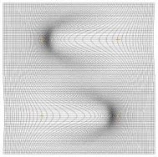
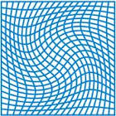
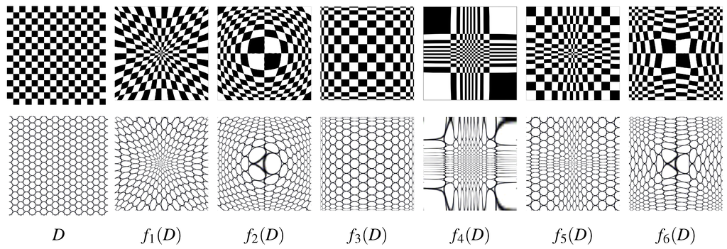
The space of diffeomorphisms
There are many ways to map a surface to
another surface by a diffeomorphism. Too many!!
How can we search this vast space for a map
closest to an isometry?

Slide 13
Isometries
Isometries have two key properties:
They preserve angles (conformal)
They preserve area (area preserving)
Lemma
f:S1 S2
f is an isometry
f preserves angles and area
f
v
df(v)
w
df(w)

Slide 14
Searching among diffeomorphisms
How can we search the vast space of
diffeomorphisms for a map closest to an isometry?
Choosing the best f:S1 S2 from an
infinite-dimensional spaces is hard.
Idea: Restrict our search to conformal maps
c:S1 S2
C is chosen from the much smaller space of
conformal maps. This is still a big space, but
not too big to work with.

Slide 15
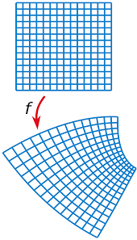
Conformal maps
A Conformal Map has some of the properties of an isometry.
A Conformal Map is a map between two smooth surfaces that
preserves angles.

Slide 16
Conformal maps
The angle between two vectors is the same
as the angle between their images.
V
Take two unit vectors at any point.
The angle between them
is the same as the angle between
their images under f.
W
<V, W>1 = <df(V), df(W)>2
df(V)
df(W)
They are stretched equally.

Slide 17
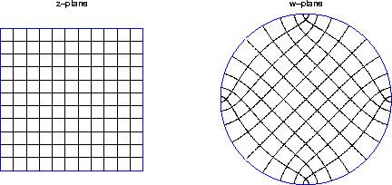
Riemann Mapping Theorem
v
v
W
W
There is a conformal map from any planar disk
region to the round unit disk.

Slide 19
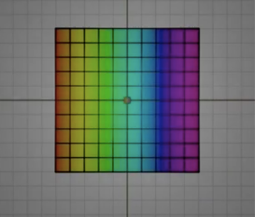
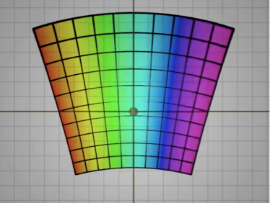
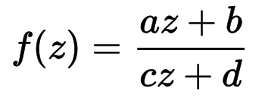
Mobius Transformations
The conformal maps from the entire complex plane,
or Riemann sphere, to itself are called Mobius
Transformations.
ad-bc = 1
Coincides with the group
PSL(2,C)=SL(2,C)/{ + Id}
This is a six dimensional space.

Slide 20
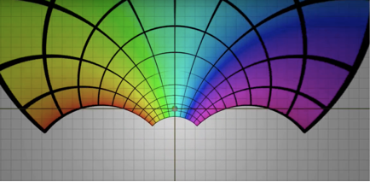
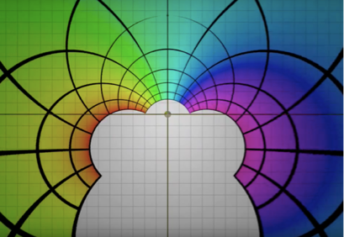
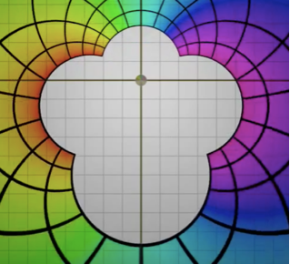
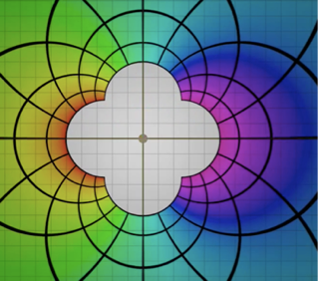
A path of Mobius Transformations

Slide 21
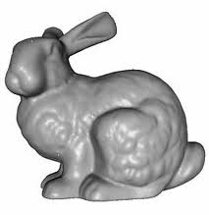
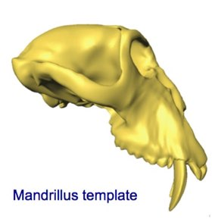
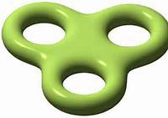
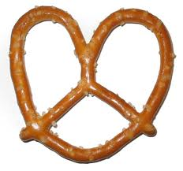
Higher genus surfaces
Can we always find a conformal diffeomorphism
between two surfaces?
Not always.

Slide 22
Conformal maps exist in genus 0
We can’t always find an isometry between S1 and S2.
But for genus zero surfaces S1 and S2,
we can always find a map that preserves angles.
?
Yes
?
Probably Not

Slide 23
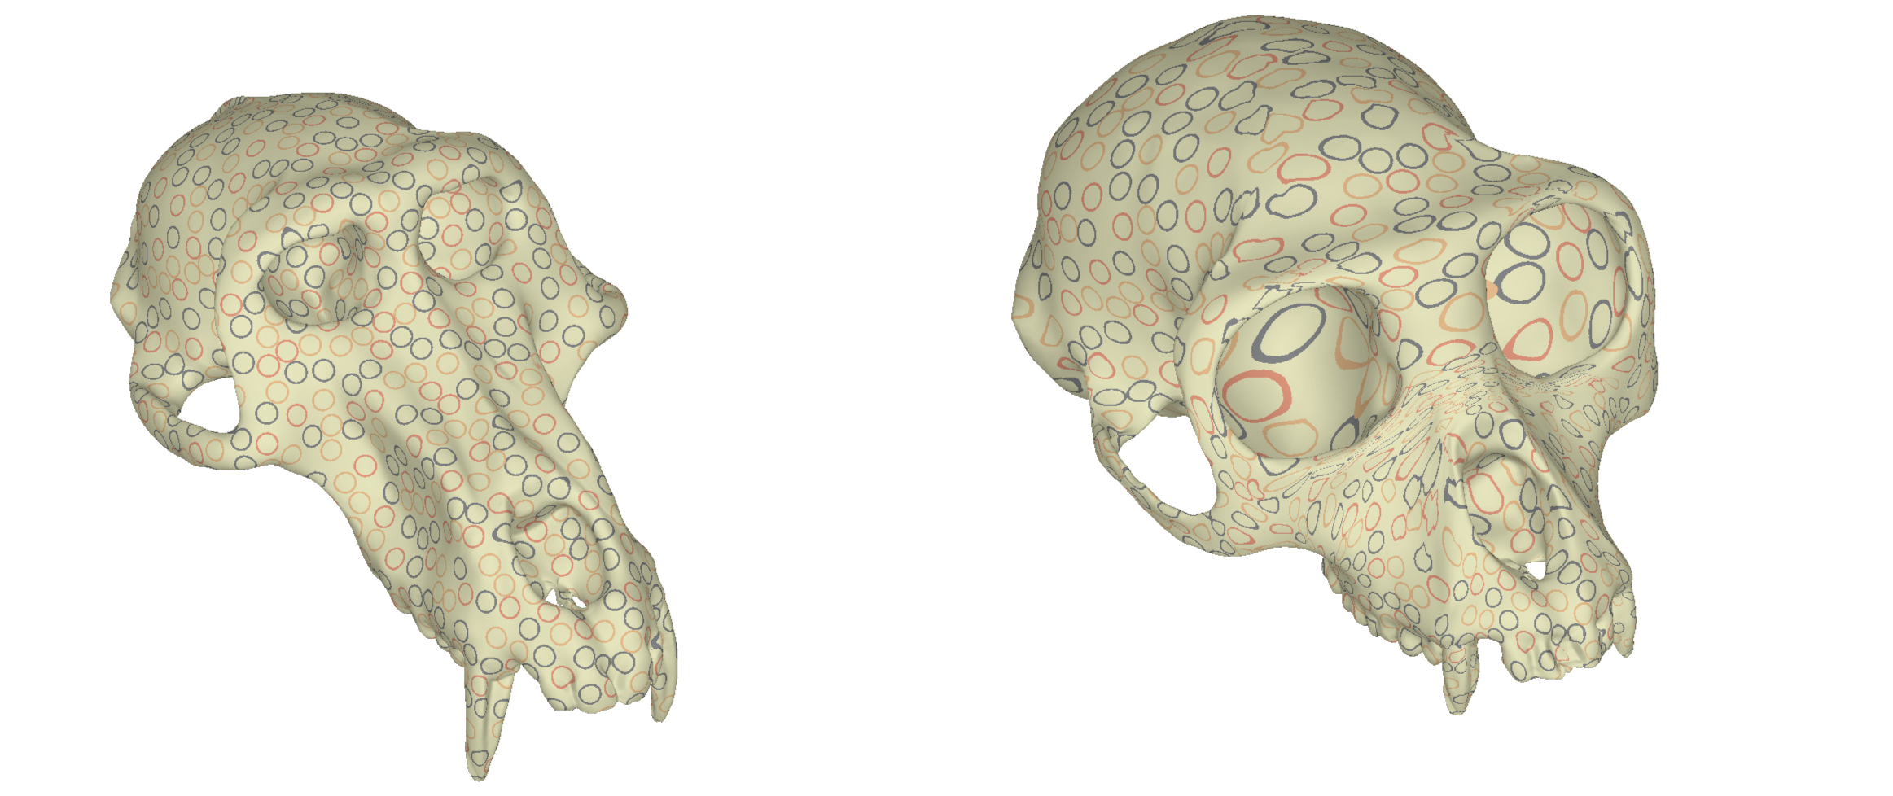
Conformal maps don’t always
exist in genus > 0
A close to conformal map of genus-two surfaces.
(Amenta)

Slide 24
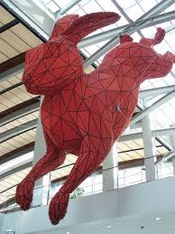
From smooth to discrete
The theory of conformal maps is well developed
for smooth surfaces.
?
Yes
What can we say about discrete surfaces?
?

Slide 25
PL metrics
In the discrete setting, a geometry on a triangulated
surface S is described by a PL metric that assigns
a length to each edge of the triangulation.
Two surfaces with PL metrics
l: E R⁺
k
l(eik)
l(ekj)
i
j
l(eij)

Slide 26
Uniformization for Discrete Surfaces?
l : {Edges} R⁺
k
l(ejk)
l(eik)
j
l(eij)
i
What does it mean for a map between two discrete
surfaces to be conformal?

Slide 27
What is a discrete conformal map?
Many definitions and algorithms exist:
1. Discrete Ricci Flow
2. Discrete Yamabe Flow
3. Conformal Mean Curvature Flow
4. Harmonic Maps
5. Finite Elements
6. Optimize a cost function
7. Discrete Differential Equation
8. Wilmore Flow
9. Circle Packings

Slide 28
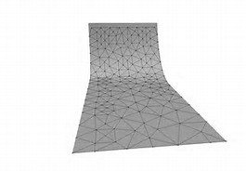
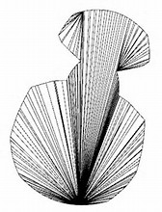
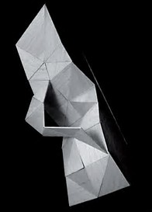
Good and Bad triangulations
Warning: Working with discrete surfaces often
requires special types of “nice” triangulations.
eg Delaunay triangualtions.
Good triangulations
Bad triangulation

Slide 29
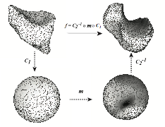
How to compute a conformal map
Finding a conformal map c: S1 S2
??
S1
c
S2
Question: What does it mean to say that a map
c: S1 S2 is conformal when the surfaces are
triangulated rather than smooth?

Slide 30
Conformal maps preserve angles
Conformal maps stretch, rotate or both
f3
f1
f2

Slide 31
Circle to circle maps also preserve angles
These maps can change radius and rotate a circle.
But angles are preserved.
R=1
stretch and rotate
stretch
f3(z) = 2e^{iπ/3}z
f1(z) = 2z
rotate
R=2
f2(z)= e^{iπ/3}z
R=1
R=2
Map of circles is f(z) = Az, simplest conformal map.

Slide 32
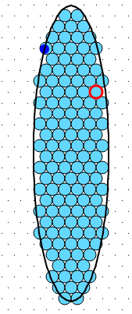
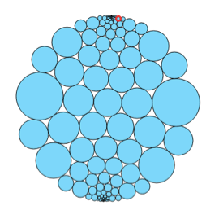
Circle Packing (Thurston-Andreev)
?
S1
S2
How can we find a (roughly) conformal map?
Pack circles
S1
Change radii
S2

Slide 33
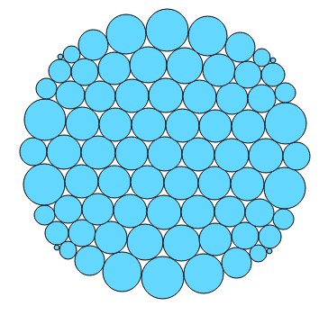
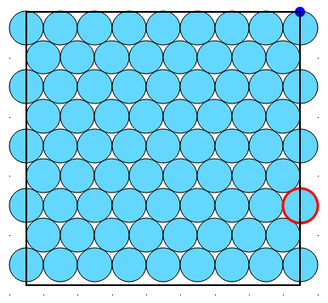
Discrete Conformal Maps by Circle Packing
?
S1
S2
How can we find a (roughly) conformal map?
Pack circles
Change radii
S1
S2

Slide 34
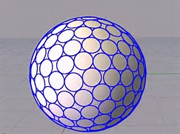
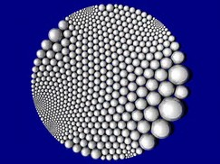
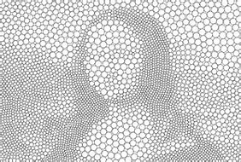
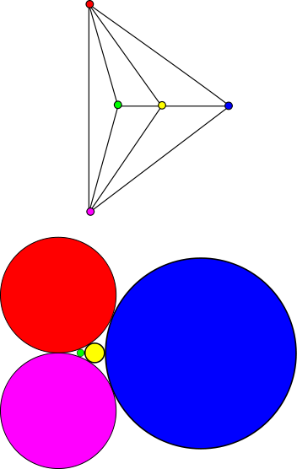
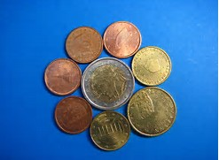
Circle Packing
A circle packing is a collection of tangent circles whose bounded
complementary regions are “triangular”.
Each circle packing has a corresponding triangulation.
For each vertex there is a circle, for each edge a tangency and
for each triangular face a triple of circles.
?

Slide 35
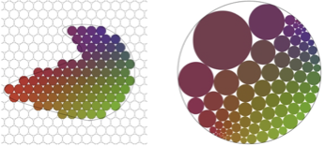
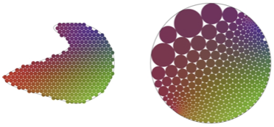
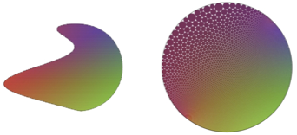
Discrete Analytic Map
Theorem. (Thurston-Andreev-Koebe)
For any triangulation T of a surface, there exists a collection
of radii that produce a circle packing corresponding to T.
Thurston gave a simple algorithm for finding these radii.
This gives one way to compute a discrete conformal map.
?
Just need to find these radii.

Slide 36
Smooth and Discrete Conformal Maps
In a smooth surface S, a conformal change scales a Riemannian metric at each point.
A metric g changes to a new metric g*.
A function u: S R gives the scaling factor
at each point.
g*= e^{u}g
w
w
v
g*(v,w) = e^{u}g(v,w)
v
Angles between vectors are the same in g and in g*.
If u(p) = 10, then a vector at p is stretched by
a factor of ???
e⁵

Slide 37
Discrete Conformal map
The corresponding idea for a map between two triangulated
surfaces is called a Discrete Conformal Map. What is this?
PL metric l: E R+
Vertex scaling function
u: V R
New PL metric l*
l*(eij) = e^{u(i)+u(j)}l(eij)

Slide 38
Formula for a discrete conformal map
PL metric l: E R+
Vertex scaling function
u: V R
New PL metric l*
l*(eij) = e^{u(i)+u(j)}l(eij)
k
k
l*(eik)
l*(ekj)
l(eik)
l(ekj)
i
j
i
j
l(eij)
l*(eij)

Slide 39
Two Notions of Conformality
S Smooth
Riem. metric g
S Discrete
PL metric l: E R+
Conformal map
Discrete Conformal map
u: S R
u: V R
g g*
l l*
g* = e^{u}g
l*(eij) = e^{u(e1)+u(e2)} l(eij)
Uniformization Theorem:
S1 and S2 smooth genus-zero
Riemannian surfaces. There
is a conformal map
c: S1 S2
Discrete Uniformization Theorem:
S1 and S2 discrete genus-zero
surfaces with PL metrics and
“nice” triangulations. There is
a discrete conformal map
c: S1 S2

Slide 40
Implementing Conformal Mappings
Any genus-zero surface can be mapped conformally
to a round sphere.

Slide 42
From Conformal Map to Shape Distance
The space of diffeomorphisms is too big to work
with directly. So we don’t try to find a minimal
stretching energy among all possible
diffeomorphism correspondences.
Instead, we minimize stretching energy over all
conformal maps.
The resulting minimal energy required to stretch
one surface over a second surface gives a
distance between the two surfaces.

Slide 43
Smooth Stretching Energy

Slide 44
Discrete Stretching Energy

Slide 45
A Metric on Shapes
We can use this measure of stretching of conformal
maps to define the distance between two shapes
(of genus zero).
The distance between two surfaces is equal to the
sum of the energies needed to stretch each
over the other.

Slide 46
Where do biological surfaces come from?
Proteins
Brain surfaces
Bones
Teeth
…. many more

Slide 47
Example - Protein Surfaces
Proteins are complex molecules whose function
in biology is largely determined by their shape.
Proteins can be flexible, like the calmodulin protein
above. We would like to compare the “surfaces” of
two proteins.

Slide 48
Protein Surfaces
Two surfaces generated from two prion proteins

Slide 49
Triangulated Surface from Protein
Two representations of a protein, a stick model
and an accessible surface.

Slide 50
From Protein to Surface
Define a surface that envelops the protein.

Slide 51
Triangulated Surfaces from Brains

Slide 52
Triangulated Surfaces from Bones
Metatarsal (toe) bones from 23 old and new world monkeys and 38 prosimians.

Slide 53
Phylogenetic Tree from Toe Bones
This tree is generated from a distance
between metatarsal bones.

Slide 54
Experiment: Ellipsoids
Distance

Slide 55
Noise

Slide 56
Practice Problem: How Round is an object?
Perhaps the simplest shape question:
How round is an object?
or
How close is an object to a round sphere.
We measure the distance from objects to the
rounds sphere.

Slide 57
How Round is a Platonic Solid?

Slide 58
How round are the Platonic Solids?

Slide 59
How round is a Protein?

Slide 60
Experiment - Roundness of 533 Proteins

Slide 61
Experiment - A non-rigid Protein

Slide 62
Distance between Teeth

Slide 63
Teeth have orientations

Slide 64
Distance between Arm Bones

Slide 65
Morphometrices
A traditional approach to measuring distance
between shapes.
Requires human expertise.
Expensive and slow.

Slide 66
Comparing results
ROC tests on 61 metatarsals, 45 radius surfaces, 99 teeth.
Red is optimal diffeomorphism, Blue is optimal transport,
Black and Purple are expert observers.

Slide 67
Distance between Toe Bones

Slide 68
Comparing results
Evolutionary tree
based only on
metatarsal bone
shapes.

Slide 69
Distance between Brain Cortices

Slide 70
Step 1: Brain Cortex to Sphere

Slide 71
Computing distance between Brain Cortices
Find conformal maps to the sphere for each cortex

Slide 72
Computing distance between Brain Cortices
Chose M so that C minimizes stretching energy
among all conformal maps.

Slide 73
Computing distance between Brain Cortices
The energy of C measures how much
stretching is required to stretch the red
cortex over the green one.
This gives a distance between the
two brain surfaces.

Slide 74
How well does this work?

