Slide 1
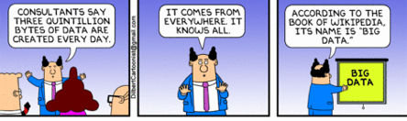
AIX0008:
Introduction to Data Science
Patrice KOEHL, UC Davis
Department of Computer Science
Genome Center
University of California, Davis

Slide 2
Introduction to Data Science
A paradigm shift in Science
2. What is “Big Data”?
3. Learning from Data / Data Science -Artificial Intelligence

Slide 3
Introduction to Data Science
A paradigm shift in Science
2. What is “Big Data”?
3. Learning from Data / Data Science Artificial Intelligence

Slide 4
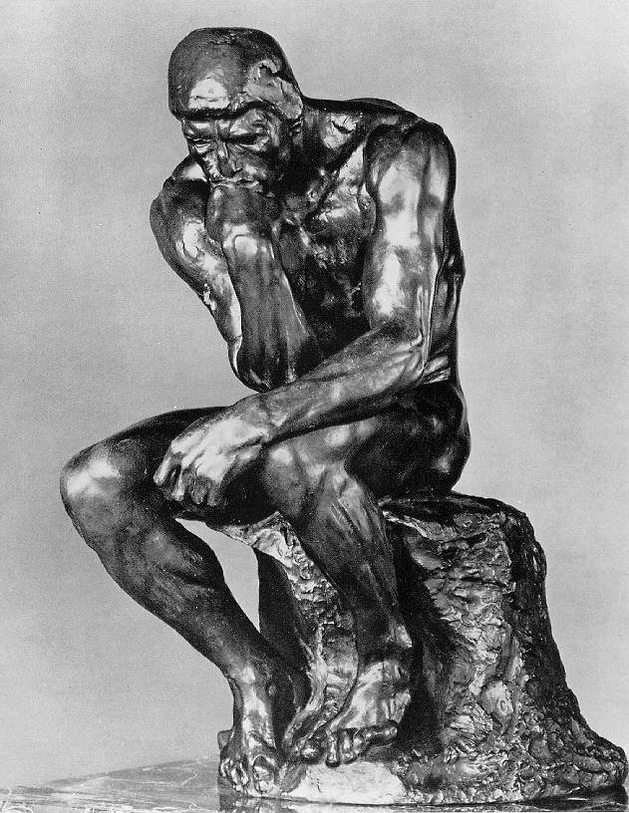
Science, then, and now
For a long time, people thought that it would be enough to reason about the existing knowledge to explore everything there is to know.
One single person could possess all knowledge in her cultural context.
(encyclopedia of Diderot and D’Alembert)
Reasoning, and mostly passive observation were the main techniques in scientific research

Slide 5
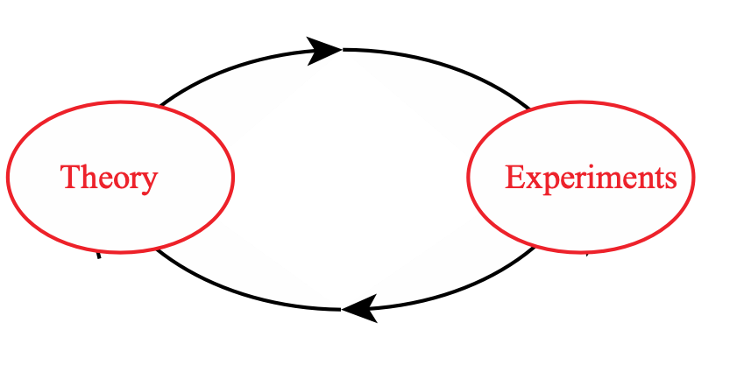
Science, then, and now

Slide 6
Science, then, and now
“All science is either physics, or stamp collecting”
Rutherford, chemist and physicist, 1876-1937

Slide 7
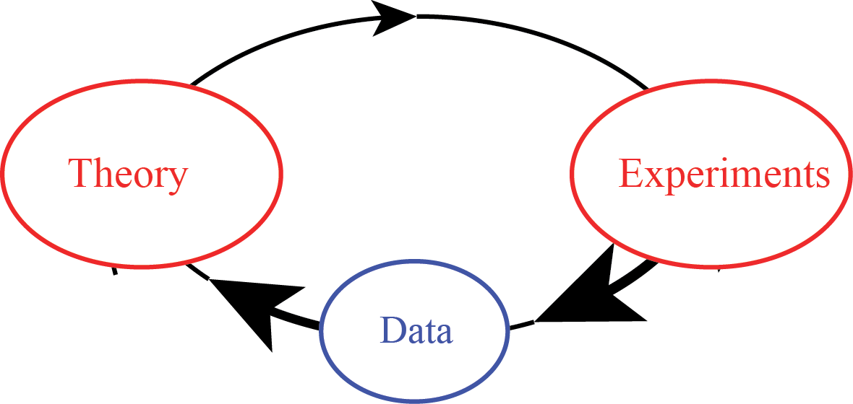
Science, then, and now

Slide 8
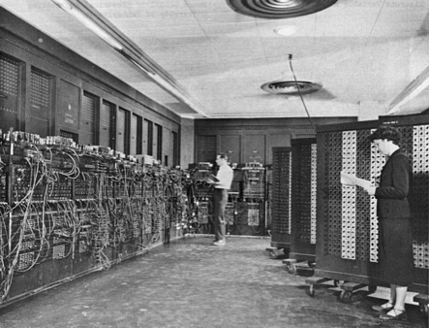

Science, then, and now
About 80 years ago: computers….

Slide 9
Science, then, and now
Computer simulations developed hand-in-hand with
the rapid growth of computers.
A computer simulation is a computer program that
attempts to simulate an abstract model of a particular
system
Computer simulations complement theory and
experiments, and often integrate them
They are becoming widesepread in: Computational
Physics, Chemistry, Mechanics, Materials, …, Biology

Slide 10
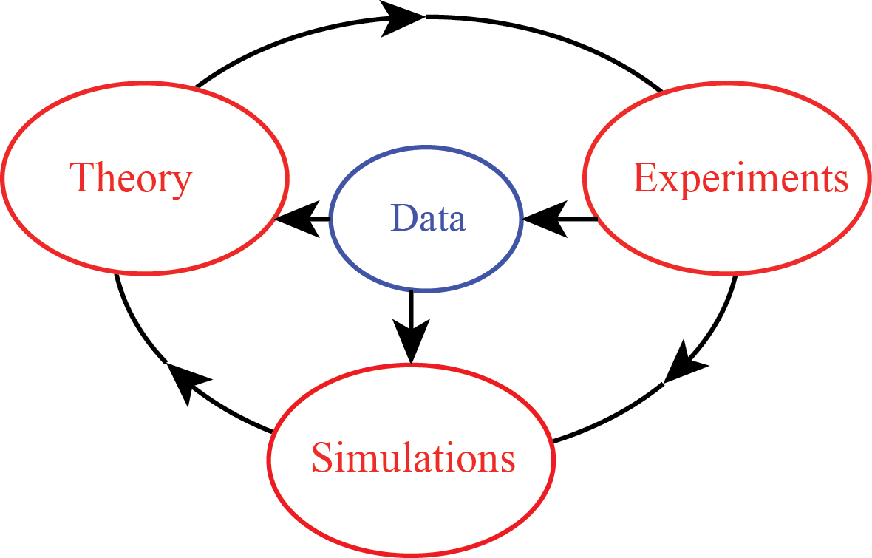
Science, then, and now

Slide 11
Mathematical Modeling
Is often used in place of experiments when they are too large, too expensive, too dangerous, or too time consuming.
Can be useful in “what if” studies; e.g. to investigate the use of pathogens (viruses, bacteria) to control an insect population.
Is a modern tool for scientific investigation.

Slide 12
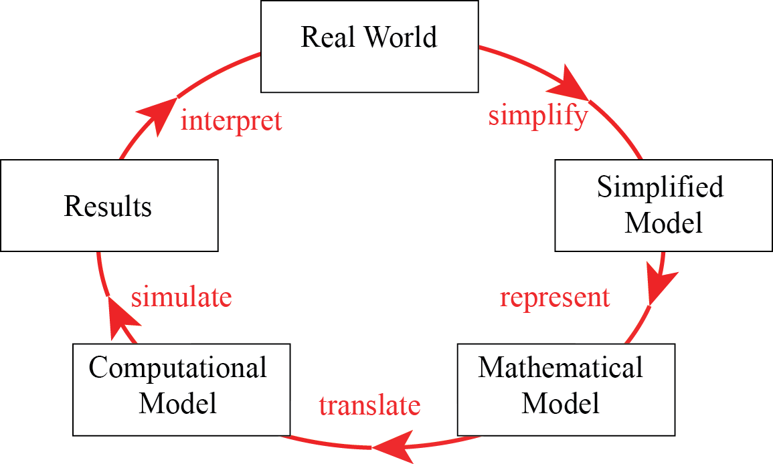
Mathematical Modeling

Slide 13
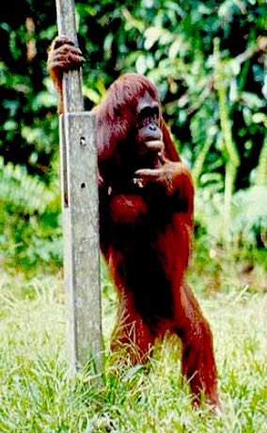
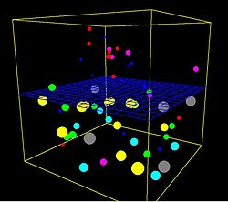
Science, then, and now
Thousand years ago – Experimental Sciences
  Description of natural phenomena
Last few hundred years – Theoretical Sciences
  Newton’s law, Maxwell’s equations…
Last few decades – Computational Sciences
  Simulation of complex phenomena
Today – Data-Intensive Sciences
  Scientist overwhelmed with data sets from many
  different sources
  Data captured by instruments
  Data generated by simulations

Slide 14
Introduction to Data Science
A paradigm shift in Science
2. What is “Big Data”?
3. Learning from Data / Data Science Artificial Intelligence

Slide 15
The three I’s of Big Data
Big Data:
Immediate (we need to do something about it now)
Intimidating (what if we don’t)
Ill-defined (what is it?)
(loosely adapted from Forbes)

Slide 16
Big Data: Volume
Byte Kilobyte Megabyte Gigabyte Terabyte Petabyte Exabyte Zettabyte Yottabyte
KB MB GB TB PB EB ZB YB
1000 bytes 1000 KB 1000 MB 1000 GB 1000 TB 1000 PB 1000 ZB 1000YB

Slide 17

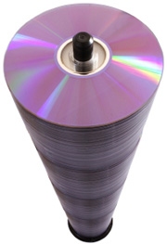
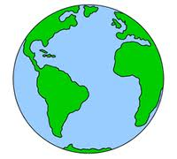





Big Data: Volume
One page
of text
One movie
6 million
books
55 storeys
of DVD
Data
up to
2003
Data
in 2011
NSA
data center
One song
30KB
5 MB
5 GB
1 TB
1 PB
5 EB
1 YB
1.8 ZB
Byte Kilobyte Megabyte Gigabyte Terabyte Petabyte Exabyte Zettabyte Yottabyte
KB MB GB TB PB EB ZB YB
1000 bytes 1000 KB 1000 MB 1000 GB 1000 TB 1000 PB 1000 ZB 1000YB

Slide 18
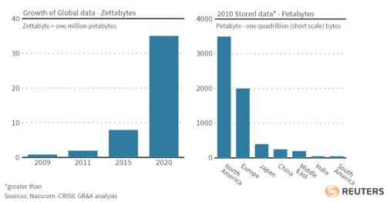
Big Data: Volume

Slide 19
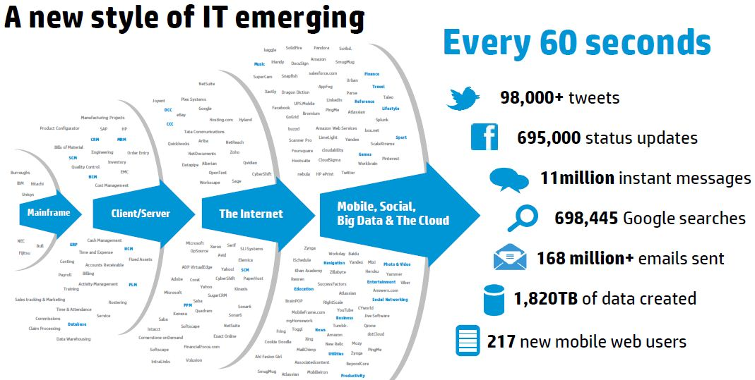
Big Data: Volume, Velocity

Slide 20
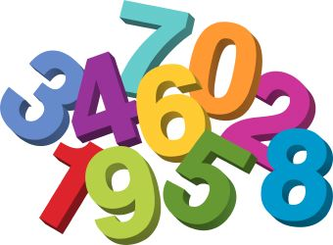
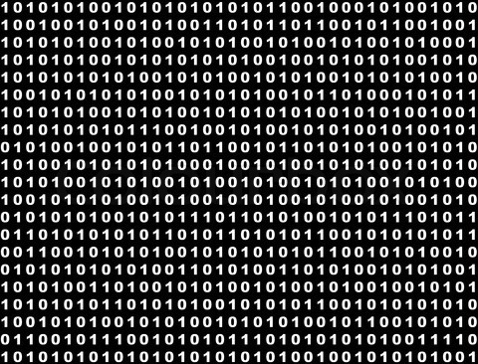
Big Data: Volume, Velocity, Variety
Numbers
text
Images
sound

Slide 21

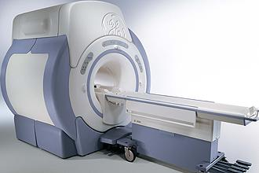
HealthCare Data
Patient records….
Test results….

Slide 22
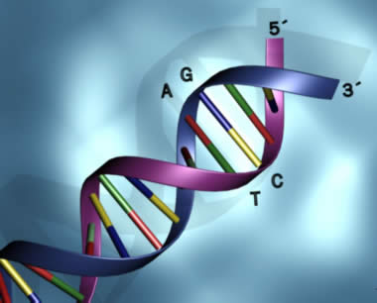
HealthCare Data
Patient records….
Genomics
research
Test results….

Slide 23
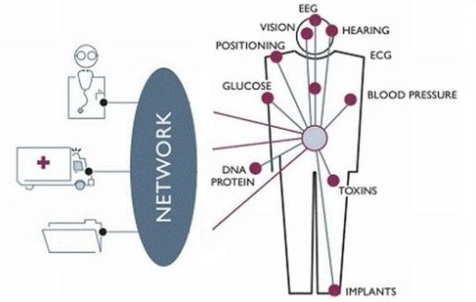
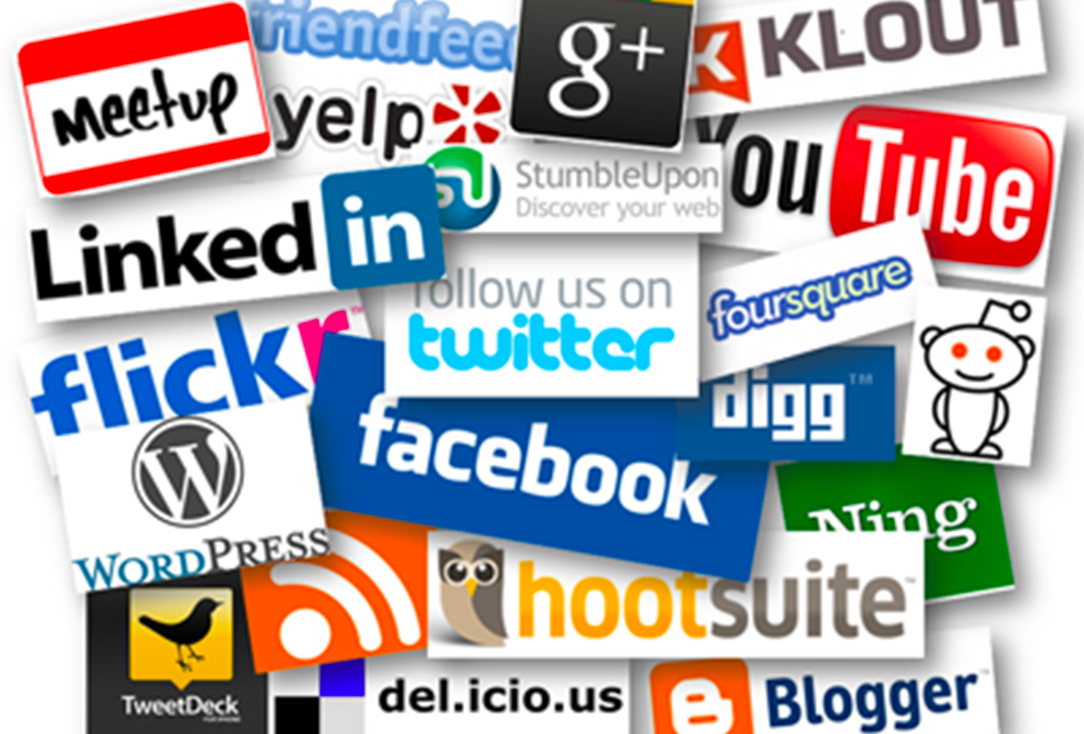
HealthCare Data
Patient records….
Genomics
research
Test results….
Wearable health monitoring…
Social medias…

Slide 24
Social Consequences of Commodity Sequencing
The danger of misuse
  predict sensitivities to various industrial or environmental agents discrimination by employers?
The impact of information that is likely to be incomplete
  an indication of a 25 percent increase in the risk of cancer?
Reversal of knowledge paradigm
Are the "products" of the Human Genome Project to be patented and commercialized?
  Myriad genetics and BRCA1/2
How to educate about genetic research and its implications?

Slide 25
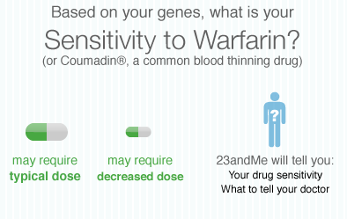
Social Consequences of Commodity Sequencing

Slide 26
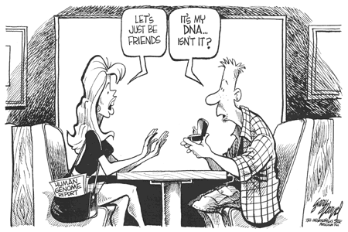
Social Consequences of Commodity Sequencing

Slide 27
Introduction to Data Science
A paradigm shift in Science
2. What is “Big Data”?
3. Learning from Data / Data Science Artificial Intelligence

Slide 28
What is Data Science?
“Data science is the study of extracting value from data”
Jeannette Wing

Slide 29
What is Data Science?
“Data science is the study of extracting value from data”
Jeannette Wing

Slide 30
What is Data Science?
“Data science is the study of extracting value from data”
Jeannette Wing

Slide 31
Data Science: Opportunities
Fourth Paradigm: data driven science
Basic
Translational
Data
Knowledge
Societal Benefit

Slide 32
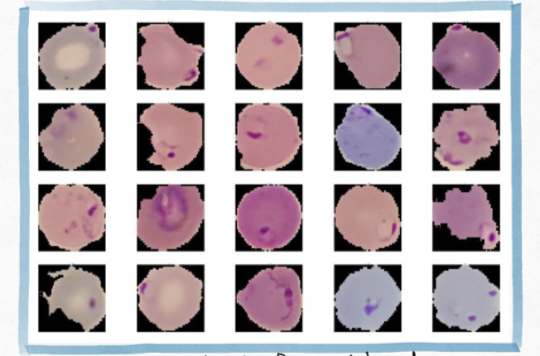
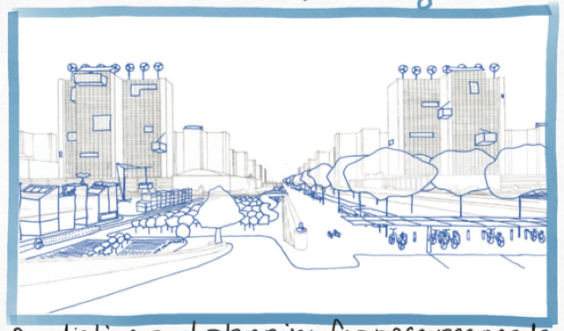
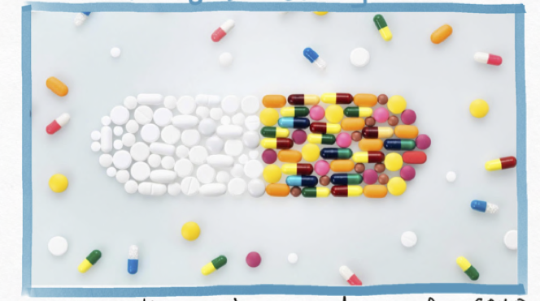
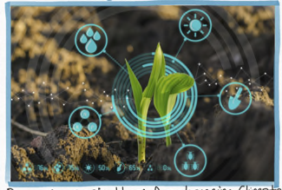
Data Science: Opportunities
Disease Diagnosis
Urban Planning
Detecting malaria from blood smears
Predicting and planning for resource needs
Drug Discovery
Agriculture
Quickly discovering new drugs for COVID
Precision agriculture

Slide 33
What is Data Science?
“Data science is the study of extracting value from data”
Jeannette Wing

Slide 34
The Data Science Process
Ask an interesting question
Get the Data
Explore the Data
Model the Data
Communicate/Visualize the Results

Slide 35
The Data Science Process
Ask an interesting question
What is the scientific goal?
Get the Data
Explore the Data
Model the Data
Communicate/Visualize the Results

Slide 36
The Data Science Process
Ask an interesting question
Get the Data
How were the data obtained?
Which data are relevant?
Are there privacy issues?
Explore the Data
Model the Data
Communicate/Visualize the Results

Slide 37
The Data Science Process
Ask an interesting question
Get the Data
Explore the Data
Plot the data
Are there anomalies?
Are there obvious patterns?
Model the Data
Communicate/Visualize the Results

Slide 38
The Data Science Process
Ask an interesting question
Get the Data
Build a model
Fit the model
Validate the model
Explore the Data
Model the Data
Communicate/Visualize the Results

Slide 39
The Data Science Process
Ask an interesting question
Get the Data
Explore the Data
What did we learn?
Is it meaningful?
Does it have “value”?
Model the Data
Communicate/Visualize the Results

Slide 40
Machine Learning
Supervised learning
Unsupervised learning
Classification of categorization | Clustering
Regression | Dimensionality Reduction
Discrete
Continuous

Slide 41
What is Data Science?
“Data science is the study of extracting value from data”
Jeannette Wing

Slide 42
Big Data: Challenges
Volume and Velocity
Variety
  Structured, Unstructured….
  Images, Sound, Numbers, Tables,…
Security
Reliability, Integrity, Validity

Slide 43
Big Data: Challenges
Large N:
“Any dataset that is collected by a scientist whose data collection skills are far superior to the analysis tools available in her field”
Computing issues:
Data transfer
Scalability of algorithms
Memory limitations
Distributed computing

Slide 44
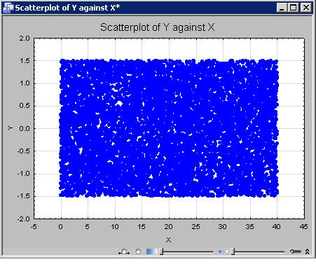
Big Data: Challenges
Vizualization issues:
The “black” screen
problem

Slide 45

How to Approach Data Science

Slide 46
How to approach Data Science
Domain
Sciences
Analytics
Discover
Develop
Training
Distribute
Infrastructure

