Slide 1
Data Analysis
Patrice Koehl
Department of Biological Sciences
National University of Singapore
http://www.cs.ucdavis.edu/~koehl/Teaching/BL5229
koehl@cs.ucdavis.edu

Slide 2
Data analysis
Statistics of a sample
  Central tendency
  Variation
  Normal distribution
Inference
  From sample to population
  P-value

Slide 3
Data analysis
Statistics of a sample
  Central tendency
  Variation
  Normal distribution
Inference
  From sample to population
  P-value

Slide 4


Measures of Central Tendency
Mean … the average score
Median … the value that lies in the middle after ranking all the scores
Mode … the most frequently occurring score

Slide 5
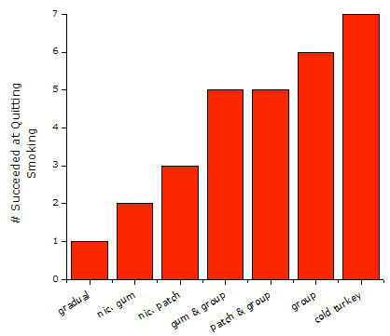
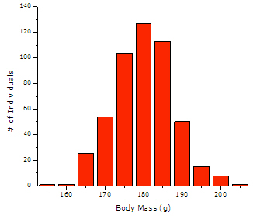
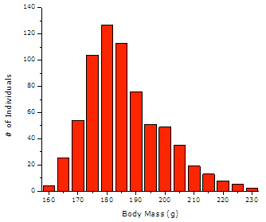
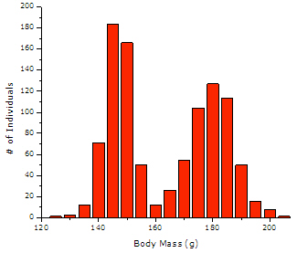
Which Measure should you use?

Slide 6
Which Measure should you use?
Mode
Mean
Median
None

Slide 7
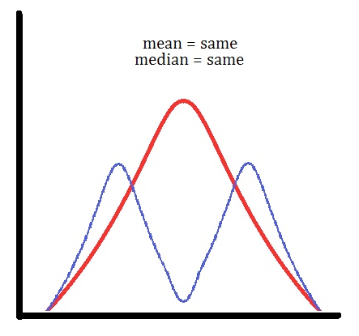
Measures of Central Tendency
Attention: danger!

Slide 8

Variation or Spread of Distributions
Range
Variance and Standard Deviation

Slide 9
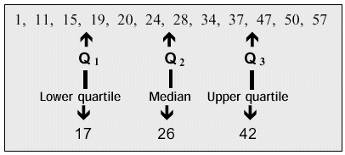
Variation or Spread of Distributions
Quartiles

Slide 10
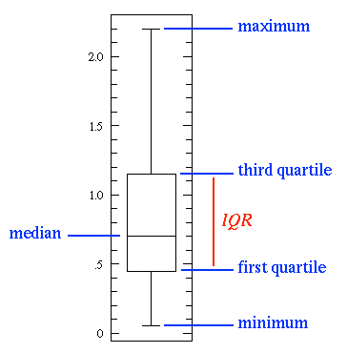
Visualization of Variation: the Box Plot
(Inter Quartile Range)

Slide 11
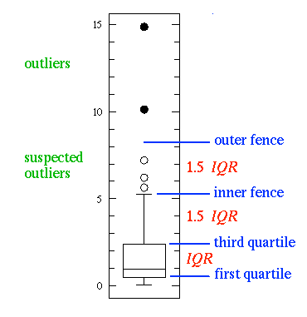
Detecting outliers

Slide 12
Correlation between two distributions

Slide 13
Correlation between two distributions

Slide 14
Correlation does not mean causality

Slide 15
Correlation does not mean causality

Slide 16
Data analysis
Statistics of a sample
  Central tendency
  Variation
  Normal distribution
Inference
  From sample to population
  P-value

Slide 17
The Normal Distribution Curve
In everyday life many variables such as height, weight, shoe size and exam marks all tend to be normally distributed, that is, they all tend to look like:
Mean, Median, Mode
It is bell-shaped and symmetrical about the mean
The mean, median and mode are equal

Slide 18
Interpreting a normal distribution
Mean = 50
Std Dev = 15
34%
34%
2%
2%
14%
14%
5
20
35
50
65
80
95
-3
-2
-1
0
+1
+2
+3

Slide 19


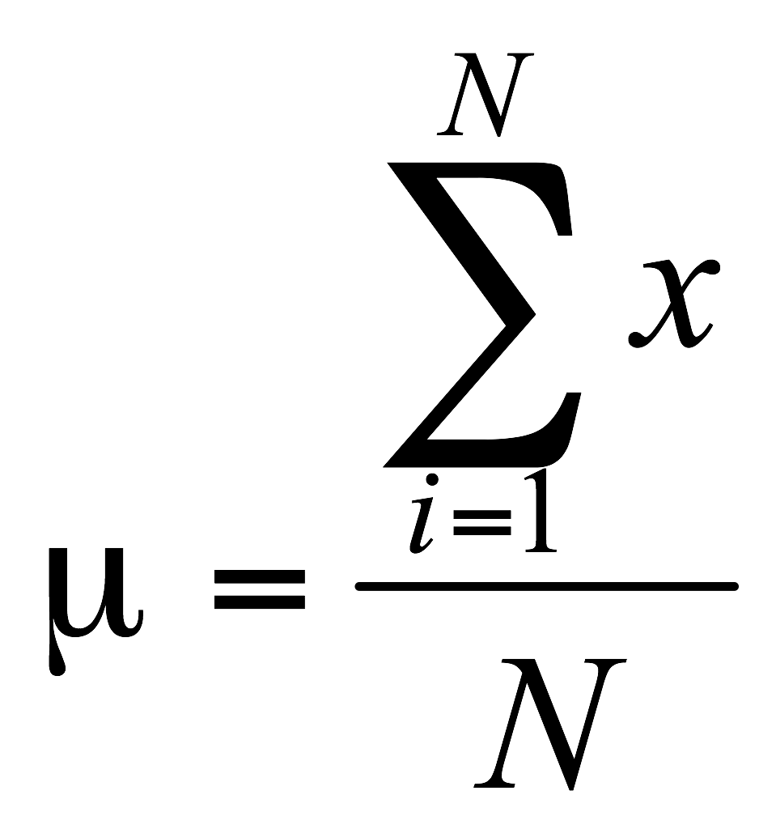
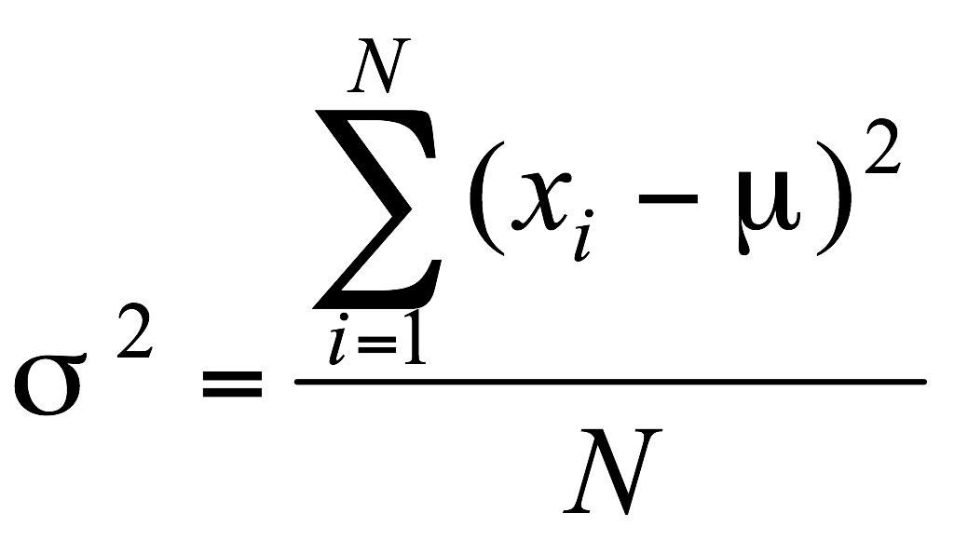
Statistical Inference
The process of making guesses about the truth from a sample
Truth (not observable)
Sample (observation)
Population parameters
Make guesses about the whole population

Slide 20
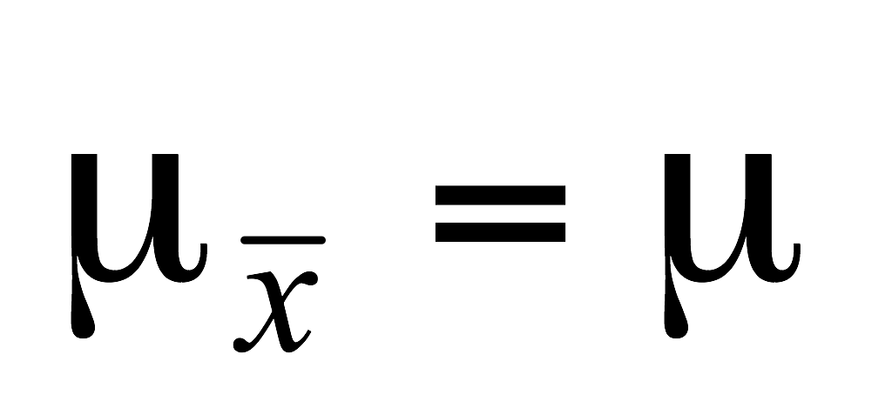
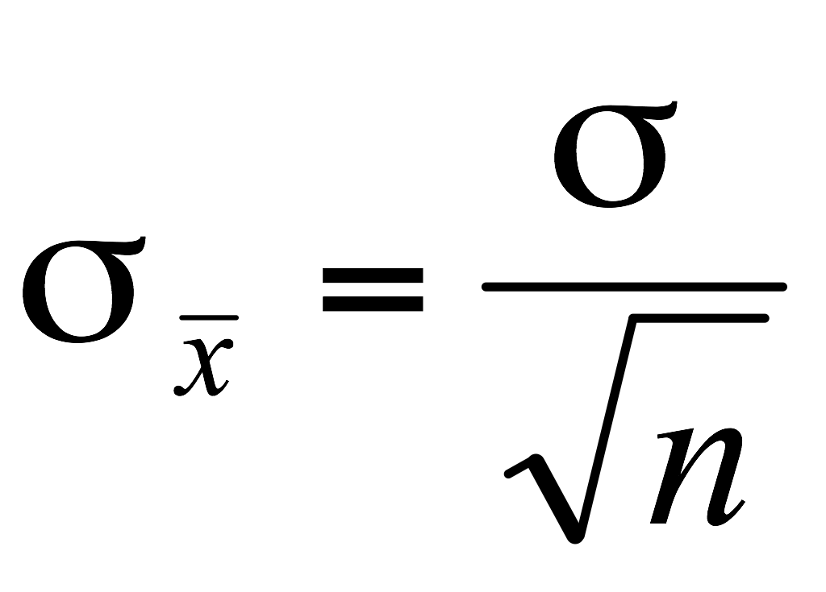
The Central Limit Theorem
If all possible random samples, each of size n, are taken from any population with a mean μ and a standard deviation σ, the sampling distribution of the sample means (averages) will:
1. have mean:
2. have standard deviation:
(standard error)
3. be approximately normally distributed regardless of the shape of the parent population (normality improves with larger n)

Slide 21
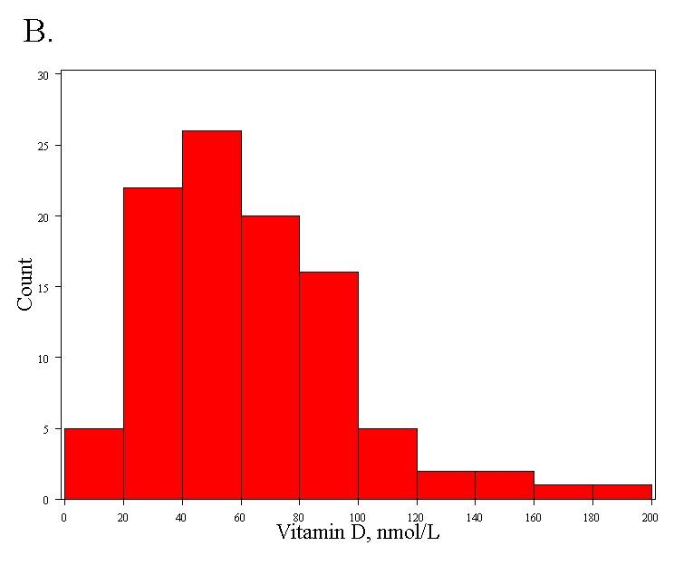
Vitamin D
Right-skewed!
Mean= 63 nmol/L
Standard deviation = 33 nmol/L
Lee DM, Tajar A, Ulubaev A, et al. Association between 25-hydroxyvitamin D levels and cognitive performance in
middle-aged and older European men. J Neurol Neurosurg Psychiatry. 2009 Jul;80(7):722-9.

Slide 22
Distribution of the sample mean, computer simulation…
Specify the underlying distribution of vitamin D in all European men aged 40 to 79.
  Right-skewed
  Standard deviation = 33 nmol/L
  True mean = 62 nmol/L
Select a random sample of 100 virtual men from the population.
Calculate the mean vitamin D for the sample.
Repeat steps (2) and (3) a large number of times (say 1000 times).
Explore the distribution of the 1000 means.

Slide 23
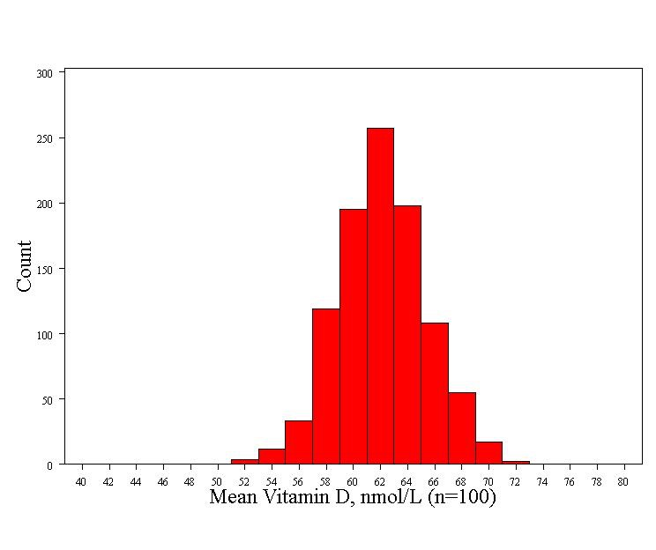
Distribution of sample mean: vitamin D
Normally distributed!
Mean= 62 nmol/L (the true mean)
Standard deviation = 3.3 nmol/L

Slide 24
Confidence interval
Given a sample and its statistics (mean and standard
deviation), is it possible to get an estimate of the true mean?
The confidence interval is set to capture the true effect
“most of the time”.
For example, a 95% confidence interval should include the
true effect about 95% of the time.

Slide 25
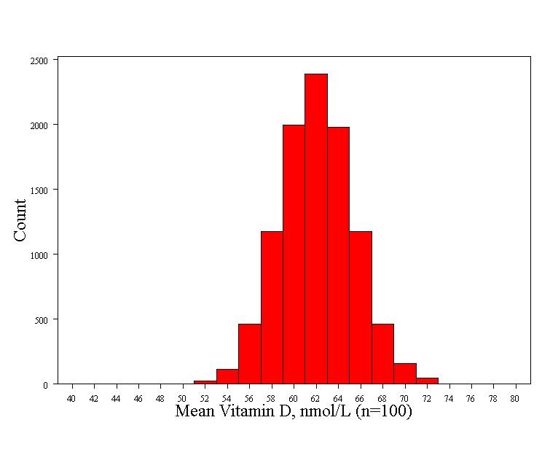
Recall: 68-95-99.7 rule for normal distributions! These is a 95% chance that the sample mean will fall within two standard errors of the true mean= 62 +/- 2*3.3 = 55.4 nmol/L to 68.6 nmol/L
Mean - 2 Std error=55.4
Mean
Mean + 2 Std error =68.6
To be precise, 95% of observations fall between Z=-1.96 and Z= +1.96 (so the “2” is a rounded number)…

Slide 26
Confidence interval
The value of the statistic in the sample (mean)
point estimate ± (measure of how confident we want to be) ⋅ (standard error)
Standard error of the statistics
From a Z table or a T table, depending on the sampling distribution of the statistic.
Confidence Level
Z value
80%
90%
95%
98%
99%
99.8%
99.9%
1.28
1.645
1.96
2.33
2.58
3.08
3.27

Slide 27
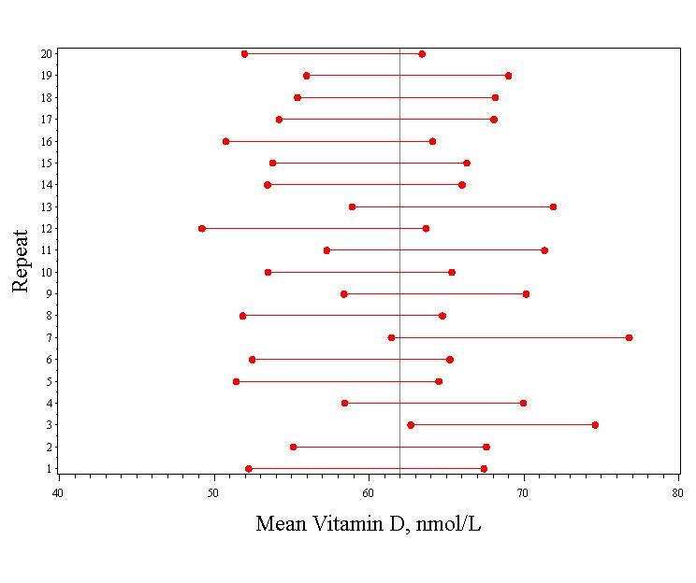
Confidence interval: simulation for Vitamin D study
Vertical line indicates the true mean (62)
95% confidence intervals for the mean vitamin D for each of the simulated studies.

Slide 28
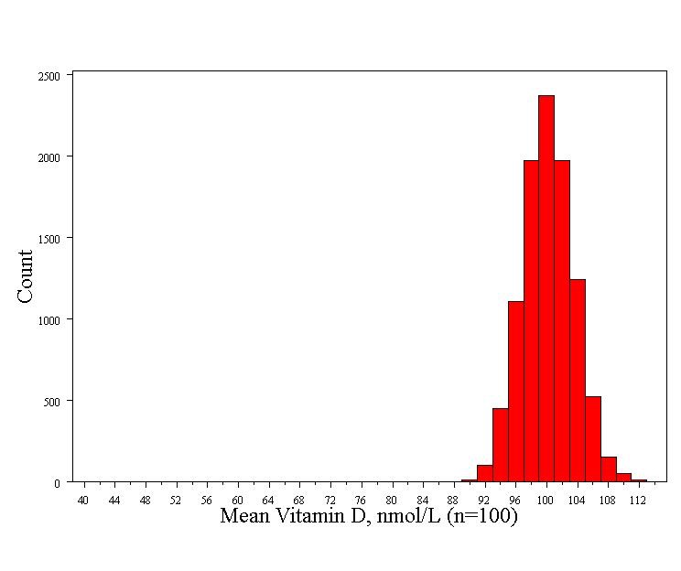
Hypothesis Testing: P-value
It didn’t happen in 10,000 simulated studies. So the probability is less than 1/10,000
What’s the probability of seeing a sample mean of 63 nmol/L if the true mean is 100 nmol/L?
    P-value is the probability that we would have seen our data just by chance if the null hypothesis (null value) is true.
    Small p-values mean the null value is unlikely given our data.

Slide 29
Hypothesis Testing
Steps:
1. Define your hypotheses (null, alternative)
Mean = 100
2. Specify your null distribution
3. Do an experiment
X = 63
4. Calculate the p-value of what you observed
p < 0.001
5. Reject or fail to reject (~accept) the null hypothesis
reject

Slide 30
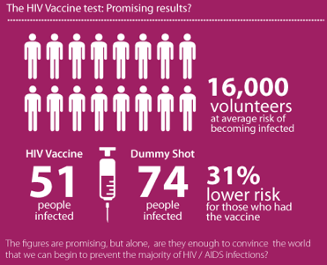
Hypothesis Testing
(http://www.ngpharma.com/news/possible-HIV-vaccine/
http://news.bbc.co.uk/go/pr/fr/-/2/hi/health/8272113.stm
Rerks-Ngarm et al, New Eng. J. of Medicine, 361, 2209 (2009))

Slide 31
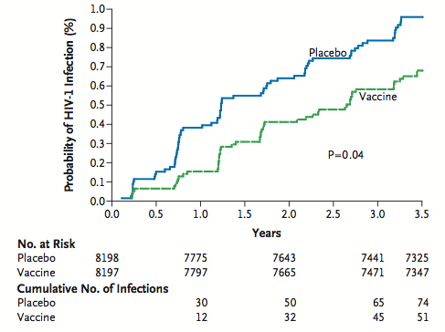
Hypothesis Testing
VE=31%
(Rerks-Ngarm et al, New Eng. J. of Medicine, 361, 2209 (2009))

Slide 32
Hypothesis Testing
Null hypothesis: VE = 0 %
P-value = 0.04. This means:
P(Data/Null) = 0.04
However, this does not mean P(Null/Data) = 0.04!

Slide 33

A Bayesian Approach: prior
User new evidence to update beliefs
Likelihood
function
Prior
probability
Posterior
probability
Model evidence
(Independent of
Model)

Slide 34
Numbers can be misleading….
Example: suppose a drug test is 99% sensitive and
99% specific.
(Namely, P(+|User) = 0.99 and P(+|Non user) = 0.01)
Suppose that 0.5% of people are users of the drug.
If a random individual tests positive, what is the
probability she is a user?

Slide 35


A Bayesian Approach
Bayes ‘s theorem:

Slide 36
Beware of lurking variables!
A real example from a medical study* comparing the success rates of two
treatments of kidney stones:
 | Treatment A | Treatment B
Patients | 78% (273/350) | 83% (289/350)
*Charig et al, Br Med J, 292, 879 (1986)

Slide 37
Beware of lurking variables!
A real example from a medical study* comparing the success rates of two
treatments of kidney stones:
 | Treatment A | Treatment B
Small Stones | 93% (81/87) | 87% (234/270)
Large Stones | 73% (192/263) | 69% (55/80)
Patients | 78% (273/350) | 83% (289/350)
What is happening here?
*Charig et al, Br Med J, 292, 879 (1986)

