Slide 1
Fourier Analysis
Patrice Koehl
Department of Biological Sciences
National University of Singapore
http://www.cs.ucdavis.edu/~koehl/Teaching/BL5229
koehl@cs.ucdavis.edu

Slide 2
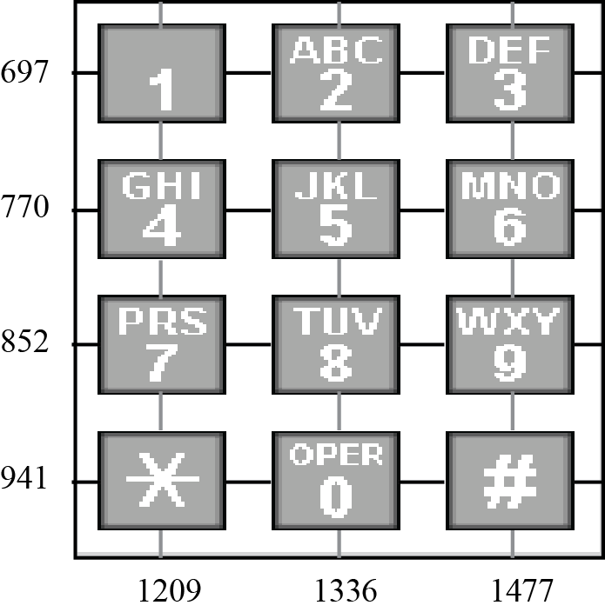
Fourier analysis: the dial tone phone
We use Fourier analysis everyday…without knowing it! A dial tone
phone is probably the best example:

Slide 3
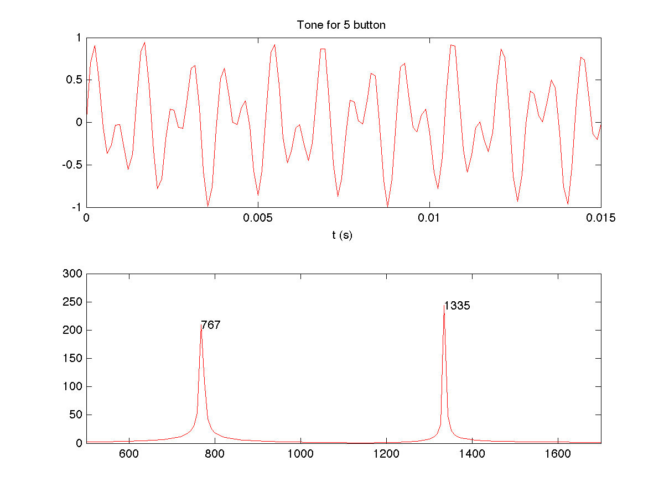
Fourier analysis: the dial tone phone
1336
770

Slide 4
Fourier Analysis
Fourier series for periodic functions
Fourier Transform for continuous functions
Sampling
Discrete Fourier Transform for discrete functions

Slide 5
Fourier Analysis
Fourier series for periodic functions
Fourier Transform for continuous functions
Sampling
Discrete Fourier Transform for discrete functions

Slide 6
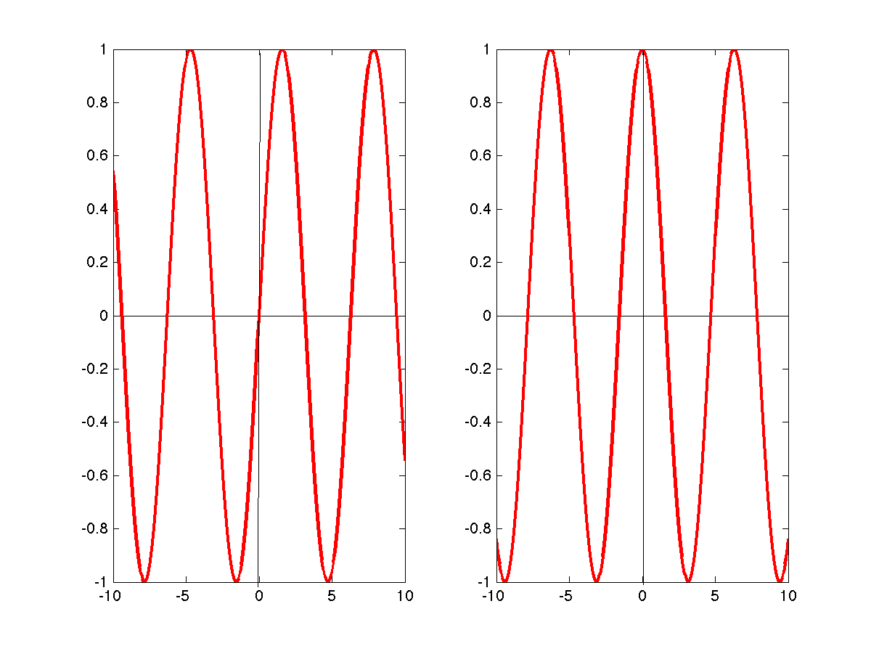
Periodic functions
A function f is periodic, with period T if and only if:
Examples of periodic functions:
sin(t)
cos(t)

Slide 7
Fourier series
A Fourier series of a periodic function f (with period 2π) defined as an
expansion of f in a series of sines and cosines such as
Fourier series are named in honor of Joseph Fourier (1768-1830), who made important contributions to the study of trigonometric series.

Slide 8
Fourier series
Computing the coefficients a and b:

Slide 9
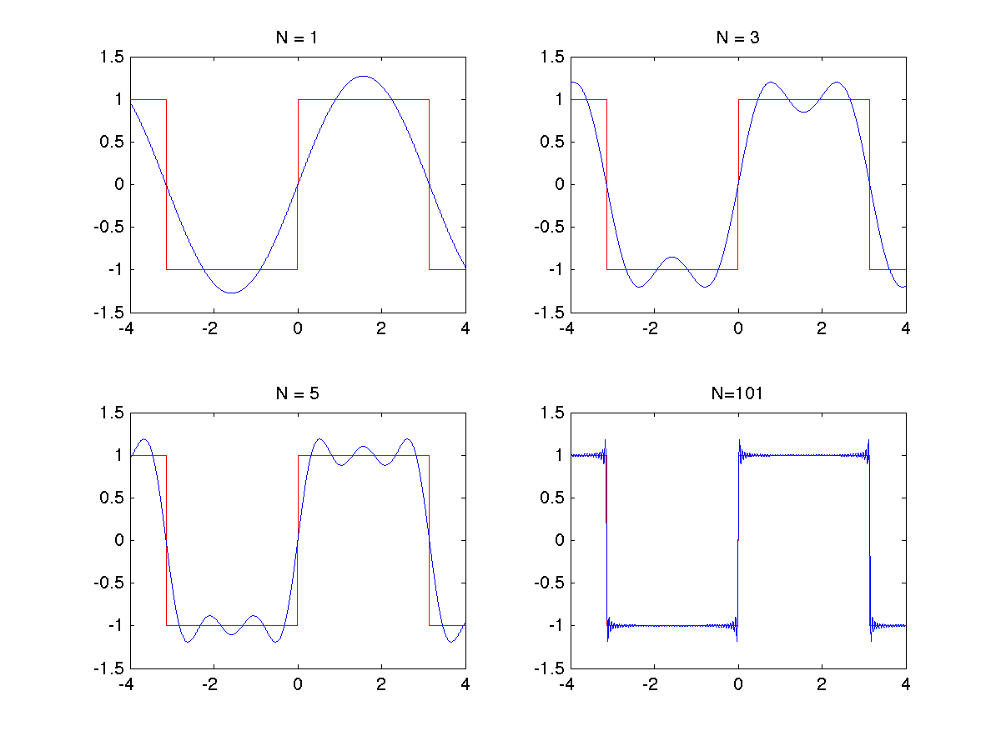
Fourier series: example 1

Slide 10
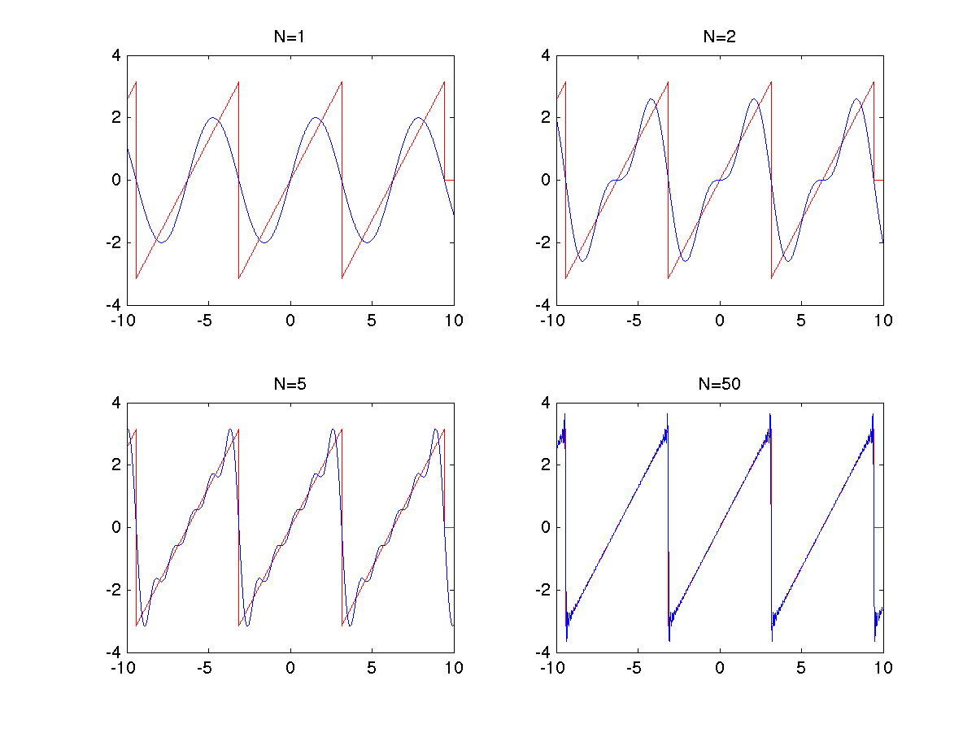
Fourier series: example 2

Slide 11
Fourier series
If we express cos nx and sin nx in exponential form,
we may rewrite this equation as
in which
and

Slide 12
Fourier series
For a function g with period T:
where f₀ = 1/T is the fundamental frequency for the function g.
In this formula, G(n) can be written as:

Slide 13
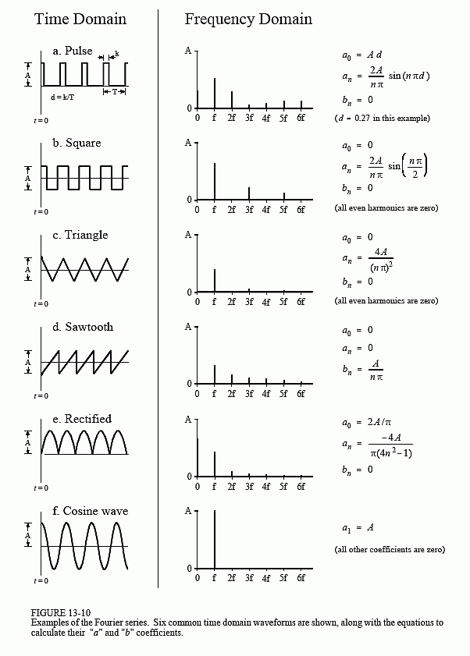

Slide 14
Fourier Analysis
Fourier series for periodic functions
Fourier Transform for continuous functions
Sampling
Discrete Fourier Transform for discrete functions

Slide 15
Fourier transform
For a periodic function f with period T, the Fourier coefficients F(n)
are computed at multiples nf₀ of a fundamental frequency f₀=1/T
For a non periodic function g(t), the Fourier coefficients become
a continuous function of the frequencies f:
(1)
g(t) can then be reconstructed according to:
(2)
Is referred to as the Fourier transform, while (2) is the inverse
Fourier transform

Slide 16
Fourier transform
Notes:
The function g(t) must be integrable; it can be real or complex
The equations above can be obtained by looking at the limits of the Fourier series
The Fourier Transform can be rewritten as a function of ω = 2πf, the angular frequency.

Slide 17
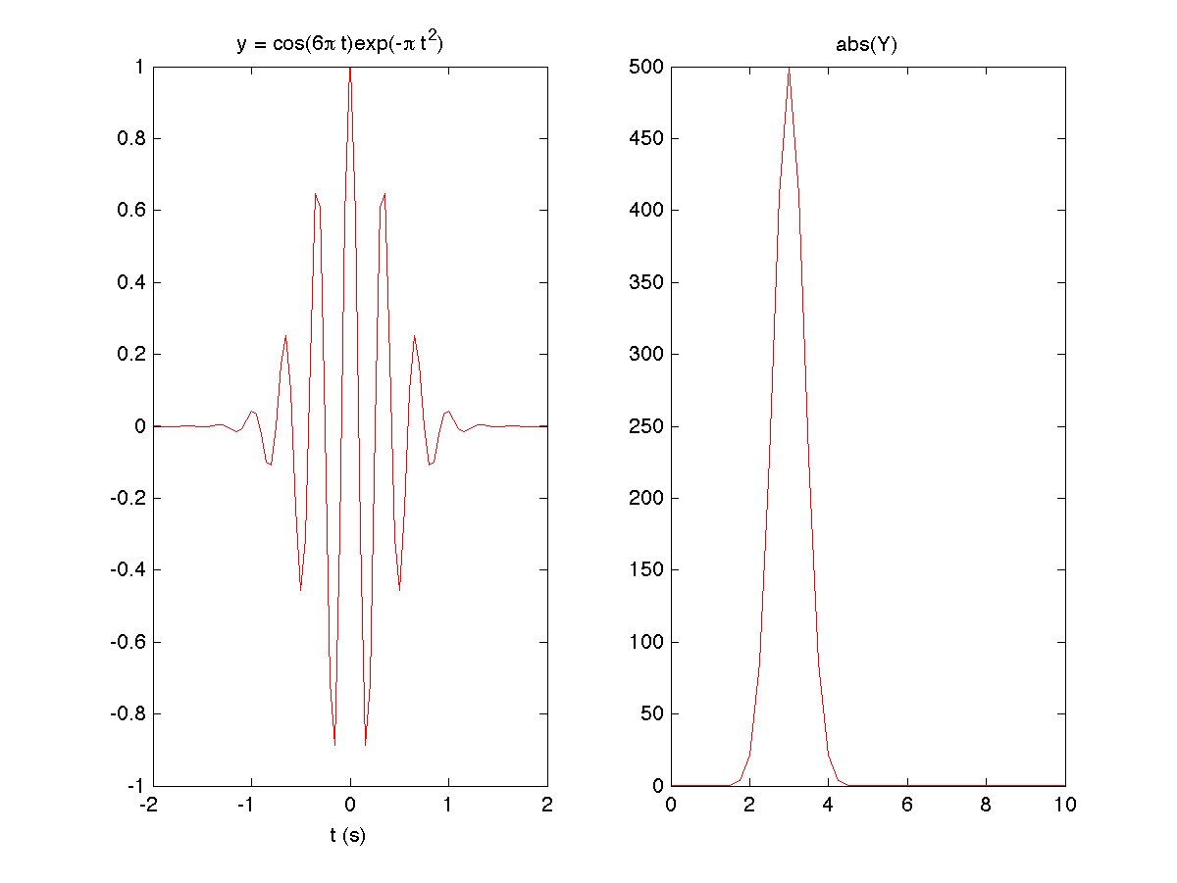
Fourier transform: example

Slide 18
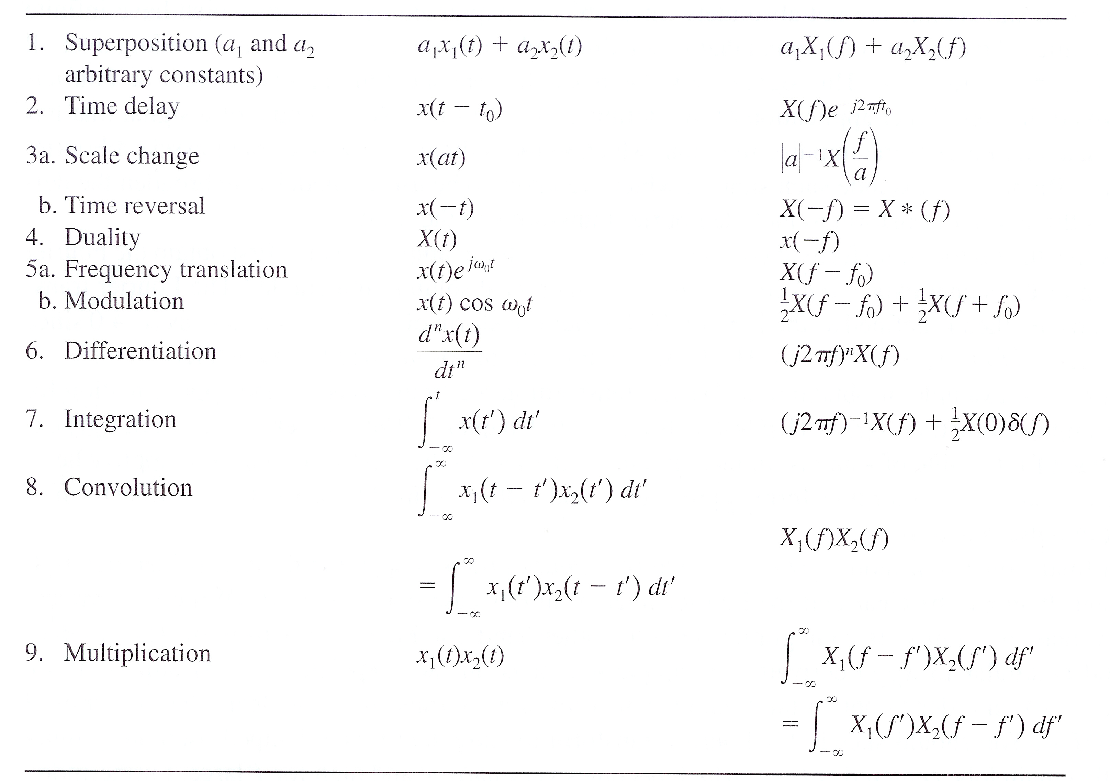
Properties of the Fourier Transform

Slide 19
Fourier Analysis
Fourier series for periodic functions
Fourier Transform for continuous functions
Sampling
Discrete Fourier Transform for discrete functions

Slide 20
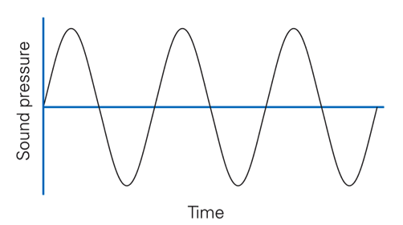
Sound is produced by the vibration of a media like air or water. Audio refers to the sound within the range of human hearing.
Naturally, a sound signal is analog, i.e. continuous in both time and amplitude.
To store and process sound information in a computer or to transmit it through a computer network, we must first convert the analog signal to digital form using an analog-to-digital converter ( ADC ); the conversion involves two steps: (1) sampling, and (2) quantization.
Digital Sound

Slide 21
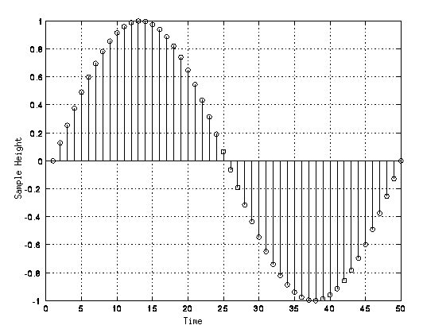
Sampling
Sampling is the process of examining the value of a continuous function
at regular intervals.
Sampling usually occurs at uniform intervals, which are referred to as sampling intervals. The reciprocal of sampling interval is referred to as the sampling frequency or sampling rate.
If the sampling is done in time domain, the unit of sampling interval is second and the unit of sampling rate is Hz, which means cycles per second.

Slide 22
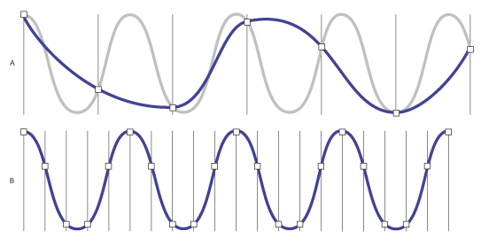
Sampling
Note that choosing the sampling rate is not innocent:
A higher sampling rate usually allows for a better representation of the original sound
wave. However, when the sampling rate is set to twice the highest frequency in the
signal, the original sound wave can be reconstructed without loss from the samples.
This is known as the Nyquist theorem.

Slide 23
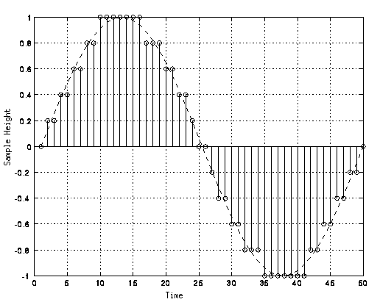
Quantization
Quantization is the process of limiting the value of a sample of
a continuous function to one of a predetermined number of
allowed values, which can then be represented by a finite number
of bits.

Slide 24
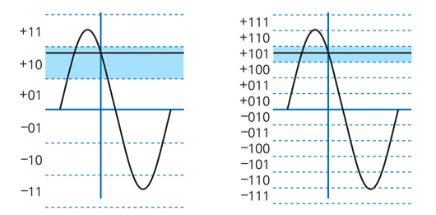
Quantization
The number of bits used to store each intensity defines the
accuracy of the digital sound:
Adding one bit makes the sample twice as accurate

Slide 25
Audio Sound
Sampling:
The human ear can hear sound up to 20,000 Hz: a sampling rate
of 40,000 Hz is therefore sufficient. The standard for digital audio
is 44,100 Hz.
Quantization:
The current standard for the digital representation of audio sound
is to use 16 bits (i.e 65536 levels, half positive and half negative)
How much space do we need to store one minute of music?
60 seconds
44,100 samples
16 bits (2 bytes) per sample
2 channels (stereo)
S = 60x44100x2x2 = 10,534,000 bytes ≈ 10 MB !!
1 hour of music would be more than 600 MB !

Slide 26
Fourier Analysis
Fourier series for periodic functions
Fourier Transform for continuous functions
Sampling
Discrete Fourier Transform for discrete functions

Slide 27
Discrete time Fourier Transform
Given a discrete set of values x(n), with n integer; the discrete
Time Fourier transform of x is:
Notice that X(f) is periodic:

Slide 28
Discrete Fourier Transform
The sequence of numbers x₀,…x_{N-1} is transformed into a new
series of numbers X₀,….X_{N-1} according to the digital Fourier transform
(DFT) formula:
The inverse DFT is given by:

Slide 29
Discrete Fourier Transform
Notes:
If x(n) is a time signal, and Δ is the constant time interval between
two time points, then the total duration of the time signal is (N-1)*Δ;
the fundamental frequency is f0=1/(N*Δ)
If n is a power of 2, X(k) can be computed really fast using the
Fast Fourier Transform (FFT)
The corresponding command in Matlab is:
X = fft(x)
x(n) can be real or complex. X(k) is always complex.

Slide 30
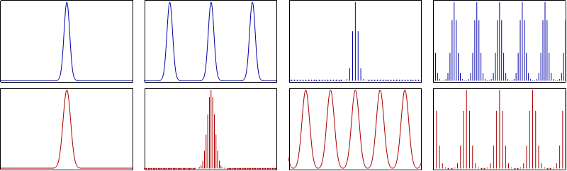
Fourier analysis
Continuous
time signal
Periodic
time signal
Discrete
time signal
Discrete, finite
time signal
Continuous
Fourier domain
Discrete Fourier
domain
Periodic Fourier
domain
Discrete, finite
Fourier domain

Slide 31
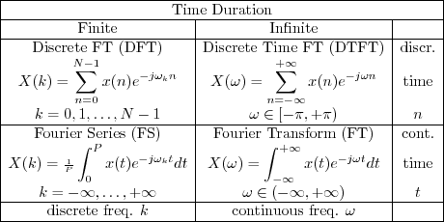
Summary table

