Slide 1
Information and Fluctuations of Information
Patrice Koehl
ECS129

Slide 2
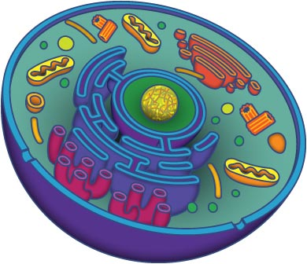
The Cell
1. Quantum of life:
from 1 cell (bacteria), to 10¹³ in a human
(trivia: there are approx. 10¹⁴ bacteria in our guts!
- we generate approx. 10¹⁶ cells during our life time)
2. Cells are “machines”:
They can produce chemical or mechanical work. They take energy from their environment.
3. Cells self-replicate
4. Their blueprint is the DNA they contain

Slide 3
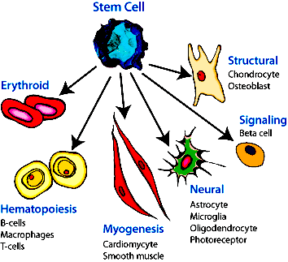
The Cell
All cells of an organism contain the same information…however
They may differ in aspect….and functions.

Slide 4
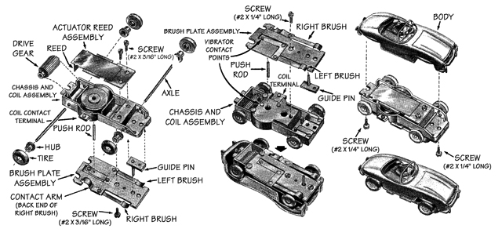
How to replicate a machine?

Slide 5
How to replicate a machine?
List of parts and parts themselves
A set of instructions on how to put parts together (design)
An operator
A manual on how to use the machine

Slide 6
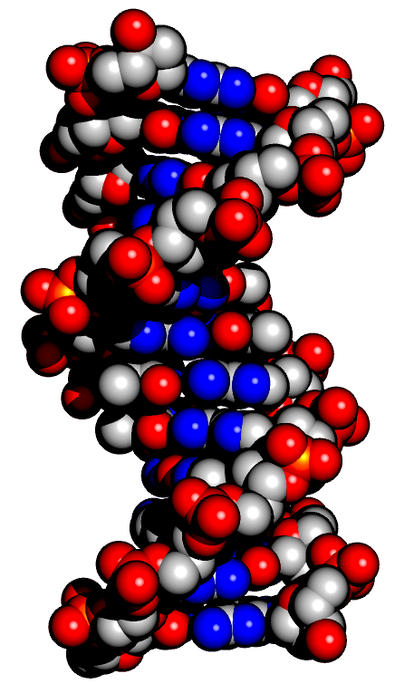
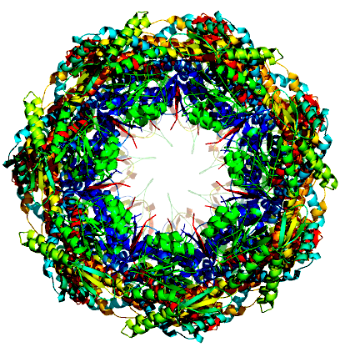
The Cell
Blueprint: parts + design
DNA, genes
Proteins,
nanomachines
Assembly
promoter
Processing:
logic
Operation “manual”
Gene

Slide 7
Information and Fluctuations
Information support: DNA
Information fidelity: copying and proofreading
Fluctuations of information

Slide 8
Information and Fluctuations
Information support: DNA
Information fidelity: copying and proofreading
Fluctuations of information

Slide 9
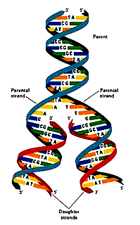
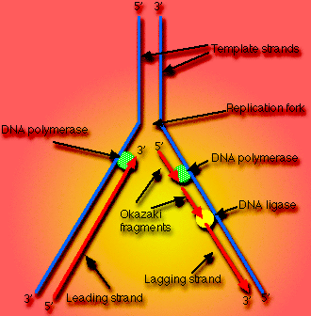
Information: copying mechanism
(replicationdna.blogspot.com)
(library.thinkquest.org)

Slide 10
Information: Fidelity
Some facts about DNA replication:
6 billion nucleotides of the human genome are replicated in only a few hours (Remark: DNA polymerase processes ~1000 nucleotides/s)
Spontaneous error rate < 1 mutation / genome /cell division
Where is this accuracy coming from?
  Specificity
  Proofreading
  Post replication repair

Slide 11
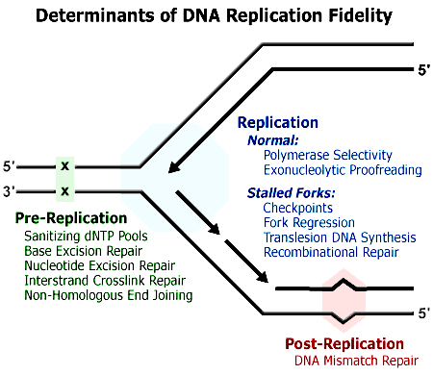
Information: Fidelity
(http://www.niehs.nih.gov/research/atniehs/labs/lmg/dnarf/)

Slide 12
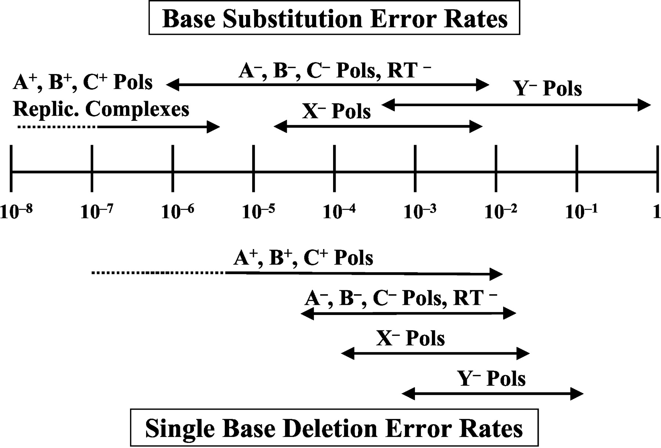
Information: Fidelity
Kunkel T A J. Biol. Chem. 2004;279:16895-16898

Slide 13
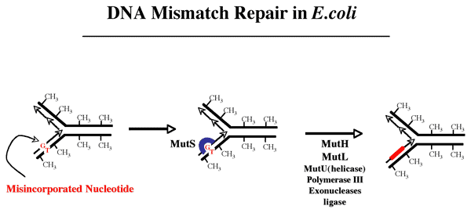
Information: Fidelity
(mmr.med.ohio-state.edu)

Slide 14
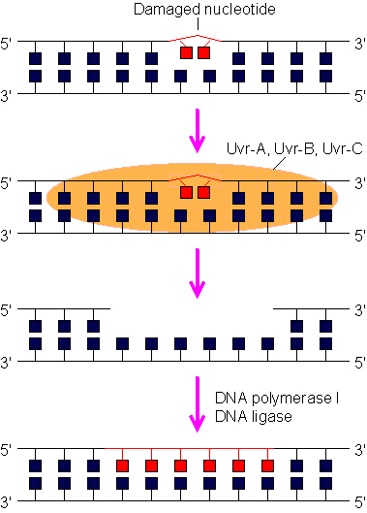
Information: Fidelity

Slide 15
Information and Fluctuations
Information support: DNA
Information fidelity: copying and proofreading
Fluctuations of information

Slide 16
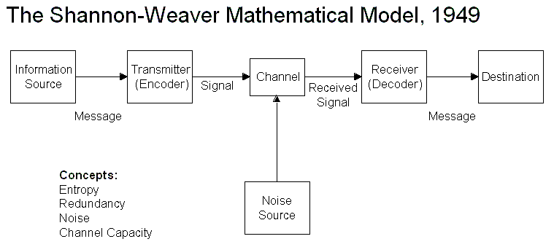
Information and Noise
Noise = unwanted signal

Slide 17
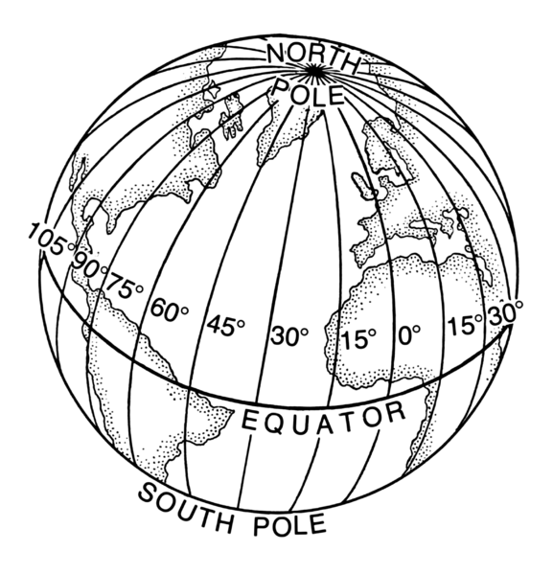
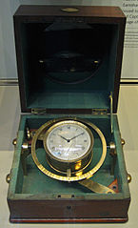
Unwanted noise
How do we measure longitude?
One approach is to look at the time
difference between the current position
and a Universal time (say at Greenwich).
Sailors would then carry a robust clock
(chronometer) to identify Universal time:
- Cook (1772) carried one
- Darwin (1831) carried 22!

Slide 18
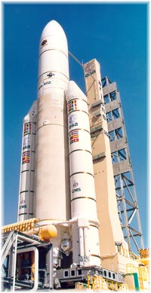
Unwanted noise
Computers also encounter noise!
The Ariane 5 tragedy: On June 1996,
The first Ariane 5 was launched…
And exploded after 40 seconds!
The failure of the Ariane 501 was
caused by the complete loss of
guidance and altitude information
37 seconds after start….due to a
numerical error!

Slide 19
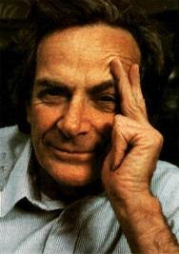
Information and Noise
“Everything that living things do can be understood in terms
of the jiggling and wiggling of atoms.”
Richard Feynman

Slide 20
Altering Information
Darwin’s view of mutation plays a central role in his theory of biological evolution:
Mutation provides the variation (raw material) upon which natural selection acts.
According to Darwin, the environment does not direct evolution, rather it passively selects among variants.

Slide 21
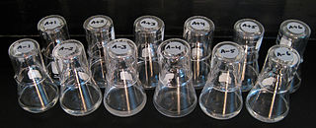
Evolution in the laboratory
In 1988, Lenski started a long term experiment: he prepared 12 identical flasks of Ecoli cultures on minimal medium, with glucose.
Each day, an aliquote of each flask is used to inoculate a fresh medium.
The experiment has been running for more than 35 years, covering more than 80,000 generations.

Slide 22
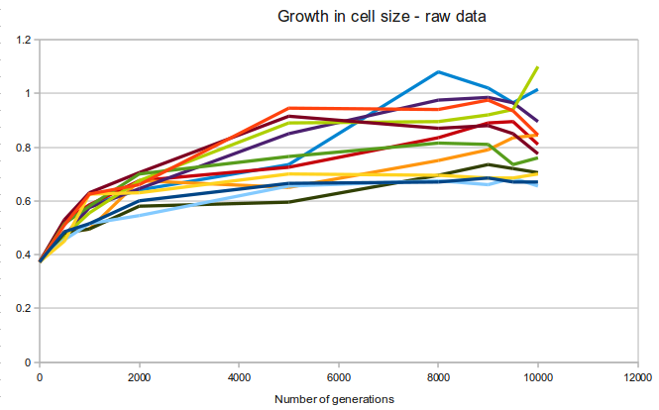
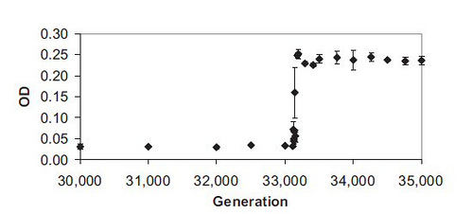
Evolution in Lenski’s cultures
All 12 cultures lead to
cells with larger volumes
(better adapted to
minimal medium)
Some bacteria
in one of the 12
cultures started
using citrate as
a food source.

Slide 23
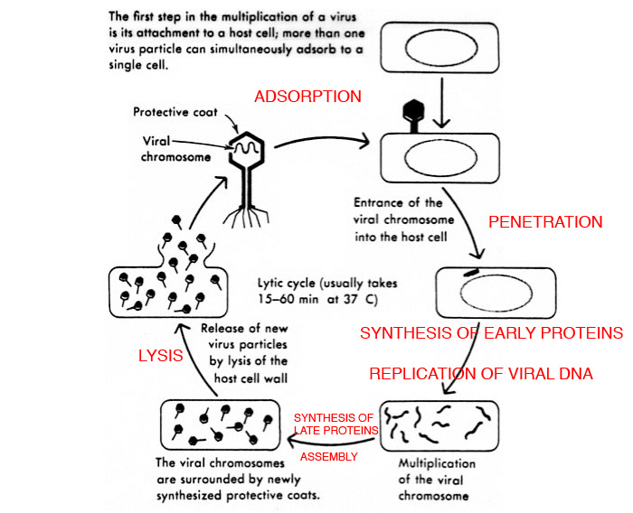
Luria and Delbruck experiments
(http://textbookofbacteriology.net/phage.html)

Slide 24
Luria and Delbruck experiments
After infection with a phage, a culture of E.Coli will clear up…to grow back again after a few hours: some resistant bacteria survived, leading to a new resistant colony.
How did these variants come to be? Two hypotheses:
Hypothesis of acquired immunity
  The variants were exposed to the phage, but survived the attacks; their progeny maintained the immunity
Hypothesis of mutation to immunity
    Immunity comes from mutations that occurred independently of the presence of the virus.

Slide 25
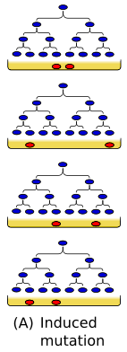
Hypothesis 1: Induced mutation
Resistant mutants arise in response to the bacteriophage. All progeny from the survivors are also resistant.
If correct, we expect:
A large # of small cultures will have a nearly constant proportion of resistant cells.
Mutant cells arise only after selection begins with the addition of phage, not before.

Slide 26

Hypothesis 2: Spontaneous mutation
Mutations arise by chance at a constant rate and at any point in time; the mutation is subsequently selected for.
If correct, we expect:
The number of resistant cells will be determined by how early in a culture the mutation event occurred.
A large # of small cultures will have the proportion of resistant cells fluctuate.

Slide 27
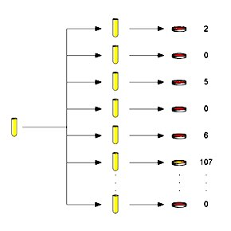
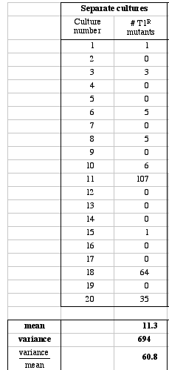
Luria and Delbruck experiments

Slide 28
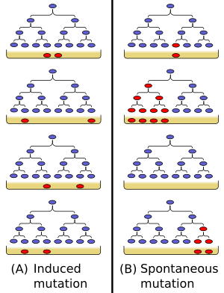
Altering information
The mutation frequency is the frequency or proportion at which a specific kind of mutation is found in a population of cells or individuals.
one mutation event
4 mutants out of 8 cells total mutation frequency = ½

Slide 29
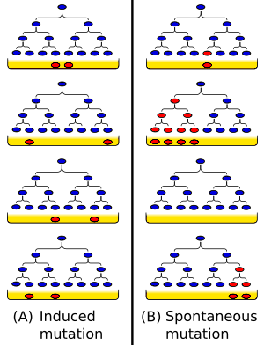
Altering information
The mutation rate is a measure of the basic tendency of a gene to mutate
1 in the total # of cell divisions (7 total)
= 1/7 (1 mutation per seven cell divisions)

Slide 30
References
DNA replication fidelity. Kunkel, T.A. J. Bio. Chem. (2004). 279:16895
Dynamics of adaptation and diversification: a 10,000-generation experiment with bacterial populations. Lenski, R.E. & Travisano, M. PNAS (USA) (1994), 91:6808.
Mutations of bacteria from virus sensitivity to virus resistance. Luria, S.E. & Delbrück, M. Genetics (1943), 28:491

