Slide 1
Nucleic Acids
ECS129
Instructor: Patrice Koehl

Slide 2
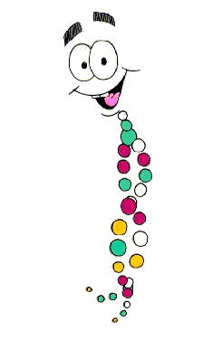
Nucleic Acids
Nucleotides
DNA Structure
RNA
  Synthesis
  Function
  Secondary structure
  Tertiary interactions
  Wobble hypothesis
Replication
DNA
Transcription
RNA
Translation
Protein

Slide 3
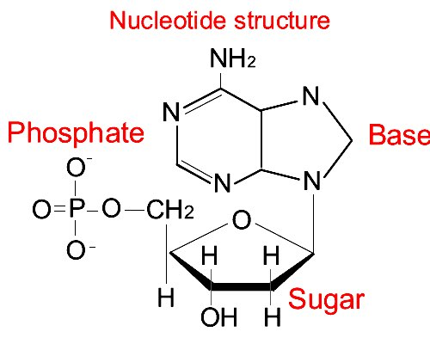
Nucleic Acids
Nucleotides
DNA Structure
RNA
  Synthesis
  Function
  Secondary structure
  Tertiary interactions
  Wobble hypothesis

Slide 4
Nucleotides
Nucleotides are found primarily as the monomeric units comprising the major nucleic acids of the cell, RNA and DNA
Other functions of nucleotides:
  serving as energy stores (mainly ATP)
  controlling numerous enzymatic reactions through allosteric effects on enzyme activity
  mediators of numerous important cellular processes such as second messengers in signal transduction events

Slide 5
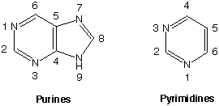
Nucleotides
The nucleotides found in cells are derivatives of the heterocyclic highly basic, compounds, purine and pyrimidine:

Slide 6
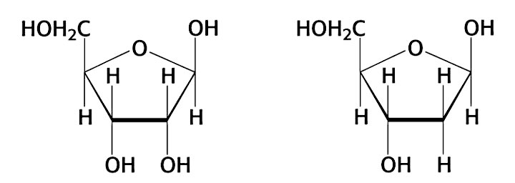
Nucleotides
These “bases” are attached to sugar rings: ribose (RNA),
deoxyribose (DNA):
5
5
4
1
4
1
3
2
3
2
ribose
2-deoxyribose

Slide 7
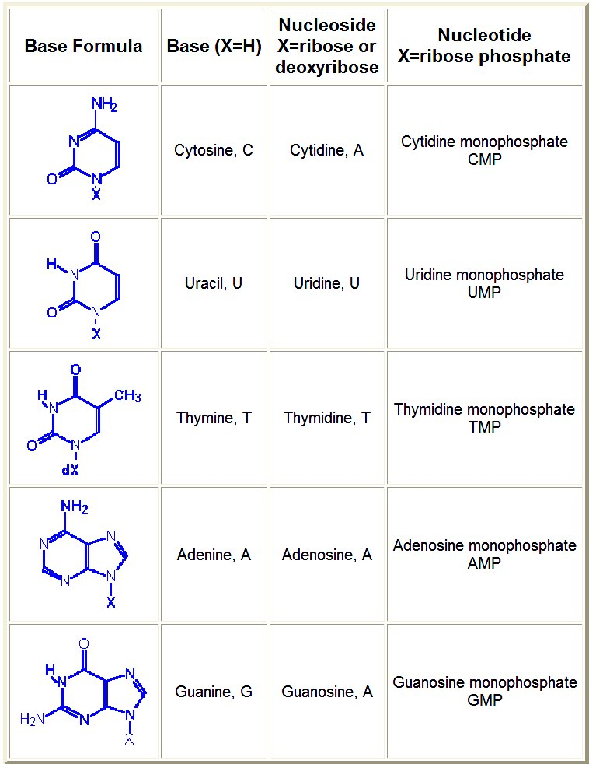

Slide 8
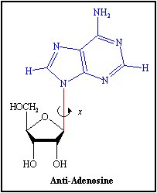
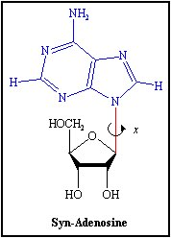
Base conformation
The base can exist in 2 distinct orientations about the
N-glycosidic bond.
These conformations are identified as, syn and anti.
The anti conformation predominates.

Slide 9
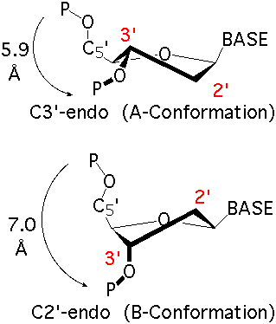
Sugar conformation
The ribose is a flexible ring
that has two preferred
conformations in polynucleotides:
C3’-endo, found mostly in RNA
and in DNA “single strand”
C2’-endo, found mostly in DNA

Slide 10
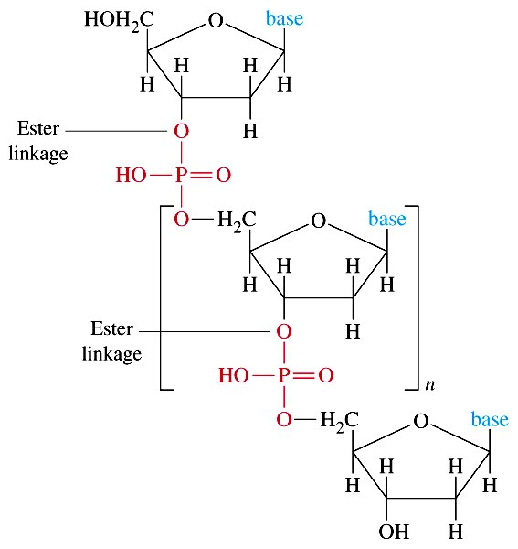
Polynucleotides
5’
3’

Slide 11
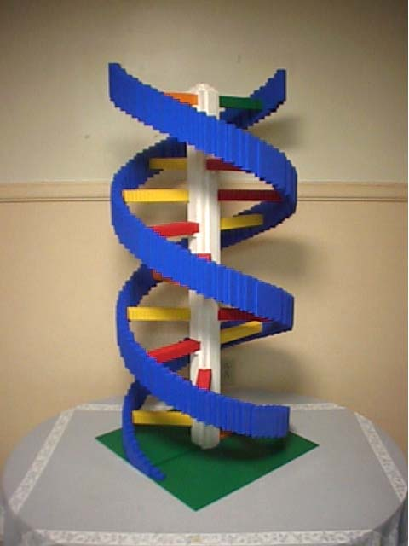
Nucleic Acids
Nucleotides
DNA Structure
RNA
  Synthesis
  Function
  Secondary structure
  Tertiary interactions
  Wobble hypothesis

Slide 12
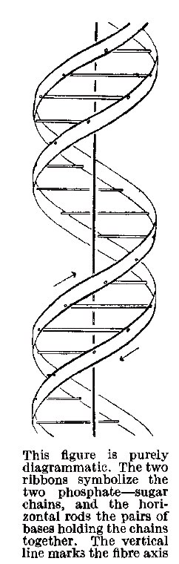
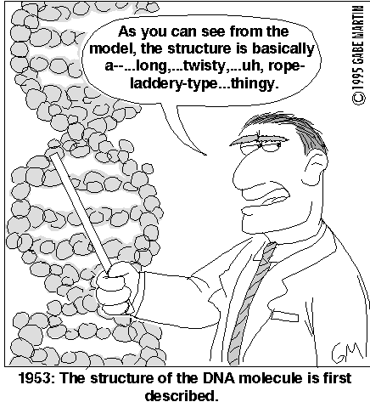
DNA: double stranded helix

Slide 13
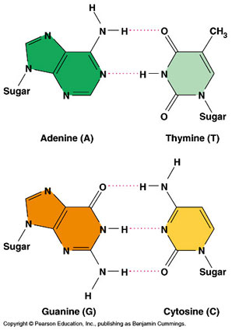
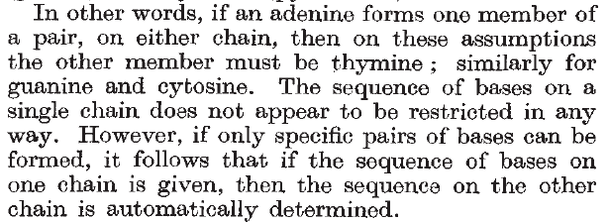
DNA: base pairs
Excerpt from Watson and Crick,
Nature, 4356, 737-728 (1953)

Slide 14
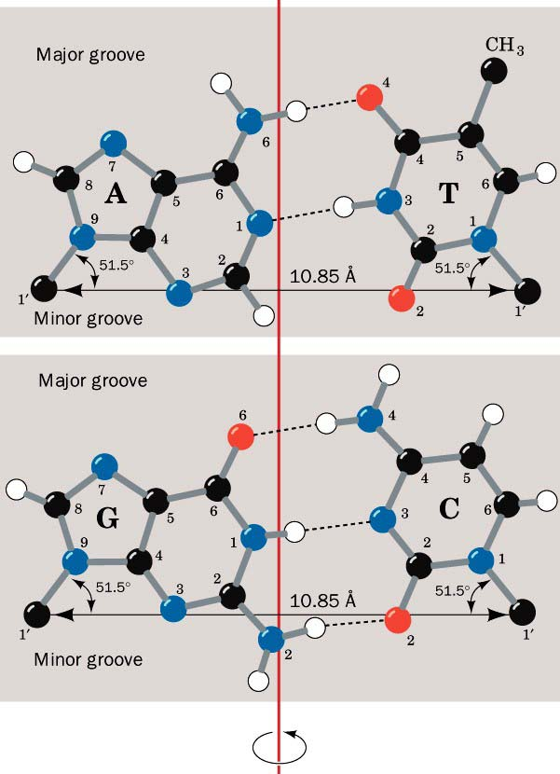
DNA: base pairs

Slide 15
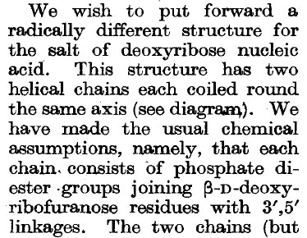
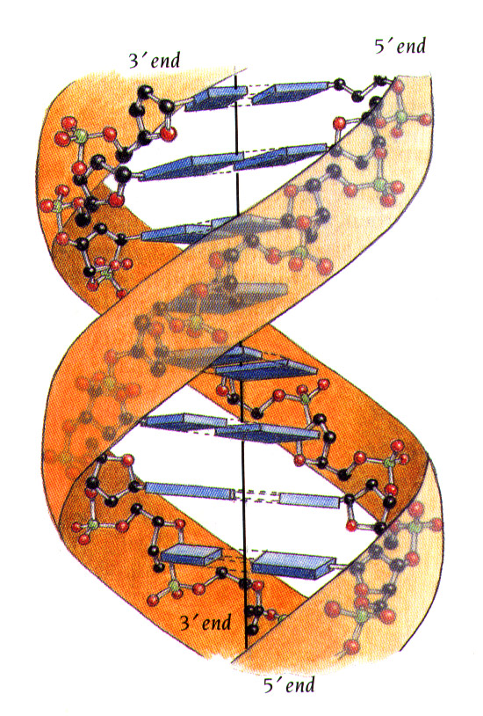


DNA: double stranded helix
Excerpts from Watson and Crick,
Nature, 4356, 737-728 (1953)

Slide 16
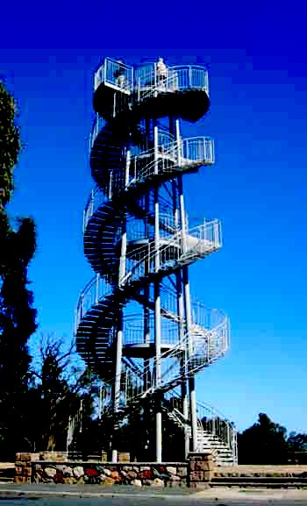
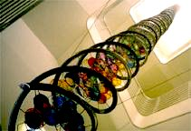
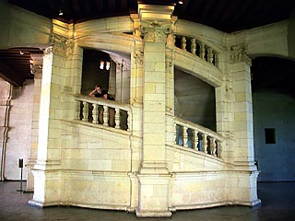
DNA: a style?
Life Science, UC Davis
Perth, Australia
Chambord, France

Slide 17
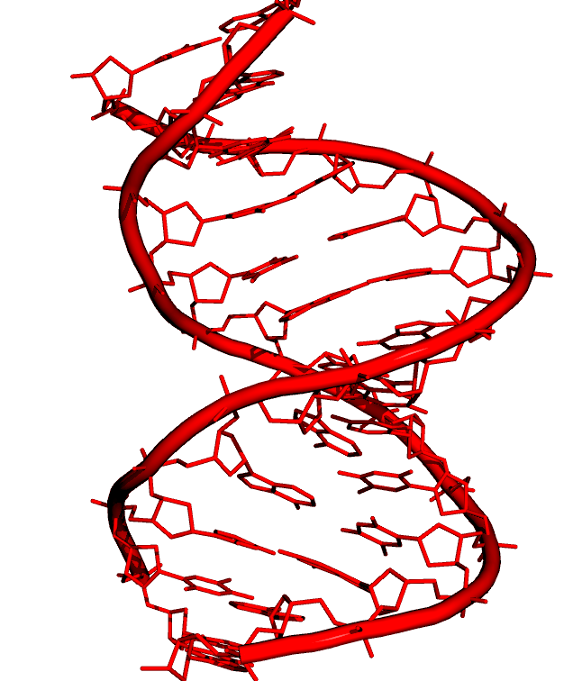
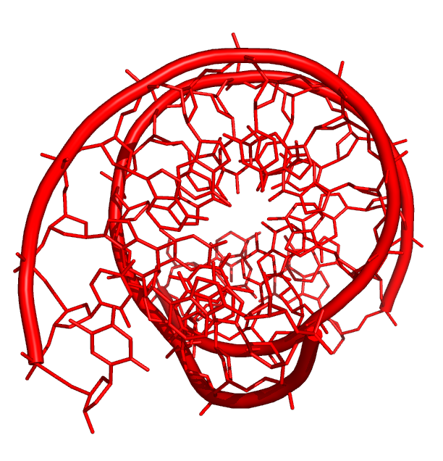
DNA Structures: A-DNA
d(AGCTTGCCTTGAG)•d(CTCAAGGCAAGCT)

Slide 18
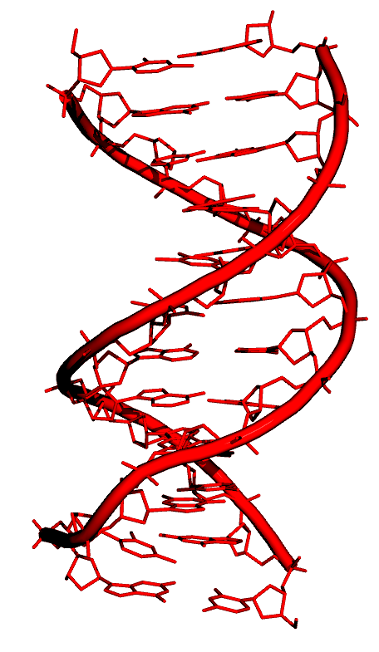
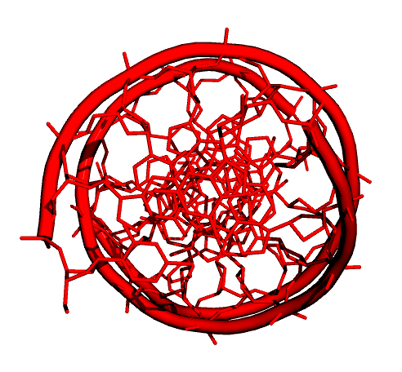
DNA Structures: B-DNA
d(CGCGAATTCGCG)•d(CGCGAATTCGCG)

Slide 19
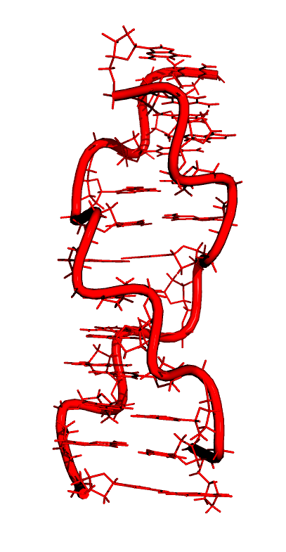
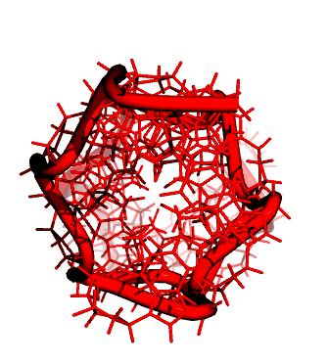
DNA Structures: Z-DNA
d(CGCGCGCGCGCG)•d(CGCGCGCGCGCG)

Slide 20
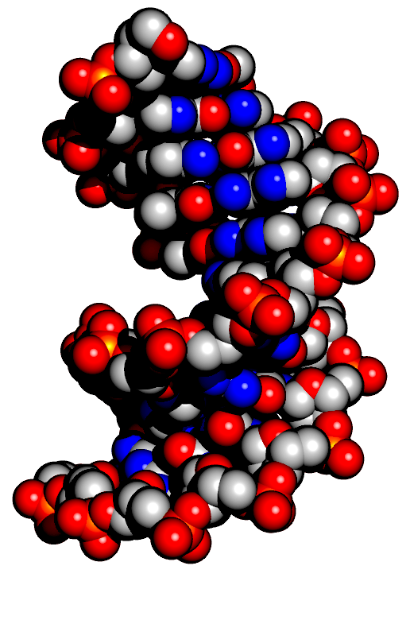
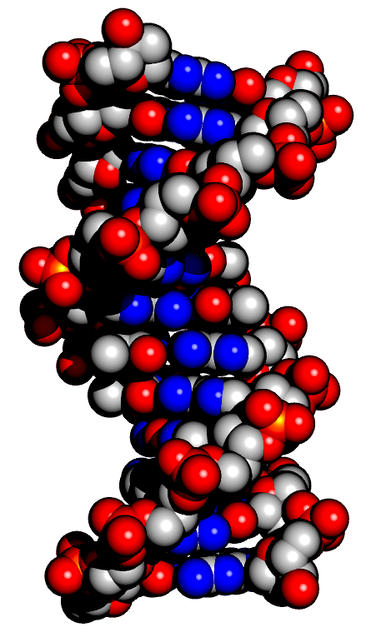
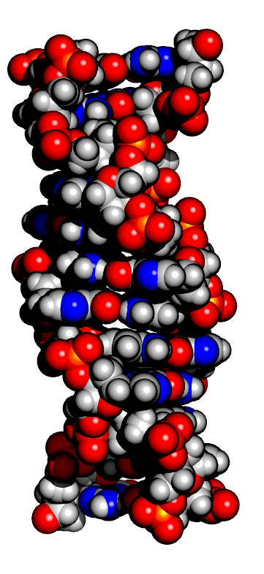
DNA Structures: A, B and Z

Slide 21
DNA Structures: A, B and Z
Property | A-DNA | B-DNA | Z-DNA
Helix | Right-handed | Right-handed | Left-handed
Sugar | C3’-endo | C2’-endo | C2’ endo (C) C3’ endo (G)
Base pairs /turn | 11 | 10 | 12
Pitch | 28 Å | 34 Å | 44.6 Å
Tilt | 20 deg | 0 | -7 deg
Rise /bp | 2.3 Å | 3.4 Å | 3.7 Å
Diameter | 23 Å | 20 Å | 17 Å

Slide 22
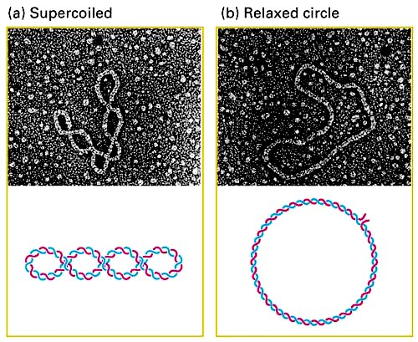
DNA: organization

Slide 23
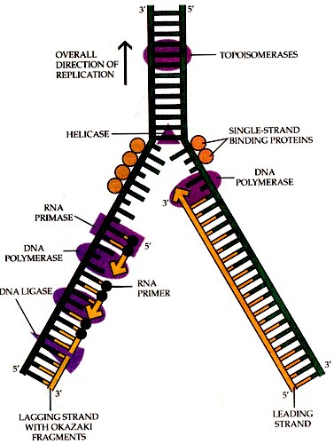
Semi-conservative DNA replication
Helicase: separates the two DNA strands, starting at replication origins (rich in A-T base pairs)
RNA primase: inserts a starter of RNA nucleotides at the initiation point
DNA polymerase binds a complementary leading strand of DNA nucleotides starting at the 3’end of the RNA primer
Exonuclease removes RNA primer, which are replace with DNA nucleotides by DNA polymerase
Tutorial : http://www.pbs.org/wgbh/aso/tryit/dna/

Slide 24
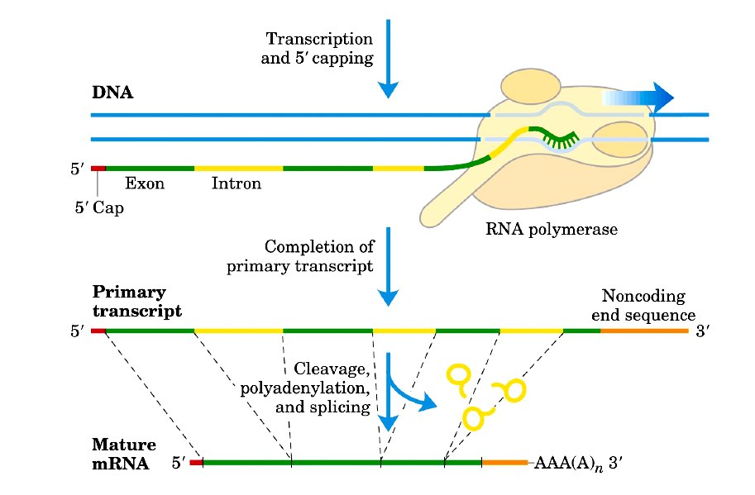
TRANSCRIPTION

Slide 25
mRNA synthesis
The mRNA is formed by adding nucleotide that are complementary
to the template strand
DNA coding strand
DNA
5’
3’
3’
3’
G
U
C
A
U
U
C
G
G
5’
  DNA template strand
5’
RNA

Slide 26
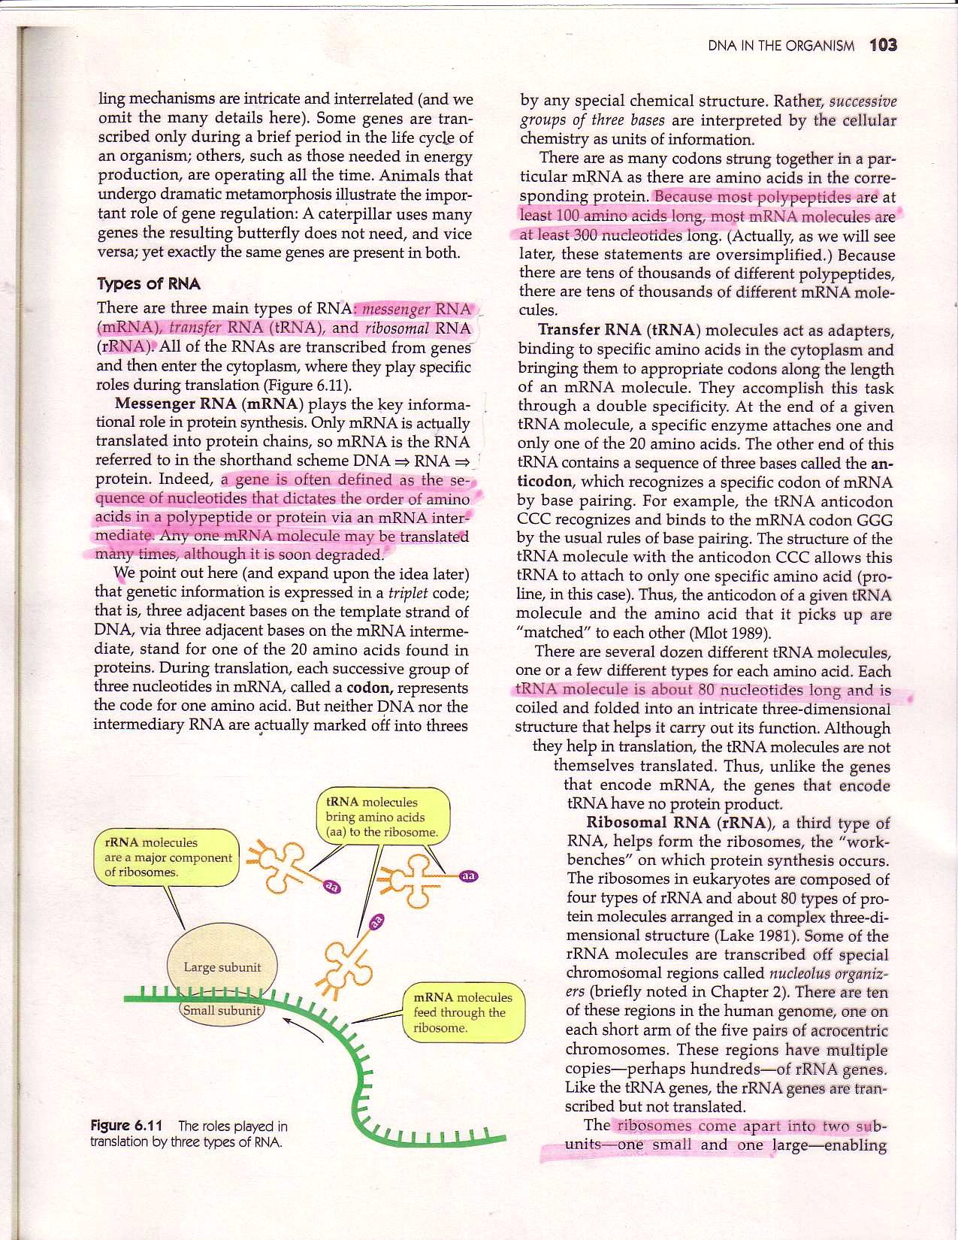

Three types of RNA play a role
in protein synthesis

Slide 27
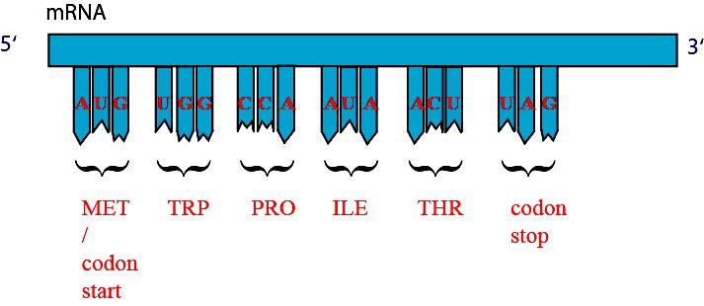
TRANSLATION
The process of reading the mRNA sequence and creating the protein is called translation
Protein are made of amino acids (20 different, 9 “essentials”)
3 bases or nucleotides make one codon
Each codon specifies one amino acid : genetic code

Slide 28
GENETIC CODE
2nd base in codon
 | U | C | A | G
U | Phe Phe Leu Leu | Ser Ser Ser Ser | Tyr Tyr STOP STOP | Cys Cys STOP Trp | U C A G
C | Leu Leu Leu Leu | Pro Pro Pro Pro | His His Gln Gln | Arg Arg Arg Arg | U C A G
A | Ile Ile Ile Met/Start | Thr Thr Thr Thr | Asn Asn Lys Lys | Ser Ser Arg Arg | U C A G
G | Val Val Val Val | Ala Ala Ala Ala | Asp Asp Glu Glu | Gly Gly Gly Gly | U C A G
3rd base in codon
1st base in codon

Slide 29
GENETIC CODE
The genetic code is universal:
- Virtually all organisms use the same genetic code
- Virtually all organisms use the same 20 amino acids
The genetic code is degenerate:
6 codons code for Leu
Some codons have special functions:
AUG encodes for Met, and is codon start
UAA, UAG and UGA are termination codons

Slide 30
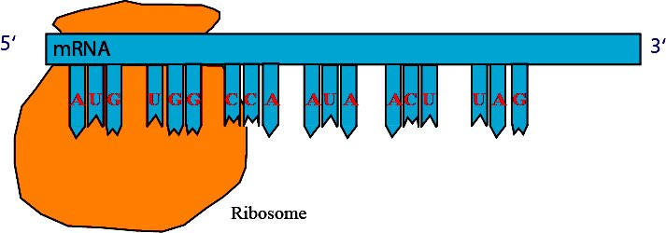
Translation : initiation

Slide 31
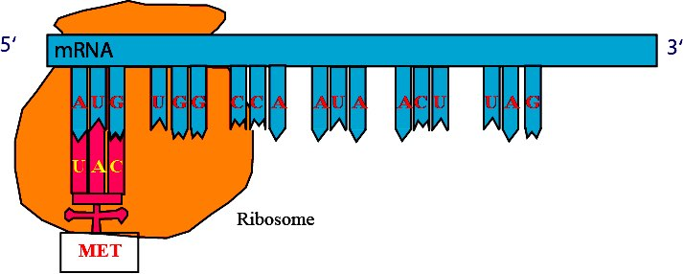
Translation : initiation
tRNA

Slide 32
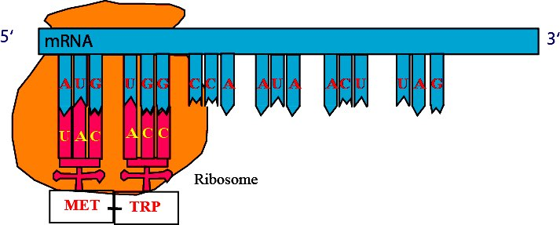
Translation : elongation
tRNA

Slide 33
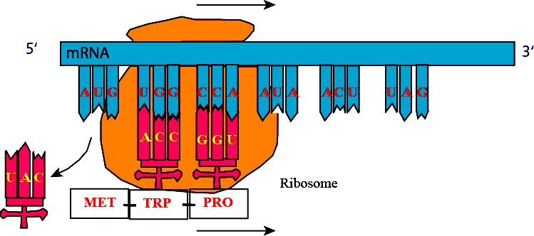
Translation : elongation

Slide 34
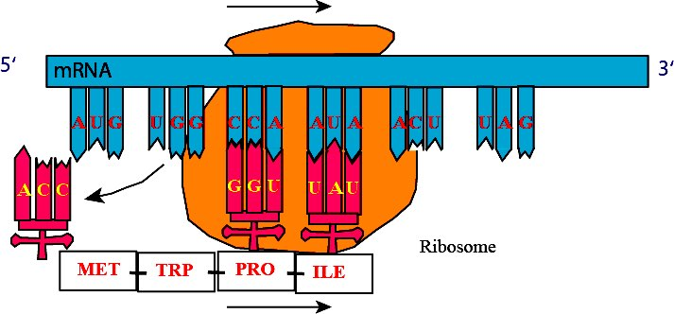
Translation : elongation

Slide 35
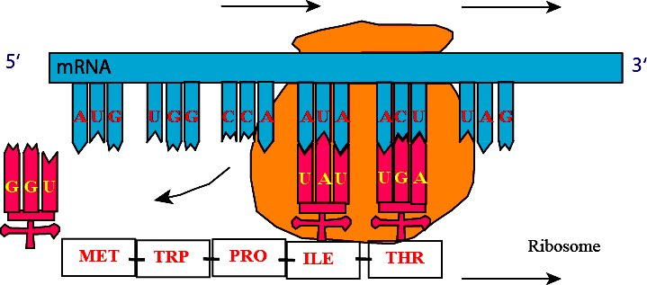
Translation : elongation

Slide 36
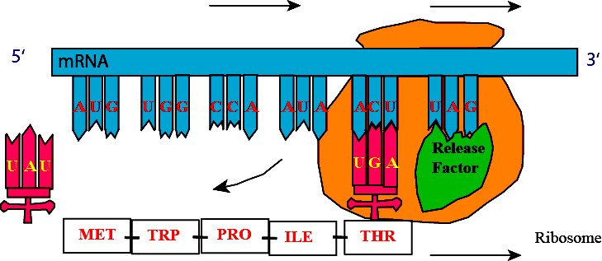
Translation : termination

Slide 37
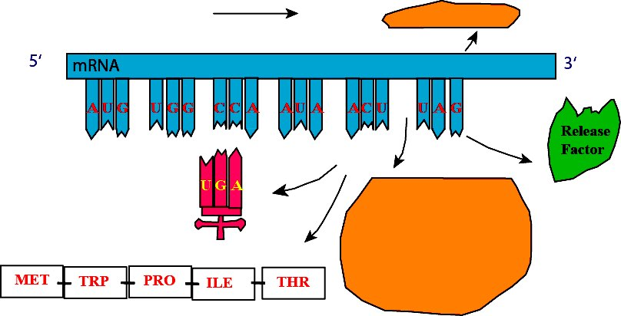
Translation : termination
Protein

Slide 38
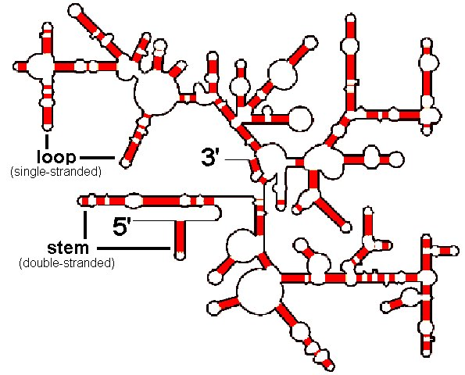
Nucleic Acids
Nucleotides
DNA Structure
RNA
  Synthesis
  Function
  Secondary structure
  Tertiary interactions
  Wobble hypothesis

Slide 39
RNA
RNA versus DNA:
- ribose instead of deoxyribose
- Uracyl instead of Thymine
- mostly single stranded
Three major RNAs:
- mRNA (messenger RNA) : DNA transcript
- tRNA (transfer RNA) : transfer amino acid during protein synthesis
- rRNA : ribosomal RNA
Can be active

Slide 40
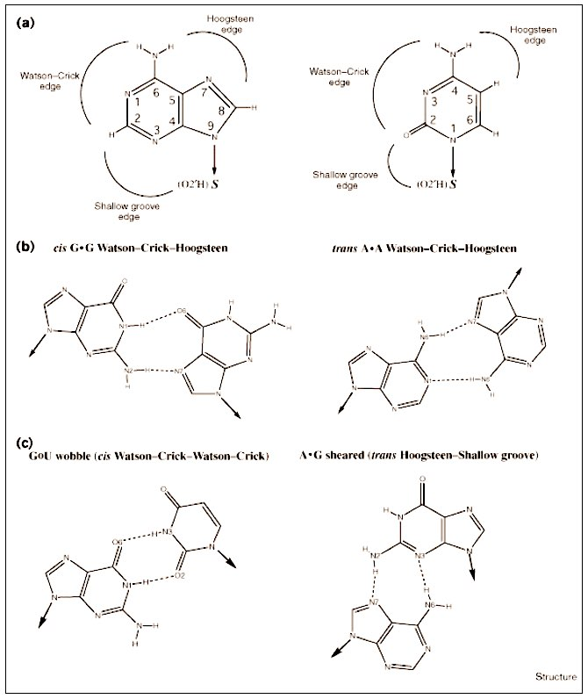
RNA: non standard base pairs
(Westhof and Fritsch,
RNA folding: beyond Watson Crick pairing,
Structure, 8:55-65 (2000)
Database of non-canonical base pairs:
http://prion.bchs.uh.edu/bp_type/

Slide 41
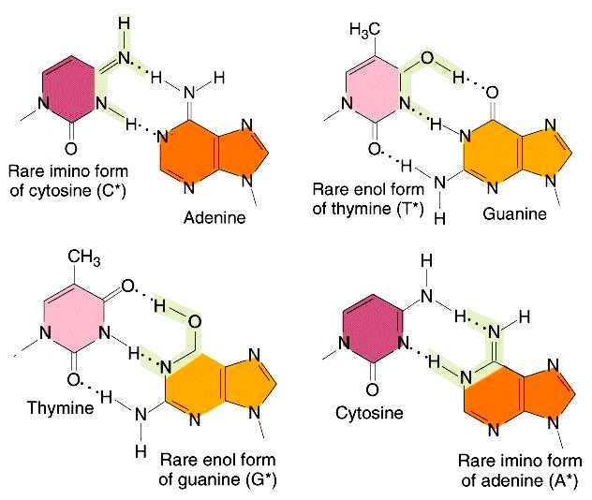
RNA: non standard base pairs

Slide 42
RNA secondary structures
G-C and A-U form hydrogen bonded base pairs and are said to be complementary
Base pairs are approximately coplanar and are almost always stacked onto other base pairs in an RNA structure. Contiguous base pairs are called stems.
Unlike DNA, RNA is typically produced as a single stranded molecule which then folds intra-molecularly to form a number of short base-paired stems. This base-paired structure is called RNA secondary structure.

Slide 43
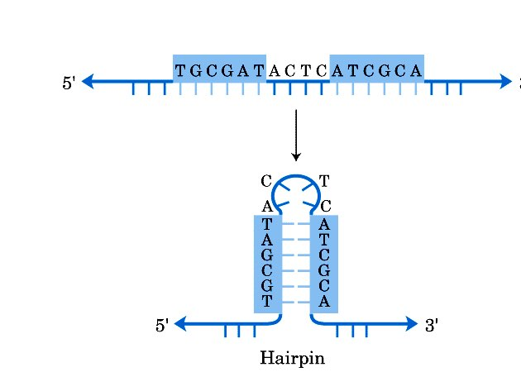
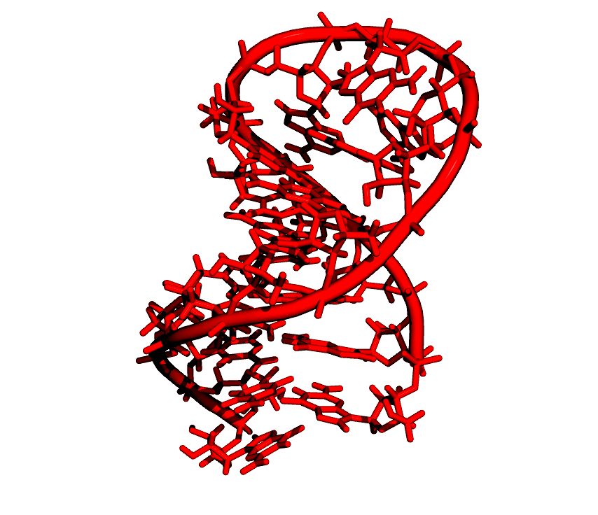
RNA: Hairpins
Single stranded subsequences bounded by base pairs are called loops.
A loop at the end of a stem is called a hairpin loop. Simple substructures
consisting of a single stem and loop are called stem loops, or hairpins.

Slide 44
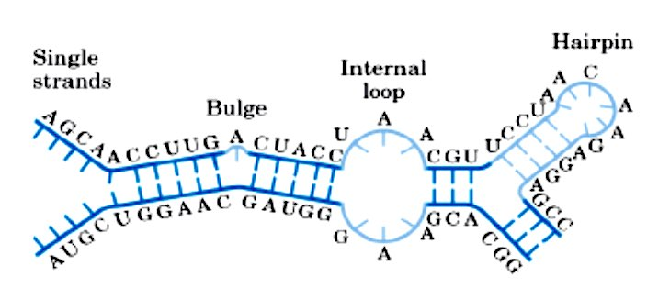
RNA secondary structures
Single stranded bases within a stem form a bulge or bulge loop if the single stranded bases are on only one side of the stem.
If single stranded bases interrupt both sides of a stem, they form an internal (interior) loop.

Slide 45
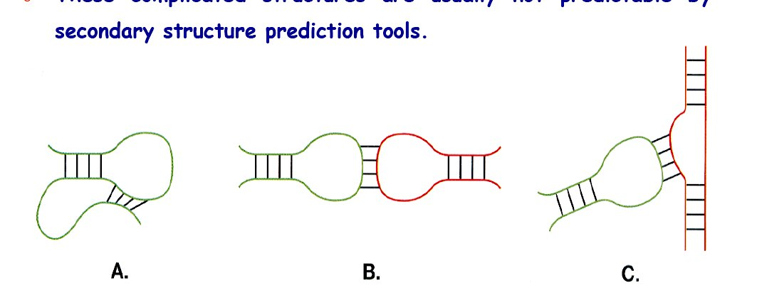
RNA “tertiary interactions”
In addition to secondary structural interactions in RNA, there are also
tertiary interactions, including: (A) pseudoknots, (B) kissing hairpins and
(C) hairpin-bulge contacts.
Pseudoknot
Kissing hairpins
Hairpin-bulge

Slide 46
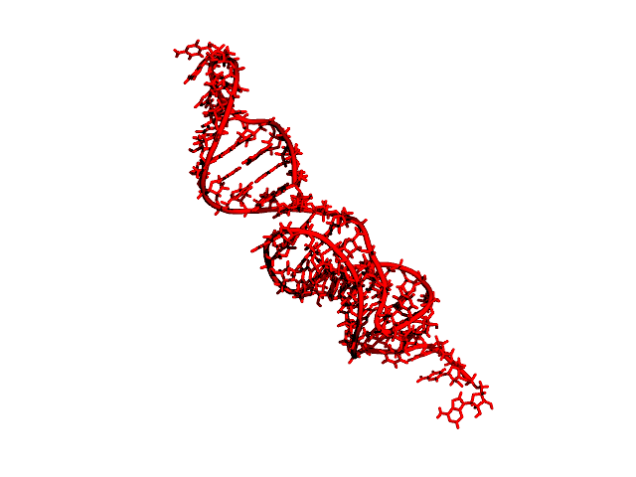
Pseudoknots

Slide 47


Kissing hairpins

Slide 48

tRNA structure
tRNA: small molecules (73 to 93 nucleotides) with cloverleaf secondary structure

Slide 49

The wobble hypothesis (Crick, 1966)
In 1965, Holley determined the sequence
of yeast tRNA(ala): he found the
nucleotide Inosine at the 5’ end in the
anticodon.

Slide 50
The wobble hypothesis (Crick, 1966)
Crick proposed the Wobble hypothesis to generalize Holley’s observation:
- Interaction between codon and anticodon need to be exact at first two positions.
- The third interaction can be less restrictive, and can include non standard base-pairing.
This hypothesis accounts for the degeneracy in the Genetic Code.
5’ anticodon base | 3’ codon base
A | U
C | G
G | C or U
U | A or G
I | A or C or U

Slide 51


Wobble base pairs
Inosine
Uracil

Slide 52
Summary (1)
Nucleotides have three parts: sugar (ribose in RNA, deoxyribose in DNA), base (purine,A, G, and pyrimidine, C, T or U), and phosphate group.
Nucleotide can polymerise to form polynucleotides, or “strands”.
DNA (deoxyribo nucleic acid) is a double stranded helix, where the two strands run in opposite directions and are maintained together by hydrogen bonds. Base pairs include one purine and one pyrimidine (A-T and G-C).
There are three main forms of DNA helices: A, B and Z.
DNA molecules have topological constraints, such as supercoiling.

Slide 53
Summary (2)
Only one DNA strand is used for RNA synthesis: the “template” strand, which is complementary to the coding strand. The sequence of the mRNA is the sequence of the coding strand, where T are replace by U.
Three types of RNA are involved in protein synthesis: messenger RNA (mRNA, carries the information), transfer RNA (tRNA, brings the correct amino acid during synthesis), and ribosomal RNA (rRNA, major consituent of the ribosome, where protein synthesis occurs.
The message carried by the mRNA is read as a collection of “words” of 3 letters, or codons. There are 64 codons, that code for 20 amino acids. AUG is the initiation codon, which codes for Methionine. UAA, UAG and UGA are stop codons. There is redundancy in the genetic code, related to the third base in the codon.

Slide 54
Summary (3)
RNA bases can be free, involved in base pairs, or base triplets.
RNA contains single stranded regions, hairpin loops, bulges, and internal loops (secondary structures)
RNA secondary structures can interact to form pseudoknots, kissing hairpins, or hairpin-bulge complexes.
The wobble hypothesis is based on the presence in some tRNA of Inosine at the 5’ end of the anticodon. It is one possible explanation of the degeneracy of the genetic code.

