Slide 1
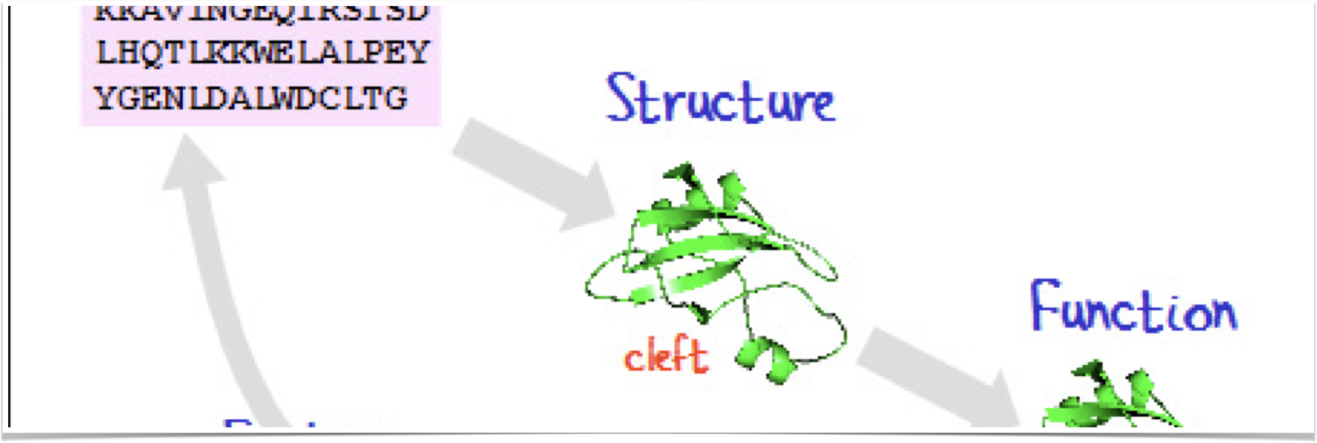
  Computational Structural Bioinformatics
Patrice Koehl

Slide 2
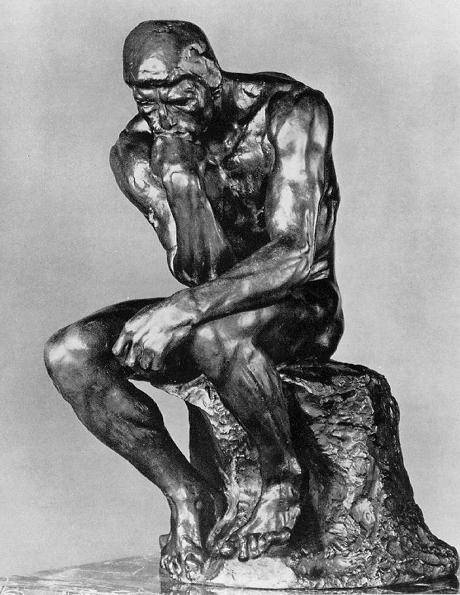
Science, then, and now…
For a long time, people thought that it would be enough to reason about the existing knowledge to explore everything there is to know.
One single person could possess all knowledge in her cultural context.
(encyclopedia of Diderot and D’Alembert)
Reasoning, and mostly passive observation were the main techniques in scientific research

Slide 3
Science, then, and now…
“All science is either physics, or stamp collecting”
Rutherford, chemist and physicist, 1876-1937

Slide 4
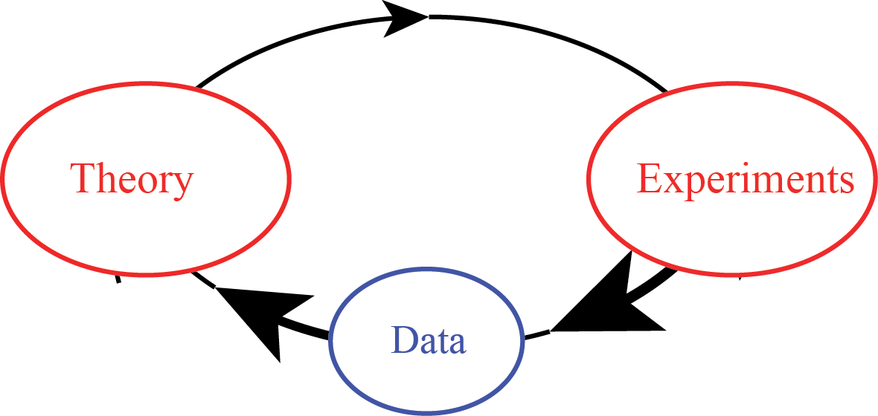
Science, then, and now

Slide 5
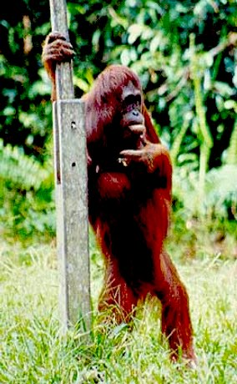
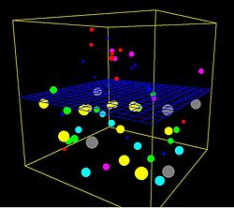
Science, then, and now
Thousand years ago – Experimental Sciences
  Description of natural phenomena
Last few hundred years – Theoretical Sciences
  Newton’s law, Maxwell’s equations…
Last few decades – Computational Sciences
  Simulation of complex phenomena
Today – Data-Intensive Sciences
  Scientist overwhelmed with data sets from many
  different sources
  Data captured by instruments
  Data generated by simulations

Slide 6
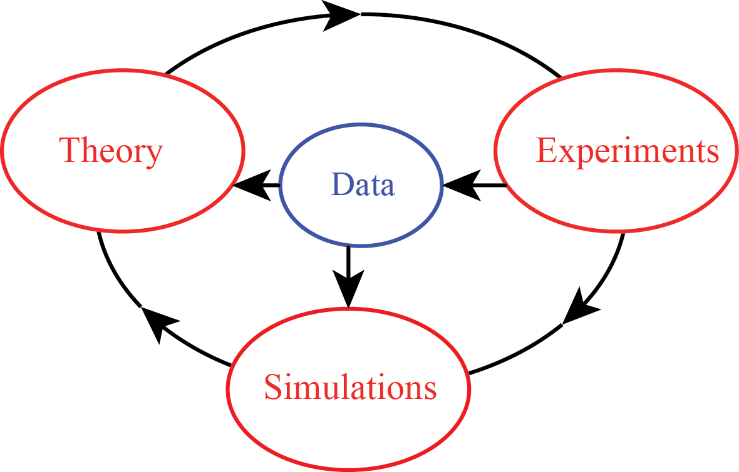
Science, then, and now

Slide 7
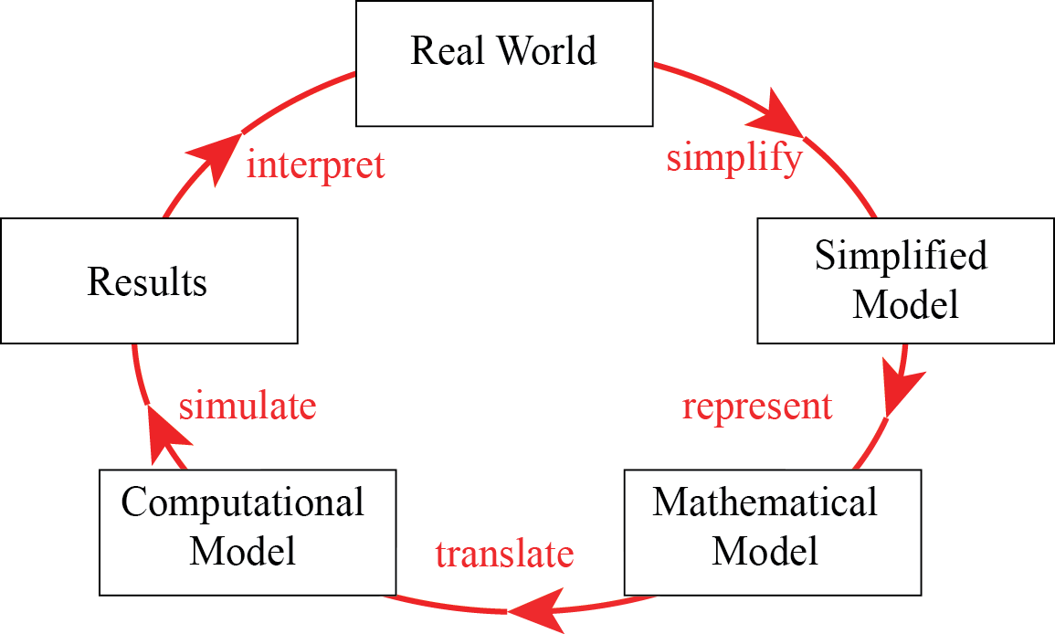
Mathematical Modeling

Slide 8
Context: Biology
“Life sciences” have their origins in ancient Greece
Aristotle wrote influential treatises on zoology, anatomy and botany, that remained influential till the Renaissance
“Life sciences” have always relied both on observation and discovery
taxonomy, classifications, theory of evolution,…
Biology is changing with the arrival of massive amount of data from the different genomics experiments
Notes:
This class is multidisciplinary. You are coming from different majors, with different expertise that will all be useful for understanding the material of the class, as well as in the future, should you decide to stay in the field. Here I list what you will get from the class: take it just as a rough description!

Slide 9
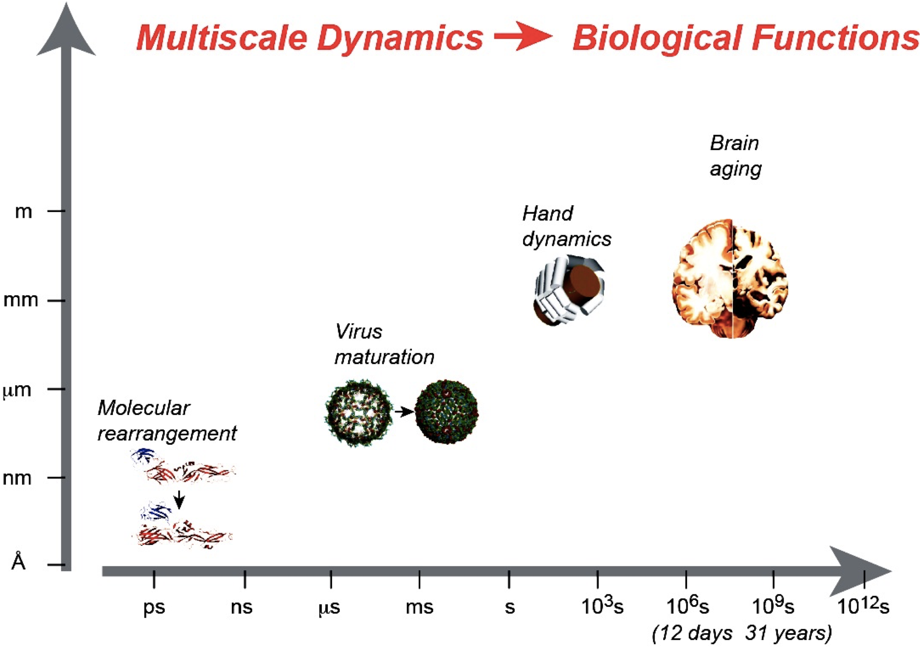
Shapes and Dynamics of Biological Systems: Connecting the dots…

Slide 10
What is ‘bioinformatics’?
The term was originally proposed in 1988 by Dr. Hwa Lim
The original definition was :
“a collective term for data compilation, organisation, analysis and dissemination”
Notes:
This class is multidisciplinary. You are coming from different majors, with different expertise that will all be useful for understanding the material of the class, as well as in the future, should you decide to stay in the field. Here I list what you will get from the class: take it just as a rough description!

Slide 11
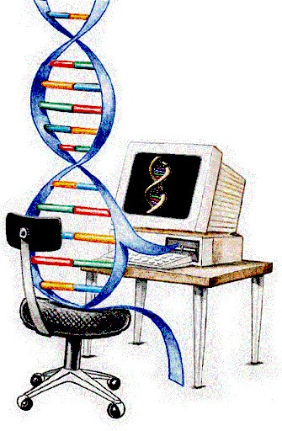
That means….
Using information technology to help solve biological problems by designing novel algorithms and methods of analyses (computational biology)
It also serves to establish innovative software and create new or maintain existing databases of information, allowing open access to the records held within them
(bioinformatics)

Slide 12
Bioinformatics is interdisciplinary
Mathematics
Statistics
Computer Science
Biomedicine
Molecular
Biology
Structural
Biology
Bioinformatics
Biophysics
Ethical,
legal and
social implications
Evolution

Slide 13
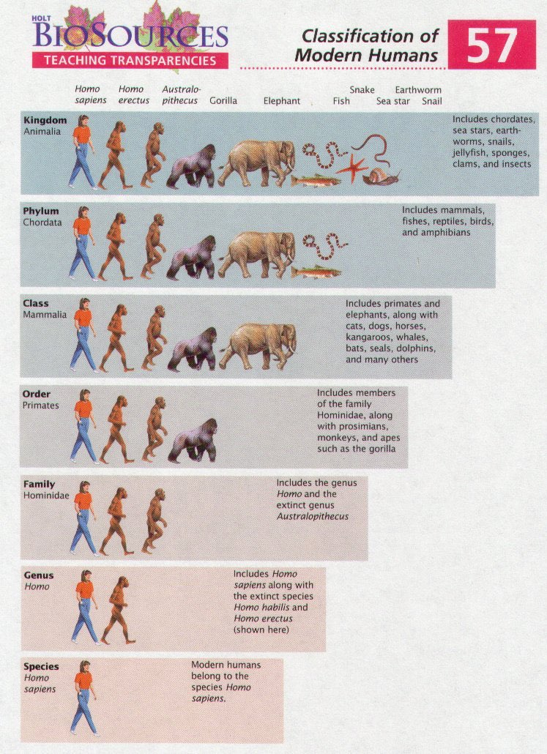
What data?
Biologists have been
classifying data on
plants and animals
since the Greeks
Notes:
This class is multidisciplinary. You are coming from different majors, with different expertise that will all be useful for understanding the material of the class, as well as in the future, should you decide to stay in the field. Here I list what you will get from the class: take it just as a rough description!

Slide 14
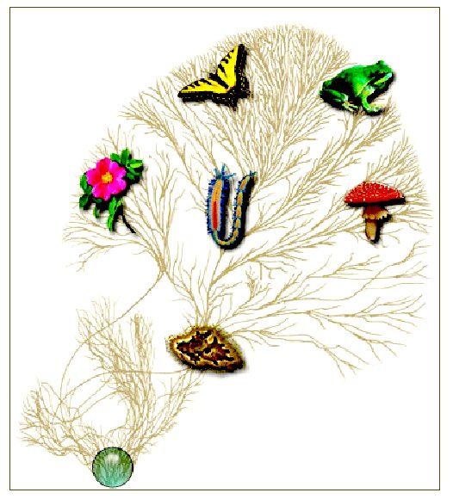

The Tree of Life
“The affinities of all beings of the same class have sometimes
been represented by a great tree… As buds give rise by growth
to fresh buds, and these if vigorous, branch out and overtop on
all sides many a feebler branch, so by generation I believe it has
been with the great Tree of Life, which fills with its dead and
broken branches the crust of the earth, and covers the surface
with its ever branching and beautiful ramifications.”
Charles Darwin, 1859
http://tolweb.org

Slide 15
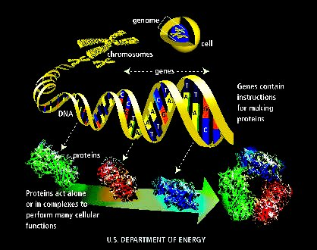

Slide 16
Central Dogma and the “omics”
Integrative Systems Biology
DNA
Genomics
RNA
Transcriptomics
Protein
Proteomics
Regulation
Interactomics
Metabolism
Metabolomics
Degradation/degradomics, Immunity/immunomics…etc

Slide 17
Genes (1)
Genes are the basic units of heredity
A gene is a sequence of bases that carries the information required for constructing a particular protein (gene “encode” the protein)
The human genome comprises ~ 20,000 genes

Slide 18
Organism | Estimated size | Estimated gene # | Number of chromosome
Homo sapiens (human) | 2900 million bases | ~20,000 | 46
Rattus norvegicus (rat) | 2,750 million bases | ~30,000 | 42
Mus musculus (mouse) | 2500 million bases | ~30,000 | 40
Oryza sativa L. (rice) | 450 million bases | ~40,000 | 12
Drosophila melanogaster (fruit fly) | 180 million bases | 13,600 | 8
Arabidopsis thaliana (plant) | 125 million bases | 25,500 | 5
Caenorhabditis Elegans (roundworm) | 97 million bases | 19,100 | 6
Saccharomyces cerevisiae (yeast) | 12 million bases | 6300 | 16
Escherichia coli (bacteria) | 4.7 million bases | 3200 | 1
H. Influenzae (bacteria) | 1.8 million bases | 1700 | 1

Slide 19
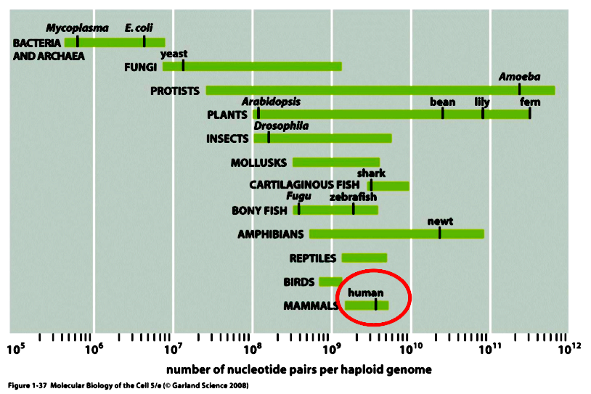

Slide 20
The genomics projects
http://www.genomesonline.org (GOLD)

Slide 21
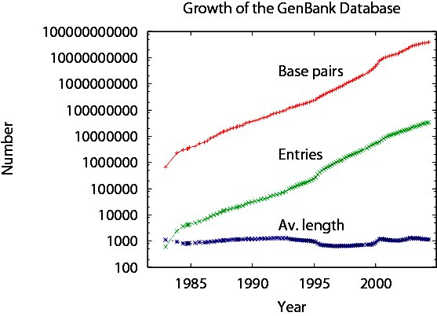
Gene Databases

Slide 22
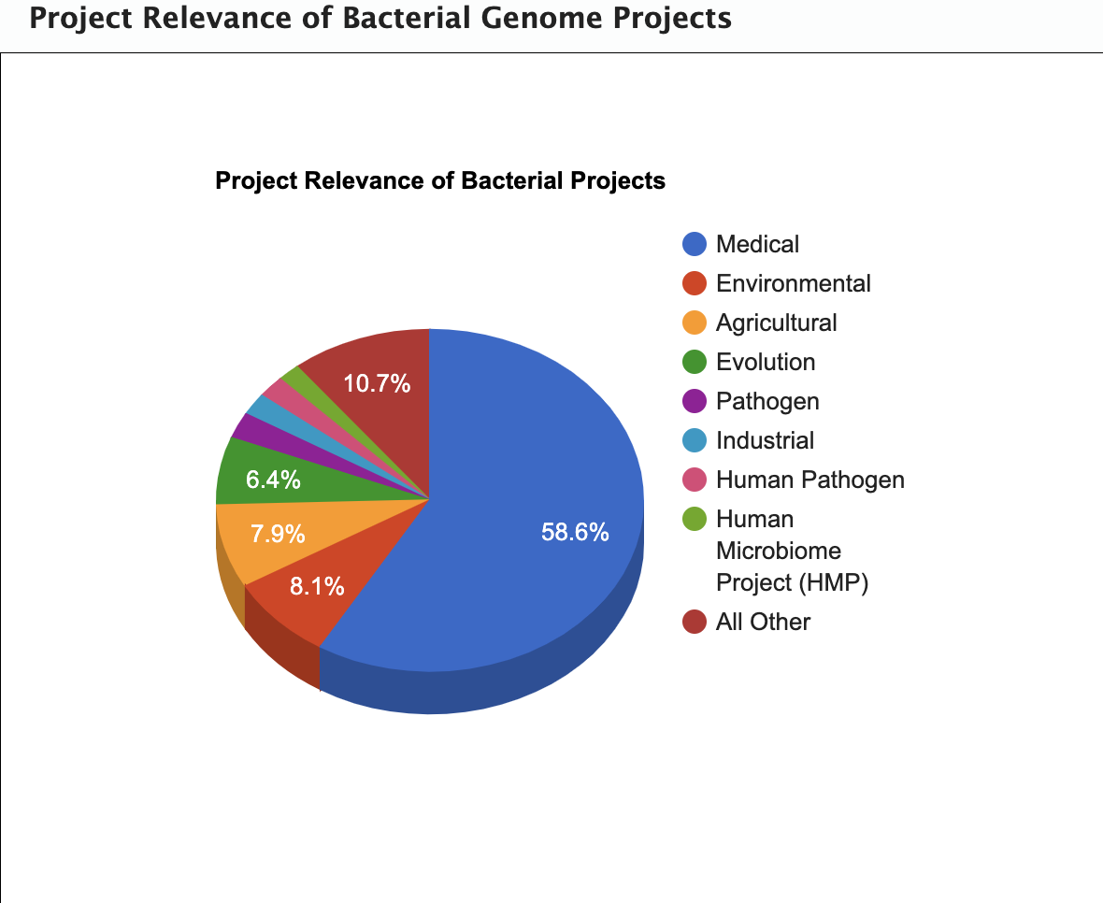

Slide 23
Genes (2)
The ~20,000 genes of the human genome encode > 100,000 polypeptides
Not all of the DNA in a genome encodes protein
microbes: 90% coding gene
human: 3% coding gene
About ½ of the non-coding DNA in humans is highly conserved (functionally important)

Slide 24
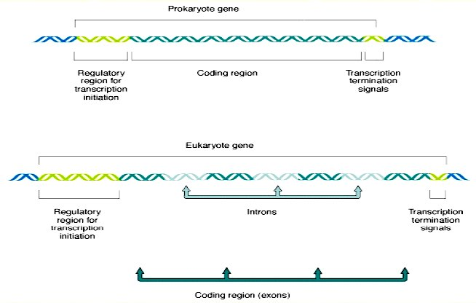
Gene Processing

Slide 25
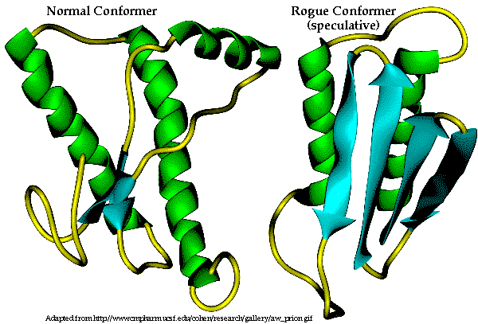
Proteins: The Molecules of Life
Ubiquitous molecules that are involved in all cellular functions
Communication agents between cells
Failure of a protein (missing, inactive, …) can lead to serious health problems (prions, …)

Slide 26
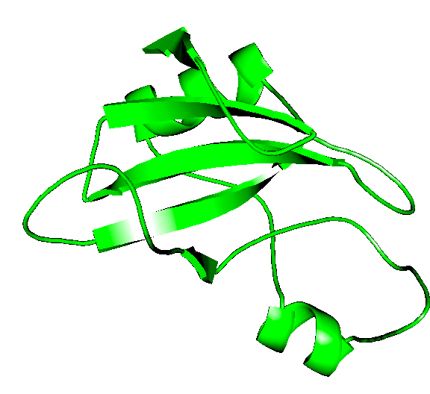
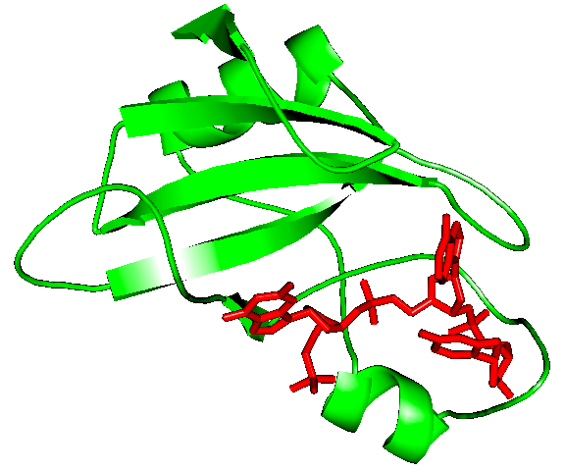
The Protein Cycle
Structure
Function
Sequence
KKAVINGEQIRSISDLHQTLKK
WELALPEYYGENLDALWDCLTG
VEYPLVLEWRQFEQSKQLTENG
AESVLQVFREAKAEGCDITI
Evolution
ligand

Slide 27
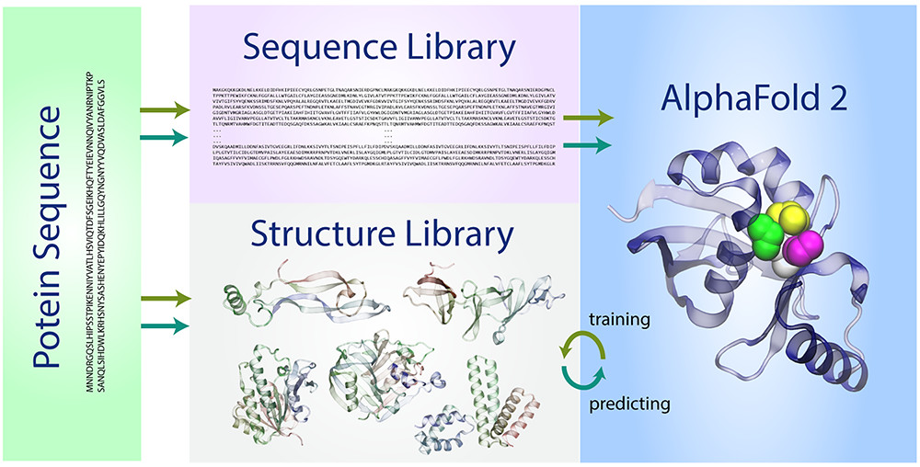
AlphaFold2: AI for Biology

Slide 28
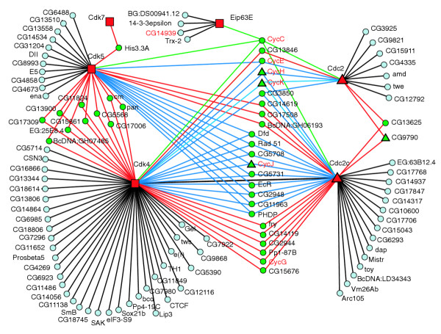
Interactomics
Which proteins (biomolecules) interact with which proteins (biomolecules)?
Stanyon et al. Genome Biology 2004 5:R96

Slide 29
Is there a danger, in molecular biology,
that the accumulation of data will get
so far ahead of its assimilation into a
conceptual framework that the data
will eventually prove an encumbrance ?
John Maddox, 1988

Slide 30
Top ten challenges for bioinformatics
Precise models of where and when transcription will occur in a genome (initiation and termination) ability to predict where and when transcription will occur in genome
Precise, predictive models of alternative RNA splicing: ability to predict the splicing pattern of any primary transcript in any tissue
Precise models of signal transduction pathways; ability to predict cellular responses to external stimuli
Determining protein:DNA, protein:RNA, protein:protein recognition codes
Accurate ab-initio protein structure prediction

Slide 31
Top ten challenges for bioinformatics
Rational design of small molecule inhibitors of proteins
Mechanistic understanding of protein evolution: understanding exactly how new protein functions evolve
Mechanistic understanding of speciation: molecular details of how speciation occurs
Development of effective gene ontologies: systematic ways to describe gene and protein function
Education: development of bioinformatics curricula
Source: Birney (EBI), Burge (MIT), Fickett (Glaxo)

Slide 32
Rough Outline of the Course
Overview of DNA, RNA and proteins
Fluctuations in biology
Sequence analysis
Structure prediction
Simulations
Durg design

