Slide 1
Choosing a Research Topic
Patrice Koehl
Computer Science, UC Davis

Slide 2
Research
Finding a research topic
Finding an advisor
Doing Research

Slide 3
Research
Finding a research topic
Finding an advisor
Doing Research

Slide 4
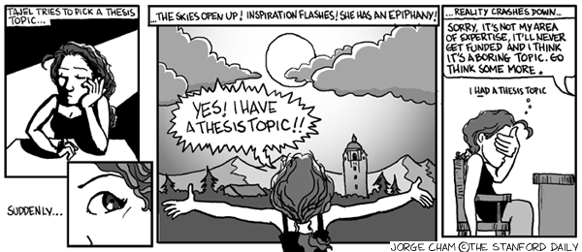
Research Topic

Slide 5
Research Topic
Who are you?
- Are you interested in theory?
- Are you “applied”?
- Are you interested in graphics?
- Are you interested in software/hardware?
What are your personal goal?
- Industry
- Academia

Slide 6
Topics in Compute Science
Security: network security, system security, formal methods, social networking, mobile security (especially cell phones)
Theory: computational geometry, computational biology, cryptography, algorithms, optimization
Systems: programming languages, parallel computation, operating systems, software engineering
Networking: optical, wireless, ad hoc, sensor, protocols, cognitive, security
Architecture: VLSI design
Graphics: visualization, rendering, animation, geometric modeling
Databases and information systems: provenance, data sharing, incomplete and probabilistic databases, security Artificial intelligence: machine learning, data mining

Slide 7
Research Topic
Read, Read, Read
Get exposed to research
Independent research project

Slide 8
Research Topic
Read, Read, Read
Read intelligently, critically, actively
Get exposed to research
Get informed! Listen to NPR,
read magazines
Go to seminars
Independent research project

Slide 9
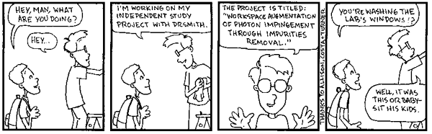
Independent Research Study

Slide 10
Research
Finding a research topic
Finding an advisor
Doing Research

Slide 11
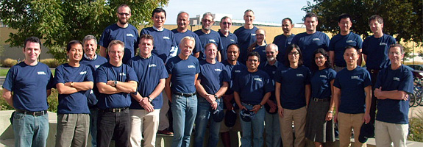
Finding an advisor

Slide 12
Research
Finding a research topic
Finding an advisor
Doing Research

Slide 13


