Slide 1
Tutorial 1
Geometry, Topology, and Biology
Patrice Koehl and Joel Hass
University of California, Davis, USA
http://www.cs.ucdavis.edu/~koehl/IMS2017/

Slide 2

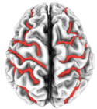
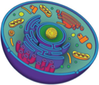
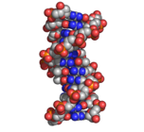
Biology = Multiscale ….
10⁶m
10³m
m
mm
μm
nm
Å
ps
ns
μs
ms
s
10³s
10⁶s
10⁹s
10¹²s

Slide 3
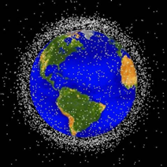
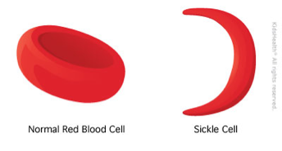
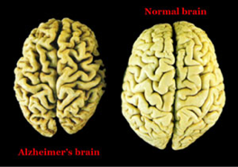
Biology = Quantitative Science ….

Slide 4
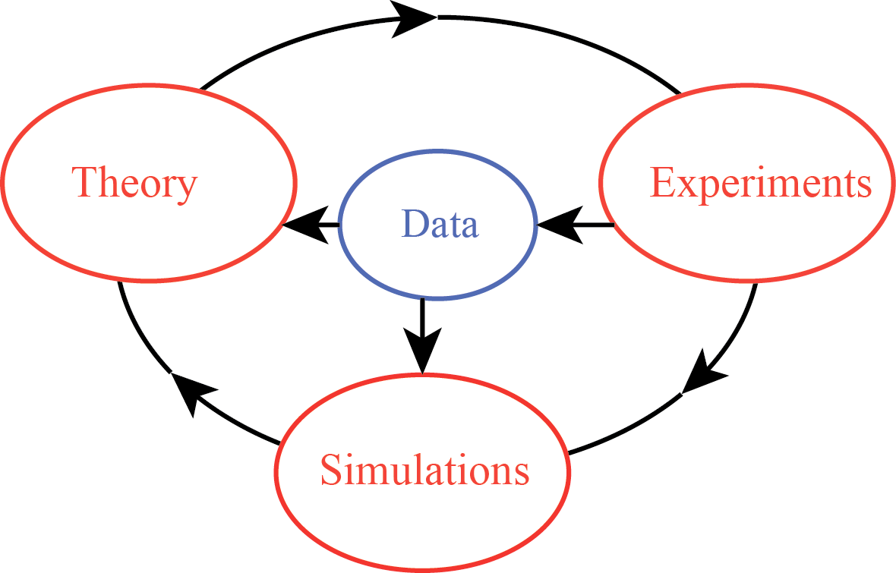
Biology = Data Science ….

Slide 5
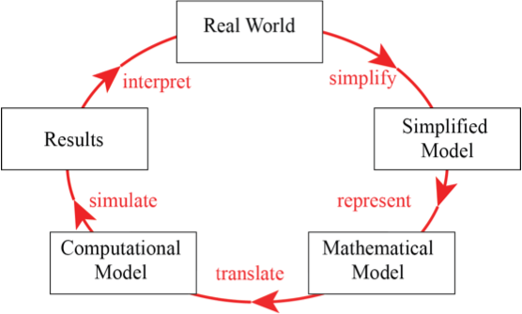
Biology = Quantitative Science ….

Slide 6
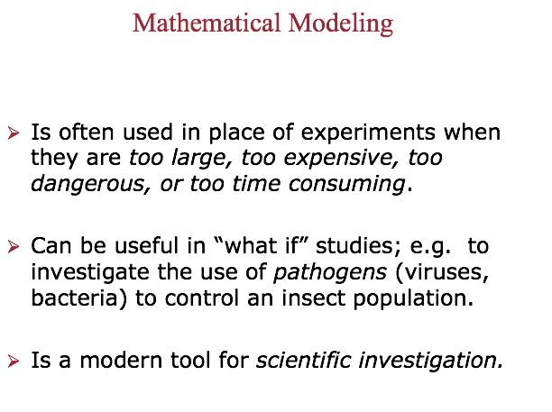

Slide 8
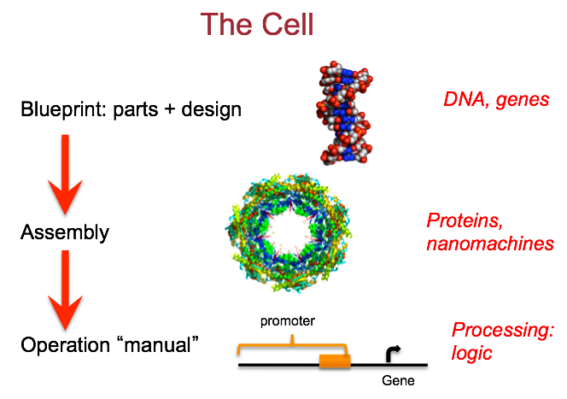

Slide 9
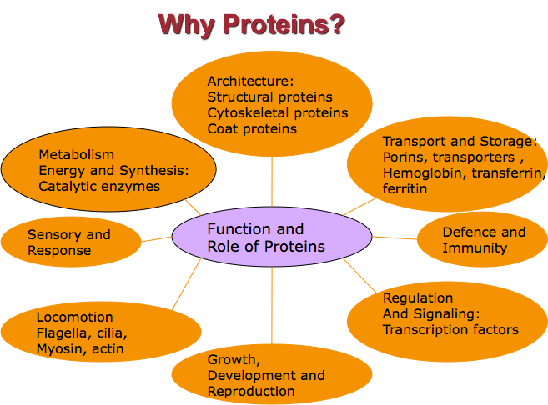

Slide 10
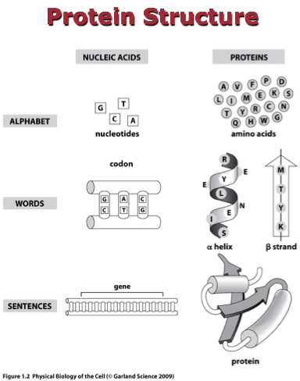

Slide 11
Observing biomolecules
Methods for finding the 3D structure of a biomolecule:
X-ray crystallography
(high resolution; finds structure of a protein in a crystal)
NMR spectroscopy
    (high resolution; finds structure of a protein in solution)
Cryo EM
(medium -high resolution; finds structure of large systems

Slide 12
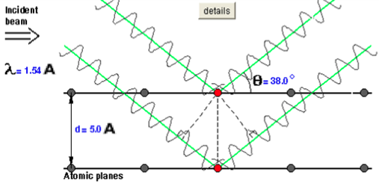
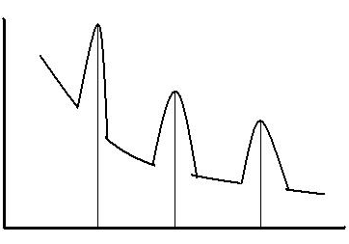
Proteins: X-ray Crystallography
Bragg’s Law:
dsin(θ)
From the “pattern of
diffraction”, i.e. the maximum
of intensities observed, we
can find the angles of
diffraction and for each
angle we get the corresponding d
using Bragg’s law
Intensity
Angle

Slide 13
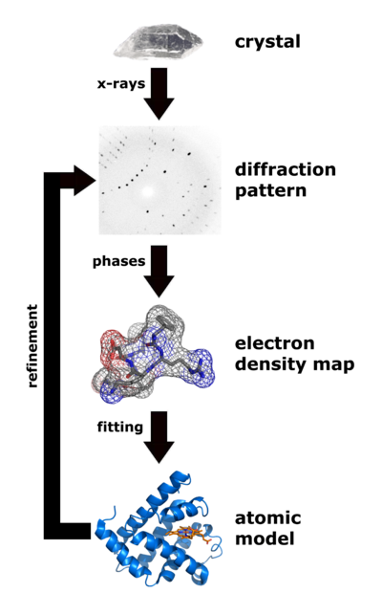
General principle of X-ray
crystallography applied to
proteins:
We need a crystal
From the diffraction pattern,
we get the crystal organization
From the diffraction intensities,
we get the electron densities
4) Once the electron density map
we fit a structure that matches
with this density
From the atomic model, we
can compute a theoretical
diffraction map; if it matches
with the experimental one,
we are done; otherwise refine

Slide 14
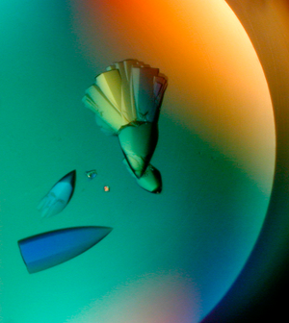
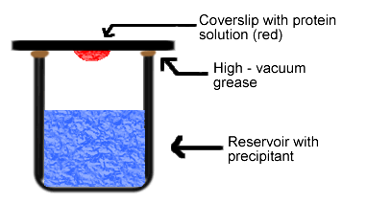
Getting a crystal
The “hanging drop” method
(http://www.molbio1.princeton.edu/macro/about.html)

Slide 15
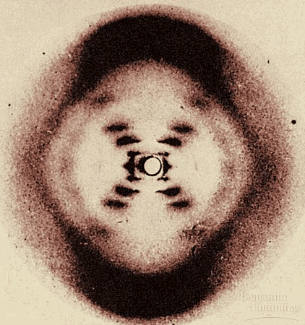
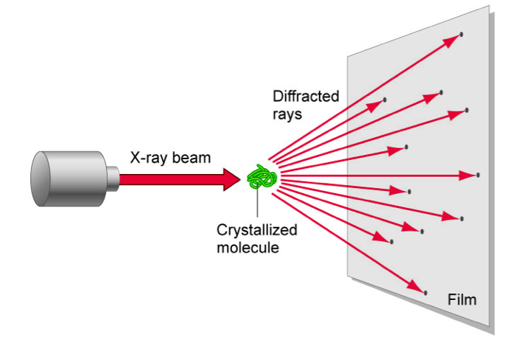
Getting the Diffraction Pattern
Rosalyn Franklin:
Diffraction pattern for DNA

Slide 16
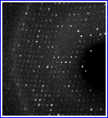
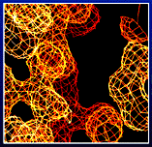
From Diffraction to Electron Density Map
3D Fourier Transform
One hidden problem: diffraction patterns provide intensities; for
Fourier transform, need intensity and phase. A significant step in
X-ray crystallography is the solve the “phase problem”.

Slide 17
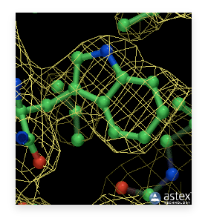
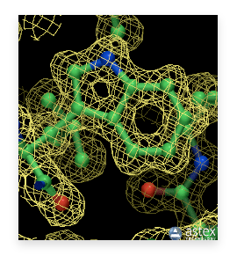
Fitting the structure:
Influence of the resolution
2.6 Å resolution
1.2 Å resolution

Slide 18
Resolution of X-ray structures
Resolution (Å) Meaning
>4.0 Individual coordinates meaningless
3.0 - 4.0 Fold possibly correct, but errors are very likely.
2.5 - 3.0 Fold likely correct except that some surface loops might be mis-modelled.
2.0 - 3.0 Many small errors can normally be detected.
        Fold normally correct and number of errors in surface loops is small. Water molecules and small ligands become visible.
1.5 - 2.0 Many small errors can normally be detected.
          Folds are extremely rarely incorrect, even in surface loops.
0.5 - 1.5 In general, structures have almost no errors at this resolution. geometry studies are made from these structures.
(http://en.wikipedia.org/wiki/Resolution_(electron_density)

Slide 19
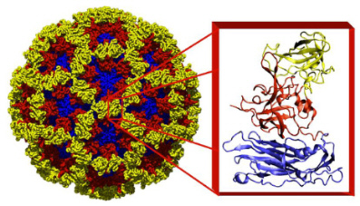
Large molecular assemblies:
X-ray crystallography and Cryo-EM
X-ray structure
(180 copies of
the same protein)
(Norwalk virus: http://www.bcm.edu/molvir/norovirus)

Slide 20
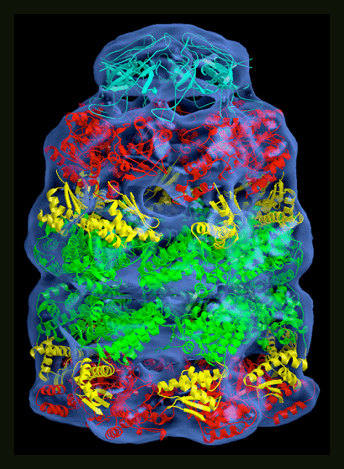
Large molecular assemblies:
X-ray crystallography and Cryo-EM
Cryo-EM:
Microscopy technique;
as such, do not need crystal
(closer to physiological
conditions)
Not high-resolution enough
to provide atomic details;
used in combination with
modeling

Slide 21
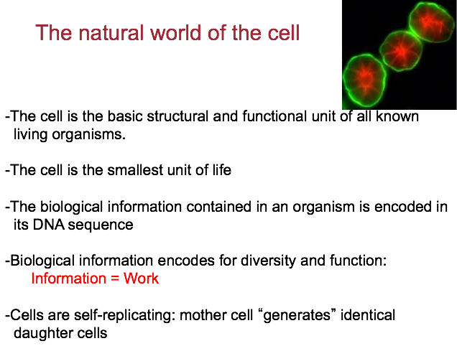

Slide 22
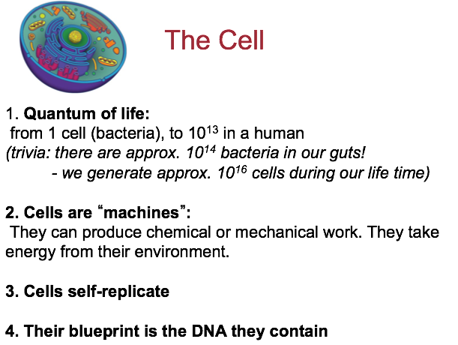

Slide 23
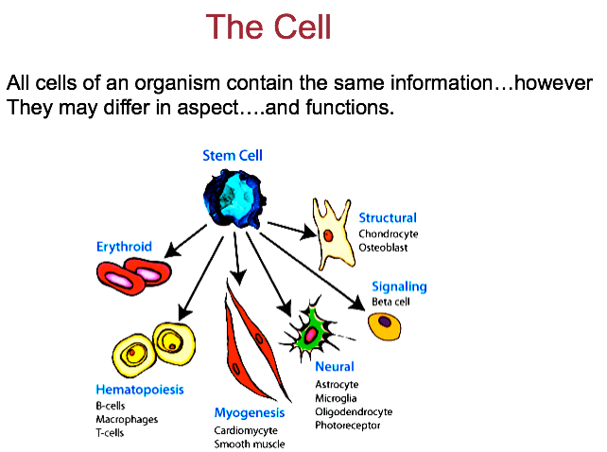

Slide 24
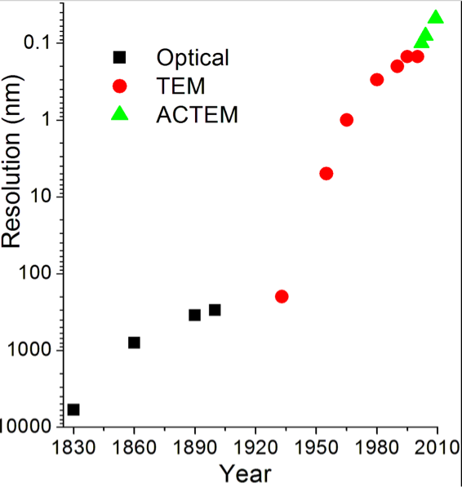
Observing cells
Methods for finding the geometry of cells:
Light microscopy
(resolution 0.2 μm; see organelles)
Fluorescence microscopy
    (see individual molecules
    inside the cells)
Electron microscopy
(high resolution)
Optical: light microscopy
TEM: Transmission EM
ACTEM: Aberration Corrected TEM
(from https://en.wikipedia.org/wiki/Microscope)

Slide 25
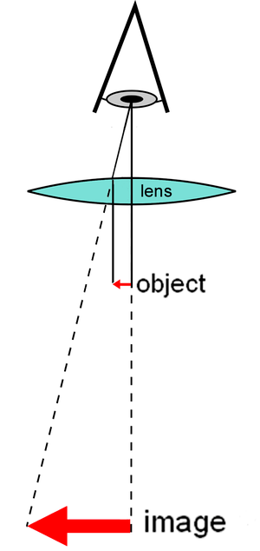
Light Microscopes

Slide 26
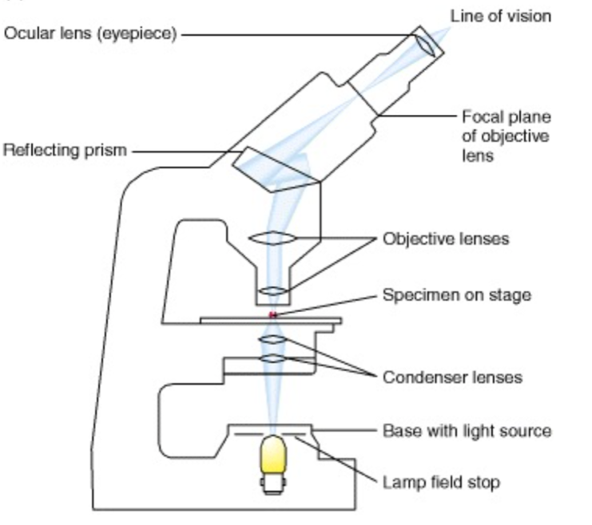
Light Microscopes
Gary Larson, “Far Side”
(from https://www.ncbi.nlm.nih.gov/books/NBK21629/ )

Slide 27
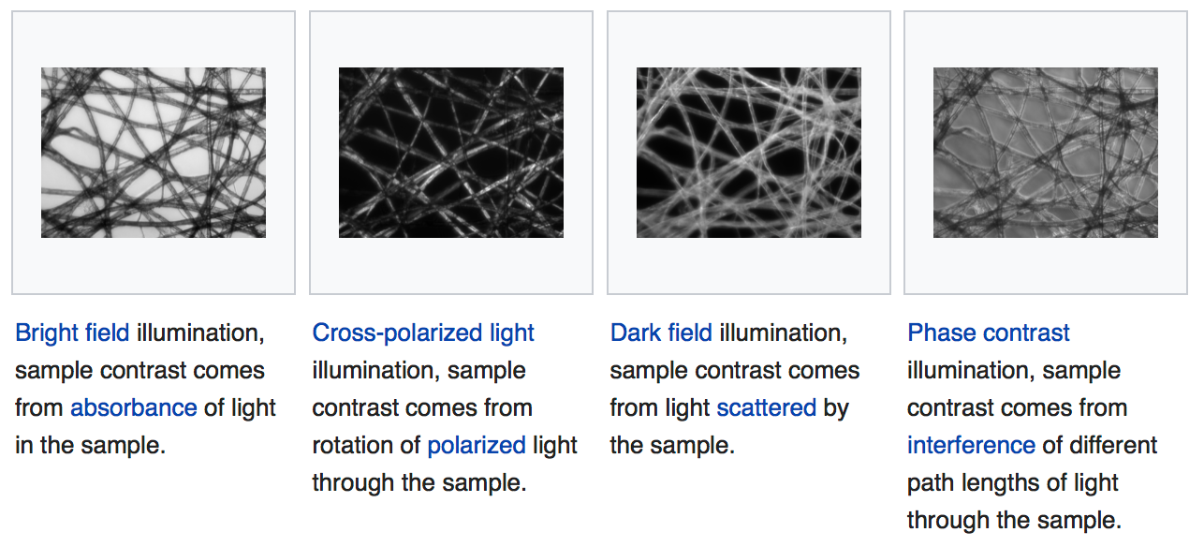
Light Microscopes
(from https://en.wikipedia.org/wiki/Microscopy )

Slide 28
Fluorescence Microscopy
(from https://www.ncbi.nlm.nih.gov/books/NBK21629/ )

Slide 29
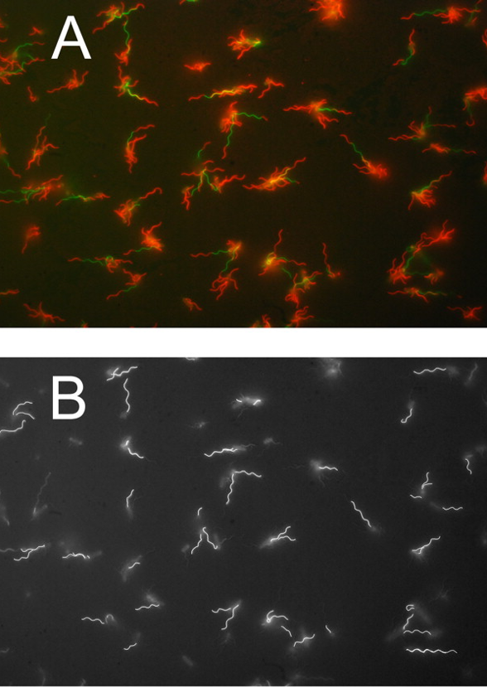
Flagellar filament (green)
from Ecoli (red)
Same image, with green shown
in white and other colors in black
(from http://jb.asm.org/content/194/10/2437/F1.expansion.html )

Slide 30
(scanning probe microscopy)
(Atomic force
microscopy)
(scanning
tunneling
microscope)
(scanning
near-field
optical
microscope)
(from https://en.wikipedia.org/wiki/Microscope)

Slide 31
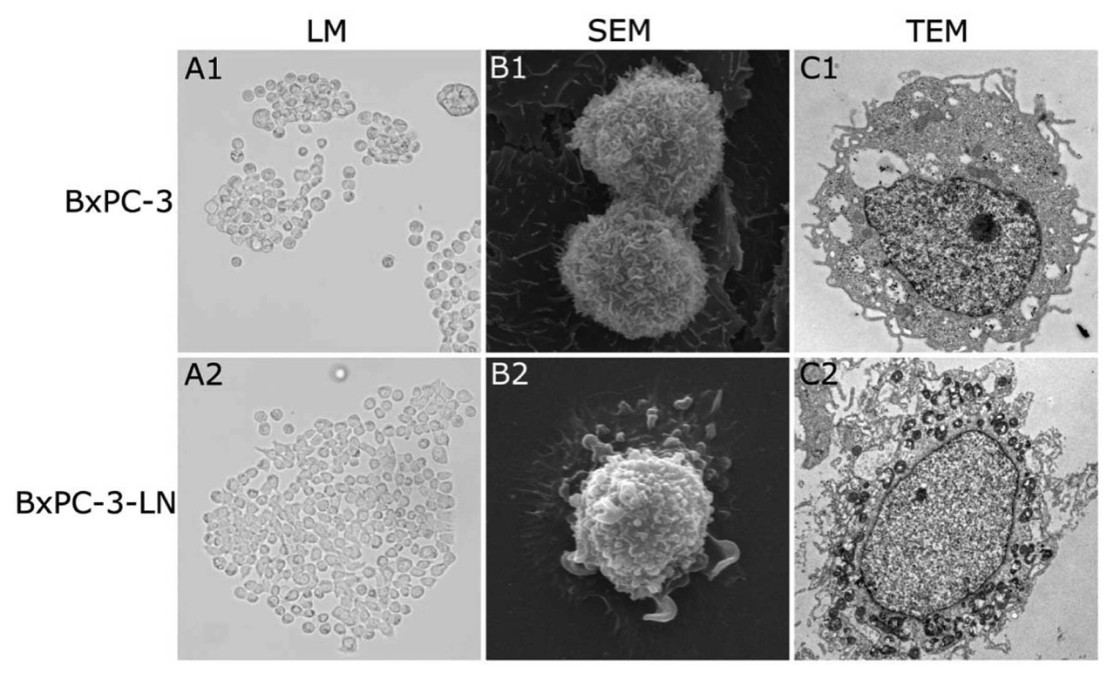
Differences between Light Microscopes and Electron Microscopes
(from https://www.spandidos-publications.com/10.3892/ijo.2012.1613 )

Slide 32
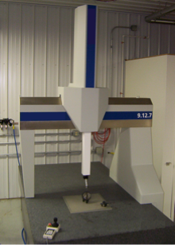
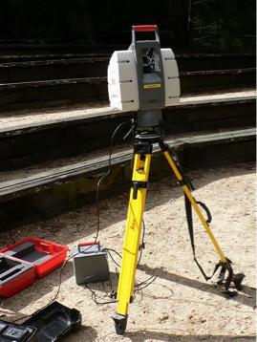
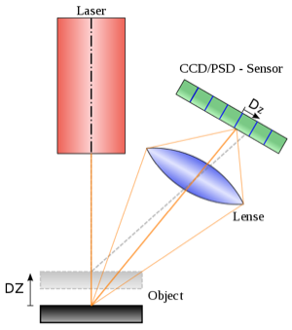
Imaging larger objects: scanners
Surface scanners
Contact scanners
                B) Laser scanner: time of flight
C) Laser scanner: triangulation
(from https://en.wikipedia.org/wiki/3D_scanner )

Slide 33
Imaging larger objects: scanners
Volumetric Scanners
X-ray computer tomography
(CT scanners)
Magnetic Resonance
Imaging (MRI)

Slide 34
Geometry and Topology in Biology
Phylogenetic trees
Geometry of Biomolecules
Morphometrics

Slide 35
Geometry and Topology in Biology
Phylogenetic trees
Geometry of Biomolecules
Morphometrics

Slide 36
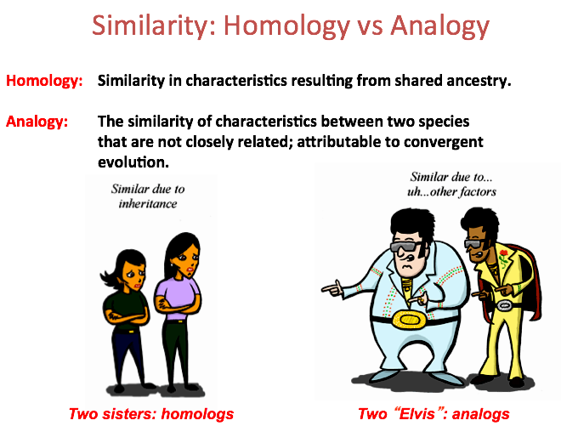

Slide 37
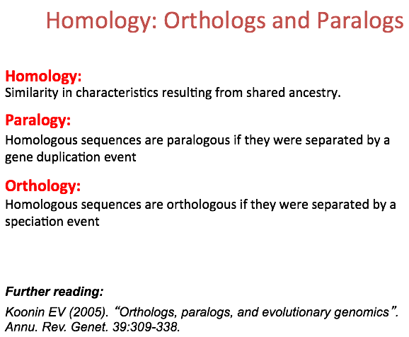

Slide 38
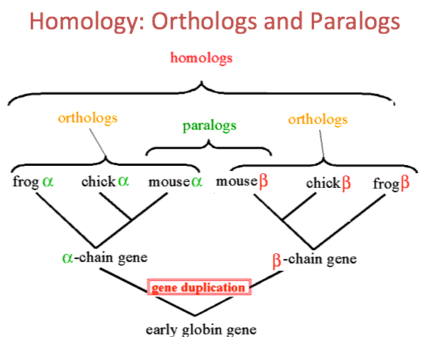

Slide 39


Slide 41
Geometry and Topology in Biology
Phylogenetic trees
Geometry of Biomolecules
Morphometrics

Slide 42
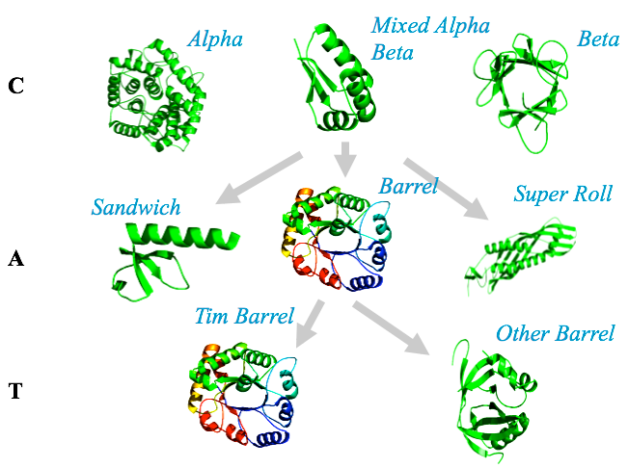
Protein Structures

Slide 43
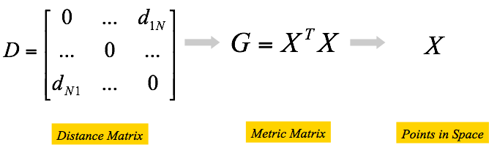
Protein Structure Space

Slide 44
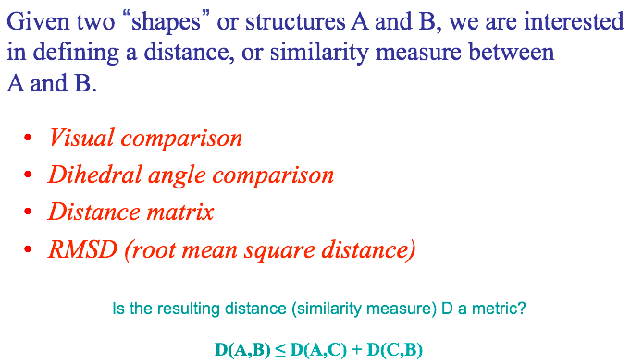
Protein Structure Comparison

Slide 45
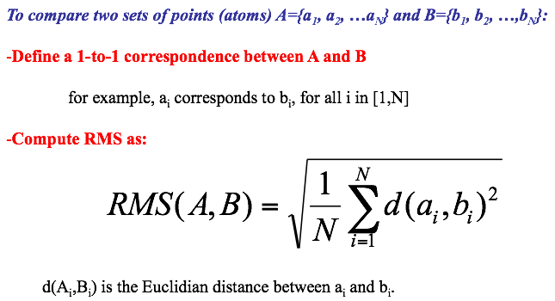
Protein Structure Comparison

Slide 46
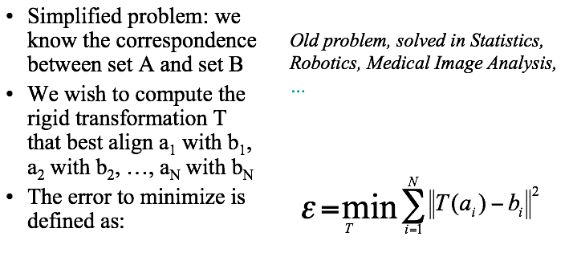
Protein Structure Comparison

Slide 47
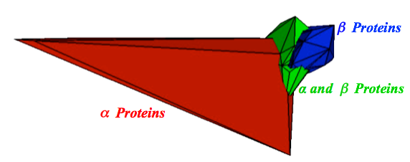
A Picture of the Protein Structure Space

Slide 48
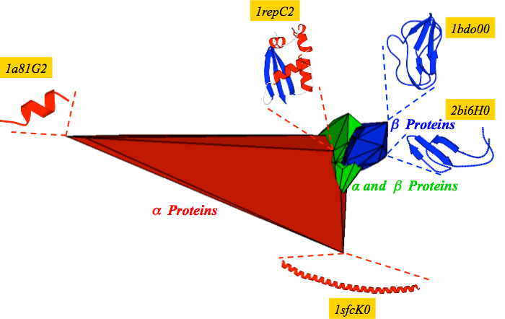
A Picture of the Protein Structure Space

Slide 49
Geometry and Topology in Biology
Phylogenetic trees
Geometry of Biomolecules
Morphometrics

Slide 50
3D Morphometrics of Orchids
(from http://www.sciencedirect.com/science/article/pii/S1360138510000981 )

Slide 51
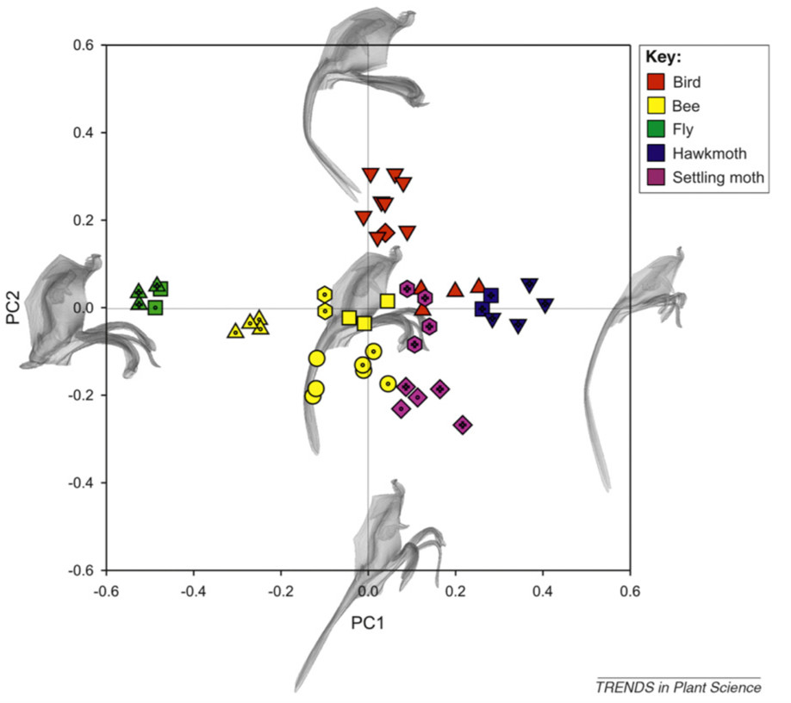
3D Morphometrics of Orchids
(from http://www.sciencedirect.com/science/article/pii/S1360138510000981 )

