Slide 1
Tutorial 3
Comparing Biological Shapes
Patrice Koehl and Joel Hass
University of California, Davis, USA
http://www.cs.ucdavis.edu/~koehl/IMS2017/

Slide 2

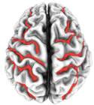
What is a shape?
A shape is a 2-manifold with a Riemannian metric (angle, distance,
surface area, volume, derivatives,…)

Slide 3
Discrete representations of shapes
Continuous surfaces
  Manifolds
  Metric on manifolds
  Topology
  Orientation
Sets of points and triangulations
  Simplicial complexes
  Triangulations
  Delaunay and applications
Discrete Surfaces
  Meshes
  Manifold/ orientation
  Geometry / topology
Manipulating discrete surfaces
  Basic mesh operations
  Remeshing

Slide 4
Discrete representations of shapes
Continuous surfaces
  Manifolds
  Metric on manifolds
  Topology
  Orientation
Sets of points and triangulations
  Simplicial complexes
  Triangulations
  Delaunay and applications
Discrete Surfaces
  Meshes
  Manifold/ orientation
  Geometry / topology
Manipulating discrete surfaces
  Basic mesh operations
  Remeshing

Slide 5
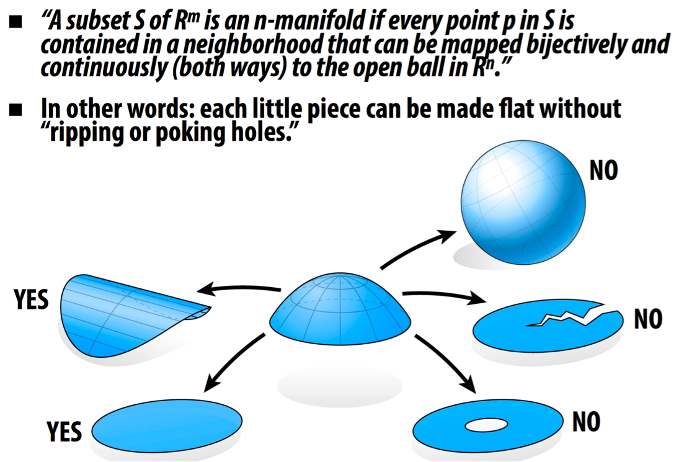
What is a manifold?

Slide 6
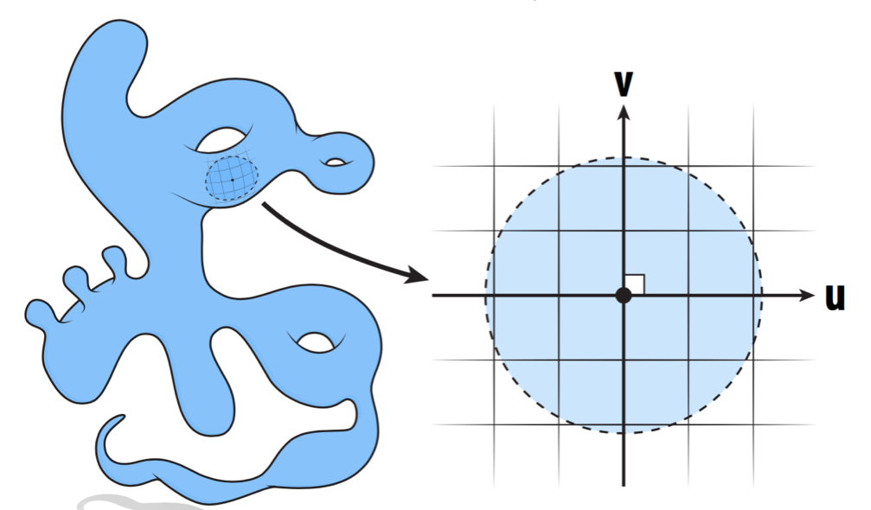
Why a manifold?
All surfaces look similar (at least locally)
We can set a (local) coordinate system

Slide 7
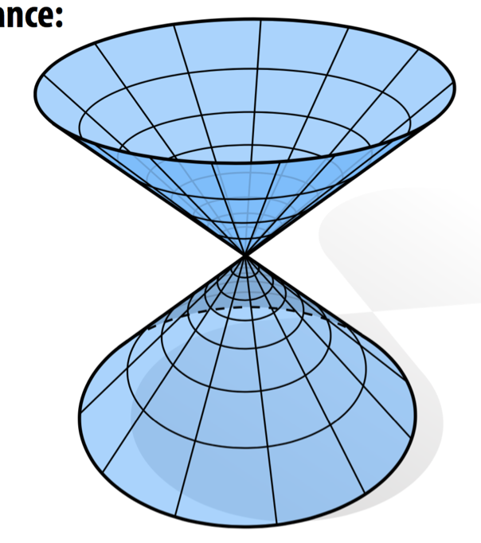
Not every surface is a manifold
Cannot set a coordinate system
at the junction point…

Slide 8
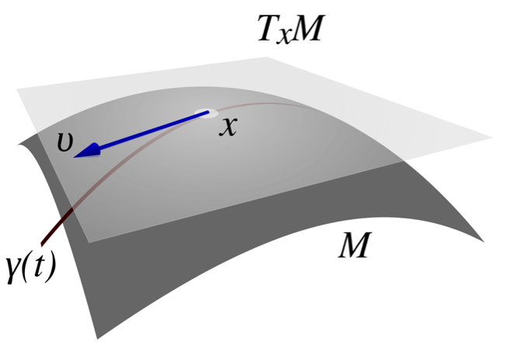

Riemannian Manifold
Tangent space:
Normal:
Metric tensor:

Slide 9
Orientation of a manifold
Orientability of a surface: a property of surfaces in
Euclidean space that measures whether it is possible to make
a consistent choice of surface normal vector at every point.
Orientable
Non orientable

Slide 10
Topology of a surface
Genus 0
Genus 1
Genus 2

Slide 11
Discrete representations of shapes
Continuous surfaces
  Manifolds
  Metric on manifolds
  Topology
  Orientation
Sets of points and triangulations
  Simplicial complexes
  Triangulations
  Delaunay and applications
Discrete Surfaces
  Meshes
  Manifold/ orientation
  Geometry / topology
Manipulating discrete surfaces
  Basic mesh operations
  Remeshing

Slide 12
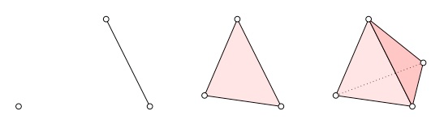
Simplices
Definition: A k-simplex is a k-dimensional polytope which is the
convex hull of its k+1 vertices
0-simplex 1-simplex 2-simplex 3-simplex …..
(vertex) (edge) (triangle) (tetrahedron)

Slide 13
Simplicial complex
Definition:
A simplicial complex K
is a set of simplices that
satisfies the two following
conditions:
Any face of a simplex
from K is also in K
The intersection of any
  two simplices S1 and S2
  is either ø or a face of
  both S1 and S2
A simplicial 3-complex

Slide 14
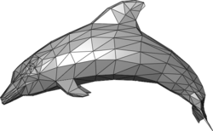
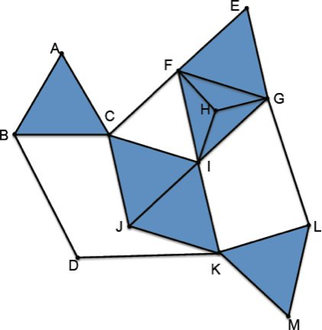
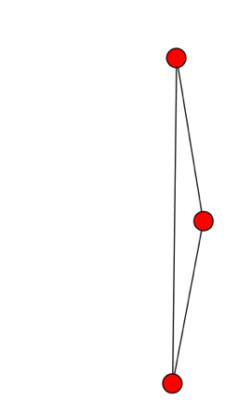
Examples of simplicial complexes

Slide 15
Counter examples of simplicial complexes

Slide 16
Counter examples of simplicial complexes

Slide 17
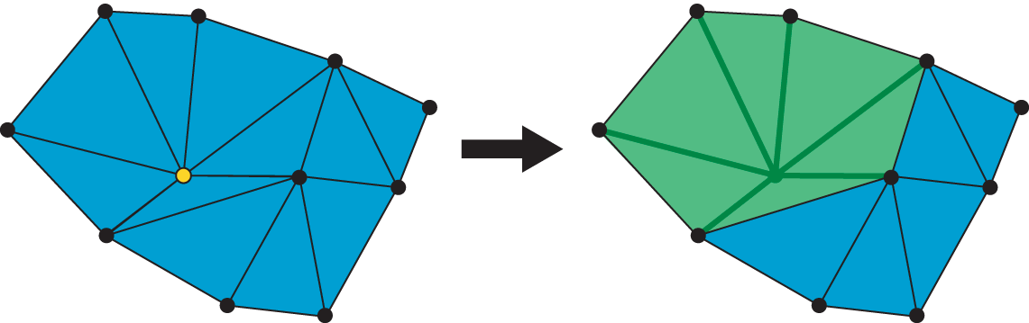
Star in a simplicial complex
Let K be a simplicial complex and S a set of simplices of K.
The star of S is the union of the stars of all simplices s in S.
The star of a simplex s is the set of simplices having a face in s.
The star of the vertex shown in yellow on the left is the set of the green
triangles, edges, and vertices on the right.

Slide 18
Closure in a simplicial complex
Let K be a simplicial complex and S a set of simplices of K.
The closure of S is is the smallest simplicial subcomplex of K that
contains each simplex in S.
The closure of the simplices shown in yellow on the left is the set of the
green triangles, edges, and vertices on the right.

Slide 19
Link in a simplicial complex
Let K be a simplicial complex and S a set of simplices of K.
The link of S is the closed star of S minus the stars of all faces of S.
The link of the vertex shown in yellow on the left is the set of the
green edges, and vertices on the right.

Slide 20
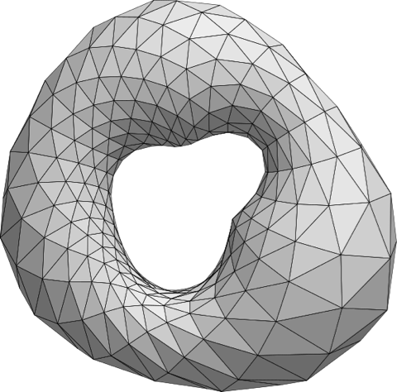
Triangulation
Triangulation is the division of a surface or plane polygon into a set of triangles,
usually with the restriction that each triangle side is entirely shared by two
adjacent triangles. It was proved in 1925 that every surface has a triangulation,
but it might require an infinite number of triangles and the proof is difficult.
A triangulation of the torus

Slide 21
Delaunay Triangulation
A Delaunay triangulation for a set P of points in a plane is a
triangulation DT(P) such that no point in P is inside the circumcircle
of any triangle in DT(P).
Delaunay triangulations maximize the minimum angle of all the angles
of the triangles in the triangulation

Slide 22
Delaunay Triangulation: edge flipping
This pair of triangles does not meet the
Delaunay condition (the circumcircle
contains more than three points).
Flipping the common edge produces
a valid Delaunay triangulation for the
four points

Slide 23
Delaunay Triangulation and Voronoi Diagram
The Delaunay triangulation of a discrete point set P in general position corresponds to the dual graph of the Voronoi diagram for P
The Delaunay triangulation with
all the circumcircles and their centers
(in red)
Connecting the centers of the
circumcircles produces the
Voronoi diagram (in red).

Slide 24
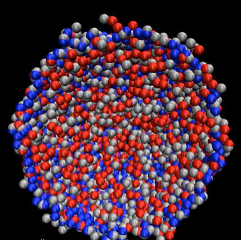
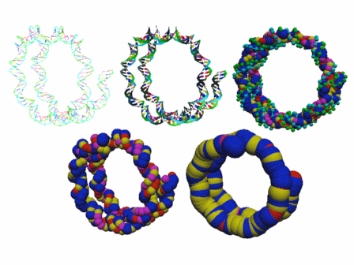
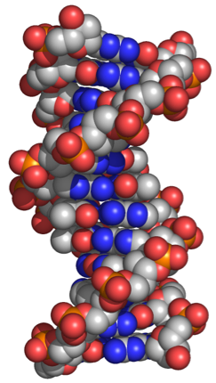
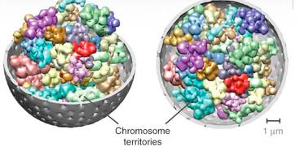
Sphere Representations in Biology
Viral DNA
DNA
Nucleosome
Chromosome arrangements

Slide 25
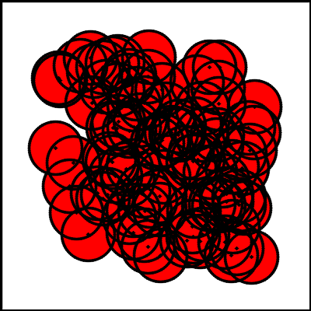
Measuring a Union of Balls

Slide 26
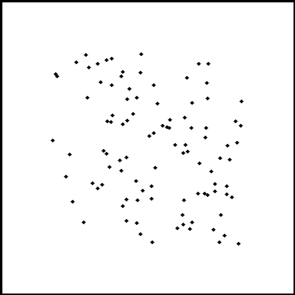
Measuring a Union of Balls

Slide 27

Measuring a Union of Balls
Algorithm for computing
Delaunay triangulation:
Input: N: number of points
Ci: position of point I
Randomize points
2) For i = 1:N
- Location: find triangle
t that contains Ci
- Addition: Divide t into 3
triangles
- Correct: flip non local triangles
Output: list of triangles

Slide 28
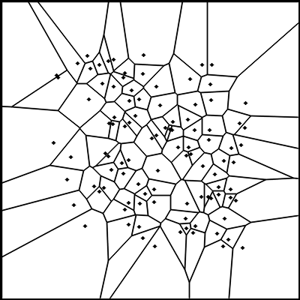
Measuring a Union of Balls
Compute Voronoi diagram from
Delaunay complex: dual

Slide 29
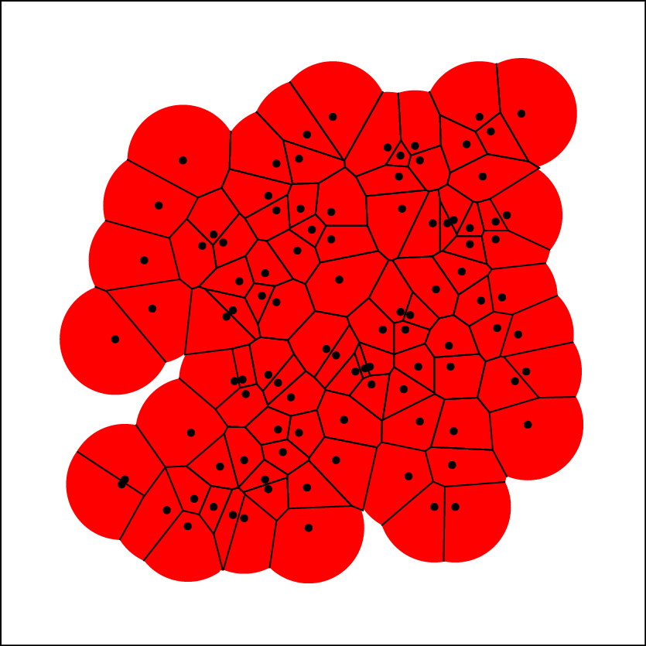
Measuring a Union of Balls
Restrict Voronoi diagram to
the Union of Balls:
Power diagram

Slide 30


Measuring a Union of Balls
r_{i}
Atom i:
Fraction in Voronoi cell:
σ_{i} and β_{i}

Slide 31
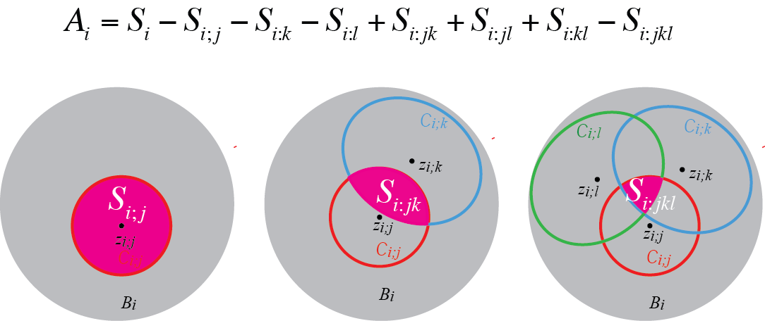
Measuring a Union of Balls

Slide 32
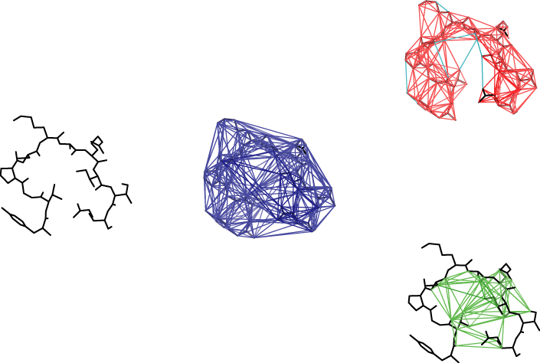
Measuring a Union of Balls
K complex
Protein
Delaunay Complex
Pocket

Slide 33
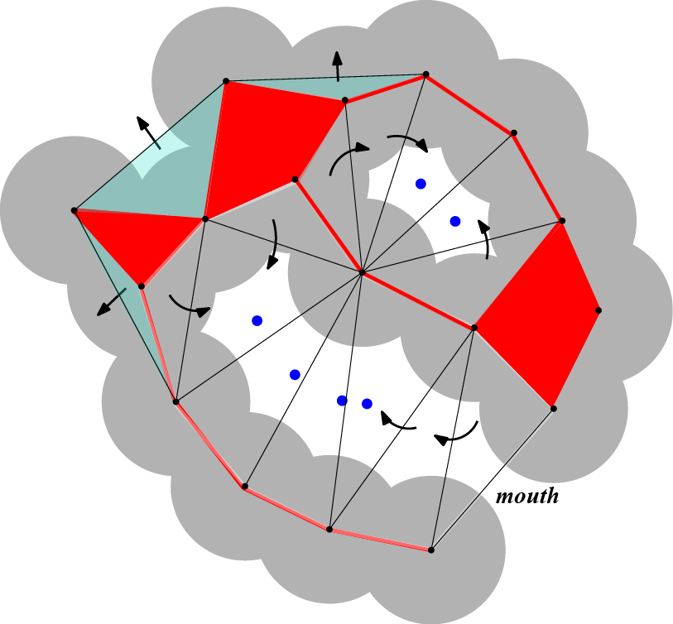
Measuring a Union of Balls
Cavity
Pocket

Slide 34
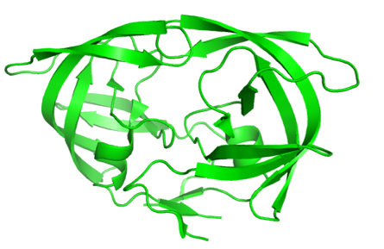
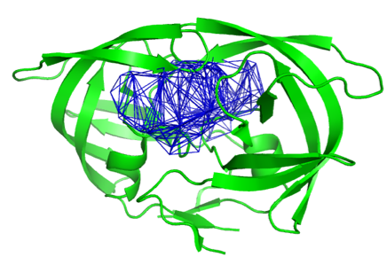
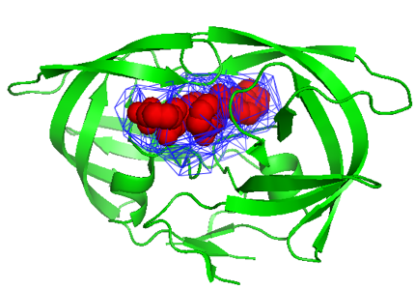
Applications to drug design
HIV protease (3MXE)
Main cavity
Actual position of K54
(inhibitor)

Slide 35
Discrete representations of shapes
Continuous surfaces
  Manifolds
  Metric on manifolds
  Topology
  Orientation
Sets of points and triangulations
  Simplicial complexes
  Triangulations
  Delaunay and applications
Discrete Surfaces
  Meshes
  Manifold/ orientation
  Geometry / topology
Manipulating discrete surfaces
  Basic mesh operations
  Remeshing

Slide 36
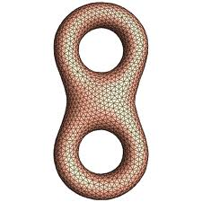
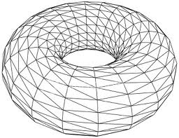
Polygonal meshes
A polygon mesh is a collection of vertices, edges and faces that
defines the shape of a polyhedral object
The faces usually consist of triangles (triangle mesh), quadrilaterals,
or other simple convex polygons, since this simplifies rendering.

Slide 37
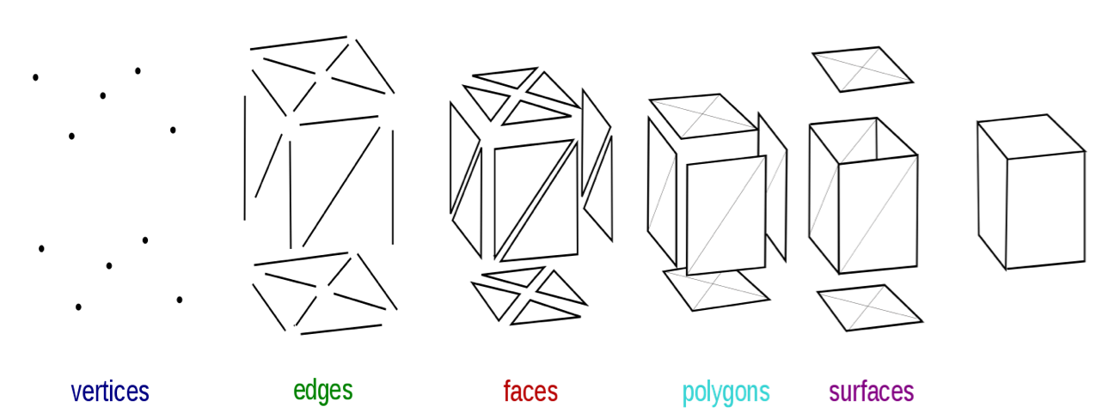
Polygonal meshes

Slide 38
Polygonal meshes

Slide 39
Some definitions about meshes
degenerate: contains duplicate triangles
            (i.e. the same three vertices describe two triangles) ,
            or triangles with two or three overlapping vertices.
  manifold: no vertex is adjacent to more than two boundary edges,
            and no edge is shared by more than two triangles.
Non-manifold
vertex
Non-manifold
vertex
Non-manifold
edge

Slide 40
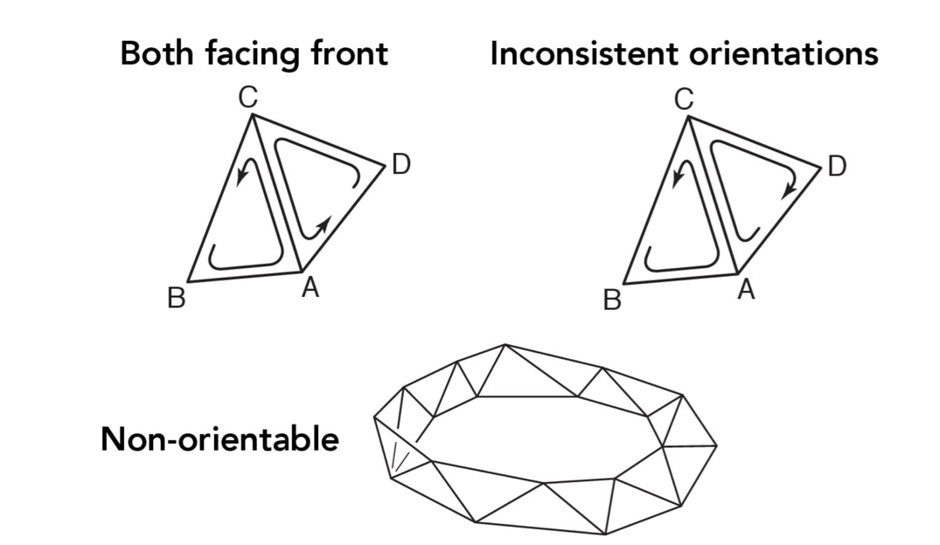
Some definitions about meshes
orientable: a mesh is orientable if all normals of the triangles can
            be made compatible

Slide 41
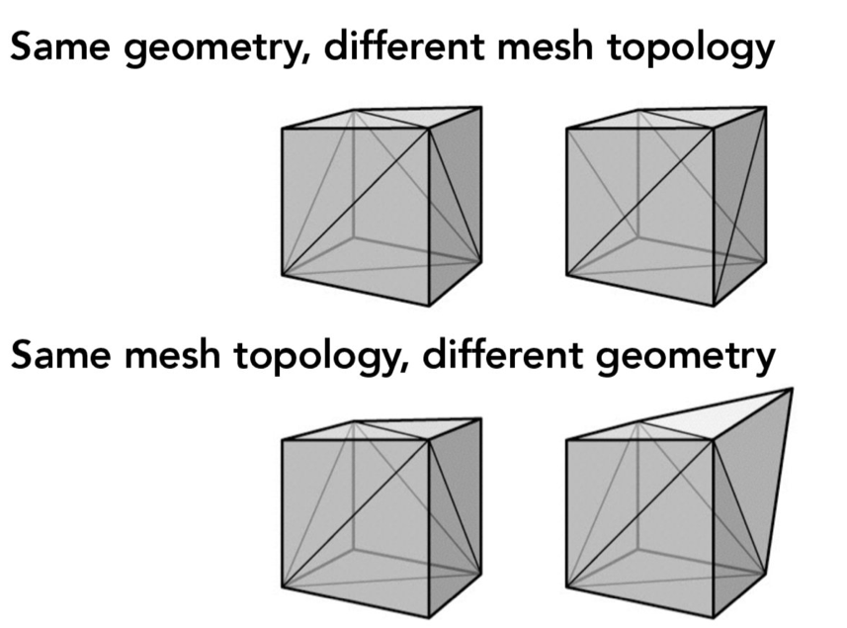
Meshes: geometry and topology
The topology of a mesh is given by the combinatorics of its edges and triangles
The geometry of a mesh is given by the position (coordinates) of
its vertices and/or lengths of its edges.

Slide 42
Euler formula for triangular meshes
Let M be a mesh that contains V vertices, E edges, T triangles, B edges
at its boundaries (if any), and C components. Let us assume that this
mesh represents a surface of genus g. Then the following formula is
true:
Most common meshes:
C = 1 (a single component), B=0 (no boundaries), g = 0 (genus 0, i.e.
topologically equivalent to the sphere); then:

Slide 43
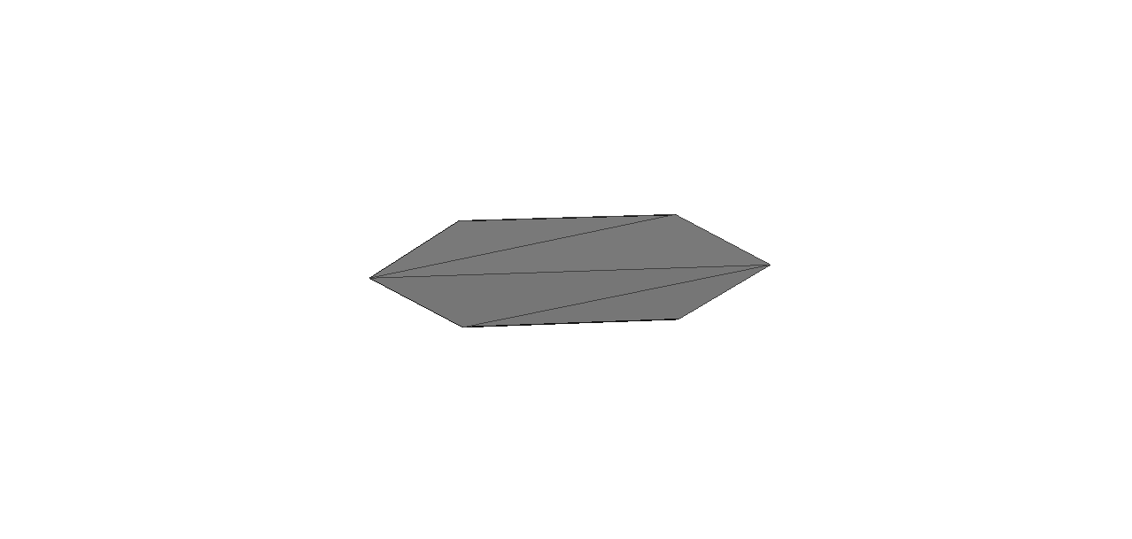
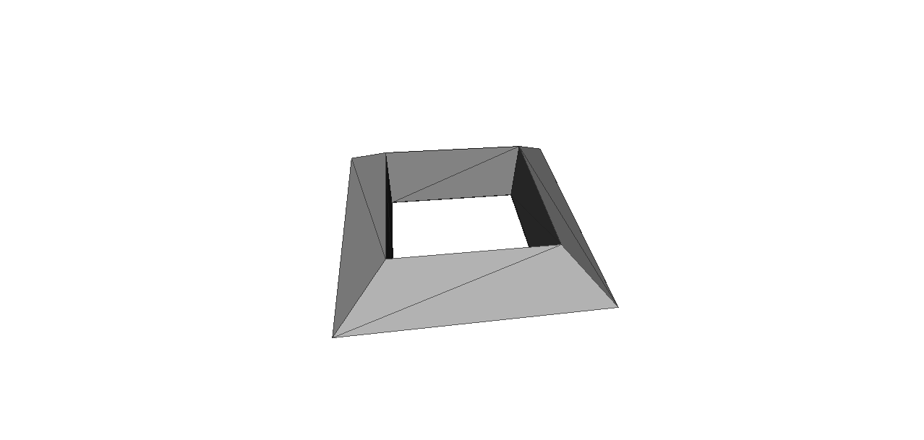
Examples
V =
E =
T =
V-E+T =
V =
E =
T =
V-E+T =
V =
E =
T =
V-E+T =

Slide 44
Examples
V = 6
E = 12
T = 8
V-E+T =2
V = 12
E = 30
T = 20
V-E+T = 2
V = 12
E = 36
T = 24
V-E+T = 0 !

Slide 45
Discrete representations of shapes
Continuous surfaces
  Manifolds
  Metric on manifolds
  Topology
  Orientation
Sets of points and triangulations
  Simplicial complexes
  Triangulations
  Delaunay and applications
Discrete Surfaces
  Meshes
  Manifold/ orientation
  Geometry / topology
Manipulating discrete surfaces
  Basic mesh operations
  Remeshing

Slide 46
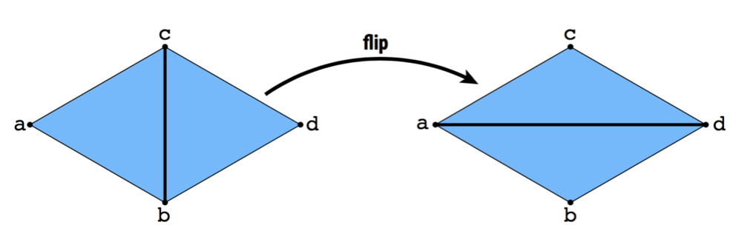
Basic mesh operations
1. Edge flip: triangles (a,b,c) and (b,c,d) become (a,c d) and (a,b,d)

Slide 47
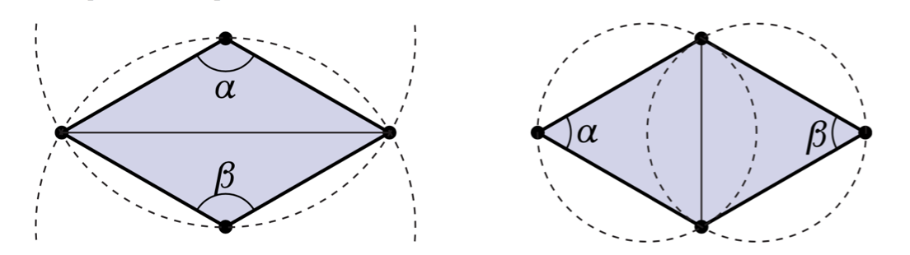

Slide 48
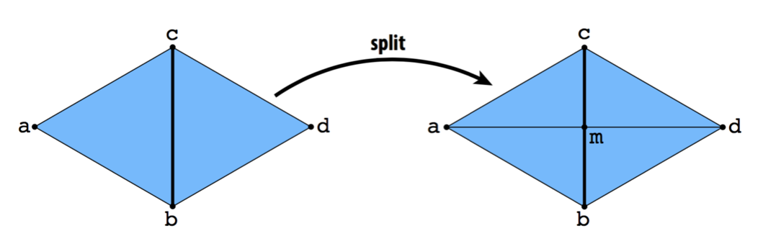
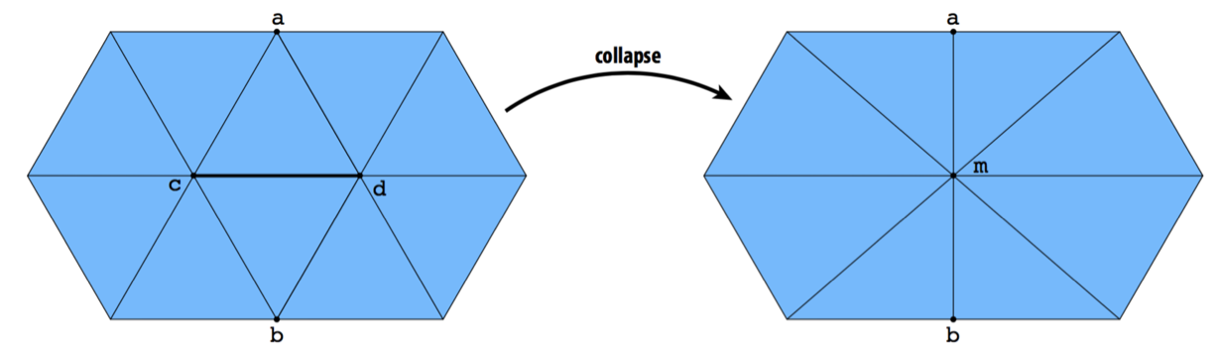
Basic mesh operations
2. Edge split: add midpoint of edge (b,c) and form 4 triangles
3. Edge removal: replace edge (c,d) by single vertex m, usually
midpoint of c and d.

Slide 49
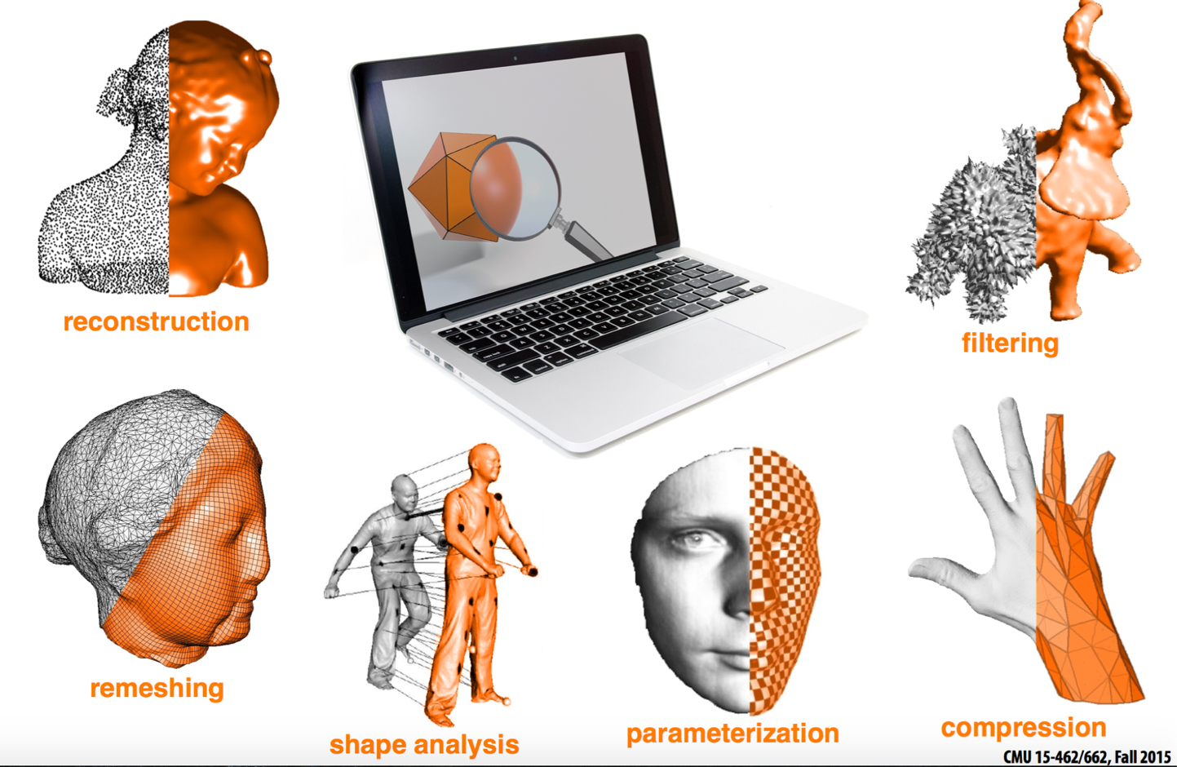

Slide 50
Reconstruction: the result of a scan of an object is a set of points.
The first step of any processing is to generate a surface
mesh from those points.

Slide 51
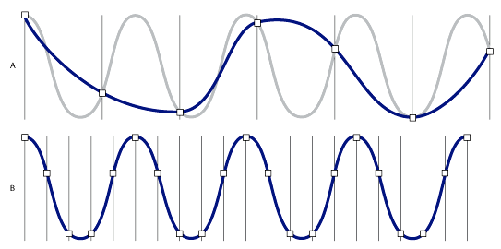
Remeshing as resampling
Sampling is the process of examining the value of a continuous function
at regular intervals.
Note that choosing the sampling rate is not innocent:
A higher sampling rate usually allows for a better representation of the signal.

Slide 52
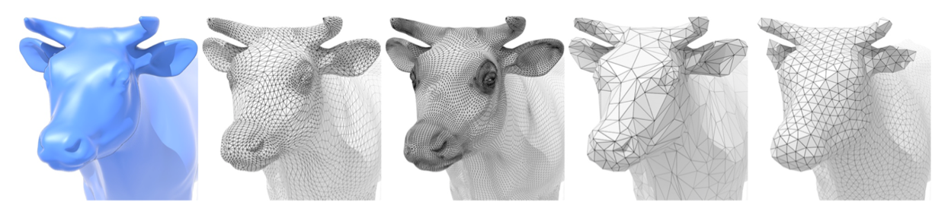
Remeshing as resampling
Surface analysis is no different from signal processing:
undersampling leads to loss of features
oversampling leads to loss of performance
quality sampling improves geometry and performance

Slide 53
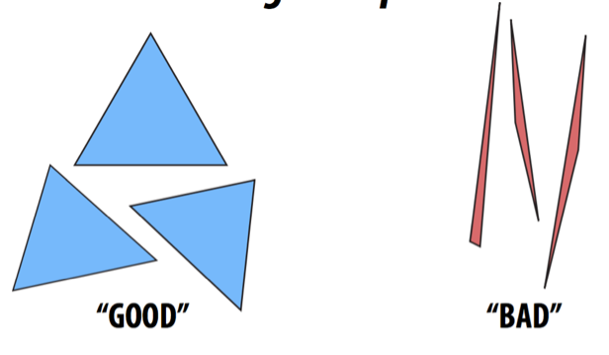
Mesh “quality”
1) Triangles should be regular
How to improve: flip edges.
When to flip? If α+β>π, flip

Slide 54
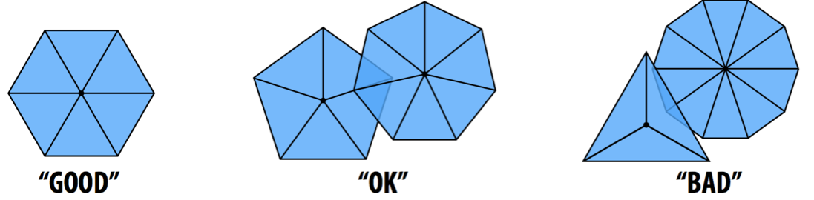
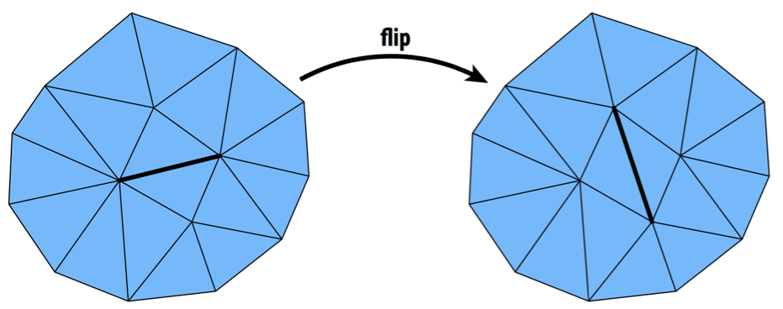
Mesh “quality”
2) Vertex degree should be regular
How to improve: flips!
When to flip an edge: if total variation from degree 6 decreases, flip.

