Slide 1


Structural DNA nanotechnology
a.k.a. DNA carpentry
a.k.a. DNA self-assembly
slides © 2021, David Doty
ECS 232: Theory of Molecular Computation, UC Davis

Slide 2
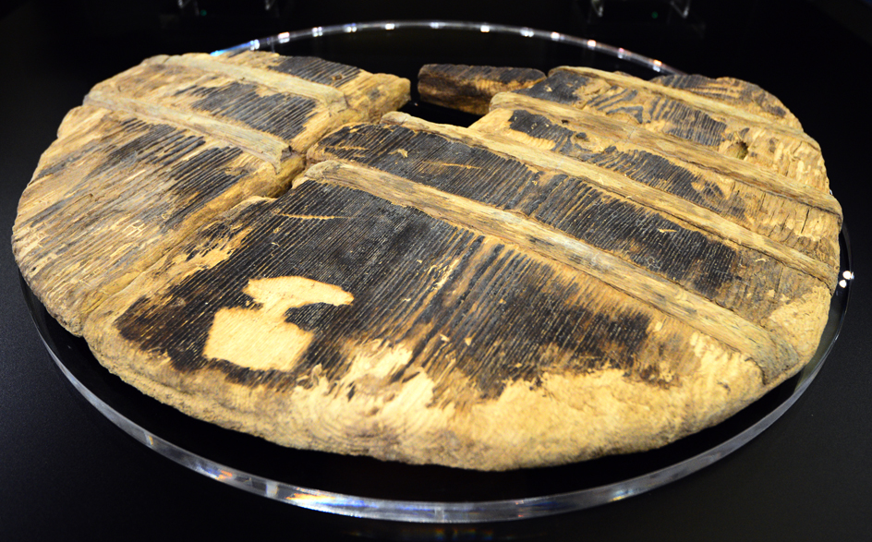
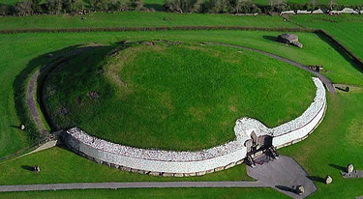

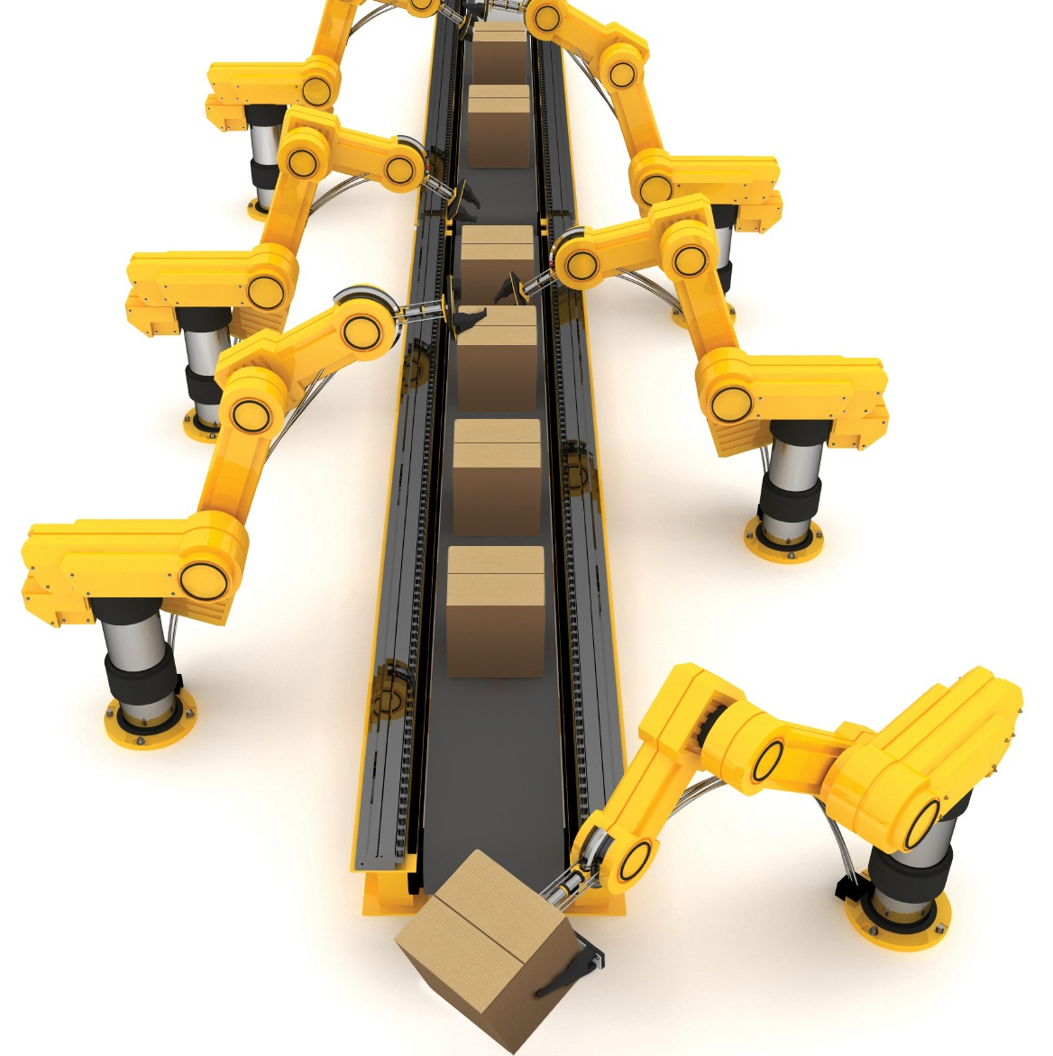
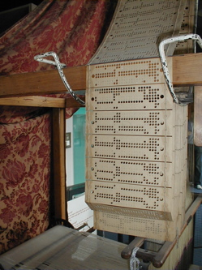
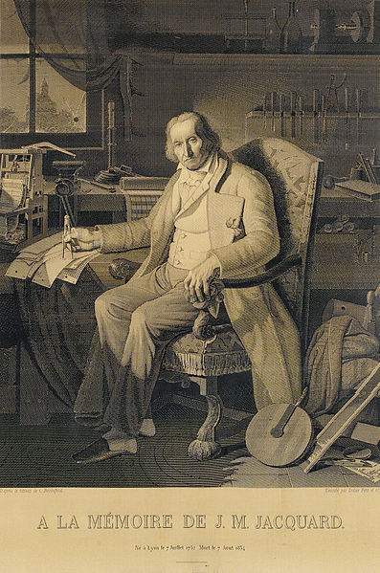

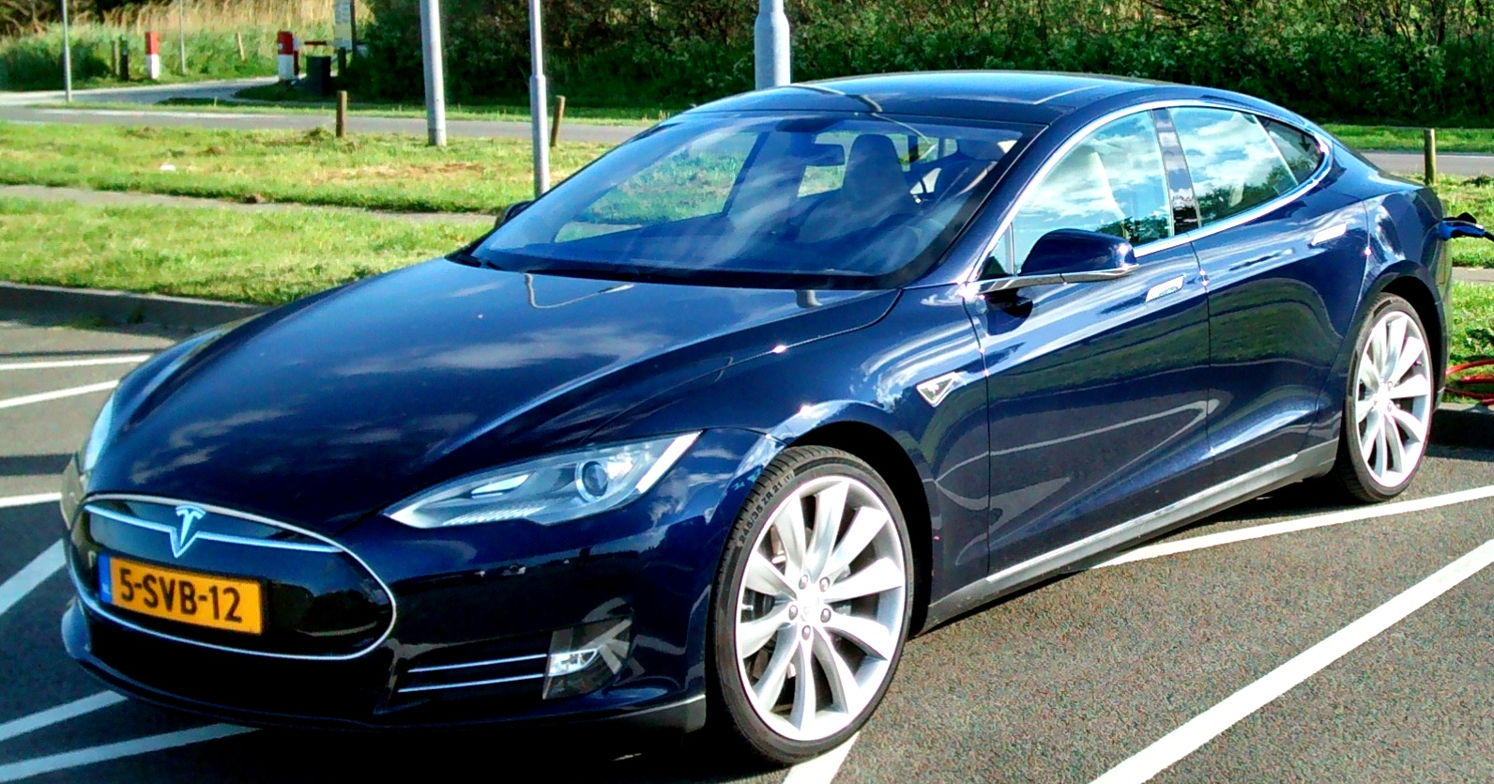
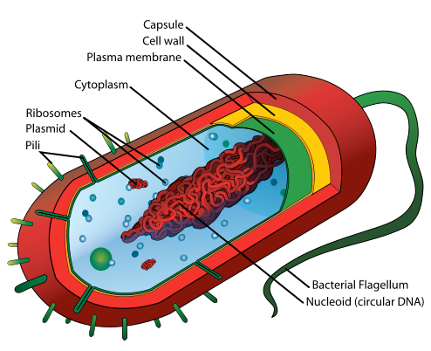
Building things
Building things by hand: use tools! Great for scale of 10^{±2} ×
Newgrange, Ireland. 5.2k years old
Ljubljana Marshes Wheel. 5k years old
Building tools that build things: specify target object with a computer program
Programming things to build themselves: for building in small wet places where our hands or tools can’t reach
[slides credit: Damien Woods]
Mariana Ruiz Villarreal
Notes:
P

Slide 3
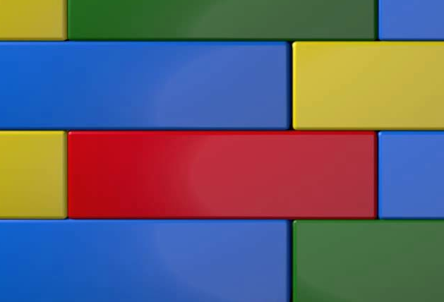

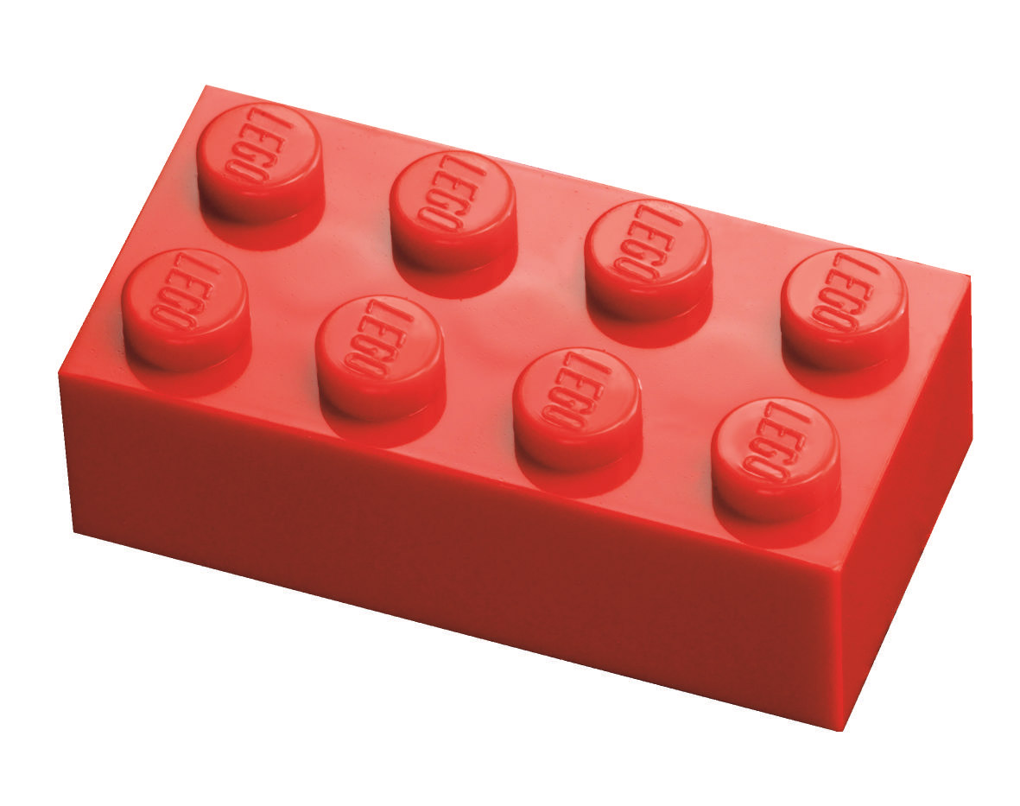
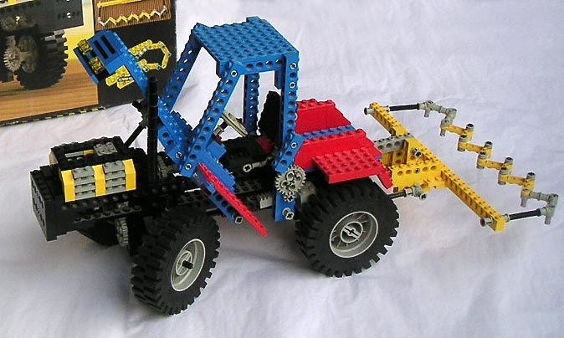


Things that build themselves
I want to stick below blue & yellow and above blue & green
Our topic: self-assembling molecules that compute as they build themselves
[slides credit: Damien Woods]

Slide 4
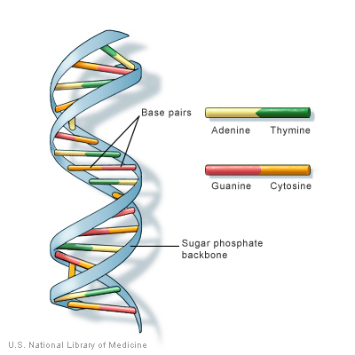
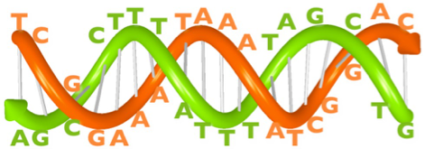
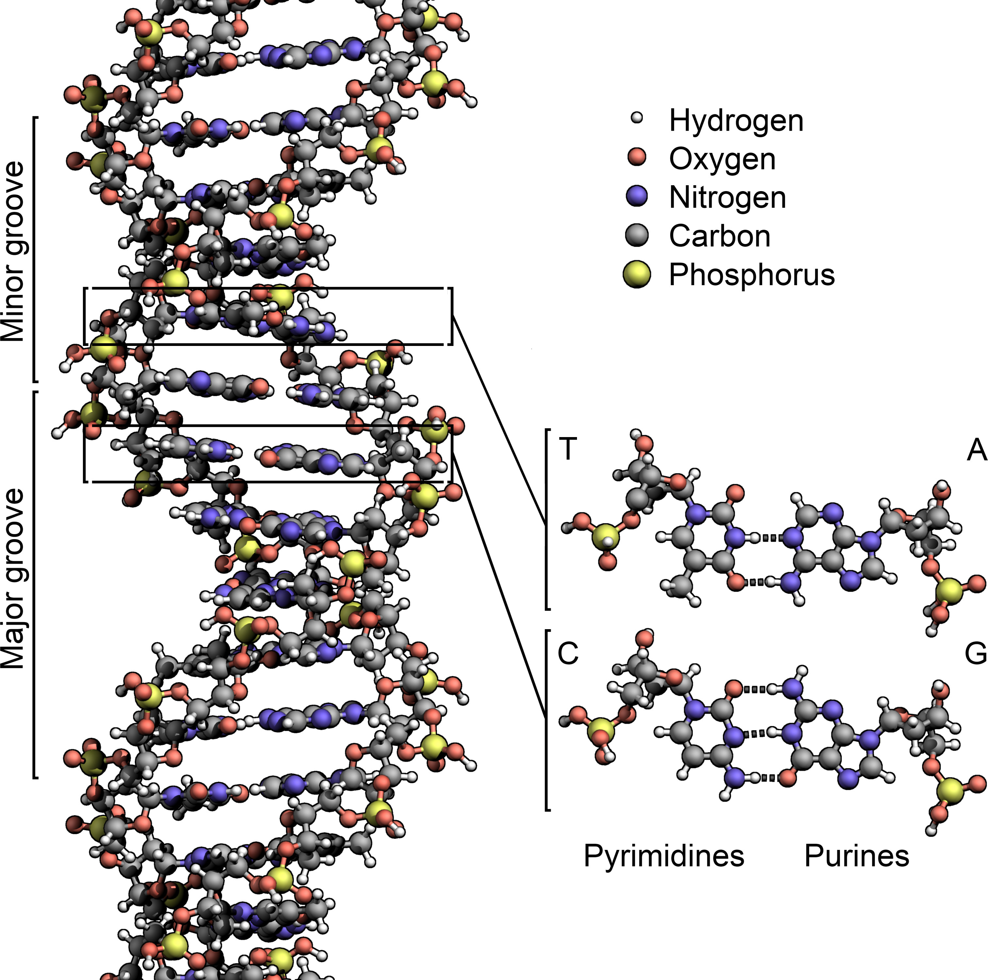
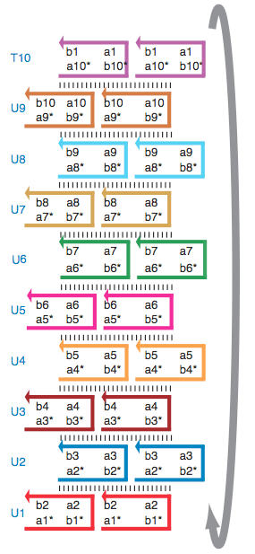
DNA as a building material
=
TCGGAAATAAAATCGGAC
AGCCTTTATTTTAGCCTG
DNA strands bind even if only part of strands are complementary:
=
ATCGCATTAA
TAGCGTAATT

Slide 5
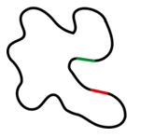


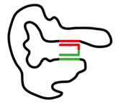
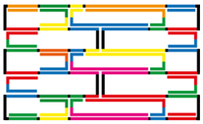

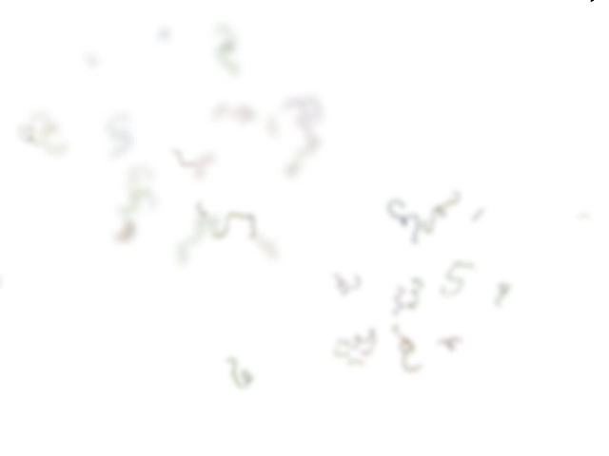
DNA origami
staple DNA strands
(+ water + salt)
folded DNA origami
heat to 90C, cool to 20C over an hour
scaffold DNA strand
(M13mp18 bacteriophage virus)
Paul Rothemund
Folding DNA to create nanoscale shapes and patterns
Nature 2006
© http://openwetware.org/wiki/Biomod/2014/Design
© Shawn Douglas

Slide 6
DNA origami
Paul Rothemund
Folding DNA to create nanoscale shapes and patterns
Nature 2006
Atomic force microscope images
100 nm

Slide 7
Binding graphs
DNA origami: star graph
(all binding is between staples and scaffold)
DNA tiles: grid graph
(tiles bind to each other, each has ≤ 4 neighbors)

Slide 8
DNA tile self-assembly
monomers (“tiles” made from DNA) bind into a crystal lattice
tile
lattice
Source: Programmable disorder in random DNA tilings. Tikhomirov, Petersen, Qian, Nature Nanotechnology 2017
Notes:
What does it mean to say that a physical system “does computation via molecular binding”? Well, it could mean a lot of things, but there’s two popular lines of experimental research, with associated theoretical models, that make this idea specific.
One is DNA tile self-assembly. DNA complexes called tiles---each could be just one strand, could be 4 or 5 strands, this one here is actually made from hundreds of strands---bind to each other in a lattice to form a crystal. Here’s an AFM image of a 2D square lattice crystal made of DNA tiles. It’s not clear how “computation” could happen here, but we’ll get to that.
Another popular nanoscale technology is DNA strand displacement. Here, DNA complexes are more “dynamic”, they can bind, but they can also exchange individual DNA strands with each other and break apart.
I’ll give just enough details of these two methods to justify that they can “compute”, and as I warned, after that we’re going to stop talking about them. →

Slide 9
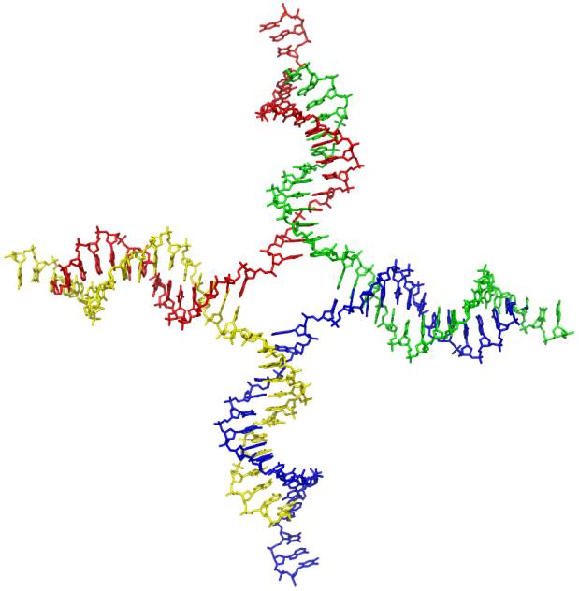
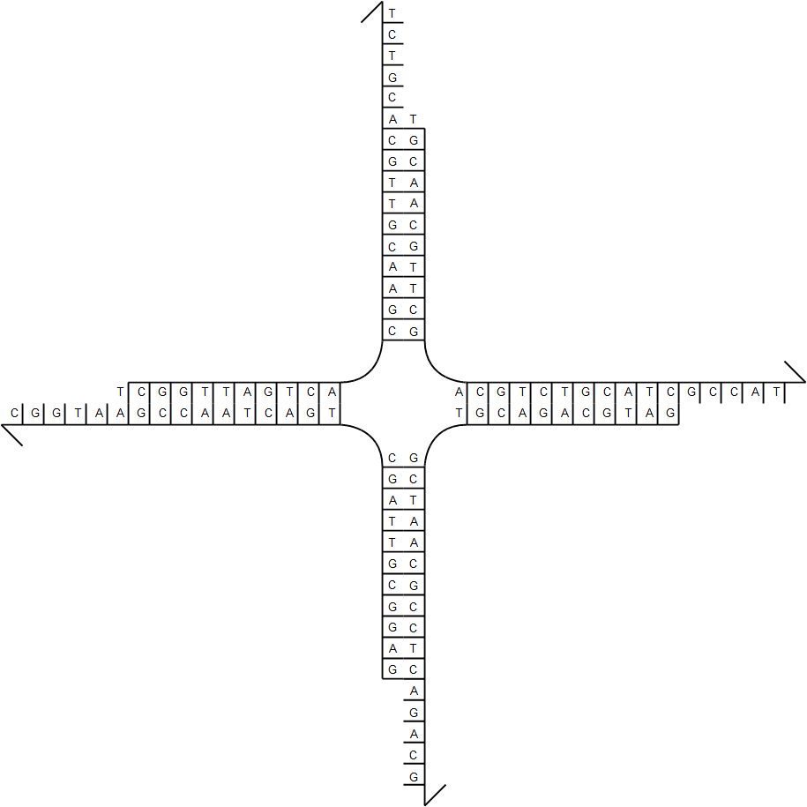
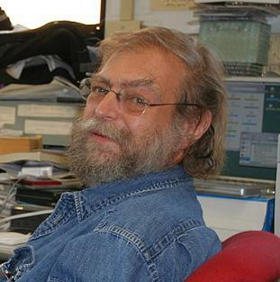
Practice of DNA tile self-assembly
Source:en.wikipedia; Author: Zephyris at en.wikipedia; Permission: PDB; Released under the GNU Free Documentation License.
DNA tile
Ned Seeman, Journal of Theoretical Biology 1982
sticky end
Notes:
DNA tile assembly was pioneered by Ned Seeman, whose first idea used something called a “branched junction” molecule. By synthesizing four strands of DNA as shown, they form this “tile” which has
four “sticky ends”, meaning single strands that are “sticky” because they want to bind to their Watson-Crick complement.
In this case, west is complementary to east, and north is complementary to south, →

Slide 10
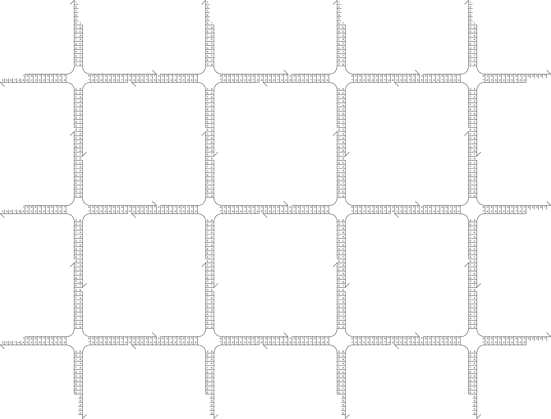
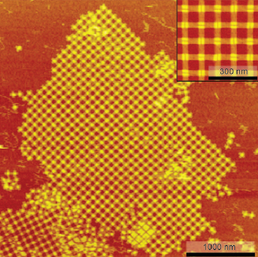
Practice of DNA tile self-assembly
Place many copies of DNA tile in solution…
(not the same tile motif in this image)
Liu, Zhong, Wang, Seeman, Angewandte Chemie 2011
Notes:
so mixed in solution, they self-assemble a regular grid like this. The right image is actually a different tile motif closer to the one you saw a few slides ago, the one on the left doesn’t actually work so well, but it illustrates the idea nicely. →

Slide 11
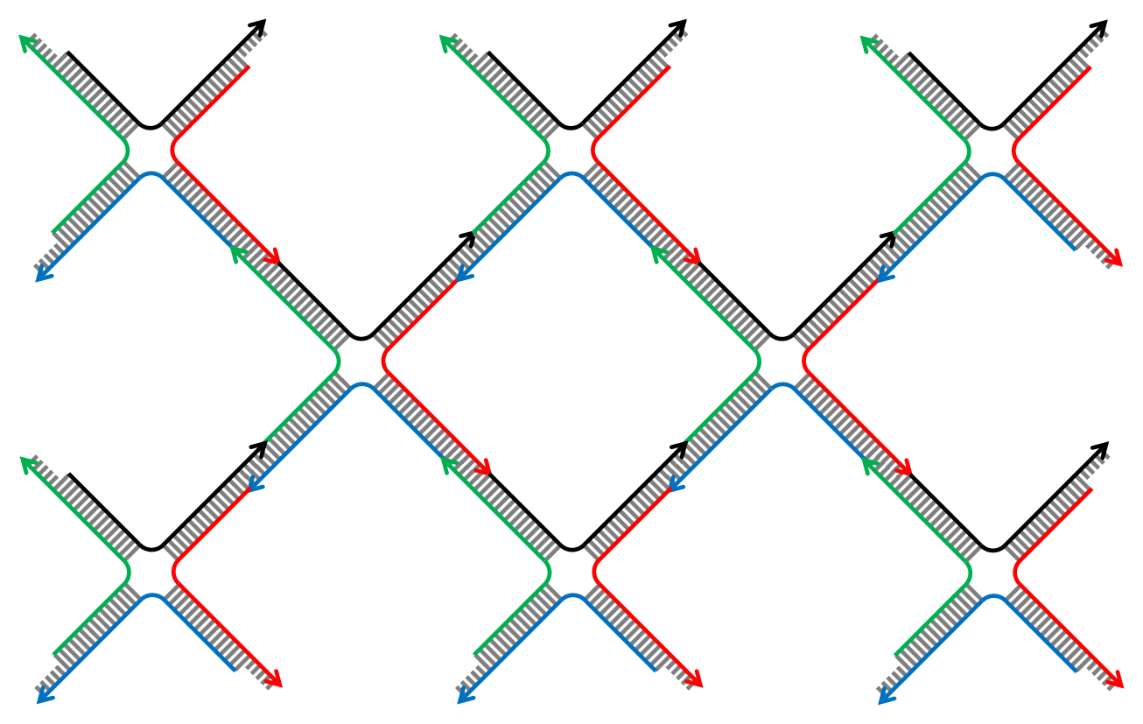
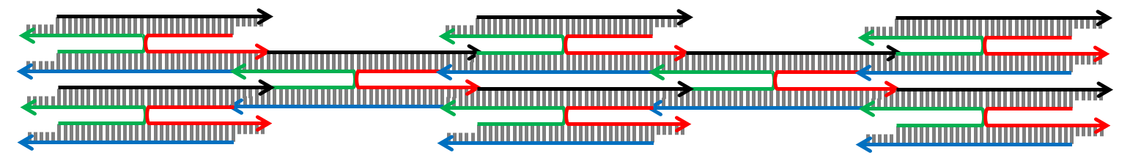
Practice of DNA tile self-assembly
What really happens in practice to Holliday junction (“base stacking”)
Notes:
Now in reality, a phenomenon called “base stacking” implies the tile is more likely to be → shaped like this, → or like this. If we could ensure that the tile always folds consistently, → then the shape of the grid would → flatten, but its connectivity would not change. So how to ensure they all fold the same way? →

Slide 12
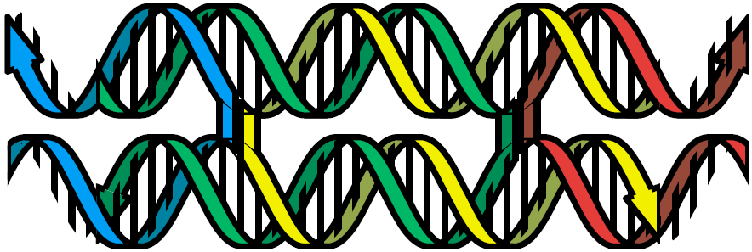
Practice of DNA tile self-assembly
single crossover
Figure from Schulman, Winfree, PNAS 2009
double crossover
Notes:
In this configuration, → the tile consists of two DNA helices in parallel, with a single crossover point where they exchange single strands. → If instead we have two crossovers, then the tile always orients the same way. So does this work? →

Slide 13
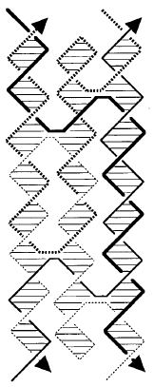
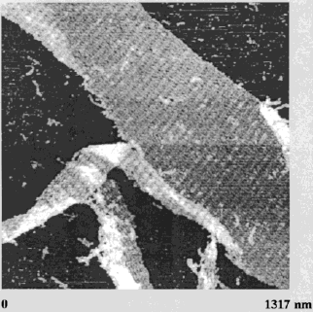
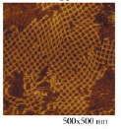
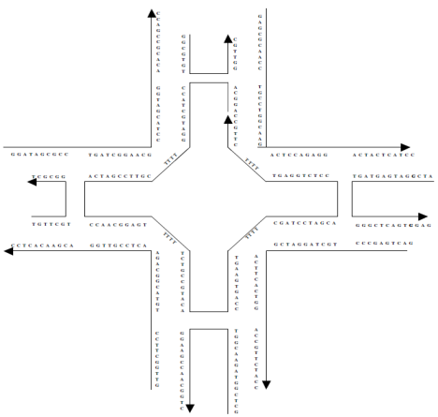

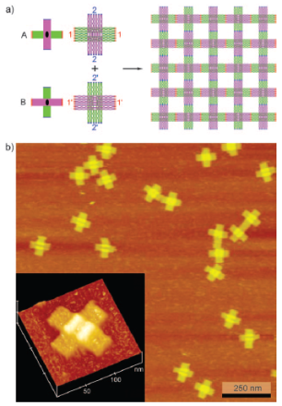
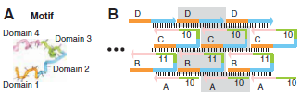



Practice of DNA tile self-assembly
4x4 tile (Yan, Park, Finkelstein, Reif, LaBean, Science 2003)
double-crossover tile (Winfree, Liu, Wenzler, Seeman, Nature 1998)
triple-crossover tile (LaBean, Yan, Kopatsch, Liu, Winfree, Reif, Seeman, JACS 2000)
single-stranded tile (Yin, Hariadi, Sahu, Choi, Park, LaBean, Reif, Science 2008)
DNA origami tile (Liu, Zhong, Wang, Seeman, Angewandte Chemie 2011)
Tikhomirov, Petersen, Qian, Nature Nanotechnology 2017
150 nm
Notes:
There’s no shortage of other experimental designs for making DNA tiles, but this video is about a fascinating theory inspired by these tiles that is independent of the underlying DNA architecture. →

Slide 14

Theory of algorithmic self-assembly
What if…
… there is more than one tile type?
… some sticky ends are “weak”?
Erik Winfree
Notes:
So what’s so “algorithmic” about tiles forming a crystal? Erik Winfree asked two questions, “What if there is more than one tile type?” And “What if some sticky ends are ‘weak’?” →

Slide 15
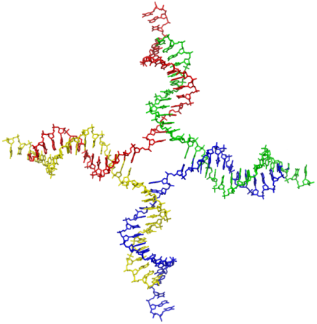
abstract Tile Assembly Model (aTAM)
tile type = unit square
each side has a glue with a label and strength (0, 1, or 2)
tiles cannot rotate
finitely many tile types
infinitely many tiles: copies of each type
assembly starts as a single copy of a special seed tile
tile can bind to the assembly if total binding strength ≥ 2 (two weak glues or one strong glue)
north glue label
west glue label
south glue label
strength 0
strength 1 (weak)
strength 2 (strong)
Erik Winfree, Ph.D. thesis, Caltech 1998
Notes:
Let’s formalize those ideas.
We model the tile as a square.
Each side has a “glue” with a label and an integer strength, strength 1 is weak, and strength 2 is strong .
The tiles cannot rotate. Obviously, real tiles will rotate; what we mean is that we’ll design glues so that they cannot match between two tiles rotated relative to each other.
There are finitely many types of tiles but an infinite number of tiles of each type available, ∞ serving as a useful approximation of 50 billion, which is about how many will be in a test tube at one time.
Assembly starts from a single copy of a specially designated “seed” tile type, and
the key rule that makes it all work, a tile can only bind to an assembly if it binds with total strength at least 2; that means either two weak glues, or one strong glue. →

Slide 16
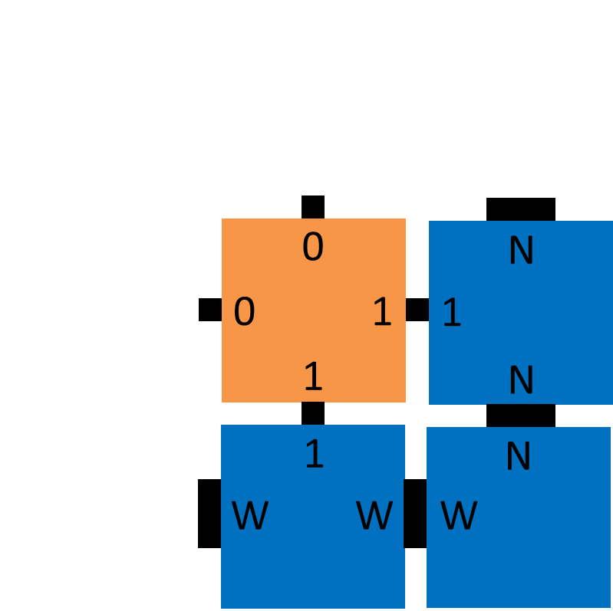




Example tile set
“cooperative binding”
seed
N
N
W
W
XOR
N
1
1
W
W
N
1
1
1
0
1
1
1
0
0
0
0
0
0
1
0
1
Notes:
Let’s see an example. I said we have a finite set of tile types; there’s 7 of them.
We start with a single copy of the seed. Tiles bind asynchronously and nondeterministically whenever there is a way to attach with strength 2,
so the first few attachments might involve these strong bonds.
More interesting is when a tile binds using two weak bonds; this is known as cooperative binding. Because both the bottom and right glues have to match for the orange tile to attach, we think of the tile as computing a
function of two inputs, which are the bits representing each glue.
If you examine these four tile types, you’ll see that the bottom and right glues enumerate every pair of bits, and that the logical XOR of these bits
is then “advertised” on the top and left glues.
If we allow growth to continue, a pattern emerges, →

Slide 17
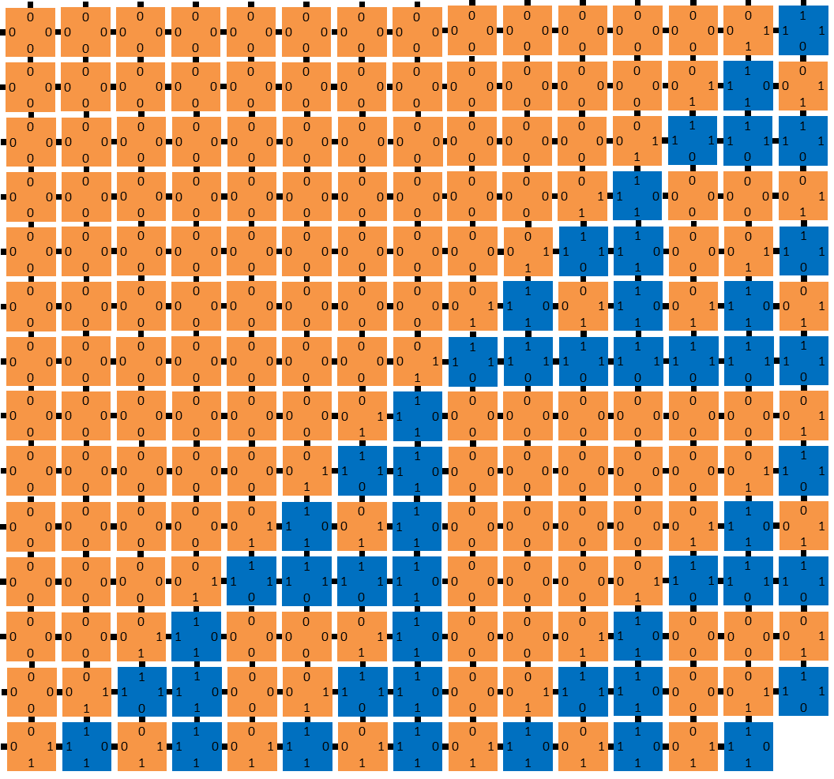
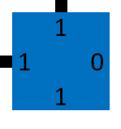
Example tile set
seed
N
W
N
1
1
W
W
N
1
1
1
0
1
1
1
0
0
0
0
0
0
1
0
1
Notes:
→ this pattern that we call the discrete Sierpinski triangle, painted onto the entire second quadrant. Not terribly complex, but not what you would expect to see from random crystal formation, although that’s precisely what this is. I said that the tile types compute a function; we could change that function. XOR is sum modulo 2, in other words, add the bits and throw away the most significant bit of the result. →

Slide 18
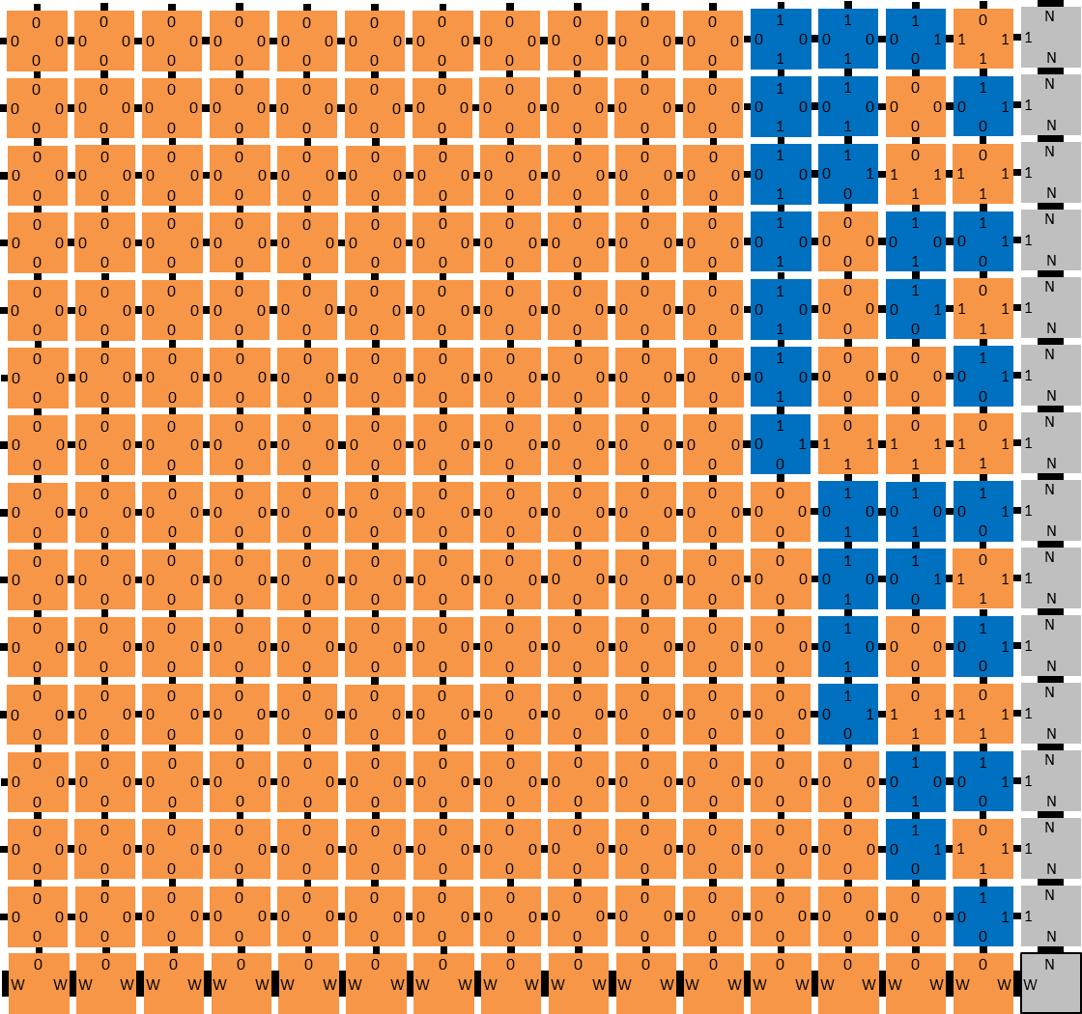
14
13
12
11
seed
10
N
9
N
W
W
8
7
N
0
6
1
W
W
N
5
4
1
1
0
c
Σ
0
0
c
Σ
1
3
HA
HA
1
0
2
change function to half-adder
1
0
0
0
c
Σ
0
1
c
Σ
1
HA
HA
0
0
1
Notes:
Well, instead of throwing it away, we could put it on the left side. Now the tiles compute a different logical function called a “half-adder”. And if we let these grow, they form a different pattern,
familiar to computer scientists; a binary counter. The n’th row of this assembly represents n in binary, with a lot of leading 0s. →

Slide 19


Algorithmic self-assembly in action
raw AFM image
sheared image
shearing
80 nm
[Crystals that count! Physical principles and experimental investigations of DNA tile self-assembly, Constantine Evans, Ph.D. thesis, Caltech, 2014]
Notes:
And here’s some lab results. These tiles aren’t square shaped, they’re elongated so the rows of the counter aren’t rectilinear, but I sheared the image to make it look like a rectangle.
On the right is some unpublished experimental research showing many more varied computations being done by tiles. And if you’re just starting to get comfortable with Tile Assembly, well now we’re going to stop talking about it. →

Slide 20
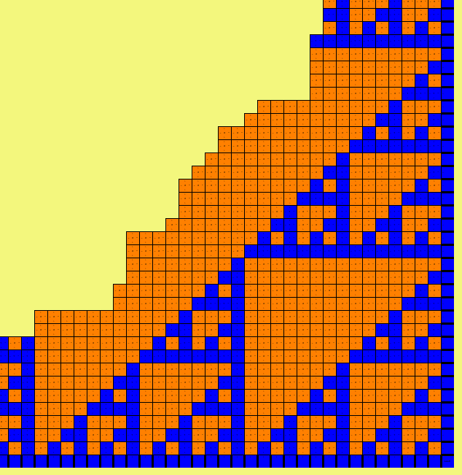
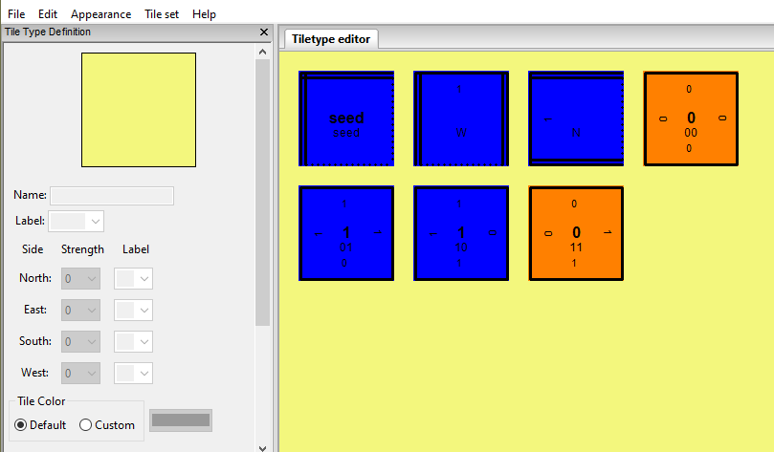
aTAM simulator (ISU TAS by Matt Patitz)
http://self-assembly.net/wiki/index.php?title=ISU_TAS
http://self-assembly.net/wiki/index.php?title=ISU_TAS_Tutorials
See also WebTAS by the same group:
http://self-assembly.net/software/WebTAS/WebTAS-latest/
VersaTile (by Eric Martinez and Cameron Chalk) https://github.com/ericmichael/polyomino
and xgrow (by Erik Winfree) https://www.dna.caltech.edu/Xgrow/

Slide 21
Tile complexity of squares

Slide 22
Tile complexity
Resource bound to minimize, like time or memory with a traditional algorithm.
Why minimize number of tile types?
  Physically synthesizing new tile types is difficult.
  Designing DNA sequences for new tile types is difficult. (DNA sequence design is tougher when more DNA sequences are present.)
  But due to how modern synthesis technologies work, once a tile type is designed, making 50 quadrillion copies of the tile is as easy as making one copy.
So, we ask: how many unique tile types to we need to self-assemble some shapes?
We start with n x n squares as the “simplest” benchmark shape.
  Why not a 1 x n line as an even simpler shape? What is its tile complexity?
[Note: we have not formally defined the aTAM yet… first let’s build intuition.]

Slide 23
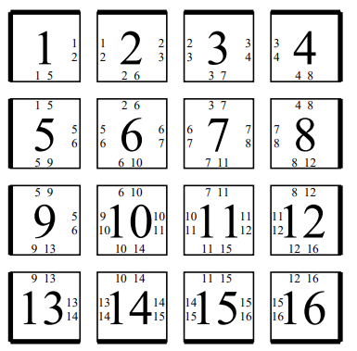
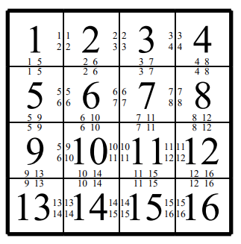
The program size complexity of self-assembled squares
Question: How many tile types do we need to self-assemble an n x n square?
Concretely: how to assemble a 4 x 4 square?
All glues are strength 2
(alternately: all are strength 1 and temperature τ = 1)
How many tile types does this construction need in general to assemble an n x n square?
n²
https://www.dna.caltech.edu/Papers/squares_STOC.pdf
This paper is directly responsible for convincing many theoretical computer scientists that DNA self-assembly is worth studying.

Slide 24
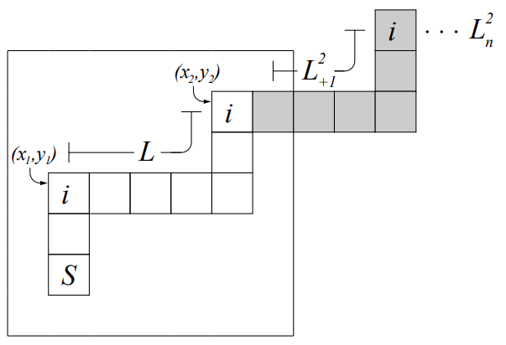
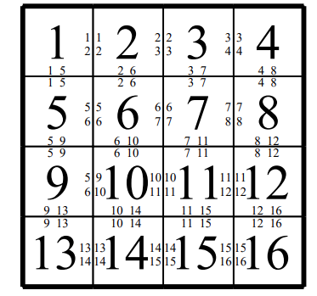
Tile complexity at temperature τ = 1
(i.e., no cooperative binding allowed)
Is n² optimal?
Can we do better?
Theorem: At temperature τ = 1, if all pairs of adjacent tiles bind with positive strength, then for every positive integer n, n² tile types are necessary to self-assemble an n x n square.
Note all pairs of adjacent tiles bind with positive strength:
Proof: Suppose for contradiction we use the same tile type i at positions (x₁,y₁) and (x₂,y₂). Then they have a path L between them with all positive-strength glues, and this can happen instead:

Slide 25
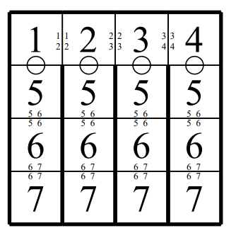
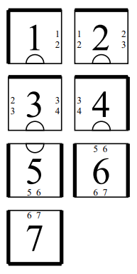
Tile complexity at temperature τ = 1, where not all adjacent tiles are bound
Is n² still optimal?
No!
Tile complexity of this construction?
2n – 1 = O(n)
Conjecture: The temperature τ = 1 tile complexity of an n x n square is Ω(n).
(most recent progress:
https://arxiv.org/abs/1902.02253
https://arxiv.org/abs/2002.04012 )
strength-0 glues

Slide 26
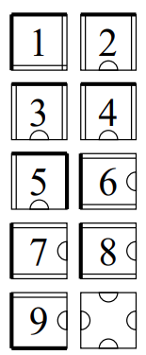
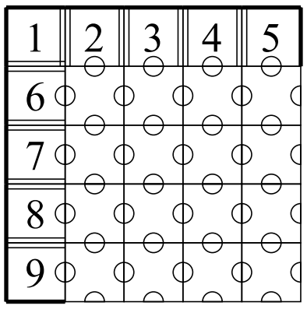
Tile complexity at temperature τ = 2
(i.e., cooperative binding allowed)
Tile complexity = 2n
these glues should all be different
strength-1 glues (with no other glues to cooperate with)
This tile completes an n x n “L shape” into an n x n square.

Slide 27
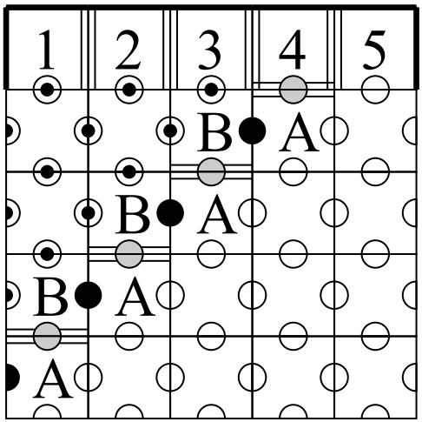
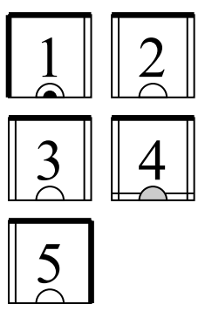
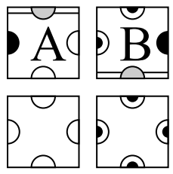
Tile complexity at temperature τ = 2
Goal: complete a 1 x n line into an n x n square
Tile complexity = n + 4
How to get sublinear tile complexity?

Slide 28












Logarithmic tile complexity at temperature τ = 2
Goal: rectangle of height n using O(log n) tile types
for width of k bits, stops when it reaches what value?
“zig-zag counter”
copy tiles
increment row
increment tiles
copy row
increment row
Unique glues (not shown)
seed tile
row encoding (a number related to) n

Slide 29


Logarithmic tile complexity at temperature τ = 2
A few more “filler” tiles complete the ≈n x log n rectangle into an n x n square.
tile complexity =
log n + 23
What number should this encode?

Slide 30
Ω(log n / log log n) tile complexity lower bound for n x n squares
What does Ω(log n / log log n) tile complexity lower bound mean?
  First let’s think about what we already showed: what does O(log n) tile complexity upper bound mean? For all n, O(log n) tile types is enough to self-assemble an n x n square.
  A lower bound looks like: For infinitely many n, o(log n / log log n) tile types is not enough to self-assemble an n x n square.
How to prove? It’s a counting argument:
  Count number of (functionally distinct) tile systems with fewer than ¼ log p / log log p tile types.
    We’ll show that it’s fewer than p.
  There are p squares with width n between p+1 and 2p; each needs a different tile system.
  By pigeonhole, some n x n square cannot be assembled with < ¼ log p / log log p tile types.
  Since p ≤ n/2, we have ¼ log p / log log p ≤ ¼ log n / log log n.
  Since we can do this for every positive integer p, there are infinitely many n that require more than ¼ log n / log log n tile types (a stronger result holds: “most” values of n require that many)

Slide 31
How many tile systems with k tile types?
Goal: show that there are fewer than p (“functionally distinct”) tile systems with k = ¼ log p / log log p tile types.
How many have exactly k tile types? Count each of the ways to define the tile system:
  How many different glues can we have?
  How many ways can we choose the 4 glues for one tile type?
  How many ways to choose the glues for all k tile types?
  How many ways to choose the seed tile?
How many tile systems?
4k
a⁴ = (4k)⁴
b^{k} = (4k)^{4k}
k
c∙d = k(4k)^{4k}

Slide 32
How many tile systems with k tile types?
Number of tile systems with exactly k tile types:
Number of tile systems with at most k tile types:
Recall k = ¼ log p / log log p; by algebra (see notes), k²(4k)^{4k} < p.
By pigeonhole principle, for some width n with p < n ≤ 2p, the n x n square is not self-assembled by one of these k²(4k)^{4k} tile systems. Since those are all the tile systems with at most k tile types, the n x n square requires more than ¼ log p / log log p tile types to self-assemble. QED
≤ k(4k)^{4k}
≤ k²(4k)^{4k}

Slide 33
“Descriptional Complexity” proof
Fact: “most” integers n require ≥ log n bits to “describe”.
(Though some require fewer: 1111111111111111111111
can be described by its length 22 in binary: 10110)
Can be formalized with Kolmogorov complexity
  https://en.wikipedia.org/wiki/Kolmogorov_complexity
We can “describe” n with a tile system that self-assembles an n x n square.
How many bits do we need to describe a tile system with k tile types?
  log(4k) to describe one of the 4k glues, e.g., 8 glues: 000, 001, 010, 011, 100, 101, 110, 111
  4 log(4k) to describe one tile type consisting of 4 glues, e.g., tile b = (010, 011, 111, 100)
  4k log(4k) to describe all k tile types, plus log k to give index of the seed.
  So O(k log k) bits total.
For any n in the Fact, log n = O(k log k), i.e., k = Ω(log n / log log n).
Note: we’re ignoring glue strengths here; adds 2 bits per glue to describe at temperature 2. (since there are 3 possible strengths 0, 1, 2);
see http://doi.org/10.1007/s00453-014-9879-3 for handling higher-temperature systems.

Slide 34
Which bound is tight?
All n x n squares can be assembled with O(log n) tile types; can we get it down to O(log n / log log n)?
Or do we need Ω(log n) tile types to assemble infinitely many n x n squares?

Slide 35
Improved upper bound: self-assembling an n x n square with O(log n / log log n) tile types
Recall:
Idea:
1) Use same 23 tiles that turn the seed row encoding a binary integer n’ (related to n) into an n x n square.
2) Create the binary seed row from only log n / log log n tiles.
tile complexity =
O(log n) + 23

Slide 36
Creating a row of log n glues with arbitrary bit string s ∈ {0,1}^{log n} using O(log n / log log n) tile types
Key idea: choose larger power-of-two base b = 2^{k}, with b ≈ log n / log log n, and convert from base b to base 2.
How many base-b digits needed to represent a log(n)-bit integer?
Each base-b digit is k bits
  e.g., if b=2³=8, then 0=000 1=001 2=010 3=011 4=100 5=101 6=110 7=111
  e.g., the octal number 7125₈ in binary is 111001010101₂
  need log(n) / k = log(n) / log (log n / log log n) = log(n) / (log log n – log log log n) ≈ log(n) / log log n base-b digits.

Slide 37
Creating a row of log n glues with arbitrary bit string s ∈ {0,1}* using log n / log log n tile types (i.e., base conversion from b to 2)
s = 110 001 011 101
b = 2³ = 8
hard-coded tiles:
1
m
1
0
0
0
1
0
1
1
1
0
1
L
1
1
10
10
101
101
1
m
1
0
0
0
1
0
1
1
n
L
L
s1
1
m
1
0
0
0
1
0
1
1
n
s1
0
0
01
01
011
011
011
011
011
011
011
011
1
m
1
0
0
0
1
n
s2
1
m
1
0
0
0
1
n
s2
0
0
00
00
001
001
001
001
001
001
001
001
001
001
001
001
001
001
1
m
1
0
n
s3
1
m
1
0
n
s3
1
1
11
11
110
110
110
110
110
110
110
110
110
110
110
110
110
110
110
110
110
110
110
110
m
m
m
m
m
m
m
m
m
m
m
m
m
m
m
m
m
m
m
m
m
m
m
m
“almost” works… what’s missing?
mark glues of most and least significant bit

Slide 38
Formal definition of aTAM

Slide 39
abstract Tile Assembly Model (aTAM), formal definition
Fix a finite alphabet Σ. A glue is a pair g = (ℓ,s) ∈ Σ* x ℕ, with label ℓ and strength s.
A tile type is a 4-tuple of glues t ∈ (Σ* x ℕ)⁴, with each glue listed in order north, east, south, west.
  Define unit vectors N = (0,1), S = (0,–1), E = (1,0), W = (–1,0)
  For d ∈ {N, E, S, W}, let d* denote the opposite direction of d, i.e., N* = S, S* = N, E* = W, W* = E.
  Let t[N], t[E], t[S], t[W] be the glues of t in order.
  T denotes the set of tile types.
An assembly is a partial function α: ℤ² ⇢ T, such that dom α (set of points where α is defined) is connected.
  a partial function indicating, for each (x,y) ∈ ℤ², which tile is at (x,y), with α(x,y) undefined if no tile appears there.
Let S_{α} = dom α denote the shape of α. Let |α| = |S_{α}|.
Given p,q ∈ S_{α}, two tiles t_{p} = α(p) and t_{q} = α(q) interact (a.k.a. bind) if:
  ∥p − q∥₂ = 1 (positions p ∈ ℤ² and q ∈ ℤ² are adjacent)
  letting d = q – p (the direction pointing from p to q), t_{p}[d] = t_{q}[d*] (the glues match where t_{p} and t_{q} touch)
  t_{p}[d] has positive strength (the glues are not zero-strength)
Let B_{α} = (V,E) denote the binding graph of α, where
  V = S_{α}
  E = { (p,q) | α(p) and α(q) interact }
  B_{α} is a weighted, undirected graph: Each edge’s weight is the strength of the glue it represents.
Given τ ∈ ℕ⁺, α is τ-stable if the minimum weight cut of B_{α} is at least τ.
  i.e., to separate α into two pieces requires breaking bonds of strength at least τ.

Slide 40
abstract Tile Assembly Model (aTAM), formal definition
Given assemblies α,β: ℤ² ⇢ T, we say α is a subassembly of β, written α ⊑ β if
  S_{α} ⊆ S_{β} (α is contained in β), and
  for all p ∈ S_{α}, α(p) = β(p) (α and β agree on tile types wherever they share a position)
We say Θ = (T,σ,τ) is a tile system, where T is a finite set of tile types, τ ∈ ℕ⁺ is the temperature, and σ: ℤ² ⇢ T is the finite, τ-stable seed assembly.
We say α produces β in one step, denoted α →₁ β, to denote that α ⊑ β, |S_{β} \ S_{α}| = 1, and letting {p} = S_{β} \ S_{α} be the point in β but not α, the cut ({p},S_{α}) of the binding graph B_{β} has weight ≥ τ.
  (one new tile β(p) attaches to α with strength at least τ to create β)
  If the tile type added is t, write β = α + (p ↦ t).
The frontier of α is denoted ∂α = ⋃_{α →1 β} (S_{β} \ S_{α}) (empty locations adjacent to α where a tile can stably attach to α.)
A sequence of k ∈ ℕ∪{∞} assemblies α₀, α₁, … is an assembly sequence if for all 0 ≤ i < k, α_{i} →₁ α_{i+1}.
We say that α produces β (in 0 or more steps), denoted α → β, if there is an assembly sequence α₀, α₁, … of length k ∈ ℕ∪{∞} such that
  α = α₀
  for all 0 ≤ i < k, α_{i} ⊑ β, and
  S_{β} = ⋃_{i} S_{αi}
We say β is the result of the assembly sequence.
If k is finite, it is routine to verify that β = α_{k}, and → is the reflexive, transitive closure →₁* of →₁.
Question: If α ⊑ β, can α grow into β?
Sometimes we write α →^{Θ} β to emphasize this is with respect to a particular tile system Θ.
Why can’t we just say → is the reflexive, transitive closure →₁* of →₁?

Slide 41

abstract Tile Assembly Model (aTAM), formal definition
Given tile system Θ = (T,σ,τ), we say α is producible if σ → α.
  Write A[Θ] to denote the set of all producible assemblies.
We say α is terminal if α is stable and ∂α = ∅. (no tile can stably attach to it)
  Write A□[Θ] ⊆ A[Θ] to denote the set of all producible, terminal assemblies.
We say Θ is directed (a.k.a., deterministic) if
  |A□[Θ]| = 1. (this is what we want it to mean: only one terminal producible assembly)
  equivalently, the partially ordered set (A[Θ], →) is directed: for each α,β ∈ A[Θ], there exists γ ∈ A[Θ] such that α → γ and β → γ.
  equivalently, for all α,β ∈ A[Θ] and all p ∈ S_{α} ⋂ S_{β}, α(p) = β(p).
Let X be a shape, a connected subset of ℤ². Θ strictly self-assembles X if, for all α ∈ A□[Θ], S_{α} = X. (every terminal producible assembly has shape X)
  Note X can be infinite.
  Example: strict self-assembly of entire second quadrant X = { (x,y) ∈ ℤ² | x ≥ 0 and y ≤ 0 }
  Example of tile system Θ that does not strictly self-assemble any shape?
Let X ⊆ ℤ². Θ weakly self-assembles X if there is a subset B ⊆ T (the “blue tiles”) such that, for all α ∈ A□[Θ], X = α^{–1}(B). (every terminal producible assembly puts blue tiles exactly on X.)
  example: weak self-assembly of the discrete Sierpinski triangle.

Slide 42
Basic stability result
Observation: Let α ⊑ β be stable assemblies and p ∈ ℤ² \ S_{β} such that α + (p↦t) is stable. Then β + (p↦t) is also stable.
Intuition: if a tile can attach to α, it can attach in the presence of extra tiles on α.
example:
Proof:
Since β is stable and glue strengths are nonnegative, the only potentially unstable cut is ({p},S_{β}).
But:
  α ⊑ β,
  α + (p↦t) is stable,
  compared to α, β only has extra tiles on the other side of the cut (t,S_{β}).
  so the cut (t,S_{β}) is also stable. QED
β
α
⇒
p
p
t
t

Slide 43
Basic reachability result
Intuition: if α can grow into γ, then if some of what will attach is already present (β), the remaining tiles can still attach.
Rothemund’s Lemma: Let α ⊑ β ⊑ γ be stable assemblies such that α → γ. Then β → γ.
Proof:
Let α=α₀, α₁, … be an assembly sequence with result γ.
For each i, let p_{i} = S_{αi+1} \ S_{αi} (i’th attachment position) and t_{i} the i’th tile added.
Let i(0) < i(1) < … such that S_{γ} \ S_{β} = {i(0), i(1), …} (subsequence of indices of tile attached outside of β).
Define assembly sequence β=β₀,β₁,… by β_{j+1} = β_{j}+(p_{i(j)}↦t_{i(j)}). (adding tiles to S_{γ} \ S_{β} in order they were added to α, skipping tiles already in S_{β}.)
Then for each j, α_{i(j)} ⊑ β_{j}, so previous Observation implies that β_{j} + (p_{i(j)}↦t_{i(j)}) is stable.
Thus the assembly sequence is valid (each tile attachment is stable), showing β → γ. QED
example:
α
γ
if
→
→
β
then

Slide 44
example of usefulness of Rothemund’s Lemma
Recall two alternate characterizations of deterministic tile systems:
  (a) |A□[Θ]| = 1.
  (b) for all α,β ∈ A[Θ] and all p ∈ S_{α} ⋂ S_{β}, α(p) = β(p).
Rothemund’s Lemma can be used to show that (b) implies (a)
  will skip in lecture (optional problem on homework 1)

Slide 45
Fair assembly sequences
Definition: Let α₀, α₁, … be an assembly sequence. We say it is fair if, for all i ∈ ℕ and all p ∈ ∂α_{i}, there exists j > i such that p ∈ S_{αj}.
Intuition: Every frontier location eventually gets a tile; none are “starved”
Lemma: Let α₀, α₁, … be a fair assembly sequence. Then its result γ is terminal.
Corollary: For every assembly α, there is a terminal assembly γ such that α → γ.
Proof:
Suppose for the sake of contradiction that γ is not terminal, i.e., it has frontier location p ∈ ∂γ; note in particular p ∉ S_{γ}.
Simpler if assembly sequence is finite:
  in this case, γ = α_{k-1}, so p never receives a tile.
  Thus the assembly sequence is not fair. (there is no j > k-1 such that p ∈ S_{αj})
Now assume assembly sequence is infinite. (actually, rest of proof works in finite case)
Since p ∈ ∂γ, there are positions adjacent to p with enough strength to bind a tile t. Let N be the set of these positions. Note N is finite since p has at most four neighbors.
Since S_{γ} = ⋃_{i} S_{αi}, there exists i such that N ⊆ ∂α_{i} (after some finite number of tile attachments, all of the positions in N are on the frontier of the current assembly)
Thus p ∈ ∂α_{i}. (the tile t can attach to α_{i}, reached after only i steps)
By fairness, there exists j such that p ∈ S_{αj} ⊆ S_{γ} (eventually p gets a tile), which contradicts the claim that p ∉ S_{γ}. QED
Proof: Pick any fair assembly sequence α=α₀, α₁, … ; its result γ is terminal and α → γ . QED
Concrete example of simulation algorithm creating a fair assembly sequence?

Slide 46
How computationally powerful are self-assembling tiles?

Slide 47
Turing machines
state ≈ line of code
current symbol
next symbol
initial state = s
current state
next state
next move
s
q
t
q
s,0: q,0,→
s
u
q,0: t,1,←
q,1: s,0,→
…
0
1
1
_
_
_
0
1
0
0
1
1
t,0: u,1,→
u,1: HALT
transitions
(instructions)
tape ≈ memory

Slide 48
Tile assembly is Turing-universal
time
HALT
halt
0
0
1
u 1
1
1
_
_
_
_
_
_
0
0
1
halt
1
1
_
_
_
_
_
_^
→
→
→
→
u
→
u
→
←
←
←
←
←
←
←
←
←
←
←
←
←
←
*
*
0
0
t 0
1
1
1
_
_
_
_
_^
0
0
t 0
1
1
1
_
_
_
_
_
0
0
t 0
1
1
1
_
_
_
_
_^
→
→
→
→
t
←
t
←
←
←
←
←
←
←
←
←
←
←
←
←
*
*
0
0
0
q 0
1
1
_
_
_
_^
0
0
0
q 0
1
1
_
_
_
_
0
0
0
q 0
1
1
_
_
_
_^
→
→
→
→
q
→
q
→
←
←
←
←
←
←
←
←
←
←
*
*
0
0
s 0
0
1
1
_
_
_^
0
0
s 0
0
1
1
_
_
_
s,0: q,0,→
0
0
s 0
0
1
1
_
_
_^
→
→
s
→
s
→
←
←
←
←
←
←
←
←
←
←
*
*
0
q 1
0
0
1
1
_
_^
q,0: t,1,←
0
q 1
0
0
1
1
_
_
0
q 1
0
0
1
1
_
_^
q
→
q
→
←
←
←
←
←
←
←
←
←
←
*
*
q,1: s,0,→
s 0
1
0
0
1
1
_^
s 0
1
0
0
1
1
_
t,0: u,1,→
s 0
1
0
0
1
1
_^
1
1
2
2
3
3
4
4
5
5
6
6
u,1: HALT
space
Notes:
The model is Turing-universal, which means that it can simulate any algorithm, in a straightforward manner. We can define “algorithm” to mean “single-tape Turing machine”, which is defined by → rules like this, which stipulate that if the machine is in a → state s and reading the → bit 0, then it changes to → state q, writes a → bit 0 (in other words, leaves the bit alone), and → moves to the right. → A finite list of such rules define a Turing machine. We can represent this machine in its initial state s by a → tile that encodes the state s, and → some tiles that immediately bind to the right to represent the initial input bit string, with a blank symbol just to the right. The orange tile represents where the tape head is. → This means the first rule applies, and on the → next tile to attach, we represent the written bit on the → top glue and the next state and tape move → on the right glue. The → next attachment crucially uses cooperative binding to combine the → new state with the symbol on the new tape cell. → Some tiles bind to copy the rest of the bits to the next row. We also design the tiles at the edge to expand the number of tape cells by one each time, → which ensures that the Turing machine has an arbitrary amount of tape space available, should it be needed. Now that we’ve simulated a step of the Turing machine, → a new transition rules applies. → We apply it as before. → And again. → And again. → And again. Finally, → the computation is done. What we’ve assembled is a → space → time configuration history of the Turing machine. What this means is that self-assembling tiles can do any computation that is possible that is possible to do by any algorithm, and therefore that computation can be used to control the assembly of the tiles. It’s essentially a → crystal that thinks about how it’s growing. And this is the reason that computer science has had so much to say about the possibilities, and limitations, of molecular self-assembly. →

Slide 49
Complexity of self-assembled shapes
We’ve seen how use algorithmic tiles to:
  self-assemble n x n squares with “few” tile types O(log n / log log n)
  simulate a Turing machine that grows a “wedge” describing its space-time configuration history
What other shapes can be self-assembled?
  Define a shape to be a finite, connected subset of ℕ².
  Any shape with n points can be self-assembled with at most how many tile types?
Is there an infinite family of shapes S₁, S₂, …, with |S_{n}| = n, such that each S_{n} requires at least n tile types to self-assemble?
2,3
0,2
1,2
2,2
1,2
2,2
0,1
1,1
2,1
0,1
1,1
2,1
0,0
1,0
2,0
2,0
n
…
S₁ =
S₂ =
S₃ =
S₄ =

Slide 50
Complexity of self-assembled shapes
Suppose we are content to create a scaled up version of the shape:
S
S³
scale factor 3
Theorem: For any shape S, there is a constant c so that S^{c} can be self-assembled with O(k / log k) tile types, where k is the length in bits of the shortest program (input to a universal Turing machine) that, on input (x,y), indicates whether (x,y) ∈ S.
Theorem (that we won’t prove): This is optimal! No smaller tile system could self-assemble any scaling of S. If one existed, we could turn it into a program with < k bits “describing” S in this way. (Why?)
[Complexity of Self-Assembled Shapes. Soloveichik and Winfree, SIAM Journal on Computing 2007]

Slide 51


Slide 52
Programming a shape (inaccurate cartoonish overview)
base-conversion to produce k bits from k / log k tile types
y
P
1
program
for UTM
0
x
P
0
1
compute P(0,0)
0
1
1
input to P
0
P
0
1
0
P
compute P(1,0)
1
0
1
slight modification of how P “computes” shape S: P(x,y) computes spanning tree of S, outputs children of point (x,y)
-1
0
P
0
-1
compute P(0,-1)
Notes:
* Finally, the main task.
* We have a shape we want to grow, and I want to think of one of its points as being at the origin; we'll start the growth of tiles there.
* Now this point won't correspond to a single tile; it'll be represented by a big square block of tiles; we assemble a scaled-up version of the shape instead of the shape itself.
* We start with what we know how to do, assemble a rectangle inside this block that encodes a binary string of our choosing.
* So what string should we choose? It'll be three parts, a program (as in, something you could give to a universal Turing machine), together with two integer inputs to the program, which represent coordinates of a point in this shape.
* P is specific to this shape, so different shapes would have a different program.
* What does P do? It figures out a spanning tree of the shape, rooted at the origin, and it outputs the children of the input point in the spanning tree.
* The tiles run this program on input (0,0), and it outputs the children of (0,0), which are the point below (0,-1), and the point to the right (1,0), along with copies of the program P.
* Now some tiles grow to propagate this data to the neighboring blocks that represent these points, so this one goes below and this one goes to the right.
* Some tiles fill in the rest of the block.
* And now, look at what we have; these blocks now have the information needed to do what this block just did: figure out *their* child blocks and grow into them.
* And in this way, the tiles assemble the whole shape, in an order dictated by the spanning tree.
* And that's how we make whatever shape we want grow from this universal tile set, just by adjusting their concentrations.

Slide 53


More accurate detailed overview
seed block
growth block

Slide 54

fully-detailed example of growth block

Slide 55
Two interpretations
i.e., T is a universal set of tile types that can self-assemble any shape, by giving it the right seed.
as stated for single seed tile:
alternative statement for larger seed:
Theorem: For any shape S, there is a constant c so that S^{c} can be self-assembled with O(k / log k) tile types, where k is the length in bits of the shortest program (input to a universal Turing machine) that, on input (x,y), indicates whether (x,y) ∈ S.
Theorem: There is a single set T of tile types (O(1) tile types), so that, for any finite shape S, there a constant c and a seed assembly σ_{S} “encoding” S, so that T self-assembles S^{c} from σ_{S}.
most of the tile complexity is encoding the binary string representing the program P that encodes shape S, and O(1) tile types can read that string and self-assemble S^{c} from it.
program
for UTM
P
σ_{S} =
input to P
0
0

Slide 56
Strict and weak self-assembly
Computability-theoretic questions about self-assembly

Slide 57
Strict and weak self-assembly
Recall:
Let X ⊆ ℤ² be a shape, a connected subset of ℤ². Θ strictly self-assembles X if, for all α ∈ A□[Θ], S_{α} = X.
(every terminal producible assembly has shape X)
Let X ⊆ ℤ². Θ weakly self-assembles X if there is a subset B ⊆ T (the “blue tiles”) such that, for all α ∈ A□[Θ], X = α^{–1}(B).
(every terminal producible assembly puts blue tiles exactly on X.)
Tile system on right strictly self-assembles the whole second quadrant, and it weakly self-assembles the discrete Sierpinski triangle.

Slide 58
Strict self-assembly
Homework problem: you will show that any shape S ⊆ ℤ² that can be strictly self-assembled is also computably enumerable.
Use that fact now to define an explicit shape that cannot be strictly self-assembled.
Observation: There is an infinite shape S ⊆ ℤ² that cannot be strictly self-assembled by any tile system.
Proof:
There are uncountably many shapes but only countably many tile systems.
path in block n has a “turnout” if and only if n’th Turing machine halts on empty input
?
…
Observation is non-constructive: Doesn’t tell us what is the shape S. Can we devise a concrete example of a shape that cannot be strictly self-assembled?
0
1
2
3
4
5
6
Question: Is there a computable shape S ⊆ ℤ² that cannot be strictly self-assembled?

Slide 59
A famous fractal
Let S₀ = { (0,0) }
Let V = { (0,0), (0,1), (1,0) } be three vectors for “recursive translation”.
S is known as the discrete Sierpinski triangle…
Observation: S is computable (easily).
…
[slide credit: Scott Summers]
S₀
S₁
S₂
S₃
S₄

Slide 60
The discrete Sierpinkski triangle cannot be strictly self-assembled
…
Proof:
The shape is a tree: no cycles in the grid graph.
The x-axis has infinitely many pinch points: points where the subtree above the point is distinct from any other pinch point.
The north glue must be distinct at each pinch point, so no finite tile set suffices to self-assemble X. QED
[Lathrop, Lutz, Summers, Strict self-assembly of discrete Sierpinski triangles, Theoretical Computer Science 2009.]
…
…

Slide 61

Weak self-assembly
Theorem: Some computable sets X ⊆ ℤ² cannot be weakly self-assembled.
Proof:
The Time Hierarchy Theorem says there is a computable set A ⊆ {1}* not computable in O(n⁴) time.
Let R = {|x| : x ∈ A} be the set of lengths of strings in A.
Define X ⊆ ℤ² to be the set of “concentric diamonds” whose L₁ radii are in R, e.g., if R = {1, 4, 8, …}
Suppose X could be weakly self-assembled. Then simulating self-assembly for (2n)² steps necessarily places a tile at some point at L₁ radius n from the origin; the tile’s color tells us whether n ∈ R ⇔ 1^{n} ∈ A.
This can be done in time O(n⁴) time (why?), a contradiction. QED
Theorem: Every computable set X ⊆ ℕ, “embedded straightforwardly” in ℤ², can be weakly self-assembled.
y
x
e.g., X = {0, 2, …}
Turing machine M computes X; tiles sequentially simulate M on all inputs 0, 1, 2, …,
[Patitz, Summers, Self-assembly of decidable sets, UCNC 2008.]
[Lathrop, Lutz, Patitz, Summers, Computability and Complexity in Self-Assembly, CiE 2008.]

Slide 62
Randomized self-assembly

Slide 63
Tile complexity of universal shape construction
Recall: if we can have a seed structure encoding a shape S (in a binary string x ∈ {0,1}*, in glues on one side), we can self-assemble some scaling S^{c} of S with O(1) additional tile types that read and interpret x.
Θ(K(x) / log K(x)) tile types are necessary and sufficient to create x from a single seed tile in the aTAM. (K(x) = length in bits of shortest program for universal Turing machine that prints x)
We’ll see how to get this down to O(1) with high probability by concentration programming.
  i.e., move the effort from designing new tile types to (the plausibly simpler lab step of) altering concentrations of existing tile types

Slide 64
Nondeterministic binding
G
concentration 11
1
seed
1
S
concentration 1
1
Pr[ ] = 11/12
seed
G
1
1
Pr[ ] = 1/12
seed
S
1
1
Notes:
* The tile sets I showed already were deterministic in the sense that, no matter the binding site chosen for the next attachment, at any given binding site, only one tile type can attach.
* If instead two tile types compete, it's reasonable to assume that their relative concentrations determine the probability that each succeeds.
* In this case, the probability of ending up with a green tile is 11/12, since it's 11 times more concentrated than the red tile.
* If a tile set is deterministic, it can only assemble one structure. If you want to assemble different structures, you're going to need to design more and more tile types to assemble them.
* Here's what playing around with the concentrations of a nondeterministic tile set buys us.

Slide 65
Programming polymer length with concentrations
[Becker, Rapaport, Rémila, FSTTCS 2006]
G
concentration 11
1
1
seed
1
S
concentration 1
expected length 12
1
seed
G
G
G
G
G
G
G
G
G
G
G
S
1
1
1
1
1
1
1
1
1
1
1
1
1
1
1
1
1
1
1
1
1
1
1
1
seed
G
G
G
G
G
G
G
G
G
G
G
G
G
G
G
S
1
1
1
1
1
1
1
1
1
1
1
1
1
1
1
1
1
1
1
1
1
1
1
1
1
1
1
1
1
1
1
1
seed
G
G
G
S
Large variance
1
1
1
1
1
1
1
1
seed
G
G
G
G
G
G
G
G
G
G
G
G
G
G
G
G
G
G
G
G
G
G
G
G
1
1
1
1
1
1
1
1
1
1
1
1
1
1
1
1
1
1
1
1
1
1
1
1
1
1
1
1
1
1
1
1
1
1
1
1
1
1
1
1
1
Notes:
* We start with these three tile types.
* The green tile has the same left and right glue, so it can keep attaching to form this polymer (by which I mean “line”), which will stop growing when the red tile attaches.
* So we can control the expected length of the line with concentrations.
* But... not very precisely. The length will have what's called a “geometric distribution”, which has a high variance, so the actual length of the line is quite likely to be far from this expected length.
* Let's boost the precision.

Slide 66
Programming polymer length (improved)
G
G
G
concentration 3
1
1
2
2
3
3
seed
1
S
S
S
concentration 1
1
2
2
3
3
expected length 12
3 "stages", each of expected length 4
seed
G
G
G
S
G
G
G
S
G
G
G
S
1
1
1
1
1
1
1
1
2
2
2
2
2
2
2
2
3
3
3
3
3
3
3
3
seed
G
G
S
G
S
G
G
G
G
G
G
S
1
1
1
1
1
1
2
2
2
2
3
3
3
3
3
3
3
3
3
3
3
3
3
3
Lower variance… how much lower?
seed
G
G
G
G
S
S
G
G
G
G
S
1
1
1
1
1
1
1
1
1
1
2
2
3
3
3
3
3
3
3
3
3
3
seed
G
G
G
G
S
G
G
G
G
S
G
G
G
G
S
S
1
1
1
1
1
1
1
1
1
1
2
2
2
2
2
2
2
2
2
2
3
3
3
3
3
3
3
3
3
3
3
Notes:
* Instead of a single decision to “stop growth”, now, we have 3 separate stages of growth, and the first 2 S's don't mean “stop”, they mean “go to the next stage”.
* 3 stages, each of expected length 4, have total expected length 12 by linearity of expectation, but because errors in each stage tend to cancel, the actual length is likely to be closer to the expected length.
* The question is, how likely and how close?

Slide 67
Bounding the probability the length deviates much from its mean
r total stages, each with Pr[next tile increments stage] = p.
Let L(r,p) = total length; number of tile attachments until attaching
Expected total length E[L(r,p)] = r / p.
Recall: a binomial random variable B(n,p) = number of heads when flipping a coin n times, with Pr[heads] = p. E[B(n,p)] = np.
for any n,r,p: Pr[L(r,p) ≤ n] = Pr[B(n,p) ≥ r]
similarly, Pr[L(r,p) ≥ n] = Pr[B(n,p) ≤ r]
S
i
i+1
S
r
flipping a coin until the r’th heads requires ≤ n flips
⇔
flipping a coin n times results in ≥ r heads

Slide 68
Chernoff bound
Chernoff bound: For a binomial random variable B(n,p) (recall E[B(n,p)] = np), and for any 0 < δ < 1,
Pr[B(n,p) > (1+δ)np] < exp(–δ²np/3)
Pr[B(n,p) < (1–δ)np] < exp(–δ²np/2)
Let δ ≈ 0.27 and set p such that r/p(1–δ) = 2^{k}.
Let δ’ ≈ 0.44: then r/p(1+δ’) ≈ 2^{k–1}.
Applying this to our setting gives
Pr[L(r,p) is not between 2^{k–1} and 2^{k}] < 2·0.9421^{r}

Slide 69
Programming polymer length (improved)
if r = 90 stages, expected length midway in [2^{k–1}, 2^{k})
with probability > 99%, actual length in [2^{k–1}, 2^{k})
[ ] ≈ 7 [ ] = [ ] ≈ 2
i.e., we can’t target a precise length L, but we can target precisely the number of bits ⌈log L⌉ in L’s binary expansion.
G
S
S
G
G
S
G
G
G
G
S
G
S
G
G
G
G
S
G
G
G
G
S
G
G
G
S
G
G
G
S
G
G
G
S
S
1
2
4
8
16
32
G
G
G
G
G
G
G
G
S
G
G
G
G
G
G
S
G
G
G
G
G
G
G
G
G
G
S
G
G
G
G
G
G
S
G
G
G
G
G
G
G
G
G
G
S
G
G
G
G
G
G
S
G
G
G
G
G
S
G
G
G
G
G
G
G
G
G
S
G
G
G
G
S
[ ] ≈ 7 [ ] = [ ] ≈ 1
G
S
S
Notes:
* It turns out, with 90 stages, you can make the line be 99% certain to have length in between any two consecutive powers of 2 that you want.
* Set concentrations like this, and the line's length will probably be between 8 and 16.
* Change the concentrations, and the length will probably be between 16 and 32.
* So we aren't controlling the exact length, but we can do that if we are willing to settle for only lengths that are powers of 2, as we will now see.

Slide 70
Programming polymer length 2^{k} precisely
1
1
1
1
1
1
distance
from seed
0
0
0
0
0
1
signal to stop at next power of two
0
0
0
0
0
1
1
1
1
1
1
1
1
0
0
0
0
1
1
1
1
1
1
0
1
1
1
1
0
1
1
1
0
0
1
1
0
0
0
1
1
0
1
1
0
1
0
1
0
1
0
0
1
0
1
0
1
seed
G
G
G
...
...
G
G
G
S
S
G
G
S
S
G
G
S
G
S
S
S
S
0
1
2
3
4
5
6
7
8
128
255
256
Notes:
* We have in mind a power of 2, 256 in this example, and we want to assemble a structure whose length is 256.
* We first do what we know how to do: grow a line whose length is between 256 and the next power of 2 down.
* Now, some tile types, very similar to ones I already showed you that count in binary, can count how long this line is.
* I'm leaving off the glues to make it easier to read.
* These tiles have no leading 0's; they create a new most significant 1 on top whenever it is needed.
* The red S tile communicates “stop counting at the next power of 2”; in other words, if the number is all 1's, stop instead of growing a new MSB. So these pink tiles count just like the white tiles, except they stop at all 1's.
* This is a way to grow a “polymer” (rectangle, actually, if we fill in the gaps with some tiles), whose horizontal length is any power of 2 that we want.
* What can we do with this? Let's switch gears for a moment and think about using concentrations to encode not a shape, but a piece of data.

Slide 71
Programming a binary string
length 2^{k}
1101
13 in binary
≈ 13²
seed
G
G
G
...
S
S
G
G
G
S
S
G
G
S
S
G
G
S
B
B
B
B
B
B
B
B
B
B
B
B
0
1
1
0
0
1
0
0
1
1
1
1
1
0
0
0
# blue tiles
0
low-order bits absorb error
1
1
1
1
0
1
1
2
2
3
4
4
5
0
compete in Bernoulli trials
1
with high probability,
0
B
B
13/16 ≤
fraction of
< 14/16
1
concentration 13.5/16
concentration 1 - 13.5/16
(again by Chernoff bound)
1
Notes:
* Let's say I have in mind a binary string (or equivalently the integer it represents), and I want the tiles to assemble a structure that encodes that string in the identity of some of its tiles.
* We'll start with what we know how to do: grow a rectangle of a prescribed power-of-2 length; it turns out, for reasons I won't elaborate on, that the correct length something like the square of this integer.
* The bottom of these tiles share an identical strength-2 glue, which matches the top glue of these two tiles.
* The blue tile's concentration is 13.5/16, in other words, this number, point 5, divided by the next highest power of two, and the other tile's concentration is 1 minus that; we'll see in a moment what all this sorcery accomplishes.
* They now compete to bind to the bottom of the rectangle, we're just flipping 2^a biased coins here, and we expect 13.5/16'ths fraction of the tiles to be blue.
* To figure out how many are actually blue, a second counter assembles on the bottom. This one doesn't increment every time, only when there is a blue tile.
* So when it gets to the end, this string represents in binary the total number of blue tiles.
* With enough trials, that number is very likely to be between 13/16'ths and 14/16'ths fraction of the total. Put differently, since the total was a power of 2, the most significant 4 bits are very likely to represent the number 13, exactly what we wanted.
* The low order bits essentially absorb the error.

Slide 72
Programming a shape (inaccurate cartoonish overview)
Sampling tiles to (probably) produce a binary string
y
P
1
program
for UTM
0
x
P
0
1
compute P(0,0)
0
1
1
input to P
0
P
0
1
0
P
compute P(1,0)
1
0
1
slight modification of how P “computes” shape S: P(x,y) computes spanning tree of S, outputs children of point (x,y)
-1
0
P
0
-1
compute P(0,-1)
Notes:
* Finally, the main task.
* We have a shape we want to grow, and I want to think of one of its points as being at the origin; we'll start the growth of tiles there.
* Now this point won't correspond to a single tile; it'll be represented by a big square block of tiles; we assemble a scaled-up version of the shape instead of the shape itself.
* We start with what we know how to do, assemble a rectangle inside this block that encodes a binary string of our choosing.
* So what string should we choose? It'll be three parts, a program (as in, something you could give to a universal Turing machine), together with two integer inputs to the program, which represent coordinates of a point in this shape.
* P is specific to this shape, so different shapes would have a different program.
* What does P do? It figures out a spanning tree of the shape, rooted at the origin, and it outputs the children of the input point in the spanning tree.
* The tiles run this program on input (0,0), and it outputs the children of (0,0), which are the point below (0,-1), and the point to the right (1,0), along with copies of the program P.
* Now some tiles grow to propagate this data to the neighboring blocks that represent these points, so this one goes below and this one goes to the right.
* Some tiles fill in the rest of the block.
* And now, look at what we have; these blocks now have the information needed to do what this block just did: figure out *their* child blocks and grow into them.
* And in this way, the tiles assemble the whole shape, in an order dictated by the spanning tree.
* And that's how we make whatever shape we want grow from this universal tile set, just by adjusting their concentrations.

Slide 73





Universal self-assembling molecules
A fixed set of tile types can assemble any finite (scaled) shape (with high probability) by mixing them in the right concentrations.
[Doty, Randomized self-assembly for exact shapes, SICOMP 2010, FOCS 2009]
Notes:
* There's a single, fixed set of tile types that can be made very likely to assemble whatever finite shape you want (possibly scaled up by some constant factor) just by mixing them in the right concentrations based on the shape you want.
* So if you want the tiles to assemble smiley faces, mix them in certain proportions, and nearly everything that is assembled will be a smiley face, though you may see the occasional erroneous shape.
* If instead you want little Eiffel towers, use the exact same tile types, just mix them in different proportions, and you'll get mostly Eiffel towers, with the occasional erroneous shape.
* So how on earth is something like this possible?

Slide 74
Other plausible modifications of aTAM model that can reduce tile complexity
staged self-assembly:
  https://doi.org/10.1007/s11047-008-9073-0
temperature programming:
  https://dl.acm.org/doi/10.5555/1109557.1109620

Slide 75
The power of nondeterminism in self-assembly

Slide 76
Can nondeterminism help to self-assemble shapes?

Slide 77


Nondeterminism in Biology
Genetic mutation
Cytoskeleton formation
Nondeterminism can allow complex structures to be created from a compact encoding.

Slide 78
Nondeterminism in Computer Science
Nondeterministic: flips coins; magical
Algorithm types:
Randomized: flips coins; realistic
Power
Trivially nondeterministic (“pseudodeterministic”): flips coins, but final output independent of flip results
Deterministic: entire computation uniquely determined by input

Slide 79
Nondeterminism in Self-Assembly
Perhaps:
1
... only one possible terminal assembly.
N
seed
N
E
N
1
1
Either could bind first, but ...
N
1
N
1
1
1
1
seed
N
1
seed
≥ 2 potential binding sites
E
E
N
E
E
1
seed
E
1
N
E
seed
So the tile set is still deterministic.
N
E
E
1
More meaningful:
A
1
X
Y
1
1
B
1
N
1
seed
A
N
E
E
1
1
B
at a single binding site, ≥ 2 tile types attachable
1
1
... ≥ 2 possible terminal assemblies.
N
seed
N
E
E
1
If tile types compete ...
1
1
X
Y
N
1
seed
N
E
E
1

Slide 80
Nondeterminism in Self-Assembly
A tile set is deterministic if it has only one terminal assembly (map of tile types to points).
This tile set has multiple terminal assemblies, but they all have the same shape.
1
1
A
B
X
N
1
seed
1
1
Y
N
E
E
1
N
1
1
A
B
1
1
1
X
Y
seed
1
N
E
E
N
1
seed
N
E
E
1
The tile set self-assembles a 2 x 2 square.

Slide 81
Power of Nondeterminism
Question: Let S be a finite shape self-assembled by some nondeterministic tile set. Does some deterministic tile set also self-assemble S?
In this example, we can convert this nondeterministic tile set that self-assembles a 2 x 2 square ...
... to this deterministic tile set that self-assembles the same shape.
1
X
Y
1
1
N
1
N
A
A
1
B
1
B
1
1
seed
1
seed
1
N
N
E
E
E
E
In general???

Slide 82
Power of Nondeterminism
Question: Let S be a finite shape self-assembled by some nondeterministic tile set. Does some deterministic tile set also self-assemble S?
Is there some way that nondeterminism helps to self-assemble shapes?
Answer: Trivially yes.
deterministic tile set (hard-coding S)
nondeterministic tile set
shape S
1,2
3,2
1,2
3,2
1,2
1,2
2,2
2,2
1,1
2,1
3,1
1,1
2,1
3,1
1,1
1,1
2,1
2,1

Slide 83
Power of Nondeterminism
Question 1: Let S be an infinite shape strictly self-assembled by some nondeterministic tile system. Does some deterministic tile set also self-assemble S?
Is tile computability unaffected by nondeterminism?
There is an infinite shape S strictly self-assembled by only nondeterministic tile systems.
Answer: No
Remainder of talk
Question 2: Let S be a finite shape strictly self-assembled by some nondeterministic tile system with k tile types. Does some deterministic tile system with at most k tile types also self-assemble S?
Is tile complexity unaffected by nondeterminism?
There is a finite shape S strictly self-assembled with at most k tile types by only nondeterministic tile systems.
Answer: No

Slide 84
Optimization Problems
MINTILESET
Given: finite shape S
Find: size of smallest tile system that self-assembles S
MINDETTILESET
Given: finite shape S
Find: size of smallest deterministic tile system that self-assembles S
False statement: Nondeterminism does not affect tile complexity: for every nondeterministic tile set of size k that self-assembles a shape S, there is a deterministic tile set of size at most k that self-assembles S.
if true, would imply MINDETTILESET = MINTILESET

Slide 85

Main Result
We show: MINTILESET is NP^{NP}-complete.
MINDETTILESET is NP-complete. (Adleman, Cheng, Goel, Huang, Kempe, Moisset de Espanés, Rothemund, STOC 2002)
NP ≠ NP^{NP} ⇒ MINTILESET ≠ MINDETTILESET
a.k.a., $Σ_{2}^{P}$

Slide 86
Nondeterminism in Algorithms and Self-Assembly
Algorithm that flips coins but always produces same output
coin flips useless
Tile set that flips coins but always produces same shape
coin flips useful
But … finding smallest tile set is harder if it flips coins.

Slide 87
A Finite Shape for which Nondeterminism Affects Tile Complexity
in NP^{NP}-hardness reduction, compete to assign bits to variable in Boolean formula
Smallest tile set: ≈ 2h tile types
Smallest deterministic tile set: ≈ 3h tile types
h

Slide 88
NP^{NP}-hardness Reduction
NP^{NP}-complete problem (Stockmeyer,Wrathall 1976): ∃∀CNF-UNSAT
  Given: CNF Boolean formula Φ with k+n input bits x=x₁...x_{k} and y=y₁...y_{n}
  Question: is (∃x)(∀y)¬Φ(x,y) true?
Reduction goal: Given Φ, output shape S and integer c such that (∃x)(∀y)¬Φ(x,y) holds if and only if some tile set of size at most c self-assembles S.
Notes:
blah

Slide 89
NP^{NP}-hardness Reduction
Main idea (due to Adleman et al. STOC 2002):
Given a tree shape (no simple cycles), it is possible to compute its minimum tile set in polynomial time.
Create a tree shape ϒ that “encodes” Φ.
Compute ϒ's minimal tile set T. (c=T)
Create shape S ⊃ ϒ such that
  If (∃x)(∀y)¬Φ(x,y), tiles from T can be altered to assemble S.
  Otherwise, tiles from T cannot be altered to assemble S.
  “Since ϒ ⊆ S,” every tile set that assembles S contains T, so if tiles from T cannot be altered to assemble S then additional tiles are needed; i.e., S requires more than c = |T| tile types.
ϒ
S

Slide 90
Evaluation of Formula
Order variables w = w₁...w_{n} (both ∃ and ∀ variables) and clauses C₁… C_{m} arbitrarily.
Fix an assignment to variables.
For each clause C_{j} and variable w_{i}, let a_{ij} be the pair (U/S, T/F) representing whether C_{j} is satisfied by w_{k} for k ≤ i, and whether w_{k} is true or false.
The matrix A = (a_{ij}) looks like
w = 0011
Φ = (w₁ ∨ w₃) ∧ (w₁ ∨ w₂ ∨ w₄) ∧ (¬w₁ ∨ w₂)
highlighting when C_{i} goes from unsatisfied (U) to satisfied (S)
C₃ | SF | SF | ST | ST
C₂ | UF | UF | UT | ST
C₁ | UF | UF | ST | ST
 | w₁ | w₂ | w₃ | w₄
C₃ | USF | SSF | SST | SST
C₂ | UUF | UUF | UUT | UST
C₁ | UUF | UUF | UST | SST
 | w₁ | w₂ | w₃ | w₄

Slide 91

Gadgets (Adleman et al. 2002)
For each variable w_{i} and clause C_{j}, value of w_{i} = T/F and
SS_{ij} – C_{j} satisfied by a previous variable (w_{k} for k < i)
US_{ij} – C_{j} unsatisfied by previous variables but is satisfied by w_{i}
UU_{ij} – C_{j} unsatisfied by previous variables and by w_{i}

Slide 92

Shape S
…
by changing these glues
T_{ϒ} = tile types to self-assemble ϒ; size c = |T_{ϒ} |
(∃x)(∀y)¬Φ(x,y) is true ⇔ tiles in T_{ϒ} can be modified to self-assemble S

Slide 93
Open Questions
How large is the gap between deterministic tile complexity and unrestricted tile complexity? our example has ratio 3/2; Schweller (unpublished) improved to quadratic gap: https://faculty.utrgv.edu/robert.schweller/papers/TheGap.pdf
Hardness of approximation of minimum tile set problem
Minimum tile set problem when shape is a square
  deterministic case in P; likely not NP-hard by Mahaney's theorem (no sparse set is NP-hard unless P=NP)
Weak self-assembly (pattern painting): paint some tile types “black”, and say “pattern assembled” is set of points with a black tile
  Minimum tile set problem: uncomputable! (NP-complete with some restrictions: https://arxiv.org/abs/1404.0967 )
  Power of nondeterminism: is it possible to uniquely paint a pattern, but only by assembling more than one shape on which the pattern is painted?

Slide 94
Errors in algorithmic self-assembly

Slide 95




Errors in self-assembly
abstract Tile Assembly Model (aTAM, the model we’ve used so far):
  tiles attach but never detach
  tiles bind only with strength 2 or higher
unrealistic… what’s a better model?
kinetic Tile Assembly Model (kTAM); essential differences with aTAM:
  tiles can detach
  tiles can bind with strength 1
errors

Slide 96

Modeling errors: kinetic Tile Assembly Model
main cause of algorithmic errors: tile matches one glue but not the other
All tiles attach with rate r_{f} (no matter how many glues match)
Tiles detach with rate r_{r,b}, if they are attached by total glue strength b
“rate” = time until it occurs is exponential random variable with that rate; expected time 1/rate
  a.k.a., continuous time Markov process
Take home message: tiles bound with fewer glues (potential errors) fall off faster, but could get locked in by subsequent neighboring attachment

Slide 97
kTAM simulators
ISU TAS (developed by Matt Patitz) also does kTAM simulation:
  http://self-assembly.net/wiki/index.php?title=ISU_TAS
  http://self-assembly.net/wiki/index.php?title=ISU_TAS_Tutorials
xgrow (developed by Erik Winfree)
  https://www.dna.caltech.edu/Xgrow/
  older and a bit less intuitive

Slide 98

Tradeoff between assembly speed and errors
attach rate r_{f} can be controlled through concentrations
  “energy” of attachment is called G_{mc} (monomer concentration): r_{f} ∝ e^{–Gmc}
detach rate r_{r,b} can be controlled through temperature
  “energy” of detachment is called G_{se} (sticky end): r_{r,b} ∝ e^{–b∙Gse}
Intuitively, setting r_{f} ≈ r_{r,2} is like “temperature τ = 2” assembly
  … but with net zero growth rate
  make r_{f} a little larger, and growth is faster, but error rates go up
Theorem [Winfree, 1998]: To have total error rate ε, for fastest assembly speed, set G_{se} = ln(4/ε) and G_{mc} = ln(8/ε²),
i.e., G_{mc} = 2G_{se} – ln 2, i.e., r_{f}/r_{r,2} = 2

Slide 99

Proofreading: Algorithmic error correction
glues external to the block come in k versions that each represent an original glue
k x k proofreading: replace each tile with all strength-1 glues by a k x k block of tiles:
glues internal to the block all unique
Theorem(ish): If the error rate of the original tile system is ε, the error rate of the k x k proofreading tile system is O(ε^{k}), e.g., if ε = 0.01, then 2 x 2 proofreading gets error rate about ε² = 0.0001.
Proposition: No tiling of the k x k region with “consistent external glues” (all represent the same glue in original tile set) has m mismatches, where 0 < m < k, i.e., if any mismatch occurs, then at least k mismatches occur before the k x k block can be completed to represent the wrong external glue.

Slide 100
Experimental algorithmic self-assembly

Slide 101





Crystals that think about how they’re growing
joint work with Damien Woods, Erik Winfree, Cameron Myhrvold, Joy Hui, Felix Zhou, Peng Yin
slides for ECS 232: Theory of Molecular Computation
Caltech
Inria Paris
UC Davis
Harvard
Notes:
Thank you very much.

Slide 102










Acknowledgements
Caltech
Inria Paris
UC Davis
Harvard
lab/science help
Damien Woods
(co-first author)
Erik Winfree
co-authors
Sungwook Woo
Constantine Evans
Cameron Myhrvold
Peng Yin
Sarina Mohanty
Niranjan Srinivas
Deborah Fygenson
Yannick Rondolez
Mingjie Dai
Nikhil Gopalkrishnan
Chris Thachuk
Nadine Dabby
Jongmin Kim
Paul Rothemund
Felix Zhou
Joy Hui
Bryan Wei
Cody Geary
Ashwin Gopinath
Diverse and robust molecular algorithms using reprogrammable DNA self-assembly.
Damien Woods†, David Doty†, Cameron Myhrvold, Joy Hui, Felix Zhou, Peng Yin, Erik Winfree.
Nature 2019. †These authors contributed equally.
Notes:
I want to thank my co-authors on this work, especially Damien Woods and Erik Winfree, and all the people who helped me learn the lab skills necessary to pull it off.

Slide 103
Hierarchy of abstractions
Bits: Boolean circuits compute
Tiles: Tile growth implements circuits
DNA: DNA strands implement tiles
Notes:
Finally, we build the tiles, out of our favorite molecule.

Slide 104

Harmonious arrangement
a.k.a. sorting
0
1
1
1
1
=
1
1
0
1
1
1
=
1
1
1
0
1
1
=
1
0
0
1
0
1
=
1
1
1
0
1
0
=
0
1
1
1
0
0
=
0
Notes:
There’s some bits… I don’t like them... Don’t care for these bits.
Now these bits on the other hand… these bits I like.
In truth, they’re the same bits, but they’re arranged so nicely, with all the 1’s on top.
How I can get the former bits to be like this?
Imagine we can examine a pair of adjacent bits and change them.
In this pair, the 0 is on top and the 1 on bottom, but we want the 1 on top, so we swap them.
This pair is already in the correct relative order, so we leave it.
These are both 1’s, so there’s only one order, so we leave it.
If we looked at these pairs again, the bits would stay the same, so we shift the reading frame; this lets more bits get swapped.
In the shifted reading frame, we have a lonesome bit on top and one on bottom, so we add half-gates to propagate these.
Now we just repeat these gates, and eventually, the bits end up sorted.

Slide 105
Odd bits
a.k.a. parity
4
4
4
1
0
0
0
0
0
0
0
1
1
1
1
0
1
0
0
0
0
0
0
5
5
5
1
0
1
0
0
0
0
0
…
2
2
2
2
move 1’s to here
0
1
0
1
1
1
1
1
6
6
6
0
1
0
0
0
0
0
0
3
3
3
3
1
0
0
0
0
0
0
0
7
7
7
Notes:
Here’s some more bits… I don’t know yet whether I like these.
I like odd numbers of 1’s, but I don’t know how many there are.
Let’s move them to this line to count them.
So the 1’s above the line should move down, but below the line they should move up,
indicating I want to allow different gates to compute different functions, so we’ll label the gates differently.
If we see two 1’s, we’ll change them both to 0.
Now, this decreases the number of 1’s by 2, so if it was odd before, it’s still odd.
Eventually the remaining 1 makes its way to the middle, and stays there.

Slide 106
Parity
1
0
0
0
0
0
0
0
0
1
0
0
0
0
0
0
1
0
1
0
0
0
0
0
…
1
0
1
0
0
0
0
0
0
1
0
0
0
0
0
0
1
0
0
0
0
0
0
0
Notes:
Now consider if we start with an even number of 1’s.
The middle two cancel, and the outer two move toward the middle.
They move again.
Eventually they meet and cancel.
And now we have all 0’s.

Slide 107


Circuit model
truth table
i₁
o₁
i₁ | i₂ | o₁ | o₂
0 | 0
0 | 1
1 | 0
1 | 1
0
1
1
0
0
0
0
1
i₂
o₂
gate
gate: function with two input bits i₁,i₂
and two output bits o₁,o₂
Notes:
These are examples of a formal circuit model I’ll define now.
The basic unit is a gate, most gates have two input bits and two output bits, though we also allow one-input/one-output.
The gate is defined by a truth table.
The outputs can be any function of the inputs you want, so any way to fill in these output bits in the truth table defines a legitimate gate.

Slide 108


Circuit model
i₁
1
o₁
2
7 rows in layer
3
o₂
4
i₁
i₂
o₁
5
6
7
i₂
o₂
one layer
Notes:
Each gate has a row number, this one is row 3.
The gate connects to gates in adjacent rows.
All rows put together make a layer.
And gates in different rows can compute different functions.

Slide 109
Circuit model
i1
o1
g_{NN}
o2
1
i2
2
3
i1
o1
4
g_{XA}
5
o2
6
i2
7
Randomization: Each row may be assigned ≥ 2 gates, with associated probabilities, e.g., Pr[g_{NN}] = Pr[g_{XA}] = ½
Notes:
A feature of the model we haven’t yet seen is randomization.
The programmer can optionally specify multiple gates per row,
and assign a probability to each to be used each time the gate is evaluated.

Slide 110

Circuit model
x₁
1
1
1
Programmer specifies layer: gates to go in each row
2
2
2
x₂
3
3
3
x₃
4
4
4
x₄
User gives $n$ input bits
5
5
5
x₅
6
6
6
x₆
7
7
7
input
layers:
1
2
3
Notes:
So the programmer defines a circuit by specifying a layer: the gates that go in each row.
The user gives n input bits to the first layer, n=6 here.
And the layers repeat forever, with computation flowing from left to right.

Slide 111

Example circuits with same gate in every row
Copy
Copy gates
i₁ | i₂ | o₁ | o₂
0 | 0 | 0 | 0
0 | 1 | 0 | 1
1 | 0 | 1 | 0
1 | 1 | 1 | 1
i₁
i₁
1
1
0
0
1
1
1
1
0
0
1
1
i₂
i₂
Sorting
Sorting gates
i₁ | i₂ | o₁ | o₂
0 | 0 | 0 | 0
0 | 1 | 1 | 0
1 | 0 | 1 | 0
1 | 1 | 1 | 1
i₁
OR(i₁,i₂)
0
0
0
1
1
1
1
1
1
0
0
0
i₂
AND(i₁,i₂)
Notes:
Let’s go through some more examples.
The simplest circuit we could imagine is copying: every gate is simply the identity function, so the 1’s and 0’s move in a straight horizontal path to the right.
From now on I’ll draw circuit evaluations like this, with an asterisk indicating a 1, and everywhere else is 0’s.
We already saw how to sort: pushing the 1’s up to the top as computation flows from left to right.

Slide 112
Example circuits with different gates in each row
Parity
1
0
0
1
0
1
00
0
1
00
1
0
1
1
0
1
00
0
0
00
MultipleOf3
011011₂
= 27₁₀ = 3∙9
111011₂
= 59₁₀ = 3∙19 + 2
0
1
1
0
1
1
1
1
1
0
1
1
Notes:
Let’s go through some more examples.
The simplest circuit we could imagine is copying: every gate is simply the identity function, so the 1’s and 0’s move in a straight horizontal path to the right.
From now on I’ll draw circuit evaluations like this, with an asterisk indicating a 1, and everywhere else is 0’s.
We already saw how to sort: pushing the 1’s up to the top as computation flows from left to right.

Slide 113
Randomization: “Lazy” sorting
0
0
0
1
1
1
1
1
1
0
0
0
1
2
3
copy gate
4
If 1 and 0 out of order, flip a coin to decide whether to swap them.
5
6
0
0
0
1
1
1
1
1
1
0
0
0
7
sort gate
Notes:
Here’s a simple example of a randomized circuit: we call this lazy sorting.
Every row has a copy and a sort gate, which get randomly chosen.
So the bits eventually get sorted, but it takes longer than normal sorting,
because sometimes copy is chosen when a 1 and 0 should be swapped.

Slide 114



Deterministic circuits
Parity
MultipleOf3
Palindrome
answer yes/no question
yes
no
Cycle63
“count” as high as possible
1 | 2 | 3 | 4 | 5 | 6 | 7 | 8 | 9 | 10 | 11 | 12 | 13 | 14 | 15 | 16 | 17 | 18 | 19 | 20 | 21 | 22 | 23 | 24 | 25 | 26 | 27 | 28 | 29 | 30 | 31 | 32 | 33 | 34 | 35 | 36 | 37 | 38 | 39 | 40 | 41 | 42 | 43 | 44 | 45 | 46 | 47 | 48 | 49 | 50 | 51 | 52 | 53 | 54 | 55 | 56 | 57 | 58 | 59 | 60 | 61 | 62 | 63 | 1 | 2
Rule110
simulate cellular automata
Theorem: Rule 110 can efficiently execute any algorithm.
[Cook, Complex Systems 2004]
time
[Neary, Woods, ICALP 2006]
Notes:
We saw how to compute parity, which makes a stripe of 1’s, or not, depending on whether the initial number of 1’s is odd.
Erik Winfree found a circuit to decide if the bits are a palindrome, meaning they read the same forward and backward, like the name of this Swedish band, making this pattern if so, and this other pattern if not.
The bits could represent an integer in binary, and we want to know if it’s a multiple of 3.
These bits are the binary expansion of 21, a multiple of 3, and the circuit makes this pattern.
Let’s flip the first bit to a 1, quick: what’s that binary integer? Is it a multiple of 3? … turns out no, it’s not, so this other pattern appears
These are all examples of what computer scientists call decision problems, questions with a yes/no answer.
Each layer receives 6 bits as input, so after 2^6 = 64 layers, the circuit must repeat…
can we design a circuit that goes through all 64 strings before repeating?
In order words, how high can these circuits count?
We still don’t know, but Erik found this one that goes through 63 strings before repeating.
Another model of computation similar to ours is a cellular automaton, which examines triples of bits and updates the middle one based on all three.
This one is called “Rule 110”, which makes this pattern.
Our model can only look at pairs, not triples, so it’s not obvious if it could emulate the behavior of Rule 110.
In fact, there are some cellular automata that our model provably cannot emulate, but Damien figured out how to do Rule 110.
Rule 110 is especially interesting to computer scientists because of this theorem, which Damien helped to prove a decade ago, stating that with enough bits, Rule 110 can efficiently execute any algorithm whatsoever.

Slide 115
Randomized circuits
LazyParity
RandomWalkingBit
DiamondsAreForever
FairCoin
Pr
= Pr
= ½
use biased coin to simulate unbiased coin
for any (positive) probabilities for the randomized gate
Notes:
Here’s some more examples of randomized circuits.
We saw lazy sorting; lazy parity is similar, bring 1’s slowly to the middle and cancel them in pairs when they meet.
Random walking bit just has a single bit that walks up and down randomly.
Here’s one of Damien’s favorites: usually it’s all 0’s, but occasionally a pair of 1’s materialize in the middle, move out to the edges and back, and annihilate each other, making diamonds, forever.
This is my favorite randomized circuit.
It has one gate with two randomized choices, and it results in one of two eventual patterns: all 0’s eventually, or stripes of 1’s near the bottom.
Each pattern appears with probability exactly ½.
Here’s the cool part: this happens no matter what are the underlying randomized gate probabilities:
they could be 99 to 1, and you’ll still get half the circuits with stripes, and the other half without, using a technique called von Neumann rejection sampling.

Slide 116





100 nm
Notes:
So we have all these circuits that we thought up, and here’s images of them being simulated.
What else did we do?
We went in the lab, and
using self-assembling DNA strands,
we implemented every one of these circuits,
and many more,
and they all worked,
with very low error rates.
The scale bar on top tells you how big this stuff is, BUT, you’re not yet supposed to understand what… this… stuff… actually is.
That’s what the rest of the talk is about.

Slide 117
Hierarchy of abstractions
Bits: Boolean circuits compute
Tiles: Tile growth implements circuits
DNA: DNA strands implement tiles
Notes:
We’ll move now from static circuits,
which lay still while bits flow through them,
to an abstract model of self-assembling square tiles,
which dynamically bind to each other.
The third part of the talk shows how to actually build these tiles from DNA.

Slide 118
Gates → Tiles
input glues
output glues
0
0
gate
1
0
i₁
o₁
1
0
0
0
i₂
o₂
1
0
1
1
i1 | i2 | o1 | o2
0 | 0 | 0 | 0
0 | 1 | 1 | 0
1 | 0 | 1 | 0
1 | 1 | 0 | 1
1
1
0
0
tiles
truth table row is encoded by a tile with 4 glues encoding bits
Notes:
Each gate is represented by four tiles.
Each entry of the gate’s truth table corresponds to a tile.
Each side of the tile has a glue, which helps it bind to other tiles.
Each glue encodes two pieces of information:
a bit, and
the gate’s row, so a 0 on row 2 will have a different glue than a 0 on row 3
The input bits to the gate are on the left of the tile and the output bits are on the right.

Slide 119

How tiles compute while growing
(algorithmic self-assembly)
U_
U_
U_
U_
U_
U7
U_
U7
U7
U7
U_
U1
U1
U1
U1
U1
U1
U_
U_
U1
U2
U2
U2
U2
U2
U2
U1
U1
U1
1
1
1
U2
U2
U2
x₁
2
2
2
x₂
3
3
3
x₃
4
4
4
x₄
5
5
5
x₅
6
6
6
two glues match: cooperative binding
x₆
7
7
7
_
U_
U1
U_
U1
U_
U1
0₂
x₁
U2
U2
U2
U3
1₁
1₃
x₂
U3
U3
?
1₂
U3
0₂
1₂
1₂
U3
1₃
1₃
x₃
U4
U4
U4
0₃
one mismatch
“data-free” tile wraps top to bottom to form a tube
1₃
x₄
0₂
0₂
U5
U5
U5
0₄
U3
1₂
1₂
0₃
0₃
U3
U_
x₅
U6
U6
U6
0₃
0₃
x₆
U7
U7
U7
two mismatches
_
U_
U_
U_
Notes:
Now we’ll see how tiles can self-assemble so as to carry out the circuit computation.
We start with glues representing the input bits somehow just hanging there in space; in the next part of the talk we’ll see how to implement this.
Tiles attach to these glues, and to each other, in an order like this.
For now I’m hiding the glue information just to show how tiles grow.
Now, I’m drawing the tiles as if they lay flat, but in fact, there’s one special tile that carries no “data” (its glues encode a row but no bit),
and it helps wrap the tiles around into a tube.
To help you visualize, I’ve used advanced GPU hardware to create this 3-dimensional rendering of tiles rolled into a tube.
So the tiles grow a tube from left to right.
Now let’s see some actual glue information… suppose these two tiles have glues encoding bits 0 and 1.
There’s four tiles that could go in row 3, one for each pair of input bits.
But two of these tiles mismatch one of those glues.
One of the tiles mismatches both of the glues.
Only 1 of the 4 tiles correctly matches both of the glues, so it will be the only one to bind here.
We call this cooperative binding, since both glues must cooperate to attach the tile.
And of course, this tile has two other glues on the right side, which are the outputs of the gate on this input.
This is how a tile attaching can compute its gate’s function.

Slide 120
Hierarchy of abstractions
Bits: Boolean circuits compute
Tiles: Tile growth implements circuits
DNA: DNA strands implement tiles
Notes:
Finally, we build the tiles, out of our favorite molecule.

Slide 121




DNA single-stranded tiles
assembly
glue 4
glue 3
glue 1
glue 2
Yin, Hariadi, Sahu, Choi, Park, LaBean, and Reif.
Programming DNA tube circumferences.
Science 2008
Notes:
There’s many DNA motifs for creating self-assembling tiles.
We use the single-stranded tile, which is just a single strand of DNA, logically sectioned into 4 binding domains, each implementing a glue.
So the tile isn’t shaped like a square, but it binds to 4 neighboring tiles in a so-called square lattice.
This slide shows the tiles in a flat ribbon shape, but…

Slide 122
Single-stranded tiles for making any shape
Bryan Wei, Mingjie Dai, and Peng Yin.
Complex shapes self-assembled from single-stranded DNA tiles. Nature 2012.

Slide 123
Uniquely addressed self-assembly versus algorithmic
Unique addressing: each DNA “monomer” appears exactly once in final structure.
Algorithmic: DNA tiles are reused throughout the structure.
single DNA origami
array of many DNA origamis
uniquely-addressed tiles
staple strand for position (4,2)
origami for position (4,2)
tile for position (4,2)

Slide 124


Single-stranded tile tubes
DNA-level diagram of 20-helix tube
Yin, Hariadi, Sahu, Choi, Park, LaBean, and Reif. Programming DNA tube circumferences, Science 2008.
Notes:
We’ll actually construct tiles to wrap into a 16-helix tube.
So there’s no special tiles for the “top” or “bottom”; they’re all symmetric.

Slide 125



Seeded growth
can later add streptavidin (5 nm wide protein) to bind biotins and visualize where the 1’s are
1
0
1₂
0₂
1₃
1₃
1
1
DNA origami seed
single-stranded “input-adapter” extensions encoding 6 input bits
single-stranded tiles implementing circuit gates
0₄
1₄
0₄
1₄
0₅
0₅
1₅
1₅
0₂
0₂
0₄
0₄
biotins where output = 1
1₃
0₃
1₅
1₅
1₄
0₄
0₅
1₅
need barrier to nucleation (tile growth without seed); [tile]=100 nM; temperature=50.9° C
hold 8-48 hours
seed
input-adapters
growing tiles
Notes:
We’ll operate at a concentration and temperature at which the tiles actually won’t prefer to grow on their own, there’s an energetic barrier to nucleation.
But, by adding a seed structure, the tiles grow from the seed.
Our seed is a DNA origami rectangle, rolled up into a tube.
It has single-stranded extensions we call “adapters” to which the tiles bind to initiate growth.
By choice of DNA sequence for these adapters to encode 0 or 1 glues, they supply the 6-bit input to the circuit.
We add the tiles, 100 of them to implement a particular circuit (I’m just showing 5 here).
So the tiles encode the circuit, the origami seed encodes the input through its adapters, and the tiles grow from the seed to carry out the circuit computation.
We’d like to know which tiles end up where, but that level of detail is difficult to read out.
What we can do, is put a biotin on any tile with a 1 output, so by later adding streptavidin, we can at least see where are the 1’s in the circuit.

Slide 126


Tubes to ribbons
tube
remove “seam” by strand displacement
ribbon
AFM image
500 nm
Notes:
So we grow tiles into tubes, and we could image those with an atomic force microscope.
But we’d like to see more detail on individual helices, so we do the following.
We pick out one helix and rip it open using strand displacement.
Then, by laying the tiles down on mica, they flatten into a ribbon.

Slide 127






DNA sequence design
Random sequences vs designed sequences
0.9
1 domain
0.9
1 domain
2 domains
2 domains
0
0
normalized count
normalized count
0.5
0.5
0
0
incorrect binding
0.0
4
6
8
10
12
14
16
18
0.0
16
18
4
6
8
10
12
14
more favorable
energy (-kcal/mol)
✓
energy (-kcal/mol)
✓
correct attachment:
both domains match
0
1
1
0
Other goals:
low strand secondary structure
low interaction between strands
incorrect attachment:
only one domain matches
correct binding

Slide 128




Bar-coding origami seed for imaging multiple samples at once
some staples of origami seed have version with a biotin
represents some combination of circuit and input, e.g.,
013 = “parity circuit, input=011010”
Generate plate map
label with
streptavidin
Notes:
We want to run several experiments in parallel and mix them together in one imaging session, since anyone who’s used an AFM knows they can be cranky, so once it works we’d like to get a lot of data at once.
Now, functionally the origami without the adapter strands always acts the same, it’s just rectangle rolled up into a tube.
But, to help us tell different experiments apart in a single imaging session, we mark each origami with some experiment-specific information.
How do we do this? Some of the origami staples have a version with a biotin.
By selecting an appropriate subset of these
and then adding streptavidin, we can spell a 3-digit sequence of our choosing on the unrolled origami rectangle, which represents both the circuit and the input to the circuit in that experiment.

Slide 129



Experimental protocol
To execute circuit $γ$ on input $x∈{\left\{0,1\right\}}^{∗}$:
Mix
  origami seed (bar-coded to identify $γ$ and $x$)
  “adapter” strands encoding $x$
  tiles computing $γ$
1₂
1₂
1₄
0₄
0₄
1₃
1₄
0₃
0₄
1₄
0₂
0₂
0₅
1₅
1₅
1₅
0₅
0₅
1₃
0₃
Anneal 90° C to 50.9° C in 1 hour (origami seeds form)
Hold at 50.9° C for 1-2 days (tiles grow tubes from seed)
Add “unzipper” strands (remove seam to convert tube to ribbon)
Add “guard” strands (complements of output sticky ends, to deactivate tiles)
Deposit on mica, buffer wash, add streptavidin, AFM
Notes:
Here’s the full experimental procedure. To execute a circuit $γ$ on input bits x: mix together the
origami, bar-coded to identify both $γ$ and x
adapter strands to encode the input x
the appropriate hundred tiles implementing the circuit $γ$
anneal slowly from 90C to about 50C, this lets the origami seeds assemble
hold there for a while, which lets the tiles grow onto the seeds
then there’s a bunch of important steps I don’t have time to explain,
and then we image.

Slide 130
Results
def test_parity():
actual = parity('100101')
expected =
assertEquals(expected, actual)
Notes:
Now lets look at the results.
What do we expect to see?
An origami rectangle, with 3 digits written on it.
You’ll have to take my word that the 3 digits always represent the proper experiment.
and streptavidins to the right of there, showing how the 1’s moved around as the circuit grew.

Slide 131
Sorting
Parity
MultipleOf3
Palindrome
100 nm
Copy
Recognise21
Zig-Zag
Notes:
Our first circuit was sorting. As we scan from left to right, we should see the 1’s move from the bottom to the top, and we do.
Lazy sorting is similar… it takes longer for the 1’s to reach the top, but they get there.
This shows 3 different runs of lazy sorting on the same input, showing that while the 1’s always get to the top, unlike normal sorting, they don’t do it the same way every time.
Rule 110 on 6 bits doesn’t do much interesting, but it does it very well.
And here are the palindrome circuit and the multiple-of-3 circuit.

Slide 132
LazyParity
LazySorting
RandomWalkingBit
Waves
AbsorbingRandomWalkingBit
LeaderElection
Notes:
Here’s parity, recall
a stripe of 1’s should appear if the initial number of 1’s is odd,
eventually all 0’s otherwise.
Lazy parity does the same thing, only slower.
This is the circuit that counts 63 bitstrings before repeating; as you can see, reading this one is a little tougher.
Waves is an interesting randomized circuit I didn’t show yet: this has a stripe of 1’s along the bottom, but occasionally at random the 1 CRESTS to the top before crashing back down.
Most circuits were tested on only a handful of inputs…

Slide 133
FairCoin
Rule110

Slide 134

Counting to 63
Circuit with 63 distinct strings
1 2 3 …
…62 63 1 2 3 …
42
Is there a 64-counter?
No!
Proof by Tristan Stérin, Maynooth University
Consequence of following theorem:
No Boolean function computes an odd permutation if some output bit does not depend on all input bits.

Slide 135

Parity tested on all inputs
2⁶ = 64 inputs with 6 bits
32 inputs with even # of 1’s
32 inputs with odd # of 1’s
We used all 355 tiles in some experiment, so we’ve verified “all tiles work”.
For 14 circuits, every tile for that circuit was used for some input, verifying all gate tiles work “together”.
σ(6-bit input) = 3-digit barcode representing that input
150 nm
Notes:
Parity we tested on all 64 inputs.
32 of them have an even number of 1’s, so we expect no stripe, that’s what you see on the left
The other 32 we expect a stripe of 1’s; that’s on the right.
This is one way to do a so-called “full coverage test”, but we can imagine others:
All 356 of the tiles in our library were used in some experiment, so we’ve verified that in some sense “all tiles work”
For 14 of the circuits, although we didn’t test every input, we tested enough inputs that every tile in that circuit got used for some input, so we’ve verified for those that all gate tiles work “together”.
Now, the images I’ve shown so far are obviously cherry-picked, so next let’s see some raw data.

Slide 136

12 μm AFM image of parity ribbons for several inputs whose output is 1
error statistics:
seeding fraction: 61% of origami seeds have tile growth into a tube
error rate: 0.03% ± 0.0008 per tile attachment
(1,419 observed errors out of an estimated 4,600,351 tile attachments, comparable to best previous algorithmic self-assembly experiments)
500 nm
Notes:
This is a 12 micron AFM image showing parity on several inputs whose answer is 1.
Zooming in, we expect to see stripes of streptavidins on each ribbon, and we do.
Let’s look at some non-ideal parts of this image.
Here’s a tile attachment error: there is a stripe on this ribbon for a while, and then it disappears, erroneously flipping a 1 into a 0.
Here are ribbons with no origamis attached.
We believe from control experiments that these did not grow on their own, that they were ripped away from origamis, but of course we don’t know for sure.
And finally, the most frustrating and frequent type of error, which we tried several ideas to eliminate but never could:
Several origami seeds have little or no growth of tiles;
There appears to be some energetic barrier to initiating growth.
Now, the numbers I’ll throw up here are very approximate, very back of the envelope, we are still in the process of counting and analyzing data, but these are roughly accurate.
About ½ of origami seeds have significant tile growth into a tube.
Of those, 92% have no bit-flipping error, in other words, the circuit computation is correct.
Now, that looks like an 8% error rate, but bear in mind this is the error rate per tube.
Most tubes are hundreds of nanometers long, corresponding to hundreds to over a thousand tile attachments,
so this implies an error rate per tile attachment of something like 1/10,000,
comparable with the best prior algorithmic self-assembly experiments,
but now demonstrated on a much wider variety of computations.

Slide 137






What did we learn?
A small(ish) library of molecules can be reprogrammed to self-assemble reliably into many complex patterns, by processing information as they grow.
Contrasting with other self-assembly work:
more algorithmic control
than periodic self-assembly
fewer types of DNA strands required than uniquely-addressed self-assembly
order of magnitude more tile types available than previous
algorithmic self-assembly
double-crossover tile lattices
(Rothemund et al., PLoS Bio 2004)
(Fujibayashi et al., Nano Letters 2008)
2D tile lattices (Winfree et al., Nature 1998)
1D tile tubes (Yin et al., Science 2008)
DNA origami (Rothemund, Nature 2006)
hard-coded tile lattice (Wei et al., Nature 2012)
(Barish et al., PNAS 2009)
(Evans, Ph.D. thesis 2014)
Notes:
So what did we learn?
A single library consisting of a relatively small number of different types of molecules can be mixed and matched to construct a huge variety of complex patterns by processing information as they grow, and this can be done reliably.
Contrasting with other self-assembly approaches:
Compared to “periodic” approaches such as 2D unbounded lattices or periodic tubes, we have greater control over the sort of pattern formed. (Although we aren’t controlling the underlying structure. As in previous work, it’s an unboundedly growing tube.)
Compared to “uniquely-addressed” or “hard-coded” approaches such as DNA origami or single-stranded tile lattices, we require fewer distinct types of molecular components that must be synthesized. (On the other hand, we need to design those strands more carefully, since our system is more sensitive to energetics.)
Compared to previous algorithmic self-assembly, which used tiles with shorter sticky ends, we have available more types of tiles, in order to achieve a greater variety of computations.

Slide 138



Next big challenge: Algorithmically control shape
We “drew” interesting patterns on a boring shape (infinite rectangle)
Can we run algorithms to
grow interesting shapes?
σ_{smiley_face}
σ_{dolphin}
?
?
Theorem: There is a single set T of tile types, so that, for any finite shape S, from an appropriately chosen seed σ_{S} “encoding” S, T self-assembles S.
These tiles are universally programmable for building any shape.
[Complexity of Self-Assembled Shapes. Soloveichik and Winfree, SIAM Journal on Computing 2007]

