Slide 1
Computation with chemistry
slides © 2021, David Doty
ECS 232: Theory of Molecular Computation, UC Davis

Slide 2
Chemical reaction networks
a
a
a
a
aTAM self-assembly describes stateless molecules that collide and stick together.
Chemical reaction network model describes stateful molecules that collide and bounce apart, but that might change state as a result of the collision.
Allow more general reactions that produce/consume molecules.
B
C
A
D
reactant(s)
R→P₁+P₂
product(s)
monomers
M₁+M₂→D
dimer
catalyst
C+X→C+Y
Traditionally a descriptive modeling language…
Let’s instead use it as a prescriptive programming language
Notes:
What molecules actually do!
Fundamental mathematical structure: it comes up over and over again in different contexts: vector addition systems, Petri nets, commutative semigroups, bounded context-free languages, uniform recurrence equations

Slide 3
What behavior is possible for chemistry in principle?
formally definable chemical reaction network
what we’ll study
ultimate interest
actual chemicals
found in biology
inspiration

Slide 4

Computation with chemical reaction networks
Key ideas setting chemical computation apart from others:
cannot control order in which molecules collide
can control how they react when they collide
Related model of distributed computing called population protocols
originally motivated by mobile wireless sensor networks, e.g., attached to a birds in a flock
[Computation in networks of passively mobile finite-state sensors, Angluin, Aspnes, Diamadi, Fischer, Peralta. PODC 2004]

Slide 5
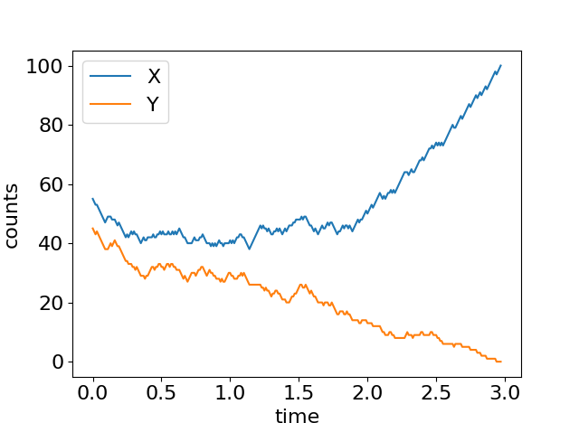
Example: Chemical caucusing
opposite opinions cancel
X+Y→U+U
X
U
Y
X+U→X+X
Y+U→Y+Y
both opinions influence the unopinionated
distributed algorithm for “approximate majority”:
initial majority (X or Y) quickly overtakes whole population (with high probability)
[Angluin, Aspnes, Eisenstat, A simple population protocol for fast robust approximate majority, DISC 2007]

Slide 6
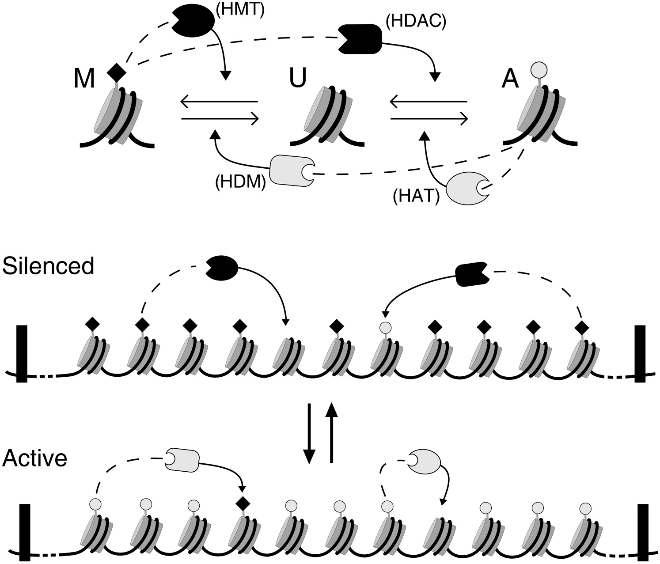
Does chemistry compute?
=
X
U
Y
X
U
Y
≈
X
Y
[Cardelli, Csikász-Nagy. The cell cycle switch computes approximate majority. Nature Scientific Reports 2012]
[Dodd, Micheelsen, Sneppen, Thon. Theoretical analysis of epigenetic cell memory by nucleosome modification, Cell 2007]
[Cardelli, Morphisms of reaction networks that couple structure to function, BMC Systems Biology 2014]

Slide 7
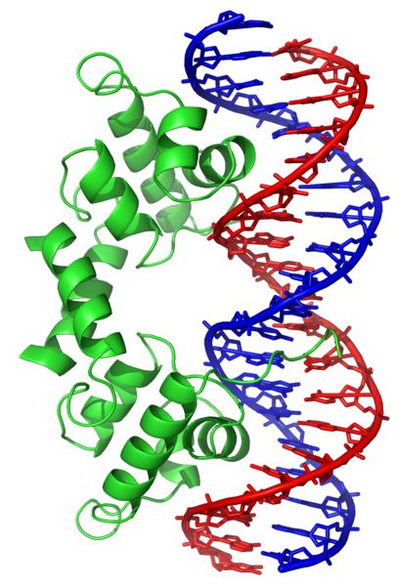
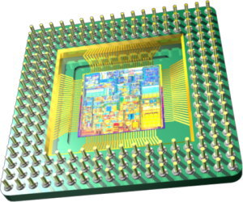

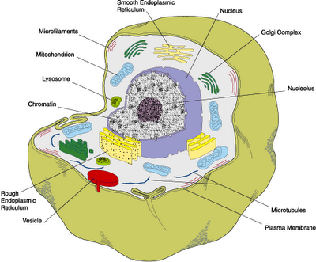


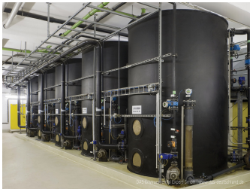
Why compute with chemistry?
versus
cells
slow
speed?
fast
smart drug released only in certain cellular conditions
≈ 10-20 nm
component size?
≈ 10-20 nm
yes
compatible with “wet environments”?
not easily
DNA storage
bioreactors
in-place computation replacing expensive read/write lab steps
chemical controller to optimize yield of metabolically produced biofuels/drugs/etc.

Slide 8












Can we compute with chemistry?
“Not every chemical reaction network describes real chemicals!”, i.e. “where’s the compiler?”
Response: [Soloveichik, Seelig, Winfree, PNAS 2010] showed how to physically implement any chemical reaction network using DNA strand displacement
X₁+X₂→X₃
↔
+
+
→
+
+
+
→
+
Notes:
What molecules actually do!
Fundamental mathematical structure: it comes up over and over again in different contexts: vector addition systems, Petri nets, commutative semigroups, bounded context-free languages, uniform recurrence equations

Slide 9
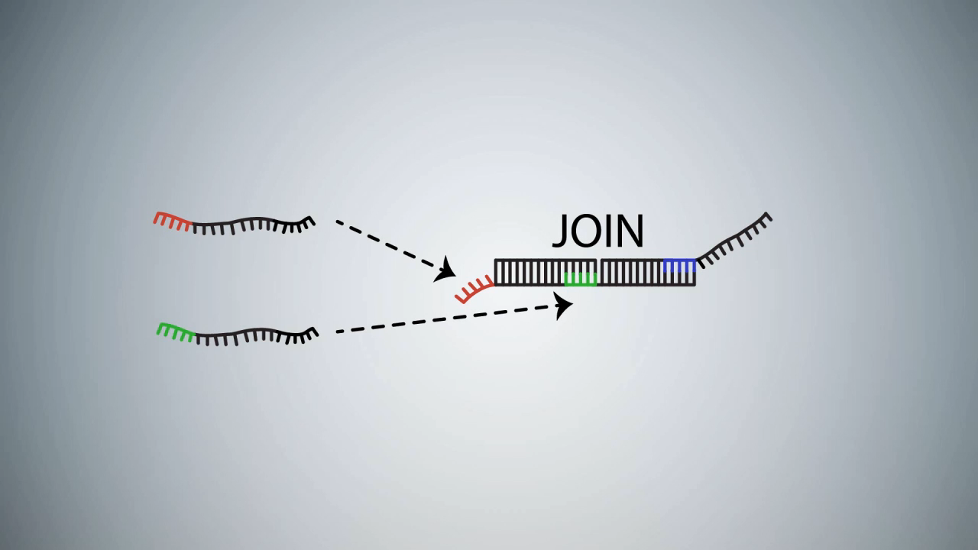
DNA strand displacement implementing A+B→C
video: Microsoft Research Cambridge

Slide 10
Experimental implementations of synthetic chemical reaction networks with DNA
Analog majority computation
Chemical oscillator
relative amount (%)
X+Y→B+B
X+B→X+X
Y+B→Y+Y
A+B→B+B
B+C→C+C
C+A→A+A
2
conc. deriv. (nM/hr)
1
time (hours)
15
30
45
60
[Programmable chemical controllers made from DNA. Chen, Dalchau, Srinivas, Phillips, Cardelli, Soloveichik, Seelig, Nature Nanotechnology 2013.]
[Enzyme-free nucleic acid dynamical systems. Srinivas, Parkin, Seelig, Winfree, Soloveichik, Science 2017.]
time (hours)

Slide 11
What behavior is possible for chemistry in principle?
formally definable chemical reaction network
≈
actual chemicals
found in biology

Slide 12



Theoretical Computer Science Approach
NP-complete
NP
protein folding
Boolean satisfiability
Hamiltonian path
integer factoring
P
DNA/RNA folding
polynomial factoring
integer multiplication
shortest path
What computations necessarily take a long time and what can be done quickly?
(Computational complexity theory)
What computation is possible and what is not?
(Computability theory)

Slide 13
Chemical Reaction Networks (formal definition)
finite set of d species Λ = { A, B, C, D, ... }
A+B→A+C
finite set of reactions: e.g.
k₁
C→A+A
k₂
k₁, k₂, k₃ are called rate constants; if not specified, assume = 1.
C+2B→C
k₃
configuration x∈ℕ^{d}: molecular counts of each species
reaction is applicable to x if x has enough of each reactant.
Notes:
[d stands for dimension]
[Transition to next slide:] Unless otherwise noted, we’ll say that the rate constants are 1. So suppose we have this set of reactions... and we start in this state...

Slide 14
What is possible:
Example reaction sequence (a.k.a. execution)
A B C
α:
A+B→A+C
β:
C→A+A
x =
(2, 2, 0)
α applicable but not β
α
⟹
A
A
(2, 1, 1)
α,β both applicable
β
⟹
α (another possibility)
Formally, an execution is a sequence of configurations x₁, x₂, … such that each x_{i} ⟹ x_{i+1} by a single reaction.
If initial configuration x₁ is understood, the sequence of reactions is sometimes called the execution.
⟹
C
B
(4, 1, 0)
(2, 0, 2)
A
B
C
α
⟹
A
(4, 0, 1)
...
Notes:
...

Slide 15
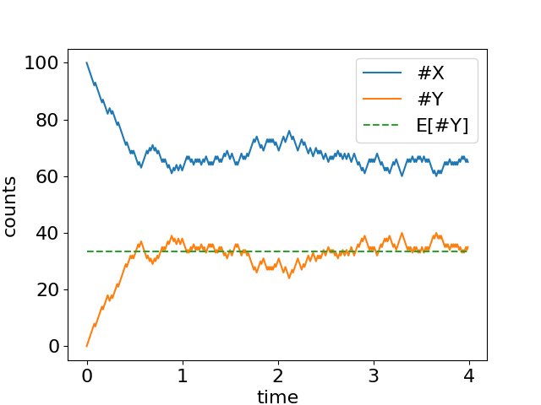
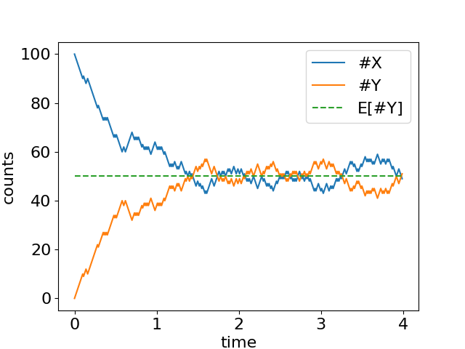
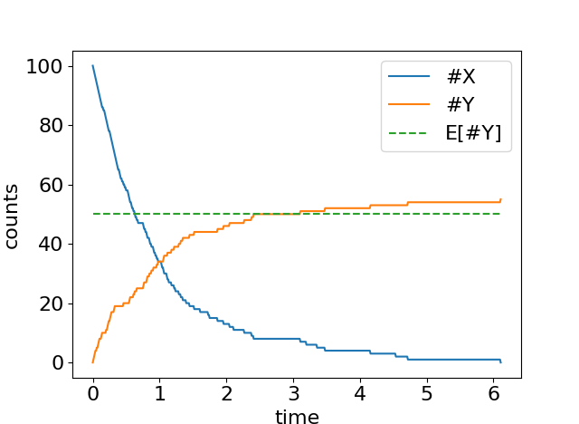
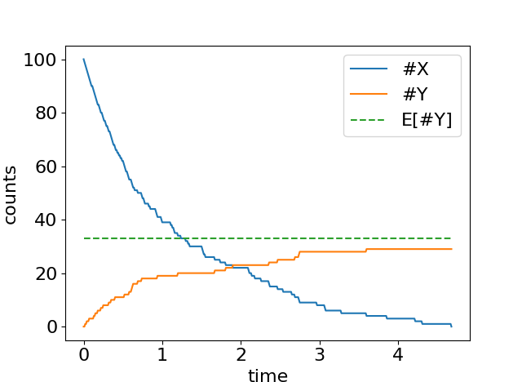
Some simple reactions
Worse yet, both depend crucially on rate constants.
X Y
1
Count of Y never stabilizes
1
Count of Y stabilizes, but not to a deterministic value based on initial count of X
X Y
1
2
X
1
2
start with n copies of molecule X
n/3
n/3
#Y = n/2 expected at equilibrium
#Y stabilizes, with expected value n/2

Slide 16
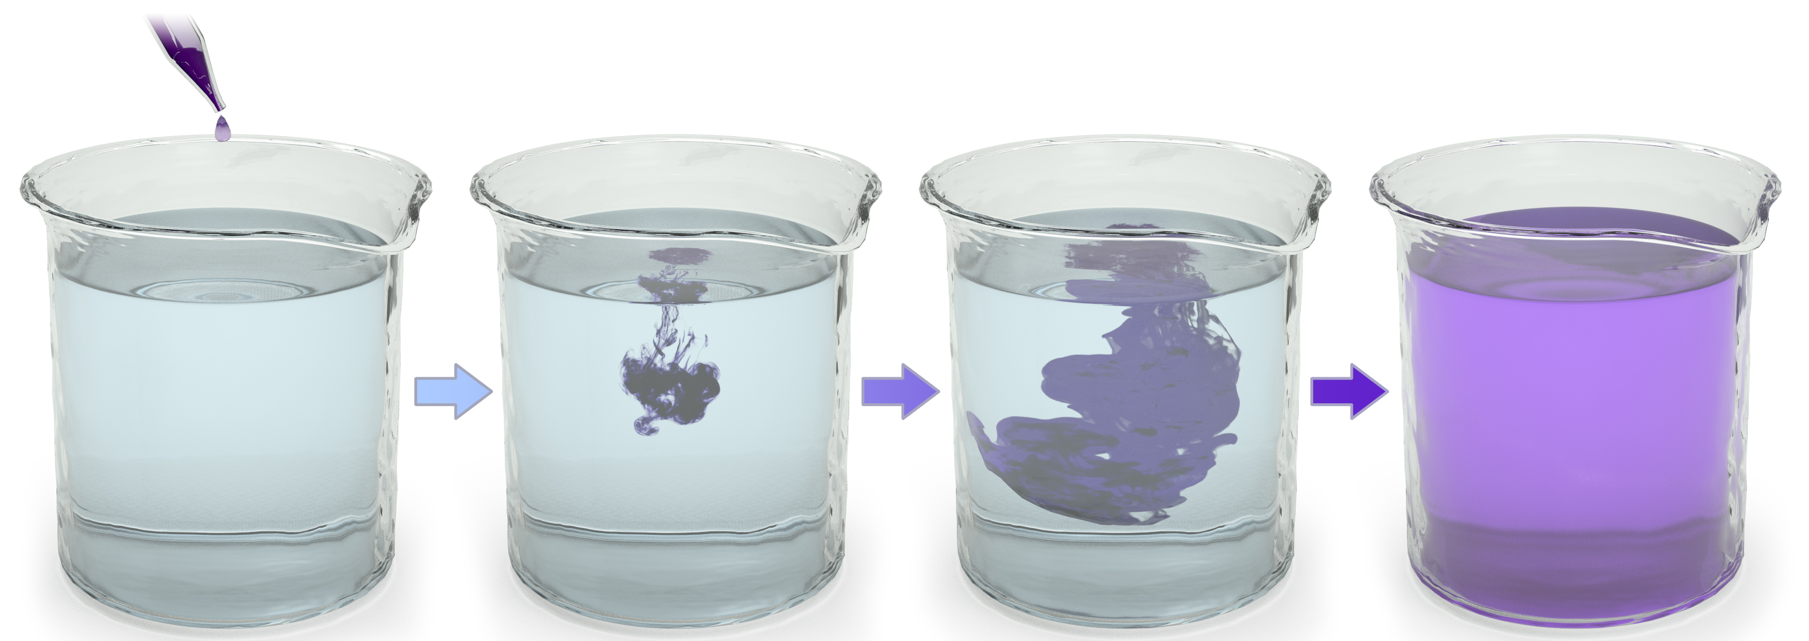
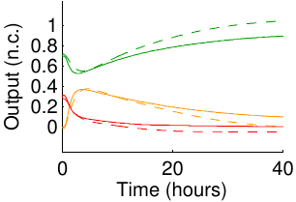
What if we don’t know/can’t control rates?
solution may not be well-mixed
rate constants difficult to engineer precisely
predicted
measured

Slide 17
Examples of stable (rate-independent) CRN computation

Slide 18
Examples of function computation
??
multiplication by 2: f(a) = 2a
⌊
⌋
division by 2: f(a) = a/2
goal: end up with a/2 copies of Y
A→2Y
2A→Y
A
Y
A
Y
Y
Y
A
A
Y
A
A
A
Y
Y
A
A
Y
A
Y

Slide 19
Examples of function computation
multiplication by 3: f(a) = 3a
division by 3: f(a) = ⌊a/3⌋
A→3Y
3A→Y
Y
Y
Y
Y
A
A
A
Y
A
A
Y
A
Y
Y
A
A
Y
Y
A
A
Y

Slide 20
Examples of function computation
f(a) = 3a using (≤ 2)-product reactions
f(a) = ⌊a/3⌋ using bimolecular ((≤ 2)-reactant) reactions, starting in config { 1 L₀, a A } (a.k.a., leader-driven)
A→Y+Y’
Y’→2Y
L₀+A→L₁
L₁+A→L₂
L₂+A→L₀+Y
ends with 1 copy of L_{i} for i = ???
Y
Y’
Y
Y
Y’
Y
A
A
Y
Y
L₀
L₁
L₂
Y
A
A
Y
A
A
A
A
A

Slide 21
Examples of function computation
f(a) = ⌊a/3⌋ using bimolecular (≤ 2-reactant) reactions, starting in config {a A} (a.k.a., leaderless)
A+A→ A₂
A₂+A→Y
Calling A = A₁, in general to divide by constant c:
A_{i}+A_{j}→A_{k} if i+j < c, where k = i + j
A_{i}+A_{j}→A_{k}+Y if i+j > c, where k = i + j – c
A_{i}+A_{j}→Y if i+j = c
i.e., A’s start with 1 “ball” and pass balls to each other;
whenever someone gets ≥ c balls,
throw away c balls and produce a Y
A₂+A₂→A+Y

Slide 22
Examples of function computation
???
addition: f(a,b) = a+b
subtraction: f(a,b) = a–b
max(0, a–b)
A→Y
B→Y
A→Y
B+Y→ ∅
Y
Y
A
A
A
A
A
A
A
B
Y
Y
Y
Y
Y
Y
Y
A
B
B
B
B
B
B
B

Slide 23
Examples of function computation
composition: f(a,b) = 3a–b
maximum: f(a,b) = max(a,b)
???
= a+b–min(a,b)
A→3Y
B+Y→∅
3a–(b/2)
A→Y+A₂
B→Y+B₂
2
addition
A₂+B₂→K
minimum
only linear functions computable?
K+Y→∅
subtraction
minimum: f(a,b) = min(a,b)
A+B→Y

Slide 24
Examples of function computation
constant: f(a) = 1
A→Y
a.k.a. “leader election”
2Y→Y
subtract constant: f(a) = a–1
2A→A+Y

Slide 25
Examples of predicate computation
Detection: φ(a,b) = yes ⇔ b > 0
Counting: φ(a,b) = yes ⇔ b > 1
B+A → 2B
2B→2Y
Y+B→2Y
Y+A→2Y
A votes no; B votes yes
A
A,B vote no; Y votes yes
A
B
A
B
B
A
B
A
B
A
B
A
B
A
B
A
B

Slide 26
Examples of predicate computation
Majority: φ(a,b) = yes ⇔ a ≥ b
A+B→A_{f}+B_{f} (both become “followers” but preserve difference between A’s and B’s)
A+B_{f}→A+A_{f} (leader changes vote of follower)
B+A_{f}→B+B_{f} (leader changes vote of follower)
A_{f}+B_{f}→A_{f}+A_{f} (tiebreaker if no leaders left when a=b)
[Draief, Vojnovic. Convergence speed of binary interval consensus. SIAM Journal on Control and Optimization, 50(3):1087–1109, 2012]
[Mertzios, Nikoletseas, Raptopoulos, Spirakis, Determining Majority in Networks with Local Interactions and very Small Local Memory, Distributed Computing 2015]

Slide 27
Examples of predicate computation
Parity: φ(a)=Y ⇔ a is odd
a = A_{o} (subscript o/e means ODD/EVEN, and capital A means it is leader)
A_{o}+A_{o}→ A_{e}+a_{e}
A_{e}+A_{e} → A_{e}+a_{e}
A_{o}+A_{e} → A_{o}+a_{o}
two leaders XOR their parity, and one becomes follower
A_{o}+a_{e} → A_{o}+a_{o}
A_{e}+a_{o} → A_{e}+a_{e}
leader overwrites
bit of follower

Slide 28
Formal definition of CRN computation

Slide 29
Modeling choices in formalizing “Computing with chemistry”
integer counts (“stochastic”) or real concentrations (“mass-action”/“deterministic”)?
what is the object being “computed”?
yes/no decision problem? “#A’s > #B’s?”
numerical function? “set #Y = #X/2”
guaranteed to get correct answer? or allow small probability of error?
if Pr[error] = 0, system works no matter the reaction rates
to represent input a₁,…,a_{k}, what is the initial configuration?
only input species A₁, …, A_{k} present?
auxiliary species can be present?
when is the computation finished? when…
the output stops changing? (convergence)
the output becomes unable to change? (stabilization)
a certain species T is first produced? (termination)
require exact numerical answer? or allow an approximation?
we’ll start with these choices

Slide 30
Defining stable computation
o is stable
∀
∃
∀
i
x
reactions
o
reactions
o’
reactions
initial
configuration
any reachable
configuration
correct
output
correct
output
(assuming finite set of reachable configurations) equivalent to:
The system will reach a correct stable configuration with probability 1.
Notes:
-This is the appropriate notion of determinism here
-Say “such that” when talk about there not existing a path to o’

Slide 31
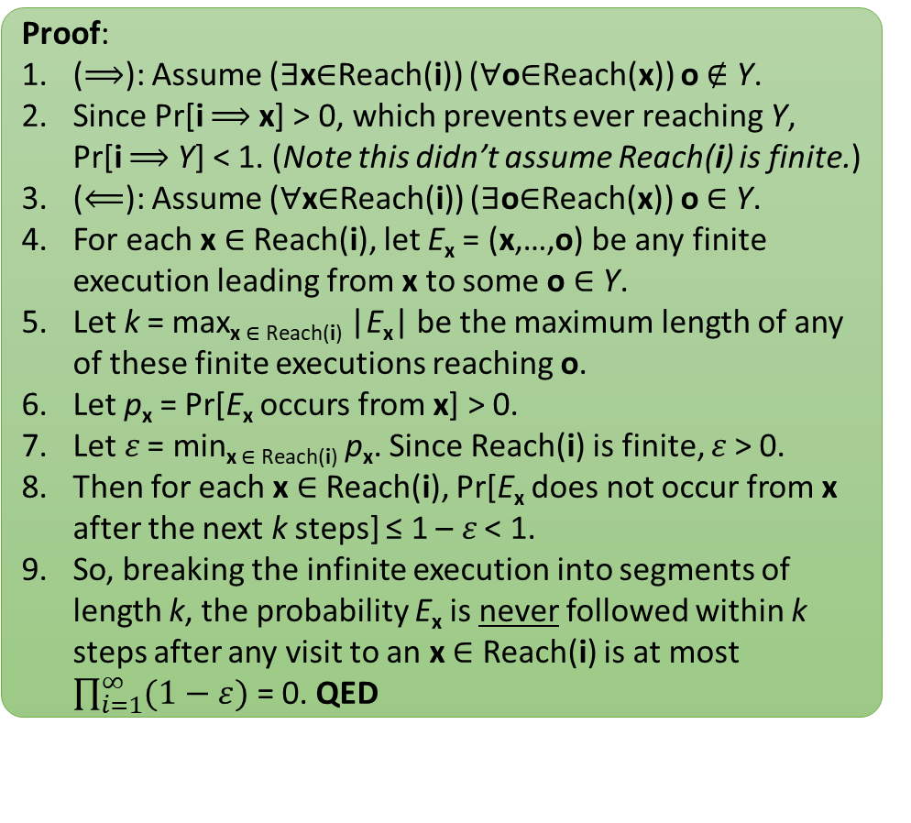
Probability-1 correctness can be characterized with only reachability
To understand this slide, only need the following fact: if a reaction is applicable, then there is a positive probability it occurs.
Definition: Let i be a configuration and Y be a set of configurations. Write Pr[i ⟹ Y] to denote the probability of the random event that, starting in configuration i, the CRN eventually reaches some configuration o ∈ Y.
Proof:
(⟹): Assume (∃x∈Reach(i)) (∀o∈Reach(x)) o ∉ Y.
Since Pr[i ⟹ x] > 0, which prevents ever reaching Y, Pr[i ⟹ Y] < 1. (Note this didn’t assume Reach(i) is finite.)
(⟸): Assume (∀x∈Reach(i)) (∃o∈Reach(x)) o ∈ Y.
For each x ∈ Reach(i), let E_{x} = (x,…,o) be any finite execution leading from x to some o ∈ Y.
Let k = max_{x ∈ Reach(i)} |E_{x}| be the maximum length of any of these finite executions reaching o.
Let p_{x} = Pr[E_{x} occurs from x] > 0.
Let 𝜀 = min_{x ∈ Reach(i)} p_{x}. Since Reach(i) is finite, 𝜀 > 0.
Then for each x ∈ Reach(i), Pr[E_{x} does not occur from x after the next k steps] ≤ 1 – 𝜀 < 1.
So, breaking the infinite execution into segments of length k, the probability E_{x} is never followed within k steps after any visit to an x ∈ Reach(i) is at most $\prod_{i=1}^{∞}{(1−\text{ε})}$ = 0. QED
Definition: For any configuration i, let Reach(i) denote the set of configurations reachable from i.
Theorem: Let i be a configuration where Reach(i) is finite, and let Y be a set of configurations. Then
(Pr[i ⟹ Y] = 1) ⇔ (∀x∈Reach(i)) (∃o∈Reach(x)) o ∈ Y.
This theorem lets us use (often simpler) reachability arguments and avoid discussing probability, while still ensuring probability-1 correctness.

Slide 32
Deterministic computation ≠ all executions correct
False statement: If Pr[i ⟹ Y] = 1, then every sufficiently long execution starting at i reaches to some c ∈ Y.
Counterexample??
Suppose i = {A}, with reactions
A ⇌ B
B→C
Then Pr[{A} ⟹ {C}] = 1, but the execution {A} ⟹ {B} ⟹ {A} ⟹ {B} ⟹ {A} ⟹ … avoids it forever.
Lesson: it is too strict to require all sufficiently long executions to reach Y.

Slide 33
Fair executions: Alternative characterization of stable computation
Goal of definition of fair is to make this theorem true:
“there exist infinitely many”
Theorem: Let i be a configuration, and let Y be a finite set of configurations. Then
(every fair execution starting at i reaches some o ∈ Y)
⇔ (∀x∈Reach(i)) (∃o∈Reach(x)) o ∈ Y.
Definition: An infinite execution x₀, x₁, … is fair if
(∀o∈ℕ^{Λ}) [(∃∞i∈ℕ x_{i} ⟹ o) implies (∃∞k∈ℕ x_{k} = o)]
(every configuration infinitely often reachable is infinitely often reached)
Proof:
(⟹): Suppose every fair execution from i reaches Y.
Any finite execution can be extended to be fair. (why??)
Thus (∀x∈Reach(i)), i.e., for all x reachable via some finite execution starting at i, (∃o∈Reach(x)) o ∈ Y, Y is reachable from x by extending with a fair execution.
(⟸): Suppose (∀x∈Reach(i)) (∃o∈Reach(x)) o ∈ Y.
Let x₀, x₁, … be a fair execution with i=x₀.
Since all x_{j}∈Reach(i), for each j, by hypothesis ∃o_{j}∈Reach(x_{j}) o_{j} ∈ Y.
Since Y is finite, some o ∈ Y is reachable from infinitely many x_{j}.
Since x₀, x₁, … is fair and o is infinitely often reachable, there is k such that x_{k} = o ∈ Y, i.e., the fair execution reaches Y. QED

Slide 34
Definition of function computation
goal: compute function f: ℕ^{k}→ℕ, e.g., f(a,b) = 2a + b/2
input specification: designate subset Σ ⊆ Λ as “input” species
valid initial configuration i: all molecules are from Σ, e.g., {100 a, 100 b}
output specification: designate one species Y∈Λ whose count is the output
o is stable if, for all o’ reachable from o, o(Y) = o’(Y)
CRN stably computes f if, for all valid initial configurations i, and all x reachable from i, there is a stable o reachable from x such that o(Y) = f(i).
Recall: this is equivalent to saying that i reaches to a correct, stable o with probability 1, and equivalent to saying that every fair execution from i reaches to a correct, stable o.

Slide 35
Definition of predicate (decision problem) computation
goal: compute predicate φ: ℕ^{k}→{Y,N}, e.g., φ(a,b)=Y ⇔ a>b
input specification: designate subset Σ ⊆ Λ as “input” species
in valid initial configurations i all molecules are from Σ, e.g., {100 A, 55 B}
output specification: partition species Λ into “yes” voters Λ_{Y} and “no” voters Λ_{N}
ψ(o) = Y (configuration o outputs “yes”) if vote is unanimously yes: o(S)>0 ⟹ S∈Λ_{Y}
ψ(o) = N (configuration o outputs “no”) if vote is unanimously no: o(S)>0 ⟹ S∈Λ_{N}
ψ(o) undefined otherwise: (∃ S∈Λ_{N}, S’∈Λ_{Y}) o(S)>0 and o(S’)>0
o is stable if ψ(o) = ψ(o’) (and is defined) for all o’ reachable from o
CRN stably computes φ if, for all valid initial configurations i, and all x reachable from i, there is a stable o reachable from x such that ψ(o) = φ(i) (o is correct).
We say the CRN stably decides the set φ^{–1}(Y) = set of inputs mapping to output Y
[Angluin, Aspnes, Diamadi, Fischer, Peralta, Computation in networks of passively mobile finite-state sensors, PODC 2004]

Slide 36
Feedforward CRNs
A class of CRNs with a simpler definition/proofs for computation

Slide 37
Stable versus terminal
All CRNs we’ve seen so far obey a stronger condition than stabilizing (no reaction can change the output): they reach a configuration where no reaction can happen at all. Further, they all have the property that every sufficiently long execution reaches this configuration.
Definition: A configuration is terminal if no reaction is applicable to it.
Observation: Every terminal configuration is stable.
Note: A configuration can be stable without being terminal. Example?

Slide 38
Feed-forward CRNs
Definition: A CRN is feed-forward if reactions can be ordered r₁, r₂, …, r_{n} such that, for all k < ℓ, no reactant of r_{k} appears in r_{ℓ} (as either reactant or product).
Lemma: Suppose in a feed-forward CRN that i ⟹ c by execution P, and i ⟹ d by execution Q. If any reaction occurs less in P than Q, then c is not terminal.
Example: The max(A,B) CRN:
1. A→Y+A₂ (A doesn’t appear below)
2. B→Y+B₂ (B doesn’t appear below)
3. A₂+B₂→K (A₂,B₂ don’t appear below)
4. K+Y→∅
#(r_{k},P) = number of times r_{k} occurs in P
Proof:
Let r_{k} be first reaction in feed-forward order such that #(r_{k},P) < #(r_{k},Q).
For ease of exposition, assume r_{k} has only one reactant A.
r_{k+1} … r_{n} do not change #A, by the definition of feed-forward.
r₁ … r_{k–1} can produce but not consume A. (why??)
So only r₁ … r_{k} can increase #A, and only r_{k} can decrease #A.
Let m = #(r_{k},P); Let Q’ be prefix (i, x₁, …, x_{p}) of Q such that x_{p} ⟹ x_{p+1} by the (m+1)’st execution of reaction r_{k}.
x_{p} is the config just before the first time that r_{k} happens more in Q than P.
Note r₁ … r_{k–1} occur least as much in P as in Q. (#(r_{i},P) ≥ #(r_{i},Q) for i=1 to k–1)
Thus r₁ … r_{k–1} occur least as much in P as in Q’. (since Q’ is prefix of Q)
Also, #(r_{k},P) = #(r_{k},Q’) by our choice of Q’.
So A is present in c, i.e., c(A) > 0.
Thus r_{k} is applicable at c, so c is not terminal. QED
We often convince ourselves a CRN works by examining just one execution that stabilizes to the correct output, and thinking, “The other executions probably/hopefully end up with the same output.” This reasoning becomes sound with feed-forward CRNs.
Ideas taken from [M. Vasić, C. Chalk, A. Luchsinger, S. Khurshid, and D. Soloveichik. Programming and training rate-independent chemical reaction networks. Proceedings of the National Academy of Sciences, 119(24):e2111552119, 2022.]

Slide 39
Stable function computation by feed-forward CRNs
Lemma (restated): Suppose that in a feed-forward CRN, i ⟹ c by execution P, and i ⟹ d by execution Q. If any reaction occurs less in P than Q, then c is not terminal.
Corollary: The CRN:
1. A→Y+A₂
2. B→Y+B₂
3. A₂+B₂→K
4. K+Y→∅
stably computes the function f(A,B) = max(A,B).
Corollary 1: A feed-forward CRN has at most one terminal configuration reachable from any initial configuration.
Proof:
Do the following reactions:
#A times rxn 1
#B times rxn 2
min(#A,#B) times rxn 3
min(#A,#B) times rxn 4
This removes all A, B, (at least one of A₂ or B₂), and K, so this is terminal. By Corollary 2 it stably computes whatever #Y is now, which is…
CRN produces #A+#B count of Y by rxns 1 and 2, and consumes min(#A,#B) Y’s by rxn 4, so computes #A+#B–min(#A,#B) = max(#A,#B). QED
Corollary 2: If a feed-forward CRN has at least one terminal configuration reachable from any initial configuration (i.e., exactly one), then the CRN stably computes a function.
Question: What’s the function?
Answer: Letting o_{i} = the unique terminal configuration reachable from i, it computes f(i) = o_{i}(Y).

Slide 40
In feed-forward CRNs, if there is a terminal configuration, any long enough execution reaches it
Lemma (restated): Suppose that in a feed-forward CRN, i ⟹ c by execution P, and i ⟹ d by execution Q. If any reaction occurs less in P than Q, then c is not terminal.
Proof:
Let P be the execution leading from i to c_{i}.
Any execution Q with with |Q| > |P| must have more of some reaction r by the pigeonhole principle.
By the Lemma, c_{i} is not terminal, a contradiction.
So no execution Q is longer than P.
Any execution Q with |Q| = |P| must be a permutation of P, or else by pigeonhole Q would have more of some reaction, and this would again contradict the terminality of c_{i}.
Finally, to rule out that we might have some shorter terminal execution, any execution Q with |Q| < |P| must have some reaction r occurring more in P than Q, so by the Lemma, Q cannot reach a terminal configuration. QED
Corollary: In a feed-forward CRN, if there is a terminal configuration c_{i} reachable from initial configuration i, then c_{i} is reached by every sufficiently long execution from i. Furthermore, all of these executions are permutations of the same number of each reaction type.

Slide 41
Noncompetitive CRNs
Definition: A CRN is non-competitive if, for every species R, if R is net consumed in some reaction (e.g., R→A or 2R→R), then R is not a reactant in any other reaction. (R can be a non-consumed catalyst in any number of reactions, e.g., R→2R or R+X→R+Y, but then no reaction can net consume it)
Lemma: Suppose in a non-competitive CRN that i ⟹ c by execution P, and i ⟹ d by execution Q. If any reaction occurs less in P than Q, then c is not terminal.
Example: The max(A,B) CRN:
1. A→Y+A₂ (A isn’t a reactant elsewhere)
2. B→Y+B₂ (B isn’t a reactant elsewhere)
3. A₂+B₂→K (A₂,B₂ aren’t reactants elsewhere)
4. K+Y→∅ (K, Y aren’t reactants elsewhere)
#(r,P) = number of times r occurs in P
Proof:
Q’ = longest prefix (i, x₁, …, x_{p}) of Q such that #(r,P) ≥ #(r,Q) for all reactions r.
i.e., x_{p+1} is the first time in Q that some reaction exceeds its count in P.
Let r be the reaction such that x_{p} ⟹ x_{p+1} via r.
Note #(r,P) = #(r,Q’) and #(t,P) ≥ #(t,Q’) for all other reactions t ≠ r.
Since CRN is non-competitive, no reactant A of r can be consumed in t ≠ r.
Some other reactions t might produce A.
Since #(t,P) ≥ #(t,Q’), each t ≠ r produces at least as much A in P has in Q’.
Exactly as much A is consumed by r in P as in Q’.
Thus x_{p}(A) ≤ c(A) for all reactants A of r.
Since r is applicable to x_{p}, it is applicable to c.
So c is not terminal. QED
We often convince ourselves a CRN works by examining just one execution that stabilizes to the correct output, and thinking, “The other executions probably/hopefully end up with the same output.” This reasoning becomes sound with non-competitive CRNs.
[M. Vasić, C. Chalk, A. Luchsinger, S. Khurshid, and D. Soloveichik. Programming and training rate-independent chemical reaction networks. Proceedings of the National Academy of Sciences, 119(24):e2111552119, 2022.]

Slide 42
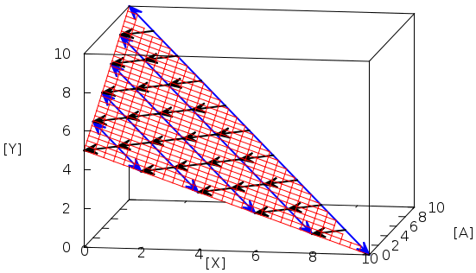
Non-feedforward CRNs
Example of a non-feedforward CRN that stably computes a function?
f(x) = x/2
1. X ⇌ Y+A
2. X+A→∅
Not a plot of f! It's the space of reachable states.
final
config
It’s even non-non-competitive!
initial config

Slide 43
Time complexity of CRNs

Slide 44

What is probable:
Stochastic kinetic model of chemical reaction networks
Solution volume v
reaction type
rate / propensity
k
k⋅ #A
k⋅ #A⋅ #B / v
A → …
k
A+B → …
System evolves via a continuous time Markov process:
Pr[next reaction is j^{th} one] = rate of j^{th} reaction / (sum of all reaction rates)
expected time until next reaction is 1 / (sum of all reaction rates)
[McQuarrie 1967, van Kampen, Gillespie 1977]

Slide 45
Relationship to distributed computing
population protocol = list of transitions such as
x,y→x,x a,b→c,d a,a→a,a (null transition)
Repeatedly, two agents (molecules) are picked at random to interact (react) and change state (species).
A population protocol is a chemical reaction network with
two reactants, two products per reaction
unit rate constants
volume = n = number of agents (never changes)
population protocols ⊊ chemical reactions, but “most” ideas that apply to one model also apply to the other
[Angluin, Aspnes, Diamadi, Fischer, Peralta, Computation in networks of passively mobile finite-state sensors, PODC 2004]:
Winner of 2020 Dijkstra Prize in Distributed Computing: https://www.podc.org/dijkstra/2020-dijkstra-prize/

Slide 46
Time complexity in population protocols
pair of agents picked uniformly at random to interact (possibly null interaction)
parallel time = number of interactions / n
i.e., each agent has O(1) interactions per “unit time”

Slide 47

Speed of computation
How to fairly assess speed?
Like any respectable computer scientist…
1) as a function of input size n (how required time grows with n)
2) ignoring constant factors
n = total molecular count
reasonable requirement on volume: v = O(n)
i.e., require bounded concentration (finite density constraint)

Slide 48
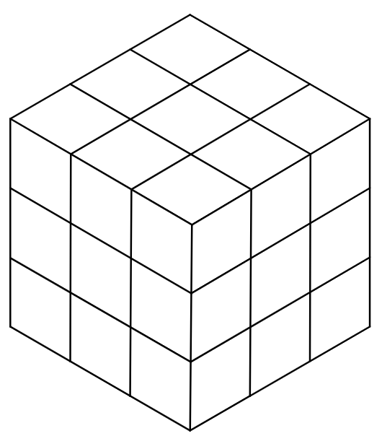
Full CRN time model (Gillespie kinetics)
k
What should influence total rate λ (a.k.a., propensity) of bimolecular reaction A+B→C?
molecular counts of reactants: λ ∝ #A∙#B (the more there are, the faster collisions happen)
volume v: λ ∝ 1/v (the bigger the volume, the slower collisions happen)
rate constant k: λ ∝ k (captures things not directly modeled, e.g., diffusion rates, probability that a collision results in a reaction)
For this example reaction A+B→C, combining these we get λ = k∙#A∙#B / v
Other reaction types:
A+A→… λ = k∙#A∙(#A–1) / v (symmetric bimolecular reaction)
#A∙(#A–1)/2 = # ways to pick two A’s to react; factor ½ by convention is put into rate constant k
A→… λ = k∙#A (unimolecular reaction)
no volume term since no collision required
A+B+C→… λ = k∙#A∙#B∙#C / v² (trimolecular reaction)
The volume term is squared because (roughly) if we define coordinate system so position of A is always at the origin, then B and C are randomly moving around through v volume “cells”, and it takes v² expected time for them both to occupy the origin, to cause a three-way A-B-C collision
In general, with r reactants, propensity is number of ways to pick reactants, times k, divided by v^{r–1}
k
k
B
k
C
k
A

Slide 49
Discrete versus continuous time
Time between interactions in CRN model is exponential random variable T
Time between interactions in PP model is geometric random variable T
T = # of coin flips until a heads, with Pr[heads] = p, E[time] = 1/p
(essentially the discrete version of an exponential random variable)
in population protocol, heads event = non-null interaction
CRN model: time = sum of exponential random variables
define volume = n, and rate of interaction a,b →… as #a∙#b / n, i.e., expected time n / (#a∙#b)
PP model (time = #interactions / n)
probability that next interaction is a,b →… is #a∙#b / (n choose 2) = 2∙#a∙#b / (n(n–1))
expected interactions until next a,b →… interaction = n(n–1) / (2∙#a∙#b), i.e., time (n–1) / (2∙#a∙#b)
If we treat interactions symmetrically, (i.e., a,b →c,d is an interaction if and only if b,a→d,c is an interaction), then we have twice the probability, i.e., expected time becomes (n–1) / #a∙#b ∼ n / (#a∙#b), essentially the same as the CRN model
one possible convention to avoid symmetric interactions is simply define time = 2∙#interactions/n
both are memoryless: ∀ s,r > 0
Pr[ T > s + r | T > s ] = Pr[ T > r ]
no rxn after r additional secs.
no rxn in first s secs.
no rxn in first r secs.
Can use Chernoff bounds to show it is very likely that they end up taking very close to the same amount of time for any event.

Slide 50
An exponential time difference
B
B
X
B
X
X
n molecules
volume v = O(n)
B
B
X
B
X
X
B
B
X
B
X
X
B
B
X
X
B
B
X
B
X
B
B
X
X
B
X
B
X
A
Y
X
B
one of these is always count ≥ n/2
B
B
X
X
B
B
X
X
B+X→B+B
A+B→Y+B
distributed computing terms:
epidemic
rumor/gossip spreading
chemical term:
autocatalysis
A+B→Y+B
propensity: #A·#B / v = O(1/n)
expected time to
produce Y:
O(n)
O(log n)
Notes:
-Suppose you want A to know there is a B, or in other words for Y to get produced if both A and B are present.
-B recruits X’s to become B, which can in turn recruit other X’s...
-Exponential amplification!
-n is large (Avogadro scale)

Slide 51


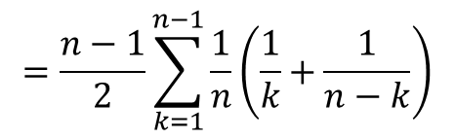
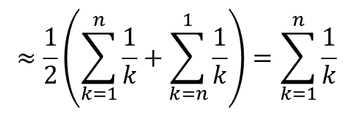
Time complexity analysis (basic motifs)
“direct communication”
“epidemic”, “gossip”, “rumor spreading”
A+B→Y+W
#A=#B=1, #X=n-2
B+X→B+B
population protocol time complexity:
time until non-null interaction is geometric random variable with success probability p = 1 / (n choose 2) = 2 / (n(n–1))
E[# interactions] = 1/p = (n(n–1)) / 2
E[time] = E[# interactions]/n = (n–1) / 2 = O(n)
population protocol time complexity:
when #B = k, we have #X = n–k
Pr[ B+X→B+B is next interaction | #B=k ] = k(n–k) / (n choose 2)
= 2k(n–k) / ((n(n–1))
expected time until one X converted to B = 1/(n∙probability) = (n–1) / (2k(n–k))
expected time until all X converted to B =
$$\frac{n−1}{2}\sum_{k=1}^{n−1}{\frac{1}{k(n−k)}}$$
$$=\frac{n−1}{2}\sum_{k=1}^{n−1}{\frac{1}{n}\left(\frac{1}{k}+\frac{1}{n−k}\right)}$$
CRN time complexity:
time until reaction is exponential random variable with
rate λ = #A∙#B / n = 1 / n
E[time] = 1/λ = n
$$≈\frac{1}{2}\left(\sum_{k=1}^{n}{\frac{1}{k}}+\sum_{k=n}^{1}{\frac{1}{k}}\right)=\sum_{k=1}^{n}{\frac{1}{k}}$$
$$≈\ln{n}$$

Slide 52
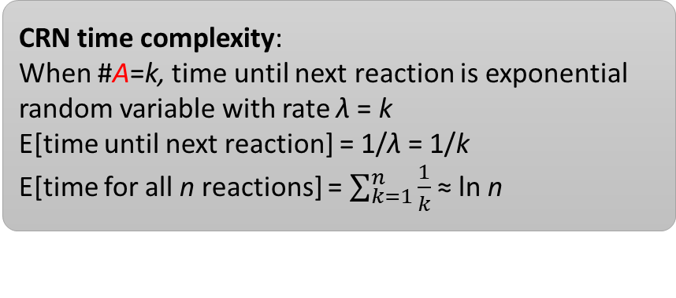
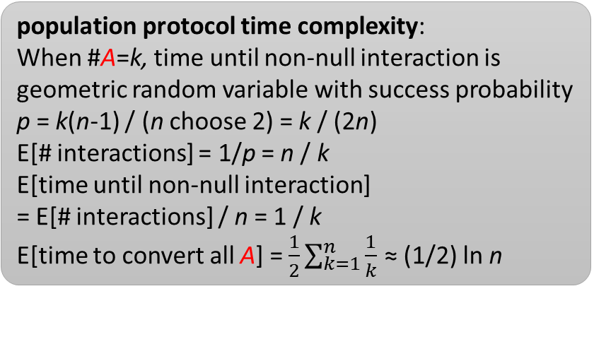
Time complexity analysis (basic motifs)
“no communication”
? here means “every species” (including A)
“no communication/ unimolecular decay” (unimolecular CRN version)
A+?→B+?
#A=n, #B=0
A→B
#A=n, #B=0
population protocol time complexity:
When #A=k, time until non-null interaction is geometric random variable with success probability p = k(n-1) / (n choose 2) = k / (2n)
E[# interactions] = 1/p = n / k
E[time until non-null interaction]
= E[# interactions] / n = 1 / k
E[time to convert all A] = $\frac{1}{2}\sum_{k=1}^{n}{\frac{1}{k}}$ ≈ (1/2) ln n
CRN time complexity:
When #A=k, time until next reaction is exponential random variable with rate λ = k
E[time until next reaction] = 1/λ = 1/k
E[time for all n reactions] = $\sum_{k=1}^{n}{\frac{1}{k}}$ ≈ ln n

Slide 53
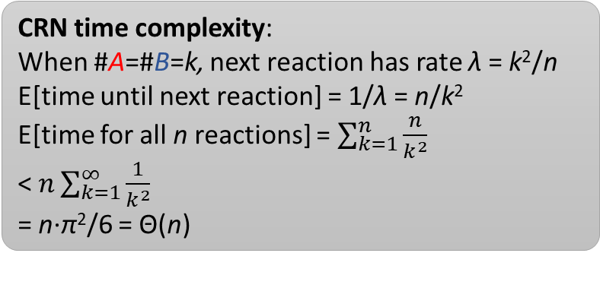
Time complexity analysis (basic motifs)
“pairing off”
A+B→C
#A=n, #B=n, total volume = O(total count) = n
CRN time complexity:
When #A=#B=k, next reaction has rate λ = k²/n
E[time until next reaction] = 1/λ = n/k²
E[time for all n reactions] = $\sum_{k=1}^{n}{\frac{n}{k^{2}}}$
< $n\sum_{k=1}^{∞}{\frac{1}{k^{2}}}$
= n∙π²/6 = Θ(n)
“pairing off” (symmetric version)
A+A→C
similar analysis

Slide 54
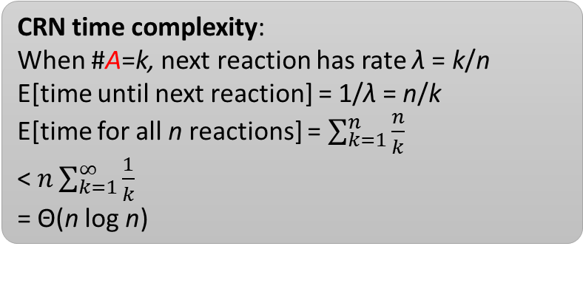
Time complexity analysis (basic motifs)
“coupon collecting”
L+A→L+B
#L=1, #A=n, #B=0, total volume = O(total count) = n
CRN time complexity:
When #A=k, next reaction has rate λ = k/n
E[time until next reaction] = 1/λ = n/k
E[time for all n reactions] = $\sum_{k=1}^{n}{\frac{n}{k}}$
< $n\sum_{k=1}^{∞}{\frac{1}{k}}$
= Θ(n log n)

Slide 55
Time complexity analysis of stably computing CRNs

Slide 56
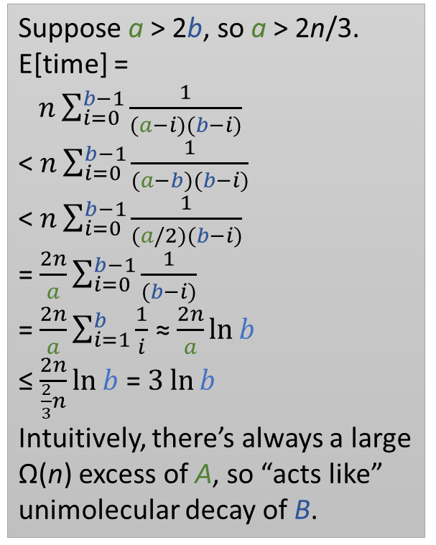
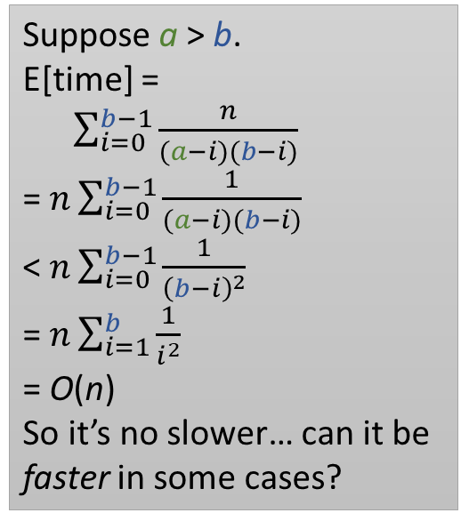
Time complexity analysis of stably computing CRNs
multiplication by 2: f(a) = 2a
A→2Y
minimum: f(a,b) = min(a,b)
A+B→Y
Suppose a > 2b, so a > 2n/3.
E[time] =
$n\sum_{i=0}^{b−1}{\frac{1}{(a−i)(b−i)}}$
< $n\sum_{i=0}^{b−1}{\frac{1}{(a−b)(b−i)}}$
< $n\sum_{i=0}^{b−1}{\frac{1}{(a/2)(b−i)}}$
= $\frac{2n}{a}\sum_{i=0}^{b−1}{\frac{1}{(b−i)}}$
= $\frac{2n}{a}\sum_{i=1}^{b}{\frac{1}{i}}$ ≈ $\frac{2n}{a}\ln{b}$
≤ $\frac{2n}{\frac{2}{3}n}\ln{b}$ = $3\ln{b}$
Intuitively, there’s always a large Ω(n) excess of A, so “acts like” unimolecular decay of B.
O(log n) “unimolecular decay”
O(n): “pairing off”
… worst case if a = b
division by 2: f(a) = a/2
2A→Y
Suppose a > b.
E[time] =
$\sum_{i=0}^{b−1}{\frac{n}{(a−i)(b−i)}}$
= $n\sum_{i=0}^{b−1}{\frac{1}{(a−i)(b−i)}}$
< $n\sum_{i=0}^{b−1}{\frac{1}{{\left(b−i\right)}^{2}}}$
= $n\sum_{i=1}^{b}{\frac{1}{i^{2}}}$
= O(n)
So it’s no slower… can it be faster in some cases?
O(n) “pairing off”
addition: f(a,b) = a+b A→Y
B→Y
O(log n): same as unimolecular decay, just with two names for decaying species

Slide 57
Time complexity analysis of stably computing CRNs
subtraction: f(a,b) = a–b
A→Y
B+Y→∅
Unlike addition, this is a nontrivial combination of reactions: rate of second reaction depends how many times first has happened.
To simplify, we assume second reaction cannot happen until first has finished.
This simpler process “stochastically dominates” the real process: it takes even longer than the real process, so suffices to show a time upper bound.
E[time] = E[time for first to finish] + E[time for second to finish]
E[time for first to finish] = O(log n) (unimolecular decay)
E[time for second to finish] = O(n) in worst case: similar to minimum, worst case when a=b, but O(log n) time if |a–b| = Ω(n).
E[time] = O(log n) + O(n) = O(n)

Slide 58
Time complexity analysis of stably computing CRNs
maximum: f(a,b) = max(a,b)
1. A→Y+A₂
2. B→Y+B₂
3. A₂+B₂→K
4. K+Y→∅
Assume reaction 3 waits for reactions 1 and 2 before starting, and reaction 4 waits for reaction 3.
E[time for 1 and 2] = O(log n)
E[time for 3] = O(n)
E[time for 4] = O(n)
So E[time] = O(log n) + O(n) + O(n) = O(n)

Slide 59
Possibilities of stable computation
What can be stably computed?

Slide 60
Summary: Possibilities and limits of stable computation
Predicates
Functions
φ is stably computable if and only if φ is semilinear.
semilinear = Boolean combination of threshold and mod predicates: take weighted sum s = w₁∙a₁ + … w_{d}∙a_{d} of inputs and ask if
s > t? (threshold)
s ≡ c mod m? (mod)
f is stably computable if and only if graph(f) = { (a,y) | f(a)=y } is semilinear.
piecewise affine, with semilinear predicate to determine which piece.
a+b a–b 2a a/2 min(a,b) a+1 a–1
f(a) = 2a–b/3 if a+b is odd, else f(a) = a/4+5b
NOT a² 2ª 2a if a is prime, else 3a
a>b? a=b? a is odd? a>0? a>1?
All semilinear predicates/functions are known to be computable in O(n) time.
NOT a=b²? a is a power of 2? a is prime?
[Angluin, Aspnes, Diamadi, Fischer, Peralta, Computation in networks of passively mobile finite-state sensors, PODC 2004]
[Angluin, Aspnes, Eisenstat, Stably computable predicates are semilinear, PODC 2006]
[Chen, Doty, Soloveichik, Deterministic function computation with chemical reaction networks, DNA 2012]
[Doty, Hajiaghayi, Leaderless deterministic chemical reaction networks, DNA 2013]

Slide 61
Linear sets
Definition: A set X ⊆ ℕ^{d} is linear if there are vectors b, u₁, …, u_{p} ∈ ℕ^{d} such that
X = { b + n₁∙u₁ + … + n_{p}∙u_{p} | n₁, …, n_{p} ∈ ℕ }
multi-dimensional generalization of eventually periodic
Example in dimension d=2:
b = (2,1)
u₁ = (4,1)
u₂ = (2,2)
b + 3u₁ + 2u₂

Slide 62
Semilinear sets
Definition: A set X ⊆ ℕ^{d} is semilinear if it is a finite union of linear sets.
union of two linear sets:

Slide 63
Equivalent definitions of semilinear
TODO: remove these examples since we already went through them
Definition 1: X ⊆ ℕ^{d} is semilinear if it is Boolean combination (through finite unions, intersections, and complements) of threshold and mod sets
Definition 2: A set X ⊆ ℕ^{d} is semilinear if it is a finite union of linear sets.
Definition 1a: X ⊆ ℕ^{d} is a threshold set if there are integers t and w₁ … w_{k} such that X = { (x₁, …, x_{d}) ∈ ℕ^{d} | w₁∙x₁ + … + w_{d}∙x_{d} > t }
Definition 1b: X ⊆ ℕ^{d} is a mod set if there are integers c,m and w₁ … w_{k} such that
X = { (x₁, …, x_{d}) ∈ ℕ^{d} | w₁∙x₁ + … + w_{d}∙x_{d} ≡ c mod m }
examples:
is x₁ > x₂?
is x₁ – 3x₂ > x₂ + 5?
examples:
is x odd?
is x 2 more than a multiple of 3? = {2, 5, 8, 11, 14, …}
is x₁ – 3x₂ odd?
example semilinear set:
is x₁ > x₂ and x₁ + x₂ is odd?
example semilinear set:
is x₁ + x₂ is not a multiple of 3?

Slide 64
Equivalent definitions of semilinear
Definition 3: X ⊆ ℕ^{d} is semilinear if it is definable in the first-order theory of Presburger arithmetic.
(original definition,
hardest to understand;
we won’t use it.)
Other places semilinear sets show up in computer science:
Sets decidable by reversal-bounded counter machines.
In 2D, they are conjectured to be the sets weakly self-assembled by temperature τ=1 tile systems.

Slide 65
Limits of stable computation
Theorem 1: A set X ⊆ ℕ^{d} is stably decided by some CRN if and only if it is semilinear.
Theorem 2: A function f: ℕ^{d}→ℕ is stably computed by some CRN if and only if it is semilinear.
Full proof is too complex to do in this course. But we’ll show:
All semilinear sets can be stably decided.
The non-semilinear “squaring” set X = { (a,y) ∈ ℕ² | a² = y } cannot be stably decided.
X = graph(f), where f(a) = a²
Definition: A function f: ℕ^{d}→ℕ is semilinear if graph(f) = { (a,y) | f(a)=y } is a semilinear set.
Example of function graph: The squaring set X to the right is the graph of the function f(a) = a².

Slide 66
Possibilities of stable computation
All semilinear functions/predicates can be stably computed by CRNs

Slide 67
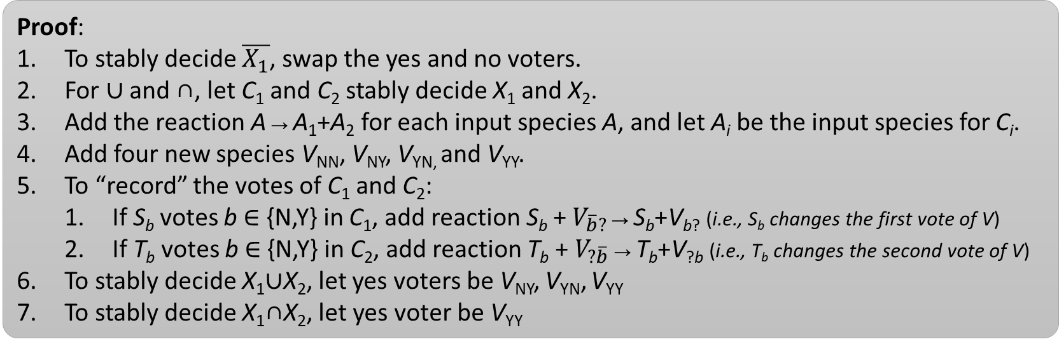
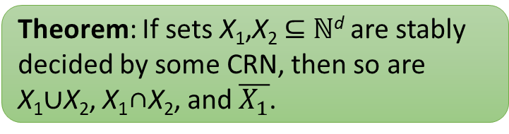
Stably decidable sets are closed under Boolean operations
For this proof, we assume that the voting species can be a strict subset of all species.
Theorem: If sets X₁,X₂ ⊆ ℕ^{d} are stably decided by some CRN, then so are
X₁∪X₂, X₁∩X₂, and $\overline{X_{1}}$.
What if all species are required to vote??
Proof:
To stably decide $\overline{X_{1}}$, swap the yes and no voters.
For ∪ and ∩, let C₁ and C₂ stably decide X₁ and X₂.
Add the reaction A→A₁+A₂ for each input species A, and let A_{i} be the input species for C_{i}.
Add four new species V_{NN}, V_{NY}, V_{YN,} and V_{YY}.
To “record” the votes of C₁ and C₂:
If S_{b} votes b ∈ {N,Y} in C₁, add reaction S_{b} + $V_{\overline{b}?}$→S_{b}+V_{b?} (i.e., S_{b} changes the first vote of V)
If T_{b} votes b ∈ {N,Y} in C₂, add reaction T_{b} + $V_{?\overline{b}}$→T_{b}+V_{?b} (i.e., T_{b} changes the second vote of V)
To stably decide X₁∪X₂, let yes voters be V_{NY}, V_{YN}, V_{YY}
To stably decide X₁∩X₂, let yes voter be V_{YY}

Slide 68
Mod and threshold sets are stably decidable
Theorem: Every mod set
M = { (x₁, …, x_{d}) | w₁∙x₁ + … + w_{d}∙x_{d} ≡ c mod m }
is stably decidable by a CRN.
Theorem: Every threshold set
T = { (x₁, …, x_{d}) | w₁∙x₁ + … + w_{d}∙x_{d} > t }
is stably decidable by a CRN.
Proof:
Start with 1 L₀ leader.
The leader will “count the (weighted) input mod m.”
For each 1 ≤ i ≤ d and 0 ≤ j < m, add the reaction X_{i} + L_{j}→L_{j+wi mod m}
Let L_{c} vote yes and all others vote no.
Proof:
If w_{i} > 0, add reaction X_{i}→w_{i} P
If w_{i} < 0, add reaction X_{i}→(–w_{i}) N
Need to decide if (#P produced) > (#N produced) + t
Start with 1 L_{N} leader and
t N if t > 0.
(–t) P if t < 0.
Now need to decide if #P > #N (including those present initially)
Add reactions
L_{Y} + N → L_{N}
L_{N} + P → L_{Y}
Corollary (since stably decidable sets are closed under Boolean combinations): Every semilinear set is stably decided by some CRN.
Also true for leaderless CRNs.
[Computation in networks of passively mobile finite-state sensors, Angluin, Aspnes, Diamadi, Fischer, Peralta. PODC 2004]

Slide 69
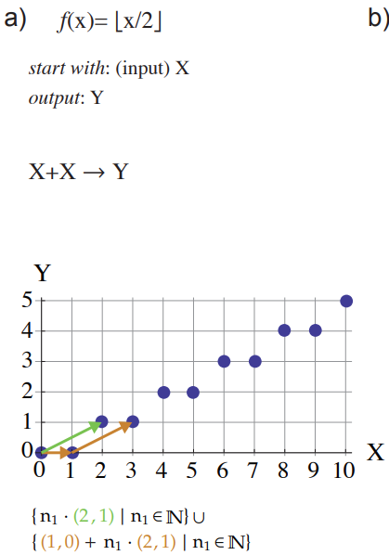
Semilinear functions are stably computable
Lemma: If f: ℕ^{d}→ℕ is a semilinear function, then it is piecewise affine: a finite union of partial affine functions g_{i}: ℕ^{d} ⇢ ℕ.
Each g_{i} is affine (linear with constant offsets): there are w₁ … w_{d} ∈ ℚ and b, c₁, …, c_{d} ∈ ℕ such that each
g_{i}(x₁, …, x_{d}) = w₁∙(x₁–c₁) + … + w_{d}∙(x_{d}–c_{d}) + b.
Furthermore, each “piece” dom g_{i} is a linear set.
g₁(x) = ½∙x
g₂(x) = ½∙(x–1)
dom g₁ = {x ≡ 0 mod 2}
dom g₂ = {x ≡ 1 mod 2}
We won’t prove this; see [Chen, Doty, Soloveichik, Deterministic function computation with chemical reaction networks. DNA 2012]

Slide 70
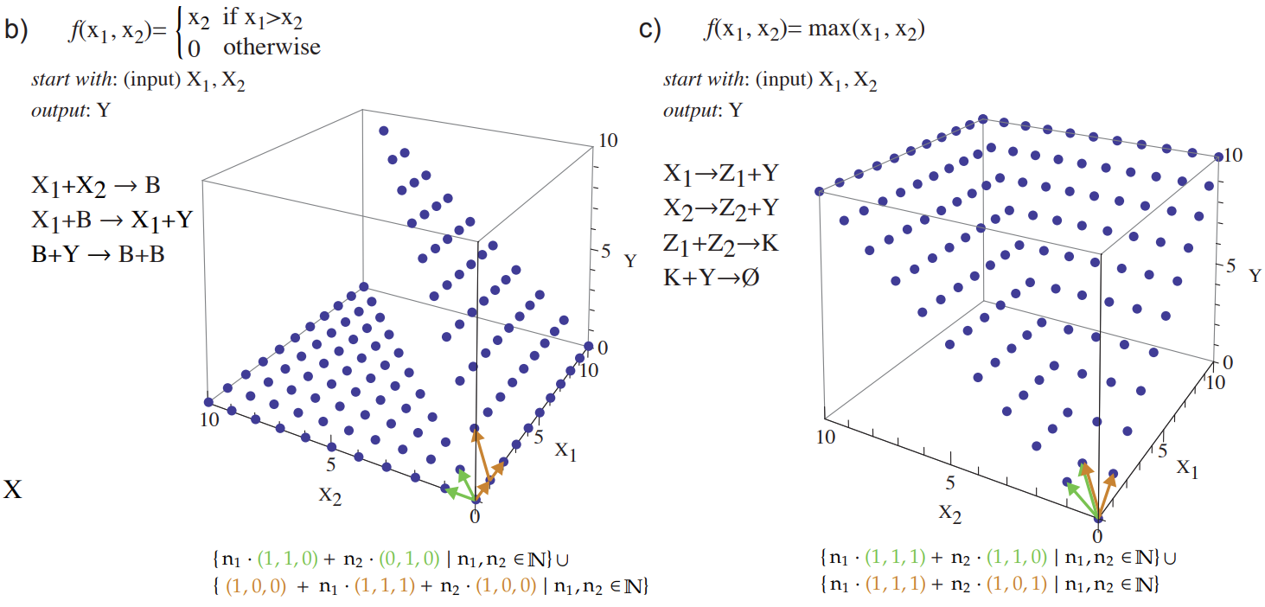
Semilinear function examples
g₁(x) = x₁
g₂(x) = x₂
dom g₁ = {x₁ > x₂}
g₁(x) = x₂
g₂(x) = 0
dom g₁ = {x₁ > x₂}

Slide 71
Computing affine functions (by example)
linear:
f(a,b,c) = 2a + (4/3)b – (5/6)c
A→2Y
3B→4Y
6C+5Y→∅
General form: w₁ … w_{d} ∈ ℚ and b, c₁, …, c_{d} ∈ ℕ
g_{i}(x₁, …, x_{d}) = w₁∙(x₁–c₁) + … + w_{d}∙(x_{d}–c_{d}) + b.
subtract constant offset c_{i} from input x_{i}:
start with 1 L, a A’s, b B’s
f(a,b) = 2(a–3) – (5/4)(b–1) + 6
L→ 6Y + L_{a0} + L_{b0} create d offset, and one leader for each input
L_{a0} + A→ L_{a1} remove 3 copies of A
L_{a1} + A→ L_{a2}
L_{a2} + A→ L_{a3}
L_{a3} + A→ L_{a3} + A’ convert remaining A to A’
A’→2Y compute 2(a–3) by doubling A’
L_{b0} + B→ L_{b1} remove 1 copy of B
L_{b1} + B→ L_{b1} + B’ convert remaining B to B’
4B’+5Y→∅ compute (–5/4)(b–1) on B’
add constant offset:
start with 1 L, a A’s, b B’s
f(a,b) = 2a + 3b + 4
L→4Y
A→2Y
B→3Y

Slide 72
Combining all affine function computations
Lemma: If f: ℕ^{d}→ℕ is a semilinear function, then it is piecewise affine: a finite union of partial affine functions g_{i}: ℕ^{d} ⇢ ℕ.
Furthermore, each “piece” dom g_{i} is a linear set.
Theorem: If f: ℕ^{d}→ℕ is a semilinear function, then some CRN stably computes f.
⇒
Proof sketch:
To compute whole semilinear function f, compute all these affine functions g_{i} in parallel, storing output of g_{i} in species Y_{i}.
in parallel means: split each input species A via reaction A→A₁ + A₂ + …, where A_{i} is used as input for computing g_{i}.
Also in parallel, for each domain dom g_{i}, compute the predicate [x ∈ dom g_{i}?].
Yes-voters T_{i} and no-voters F_{i} for [x ∈ dom g_{i}?] do:
T_{i} + Y_{i} →T_{i} + Y + Ŷ_{i} convert g_{i}’s output Y_{i} to “global” output Y
F_{i} + Y + Ŷ_{i} →F_{i} + Y_{i} convert back
Question 1: what’s the point of species Ŷ_{i}?
Question 2: Something else doesn’t work as described… what is it?
Answer 2: Consuming Y_{i} can disrupt computation of g_{i}.
Can be solved using dual-rail encoding. (not shown)

Slide 73
Limits of stable computation
Non-semilinear functions/predicates cannot be stably computed by CRNs

Slide 74
Impossibility of stably deciding non-semilinear sets
Theorem: Every stably decidable set X ⊆ ℕ^{d} is semilinear.
We won’t prove this in full generality, but we will prove the simpler corollary that the “squaring set” X = { (a,b) ∈ ℕ² | a² = b } is not stably decidable.
To start, we use the above theorem to prove the following:
Theorem: Every stably computable function f: ℕ^{d}→ℕ is semilinear.

Slide 75
Impossibility of stably computing non-semilinear functions
Theorem: Every stably computable function f: ℕ^{k}→ℕ is semilinear.
Proof:
Let C be a CRN stably computing f.
We convert C to a CRN D stably deciding graph(f) = { (x₁,x₂,…,x_{k},y) ∈ ℕ^{k+1} | f(x₁,x₂,…,x_{k}) = y }.
Then graph(f) must be semilinear, since a CRN stably decides it. (By first theorem on previous slide.)
Key challenge: D will run C with D’s first k inputs. But D has to test the count of C’s output Y to compare it to D’s last input, without consuming Y, since consuming Y could disrupt the correctness of C.
Solution: we introduce two new species Y_{P} and Y_{C} representing #Y that are only produced by C, never consumed, so we are free to add reactions consuming them. This is called dual-rail encoding: #Y = #Y_{P} – #Y_{C}
For each reaction in C changing the count of output Y, add Y_{P} or Y_{C} as products to track the change:
X→ Z + 2Y becomes X→Z + 2Y + 2Y_{P} since there are net 2 Y’s produced
X + 6Y→2Y becomes X + 6Y→2Y + 4Y_{C} since there are net 4 Y’s consumed
For concreteness, assume k=1.
CRN D deciding graph(f) has 2 input species. The first is A. Let the second input species be Y_{C}.
Since C stably computes f, eventually f(initial #A) more Y_{P} are produced than Y_{C}.
If and only if initially f(#A) = #Y_{C}, then eventually #Y_{P} = #Y_{C}.
Add reactions to test for equality between #Y_{P} and #Y_{C}. (not shown, but easy)

Slide 76
Impossibility of stably deciding a non-semilinear set
goal:
Theorem: The “squaring set” S = { (x,y) ∈ ℕ² | x²=y } is not stably decidable by any CRN.

Slide 77
Additivity, nondecreasing sequences, minimal elements
Observation: Reachability is additive: if c ⇒ d, then for all e ∈ ℕ^{d}, c+e ⇒ d+e, i.e., the presence of extra molecules e cannot prevent reactions from being applicable.
Definition: An infinite sequence of vectors c₁, c₂, … is nondecreasing if c_{i} ≤ c_{i+1} for all i. (c_{i} ≤ c_{i+1} means c_{i}(S) ≤ c_{i+1}(S) for all species S)
Definition: Given A ⊆ ℕ^{d}, we say y ∈ A is minimal if, for all x ∈ A, x ≤ y implies x = y, i.e., nothing in A is strictly smaller than y. Let min(A) = minimal elements of A.

Slide 78
All vectors have a minimal vector under them
Observation: For all x ∈ A, there is a minimal vector m ∈ min(A) such that m ≤ x.
Proof:
If x ∈ min(A) then we’re done.
Otherwise, since x ∉ min(A), there is x₁ ∈ A such that x₁ < x.
If x₁ ∈ min(A) then we’re done since x₁ ≤ x.
Otherwise, since x₁ ∉ min(A), there is x₂ ∈ A such that x₂ < x₁.
…
Since there are only a finite number of y in ℕ^{d} such that y < x, this process must terminate with a minimal vector m ∈ min(A). QED

Slide 79
Dickson’s Lemma: Nondecreasing subsequences
Dickson’s Lemma: (1) Every infinite sequence (x₀, x₁, …) of vectors in ℕ^{d} has an infinite nondecreasing subsequence, and (2) every set A ⊆ ℕ^{d} has a finite number of minimal elements.
Proof:
We’ll show condition (1) by induction on d.
Base case d = 1: Let X = x₀, x₁, … be an infinite sequence of nonnegative integers.
case 1: some x ∈ ℕ appears infinitely often. Let the subsequence be (x, x, …), e.g. 1,1,5,3,4,3,4,3,4,3,4,3,4,3,4,3,4,…
case 2: every x ∈ ℕ appears finitely many times.
First element of subsequence is y₀ = x₀.
Assuming we have finite increasing subsequence y₀ < y₁ < … < y_{k–1}, let x_{j} be last occurrence of any integer ≤ y_{k–1} in original sequence x₀, x₁, …, and let y_{k} = x_{j+1}, e.g., 2,1,0, 3,2,1, 4,3,2, 5,4,3, 6,5,4, 7,6,5, 8,7,6, 9,8,7, 10,9,8, 11,10,9…
Inductive case d > 1:
Inductively pick infinite subsequence X’ such that the length-(d–1) prefix vectors are nondecreasing.
Pick an infinite subsequence of X’ such that the d’th elements are also nondecreasing, as in base case.
For condition (2), suppose that min(A) is infinite; put them in any order to make an infinite sequence.
By first condition, there’s an infinite nondecreasing subsequence m₁ ≤ m₂ ≤ … of distinct vectors in min(A).
Since they are distinct, m₁ < m₂ < …, but m₁ < m₂ contradicts the minimality of m₂. QED

Slide 80
Properties of stable configurations
For convenience, assume every species votes.
Thus a stable YES-output configuration o with output φ(o) = YES is one in which, for all o’ ∈ Reach(o), all NO voters are absent from o’. (Similarly for stable NO-output.)
Conversely, an unstable configuration c is one in which at least one of the following holds:
YES and NO voters both exist already in c (output undefined)
Only YES voters exist, but a NO voter is producible in some c’ ∈ Reach(c).
Only NO voters exist, but a YES voter is producible in some c’ ∈ Reach(c).
By additivity, for all δ ∈ ℕ^{d}, c+δ is unstable as well, since c’+δ ∈ Reach(c+δ) (since c’ has the contradictory voter, so does c’+δ), leading to the following observation:
Observation: The unstable configurations are closed upwards: for all unstable c and all d ≥ c, d is also unstable.
Corollary: The stable configurations are closed downwards: for all stable c and all b ≤ c, b is also stable.

Slide 81
Upper cones
Definition: For all c ∈ ℕ^{d}, let ∇(c) = { d ∈ ℕ^{d} | c ≤ d } denote the upper cone of c.
Observation (reworded from previous slide):
For all unstable c and all d ∈ ∇(c),
d is also unstable.
∇(c)

Slide 82
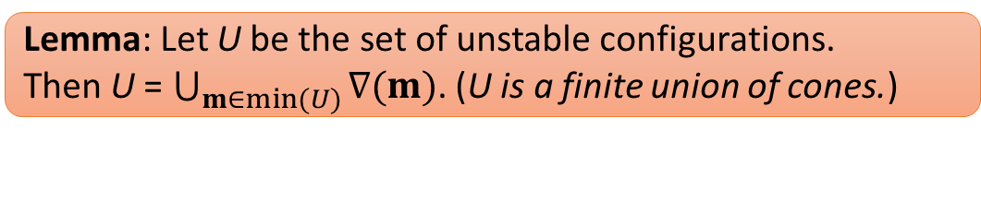
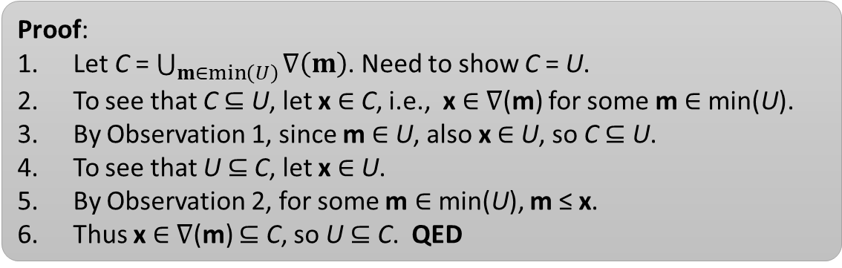
Set of unstable configurations is finite union of cones
Recall:
Observation 1: Unstable configs are closed upwards: For all unstable c and all d ∈ ∇(c), d is also unstable.
Observation 2: For all x ∈ A, there is a minimal m ∈ min(A) such that m ≤ x.
Lemma: Let U be the set of unstable configurations.
Then U = $\bigcup_{m∈min⁡(U)}{∇(m)}$. (U is a finite union of cones.)
Proof:
Let C = $\bigcup_{m∈\min\left(U\right)}{∇\left(m\right)}$. Need to show C = U.
To see that C ⊆ U, let x ∈ C, i.e., x ∈ ∇(m) for some m ∈ min(U).
By Observation 1, since m ∈ U, also x ∈ U, so C ⊆ U.
To see that U ⊆ C, let x ∈ U.
By Observation 2, for some m ∈ min(U), m ≤ x.
Thus x ∈ ∇(m) ⊆ C, so U ⊆ C. QED

Slide 83
Stable configurations are closed upwards for species that are already “large”
Recall stable configs are closed downward. They are also closed upward for “already large” species.
#S
Definition: Let τ = max { m(S) | m ∈ min(U), S ∈ Λ }.
The hypercube with corner (τ, τ, …, τ) ∈ ℕ^{d} (and other corner at origin) contains every minimal m defining U.
Lemma: Let c be stable such that for some species
S ∈ Λ, c(S) ≥ τ. Let d = c + {any amount of S}.
Then d is also stable.
τ
Proof: By picture. τ = 6, c(S) = 6, d(S) = 8.
If c is not already in a cone ∇(m) defining the unstable configurations U, we cannot enter any cone by adding more S.
τ

Slide 84
A pumping lemma
Pumping Lemma: Suppose a CRN stably decides infinite set A ⊆ ℕ^{d}.
Then there are c<d such that, letting δ = d–c, for all n ∈ ℕ, c+nδ ∈ A.
Proof:
By Dickson’s Lemma there is infinite nondecreasing subsequence c₀ ≤ c₁ ≤ …, each c_{i} ∈ A. Let δ_{i} = c_{i+1} – c_{i}.
Define sequence of stable o₀, o₁, … inductively as follows.
Base case: c₀ ⇒ o₀ for some stable o₀.
Inductive case: By additivity c_{i+1} = c_{i} + δ_{i} ⇒ o_{i} + δ_{i}.
By correctness o_{i} + δ_{i} ⇒ o_{i+1} for some stable o_{i+1}.
By Dickson’s Lemma pick infinite nondecreasing subsequence o’₀ ≤ o’₁ ≤ … of o_{i}’s. For the sake of readability let’s assume this is just the original sequence o₀ ≤ o₁ ≤ ….
Let Γ = { S | lim_{i→∞} o_{i}(S) = ∞ } (species with unbounded counts).
For large enough i, if S ∈ Γ, then o_{i}(S) ≥ τ, and if S ∉ Γ, then o_{i}(S) = c_{S} where c_{S} is the largest S ever gets in the o_{i}’s.
Then o_{i+1}(S) = o_{i}(S) if S ∉ Γ and o_{i}(S) ≥ τ otherwise.
c₃=
δ₂
δ₁
c₂=
o₂
⇒
δ₀
o₁
c₁=
⇒
c₀
⇒
o₀

Slide 85
A pumping lemma (proof continued)
Pumping Lemma: Suppose a CRN stably decides infinite set A ⊆ ℕ^{d}.
Then there are c<d such that, letting δ = d–c, for all n ∈ ℕ, c+nδ ∈ A.
Proof: (continued)
Fix large enough i that o_{i+1}(S) = o_{i}(S) if S ∉ Γ and o_{i}(S) ≥ τ otherwise.
Write ε = o_{i+1} – o_{i}.
Note that ε(S) > 0 implies o_{i}(S) ≥ τ.
Then o_{i} +δ_{i} ⇒ o_{i+1} = o_{i}+ε, i.e., o_{i} is like a “catalyst” that transforms δ_{i} into ε.
Apply the same execution to n copies of δ_{i}: o_{i} +nδ_{i} ⇒ o_{i}+nε.
o_{i} +nε is larger than o_{i} only on species S with count o_{i}(S) ≥ τ.
By closure of stable configurations upwards for “already large” species, since o_{i} is stable, o_{i} +nε is also stable, with the same output YES, since they have the same species present.
In other words, we can reach from c_{i}+nδ_{i} to a stable YES configuration, so c_{i}+nδ_{i} ∈ A for all n ∈ ℕ.
Let c = c_{i} and d = c_{i+1}, with δ = δ_{i}. QED
o_{i}
o_{i}
δ_{i}
⇒
ε
δ_{i}
⇒
ε
δ_{i}
⇒
ε

Slide 86
Impossibility of stably deciding squaring set
Pumping Lemma : Suppose a CRN stably decides infinite set A ⊆ ℕ^{d}.
Then there are c<d such that, letting δ = d–c, for all n ∈ ℕ, c+nδ ∈ A.
Theorem: The “squaring set” S = { (x,y) | x²=y } is not stably decidable by any CRN.
Proof:
By our Pumping Lemma, there are points c=(x,x²) and d=(z,z²), x < z, such that, letting δ = d–c, for all n ∈ ℕ, c+nδ ∈ S.
Claim: the point c+2δ ∉ S, contradicting our Pumping Lemma.
Proof: by picture. (straight line intersects a parabola at ≤ 2 points)
Formally, suppose otherwise: c+2δ = (2z–x, 2z²–x²) ∈ S.
Then (2z–x)² = (2z²–x²), so
0 = (2z–x)² – (2z²–x²)
= (4z²–4xz+x²) – (2z²–x²)
= 2z² – 4xz + 2x²
= 2(z–x)², which contradicts x ≠ z. QED
c+2δ
d
δ
c

Slide 87
Limits of efficient stable computation

Slide 88
What is known to be computable in less than time O(n)?
Predicates
Functions
Boolean combination of detection predicates
“detection” means φ(a) = [a > 0?]
ℕ-linear functions (coefficients are nonnegative integers)
e.g., f(a,b) = 2a + 3b
a→y+y
b→y+y+y
φ(a,b,c) = a>0 OR (b>0 AND c=0)
i.e., constant except when a variable changes from 0 to positive
Both computable in O(log n) time
[Angluin, Aspnes, Eisenstat, Fast computation by population protocols with a leader, DISC 2006]
[Chen, Doty, Soloveichik, Deterministic function computation with chemical reaction networks, DNA 2012]

Slide 89
Known time lower bounds: leader election/majority
Leader election
Majority (and other “explicit” predicates)
Leader election (computing the constant function f(a)=1) requires Ω(n) time
Majority (and many other “explicit” predicates such as equality) require Ω(n / polylog n) time, even with up to ½ log log n states.*
If the protocol satisfies a technical condition called “output dominance”, then even with up to log n states, Ω(n^{0.999}) time is required.**
*[Alistarh, Aspnes, Eisenstat, Gelashvili, Rivest, SODA 2017]
[Doty, Soloveichik, Stable leader election in population protocols requires linear time, DISC 2015]
**[Alistarh, Aspnes, Gelashvili, SODA 2018]: “output dominance” = changing positive counts of states in a stable configuration leaves it able to reach a stable configuration with the same output

Slide 90
Known time lower bounds: “most” predicates/functions
Informal: “most” semilinear predicates and functions not known to be computable in o(n) time, actually require at least Ω(n) time to compute
Definition: φ: ℕ^{k}→{Y,N} is eventually constant if there is m∈ℕ so that φ(a) = φ(b) for all a,b with all components ≥ m
Definition: f: ℕ^{k}→ℕ is eventually ℕ-linear if there is m∈ℕ so that f(a) is ℕ-linear for all a with all components ≥ m
Both definitions allow exceptions “near a face of ℕ^{k}”
Formal theorem: Every predicate that is not eventually constant, and every function that is not eventually ℕ-linear, requires at least time Ω(n) to compute.
They’re all computable in at most O(n) time, so this settles their time complexity.
[Belleville, Doty, Soloveichik, Hardness of computing and approximating predicates and functions with leaderless population protocols, ICALP 2017]

Slide 91
What is currently known/unknown
 | Predicates | Functions
computable in O(log n) time | detection (constant unless changing between 0 and positive) a>0 AND (b>0 OR c=0) | ℕ-linear 3a + b + 2c
not computable in less than Ω(n) time | non-eventually constant a>b? a=b? a is odd? | non-eventually ℕ-linear a/2 a–b a+1 a–1 1 min(a,b) max(a,b) max(a, min(b + 3, 2c)) – c – 1
unknown (best known protocol is O(n) time) | eventually constant but not constant on all positive values a>1? | eventually ℕ-linear but not ℕ-linear
f(a)
a if a>1,
0 otherwise
f(a) =
a

Slide 92
Other modeling choices?

Slide 93
Modeling choices in formalizing “Computing with chemistry”
integer counts (“stochastic”) or real concentrations (“mass-action”)?
what is the object being “computed”?
yes/no decision problem? “number of A’s > number of B’s?”
numerical function? “make Y become double the amount of X”
guaranteed to get correct answer? or allow small probability of error?
if Pr[error] = 0, system works no matter the reaction rates
to represent an input n₁,…,n_{k}, what is the initial configuration?
only input species present?
auxiliary species can be present?
when is the computation finished? when…
the output stops changing? (convergence)
the output becomes unable to change? (stabilization)
a certain species T is first produced? (termination)
require exact numerical answer? or allow an approximation?
first part of slides
summarized in next few slides

Slide 94
Auxiliary species present initially ≈ “initial leader”
Instead of starting with { 100 A } to represent input value 100, start with { 1 L, 100 A }
some predicates/functions get “easier” (i.e., it’s easy to think of the reactions)
parity: φ(a) = “a is odd”
without a leader
A_{o}+A_{o}→ A_{e}+a_{e}
A_{e}+A_{e} → A_{e}+a_{e}
A_{o}+A_{e} → A_{o}+a_{o}
A_{o}+a_{e} → A_{o}+a_{o}
A_{e}+a_{o} → A_{e}+a_{e}
L_{e}+A→L_{o}
L_{o}+A→L_{e}
with a leader L_{e}
But fundamental computability doesn’t change: exactly the semilinear predicates/functions can be computed (same as without a leader).
[Angluin, Aspnes, Diamadi, Fischer, Peralta, PODC 2004] [Angluin, Aspnes, Eisenstat, PODC 2006] [Chen, Doty, Soloveichik, DNA 2012] [Doty, Hajiaghayi, DNA 2013]

Slide 95
Convergence vs stabilization and leader vs anarchy
#
Y
=3
#
Y
=2
#
Y
=2
#
Y
=2 stable
...
...
initial
convergence
stabilization
Theorem: Without a leader, all non-eventually constant predicates and non-eventually-ℕ-linear functions require at least Ω(n) stabilization time. [Belleville, Doty, Soloveichik, ICALP 2017]
Previous work: With a leader, all semilinear predicates/functions can be computed in at most O(log⁵ n) convergence time. [Angluin, Aspnes, Eisenstat, DISC 2006]
Conjecture: With a leader, all non-detection predicates and non-ℕ-linear functions require at least Ω(n) stabilization time.
False conjecture: Without a leader, all non-detection predicates and non-ℕ-linear functions require at least Ω(n) convergence time.
[resolved negatively by Kosowski, Uznański, Population Protocols are Fast , PODC Brief Announcement 2018]

Slide 96
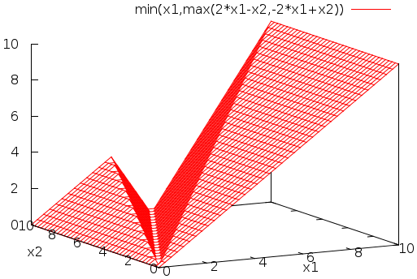
What if we use real-valued concentrations?
Theorem: A function is stably computable by an integer-valued chemical reaction network if and only if it is semilinear.
Theorem: A function is stably computable by a real-valued chemical reaction network if and only if it is continuous and piecewise linear.
f(n)
semilinear example
continuous piecewise linear example
n
[Angluin, Aspnes, Eisenstat, PODC 2006]
[Chen, Doty, Soloveichik, DNA 2012]
[Chen, Doty, Reeves, Soloveichik, JACM 2023]

Slide 97
What if we allow a small probability of error? (i.e., allow reaction rates to influence outcome)
Theorem: A function is computable with probability of error < 1% by an integer-valued chemical reaction network if and only if it is computable by any algorithm whatsoever…
[Soloveichik, Cook, Bruck, Winfree, Natural Computing 2008]
… “efficiently” (polynomial-time slowdown) …
f(n)
computable example
… if we have an initial leader.
11
Furthermore, computation doesn’t merely converge to the correct answer eventually, but can be made “terminating”: producing a molecule T signaling when the computation is done.
(provably impossible when Pr[error] = 0)
7
5
3
2
Conjecture: Even without a leader, any computable function can be efficiently computed with high probability.
n

Slide 98
What if we use real-valued concentrations… and allow reaction rates to influence outcome??
Theorem: A function is computable by a real-valued chemical reaction network using mass-action kinetics if and only if it is computable by any algorithm whatsoever.
[Fages, Le Guludec, Bournez, Pouly. Strong Turing completeness of continuous chemical reaction networks and compilation of mixed analog-digital programs. Computational Methods in Systems Biology – CMSB 2017]
mass-action kinetics:
[X] = –k₁[X] + k₂[Y][Z]
… with only a polynomial-time slowdown.
k₁
X → Y+Y
[Y] = 2k₁[X] – k₂[Y][Z]
[Bournez, Graça, Pouly. Polynomial time corresponds to solutions of polynomial ordinary differential equations of polynomial length. Journal of the ACM 2017]
k₂
Y+Z → X
[Z] = – k₂[Y][Z]

Slide 99
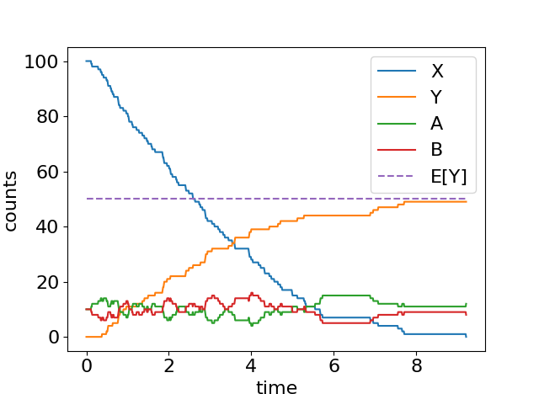
Fast approximate division by 2
n = 100 ε = 0.1
initial configuration:
{ n X, εn A, εn B }
X+A→B+Y
X+B→A
guaranteed to get
Y = n/2 ± εn
E[time] = O(log n) / ε
[Belleville, Doty, Soloveichik, Hardness of computing and approximating predicates and functions with leaderless population protocols, ICALP 2017]

Slide 100
CRN computation with a small chance of error

Slide 101
Counter (register) machine
dec r
inc s
inc s
inc s
dec t
inc s
“input” counter
if empty goto 6
r
s
t
if empty goto 1
computes f(n) = 3n+1
HALT

Slide 102
Counter machines
Finite state machine with a fixed number of counters c₁, c₂, …, c_{k}, each holding a nonnegative integer.
Start with inputs n₁, n₂, …, n_{l} ∈ ℕ as values of c₁, c₂, …, c_{l}, and c_{l+1}, …, c_{k} start 0.
Finite-state machine, where each state is one of:
inc c: increment counter c
dec c: decrement counter c; no effect if c = 0
if c=0 goto i: if counter c is 0, then jump to state i
goto i (can be shorthand for if c=0 goto i for unused c)
may also have accept/reject semantics, or interpret the final value of some counter as the output

Slide 103
Example counter machines
input a
φ(a) = “a is odd”
if a=0 goto 7
dec a
if a=0 goto 6
dec a
goto 1
accept
reject
input a
f(a) = 2a
input a
f(a) = ⌊a/2⌋
if a=0 goto 6
dec a
inc b
inc b
goto 1
end
while a>0:
dec a
dec a
inc b
input a
f(a) = 2ª
inputs a,b
f(a,b) = ab
while a>0:
<instruction>
<instruction>
…
i. …
is a shorthand for
if a=0 goto i
<instruction>
<instruction>
…
i-1. goto 1
i. …
inc b
while a>0:
dec a
while b>0:
dec b
inc c
inc c
while c>0:
dec c
inc b
while a>0:
dec a
while b>0:
dec b
inc c
inc d
while c>0:
dec c
inc b

Slide 104
Alternative formalism of counter machines
I made up the “line number” definition to make this model more palatable to scientists who have programmed, but who have not seen finite-state machines.
Equivalent to the following definition: a k-counter machine is a triple
Q: finite set of states,
q₀: initial state,
δ: (Q \ {q_{A},q_{R}}) × {z,n}^{k} → Q × {+1,–1,0}^{k}
δ(q, z, n, z) = (r, 1, –1, 0) means:
if the 3-counter machine is in state q, counters 1 and 3 are =0, counter 2 is >0,
then go to state r, increment counter 1, and decrement counter 2.

Slide 105
3-counter machines are Turing universal
Assume Turing machine
has a single blank on rightmost cell
if rightmost blank overwritten, it grows a new blank cell to right
Need a third “work” counter c to help do the following operations on counters a and b:
q₆
Turing machine operation | Counter machine implementation
read bit under tape head
change bit under tape head
move tape head right
move tape head left
test if tape head is on blank and if so, change it to 1
is a odd?
0 | 0 | 1 | 1 | 1 | 0 | 0 | 0 | 1 | _
inc/dec a
set a = 2a (+ 1) ; set b = ⌊b/2⌋
a =
1 | 0 | 0 | 1 | 1 | 1
2
set b = 2b (+ 1) ; set a = ⌊a/2⌋
= 39
if b=1 then
set a = 2a + 1
b =
1 | 1 | 0 | 0 | 0
2
= 24
Interpret tape on each side of tape head as binary number; append new leading 1 to make this mapping 1-1, in case the binary string has no leading 1 already, since 00111₂, 0111₂, and 111₂ are all considered the number 7.
1-counter machines are not Turing-universal… why?

Slide 106
2-counter machines are (sort of) Turing universal
[Minsky 1967, Computation: Finite and Infinite Machines]
To represent counter values (a,b,c) in a single counter x, let x = 2ª∙3^{b}∙5^{c} and y = 0.
To increment b, set x = 3x. (using y as a work counter)
To decrement a, set x = ⌊x/2⌋.
To test if c = 0, test if x ≡ 0 mod 5.
To start with a = n and b = c = 0, start with x = 2^{n}∙3⁰∙5⁰ =2^{n}.
If f:ℕ → ℕ is any computable function, this machine can start with x=2^{n} and halt with x=2^{f(n)}.
Caveat about encoding: there is no 2-counter machine that starts with x=n and halts with x=2^{n}.
2-counter machines can do universal computation on encoded inputs (n encoded as 2^{n}), but they cannot compute the encoding/decoding themselves.
However, the fact that 2-counter machines can simulate arbitrary 3-counter machines implies that the Halting Problem for 2-counter machines is undecidable.
[Schroeppel 1972, A Two Counter Machine Cannot Calculate 2^{N}]
“Theorem: Any counter machine can be simulated by a 2-counter machine,
provided an obscure coding is accepted for the input and output.”

Slide 107

2-counter machines: Finite automata robots on the plane
Finite automaton occupying a point (x,y) ∈ ℕ².
It cannot write anything, or see anything.
It can sense if it is touching the southern wall, or western wall (or both).
It can move north, south, east, or west based on its current state and 2 “wall bits”, and of course change state:
δ: S × {wall, no wall}²→S × {↑,↓,←,→}
There is an automaton A so that this problem is undecidable: given (x,y) ∈ ℕ², if started at (x,y), will A ever visit the lower-left corner?

Slide 108
CRNs can simulate counter machines with probability < 1
Counter machine:
r = input n, start line 1
CRN:
initial state {n R, 1 L₁}
inc r
dec r if zero goto 1
inc s
dec s if zero goto 2
L₁ → L₂ + R
L₂ + R → L₃
; L₂ → L₁
L₃ → L₄ + S
Need to be very slow!
L₄ + S → L₅
; L₄ → L₂
Error occurs when R is present, but reaction L₂ → L₁ occurs instead of L₂ + R → L₃.
Semantic effect on register machine: when r > 0, it may jump from line 2 to 1 without decrementing.
There’s a positive probability of error; how to reduce it? Need to slow down L₂ → L₁.
[Soloveichik, Cook, Winfree, Bruck, Natural Computing 2008, Angluin, Aspnes, Eisenstat, DISC 2006, Distributed Computing 2008]

Slide 109
Problem with adjusting rate constant to slow down reactions for achieving Turing-universal computation
Could make rate constant k very small
If correct reaction r_{c}: L₂+R → L₃ has rate constant 1, how small should k be to achieve Pr[r_{i} occurs instead of r_{c}] = Pr[error] = ε?
rate of r_{c} = λ_{c} = #L₂∙#R/v = #R/v ≥ 1/v
rate of r_{i} = λ_{i} = k∙#L₂ = k
Pr[error] = λ_{i} / (λ_{i} + λ_{c}) ≤ k / (k + 1/v)
For Pr[error] = ε, set k = ε / (v–vε) ≈ ε/v

Slide 110
Problems with simulation scheme so far
Adjusting rate constants means designing new chemicals.
Easier to adjust counts of existing molecules than to design new ones.
Pr[error in any time step] increases for longer computations.
By union bound we can only say Pr[error in any time step] ≤ ε∙t (t = running time), so to achieve total error probability ≤ δ over all the computation requires setting ε ≤ δ/t, i.e., k ≤ δ/(t∙v).
Universal computation requires that we can simulate a program without knowing in advance how many steps it will take.
Register machines are exponentially slower than Turing machines.
To store b bits, we need Ω(2^{b}) molecules.
Problem 4 is fundamental in CRNs: they necessarily store a “unary” encoding of any integer.
Theorem(ish): There is a CRN solving problems 1–3.
We’ll see how to solve problems 1 and 2 by simulating a register machine more efficiently.
To handle Problem 3, see [Soloveichik, Cook, Winfree, Bruck, Computation with Finite Stochastic Chemical Reaction Networks, NaCo 2008]

Slide 111
How to slow down reaction L₂ → L₁?
Use a clock:
1 C₁, 1 F, n B
C_{k} + L₂ → C₁ + L₁
F + C₁ → F + C₂ B + C₂ → B + C₁
F + C₂ → F + C₃ B + C₃ → B + C₂
…
1
1
1
1
C₁
C₂
C₃
…
C_{k}
C_{k} appears after expected time ≈ n^{k-1}
n
n
n
n
reverse-biased random walk
E[time for L₂ + R → L₃] ≤ n

Slide 112
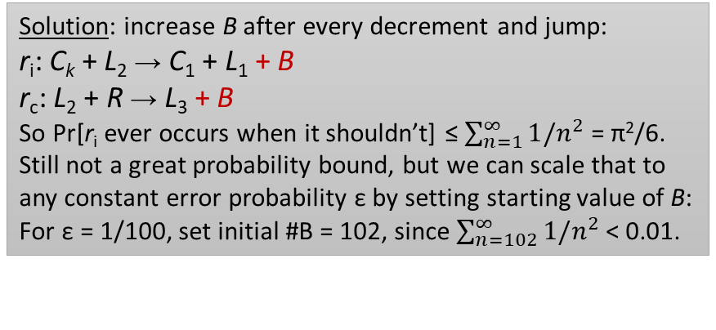
How to handle the three problems
Recall three problems we claimed we would solve:
Adjusting rate constants means designing new chemicals.
Pr[error in any time step] increases for longer computations.
Reducing error slows down the computation “significantly”.
Problem 1: Now all rate constants = 1.
Problem 2: How to make Pr[error in any time step] < ε, no matter how long the computation goes?
Solution: increase B after every decrement and jump:
r_{i}: C_{k} + L₂ → C₁ + L₁ + B
r_{c}: L₂ + R → L₃ + B
So Pr[r_{i} ever occurs when it shouldn’t] ≤ $\sum_{n=1}^{∞}{1/n^{2}}$ = π²/6.
Still not a great probability bound, but we can scale that to any constant error probability ε by setting starting value of B:
For ε = 1/100, set initial #B = 102, since $\sum_{n=102}^{∞}{1/n^{2}}$ < 0.01.
F + C₁ → F + C₂ B + C₂ → B + C₁
F + C₂ → F + C₃ B + C₃ → B + C₂
Two competing reactions, r_{i} incorrect, and r_{c} correct:
r_{i}: C_{k} + L₂ → C₁ + L₁
r_{c}: L₂ + R → L₃
If both possible, worst case is #R=1, whereas #C_{k} = 0 or 1.
Pr[r_{i}] = Pr[#C_{k} = 1] ≤ 1/n^{k}, where n = #B.
Setting k = 2, Pr[r_{i}] ≤ 1/n².
Problem 3: Also solved! i.e., halving error probability no longer doubles computation time (derivation not shown)

