Slide 1
DNA strand displacement
DNA reconfiguring itself without enzymes
slides © 2023, David Doty
ECS 232: Theory of Molecular Computation, UC Davis

Slide 2

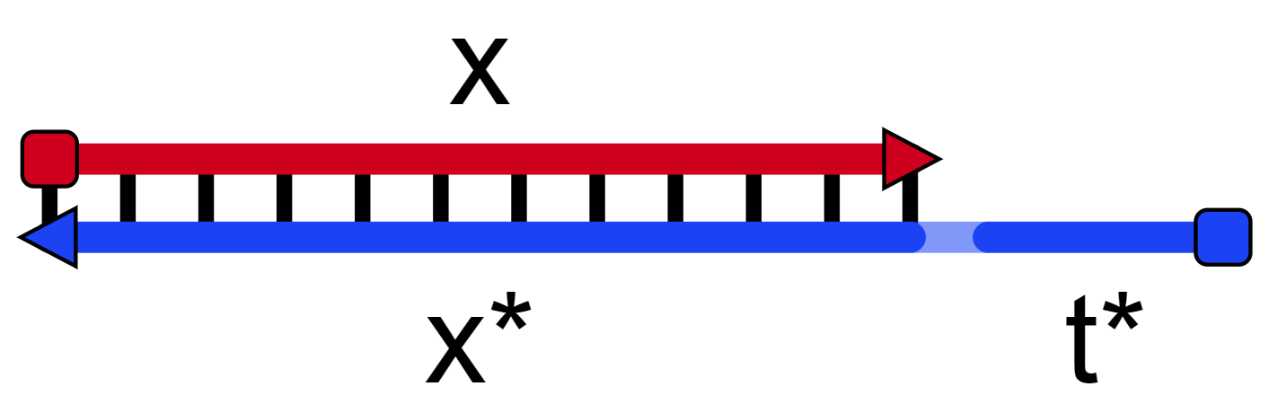
DNA strands with “long” and “short” (toehold) binding domains
x
x
=
TGTACCTGTCGA
=
ACATGGACAGCTATAC
x*
t*
x*
t*
“toehold”

Slide 3
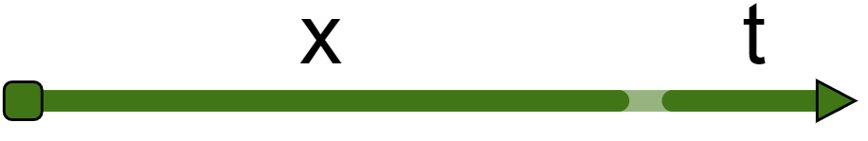
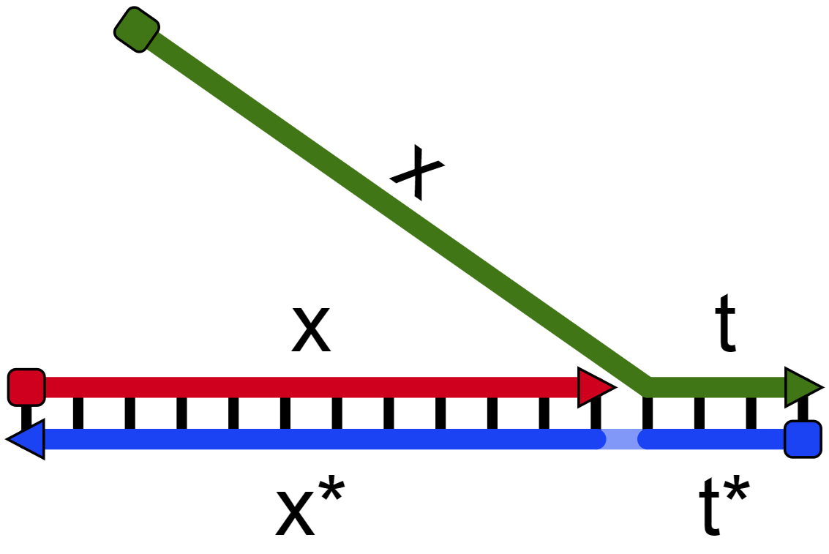
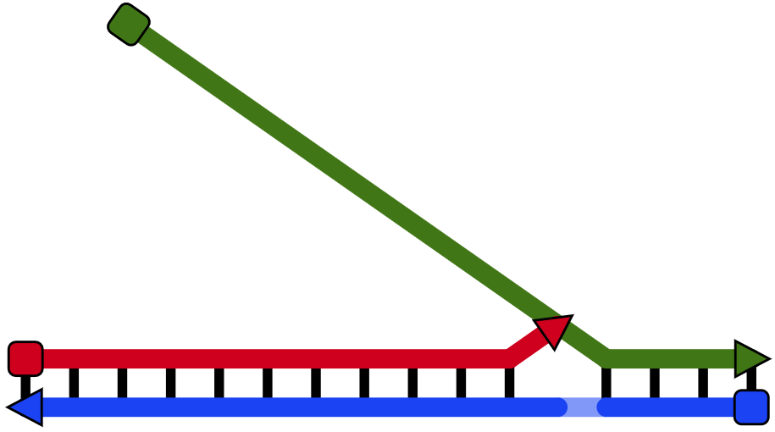
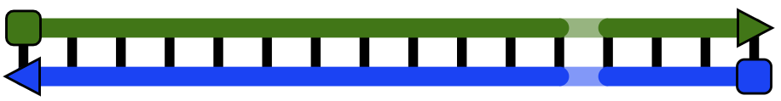
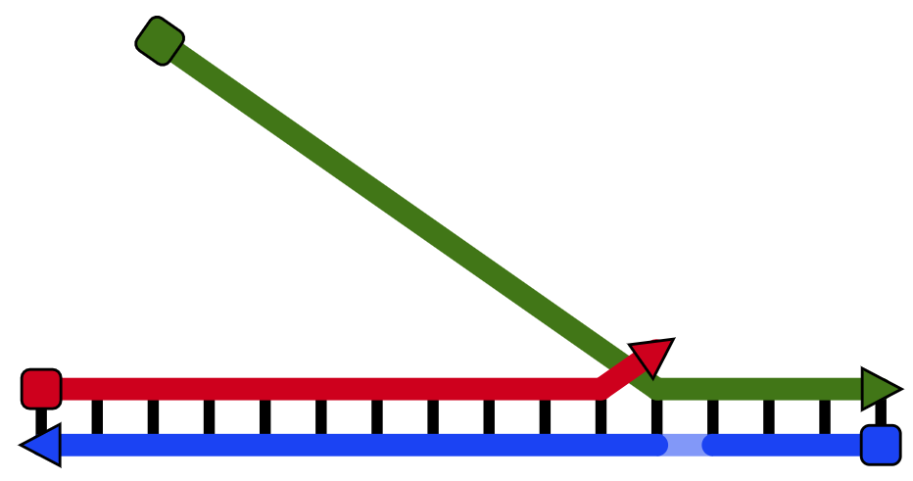
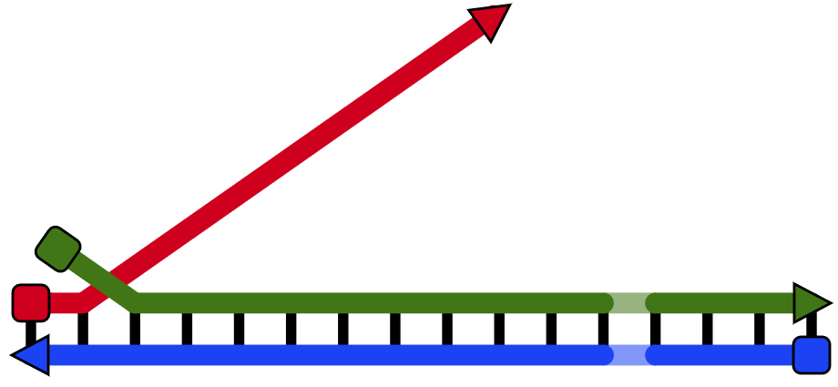
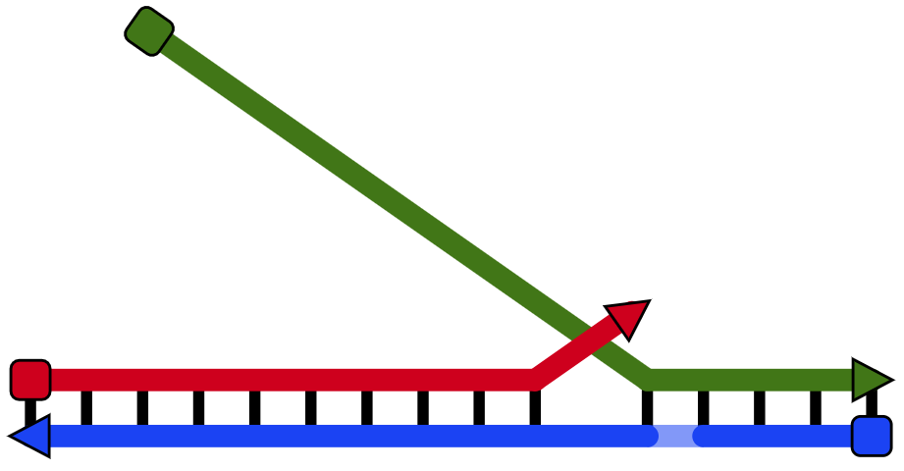
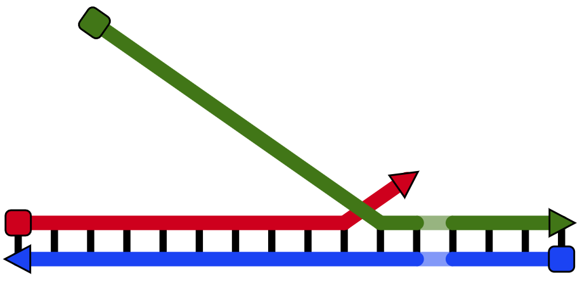
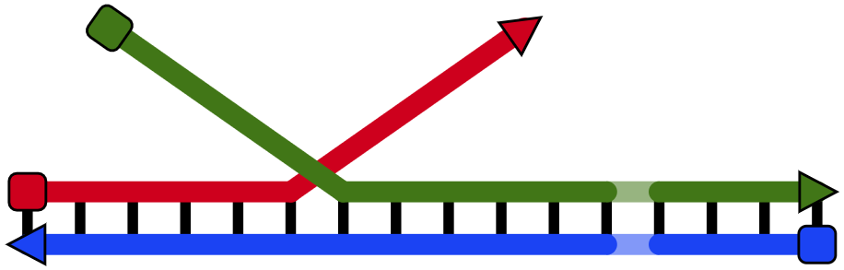
DNA strand displacement example
“breathing”/“fraying”
irreversible
branch migration

Slide 4
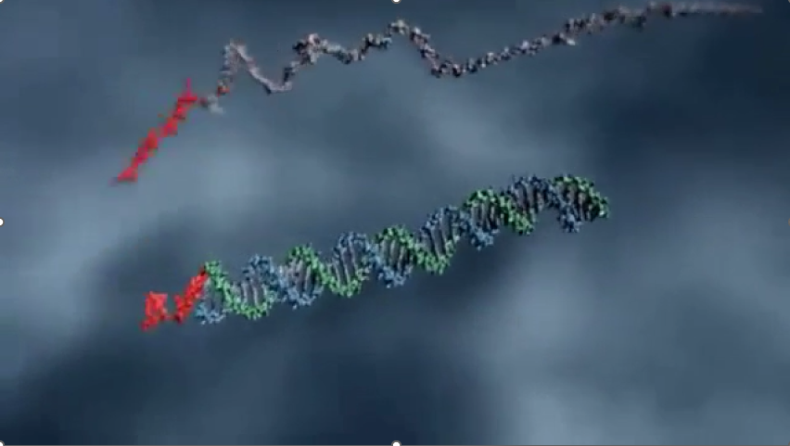

DNA strand displacement
https://www.microsoft.com/en-us/research/video/dna-strand-displacement/
t
t*

Slide 5
DNA strand displacement model
3 rules:
1. bind
2. release
3. displace

Slide 6
Bind rule
single-stranded complementary domains can bind
bind

Slide 7
Release rule
double-stranded complementary domains can unbind
IF they are toehold-length (short, < 8 nt)
release

Slide 8
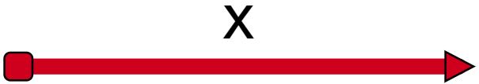
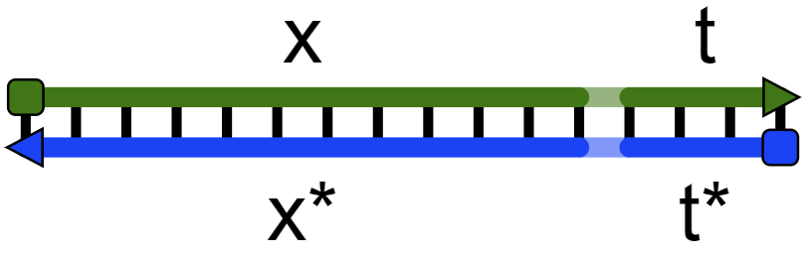
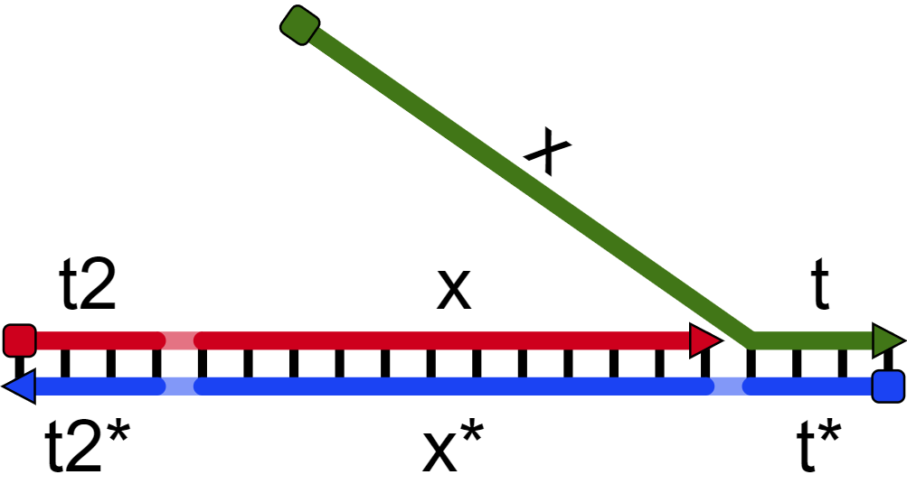
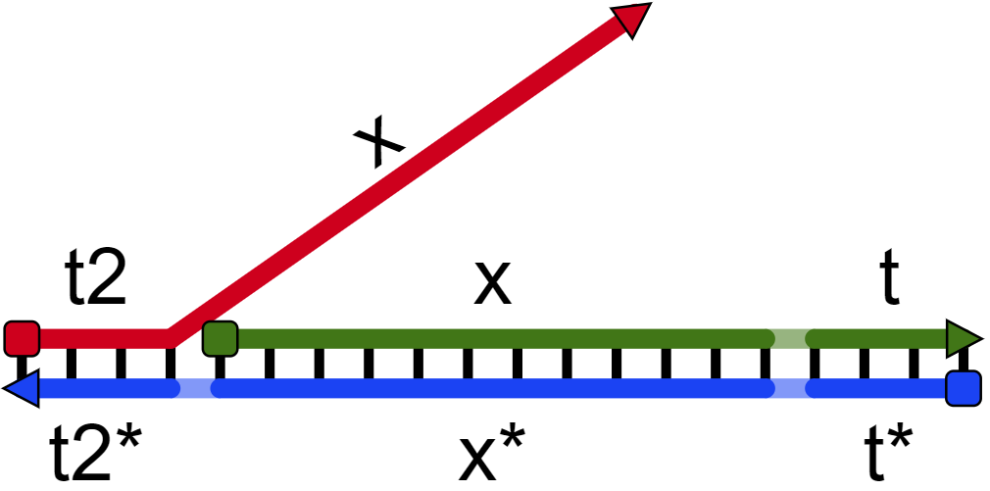
Displace rule
A domain (invader) can displace an identical domain (incumbent) of another strand,
IF neighboring domains are already bound
displace
reversible if incumbent strand remains bound by another domain
displace
displace

Slide 9
Readout
How do we read a “signal” in a DNA strand displacement system?

Slide 10
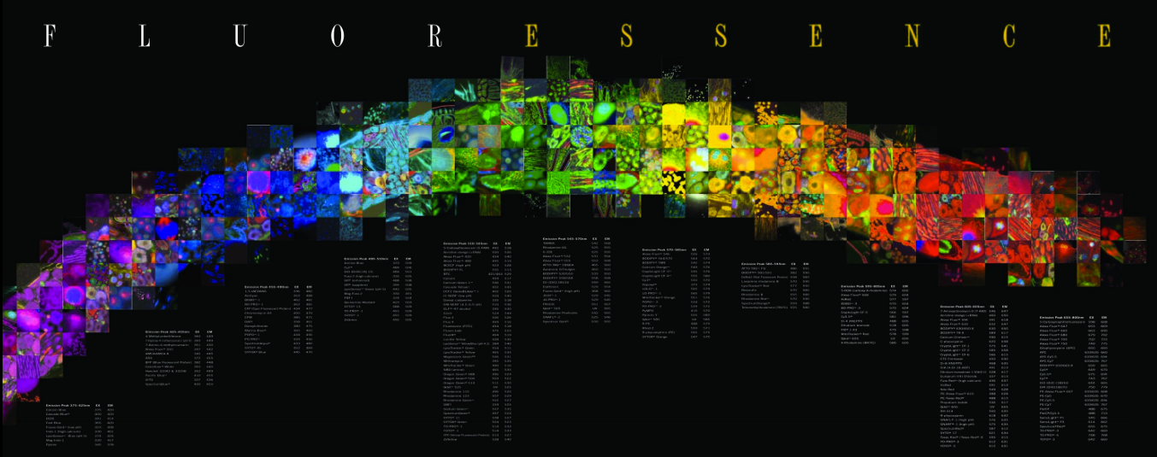
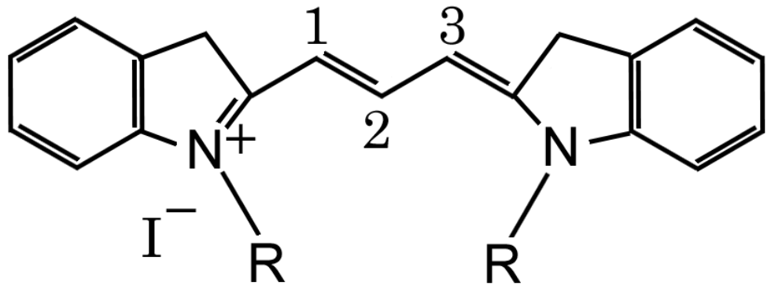
Fluorophores, when “excited” by light at one wavelength, emit light at a longer wavelength.
hv_{ex}
hv_{em}
Cy3

Slide 11
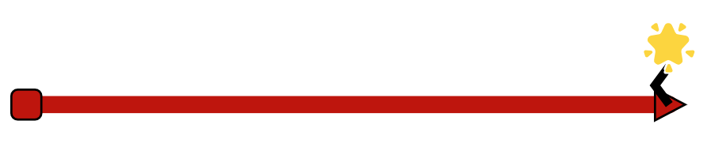
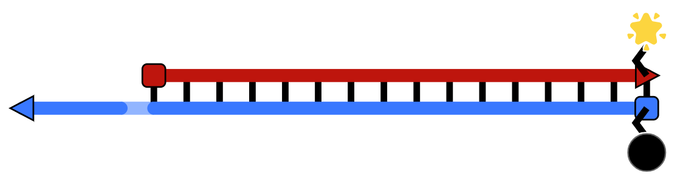
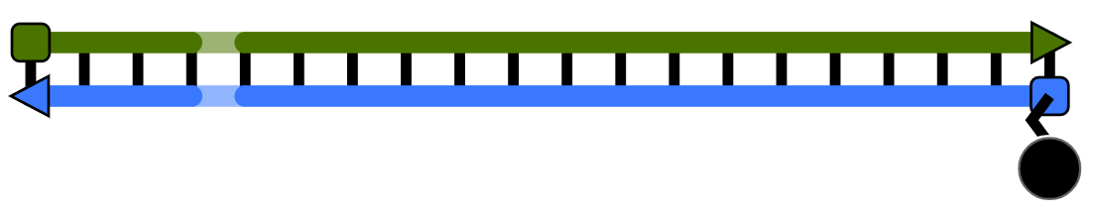
Reporter complexes
How do we read a “signal”?
“signal” = single strand is freed from a double-stranded complex.
signal strand
fluorophore
reporter complex
quencher

Slide 12
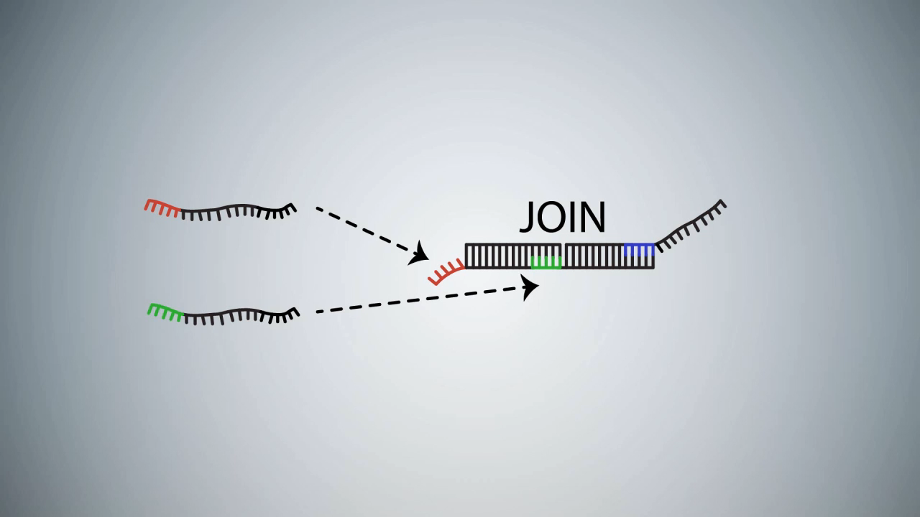
Reporter complex depiction

Slide 13
Boolean logic with DNA strand displacement

Slide 14
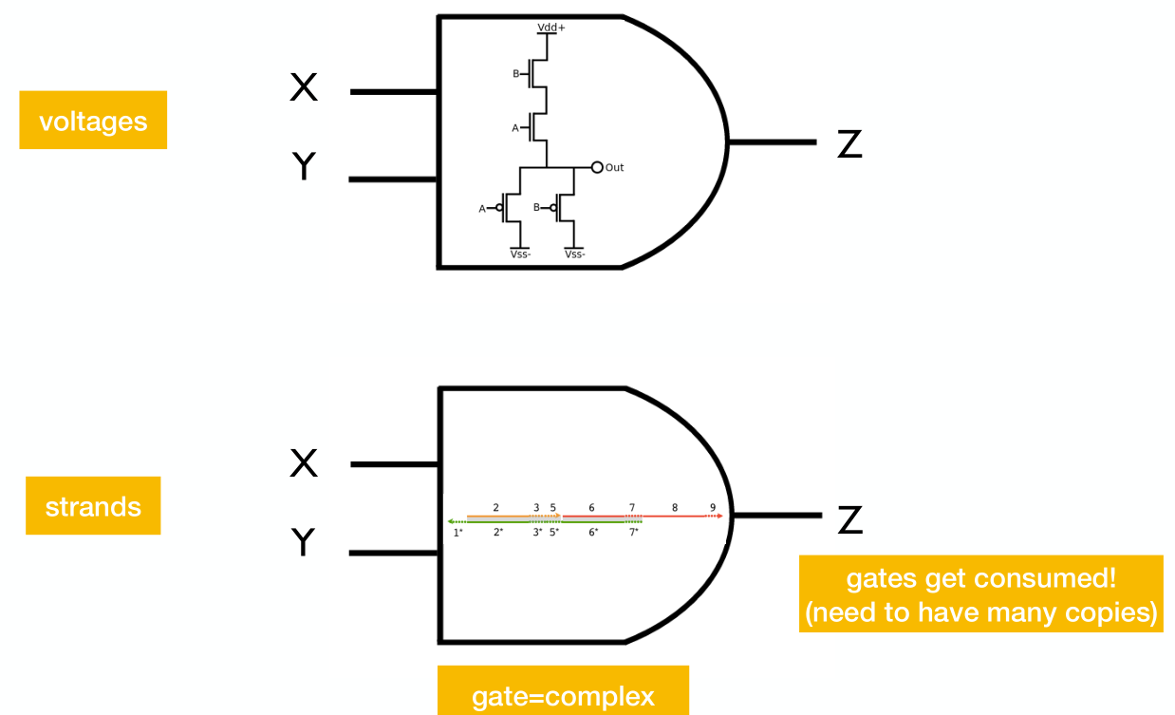
AND gate
release Z if and only if X and Y are present
[slides credit: Chris Thachuk]

Slide 15
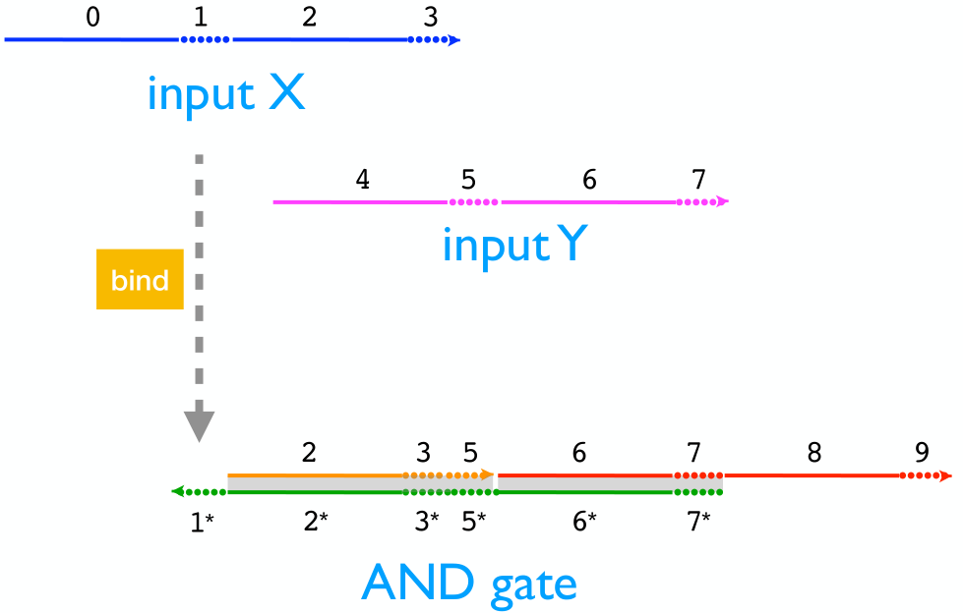
Strand displacement cascade example: AND gate
release Z if and only if X and Y are present
bind
[slides credit: Chris Thachuk]

Slide 16
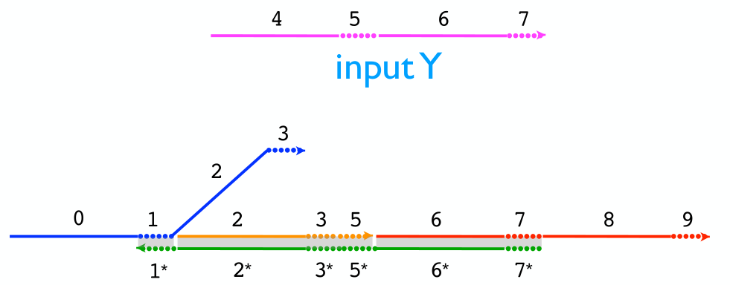
Strand displacement cascade example: AND gate
release Z if and only if X and Y are present
displace
[slides credit: Chris Thachuk]

Slide 17
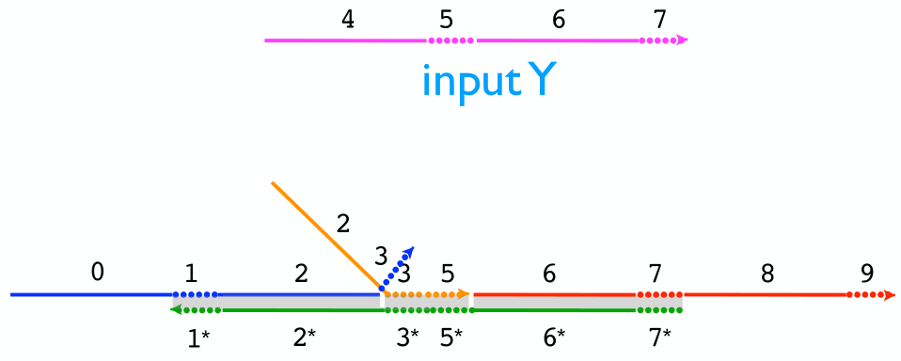
Strand displacement cascade example: AND gate
release Z if and only if X and Y are present
displace
[slides credit: Chris Thachuk]

Slide 18
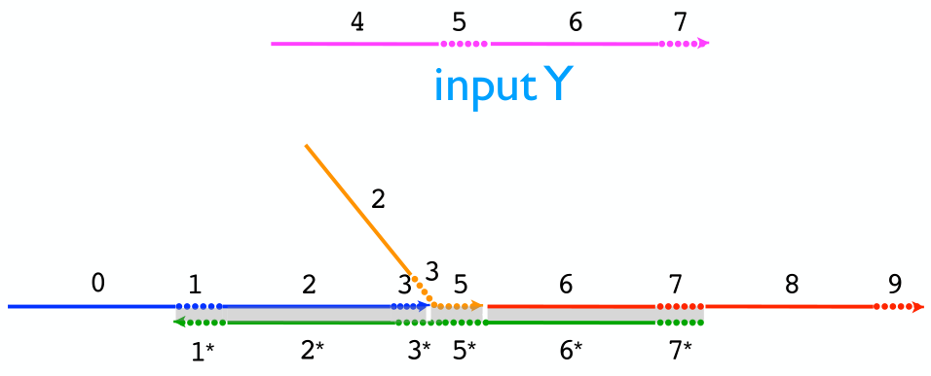
Strand displacement cascade example: AND gate
release Z if and only if X and Y are present
release
[slides credit: Chris Thachuk]

Slide 19
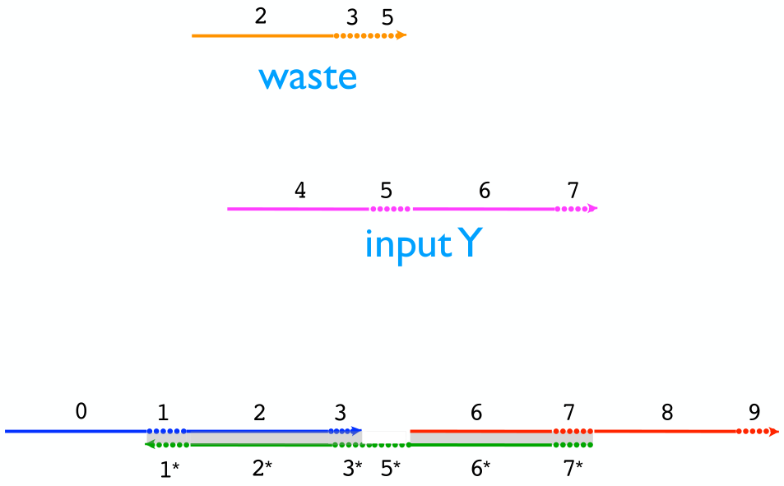
Strand displacement cascade example: AND gate
release Z if and only if X and Y are present
[slides credit: Chris Thachuk]

Slide 20
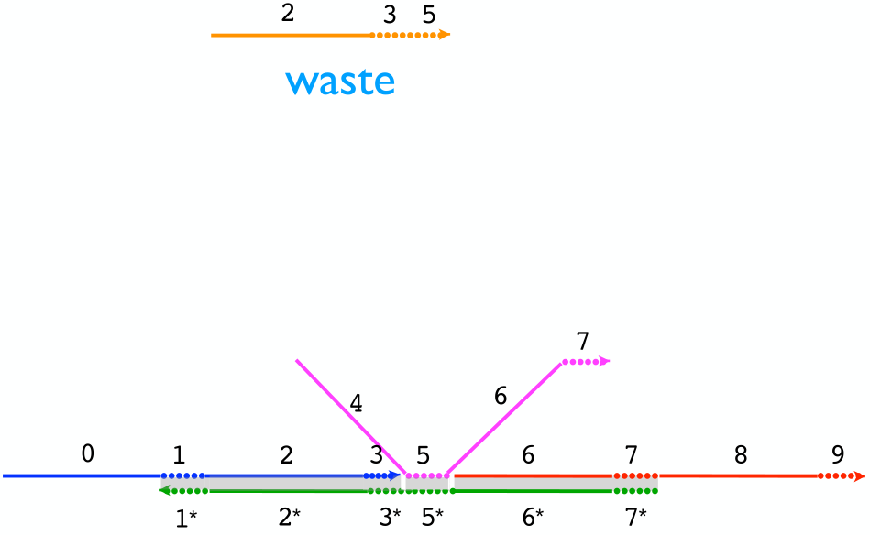
Strand displacement cascade example: AND gate
release Z if and only if X and Y are present
[slides credit: Chris Thachuk]

Slide 21
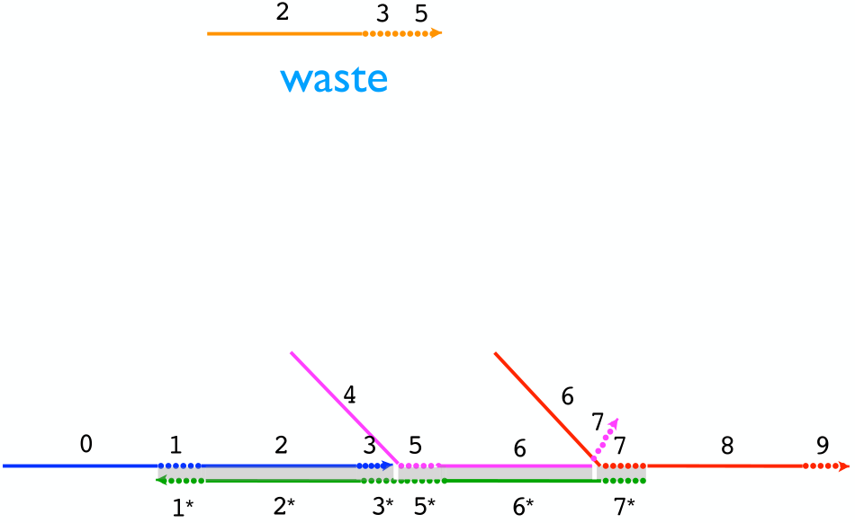
Strand displacement cascade example: AND gate
release Z if and only if X and Y are present
[slides credit: Chris Thachuk]

Slide 22
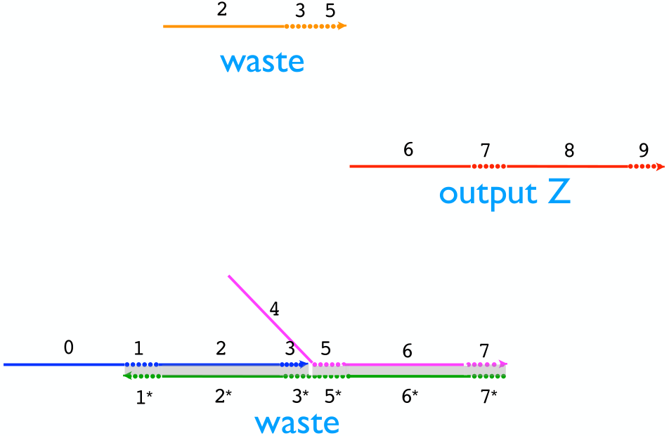
Strand displacement cascade example: AND gate
release Z if and only if X and Y are present
[slides credit: Chris Thachuk]

Slide 23
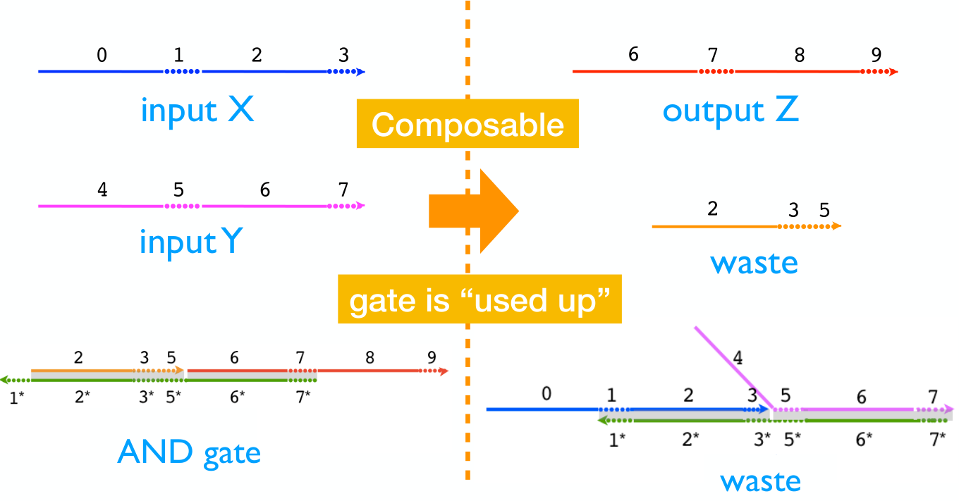
Strand displacement cascade example: AND gate
before
after
release Z if and only if X and Y are present
[slides credit: Chris Thachuk]

Slide 24
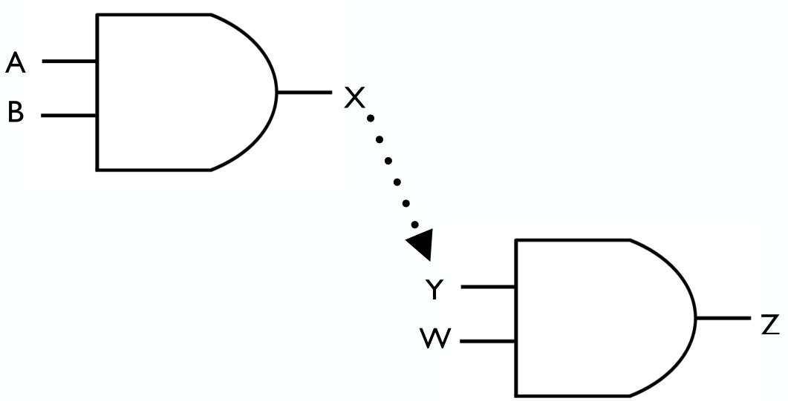
Composing AND gates
We need a “wire”.

Slide 25
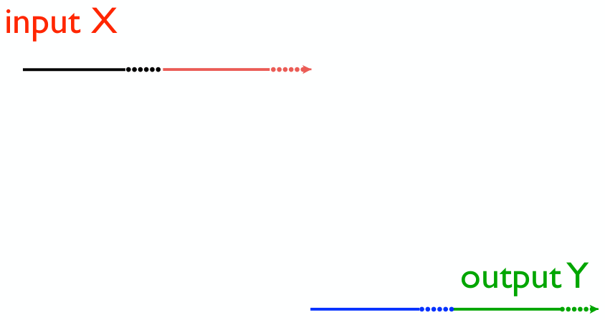
Translator gate (“wire”)
We need a “wire” to translate the signal:
X → Y
(with no shared DNA sequences between X and Y)

Slide 26
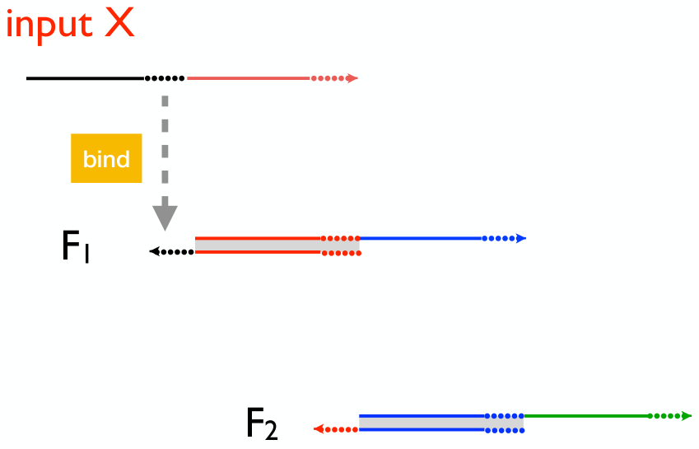
Translator gate (a “wire”)
X
Y

Slide 27
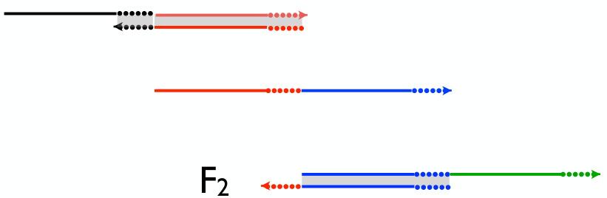
Translator gate (a “wire”)
X
Y

Slide 28
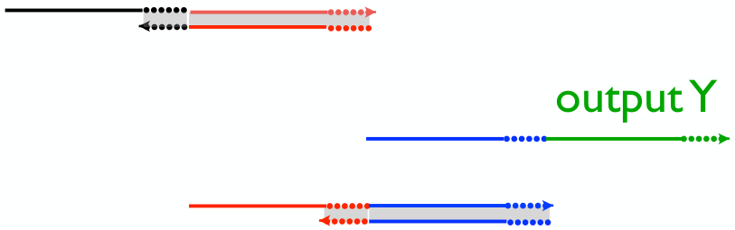
Translator gate (a “wire”)
X
Y

Slide 29
Strand displacement cascade example: OR gate
W
Z
An OR gate can be implemented by multiple translators:
Z ← W OR X OR Y
X
Z
Y
Z

Slide 30
Strand displacement cascade example: Avoiding the need for NOT gates using dual-rail logic
NOT gates are tricky with molecular circuits:
How to make a molecule Y present
if and only if X is not present??
Instead we use dual-rail logic, using de Morgan’s Laws to push all the NOT gates to the input.
(Then we can “manually” specify FALSE input values by the presence of a “negated” strand.)
X₁
NOT(A OR B) = (NOT A) AND (NOT B)
X₂
X₃

Slide 31
Strand displacement cascade example: Avoiding the need for NOT gates using dual-rail logic
NOT gates are tricky with molecular circuits:
How to make a molecule Y present
if and only if X is not present??
Instead we use “dual-rail” logic, using de Morgan’s Laws to push all the NOT gates to the input, so we can “manually” specify FALSE input values.
X₁
NOT(A OR B) = (NOT A) AND (NOT B)
X₂
X₃

Slide 32
Strand displacement cascade example: Avoiding the need for NOT gates using dual-rail logic
NOT gates are tricky with molecular circuits:
How to make a molecule Y present
if and only if X is not present??
Instead we use “dual-rail” logic, using de Morgan’s Laws to push all the NOT gates to the input, so we can “manually” specify FALSE input values.
X₁
X₂
X₃

Slide 33
Strand displacement cascade example: Avoiding the need for NOT gates using dual-rail logic
NOT gates are tricky with molecular circuits:
How to make a molecule Y present
if and only if X is not present??
Instead we use “dual-rail” logic, using de Morgan’s Laws to push all the NOT gates to the input, so we can “manually” specify FALSE input values.
X₁
X₂
X₃

Slide 34
Strand displacement cascade example: Avoiding the need for NOT gates using dual-rail logic
NOT gates are tricky with molecular circuits:
How to make a molecule Y present
if and only if X is not present??
Instead we use “dual-rail” logic, using de Morgan’s Laws to push all the NOT gates to the input, so we can “manually” specify FALSE input values.
X₁
X₂
X₃

Slide 35
Strand displacement cascade example: Avoiding the need for NOT gates using dual-rail logic
For each input X_{i}, there are two species X_{i}^{T} and X_{i}^{F}:
Give species X_{i}^{F} to specify that Boolean input X_{i} = False
Give species X_{i}^{T} to specify that Boolean input X_{i} = True.
X₁^{T}
X₁
X₁^{F}
Y^{T}
X₂
X₂^{T}
Y
X₂^{F}
X₃
For composability, can make output dual-rail as well.
X₃^{T}
Y^{F}
X₃^{F}

Slide 36
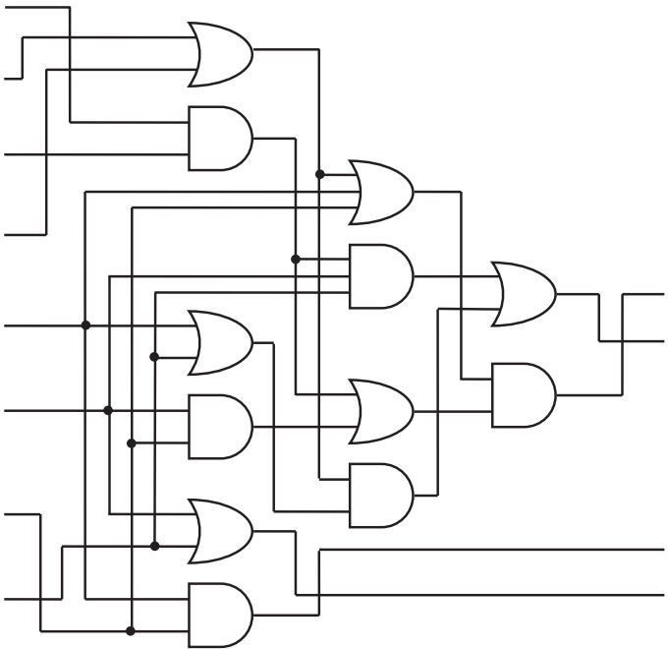
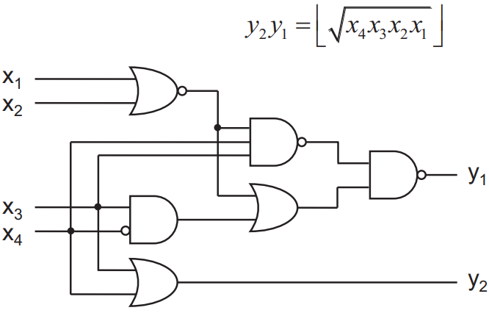
Dual-rail logic computing square root of 4-bit number
X₁^{F}
X₁^{T}
X₂^{F}
X₂^{T}
Y₁^{F}
X₃^{F}
Y₁^{T}
X₃^{T}
X₄^{F}
Y₂^{F}
X₄^{T}
Y₂^{T}
[Scaling up digital circuit computation with DNA strand displacement cascades. Lulu Qian and Erik Winfree, Science 2011]

Slide 37
Implementing CRNs with DNA
“Compiling” arbitrary chemical reaction networks into DNA strands that implement the reactions using DNA strand displacement

Slide 38
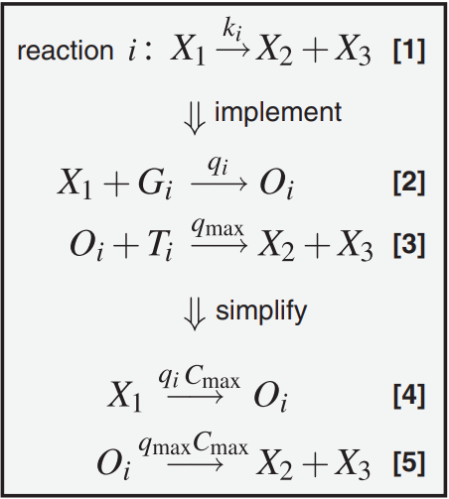
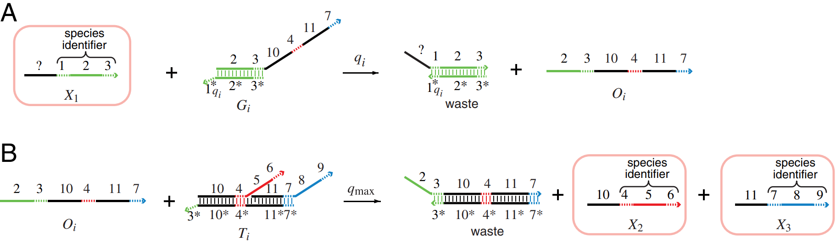
DNA strand displacement can implement any CRN
unimolecular reaction X₁ → X₂ + X₃
[DNA as a universal substrate for chemical kinetics, David Soloveichik, Georg Seelig, and Erik Winfree, PNAS 2010]

Slide 39
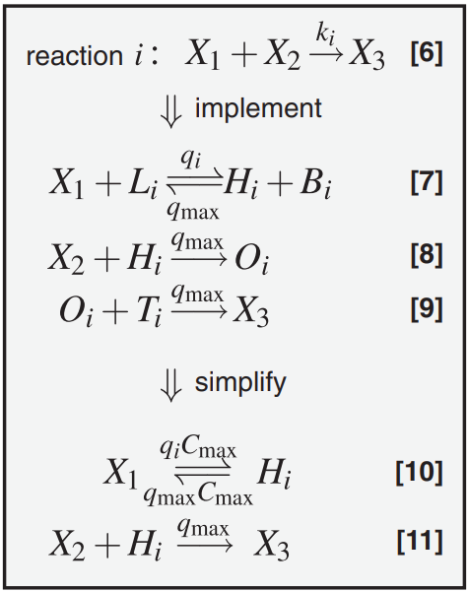
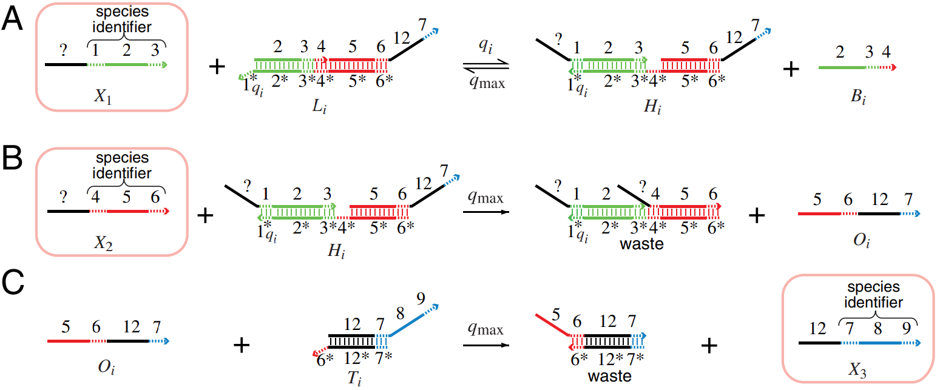
DNA strand displacement can implement any CRN
bimolecular reaction X₁ + X₂ → X₃
[DNA as a universal substrate for chemical kinetics, David Soloveichik, Georg Seelig, and Erik Winfree, PNAS 2010]

Slide 40
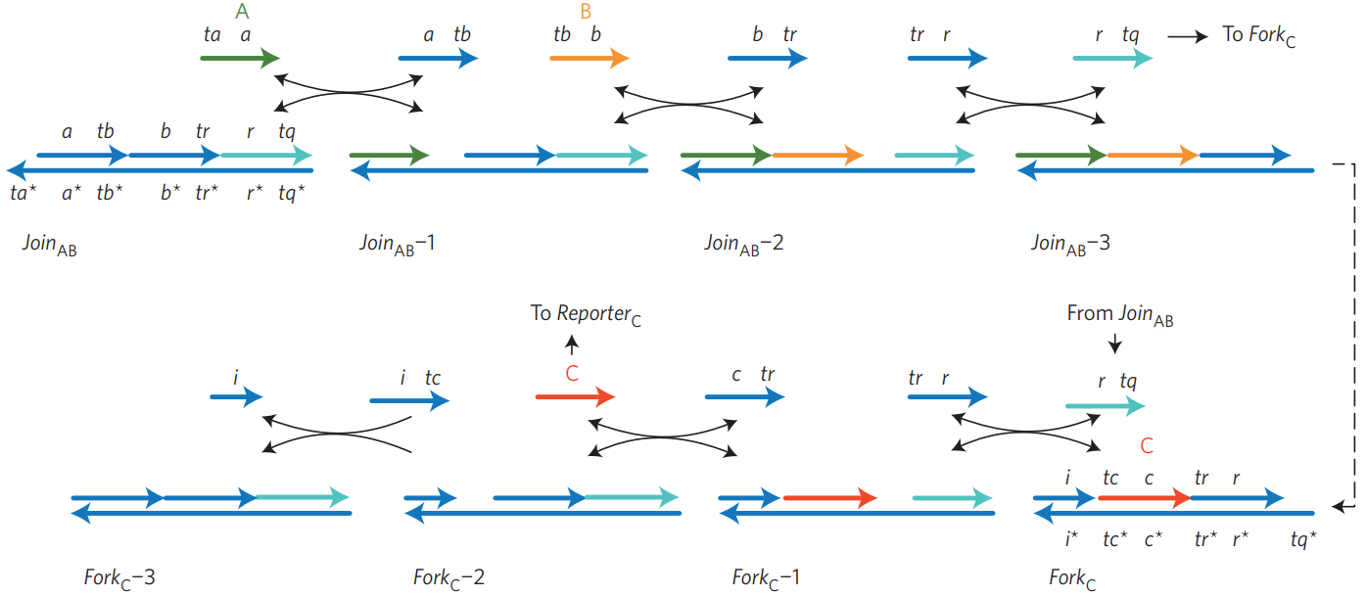
“Two-domain” scheme for compiling CRN to DSD
reaction A+B → C
[Programmable chemical controllers made from DNA. Yuan-Jyue Chen, Neil Dalchau, Niranjan Srinivas, Andrew Phillips, Luca Cardelli, David Soloveichik, and Georg Seelig. Nature Nanotechnology 2013.]

Slide 41
Experimental implementations of CRN-to-DSD schemes

Slide 42
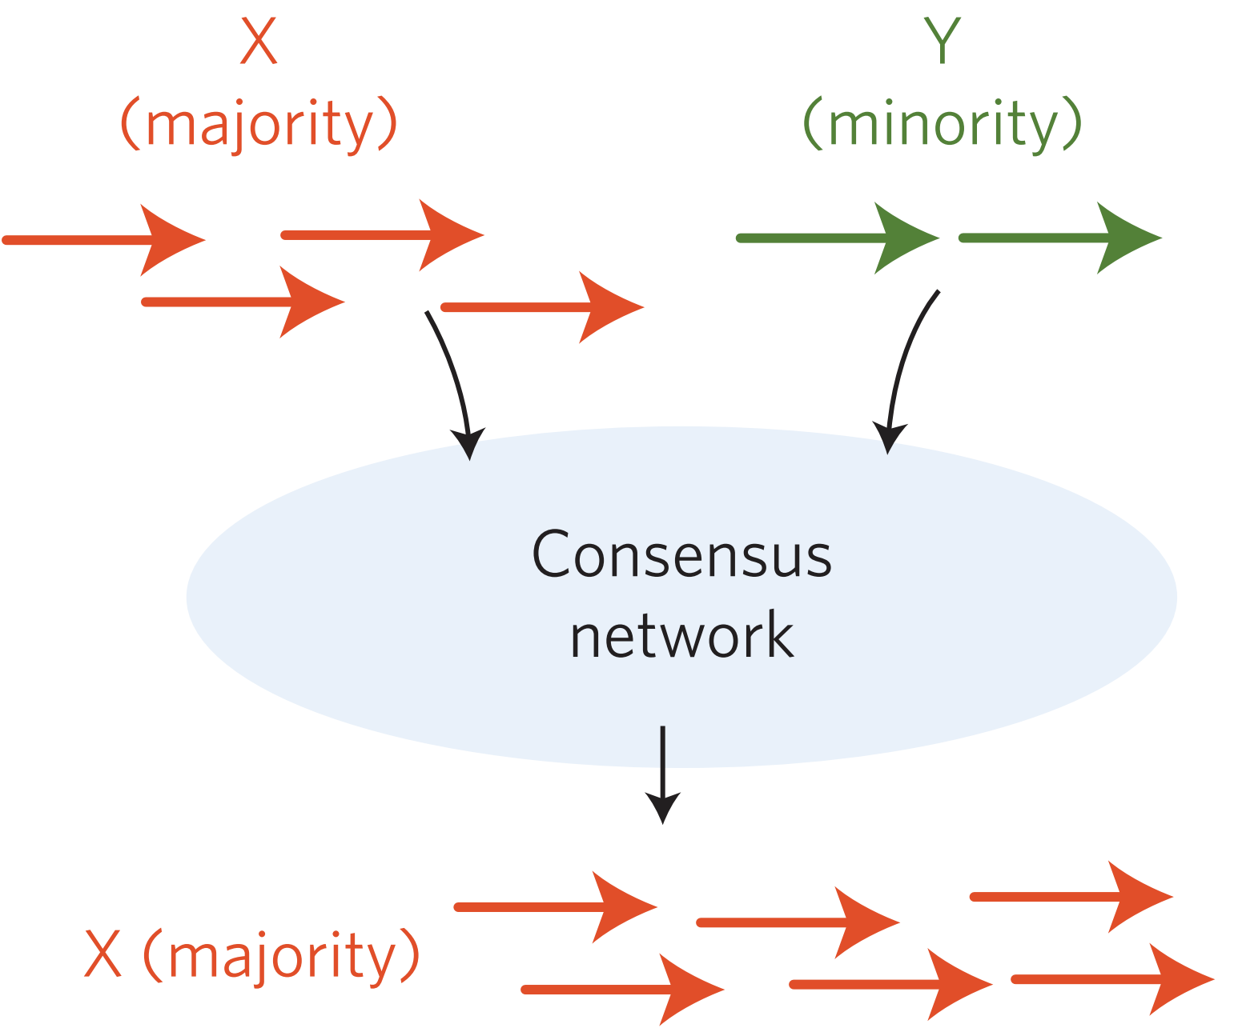
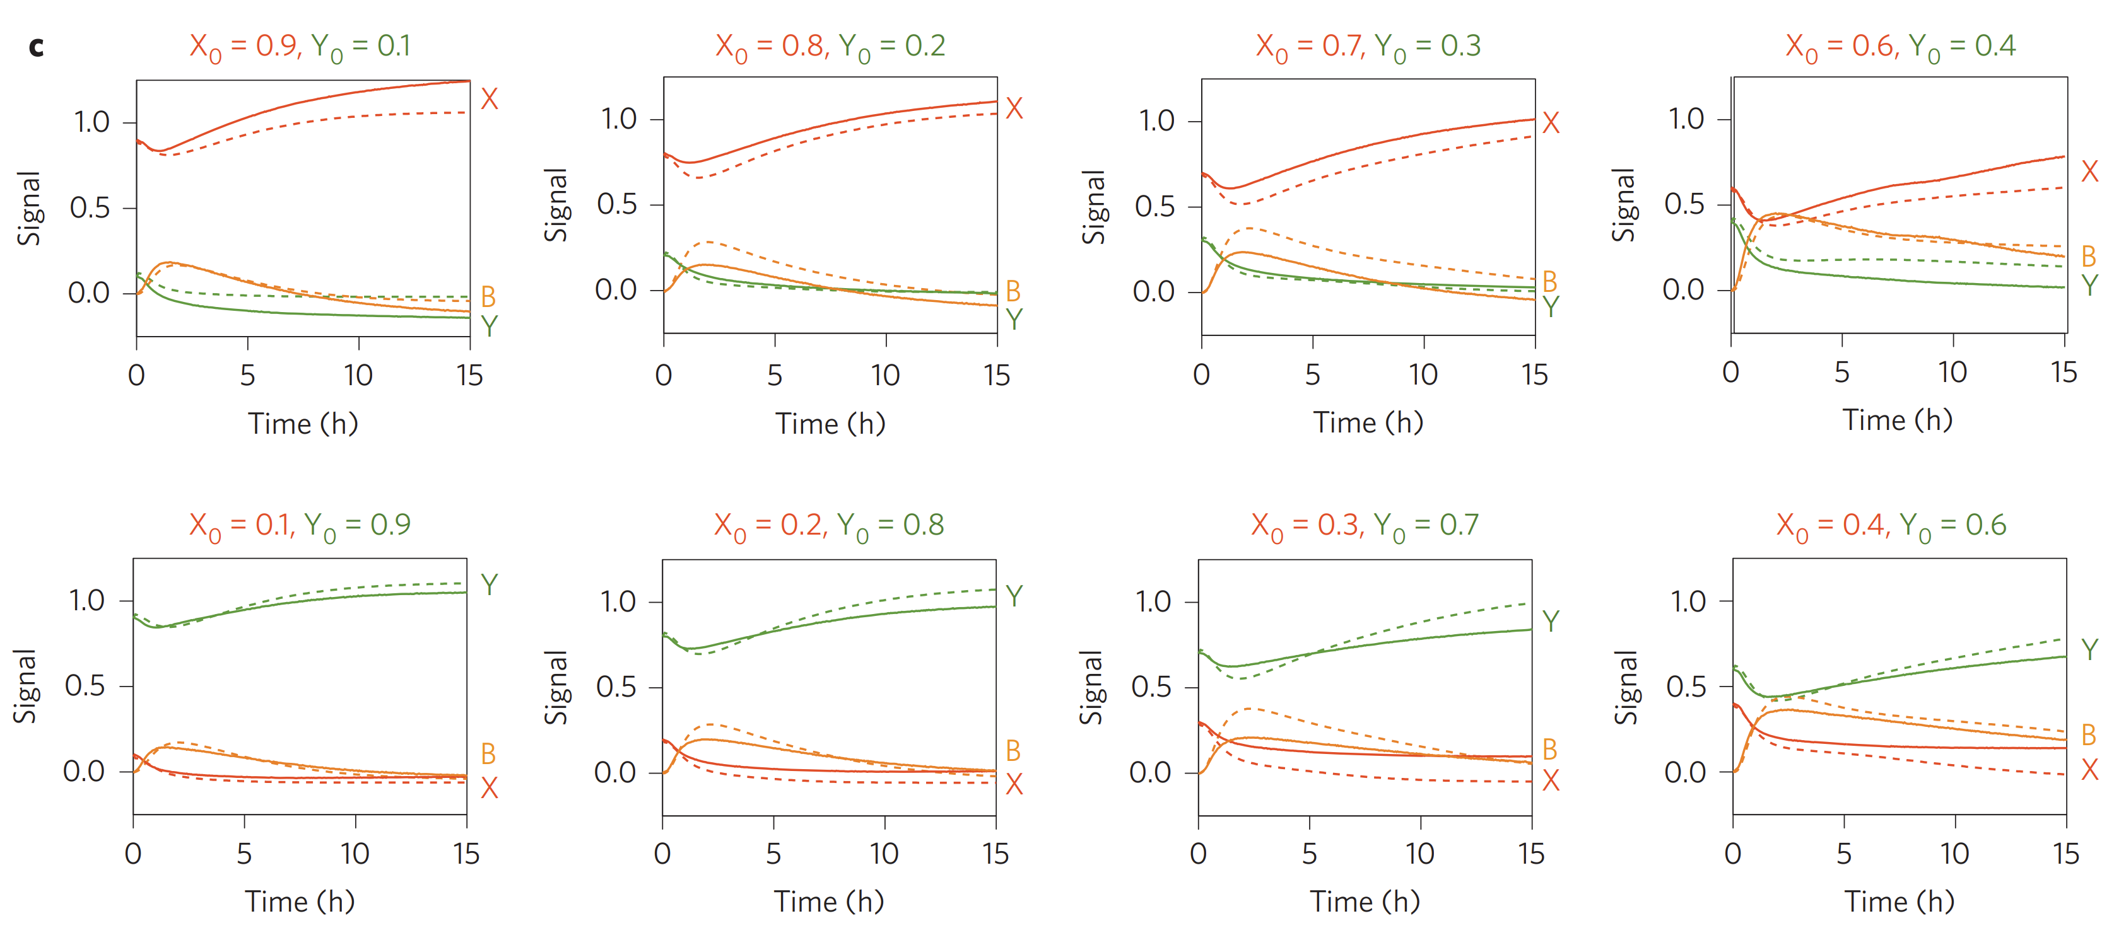
DSD computing approximate majority
Goal:
X+Y → 2B
X+B → 2X
Y+B → 2Y
CRN:
[Programmable chemical controllers made from DNA. Yuan-Jyue Chen, Neil Dalchau, Niranjan Srinivas, Andrew Phillips, Luca Cardelli, David Soloveichik, and Georg Seelig. Nature Nanotechnology 2013.]

Slide 43
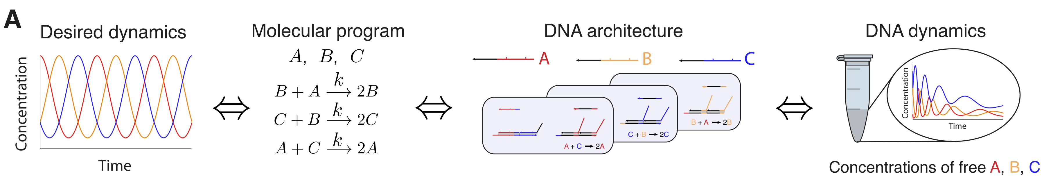
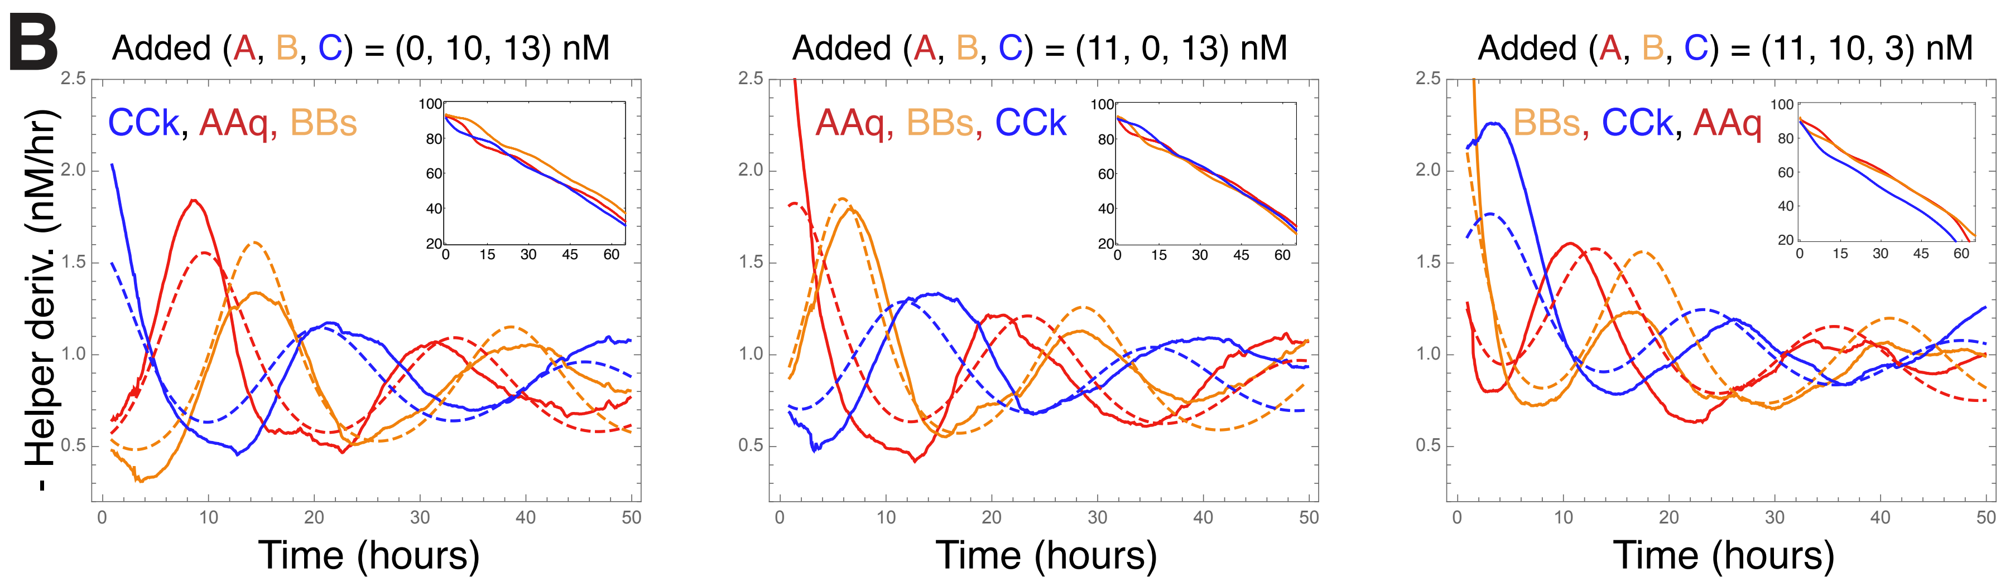
DSD implementing chemical “rock-paper-scissors” oscillator
[Enzyme-free nucleic acid dynamical systems. Niranjan Srinivas, James Parkin, Georg Seelig, Erik Winfree, David Soloveichik, Science 2017 ]

