Slide 1
DNA sequence design
slides © 2021, David Doty
ECS 232: Theory of Molecular Computation, UC Davis

Slide 2
Two layers of abstraction in DNA nanotech
DNA strands with abstract “binding domains”
DNA sequences
t
d
How to design DNA sequences to achieve “ideal” binding?
ACATC
CATTCTACCATACTCTTTCTT
d
CATTCTACCATACTCTTTCTT
t*
d*
TGTAG
GTAAGATGGTATGAGAAAGAA
This describes ideally how we want strands to bind.

Slide 3
DNA sequence design
t
d
bad choice of DNA sequence
TTTTT
most likely structure
CCGGCCGGCCAAT
GGCCG
GCCGGTTTTTCCGGCCGGCCAAT
GGCCGGCCGG
Why is this bad?
If we want the strand to bind to other strands, it first has to break up its own structure.
i.e., effective binding rate/strength is lowered

Slide 4
Common DNA sequence design goals: What to avoid
TTTTT
CCGGCCGGCCAAT
Excessive secondary structure of strands
Significant interaction between non-complementary domains
GGCCGGCCGG
domain d
AAAAAAAAAAAAAAAAAAAAA
TTTTTTTGTTTTTTTTATTTT
TTTTTTTTTTTTTTTTTTTTT
domain f*
domain d*
Certain string-based rules, e.g.
  some patterns such as GGGG (forms “G-tetraplex”: https://www.idtdna.com/pages/education/decoded/article/g-repeats-structural-challenges-for-oligo-design)
  > 70 % or < 30% G/C content (G/C binds more strongly)
  domains ending in A/T (they “breathe” more)
And often other constraints

Slide 5
DNA energy models
How do we predict what structures DNA strands are likely to form?

Slide 6
DNA duplex energy model (simple versions)
How strongly does a DNA strand bind to its perfect complement?
1st approximation: proportional to length:
  ΔG( 5’-AAGGTTAC-3’ ,
  3’-TTCCAATG-5’ ) = 1+1+1+1+1+1+1+1 = 8
2nd approximation: depends on base pair:
  G/C about twice as strong as A/T
  ΔG( 5’-AAGGTTAC-3’ ,
  3’-TTCCAATG-5’ ) = 1+1+2+2+1+1+1+2 = 11
3rd approximation: nearest neighbor model (used in practice):
  depends on base pair, and on the neighboring base pairs

Slide 7
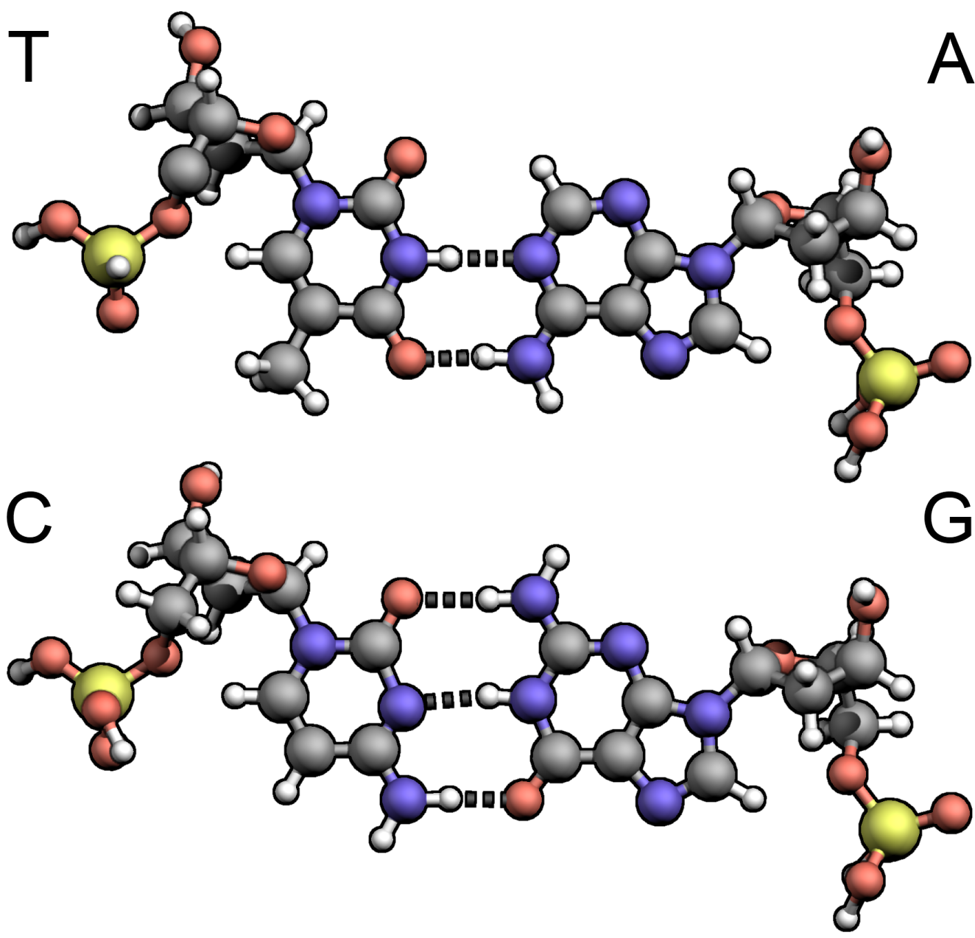
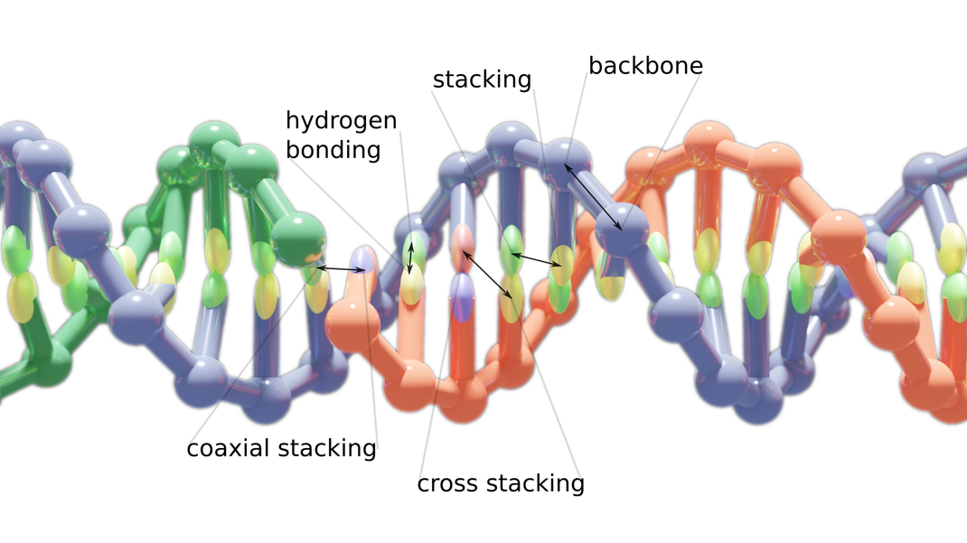
Why do the neighbors matter?
Holds adjacent bases together on a single strand (strong covalent bond)
Responsible for specific base-pairing
Much of DNA stability is not from base pair (formed by hydrogen bonds) but from “stacking” interactions between adjacent bases.
source: https://dna-robotics.eu/2019/11/29/simulating-dna/

Slide 8
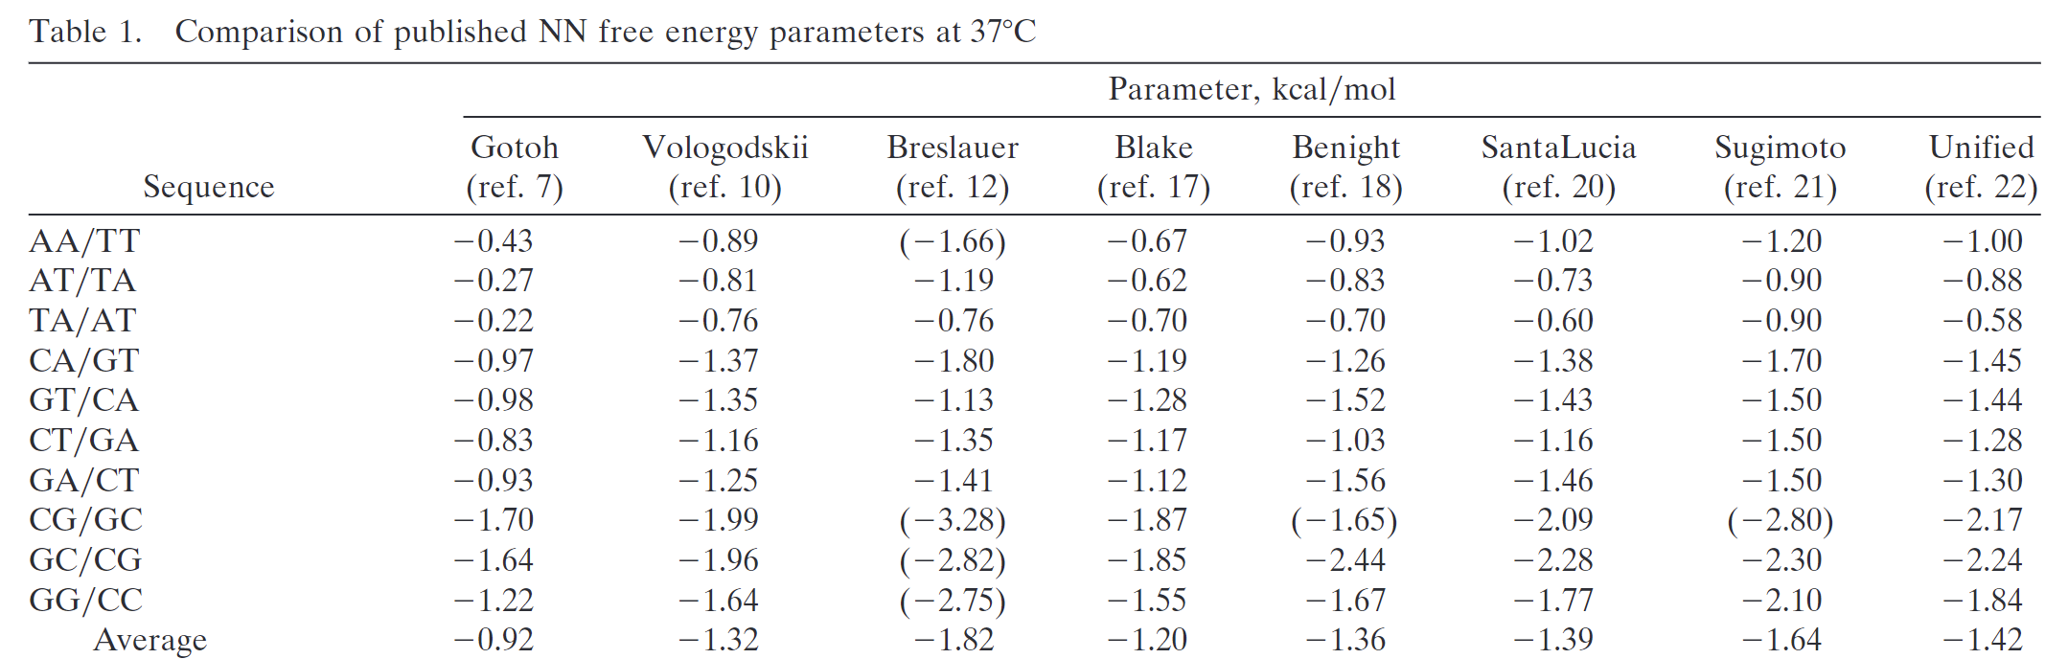
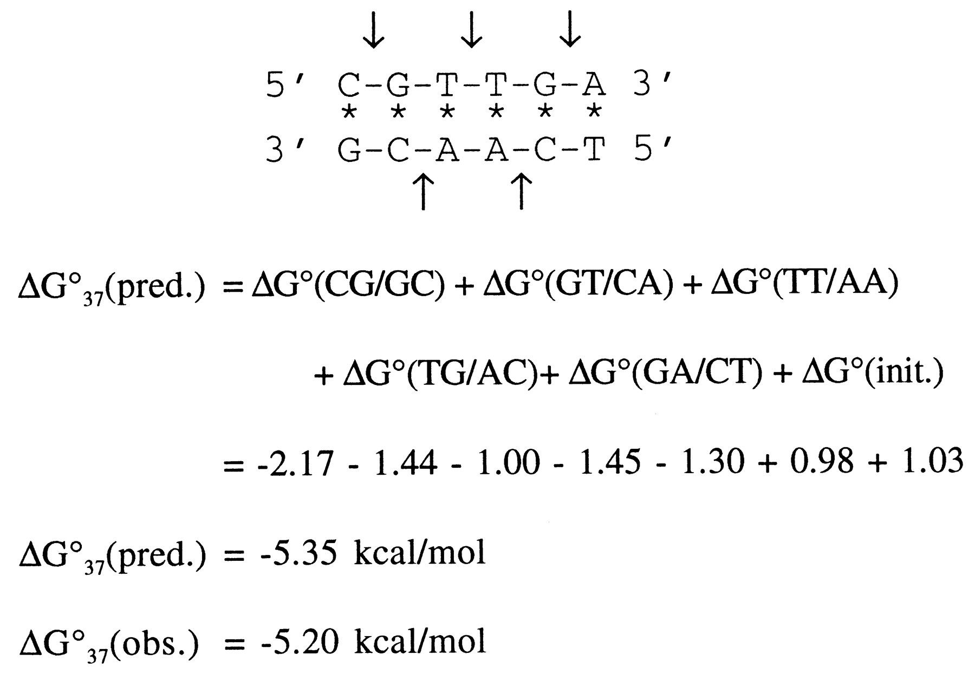
Nearest neighbor energy model
ΔG_{init} = penalty for bringing together two strands (TODO: maybe not… not explained in paper) (different terms if end is C/G or A/T)
[A unified view of polymer, dumbbell, and oligonucleotide DNA nearest-neighbor thermodynamics, John SantaLucia Jr., PNAS 1998]

Slide 9
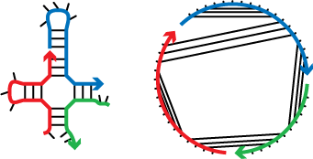
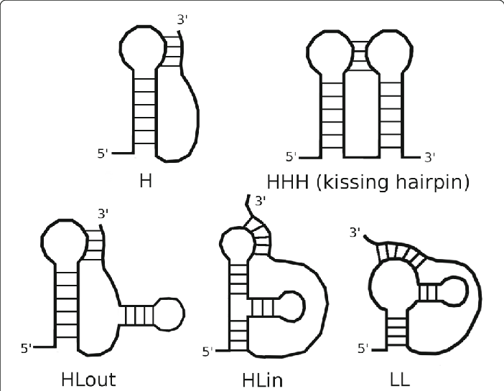
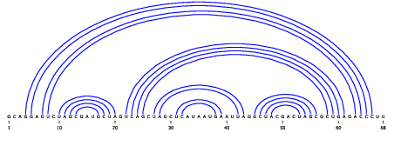
Energy of non-duplex secondary structures
What about DNA strands that are not perfectly complementary, but some bases match?
unpseudoknotted:
Definition: A secondary structure of a set of DNA strands is a set of base pairs among complementary bases.
Formally, it is a matching on the graph G=(V,E), where
V = { bases in each strand }
E = { {u,v} | {u,v} = {A,T} or {u,v} = {G,C} }
sometimes drawn with strands straight and base pairs as curved arcs:
pseudoknots:
Definition: A secondary structure is unpseudoknotted (with respect to a particular circular ordering of the strands) if, drawing strands in 5’-3’ order in a circle and connecting the base pairs by straight lines, no lines cross.

Slide 10
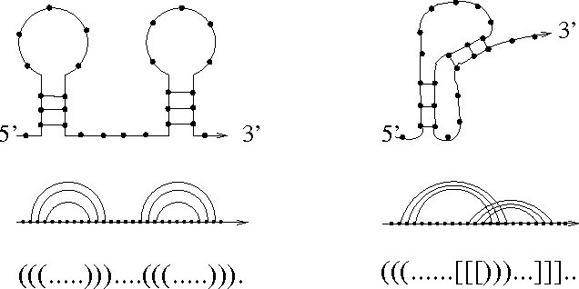
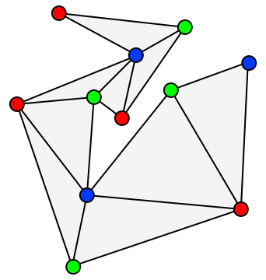
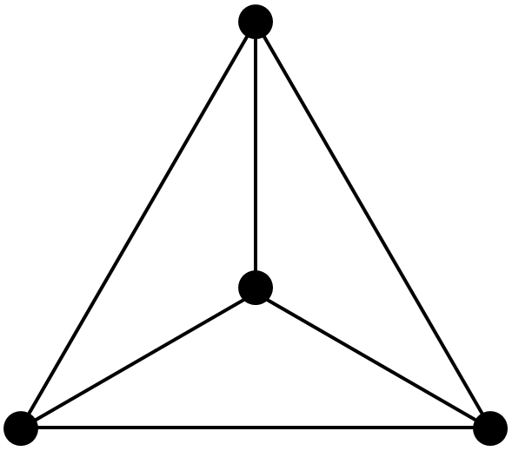
Equivalent definitions of unpseudoknotted
Definition 1: Drawing strands in 5’-3’
order in a circle and connecting the base
pairs by straight lines, no lines cross.
Definition 2: Base pair indices obey the nesting property:
there are no base pairs (a,b) ∈ ℕ² and (x,y) ∈ ℕ² such that
a < x < b < y (e.g., it can be a < b < x < y or a < x < y < b )
Definition 4: The graph G=(V,E) is outerplanar, where
V = { bases in each strand }
E = { {u,v} | {u,v} are a paired base pair,
or {u,v} are adjacent }
Definition 3: Balanced parentheses describe base pairs in
dot-parens (a.k.a., dot-bracket) notation.
outerplanar = can be drawn with no edges crossing (planar), and all vertices incident to the outer face
pseudoknotted:
need multiple parenthesis types to describe
outerplanar
not outerplanar

Slide 11
Back to first approximation of energy model
(For now, consider only one strand.)
Given a DNA sequence S, what is the maximum number of base pairs that can be formed in any unpseudoknotted secondary structure?
  Without unpseudoknotted constraint, this is trivial: min(#C,#G) + min(#A,#T)
Can be taken as a rough approximation of the minimum free energy structure of S, i.e., the most probable structure “at thermodynamic equilibrium” (what you’d see if you heat it up and slowly cool it).

Slide 12
Computing maximally bound unpseudoknotted secondary structure in polynomial time
This gives optimal value: how to find actual secondary structure?
pair j with another base or not?
A
T
1
2
i
k–1
k
k+1
j–1
j
n
Recursive solution:
Strand length is n.
For 1 ≤ i ≤ j ≤ n, let OPT(i,j) = max base pairs possible using only bases i through j.
Question: do we pair base j with some other base between i and j–1?
If not, recursively, the optimal value is:
  OPT(i,j) = OPT(i,j–1)
If we pair j with k, nesting property implies no base pair can form between any base in [i,… k–1] and any base in [k+1,j–1]
Recursively, optimal value depends on:
  OPT(i,k–1) and OPT(k+1,j–1)
Recursive algorithm (implement w/ dynamic programming):
OPT(i,j) = max of:
OPT(i,j−1), // don’t form base pair with j
max_{i≤k<j} 1 + OPT(i,k−1) + OPT(k+1,j−1) // form k,j base pair
base case: OPT(i,i) = 0
optimal value for whole strand = OPT(1,n)
only if k and j are complementary bases
Running time:
There are O(n²) subproblems: choices i,j with 1 ≤ i < j ≤ n.
Each takes time O(n) to search all values of k, so O(n³) total.

Slide 13
Example of dynamic programming algorithm
?
A
T
T
G
A
T
C
i/j | 1 | 2 | 3 | 4 | 5 | 6 | 7
1
2
3
4
5
6
7
A
0
1
1
1
2
2
3
strand sequence =
ATTGATC
T
0
0
0
1
1
2
T
0
0
1
1
2
G
0
0
1
1
base cases
A
0
1
0
T
0
0
recursive cases with complementary bases
C
0
recursive cases without complementary bases

Slide 14
Extensions to more realistic energy models
base pairs on one strand must be separated by at least 4 other bases
  base case switches from OPT(i,i) = 0 to OPT(i,j)=0 if j–i ≤ 4
G/C twice as strong as A/T?
  max_{i≤k<j} (1 if k,j is A/T base pair, else 2) + OPT(i,k−1) + OPT(k+1,j−1)
nearest-neighbor interaction?
  max_{i≤k<j} (more complex lookup here) + OPT(i,k−1) + OPT(k+1,j−1)
multiple strands?
  a ΔG_{assoc} term for each strand beyond the first one
https://piercelab-caltech.github.io/nupack-docs/definitions/

Slide 15
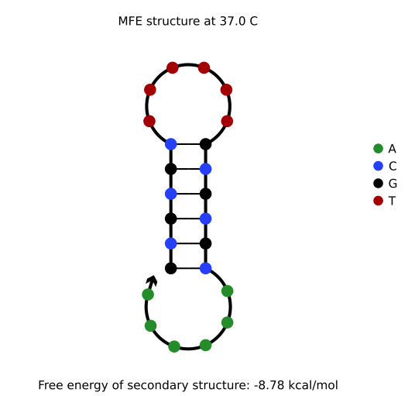
Software to compute minimum free energy DNA structures
NUPACK
http://www.nupack.org/
ViennaRNA
https://www.tbi.univie.ac.at/RNA/

Slide 16
What is “free energy”?
A way to express probability of seeing a structure, in units of energy (kcal/mol).
Energy and probability are exponentially related.
If S is a secondary structure, let Pr[S] denote probability of seeing it (“at equilibrium”).
At fixed temperature, ln(Pr[S]) ≈ ΔG(S) (recall free energy ΔG(S) is negative)
Some constants: ln(Pr[S]) ≈ ΔG(S)/(RT), usually expressed as Pr[S] ∝ e^{–ΔG(S)/(RT)}
  T = temperature in K (Kelvin), R = Boltzmann's constant ≈ 0.001987204 kcal/mol/K
To convert e^{–ΔG(S)/(RT)} to a probability, need to normalize so they sum to 1.
For a DNA strand/set of DNA strands, let Ω denote set of all secondary structures.
Definition: The partition function of Ω is Q = Σ_{S∈Ω} e^{– ΔG(S)/(RT)}.
For any secondary structure S, Pr[S] = (1/Q) ∙ e^{–ΔG(S)/(RT)}.

Slide 17
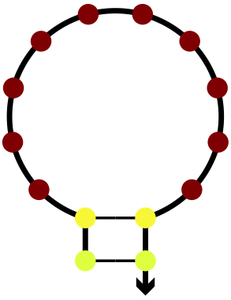
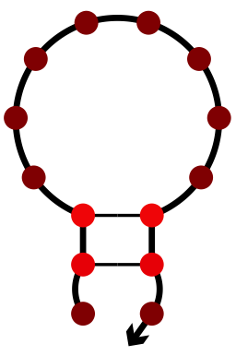
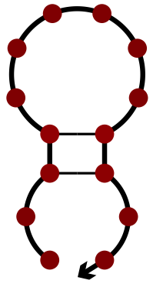
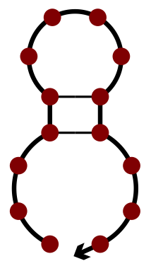
Minimum free energy versus complex free energy
Recall: For any secondary structure S, Pr[S] = (1/Q) ∙ e^{–ΔG(S)/(RT)}
Minimum free energy structure S is the most likely structure.
Problem: What if most likely structure S is not very likely?
Solution: Consider energy of
all secondary structures at once.
Pr[ ] = 0.2, but
Pr[ ] = Pr[ ] = Pr[ ]
= Pr[ ] = 0.199
Definition: The complex free energy of Ω is
ΔG = –RT ln Q.
Intuitively captures how much we expect strand to be bound/structured: higher (closer to 0) means more unstructured.
This strand spends nearly 80% of its time bound.
https://piercelab-caltech.github.io/nupack-docs/definitions/#complex-free-energy
ΔG can also be computed in time O(n³).

Slide 18
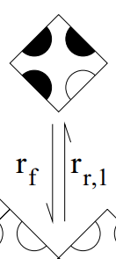
Example: DNA sequence design for single-stranded tiles
Given many single-stranded tiles with four domains each (lengths 10 and 11), assign DNA sequences to them satisfying:
∀strands s, ΔG(s) ≥ –1.65 kcal/mol
∀strand pairs s,t, ΔG(s,t) ≥ –5.4 kcal/mol if no complementary domains, ≥ –7.4 kcal/mol otherwise
all domains end with A or T
all domains have nearest-neighbor duplex energy between –9.2 and –8.9 kcal/mol
tiles with even subscript domains on top have at most one G per domain (helps to satisfy first constraint)
pairs of domains d₁,d₂ that could result in one-domain mismatches during tile binding have ΔG(d₁,d₂) ≥ –1.6 kcal/mol
1₄
0₄
0₄
1₄
1₂
1₂
0₅
1₅
1₅
1₅
1₃
0₃
0₂
0₂
0₄
1₄
1₃
0₃
0₅
0₅
Abbreviated list of constraints similar to those used in [Diverse and robust molecular algorithms using reprogrammable DNA self-assembly. Woods, Doty, Myhrvold, Hui, Zhou, Yin, Winfree. Nature 2019.]

Slide 19
DNA sequence design
If we have DNA sequences, we can compute MFE/complex free energies of individual strands, pairs of strands, etc. in polynomial time.
DNA sequence design problem: given abstract strands with abstract domains, assign concrete DNA sequences to the domains to satisfy a list of (experiment-specific) constraints.
This is almost certainly NP-hard for any “reasonable” choice of constraints.
DNA strands
with abstract domains
DNA sequences
t
d
ACATC
CATTCTACCATACTCTTTCTT
d
CATTCTACCATACTCTTTCTT
t*
d*
TGTAG
GTAAGATGGTATGAGAAAGAA

Slide 20
Stochastic local search for finding DNA sequences
Assign DNA sequences randomly to domains.
  Each domain has a fixed length.
  Implicitly assign complement sequence to complement domains.
  “Easy” single-domain constraints such as [no GGGG] or [domains have A or T at each end] can be automatically satisfied at this step.
Check list of all constraints, tallying violations and “blaming” appropriate domains.
  For example, if a strand s has too low ΔG(s), all domains on strand are blamed.
If no constraints violated, we’re done!
Otherwise, pick a domain d at random in proportion to total “score” of violations it caused.
Assign new random DNA sequence to d.
  This change propagates through to all instances of d and d* on all strands.
Repeat step 2; if the new DNA sequence for d results in lower score of violations, keep it, otherwise, ignore it and pick a new random domain at step 4.
Repeat until no constraints are violated.
Slow and unclever, but it works for any set of constraints.
https://github.com/UC-Davis-molecular-computing/nuad

