Slide 1
Thermodynamic binding networks
slides © 2021, David Haley and David Doty
ECS 289A: Theory of Molecular Computation, UC Davis

Slide 2

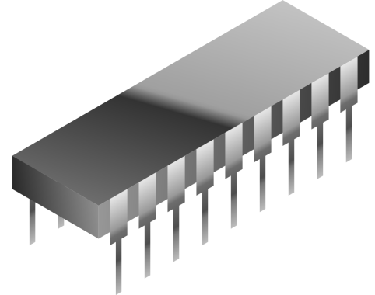
Representing Information with Molecules
Concentration
Voltage
1
0
Time
In a well-mixed solution,
concentration can represent Boolean input
In an electronic circuit,
voltage can represent Boolean input

Slide 3
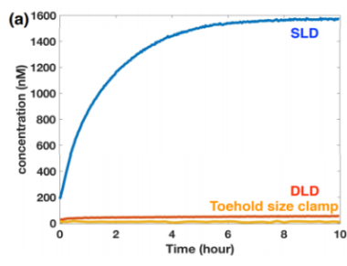
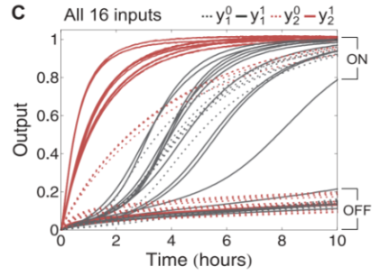
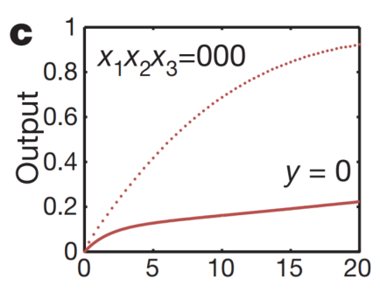
Chemical Identity Gate: Idealized vs. Actual Behavior
Experimental Implementation of Chemical Logic
Input
Output
Output
Input Present
1
Wang et al. DNA 23, 2017
Qian et al. Science 332, 2011
Leak
No Input (Ideal)
0
Qian et al. Nature 475, 2011
Time
(Don’t worry about the details in the pictures above)

Slide 4


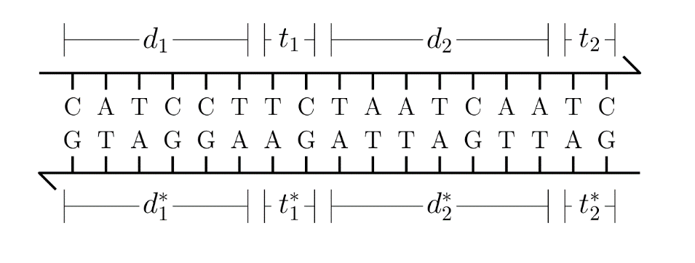
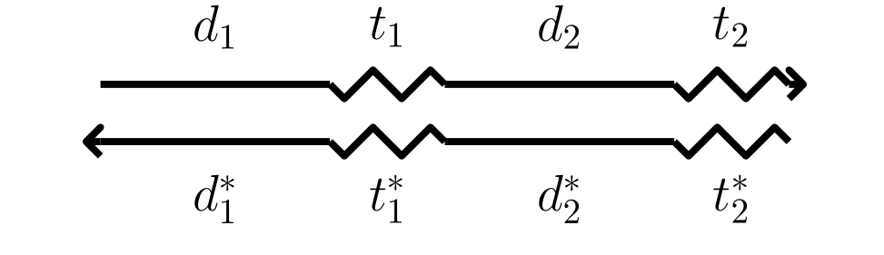
Levels of Abstraction
DNA
Base Pairs
Strands
long
short

Slide 5
DNA strand displacement
t₁
Bind
a
a
Displace
a
t₂
a
a
Release
t₁*
a*
t₂*

Slide 6
X ⟶ Y + Z
X
h_{x}
t₁
x
t₂
h_{y}
t₃
y
t₄
x
t₂
h_{y}
t₃
h_{z}
t₅
t₁*
x*
t₂*
Y
Z
y
t₄
h_{y}
t₃
h_{z}
t₅
z
t₆
t₂*
h_{y}*
t₃*
h_{z}*
t₅*

Slide 7
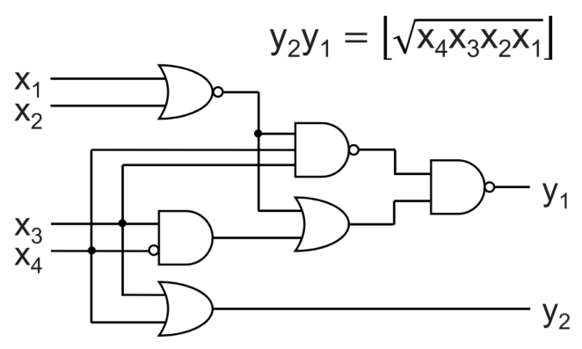

Leak in strand displacement experiments
Source:
Lulu Qian, Erik Winfree.
Scaling Up Digital Circuit Computation
Science 332, 2011

Slide 8
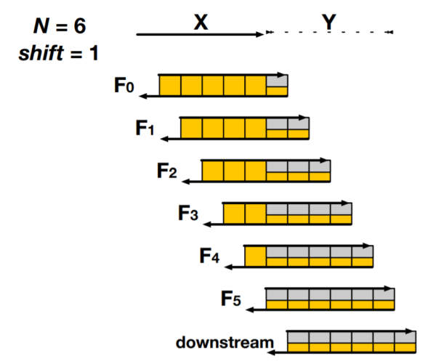
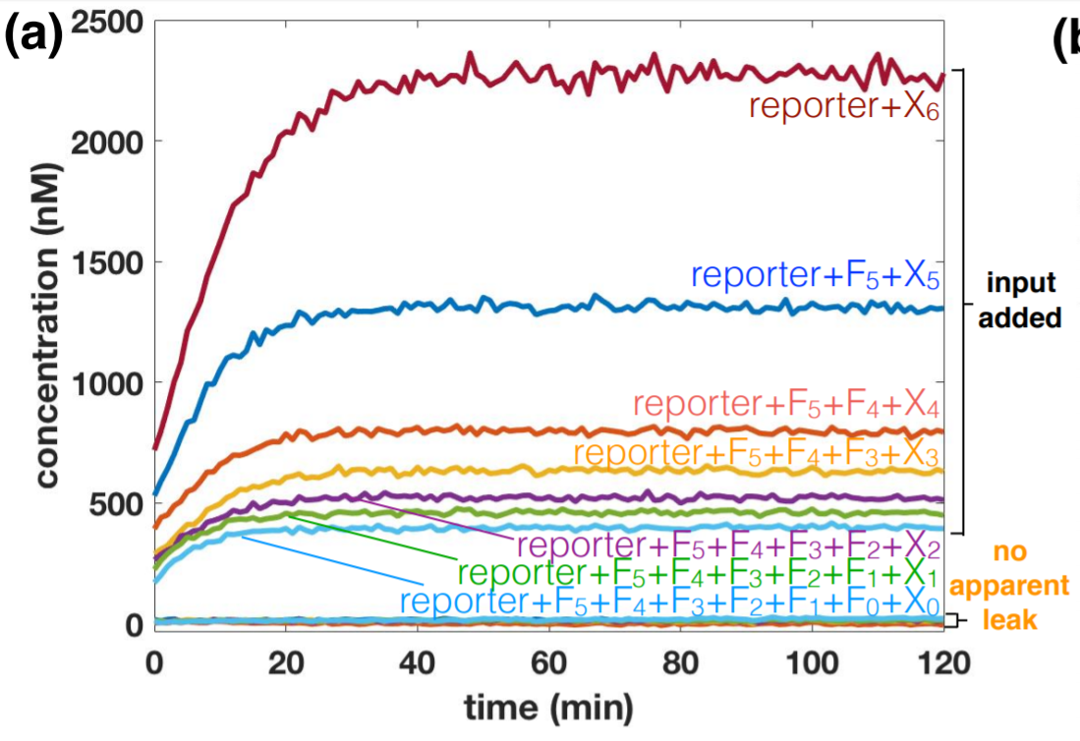
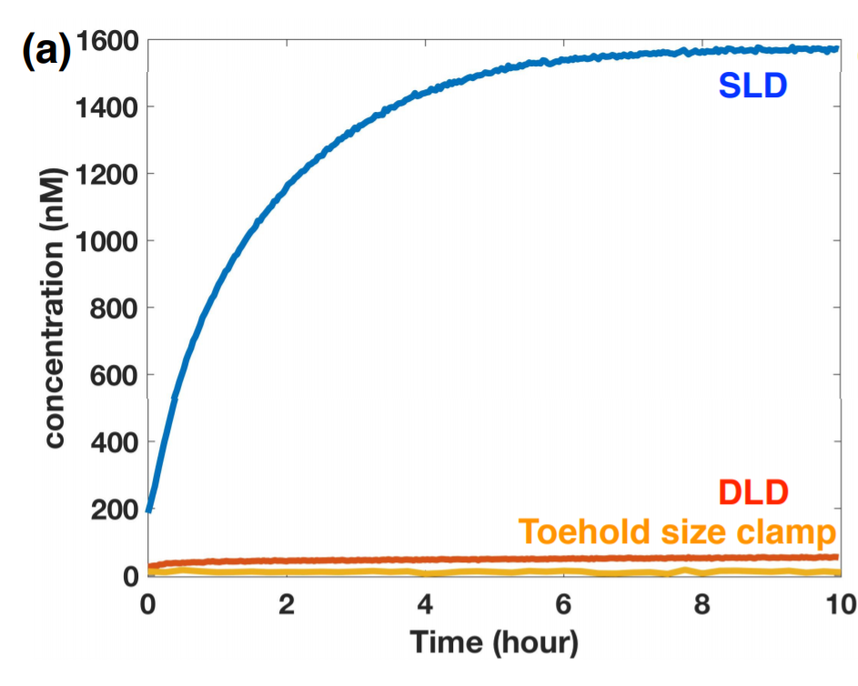
Reducing Leak
[Boya Wang, Chris Thachuk, Andrew Ellington, David Soloveichik. The Design Space of Strand Displacement Cascades with Toehold-Size Clamps
DNA Computing Conference, 2017]
Intended:
Leak:

Slide 9
Ø ⟶ Y + Z
X ⟶ Y + Z
What causes leak
“kinetically”?
h_{x}
t₁
x
t₂
h_{y}
t₃
y
t₄
x
t₂
h_{y}
t₃
h_{z}
t₅
t₁*
x*
t₂*
t₄
y
t₄
y
t₃
h_{y}
t₃
t₅
h_{y}
h_{z}
z
t₆
t₂*
h_{y}*
t₃*
h_{z}*
t₅*
t₂*

Slide 10
more favorable
What causes leak “thermodynamically”?
Before:
After:
h_{y}
t₃
y
t₄
x
t₂
h_{y}
t₃
h_{z}
t₅
slow
t₁*
x*
t₂*
h_{z}
t₅
z
t₆
y
t₄
very slow
h_{y}
t₃
h_{z}
t₅
z
t₆
x
t₂
h_{y}
t₃
h_{z}
t₅
t₂*
h_{y}*
t₃*
h_{z}*
t₅*
t₁*
x*
t₂*
h_{y}*
t₃*
h_{z}*
t₅*
less favorable

Slide 11
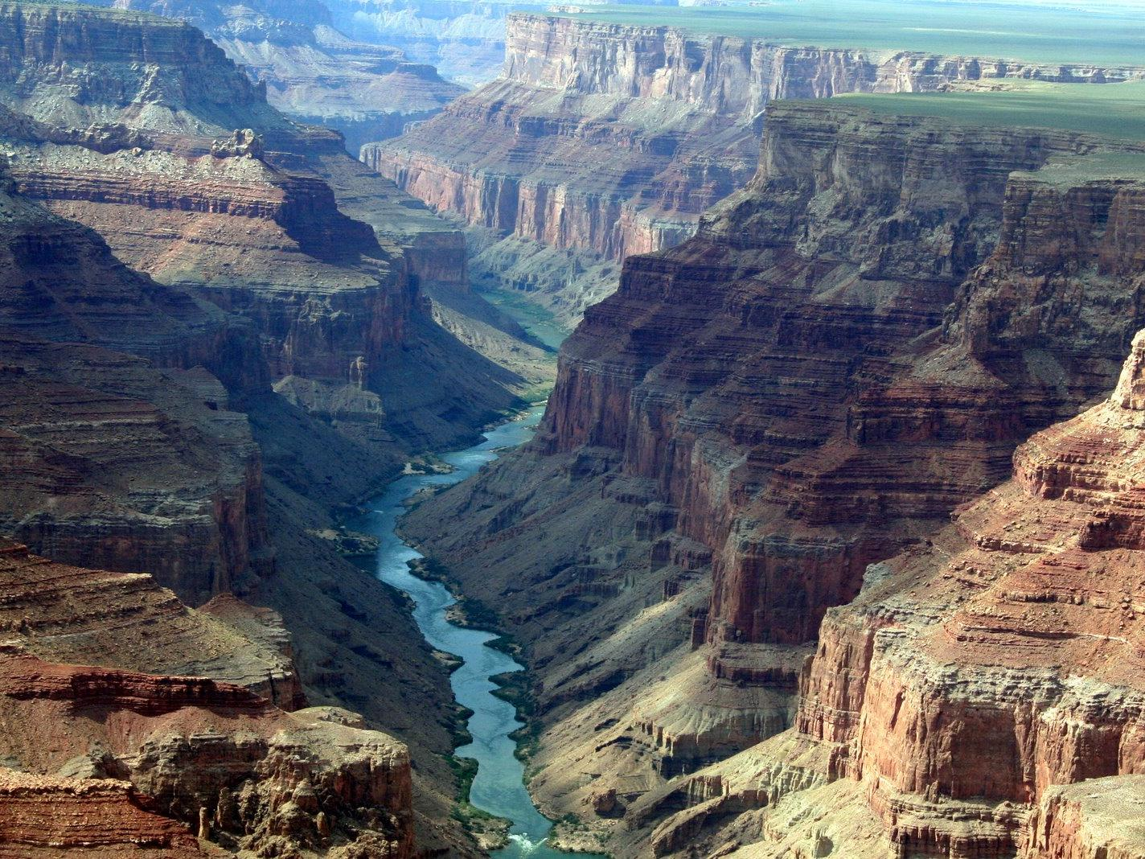
Need a kinetic binding network model
Can we design pathways that maintain local stability?
Leak
Designed Pathway
Leak

Slide 12
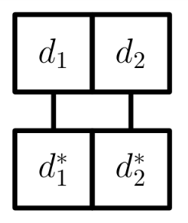
Levels of Abstraction
DNA
Base Pairs
Strands
Thermodynamic
Binding Network

Slide 13
Thermodynamic Binding Networks
a
b
b
Geometry-Free Model:
The domains within a monomer are unordered
a
a*
a*
b*
Monomer = collection of domains
Configuration = how monomers are bound

Slide 14
Energetic favorability: Bonds and complexes
a
b
a
b
a
b
all else equal,
more bonds
= more favorable
=
<
a*
b*
a*
b*
a*
b*
a
b
a
b
a
b
a
b
a
b
a
b
=
<
all else equal,
more complexes
= more favorable
a*
b*
a*
b*
a*
b*
a
b
a
b
a
b

Slide 15
Tradeoff between #bonds and #complexes
in general, there’s some weight parameter w:
  energy = w*#bonds + #complexes
  (physics notation: ΔG = ΔH – T∙ΔS)
We often consider a natural limiting case:
  favoring # bonds infinitely over #complexes
  require maximal #bonds formed; use #complexes only as tiebreaker
  Corresponds to bonds that are so strong they cannot spontaneously dissociate, but can exchange with each other to find configurations with more complexes

Slide 16
Thermodynamic Binding Networks
saturated = maximum #bonds formed
Saturated
stable = saturated, AND maximum #complexes
a
b
a
b
a
b
a
b
a
b
a*
b*
a*
b*
a*
b*
a*
b*
a*
b*
If we’re careful to make starred binding sites limiting, then saturated = all starred sites are bound
a
b
a
b
a
b
a
b
a
b
a
b
a
b
a
b
a
b
Stable
a*
b*
a*
b*
a*
b*
a*
b*
a
b
a
b
a
b
a
b

Slide 17
Computing stability is NP-complete

Slide 18
TODO

Slide 19
Computing via Thermodynamic Equilibrium

Slide 20
AND gate
output monomer to be released only if both inputs present
a
b
a
b
c
d
e
e
f
a*
b*
c*
d*
e*
f*
b
c
d
e
f
c
d
b*
c*
d*
e*

Slide 21
Issues with Boolean logic
How to compose?
  We don’t know how to prove the previous gate is composable, and used a more complex design in the paper
Want “entropy gap”:
  Need not merely that unwanted configurations are unstable (i.e., if saturated, they have lower entropy), but more strongly that they have much lower entropy.
  We can use O(n) domain/monomer types to achieve an entropy gap of n.
Output convention?
  Obvious one: “there’s a unique stable configuration with the correct output”
  It’s problematic, so we have a one-sided convention:
    if correct output is 0, unique stable configuration with correct answer
    if correct output is 1, then both the “output=1” and “output=0” configurations are stable

Slide 22
Composable AND gate with entropy gap 3
Rather than release a single output monomer, it suffices to gather all output domains on one polymer.

Slide 23
Kinetic pathways and energy barriers

Slide 24
Pathways
Thermodynamics: Which configurations are energetically favorable
Kinetics: How a system moves between configurations over time
a
b
a
b
a
b
a*
b*
a*
b*
a*
b*
a
b
a
b
a
b

Slide 25
X ⟶ Y + Z
h_{x}
t₁
x
t₂
x
t₂
h_{y}
t₃
h_{z}
t₅
t₁*
x*
t₂*
y
t₄
h_{y}
t₃
h_{z}
t₅
z
t₆
t₂*
h_{y}*
t₃*
h_{z}*
t₅*

Slide 26
X ⟶ Y + Z
X
h_{x}
x
x
h_{y}
h_{z}
x*
Y
Z
Energy
y
h_{y}
h_{z}
z
Merge
(less favorable)
Split
(more favorable)
h_{y}*
h_{z}*
progress

Slide 27
Ø ⟶ Y + Z
What causes leak
“kinetically”?
x
h_{y}
h_{z}
x*
Energy
y
h_{y}
h_{z}
z
Merge
(less favorable)
Split
(more favorable)
h_{y}*
h_{z}*
progress

Slide 28
Kinetic Binding Networks
Favorability is a combination of bond count and component count
Weighted average:
Energy := – w_{H}(# bonds) – (# components)
Define pathways to consist of merges and splits
But for w_{H} ≥ 2, only saturated pathways need be considered
Since all saturated configurations have an equal number of bonds, we can focus solely on the number of components
[Keenan Breik, Cameron Chalk, David Doty, David Haley, David Soloveichik. Programming Substrate-Independent Kinetic Barriers with Thermodynamic Binding Networks. Computational Methods in Systems Biology 2018]

Slide 29
Large Energy Barriers
Energy
Reaction Pathway
Merge
(less favorable)
Barrier
Split
(more favorable)
α
β
Configuration space

Slide 30
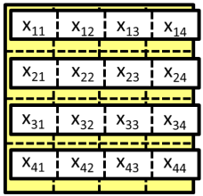
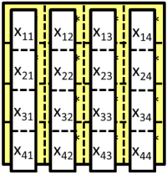
A Network with a Programmable Energy Barrier
x₁₁
x₁₂
x₁₃
x₁₄
x₁₁*
x₁₂*
x₁₃*
x₁₄*
x₁₁
x₁₂
x₁₃
x₁₄
x₂₁
x₂₂
x₂₃
x₂₄
x₂₁*
x₂₂*
x₂₃*
x₂₄*
x₂₁
x₂₂
x₂₃
x₂₄
x₃₁
x₃₂
x₃₃
x₃₄
x₃₁*
x₃₂*
x₃₃*
x₃₄*
x₃₁
x₃₂
x₃₃
x₃₄
x₄₁
x₄₂
x₄₃
x₄₄
x₄₁*
x₄₂*
x₄₃*
x₄₄*
x₄₁
x₄₂
x₄₃
x₄₄
Energy
Merge
(less favorable)
Split
(more favorable)
progress

Slide 31
Catalysis
x₁₁
x₁₁
+
x₂₁
x₂₂
+
x₂₁
x₂₂
x₃₁
x₃₂
x₃₃
x₃₁
x₃₂
x₃₃
x₄₁
x₄₂
x₄₃
x₄₄
x₄₁
x₄₂
x₄₃
x₄₄
x₁₁
x₁₁*
x₁₂*
x₁₃*
x₁₁
x₁₂
x₁₃
x₁₄*
x₁₁
x₁₃
x₁₄
x₁₂
x₁₄
x₂₁
x₂₂
x₂₁*
x₂₂*
x₂₃*
x₂₁
x₂₂
x₂₃
x₂₄*
x₂₁
x₂₃
x₂₄
x₂₂
x₂₄
x₃₁
x₃₂
x₃₃
x₃₁*
x₃₂*
x₃₃*
x₃₄*
x₃₁
x₃₂
x₃₃
x₃₄
x₃₁
x₃₂
x₃₃
x₃₄
x₄₁
x₄₂
x₄₃
x₄₄
x₄₁*
x₄₂*
x₄₃*
x₄₄*
x₄₁
x₄₂
x₄₃
x₄₄
x₄₁
x₄₂
x₄₃
x₄₄
Energy
Merge
(less favorable)
Split
(more favorable)
progress

Slide 32
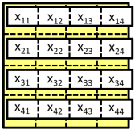
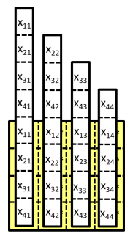
Autocatalysis
x₁₁
+
x₂₁
x₂₂
x₃₁
x₃₂
x₃₃
x₄₁
x₄₂
x₄₃
x₄₄
x₁₁
x₂₁
x₂₂
x₁₁
+
x₂₁
x₂₂
x₃₁
x₃₂
x₃₃
x₃₁
x₃₂
x₃₃
x₄₁
x₄₂
x₄₃
x₄₄
x₄₁
x₄₂
x₄₃
x₄₄
x₁₁*
x₁₁
x₁₂
x₁₃
x₁₄
x₁₁
x₁₂*
x₁₃*
x₁₂
x₁₃
x₁₄*
x₁₁
+
x₁₄
x₂₁*
x₂₁
x₂₂
x₂₃
x₂₄
x₂₁
x₂₂*
x₂₃*
x₂₂
x₂₃
x₂₄*
x₂₁
x₂₂
x₂₄
x₃₁*
x₃₁
x₃₂
x₃₃
x₃₄
x₃₁
x₃₂*
x₃₃*
x₃₂
x₃₃
x₃₄*
x₃₃
x₃₄
x₃₁
x₃₂
+
x₄₁*
x₄₁
x₄₂
x₄₃
x₄₄
x₄₁
x₄₂*
x₄₃*
x₄₂
x₄₃
x₄₄*
x₄₄
x₄₁
x₄₂
x₄₃
x₄₄

Slide 33
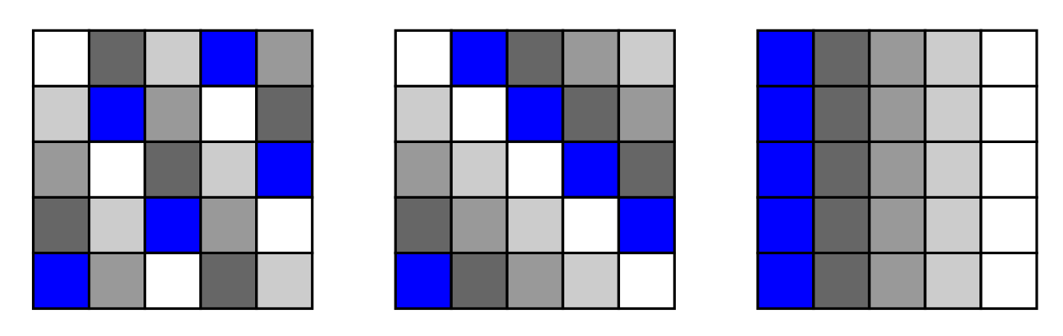
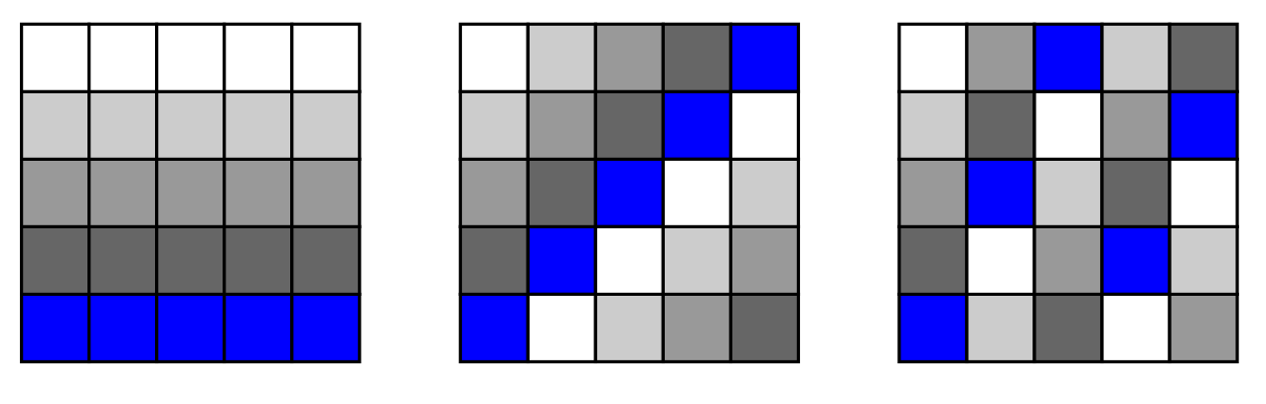
Multiple Stable Configurations
For a grid of prime size n x n, there can be at most n+1 different stable configurations with barrier n to pass between any of them

Slide 34
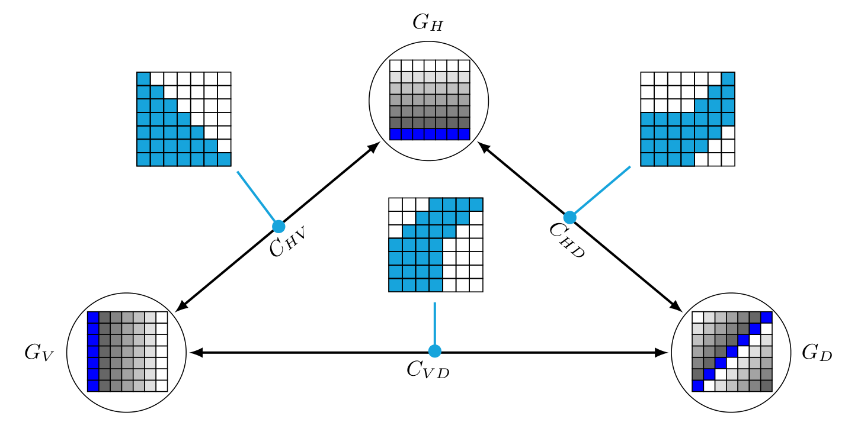
Directed Catalysis
Along a catalyzed pathway, the barrier is 1
Otherwise the barrier is n/2

Slide 35
Social Golfer Problem
Can 25 (n²) golfers play in 5-somes (n-somes) for 6 (n+1) days, so that no two golfers play together more than once?
First studied by Euler.
True if n is a prime power (2,3,4,5,7,8,9,11,13,…)
False for smallest prime power n=6: can only play for 3 days! [Gaston Tarry (1901). "Le Probléme des 36 Officiers". Compte Rendu de l'Association Française pour l'Avancement des Sciences. Secrétariat de l'Association. 2: 170–203.]
Unknown for next prime power n=10:
  trivial upper bound is 11 days
  best known lower bound is 3

Slide 36
(Feasible?) DNA implementation

Slide 37
Future directions
Simultaneous presence of multiple directed catalysts (without exponential blowup)
Minimum number of domain types to be robust to varying relative amounts of the monomers
Constrained catalytic networks using overhangs

Slide 38
Thermodynamic self-assembly
Grafting the TBN model onto self-assembly

Slide 39
A modest goal
Informal: Design monomers that self-assemble arbitrarily large polymers.
  size of a polymer = # monomers in the polymer
Formal: Design a set of monomer types so that, for all S ∈ ℕ, there is a stable polymer of size at least S.
Easy to do in Abstract Tile Assembly Model:
size-8 polymer (assembly) formed
with 8 copies of monomer
set of monomer types:
a
a*
a
a*
a
a*
a
a*
a
a*
a
a*
a
a*
a
a*
a
a*
Notes:
I showed some quite sophisticated computation done by self-assembling DNA tiles using the Abstract Tile Assembly Model, but in this new model, let’s back off from those ambitions and attempt a rather modest goal: keep growing.
What exactly do I mean by this? Let’s formalize it this way. Design a thermodynamic binding network, a set of monomer types, that with enough copies of each monomer type, grows arbitrarily large polymers, in other words for all integers S, there is a stable polymer (by that I mean a stable configuration consisting of a single polymer) of size at least S.
Now, in our first model, the Tile Assembly Model, this is trivial. Here’s a monomer, in other words, a tile, that with S copies, grows a polymer of size S. →

Slide 40
Difficulty of self-assembling large polymers
not stable! (or even saturated)
more complexes ⇒ higher entropy ⇒ more stable
a
a*
a
a*
a
a*
a
a*
a
a*
a
a*
a
a*
a
a*
a
a*
a
a*
a
a*
a
a*
a
a*
a
a*
a
a*
a
a*
These have more polymers, and each is self-saturating (every domain can be bound within the polymer)
attempt 2:
not stable!
…
w
x*
y
z*
w
x*
y
z*
w
x*
y
z*
w
x*
y
z*
x
y*
z
w*
x
y*
z
w*
x
y*
z
w*
x
y*
z
w*
Notes:
Here’s a way of depicting this as a Thermodynamic Binding Network. Does that look stable? … It’s not, first of all, it’s not even saturated, because the final a* is unbound, but that’s not the worst of it.
This is a saturated configuration, each a* is bound, but every polymer is size 1. Sort of the opposite of what we wanted. So you might think, well, the lesson here is don’t put a domain and its complement on the same monomer, they can always just bind to each other, and there’s no sense paying the entropy cost to bring two monomers together to form that bond when you can always form that bond within one monomer.
So maybe we should try to add some new domains and monomer types like so: w, x, y, z, and after a while, add a w*
and then we can expect copies of this polymer to bind to each other and form a long chain. Does that fix the problem?
Nope. This makes bigger polymers than the previous example, but as soon as we repeat a domain, it’s more favorable for each group of four monomers to “wrap up on themselves” like this and form polymers of size 4.
Observe what happened in each case: these configurations on the right are possible because each small polymer is “self-saturating”: it’s possible to bind all starred domains with only “intra-polymer bonds”. →

Slide 41
An even more modest goal
Original goal: Design a set of monomer types so that, for all S ∈ ℕ, there is a stable polymer of size at least S.
and O(1) domains per monomer
Re-
Revised goal: For all S ∈ ℕ, design a set of M monomer types using D domain types with a stable polymer of size at least S.
^
How large can we make S relative to D and M?
S ≈ D²
D,M = O(1), S = arbitrarily large
c₃*
c₃*
c₃*
c₃*
S ≈ D
c₃
c₃
c₃
c₃
d*
d*
d*
d*
d*
d*
d*
d*
c₂*
c₂*
c₂*
c₂*
d₁*
d₁
d₂*
d₂
d₃*
d₃
d₄*
d₄
d
d
d
d
d
d
d
d
c₂
c₂
c₂
c₂
c₁*
c₁*
c₁*
c₁*
c₁
d₁*
d₁
c₁
d₂*
d₂
c₁
d₃*
d₃
c₁
Notes:
So as I said, this goal is modest, but maybe it’s still too ambitious. I also want to take a moment to observe that, a priori, this difficulty is a bit surprising. This model favors enthalpy infinitely over entropy: in other words, it would seem that in a model with infinitely strong bonds that cannot be broken, it would be easy to make monomers clump together into large polymers.
So let’s lower our expectations even further and revise the goal. Instead of designing a single system that grows arbitrarily large polymers, let’s first specify a size of polymer we want, and then design a system to form it. So we fix a size bound S, then ask for M monomer types, using D domain types, that has some stable polymer of size at least S.
Now the interesting question is, how large can we make S relative to D and M?
Well, as phrased, pretty large. Here’s two domain types, and two monomer types, with many copies of the d monomer, and they make as big a polymer as you want, but of course this isn’t really what we are trying to get at with this question. We want to capture the idea that with a little work to create some small monomers, the monomers themselves do the rest of the work and self-assemble, but this huge monomer here with all the d* domains requires lots of work to create.
So let’s revise the question again to try to get at the issue: let’s stipulate that we want a constant number of domains per monomer, it can be a large constant, but it cannot depend on the target size S itself.
What if we ask for S to be approximately equal to D? Anyone see how to do that?
We can have each monomer type appear exactly once, each with unique domains to connect to the next monomer.
So if we want S to be larger, we have to reuse monomer types, and have different copies appear more than once. Could we achieve S equals something like D²?
Here’s a way to do it. Start with a chain of unique monomers like before but note they each share a c₁ domain.
That can be used to bind a similar chain of polymers, each polymer is a copy of the others, so the length of each polymer is something like O(D), but there’s O(D) of them, so the polymer has total size O(D²). →

Slide 42
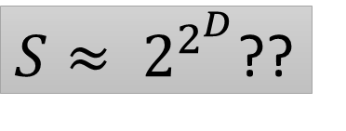
How large can we make S relative to D and M?
S ≈ 2^{D}?
$S≈ 2^{2^{D}}$??
d₁
d₁
d₂
d₁*
d₂
d₂
d₁*
d₂
d₃
d₂*
d₃
d₃
d₂*
d₃
d₃
d₂*
d₃
d₃
d₂*
d₃
d₄
d₃*
d₄
d₄
d₃*
d₄
d₄
d₃*
d₄
d₄
d₃*
d₄
d₄
d₃*
d₄
d₄
d₃*
d₄
d₄
d₃*
d₄
d₄
d₃*
d₄
d₄*
d₄*
d₄*
d₄*
d₄*
d₄*
d₄*
d₄*
d₄*
d₄*
d₄*
d₄*
d₄*
d₄*
d₄*
d₄*
Notes:
Let’s step up our ambitions. Can we make S exponentially larger than D?
Yes we can. We can have a tree of monomers, each level consisting of several monomers of the same type, twice the number in the previous level.
Can we get more ambitious still? How about a doubly-exponential size polymer?
→ It turns out no, that’s too ambitious. It can’t be done. →

Slide 43
Stable polymers have at most exponential size
Theorem: Any thermodynamic binding network with
  D domain types,
  M monomer types,
  ≤ A domains per monomer type (note D/A ≤ M ≤ A^{D+1})
has polymers of size ≤ 2(M+D)(AD)^{2D+3} = poly(D^{D}) if A = O(1)
Notes:
So we arrive at our first theorem (and close to last that I will cover in this talk), which states that stable polymers have at most “exponential size“.
The exact bound is in red here, it’s a bit messy, and involves this number A, the maximum number of domains on any monomer, but if you assume that’s constant with respect to D, then this bound is polynomial in D^{D}, which I’m simply calling “exponential in D”. →

Slide 44
Easy proof if binding graph is acyclic (tree)
Since monomers have O(1) domains, binding graph is bounded degree
# nodes of tree is at most exponential in depth (longest path length ≤ 2∙depth)
If some path has > 2D edges, it must repeat some ordered pair (d_{i},d_{i}*) or (d_{i}*,d_{i})
Break into two saturated polymers as shown.
not stable
Notes:
Let’s start with proving an easy special case. Note that all of the examples so far have been trees, in other words the binding graph of the polymer was acyclic. This special case is easy to show.
Since we assume each monomer has O(1) domains, the binding graph is bounded degree.
Now, the tree isn’t rooted, but I’ll pretend like it is to make the terminology and drawing simpler. If we have a bounded-degree tree of some depth, its total size is at most exponential in the depth. And the longest path is at most twice the depth, you start from a leaf, go up to the root, and back down to another leaf.
Note each edge on a path corresponds to an ordered pair of complementary domains: you exit one monomer through d_{i} and enter the next through d_{i}*, or vice versa. By the Pigeonhole Principle, any path longer than 2D must repeat an ordered pair. In this example, we follow this red path from left to right and encounter d₂, then d₂*, in that order, twice, where the two arrows are.
It turns out, if that happens, then we can re-bind those pairs of domains, and it will provably separate the polymer into two. So if it was saturated before, it still is, we didn’t lose any bonds, but now it’s two polymers instead of one, so the original was not stable. →

Slide 45
Monomers as vectors
monomer {a, b*,b*, d,d,d,d,d*, e,e*} represented as (1,-2,0,3,0)
sum of many monomers gives the number of excess domains in a fully bound (saturated) polymer with those monomers
  i.e., 2 copies of above monomer 2∙(1,-2,0,3,0) = (2,-4,0,6,0) have an excess of 2 a’s, 4 b*’s, 0 c’s, 6 d’s, 0 e’s

Slide 46
Somewhat easy proof that unbounded size polymers cannot be assembled
Original goal: Design a set of monomer types so that, for all S ∈ ℕ, there is a stable polymer P of size ≥ S.
Theorem: Original goal is impossible.
Proof:
Suppose otherwise, let P₁, P₂, … in ℕ^{m} be an infinite sequence of polymers increasing in size.
  m is number of monomer types, P_{i}(j) = # monomers of type j in polymer P_{i}.
Represent each monomer type as a vector in ℤ^{d} as on previous slide.
  P_{i} is composed of monomers m_{1i}, m_{2i}, …, m_{ki}.
  Let S_{i} = m_{1i} + m_{2i} + … + m_{ki}. Note that there is a m x d matrix A such that S_{i} = M∙P_{i},
Take several infinite subsequences:
  Since there are a finite number of domain types, some infinite subsequence of Pi’s agrees on which set of domain types are unbound
  By Dickson’s Lemma we may assume P₁ < P₂ < ... and S₁ < S₂ < ... i.e., each has all the monomers of the previous, plus some more, and each has all the unbound domains of the previous, plus some more.
Let d = P₂ – P₁. Then M∙d = M∙P₂ – M∙P₁ = S₂ - S₁ ≥ 0.
i.e., S₂ = S₁ + M∙d and all three are nonnegative,
i.e., we can split S₂ into 2 disjoint nonempty nonnegative subsets, S₁ and M∙d. QED

Slide 47
A digression into computational complexity
Integer-Programming problem
  Given: integer matrix A, integer vector b
  Question: is there a nonnegative integer vector x such that Ax = b?
0/1-Integer-Programming is NP-complete (Karp 1972).
Non-obvious fact: Integer-Programming is in NP. (independently due to [Borosh and Treybig 1976], [Gathen and Sieveking 1978], [Kannan and Monma 1978])
  If Ax = b has a solution, it has a “small” solution… max_{i} x_{i} ≤ exp(max_{ij}(A_{ij},b_{j}))
Papadimitriou’s proof:
  If x is a large enough solution, there is 0 < y < x, y ∈ ℕ^{m}, such that Ay = 0.
  Defining z = x – y, Az = A(x – y) = Ax – Ay = Ax – 0 = b.
  So z is a strictly smaller solution than x: x cannot be the smallest solution.
[On the complexity of integer programming. Papadimitriou, JACM 1981]
Notes:
Before we show the more general theorem for cyclic binding graphs, we’re going to take a brief detour through an interesting result in computational complexity theory. There’s this problem, called Integer-Programming, and it essentially asks us to solve a linear system of equations, but only to accept nonnegative integer solutions.
Solving linear equations over the reals (or really, the rationals) is easy as we all know, but every computer scientist learns on mother’s knee that one of the first known NP-complete problems is 0/1-Integer-Programming, where we restrict the solution entries to be 0 or 1.
Here’s a fact that’s not as obvious as it might seem: Integer-Programming is contained in NP. You might think it’s obvious, if the system has a solution, the solution is the NP-witness, right? But note I didn’t say “0/1”, I just said “Integer”. The solution is a witness, but who’s to say it’s a polynomial-size witness?
If you want to show this, you have to show that if Ax=b has a solution, then it has a polynomial-size solution, in other words the number of bits to represent x is polynomial in the number of bits to represent A and b. This amounts to showing that each integer entry in x is at most exponential in the entries of A and b.
Now, this was shown independently by several authors, but the nicest proof comes from an old paper of Papadimitriou, it’s a 4-page paper with a very nice geometric proof of this fact: that if a solution x is larger than a certain exponential bound, then there is a nonzero vector y componentwise at most x, and smaller than x on at least one component, and Ay is ZERO. That’s what he proves.
To see that this helps, note that if you look at the difference x – y, call it z, then Az is simply Ax – Ay, which is Ax – 0, which is simply b.
So z is also a solution, but it’s smaller than x. So x couldn’t be the smallest solution. →

Slide 48
Farkas’ Lemma
Given vectors m₁, m₂, … , they obey one of two constraints:
a) are directions of balanced forces
b) lie on one side of some hyperplane
m₁
∃c
(counts of monomers)
(m₁ m₂ m₃)c = 0
m₂
h
m₂
(hyperplane orthogonal vector)
m₁
∃h
h∙m_{i} ≥ 1
m₃
m₃

Slide 49
How to prove exponential polymer size bound for polymers with cycles in binding graph?
A = d x m matrix: A_{ij} = monomer m_{j}‘s excess of domain d_{i} over d_{i}*
If Ac = b, then b_{i} = total # unbound d_{i} in any saturated configuration of x
If |c| > exponential in D, Papadimtriou’s proof gives us subcollection y < c such that Ay = 0, (Farkas’ Lemma says that if this fails, then monomer vectors all lie on one side of a hyperplane, see next slide)
i.e., #d_{i} in y = #d_{i}* in y, so y is self-saturating.
So whatever bonds were broken to separate y can be re-bound within y.
By symmetry, the same bonds in z = c – y can be re-bound within z.
monomer collection c ∈ ℕ^{M}
a
b
c
Ac = (2,1,0)
z
a
b
c*
y
a
b*
a*
a
c*
c*
a*
c*
a
a*
b*
c
a*
c
b
b
b
a
a
b
b*
a
b*
a*
Notes:
Okay, so how’s that supposed to help us prove we can’t grow big polymers? Imagine we have a monomer collection x; remember that’s a vector of M integers telling us how many of each monomer type we have, and suppose it forms a saturated polymer like so. We’re going to show we can find another saturated configuration with two polymers, so this one can’t be stable.
There’s a matrix A we can define, and each column represents a monomer type in the following way: A_{ij} represents the i’th monomer’s excess of unstarred j’th domains. So for example this monomer with a and two c*’s would be +1 on a and -2 on c, and 0 on b. This one with a, b, and b* is also 0 on b, because the b and b* cancel.
So if you define this matrix, and multiply it by x, then the output vector has D components, one per domain pair, and it tells you the total number of unbound unstarred domains.
In this example, across all of x, we have ONE excess b and TWO excess a domains, so Ax = the vector (2,1,0). Remember we assume unstarred domains are in excess, so this is going to be nonnegative.
Now, if |x| is too large (exponential in D), then Papadimitriou’s proof (modified a bit) tells us there is a subcollection y of x such that Ay = 0.
Let’s think about what that means: for each domain d, there are exactly the same number of d* domains in y. So y is self-saturating, it’s possible to bind every single domain of y just within y.
So if we imagine ripping y out of the larger polymer of x, then whatever bonds were broken to separate y, can be re-bound within y. In this example, we broke an a, but also an a*, and we broke a b, but also a b*.
And by symmetry, the bonds broken in z, the remaining part of x, can also be re-bound just within z, because they’re the same bonds, just on the other side. So we get two saturated polymers, so the original was not stable. →

Slide 50
If all monomer types lie on one side of hyperplane h…
Consider “slack monomers” {d₁*}, {d₂*},…, adding just enough to bind to all the excess d_{i} domains, so saturated (fully bound) == all domains bound
If c is count of all monomers including slack monomers (c(i) = count of m_{i}), then Ac = 0, where each column of A represents a monomer (counts of domains).
dot-product h on both sides: h∙Ac = h∙0 = 0, distribute through: ∑_{i}(h∙m_{i})c(i) = 0
Let S be set of monomers with “small” counts, move them to one side:
  – ∑_{i∈S}(h∙m_{i})c(i) = ∑_{i∉S}(h∙m_{i})c(i)
Then “small”₂ ≥ – ∑_{i∈S}(h∙m_{i})c(i) = ∑_{i∉S}(h∙m_{i})c(i) ≥ ∑_{i∉S}c(i)
c(i) (count of i’th monomer) is small by definition, and h∙m_{i} = O(1)
above
since h∙m_{i} ≥ 1

Slide 51
Applying thermodynamic model to tile assembly
Let’s incorporate the thermodynamic binding network model into the abstract tile assembly model.
How can we create a large assembly from a small number of tile types?
Notes:
I said one interest we have is “grafting” these thermodynamic ideas onto existing kinetic models. Let’s give it a try with tile assembly. How can we create a large assembly from a small number of tile types? In particular, can we do it in a way where the Tile Assembly Model has a desired final assembly, but also, that assembly is thermodynamically stable when interpreted within our Thermodynamic Binding Network model? →

Slide 52
A thermodynamically unstable tile assembly counter
0
0
0
0
0
0
0
1
1
1
0
1
Notes:
I have to apologize that this part of the talk is for Tile Assembly experts. There is a well-known way to make a large structure in tile assembly, creating something called a counter of size about 2^{n} from only n tile types. It’s a modification of the infinite counter I showed earlier, and it counts from 1 up to some power of 2, then stops. The idea is that each vertical column of tiles represents a binary string with the least significant bit on the bottom.
Now, to see this is not stable in the geometry-free thermodynamic model, observe that one of the tiles in the middle has a 0 domain and a 0* domain, and an n domain (n stands for “no carry”) and an n* domain. So if we rip that tile out of the assembly, and really bend it around to bind those domains within the tile, it’s saturated, and we can do the same thing in the gap where we ripped it out. Now there are some rather bendy tile motifs, they don’t all look like rigid squares like the kind I showed. The motif I’ve worked with, the whole tile is just a single strand, so it’s not outrageous to assume this could happen. But it means the original assembly was not stable, because we can separate it into two saturated polymers. →

Slide 53
A thermodynamically stable tile assembly counter
Difference is that each row (corresponding to bits of the same significance) has glues labeled with the row number
Notes:
So one little result we show in the paper is that we can overcome this and make a counter that works in both models. Essentially, the trick is to encode the significance of the bits in each glue, so that glue 0 in the 2’s place, for example, is different from glue 0 in the 8’s place. And you still get an assembly exponentially larger than the number of monomer types, but it’s more geometrically feasible than than big branching tree I showed a while ago.

Slide 54
Conclusions
Strong bonds (surprisingly) aren’t sufficient to self-assemble large thermodynamically stable structures. Geometry helps!
Kinetically self-assembling a thermodynamically stable structure has very strong guarantees on errors:
  target structure eventually results despite arbitrary kinetic errors.
  If it’s the only stable structure, and free energy of other structures is much less, then it’s the only result you’ll see.
Bad news: NP-complete to tell if a given configuration is unstable… even NP-hard to approximate entropy of stable configuration:
  [Breik, Thachuk, Heule, Soloveichik, Computing properties of stable configurations of thermodynamic binding networks, Theoretical Computer Science 2019]
Notes:
Strong bonds, surprisingly, aren’t enough to self-assemble large thermodynamically stable structures.
You also need geometric constraints, such as those assumed in models such as Tile Assembly and DNA Strand Displacement.
If you can self-assemble a thermodynamically stable structure in the abstract Tile Assembly Model, then you have very strong guarantees on errors: Arbitrary errors in binding cannot stop the thermodynamic equilibrium from containing the target structure.
If furthermore it’s the only stable structure, and the free energy of other structures is much less, then you don’t expect to see much of anything else at equilibrium. Of course, these are some strong assumptions, but they can be studied within the model, or generalizations of it.

