Slide 1
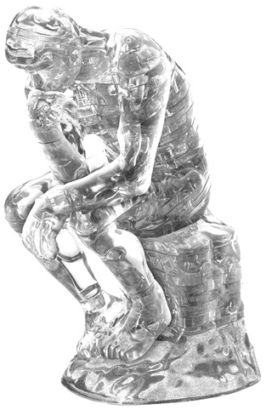




Crystals that think about how they’re growing
David Doty
joint work with Damien Woods, Erik Winfree, Cameron Myhrvold, Joy Hui, Felix Zhou, Peng Yin
Computing with Unconventional Technologies Workshop, October 18, 2021
Caltech
Inria Paris
UC Davis
Harvard

Slide 2










Acknowledgements
Caltech
Inria Paris
UC Davis
Harvard
lab/science help
Damien Woods
(co-first author)
Erik Winfree
(PI)
co-authors
Sungwook Woo
Constantine Evans
Cameron Myhrvold
Peng Yin
Sarina Mohanty
Niranjan Srinivas
Deborah Fygenson
Yannick Rondolez
Mingjie Dai
Nikhil Gopalkrishnan
Chris Thachuk
Nadine Dabby
Jongmin Kim
Paul Rothemund
Felix Zhou
Joy Hui
Bryan Wei
Cody Geary
Ashwin Gopinath
side project
Chris Thachuk
Namita Sarraf
Anya Mitskovets
Damien Woods
Pierre-Etienne Meunier
Constantine Evans
Diverse and robust molecular algorithms using reprogrammable DNA self-assembly.
Damien Woods†, David Doty†, Cameron Myhrvold, Joy Hui, Felix Zhou, Peng Yin, Erik Winfree.
Nature 2019. †These authors contributed equally.

Slide 3
Hierarchy of abstractions
Bits: Boolean circuits compute
Tiles: Tile self-assembly implements circuits
DNA: DNA strands implement tiles
Notes:
Finally, we build the tiles, out of our favorite molecule.

Slide 4

Harmonious arrangement
a.k.a. sorting
0
1
1
1
1
=
1
1
0
1
1
1
=
1
1
1
0
1
1
=
1
0
0
1
0
1
=
1
1
1
0
1
0
=
0
1
1
1
0
0
=
0
Notes:
There’s some bits… I don’t like them... Don’t care for these bits.
Now these bits on the other hand… these bits I like.
In truth, they’re the same bits, but they’re arranged so nicely, with all the 1’s on top.
How I can get the former bits to be like this?
Imagine we can examine a pair of adjacent bits and change them.
In this pair, the 0 is on top and the 1 on bottom, but we want the 1 on top, so we swap them.
This pair is already in the correct relative order, so we leave it.
These are both 1’s, so there’s only one order, so we leave it.
If we looked at these pairs again, the bits would stay the same, so we shift the reading frame; this lets more bits get swapped.
In the shifted reading frame, we have a lonesome bit on top and one on bottom, so we add half-gates to propagate these.
Now we just repeat these gates, and eventually, the bits end up sorted.

Slide 5
Odd bits
a.k.a. parity
4
4
4
1
0
0
0
0
0
0
0
1
1
1
1
0
1
0
0
0
0
0
0
5
5
5
1
0
1
0
0
0
0
0
…
2
2
2
2
move 1’s to here
0
1
0
1
1
1
1
1
6
6
6
0
1
0
0
0
0
0
0
3
3
3
3
1
0
0
0
0
0
0
0
7
7
7
Notes:
Here’s some more bits… I don’t know yet whether I like these.
I like odd numbers of 1’s, but I don’t know how many there are.
Let’s move them to this line to count them.
So the 1’s above the line should move down, but below the line they should move up,
indicating I want to allow different gates to compute different functions, so we’ll label the gates differently.
If we see two 1’s, we’ll change them both to 0.
Now, this decreases the number of 1’s by 2, so if it was odd before, it’s still odd.
Eventually the remaining 1 makes its way to the middle, and stays there.

Slide 6
Parity
1
0
0
0
0
0
0
0
0
1
0
0
0
0
0
0
1
0
1
0
0
0
0
0
…
1
0
1
0
0
0
0
0
0
1
0
0
0
0
0
0
1
0
0
0
0
0
0
0
Notes:
Now consider if we start with an even number of 1’s.
The middle two cancel, and the outer two move toward the middle.
They move again.
Eventually they meet and cancel.
And now we have all 0’s.

Slide 7
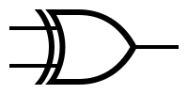

Boolean circuit model
i₁
g truth table
o₁
i₁ | i₂ | o₁ | o₂
0 | 0
0 | 1
1 | 0
1 | 1
0
1
1
0
0
0
0
1
i₂
o₂
gate g
gate g: function with two input bits i₁,i₂
and two output bits o₁,o₂
Notes:
These are examples of a formal circuit model I’ll define now.
The basic unit is a gate, most gates have two input bits and two output bits, though we also allow one-input/one-output.
The gate is defined by a truth table.
The outputs can be any function of the inputs you want, so any way to fill in these output bits in the truth table defines a legitimate gate.

Slide 8
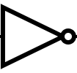
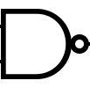
Boolean circuit model
i₁
1
o₁
2
7 rows in layer
3
o₂
4
i₁
i₂
o₁
5
gate g_{3,XA}(i1,i2) = o1,o2 = XOR(i1,i2),AND(i1,i2)
6
7
i₂
o₂
one layer
gate g_{6,NN}(i1,i2) = o1,o2 = NOT(i1),NAND(i1,i2)
Gates organized into vertical layers consisting of many rows
Possibly different gate types on different rows within a layer
Notes:
Each gate has a row number, this one is row 3.
The gate connects to gates in adjacent rows.
All rows put together make a layer.
And gates in different rows can compute different functions.

Slide 9
Boolean circuit model
i1
o1
g_{3,NN}
o2
1
i2
2
3
i1
o1
4
g_{3,XA}
5
o2
6
i2
7
Randomization: Each row may be assigned ≥ 2 gates, with associated probabilities, e.g., Pr[g_{3,NN}] = Pr[g_{3,XA}] = ½
Notes:
A feature of the model we haven’t yet seen is randomization.
The programmer can optionally specify multiple gates per row,
and assign a probability to each to be used each time the gate is evaluated.

Slide 10
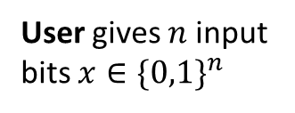
Boolean circuit model
Programmer specifies layer: gates to go in each row
x₁
1
1
1
2
2
2
x₂
3
3
3
x₃
User gives $n$ input bits $x∈\{0,1\}^{n}$
4
4
4
x₄
5
5
5
x₅
6
6
6
Computation flows from inputs to layers 1→2→3→…
x₆
7
7
7
input
layers:
1
2
3
Notes:
So the programmer defines a circuit by specifying a layer: the gates that go in each row.
The user gives n input bits to the first layer, n=6 here.
And the layers repeat forever, with computation flowing from left to right.

Slide 11
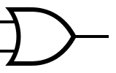
Example circuits with same gate in every row
Copy
Copy gates
i₁ | i₂ | o₁ | o₂
0 | 0 | 0 | 0
0 | 1 | 0 | 1
1 | 0 | 1 | 0
1 | 1 | 1 | 1
i₁
i₁
1
1
0
0
1
1
1
1
0
0
1
1
i₂
i₂
Sorting
Sorting gates
i₁ | i₂ | o₁ | o₂
0 | 0 | 0 | 0
0 | 1 | 1 | 0
1 | 0 | 1 | 0
1 | 1 | 1 | 1
i₁
OR(i₁,i₂)
0
0
0
1
1
1
1
1
1
0
0
0
i₂
AND(i₁,i₂)
Notes:
Let’s go through some more examples.
The simplest circuit we could imagine is copying: every gate is simply the identity function, so the 1’s and 0’s move in a straight horizontal path to the right.
From now on I’ll draw circuit evaluations like this, with an asterisk indicating a 1, and everywhere else is 0’s.
We already saw how to sort: pushing the 1’s up to the top as computation flows from left to right.

Slide 12
Example circuits with different gates in each row
Parity
1
0
0
1
0
1
00
0
1
00
1
0
1
1
0
1
00
0
0
00
MultipleOf3
011011₂
= 27₁₀ = 3∙9
111011₂
= 59₁₀ = 3∙19 + 2
0
1
1
0
1
1
1
1
1
0
1
1
Notes:
Let’s go through some more examples.
The simplest circuit we could imagine is copying: every gate is simply the identity function, so the 1’s and 0’s move in a straight horizontal path to the right.
From now on I’ll draw circuit evaluations like this, with an asterisk indicating a 1, and everywhere else is 0’s.
We already saw how to sort: pushing the 1’s up to the top as computation flows from left to right.

Slide 13

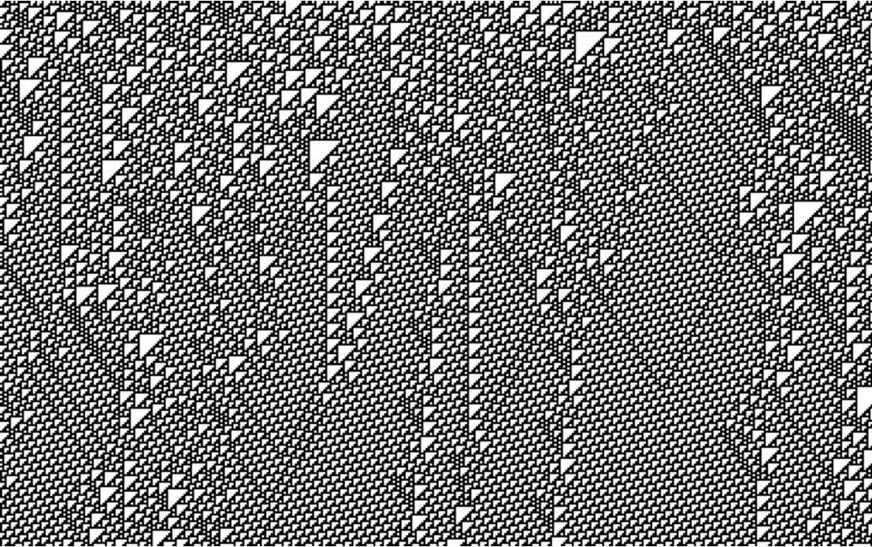

Deterministic circuits
Parity
MultipleOf3
Palindrome
answer yes/no question
yes
no
Cycle63
“count” as high as possible
1 | 2 | 3 | 4 | 5 | 6 | 7 | 8 | 9 | 10 | 11 | 12 | 13 | 14 | 15 | 16 | 17 | 18 | 19 | 20 | 21 | 22 | 23 | 24 | 25 | 26 | 27 | 28 | 29 | 30 | 31 | 32 | 33 | 34 | 35 | 36 | 37 | 38 | 39 | 40 | 41 | 42 | 43 | 44 | 45 | 46 | 47 | 48 | 49 | 50 | 51 | 52 | 53 | 54 | 55 | 56 | 57 | 58 | 59 | 60 | 61 | 62 | 63 | 1 | 2
Rule110
simulate cellular automata
Theorem: Rule 110 can efficiently execute any algorithm.
[Cook, Complex Systems 2004]
time
[Neary, Woods, ICALP 2006]
Notes:
We saw how to compute parity, which makes a stripe of 1’s, or not, depending on whether the initial number of 1’s is odd.
Erik Winfree found a circuit to decide if the bits are a palindrome, meaning they read the same forward and backward, like the name of this Swedish band, making this pattern if so, and this other pattern if not.
The bits could represent an integer in binary, and we want to know if it’s a multiple of 3.
These bits are the binary expansion of 21, a multiple of 3, and the circuit makes this pattern.
Let’s flip the first bit to a 1, quick: what’s that binary integer? Is it a multiple of 3? … turns out no, it’s not, so this other pattern appears
These are all examples of what computer scientists call decision problems, questions with a yes/no answer.
Each layer receives 6 bits as input, so after 2^6 = 64 layers, the circuit must repeat…
can we design a circuit that goes through all 64 strings before repeating?
In order words, how high can these circuits count?
We still don’t know, but Erik found this one that goes through 63 strings before repeating.
Another model of computation similar to ours is a cellular automaton, which examines triples of bits and updates the middle one based on all three.
This one is called “Rule 110”, which makes this pattern.
Our model can only look at pairs, not triples, so it’s not obvious if it could emulate the behavior of Rule 110.
In fact, there are some cellular automata that our model provably cannot emulate, but Damien figured out how to do Rule 110.
Rule 110 is especially interesting to computer scientists because of this theorem, which Damien helped to prove a decade ago, stating that with enough bits, Rule 110 can efficiently execute any algorithm whatsoever.

Slide 14
Randomization: “Lazy” sorting
0
0
0
1
1
1
1
1
1
0
0
0
1
2
3
copy gate
4
If 1 and 0 out of order, flip a coin to decide whether to swap them.
5
6
0
0
0
1
1
1
1
1
1
0
0
0
7
sort gate
Notes:
Here’s a simple example of a randomized circuit: we call this lazy sorting.
Every row has a copy and a sort gate, which get randomly chosen.
So the bits eventually get sorted, but it takes longer than normal sorting,
because sometimes copy is chosen when a 1 and 0 should be swapped.

Slide 15
Randomized circuits
LazyParity
RandomWalkingBit
DiamondsAreForever
FairCoin
Pr
= Pr
= ½
use biased coin to simulate unbiased coin
for any (positive) probabilities for the randomized gate
Notes:
Here’s some more examples of randomized circuits.
We saw lazy sorting; lazy parity is similar, bring 1’s slowly to the middle and cancel them in pairs when they meet.
Random walking bit just has a single bit that walks up and down randomly.
Here’s one of Damien’s favorites: usually it’s all 0’s, but occasionally a pair of 1’s materialize in the middle, move out to the edges and back, and annihilate each other, making diamonds, forever.
This is my favorite randomized circuit.
It has one gate with two randomized choices, and it results in one of two eventual patterns: all 0’s eventually, or stripes of 1’s near the bottom.
Each pattern appears with probability exactly ½.
Here’s the cool part: this happens no matter what are the underlying randomized gate probabilities:
they could be 99 to 1, and you’ll still get half the circuits with stripes, and the other half without, using a technique called von Neumann rejection sampling.

Slide 16



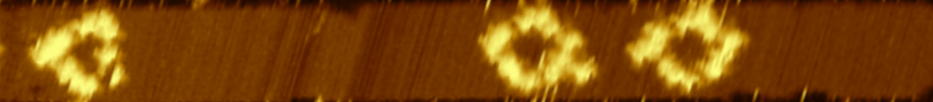

100 nm
Notes:
So we have all these circuits that we thought up, and here’s images of them being simulated.
What else did we do?
We went in the lab, and
using self-assembling DNA strands,
we implemented every one of these circuits,
and many more,
and they all worked,
with very low error rates.
The scale bar on top tells you how big this stuff is, BUT, you’re not yet supposed to understand what… this… stuff… actually is.
That’s what the rest of the talk is about.

Slide 17
Hierarchy of abstractions
Bits: Boolean circuits compute
Tiles: Tile self-assembly implements circuits
DNA: DNA strands implement tiles
Notes:
We’ll move now from static circuits,
which lay still while bits flow through them,
to an abstract model of self-assembling square tiles,
which dynamically bind to each other.
The third part of the talk shows how to actually build these tiles from DNA.

Slide 18
Gates → Tiles
input glues
output glues
0
0
gate
1
0
i₁
o₁
1
0
0
0
i₂
o₂
1
0
1
1
i1 | i2 | o1 | o2
0 | 0 | 0 | 0
0 | 1 | 1 | 0
1 | 0 | 1 | 0
1 | 1 | 0 | 1
1
1
0
0
tiles
truth table row is encoded by a tile with 4 glues encoding bits
Notes:
Each gate is represented by four tiles.
Each entry of the gate’s truth table corresponds to a tile.
Each side of the tile has a glue, which helps it bind to other tiles.
Each glue encodes two pieces of information:
a bit, and
the gate’s row, so a 0 on row 2 will have a different glue than a 0 on row 3
The input bits to the gate are on the left of the tile and the output bits are on the right.

Slide 19
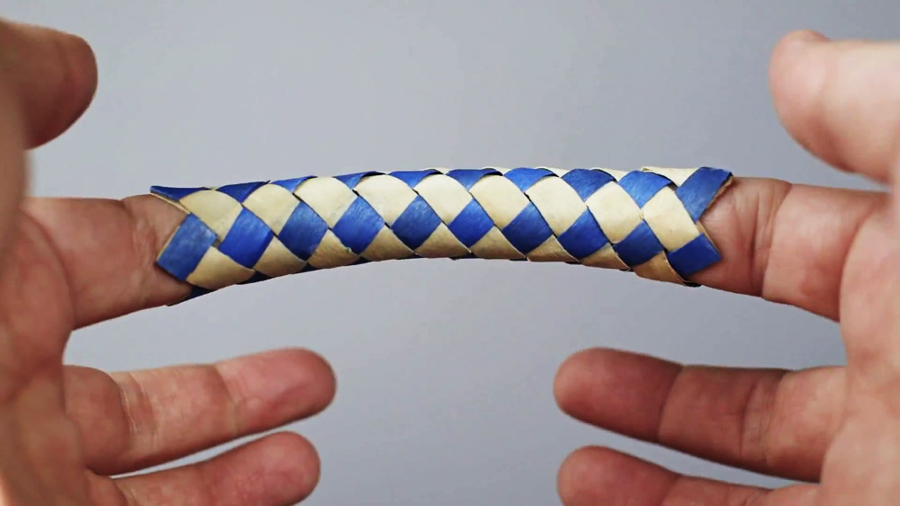
How tiles compute while growing
(algorithmic self-assembly)
U_
U_
U_
U_
U_
U7
U_
U7
U7
U7
U_
U1
U1
U1
U1
U1
U1
U_
U_
U1
U2
U2
U2
U2
U2
U2
U1
U1
U1
1
1
1
U2
U2
U2
x₁
2
2
2
x₂
3
3
3
x₃
4
4
4
x₄
5
5
5
x₅
6
6
6
two glues match: cooperative binding
x₆
7
7
7
_
U_
U1
U_
U1
U_
U1
0₂
x₁
U2
U2
U2
U3
1₁
1₃
x₂
U3
U3
?
1₂
U3
0₂
1₂
1₂
U3
1₃
1₃
x₃
U4
U4
U4
0₃
one mismatch
“data-free” tile wraps top to bottom to form a tube
1₃
x₄
0₂
0₂
U5
U5
U5
0₄
U3
1₂
1₂
0₃
0₃
U3
U_
x₅
U6
U6
U6
0₃
0₃
x₆
U7
U7
U7
two mismatches
_
U_
U_
U_
Notes:
Now we’ll see how tiles can self-assemble so as to carry out the circuit computation.
We start with glues representing the input bits somehow just hanging there in space; in the next part of the talk we’ll see how to implement this.
Tiles attach to these glues, and to each other, in an order like this.
For now I’m hiding the glue information just to show how tiles grow.
Now, I’m drawing the tiles as if they lay flat, but in fact, there’s one special tile that carries no “data” (its glues encode a row but no bit),
and it helps wrap the tiles around into a tube.
To help you visualize, I’ve used advanced GPU hardware to create this 3-dimensional rendering of tiles rolled into a tube.
So the tiles grow a tube from left to right.
Now let’s see some actual glue information… suppose these two tiles have glues encoding bits 0 and 1.
There’s four tiles that could go in row 3, one for each pair of input bits.
But two of these tiles mismatch one of those glues.
One of the tiles mismatches both of the glues.
Only 1 of the 4 tiles correctly matches both of the glues, so it will be the only one to bind here.
We call this cooperative binding, since both glues must cooperate to attach the tile.
And of course, this tile has two other glues on the right side, which are the outputs of the gate on this input.
This is how a tile attaching can compute its gate’s function.

Slide 20
Hierarchy of abstractions
Bits: Boolean circuits compute
Tiles: Tile self-assembly implements circuits
DNA: DNA strands implement tiles
Notes:
Finally, we build the tiles, out of our favorite molecule.

Slide 21
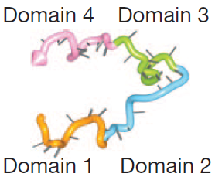
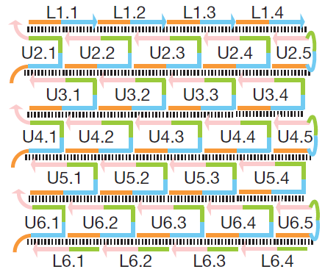
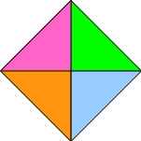
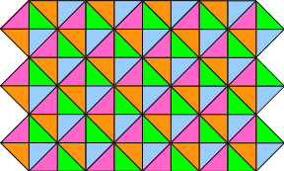
DNA single-stranded tiles
assembly
glue 4
glue 3
glue 1
glue 2
Yin, Hariadi, Sahu, Choi, Park, LaBean, Reif
Programming DNA tube circumferences
Science 321, 824-826 (2008)
Notes:
There’s many DNA motifs for creating self-assembling tiles.
We use the single-stranded tile, which is just a single strand of DNA, logically sectioned into 4 binding domains, each implementing a glue.
So the tile isn’t shaped like a square, but it binds to 4 neighboring tiles in a so-called square lattice.
This slide shows the tiles in a flat ribbon shape, but…

Slide 22
Single-stranded tiles for making any shape
Bryan Wei, Mingjie Dai, and Peng Yin. Complex shapes self-assembled from single-stranded DNA tiles. Nature 2012.

Slide 23
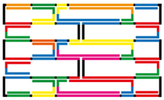
Uniquely addressed self-assembly versus algorithmic
Unique addressing: each DNA “monomer” appears exactly once in final structure:
uniquely-addressed tiles
DNA origami
staple strand for position (4,2)
tile for position (4,2)
Algorithmic: DNA tiles are reused throughout the structure.

Slide 24
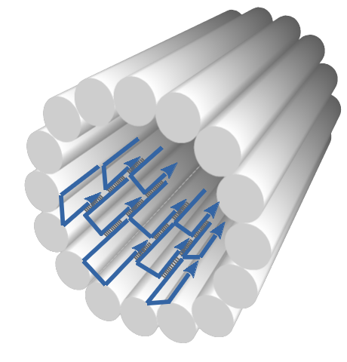
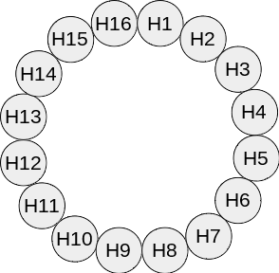
Single-stranded tile tubes
DNA-level diagram of 20-helix tube
Yin, Hariadi, Sahu, Choi, Park, LaBean, Reif, Programming DNA tube circumferences, Science 321, 824-826 (2008)
Notes:
We’ll actually construct tiles to wrap into a 16-helix tube.
So there’s no special tiles for the “top” or “bottom”; they’re all symmetric.

Slide 25
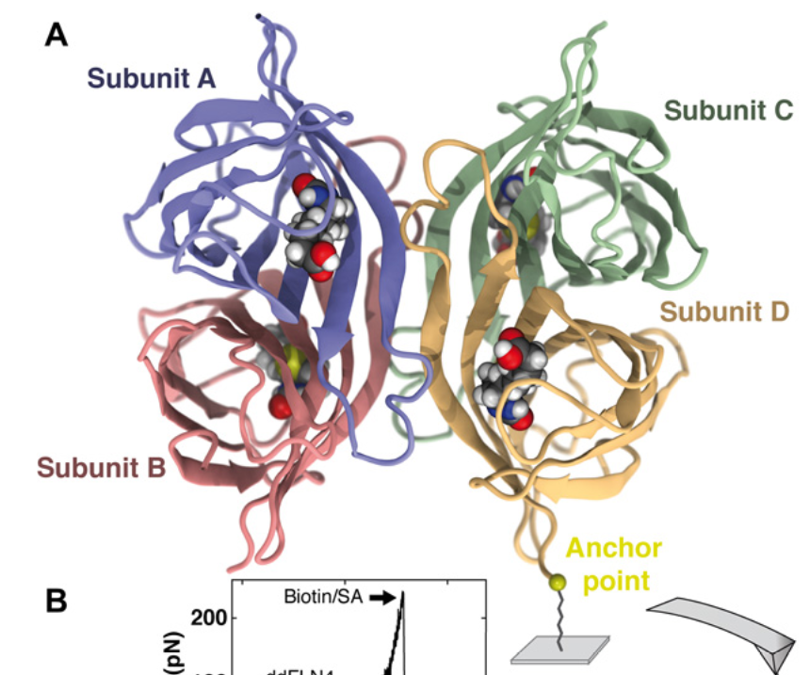
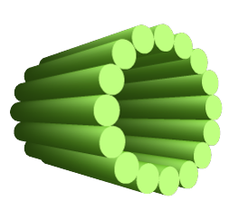
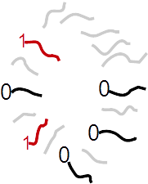
Seeded growth
can later add streptavidin (5 nm wide protein) to bind biotins and visualize where the 1’s are
1
0
1₂
0₂
1₃
1₃
1
1
DNA origami seed
single-stranded “input-adapter” extensions encoding 6 input bits
single-stranded tiles implementing circuit gates
0₄
1₄
0₄
1₄
0₅
0₅
1₅
1₅
0₂
0₂
0₄
0₄
biotins where output = 1
1₃
0₃
1₅
1₅
1₄
0₄
0₅
1₅
need barrier to nucleation (tile growth without seed); [tile]=100 nM; temperature=50.9° C
hold 8-48 hours
seed
input-adapters
growing tiles
Notes:
We’ll operate at a concentration and temperature at which the tiles actually won’t prefer to grow on their own, there’s an energetic barrier to nucleation.
But, by adding a seed structure, the tiles grow from the seed.
Our seed is a DNA origami rectangle, rolled up into a tube.
It has single-stranded extensions we call “adapters” to which the tiles bind to initiate growth.
By choice of DNA sequence for these adapters to encode 0 or 1 glues, they supply the 6-bit input to the circuit.
We add the tiles, 100 of them to implement a particular circuit (I’m just showing 5 here).
So the tiles encode the circuit, the origami seed encodes the input through its adapters, and the tiles grow from the seed to carry out the circuit computation.
We’d like to know which tiles end up where, but that level of detail is difficult to read out.
What we can do, is put a biotin on any tile with a 1 output, so by later adding streptavidin, we can at least see where are the 1’s in the circuit.

Slide 26


Tubes and ribbons
tube
remove “seam” by strand displacement
ribbon
AFM image
500 nm
Notes:
So we grow tiles into tubes, and we could image those with an atomic force microscope.
But we’d like to see more detail on individual helices, so we do the following.
We pick out one helix and rip it open using strand displacement.
Then, by laying the tiles down on mica, they flatten into a ribbon.

Slide 27
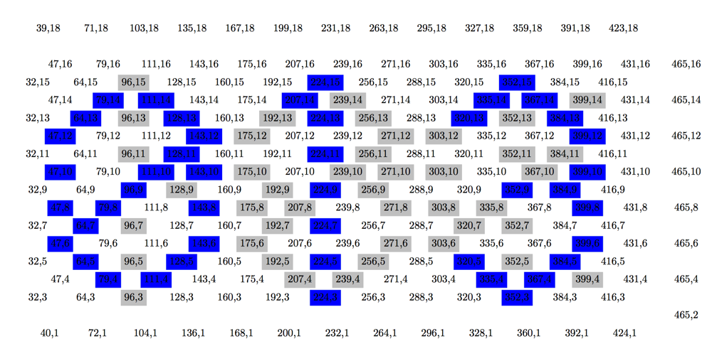

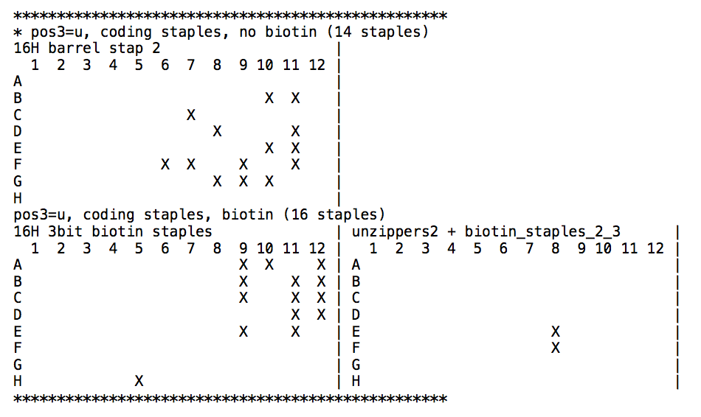
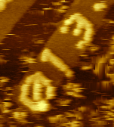
Bar-coding origami seed for imaging multiple samples at once
some staples of origami seed have version with a biotin
represents some combination of circuit and input, e.g.,
013 = “parity circuit, input=011010”
Generate plate map
label with
streptavidin
Notes:
We want to run several experiments in parallel and mix them together in one imaging session, since anyone who’s used an AFM knows they can be cranky, so once it works we’d like to get a lot of data at once.
Now, functionally the origami without the adapter strands always acts the same, it’s just rectangle rolled up into a tube.
But, to help us tell different experiments apart in a single imaging session, we mark each origami with some experiment-specific information.
How do we do this? Some of the origami staples have a version with a biotin.
By selecting an appropriate subset of these
and then adding streptavidin, we can spell a 3-digit sequence of our choosing on the unrolled origami rectangle, which represents both the circuit and the input to the circuit in that experiment.

Slide 28
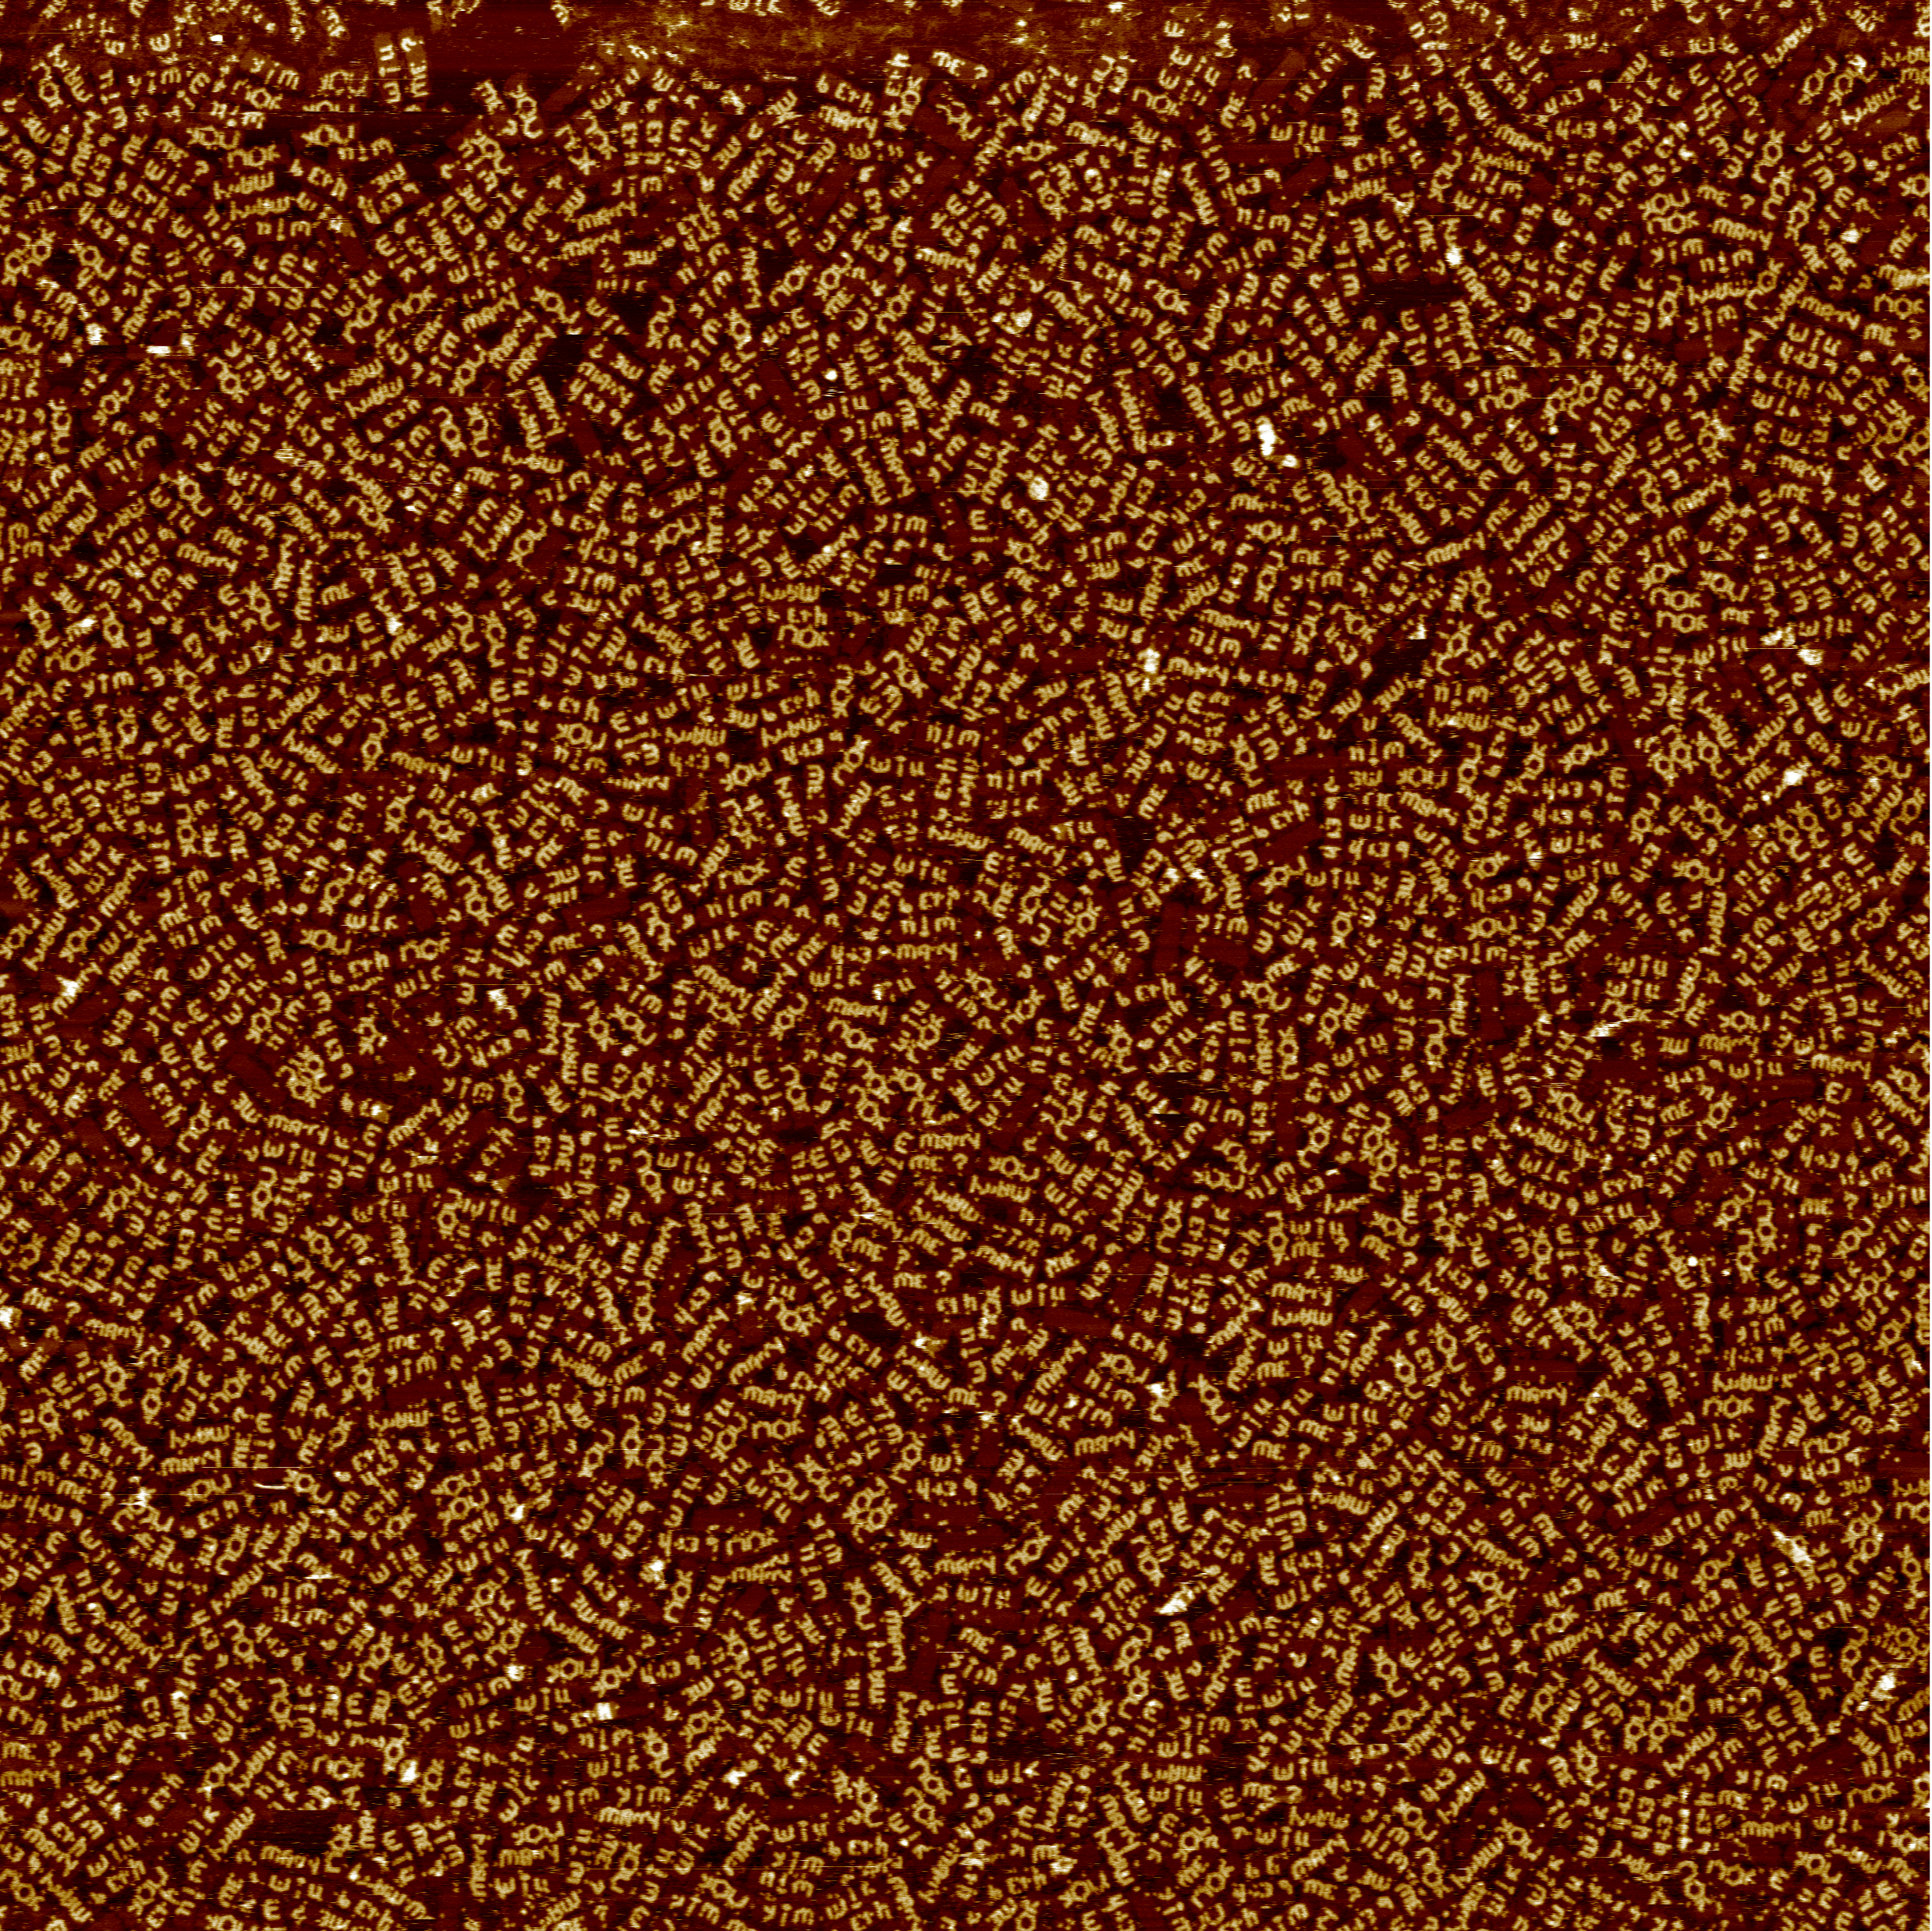
Other patterns written on DNA origami tubes
4 μm wide scan
zoom in

Slide 29

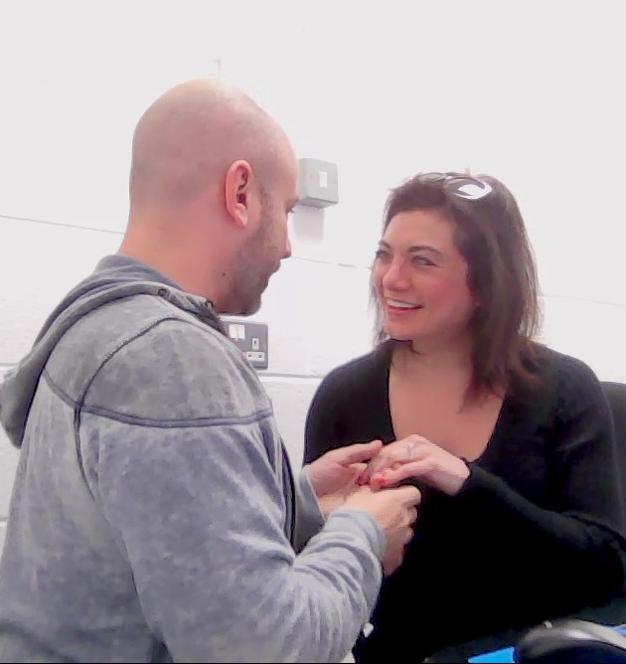
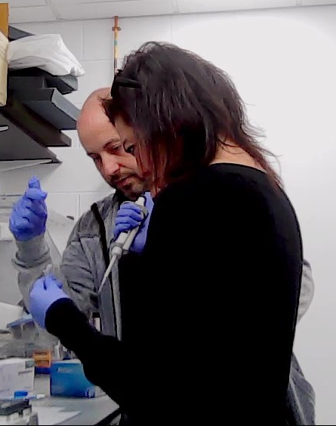
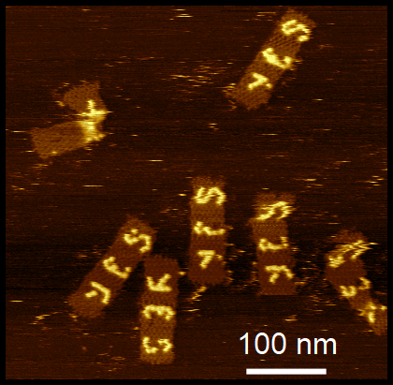
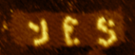
Cherry-picked samples
100 nm
Beth Yim
Notes:
Two of the patterns were apparent to my girlfriend, Beth Yim, because they spelled her name.
I’m sorry, did I say “girlfriend” just now? I must have misspoken, I meant to say “fiancé”.
I led her into every woman’s dream romantic venue, this windowless, phosphorescent white room where Damien Woods keeps his AFM, and that’s where I showed her 100 billion marriage proposals.
And after some accelerated training that wasn’t entirely within the safety rules of the lab, she was able to mix staples to give 100 billion replies.

Slide 30

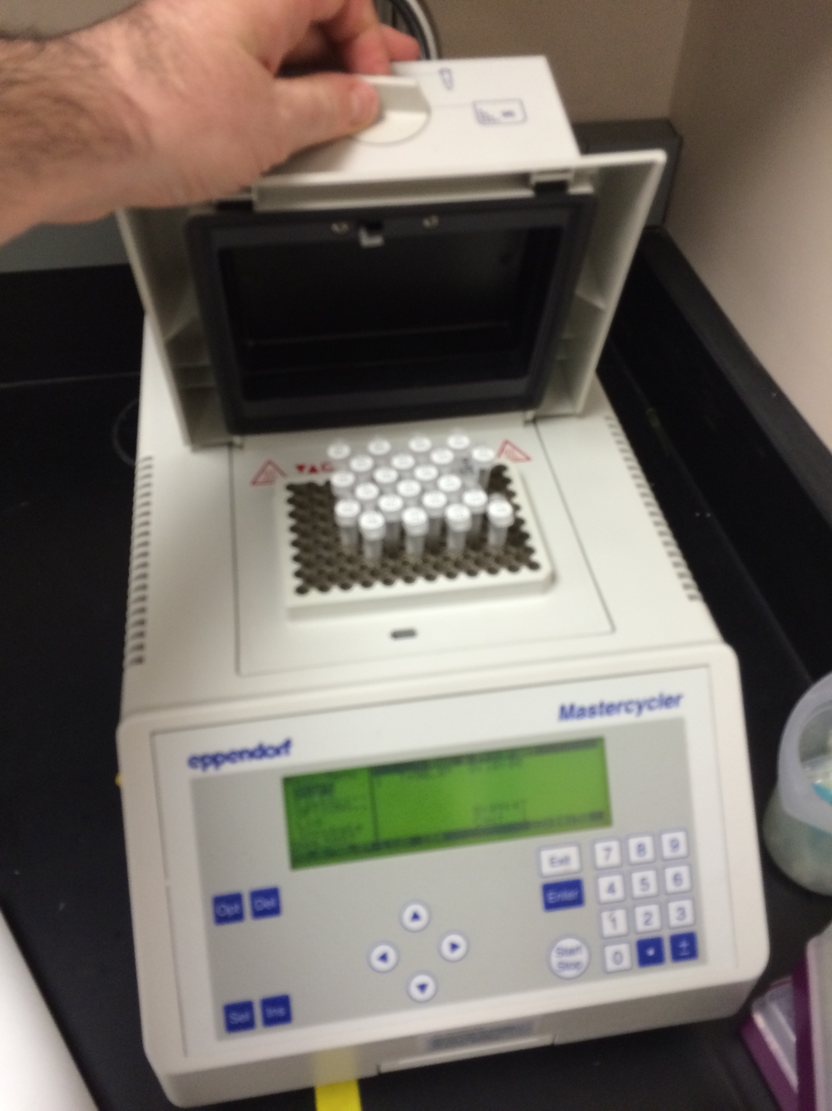
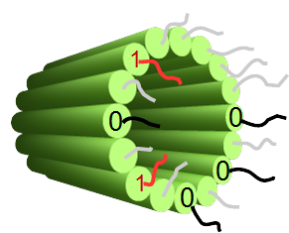
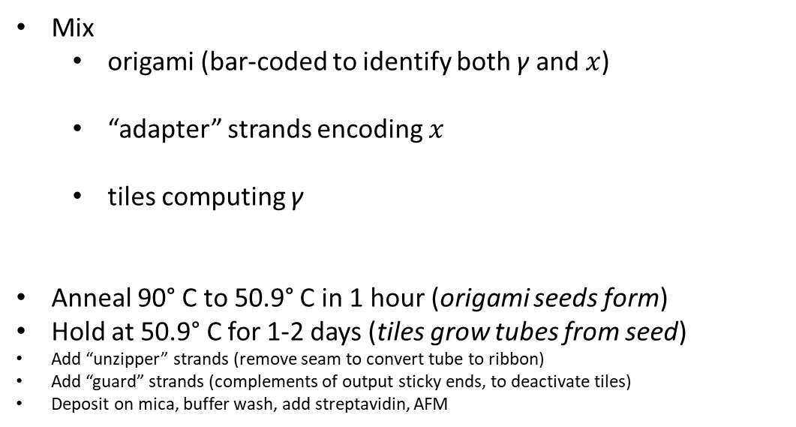
Experimental procedure
To execute circuit γ on input $x∈{\left\{0,1\right\}}^{∗}$:
Mix
  origami (bar-coded to identify both γ and $x$)
  “adapter” strands encoding $x$
  tiles computing γ
Anneal 90° C to 50.9° C in 1 hour (origami seeds form)
Hold at 50.9° C for 1-2 days (tiles grow tubes from seed)
Add “unzipper” strands (remove seam to convert tube to ribbon)
Add “guard” strands (complements of output sticky ends, to deactivate tiles)
Deposit on mica, buffer wash, add streptavidin, AFM
1₂
1₂
1₄
0₄
0₄
1₃
1₄
0₃
0₄
1₄
0₂
0₂
0₅
1₅
1₅
1₅
0₅
0₅
1₃
0₃
Notes:
Here’s the full experimental procedure. To execute a circuit $γ$ on input bits x: mix together the
origami, bar-coded to identify both $γ$ and x
adapter strands to encode the input x
the appropriate hundred tiles implementing the circuit $γ$
anneal slowly from 90C to about 50C, this lets the origami seeds assemble
hold there for a while, which lets the tiles grow onto the seeds
then there’s a bunch of important steps I don’t have time to explain,
and then we image.

Slide 31
Results
def test_parity_100101():
actual = parity('100101')
expected =
assertEquals(actual, expected)
Notes:
Now lets look at the results.
What do we expect to see?
An origami rectangle, with 3 digits written on it.
You’ll have to take my word that the 3 digits always represent the proper experiment.
and streptavidins to the right of there, showing how the 1’s moved around as the circuit grew.

Slide 32
Sorting
Parity
MultipleOf3
Palindrome
100 nm
Copy
Recognise21
Zig-Zag
Notes:
Our first circuit was sorting. As we scan from left to right, we should see the 1’s move from the bottom to the top, and we do.
Lazy sorting is similar… it takes longer for the 1’s to reach the top, but they get there.
This shows 3 different runs of lazy sorting on the same input, showing that while the 1’s always get to the top, unlike normal sorting, they don’t do it the same way every time.
Rule 110 on 6 bits doesn’t do much interesting, but it does it very well.
And here are the palindrome circuit and the multiple-of-3 circuit.

Slide 33
LazyParity
LazySorting
RandomWalkingBit
Waves
AbsorbingRandomWalkingBit
LeaderElection
Notes:
Here’s parity, recall
a stripe of 1’s should appear if the initial number of 1’s is odd,
eventually all 0’s otherwise.
Lazy parity does the same thing, only slower.
This is the circuit that counts 63 bitstrings before repeating; as you can see, reading this one is a little tougher.
Waves is an interesting randomized circuit I didn’t show yet: this has a stripe of 1’s along the bottom, but occasionally at random the 1 CRESTS to the top before crashing back down.
Most circuits were tested on only a handful of inputs…

Slide 34
FairCoin
Rule110

Slide 35

Counting to 63
Circuit with 63 distinct outputs
1 2 3 …
…62 63 1 2 3 …
42
Is there a 64-counter?
No!
Proof by Tristan Stérin, ENS Lyon & Inria
(Consequence of following theorem: Any bijective Boolean circuit having one output bit that does not depend on all of its input bits cannot compute odd bijections.)

Slide 36
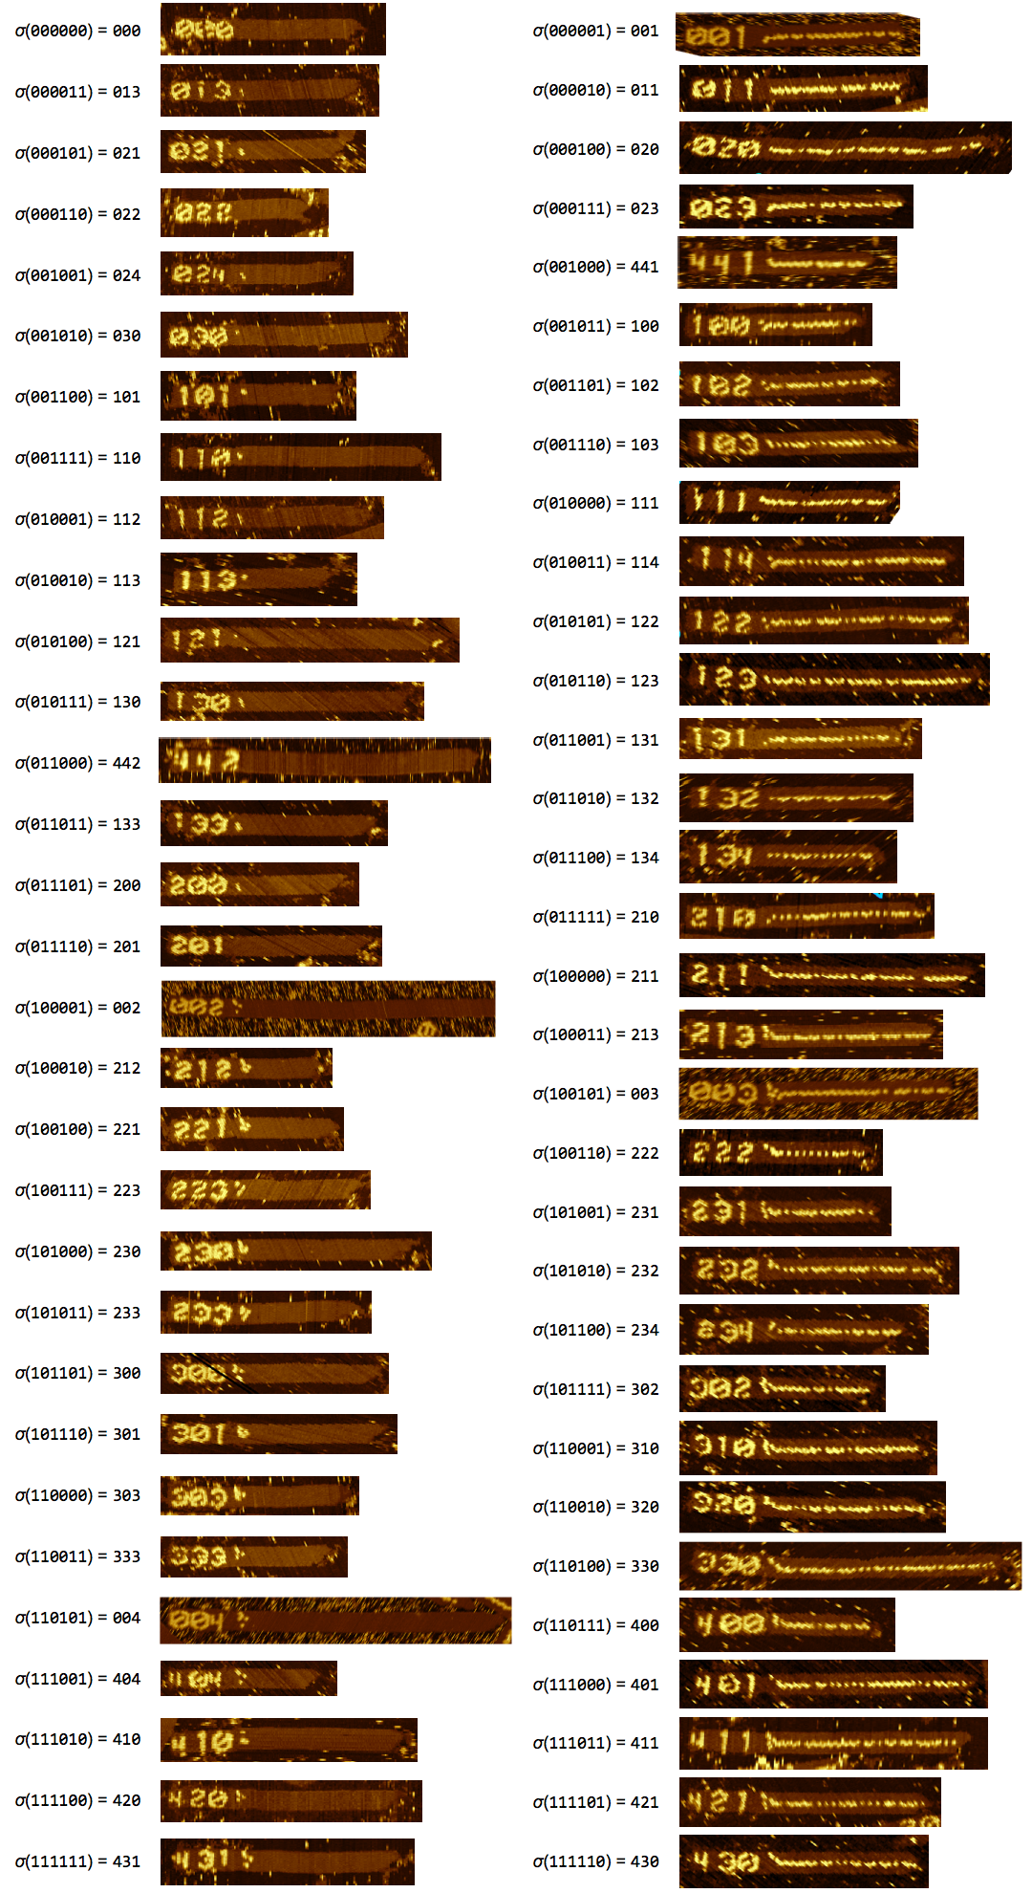
Parity tested on all inputs
2⁶ = 64 inputs with 6 bits
32 inputs with even # of 1’s
32 inputs with odd # of 1’s
We used all 355 tiles in some experiment, so we’ve verified “all tiles work”.
For 14 circuits, every tile for that circuit was used for some input, verifying all gate tiles work “together”.
σ(6-bit input) = 3-digit barcode representing that input
150 nm
Notes:
Parity we tested on all 64 inputs.
32 of them have an even number of 1’s, so we expect no stripe, that’s what you see on the left
The other 32 we expect a stripe of 1’s; that’s on the right.
This is one way to do a so-called “full coverage test”, but we can imagine others:
All 356 of the tiles in our library were used in some experiment, so we’ve verified that in some sense “all tiles work”
For 14 of the circuits, although we didn’t test every input, we tested enough inputs that every tile in that circuit got used for some input, so we’ve verified for those that all gate tiles work “together”.
Now, the images I’ve shown so far are obviously cherry-picked, so next let’s see some raw data.

Slide 37

12 μm AFM image of parity ribbons for several inputs whose output is 1
error statistics:
seeding fraction: 61% of origami seeds have tile growth into a tube
error rate: 0.03% ± 0.0008 per tile attachment
(1,419 observed errors out of an estimated 4,600,351 tile attachments, comparable to best previous algorithmic self-assembly experiments)
500 nm
Notes:
This is a 12 micron AFM image showing parity on several inputs whose answer is 1.
Zooming in, we expect to see stripes of streptavidins on each ribbon, and we do.
Let’s look at some non-ideal parts of this image.
Here’s a tile attachment error: there is a stripe on this ribbon for a while, and then it disappears, erroneously flipping a 1 into a 0.
Here are ribbons with no origamis attached.
We believe from control experiments that these did not grow on their own, that they were ripped away from origamis, but of course we don’t know for sure.
And finally, the most frustrating and frequent type of error, which we tried several ideas to eliminate but never could:
Several origami seeds have little or no growth of tiles;
There appears to be some energetic barrier to initiating growth.
Now, the numbers I’ll throw up here are very approximate, very back of the envelope, we are still in the process of counting and analyzing data, but these are roughly accurate.
About ½ of origami seeds have significant tile growth into a tube.
Of those, 92% have no bit-flipping error, in other words, the circuit computation is correct.
Now, that looks like an 8% error rate, but bear in mind this is the error rate per tube.
Most tubes are hundreds of nanometers long, corresponding to hundreds to over a thousand tile attachments,
so this implies an error rate per tile attachment of something like 1/10,000,
comparable with the best prior algorithmic self-assembly experiments,
but now demonstrated on a much wider variety of computations.

Slide 38



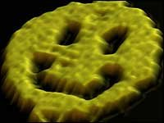
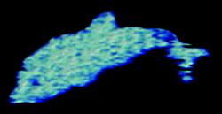
Next big challenge: Algorithmically control shape
We “drew” interesting patterns on a boring shape (infinite rectangle)
Can we grow interesting shapes?
σ_{smiley_face}
σ_{dolphin}
?
?
Theorem: There is a single set T of tile types, so that, for any finite shape S, from an appropriately chosen seed σ_{S} “encoding” S, T self-assembles S.
These tiles are universally programmable for building any shape.
[Complexity of Self-Assembled Shapes. Soloveichik and Winfree, SIAM Journal on Computing 2007]

Slide 39
Thank you!

