Slide 1


The limits of chemical computing
Computation with chemical reaction networks
David Doty
23rd International Meeting on DNA and Molecular Programming
September 2017
Notes:
10/9/2017
1
1

Slide 2










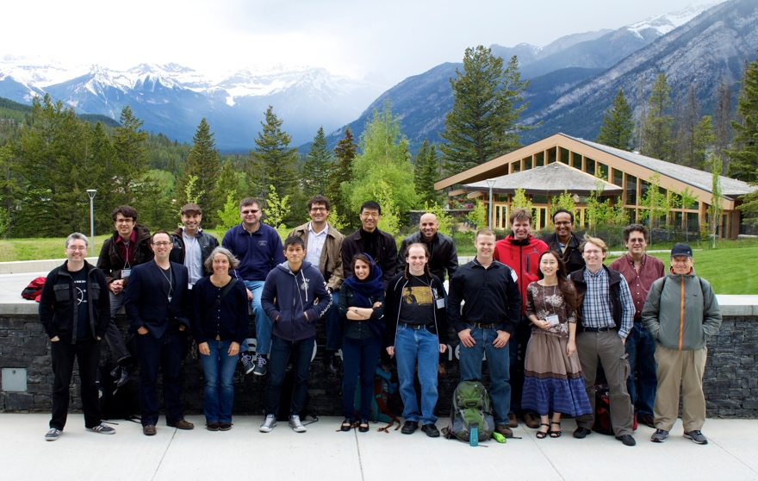


Acknowledgments
Amanda Belleville
UC-Davis
Ho-Lin Chen
NTU
Rachel Cummings
Georgia Tech
Monir Hajiaghayi
UBC
David Soloveichik
UT-Austin
co-authors
Anne Condon
Notes:
10/9/2017
2
2
Doty here!
Initial ideas at workshop

Slide 3
Chemical reaction networks
reactant(s)
R→P₁+P₂
product(s)
monomers
M₁+M₂→D
dimer
catalyst
C+X→C+Y
Traditionally a descriptive modeling language…
Let’s instead use it as a prescriptive programming language
Notes:
What molecules actually do!
Fundamental mathematical structure: it comes up over and over again in different contexts: vector addition systems, Petri nets, commutative semigroups, bounded context-free languages, uniform recurrence equations

Slide 4
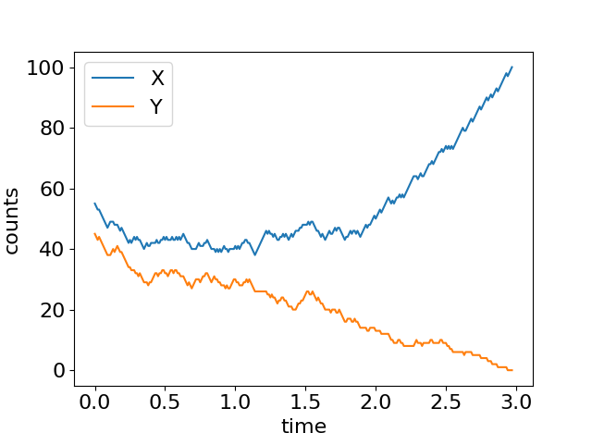
Chemical caucusing
X+Y→U+U
X
U
Y
X+U→X+X
Y+U→Y+Y
distributed algorithm for “approximate majority”:
initial majority (X or Y) quickly overtakes whole population
[Angluin, Aspnes, Eisenstat, A simple population protocol for fast robust approximate majority, DISC 2007]

Slide 5
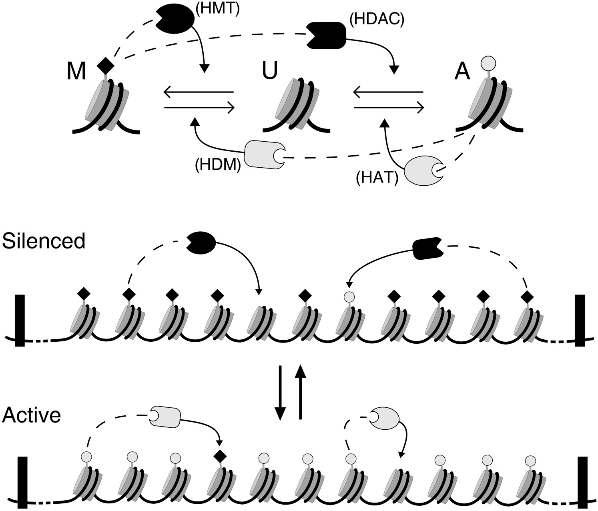
Does chemistry compute?
=
X
U
Y
X
U
Y
≈
X
Y
[Cardelli, Csikász-Nagy. The cell cycle switch computes approximate majority. Nature Scientific Reports 2012]
[Dodd, Micheelsen, Sneppen, Thon. Theoretical analysis of epigenetic cell memory by nucleosome modification, Cell 2007]
[Cardelli, Morphisms of reaction networks that couple structure to function, BMC Systems Biology 2014]

Slide 6












Can we compute with chemistry?
“Not every chemical reaction network describes real chemicals!”, i.e. “where’s the compiler?”
Response: [Soloveichik, Seelig, Winfree, PNAS 2010] showed how to physically implement any chemical reaction network using DNA strand displacement
X₁+X₂→X₃
↔
+
+
→
+
+
+
→
+
Notes:
What molecules actually do!
Fundamental mathematical structure: it comes up over and over again in different contexts: vector addition systems, Petri nets, commutative semigroups, bounded context-free languages, uniform recurrence equations

Slide 7
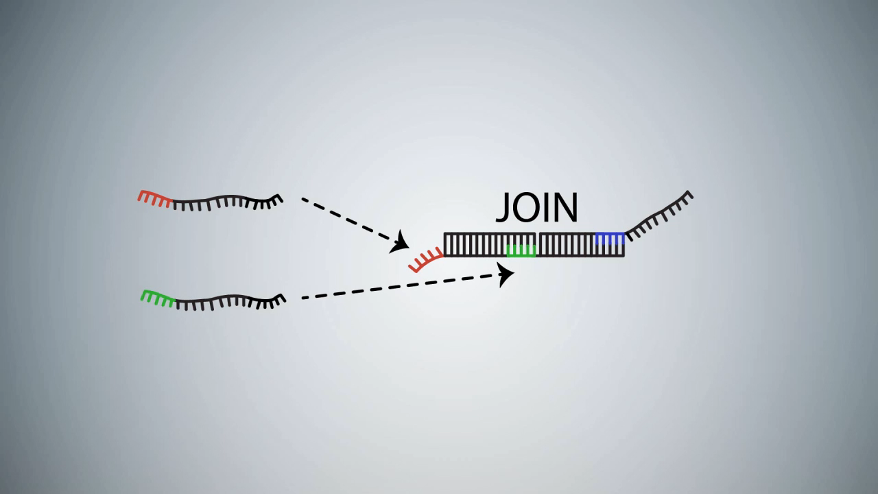
DNA strand displacement implementing A+B→C
video: Microsoft Research Cambridge

Slide 8
Experimental implementations of synthetic chemical reaction networks with DNA
Analog majority computation
Chemical oscillator
relative amount (%)
X+Y→B+B
X+B→X+X
Y+B→Y+Y
A+B→B+B
B+C→C+C
C+A→A+A
2
conc. deriv. (nM/hr)
1
time (hours)
15
30
45
60
[Programmable chemical controllers made from DNA. Chen, Dalchau, Srinivas, Phillips, Cardelli, Soloveichik, Seelig, Nature Nanotechnology 2013.]
[Enzyme-free nucleic acid dynamical systems. Srinivas, Parkin, Seelig, Winfree, Soloveichik, Science 2017.]
time (hours)

Slide 9



Theoretical Computer Science Approach
NP-complete
NP
protein folding
Boolean satisfiability
Hamiltonian path
integer factoring
P
DNA sequence alignment
polynomial factoring
integer multiplication
shortest path
What computations necessarily take a long time and what can be done quickly?
(Computational complexity theory)
What computation is possible and what is not?
(Computability theory)

Slide 10
Outline
Formal definition of chemical reaction networks
What do we mean by “computation” with chemical reactions?
What do we mean by “efficient computation” with chemical reactions?
What is known
What is not yet known

Slide 11
Chemical Reaction Networks (formal definition)
finite set of d species Λ = { A, B, C, D, ... }
A+B→A+C
finite set of reactions: e.g.
k₁
C→A+A
k₂
C+B→C
k₃
configuration x∈ℕ^{d}: molecular counts of each species
Notes:
[d stands for dimension]
[Transition to next slide:] Unless otherwise noted, we’ll say that the rate constants are 1. So suppose we have this set of reactions... and we start in this state...

Slide 12
What is possible:
Example reaction sequence
A B C
α:
A+B→A+C
β:
C→A+A
x =
(2, 2, 0)
α
⟹
A
A
(2, 1, 1)
α
C
β
⟹
B
⟹
...
A
(4, 1, 0)
B
C
α
A
⟹
(4, 0, 1)
...
Notes:
...

Slide 13

What is probable:
Stochastic kinetic model of chemical reaction networks
Solution volume v
reaction type
rate
k
k⋅ #A
k⋅ #A⋅ #B / v
A → …
k
A+B → …
System evolves via a continuous time Markov process:
Pr[next reaction is j^{th} one] = rate of j^{th} reaction / (sum of all reaction rates)
expected time until next reaction is 1 / (sum of all reaction rates)
[McQuarrie 1967, van Kampen, Gillespie 1977]

Slide 14
Relationship to distributed computing
population protocol = list of transitions such as
x,y→x,x a,b→c,d a,a→a,a (null transition)
  Repeatedly, two agents (molecules) are picked at random to interact (react) and change state (species).
A population protocol is a chemical reaction network with
  two reactants, two products per reaction
  unit rate constants
  volume = n = number of agents (never changes)
population protocols ⊊ chemical reactions, but “most” ideas that apply to one model also apply to the other
[Angluin, Aspnes, Diamadi, Fischer, Peralta, Computation in networks of passively mobile finite-state sensors, PODC 2004]

Slide 15
Time complexity in population protocols
pair of agents picked uniformly at random to interact (possibly null interaction)
parallel time = number of interactions / n
  i.e., each agent has O(1) interactions per “unit time”

Slide 16
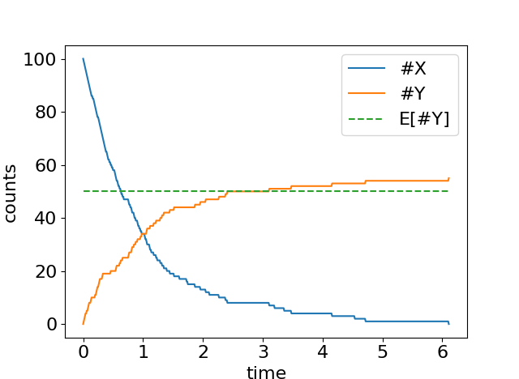
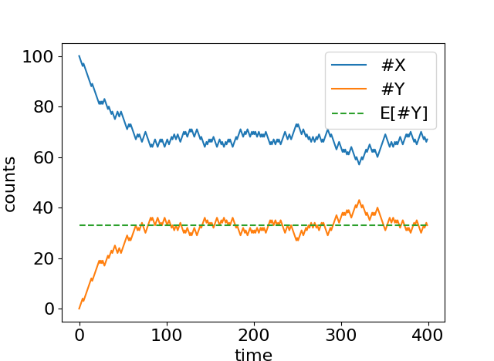
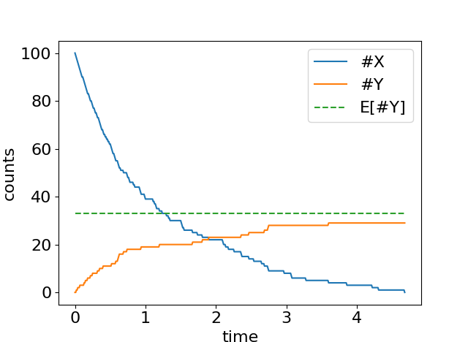
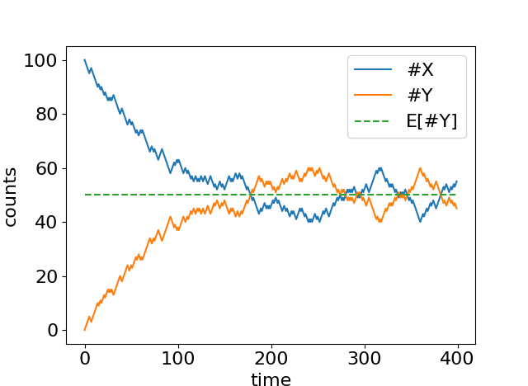
Some simple reactions
1
X Y
X Y
1
1
2
X
1
2
start with n copies of molecule X
n/3
n/3
#Y = n/2 expected at equilibrium
#Y stabilizes, with expected value n/2

Slide 17
Modeling choices in formalizing “Computing with chemistry”
integer counts (“stochastic”) or real concentrations (“mass-action”)?
what is the object being “computed”?
  yes/no decision problem? “number of A’s > number of B’s?”
  numerical function? “make Y become half the amount of X”
guaranteed to get correct answer? or allow small probability of error?
  if Pr[error] = 0, system works no matter the reaction rates
to represent input n₁,…,n_{k}, what is the initial configuration?
  only input species present?
  auxiliary species can be present?
when is the computation finished? when…
  the output stops changing? (convergence)
  the output becomes unable to change? (stabilization)
  a certain species T is first produced? (termination)
require exact numerical answer? or allow an approximation?
first part of talk

Slide 18
Defining stable computation
o is stable
∀
∃
∀
i
x
reactions
o
reactions
o’
reactions
initial
configuration
any reachable
configuration
“correct”
output
correct
output
(assuming finite set of reachable configurations) equivalent to:
The system will reach a correct stable configuration with probability 1.
Notes:
-This is the appropriate notion of determinism here
-Say “such that” when talk about there not existing a path to o’

Slide 19

Speed of computation
How to fairly assess speed?
Like any respectable computer scientist…
1) as a function of input size n (how required time grows with n)
2) ignoring constant factors
n = total molecular count
volume v = O(n)
i.e., require bounded concentration (finite density constraint)

Slide 20
An exponential time difference
B
X
B
X
X
B
n molecules
volume v = O(n)
B
B
X
B
X
X
B
X
B
X
B
X
B
B
X
X
B
B
X
B
X
B
X
X
B
X
B
B
X
A
Y
X
B
one of these is always count ≥ n/2
X
X
B
B
X
X
B
B
B+X→B+B
A+B→Y+B
distributed computing terms:
epidemic
rumor/gossip spreading
chemical term:
autocatalysis
A+B→Y+B
propensity: #A·#B / v = O(1/n)
expected time to
produce Y:
O(n)
O(log n)
Notes:
-Suppose you want A to know there is a B, or in other words for Y to get produced if both A and B are present.
-B recruits X’s to become B, which can in turn recruit other X’s...
-Exponential amplification!
-n is large (Avogadro scale)

Slide 21
Definition of predicate (decision problem) computation
goal: compute predicate φ: ℕ^{k}→{Y,N}, e.g., φ(a,b)=Y ⇔ a>b
input specification: designate subset Σ ⊆ Λ as “input” species
  in valid initial configurations all molecules are from Σ, e.g., {100 A, 55 B}
output specification: partition species Λ into “yes” voters Λ_{Y} and “no” voters Λ_{N}
  ψ(o) = Y (configuration o outputs “yes”) if vote is unanimously yes: o(s)>0 ⇔ s∈Λ_{Y}
  ψ(o) = N (configuration o outputs “no”) if vote is unanimously no: o(s)>0 ⇔ s∈Λ_{N}
  configuration o has undefined output otherwise: (∃ s∈Λ_{N}, s’∈Λ_{Y}) o(s)>0 and o(s’)>0
o is stable if ψ(o) = ψ(o’) for all o’ reachable from o
[Angluin, Aspnes, Diamadi, Fischer, Peralta, Computation in networks of passively mobile finite-state sensors, PODC 2004]

Slide 22
Examples of predicate computation
Detection: φ(a,b) = Y ⇔ b > 0
Counting: φ(a,b) = Y ⇔ b > 1
b+a → b+b
b+b→y+y O(n) time
y+b→y+y O(log n) time
y+a→y+y O(log n) time
a votes no; b votes yes
E[time] = O(log n)
exponential time difference!
a
a,b vote no; y votes yes
E[time] = O(n)
a
b
a
b
b
a
b
a
b
a
b
a
b

Slide 23
Examples of predicate computation
Majority: φ(a,b) = Y ⇔ a > b
A+B → a+b (both become “followers” but preserve difference between A’s and B’s)
A+b → A+a (leader changes vote of follower)
B+a → B+b (leader changes vote of follower)
O(n) time if a – b = O(1)
O(log n) time if a – b > 0.01n
[Draief, Vojnovic. Convergence speed of binary interval consensus. SIAM Journal on Control and Optimization, 50(3):1087–1109, 2012]
[Mertzios, Nikoletseas, Raptopoulos, Spirakis, Determining Majority in Networks with Local Interactions and very Small Local Memory, Distributed Computing 2015]

Slide 24
Examples of predicate computation
Parity: φ(a)=Y ⇔ a is odd
a = A_{o} (subscript o/e means ODD/EVEN, and capital A means it is leader)
A_{o}+A_{o}→ A_{e}+a_{e}
A_{e}+A_{e} → A_{e}+a_{e}
A_{o}+A_{e} → A_{o}+a_{o}
two leaders XOR their parity, and one becomes follower
O(n log n) time
O(n) bottleneck transition before leader reaches count 1, then O(n log n) coupon collector for leader to encounter each follower
A_{o}+a_{e} → A_{o}+a_{o}
A_{e}+a_{o} → A_{e}+a_{e}
leader overwrites
bit of follower
possible to optimize to O(n)
[Angluin, Aspnes, Eisenstat, DISC 2006]

Slide 25
Definition of function computation
goal: compute function f: ℕ^{k}→ℕ, e.g., f(a,b) = 2a + b/2
input specification: designate subset Σ ⊆ Λ as “input” species
  valid initial configuration: all molecules are from Σ, e.g., {100 a, 100 b}
output specification: designate one species y∈Λ whose count is the output
recall: o is stable if o(y) = o’(y) for all o’ reachable from o

Slide 26
Examples of function computation
division by 2: f(a) = a/2
multiplication by 2: f(a) = 2a
a+a→y
exponential time difference!
a→y+y
E[time] = O(n)
(last transition is bottleneck: has count ≤ 3 of a)
E[time] = O(log n)
y
a
y
y
y
a
y
a
a
a
a
y
y
a
a
y
a
y

Slide 27
Examples of function computation
addition: f(a,b) = a+b
subtraction: f(a,b) = a–b
a→y
b→y
a→y
b+y→
E[time] = O(log n)
E[time] = O(n) if a – b = O(1) initially
(last transition is bottleneck)

Slide 28
Examples of function computation
subtract constant: f(a) = a–1
maximum: f(a,b) = max(a,b) = a+b–min(a,b)
a+a→ a+y
a→y+a₂
b→y+b₂
E[time] = O(n)
addition
minimum: f(a,b) = min(a,b)
a₂+b₂→k
minimum
a+b→y
k+y→
subtraction
E[time] = O(n) if a – b = O(1) initially
E[time] = O(n) (uses minimum and subtraction
as “subroutines”)

Slide 29
Examples of function computation
constant: f(a) = 1
a→y
a.k.a. “leader election”
y+y→y
E[time] = O(n)

Slide 30
Limits of stable computation (unbounded time)
Predicates
Functions
φ is stably computable if and only if φ is semilinear.
semilinear = Boolean combination of threshold and mod predicates: take weighted sum s = w₁∙a₁ + … w_{k}∙a_{k} of inputs and ask if
  s > constant c?
  s ≡ c mod m for constants c,m?
f is stably computable if and only if graph(f) = { (a,y) | f(a)=y } is semilinear.
piecewise linear, with semilinear predicate to determine which piece.
a+b a–b 2a a/2 min(a,b) a+1 a–1
f(a) = 2a–b/3 if a+b is odd, else f(a) = a/4+5b
NOT a² 2ª 2a if a is prime, else 3a
a>b? a=b? a is odd? a>0? a>1?
All semilinear predicates/functions are known to be computable in O(n) time.
NOT a=b²? a is a power of 2? a is prime?
[Angluin, Aspnes, Diamadi, Fischer, Peralta, Computation in networks of passively mobile finite-state sensors, PODC 2004]
[Angluin, Aspnes, Eisenstat, Stably computable predicates are semilinear, PODC 2006]
[Chen, Doty, Soloveichik, Deterministic function computation with chemical reaction networks, DNA 2012]
[Doty, Hajiaghayi, Leaderless deterministic chemical reaction networks, DNA 2013]

Slide 31
What is known to be computable in less than time O(n)?
Predicates
Functions
Boolean combination of detection predicates
  “detection” means φ(a) = “a > 0?”
ℕ-linear functions (coefficients are nonnegative integers)
e.g., f(a,b) = 2a + 3b
a→y+y
b→y+y+y
φ(a,b,c) = a>0 OR (b>0 AND c=0)
i.e., constant except when a variable changes from 0 to positive
[Angluin, Aspnes, Eisenstat, Fast computation by population protocols with a leader, DISC 2006]
[Chen, Doty, Soloveichik, Deterministic function computation with chemical reaction networks, DNA 2012]

Slide 32
Known time lower bounds: leader election/majority
Leader election
Majority (and other “explicit” predicates)
Leader election (computing the constant function f(a)=1) requires Ω(n) time
Majority (and many other “explicit” predicates such as equality) require Ω(n / polylog n) time, even with up to ½ log log n states.*
If the protocol satisfies a technical condition called “output dominance”, then even with up to log n states, Ω(n^{0.999}) time is required.**
*[Alistarh, Aspnes, Eisenstat, Gelashvili, Rivest, SODA 2017]
[Doty, Soloveichik, Stable leader election in population protocols requires linear time, DISC 2015]
**[Alistarh, Aspnes, Gelashvili, SODA 2018]: “output dominance” = changing positive counts of states in a stable configuration leaves it able to reach a stable configuration with the same output

Slide 33
Known time lower bounds: “most” predicates/functions
Informal: “most” semilinear predicates and functions not known to be computable in o(n) time, actually require at least O(n) time to compute
Definition: φ: ℕ^{k}→{Y,N} is eventually constant if there is m∈ℕ so that φ(a) = φ(b) for all a,b with all components ≥ m
Definition: f: ℕ^{k}→ℕ is eventually ℕ-linear if there is m∈ℕ so that f(a) is ℕ-linear for all a with all components ≥ m
  Both definitions allow exceptions “near a face of ℕ^{k}”
Formal theorem: Every predicate that is not eventually constant, and every function that is not eventually ℕ-linear, requires at least time O(n) to compute.
  They’re all computable in at most O(n) time, so this settles their time complexity.
[Doty, Soloveichik, Stable leader election in population protocols requires linear time, DISC 2015]
[Belleville, Doty, Soloveichik, Hardness of computing and approximating predicates and functions with leaderless population protocols, ICALP 2017]

Slide 34
What is currently known/unknown
 | Predicates | Functions
computable in O(log n) time | detection a>0 AND (b>0 OR c=0) | ℕ-linear 3a + b + 2c
not computable in less than O(n) time | non-eventually constant a>b? a=b? a is odd? | non-eventually ℕ-linear a/2 a–b a+1 a–1 1 min(a,b) max(a,b) max(a, min(b + 3, 2c)) – c – 1
unknown (best known protocol is O(n) time) | eventually constant but not constant on positive values a>1? | eventually ℕ-linear but not ℕ-linear
f(a)
a if a>1,
0 otherwise
f(a) =
a

Slide 35
Other modeling choices?

Slide 36
Modeling choices in formalizing “Computing with chemistry”
integer counts (“stochastic”) or real concentrations (“mass-action”)?
what is the object being “computed”?
  yes/no decision problem? “number of A’s > number of B’s?”
  numerical function? “make Y become double the amount of X”
guaranteed to get correct answer? or allow small probability of error?
  if Pr[error] = 0, system works no matter the reaction rates
to represent an input n₁,…,n_{k}, what is the initial configuration?
  only input species present?
  auxiliary species can be present?
when is the computation finished? when…
  the output stops changing? (convergence)
  the output becomes unable to change? (stabilization)
  a certain species T is first produced? (termination)
require exact numerical answer? or allow an approximation?
first part of talk
summarized in next few slides

Slide 37
Auxiliary species present initially ≈ “initial leader”
Instead of starting with { 100 A } to represent input value 100, start with { 1 L, 100 A }
some predicates/functions get “easier” (i.e., it’s easy to think of the reactions)
parity: φ(a) = “a is odd”
without a leader
A_{o}+A_{o}→ A_{e}+a_{e}
A_{e}+A_{e} → A_{e}+a_{e}
A_{o}+A_{e} → A_{o}+a_{o}
A_{o}+a_{e} → A_{o}+a_{o}
A_{e}+a_{o} → A_{e}+a_{e}
L_{e}+A→L_{o}
L_{o}+A→L_{e}
with a leader L_{e}
But fundamental computability doesn’t change: exactly the semilinear predicates/functions can be computed (same as without a leader).
[Angluin, Aspnes, Diamadi, Fischer, Peralta, PODC 2004] [Angluin, Aspnes, Eisenstat, PODC 2006] [Chen, Doty, Soloveichik, DNA 2012] [Doty, Hajiaghayi, DNA 2013]

Slide 38
Convergence vs stabilization and leader vs anarchy
#
Y
=3
#
Y
=2
#
Y
=2
#
Y
=2 stable
...
...
initial
convergence
stabilization
Theorem: Without a leader, all non-eventually constant predicates and non-eventually-ℕ-linear functions require at least O(n) stabilization time. [Belleville, Doty, Soloveichik, ICALP 2017]
Previous work: With a leader, all semilinear predicates/functions can be computed in at most O(log⁵ n) convergence time. [Angluin, Aspnes, Eisenstat, DISC 2006]
Conjecture: With a leader, all non-detection predicates and non-ℕ-linear functions require at least O(n) stabilization time.
Conjecture: Without a leader, all non-detection predicates and non-ℕ-linear functions require at least O(n) convergence time.

Slide 39
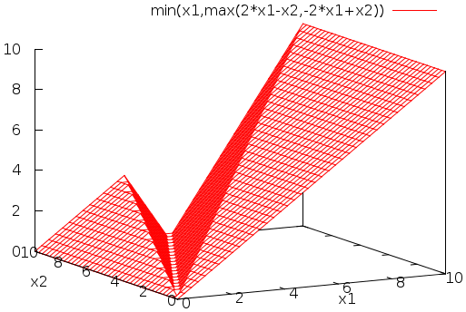
What if we use real-valued concentrations?
Theorem: A function is stably computable by an integer-valued chemical reaction network if and only if it is semilinear.
Theorem: A function is stably computable by a real-valued chemical reaction network if and only if it is continuous and piecewise linear.
f(n)
semilinear example
continuous piecewise linear example
n
[Angluin, Aspnes, Eisenstat, PODC 2006]
[Chen, Doty, Soloveichik, DNA 2012]
[Chen, Doty, Soloveichik, ITCS 2014]

Slide 40
What if we allow a small probability of error? (i.e., allow reaction rates to influence outcome)
Theorem: A function is computable with probability of error < 1% by an integer-valued chemical reaction network if and only if it is computable by any algorithm whatsoever…
[Soloveichik, Cook, Bruck, Winfree, Natural Computing 2008]
… “efficiently” (polynomial-time slowdown) …
f(n)
computable example
… if we have an initial leader.
11
Furthermore, computation doesn’t merely converge to the correct answer eventually, but can be made “terminating”: producing a molecule T signaling when the computation is done.
(provably impossible when Pr[error] = 0)
7
5
3
2
Conjecture: Even without a leader, any computable function can be efficiently computed with high probability.
n

Slide 41
What if we use real-valued concentrations… and allow reaction rates to influence outcome??
Theorem: A function is computable by a real-valued chemical reaction network using mass-action kinetics if and only if it is computable by any algorithm whatsoever.
[Fages, Le Guludec, Bournez, Pouly. Strong Turing completeness of continuous chemical reaction networks and compilation of mixed analog-digital programs. Computational Methods in Systems Biology – CMSB 2017]
mass-action kinetics:
[X] = –k₁[X] + k₂[Y][Z]
… with only a polynomial-time slowdown.
k₁
X → Y+Y
[Y] = 2k₁[X] – k₂[Y][Z]
[Bournez, Graça, Pouly. Polynomial time corresponds to solutions of polynomial ordinary differential equations of polynomial length. Journal of the ACM 2017]
k₂
Y+Z → X
[Z] = – k₂[Y][Z]

Slide 42
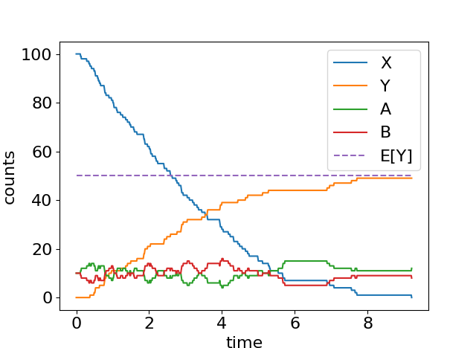
Fast approximate division by 2
n = 100 ε = 0.1
initial configuration:
{ n X, εn A, εn B }
X+A→B+Y
X+B→A
guaranteed to get
Y = n/2 ± εn
E[time] = O(log n) / ε
[Belleville, Doty, Soloveichik, Hardness of computing and approximating predicates and functions with leaderless population protocols, ICALP 2017]

Slide 43
Thank you!
Questions?
Proofs of conjectures?
Criticism of model?
  suggestions: 1) lack of reverse reactions (energy dissipated = ∞), 2) assumption of single initial copy of leader, 3) reactions aren’t mass-conserving, 4) what about leak reactions?, 5) no discussion of diffusion rates, 6) this has nothing to do with how biological cells compute

