Slide 1


The computational power of execution bounded chemical reaction networks
David Doty, Ben Heckmann
May 2024
Seminar on the Mathematics of Reaction Networks
Notes:
5/8/2024
1
1

Slide 2




Acknowledgments
Ben Heckmann
Undergraduate student
Technische Universität München, UC Davis
Matthias Köppe
Professor
UC Davis
For teaching us about “Theorems of the Alternative”
Notes:
5/8/2024
2
2
Doty here!
Initial ideas at workshop

Slide 3
Chemical reaction networks
reactant(s)
R→P₁+P₂
product(s)
monomers
M₁+M₂→D
dimer
catalyst
C+X→C+Y
Traditionally a descriptive modeling language…
Let’s instead use it as a prescriptive programming language
Notes:
What molecules actually do!
Fundamental mathematical structure: it comes up over and over again in different contexts: vector addition systems, Petri nets, commutative semigroups, bounded context-free languages, uniform recurrence equations

Slide 4



Theoretical computer science approach
What computation is possible and what is not?

Slide 5
Outline
Formal definition of chemical reaction networks
Execution bounded chemical reaction networks and linear potential functions
What is “computation” with chemical reactions?
Limitations of computation with execution bounded chemical reaction networks

Slide 6
Chemical Reaction Network (CRN)
finite set of d species Λ = { A, B, C, D, ... }
finite set of reactions: e.g.
A+B→A+C
C→A+A
C+B→C
state x∈ℕ^{d}: molecular counts of each species
Notes:
[d stands for dimension]
[Transition to next slide:] Unless otherwise noted, we’ll say that the rate constants are 1. So suppose we have this set of reactions... and we start in this state...

Slide 7
What is possible:
Example execution (reaction sequence)
A B C
α:
A+B→A+C
β:
C→A+A
x =
(2, 2, 0)
α
⟹
A
A
(2, 1, 1)
α
C
β
⟹
B
⟹
...
A
(4, 1, 0)
B
C
α
A
⟹
(4, 0, 1)
...
Notes:
...

Slide 8
Key property of reachability: additivity
If we can reach from state x to y, written x ⇒ y, then for all c ∈ ℕ^{d}, x+c ⇒ y+c
  The presence of extra molecules (represented by c) cannot prevent reactions from occurring.
c =
x
+ c
y
+ c
α
β
α
⟹
⟹
⟹

Slide 9
Notation
For vectors x,y ∈ ℕ^{d}
  x ≦ y: x(i) ≤ y(i) for 1 ≤ i ≤ d (1,2) ≦ (1,2)
  x ≤ y: x ≦ y and x ≠ y (1,2) ≤ (1,4)
  x < y: x(i) < y(i) for 1 ≤ i ≤ d (1,2) < (3,4)
  If x ≧ 0, x is nonnegative.
  If x ≥ 0, x is semipositive.
  If x > 0, x is positive.

Slide 10
Outline
Formal definition of chemical reaction networks
Execution bounded chemical reaction networks and linear potential functions
What is “computation” with chemical reactions?
Limitations of computation with execution bounded chemical reaction networks

Slide 11
Execution bounded CRNs
Definition: A CRN C is execution bounded from state x if all executions starting at x are finite.
Why prefer execution bounded CRNs?
  Wet lab implementations of CRNs use up “fuel” to execute reactions; execution bounded CRNs limit the amount of fuel needed
  Easier to reason about: as long as reactions keep happening, they make “progress” towards reaching a final state.

Slide 12
Self-covering executions
Easy Lemma: CRN C is not execution bounded from x₀ if and only if there is an execution (x₀, x₁, x₂, …) that is self-covering: x_{i} ≦ x_{k} for some i < k.
⇒: Dickson’s Lemma: If (x₀, x₁, x₂, …) is any infinite sequence of vectors from ℕ^{d}, then for some i < k , x_{i} ≦ x_{k}. (easy to show by induction on dimension d) So if C has an infinite execution, it is self-covering.
x_{k}
≦
⇐: If an execution is self-covering, by additivity we can repeat indefinitely the reactions leading from x_{i} to x_{k}, so C is not execution bounded from x₀.
x_{i}
x₀
x₁
x₂
x₃ ≧ x₁
α
β
α
β
α
β
…
⟹
⟹
⟹
⟹
⟹
⟹
⟹

Slide 13
Linear potential function
Definition: Φ: ℕ^{d}→ℝ_{≥0} is a linear potential function for a CRN if it is a nonnegative linear function of states that every reaction strictly decreases.
Example:
  A+A→B+C
  B+B→A
  A linear potential function Φ(x) = v_{A}∙x(A) + v_{B}∙x(B) + v_{C}∙x(C) must satisfy 2v_{A} > v_{B}+v_{C} and 2v_{B} > v_{A} … v_{A}=v_{B}=1 and v_{C}=0 works.
A coefficient v_{S} assigns a nonnegative “mass” to species S, and every reaction removes a positive amount of mass from the system.
By clearing denominators, we can assume each v_{S} is an integer, so each reaction decreases Φ by at least 1.

Slide 14
Linear potential functions characterize execution bounded CRNs
Theorem: A CRN has a linear potential function if and only if it is execution bounded from every state.
Forward direction is easy: Since each reaction reduces Φ by at least 1, at most Φ(x) reactions are possible from any state x.

Slide 15
Key technical tool for reverse direction
Theorem: (Gale 1960) “Theorem of the Alternative” (similar to Farkas’ Lemma): Let M be a matrix. Then exactly one of the following statements is true:
  There is a vector u ≥ 0 such that Mu ≧ 0.
  There is a vector v ≥ 0 such that vM < 0.
[David Gale. The Theory of Linear Economic Models. University of Chicago press, 1960.]
1. Either the cone of M’s column vectors intersects the nonnegative orthant:
2. Or it doesn’t, and then some hyperplane (dashed line) separates that cone from the nonnegative orthant:
x₁
u = (2,1,0)
v = (1,3)
Mu = 2x₁+x₂
vM < 0 ⇒
(∀i) v∙x_{i} < 0
x₂
x₃
M = [x₁ x₂ x₃]
x₁
x₃
x₂

Slide 16

CRN is execution bounded from every state ⇒ it has a linear potential function
α
β
Let M be the stoichiometric matrix, e.g.
α: A→B + 2C
β: 3B + C→A + B + C
If u = (2,1) is a vector indicating “do reaction α twice and reaction β once”, then the vector Mu = (–1,0,4) indicates how species counts change.
Claim: There is no u ≥ 0 such that Mu ≧ 0; suppose otherwise. Then from any sufficiently large state x, we can execute reactions in u, reaching from x to y = x + Mu, where y ≧ x, i.e., a self-covering execution, not possible since the CRN is execution bounded from x.
Then there is a vector v ≥ 0 such that vM < 0. Let v be the coefficients of a linear function Φ(x) = v∙x. Then vM < 0 means each reaction decreases Φ: it is a linear potential function. QED
$$M= \left(\begin{matrix}−1 & 1 \\ 1 & −2 \\ 2 & 0\end{matrix}\right)$$
A
B
C

Slide 17
Outline
Formal definition of chemical reaction networks
Execution bounded chemical reaction networks and linear potential functions
What is “computation” with chemical reactions?
Limitations of computation with execution bounded chemical reaction networks

Slide 18
Defining stable computation
o is stable
∀
∃
∀
i
x
reactions
o
reactions
o’
reactions
initial
state
any reachable
state
“correct”
output
correct
output
(assuming finite set of reachable states) equivalent to:
The system will reach the correct output with probability 1.
Notes:
-This is the appropriate notion of determinism here
-Say “such that” when talk about there not existing a path to o’

Slide 19
Definition of predicate (decision problem) computation
goal: compute predicate φ: ℕ^{k}→{Y,N}, e.g., φ(a,b)=Y ⇔ a≥b
input specification: designate subset Σ ⊆ Λ as “input” species
  in valid initial states all molecules are from Σ, e.g., {100 A, 55 B}
output specification: partition species Λ into “yes” voters Λ_{Y} and “no” voters Λ_{N}
  ψ(o) = Y (state o outputs “yes”) if vote is unanimously yes: o(S)>0 ⇔ S∈Λ_{Y}
  ψ(o) = N (state o outputs “no”) if vote is unanimously no: o(S)>0 ⇔ S∈Λ_{N}
  state o has undefined output otherwise: (∃ S∈Λ_{N}, S’∈Λ_{Y}) o(S)>0 and o(S’)>0
o is stable if ψ(o) = ψ(o’) for all o’ reachable from o
[Angluin, Aspnes, Diamadi, Fischer, Peralta, Computation in networks of passively mobile finite-state sensors, PODC 2004]

Slide 20
Examples of predicate computation
Detection: φ(a,b) = Y ⇔ b > 0
B+A → B+B
A votes no; B votes yes
B
B
A
B
A
A
B
A
B
A
B
A
B
A

Slide 21
Examples of predicate computation
Parity: φ(a)=Y ⇔ a is odd
input species A_{o} (subscript o/e means ODD/EVEN, and capital A means it is leader)
A_{o}+A_{o}→ A_{e}+a_{e}
A_{e}+A_{e} → A_{e}+a_{e}
A_{o}+A_{e} → A_{o}+a_{o}
two leaders XOR their parity, and one becomes follower
Not execution bounded!
A_{o}+a_{e} → A_{o}+a_{o}
A_{e}+a_{o} → A_{e}+a_{e}
leader overwrites
bit of follower

Slide 22
Limits of stable computation
Theorem: φ: ℕ^{k}→{Y,N} is stably computable by a CRN if and only if φ is semilinear.
semilinear = Boolean combination of threshold and mod predicates:
take weighted sum s = w₁∙a₁ + … w_{k}∙a_{k} of inputs and ask if
  s > constant c?
  s ≡ c mod m for constants c,m?
a>b? a=b? a is odd? a>1? a>1 and b is odd?
NOT a=b²? a is a power of 2? a is prime?
[Angluin, Aspnes, Diamadi, Fischer, Peralta, Computation in networks of passively mobile finite-state sensors, PODC 2004]
[Angluin, Aspnes, Eisenstat, Stably computable predicates are semilinear, PODC 2006]

Slide 23
Outline
Formal definition of chemical reaction networks
Execution bounded chemical reaction networks and linear potential functions
What is “computation” with chemical reactions?
Limitations of computation with execution bounded chemical reaction networks

Slide 24
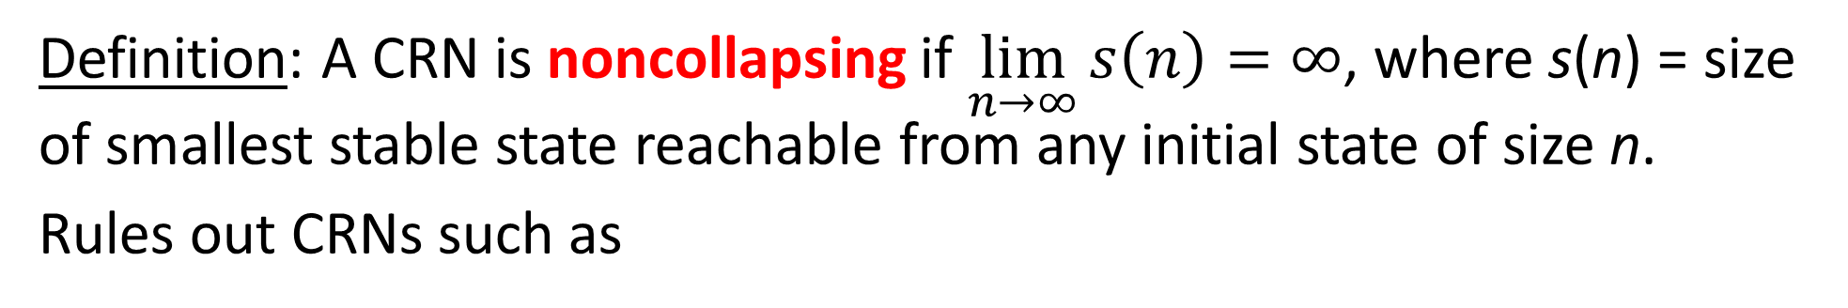
Noncollapsing CRNs
Definition: A CRN is noncollapsing if $\lim_{n→∞}{s\left(n\right)=∞}$, where s(n) = size of smallest stable state reachable from any initial state of size n.
Rules out CRNs such as
A_{e}
A_{o}+A_{o}→ A_{e}
A_{e}+A_{e} → A_{e}
A_{o}+A_{e} → A_{o}
A_{o}
A_{o}
A_{o}
A_{e}
A_{o}
which computes parity but always ends up with a single voter.

Slide 25
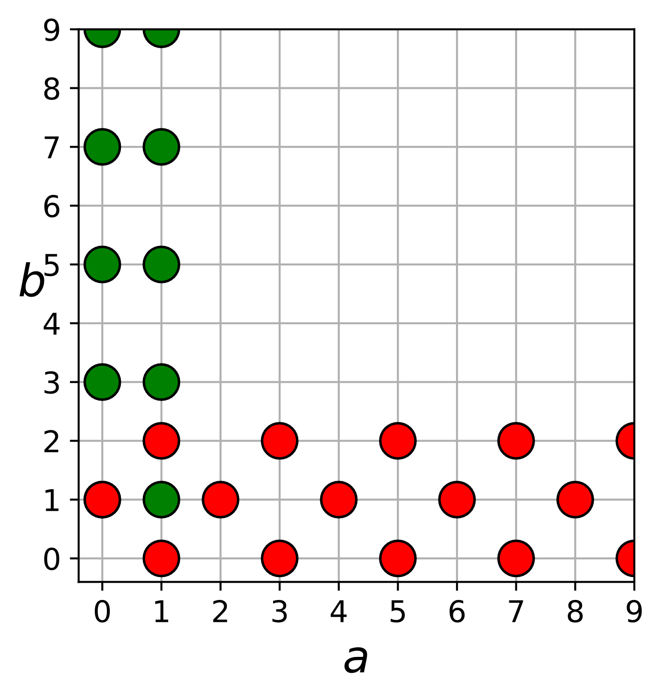
Eventually constant predicates
Definition: A φ: ℕ^{k}→{Y,N} is eventually constant if, for some c ∈ ℕ, φ(x) is constant on all inputs x ≧ (c,c,…,c).
Example of eventually constant predicate:
a < 2 and b is odd, or b < 3 and a+b is odd
Non-eventually constant predicates:
majority (a≥b?)
parity (a is odd?)
equality (a=b?)
and most anything interesting.
inputs ≧ (3,3)
all have output “no”

Slide 26
Limitations of execution bounded CRNs
Theorem: If a CRN stably computing φ is noncollapsing and execution bounded from every input state, then φ is eventually constant.
Proof: complex.
Proof that such CRNs cannot compute parity (a is odd?):
Start with {A}, CRN can reach to stable “yes” state s₁.
Add 1 A. The state s₁+{A} is reachable from {2A}, so the CRN can reach from there to a stable “no” state s₂.
Add 1 A. The state s₂+{A} is reachable from {3A}, so the CRN can reach from there to a stable “yes” state s₃.
…
⟹
Y₁
Y₂
⟹
N₁
N₂
N₁
Y₁
Y₂
…
A
A
⟹
A
A
A
A
Y₃
Y₂
{A}
+ {A}
s₁
+ {A}
s₂
+ {A}
s₃
+ {A}
+ {A}

Slide 27
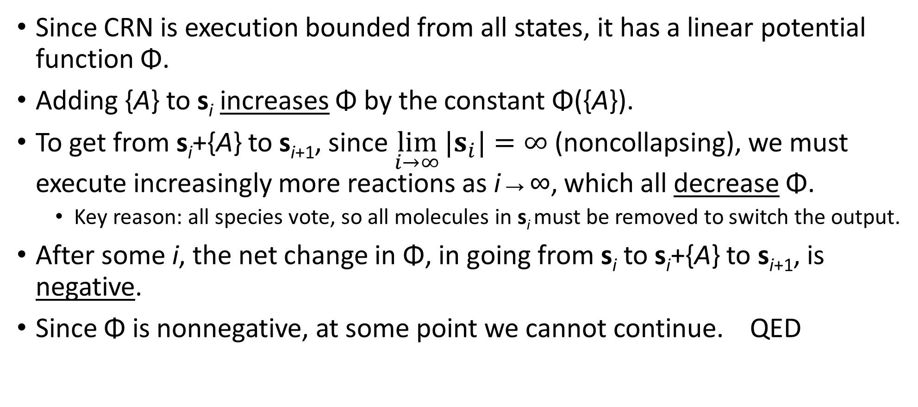
Limitations of execution bounded CRNs
Since CRN is execution bounded from all states, it has a linear potential function Φ.
Adding {A} to s_{i} increases Φ by the constant Φ({A}).
To get from s_{i}+{A} to s_{i+1}, since $\lim_{i→∞}{|s_{i}|=∞}$ (noncollapsing), we must execute increasingly more reactions as i→∞, which all decrease Φ.
  Key reason: all species vote, so all molecules in s_{i} must be removed to switch the output.
After some i, the net change in Φ, in going from s_{i} to s_{i}+{A} to s_{i+1}, is negative.
Since Φ is nonnegative, at some point we cannot continue. QED

Slide 28
Are execution bounded CRNs good for any computation?
Yes! Execution bounded CRNs can stably compute all semilinear predicates if:
  Not all species are required to vote, and
  We can start with an “initial leader”, e.g., to compute majority (a≥b?), start in initial state {1 L, a A, b B}… these are execution bounded from such states, but not from states with multiple leaders.
  Or if all species are required to vote, but the CRN can be collapsing.
Those CRNs take expected time O(n log n) to converge, whereas non-execution bounded (and leader-driven) CRNs can stably compute all semilinear predicates in expected time O(polylog(n)).
Conjecture: Any execution bounded CRN takes at least Ω(n) expected time to stably compute any non-eventually-constant predicate.

Slide 29
Thank you!
Questions?

