Slide 1



The computational power of execution bounded chemical reaction networks
David Doty, Ben Heckmann
June 2024
UC Santa Cruz Applied Mathematics Department Seminar
Notes:
5/17/2024
1
1

Slide 2




Acknowledgments
Ben Heckmann
Undergraduate student
Technische Universität München, UC Davis
Matthias Köppe
Professor
UC Davis
For teaching us about “Theorems of the Alternative”
Notes:
5/17/2024
2
2
Doty here!
Initial ideas at workshop

Slide 3
Chemical reaction networks
reactant(s)
R→P₁+P₂
product(s)
monomers
M₁+M₂→D
dimer
catalyst
C+X→C+Y
Traditionally a descriptive modeling language…
Let’s instead use it as a prescriptive programming language
Notes:
What molecules actually do!
Fundamental mathematical structure: it comes up over and over again in different contexts: vector addition systems, Petri nets, commutative semigroups, bounded context-free languages, uniform recurrence equations

Slide 4



Theoretical Computer Science Approach
NP-complete
NP
protein folding
Boolean satisfiability
Hamiltonian path
integer factoring
P
DNA sequence alignment
polynomial factoring
integer multiplication
shortest path
What computations necessarily take a long time and what can be done quickly?
(Computational complexity theory)
What computation is possible and what is not?
(Computability theory)

Slide 5
Outline
Formal definition of chemical reaction networks
Execution bounded chemical reaction networks and linear potential functions
What is “computation” with chemical reactions?
Limitations of computation with execution bounded chemical reaction networks
Possibilities of computation with execution bounded chemical reaction networks

Slide 6
Chemical Reaction Network (CRN)
finite set of d species Λ = { A, B, C, D, ... }
finite set of reactions: e.g.
A+B→A+C
C→A+A
C+B→C
state x∈ℕ^{d}: molecular counts of each species
Notes:
[d stands for dimension]
[Transition to next slide:] Unless otherwise noted, we’ll say that the rate constants are 1. So suppose we have this set of reactions... and we start in this state...

Slide 7
What is possible:
Example execution (reaction sequence)
A B C
α:
A+B→A+C
β:
C→A+A
x =
(2, 2, 0)
α
⟹
A
A
(2, 1, 1)
α
C
β
⟹
B
⟹
...
A
(4, 1, 0)
B
C
α
A
⟹
(4, 0, 1)
...
Notes:
...

Slide 8
Key property of reachability: additivity
If we can reach from state x to y, written x ⇒ y, then for all c ∈ ℕ^{d}, x+c ⇒ y+c
  The presence of extra molecules (represented by c) cannot prevent reactions from occurring.
c =
x
+ c
y
+ c
α
β
α
⟹
⟹
⟹

Slide 9
Notation
For vectors x,y ∈ ℕ^{d}
  x ≦ y: x(i) ≤ y(i) for 1 ≤ i ≤ d (1,2) ≦ (1,2)
  x ≤ y: x ≦ y and x ≠ y (1,2) ≤ (1,4)
  x < y: x(i) < y(i) for 1 ≤ i ≤ d (1,2) < (3,4)
  If x ≧ 0, x is nonnegative. (0,0)
  If x ≥ 0, x is semipositive. (0,1)
  If x > 0, x is positive. (1,1)

Slide 10
Outline
Formal definition of chemical reaction networks
Execution bounded chemical reaction networks and linear potential functions
What is “computation” with chemical reactions?
Limitations of computation with execution bounded chemical reaction networks
Possibilities of computation with execution bounded chemical reaction networks

Slide 11
Execution bounded CRNs
Definition: A CRN C is execution bounded from state x if all executions starting at x are finite.
Why prefer execution bounded CRNs?
  Wet lab implementations of CRNs use up “fuel” to execute reactions; execution bounded CRNs limit the amount of fuel needed
  Easier to reason about: as long as reactions keep happening, they make “progress” towards reaching a final state.

Slide 12
Self-covering executions
Easy Lemma: CRN C is not execution bounded from x₀ if and only if there is an execution (x₀, x₁, x₂, …) that is self-covering: x_{i} ≦ x_{k} for some i < k.
⇒: Dickson’s Lemma: If (x₀, x₁, x₂, …) is any infinite sequence of vectors from ℕ^{d}, then for some i < k , x_{i} ≦ x_{k}. (easy to show by induction on dimension d) So if C has an infinite execution, it is self-covering.
x_{k}
≦
⇐: If an execution is self-covering, by additivity we can repeat indefinitely the reactions leading from x_{i} to x_{k}, so C is not execution bounded from x₀.
x_{i}
x₀
x₁
x₂
x₃ ≧ x₁
α
β
α
β
α
β
…
⟹
⟹
⟹
⟹
⟹
⟹
⟹

Slide 13
Linear potential function
Definition: Φ: ℕ^{d}→ℝ_{≥0} is a linear potential function for a CRN if it is a nonnegative linear function of states that every reaction strictly decreases.
Example:
  A+A→B+C
  B+B→A
  A linear potential function Φ(x) = v_{A}∙x(A) + v_{B}∙x(B) + v_{C}∙x(C) must satisfy 2v_{A} > v_{B}+v_{C} and 2v_{B} > v_{A} … v_{A}=v_{B}=1 and v_{C}=0 works.
A coefficient v_{S} assigns a nonnegative “mass” to species S, and every reaction removes a positive amount of mass from the system.
By clearing denominators, we can assume each v_{S} is an integer, so each reaction decreases Φ by at least 1.

Slide 14
Linear potential functions characterize execution bounded CRNs
Theorem: A CRN has a linear potential function if and only if it is execution bounded from every state.
Forward direction is easy: Since each reaction reduces Φ by at least 1, from any state x, at most Φ(x) reactions are possible.

Slide 15
Key technical tool for reverse direction
Theorem: (Gale 1960) “Theorem of the Alternative” (similar to Farkas’ Lemma): Let M be a matrix. Then exactly one of the following statements is true:
  There is a vector u ≥ 0 such that Mu ≧ 0.
  There is a vector v ≥ 0 such that vM < 0.
[David Gale. The Theory of Linear Economic Models. University of Chicago press, 1960.]
1. Either the cone of M’s column vectors intersects the nonnegative orthant:
2. Or it doesn’t, and then some hyperplane (dashed line) separates that cone from the nonnegative orthant:
x₁
u = (2,1,0)
v = (1,3)
Mu = 2x₁+x₂
vM < 0 ⇒
(∀i) v∙x_{i} < 0
x₂
x₃
M = [x₁ x₂ x₃]
x₁
x₃
x₂

Slide 16

CRN is execution bounded from every state ⇒ it has a linear potential function
α
β
Let M be the stoichiometric matrix, e.g.
α: A→B + 2C
β: 3B + C→A + B + C
If u = (2,1) is a vector indicating “do reaction α twice and reaction β once”, then the vector Mu = (–1,0,4) indicates how species counts change.
Claim: There is no u ≥ 0 such that Mu ≧ 0; suppose otherwise. Then from any sufficiently large state x, we can execute reactions in u, reaching from x to y = x + Mu, where y ≧ x, i.e., a self-covering execution, not possible since the CRN is execution bounded from x.
Then there is a vector v ≥ 0 such that vM < 0. Let v be the coefficients of a linear function Φ(x) = v∙x. Then vM < 0 means each reaction decreases Φ: it is a linear potential function. QED
$$\left(\begin{matrix}−1 & 1 \\ 1 & −2 \\ 2 & 0\end{matrix}\right)$$
A
M =
B
C

Slide 17
Outline
Formal definition of chemical reaction networks
Execution bounded chemical reaction networks and linear potential functions
What is “computation” with chemical reactions?
Limitations of computation with execution bounded chemical reaction networks
Possibilities of computation with execution bounded chemical reaction networks

Slide 18












Can we compute with chemistry?
“Not every chemical reaction network describes real chemicals!”, i.e. “where’s the compiler?”
Response: Soloveichik et al. showed how to physically implement any chemical reaction network using DNA strand displacement
X₁+X₂→X₃
↔
+
+
→
+
+
+
→
+
[Soloveichik, Seelig, Winfree, DNA as a Universal Substrate for Chemical Kinetics, PNAS 2010]
Notes:
What molecules actually do!
Fundamental mathematical structure: it comes up over and over again in different contexts: vector addition systems, Petri nets, commutative semigroups, bounded context-free languages, uniform recurrence equations

Slide 19
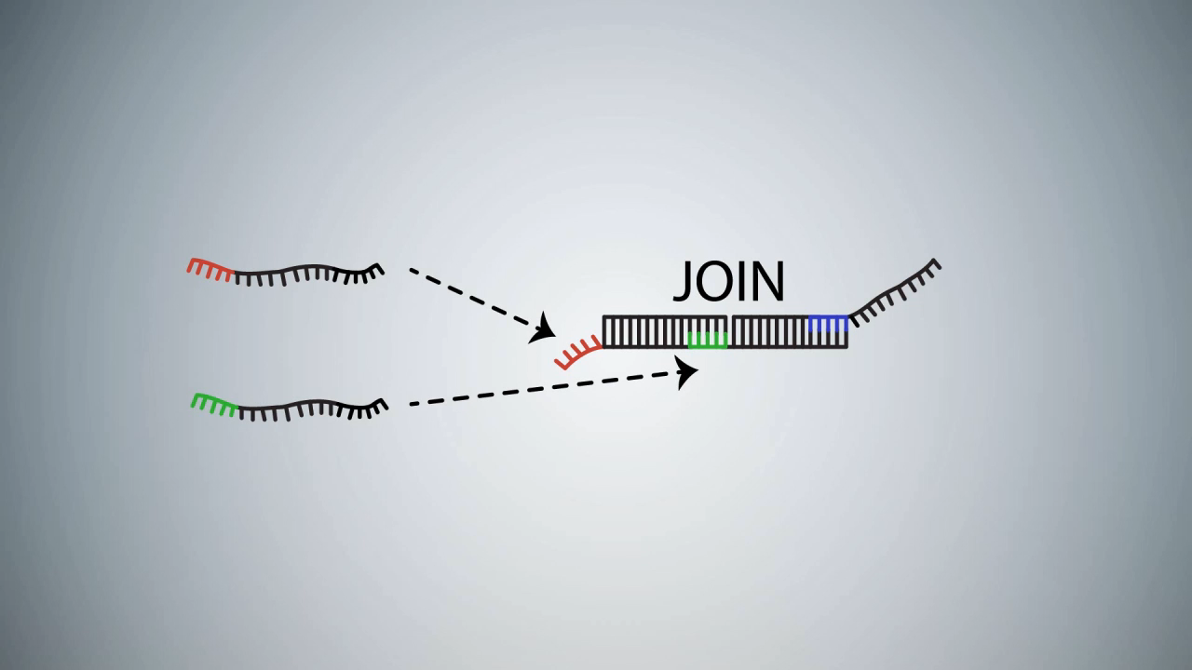
DNA strand displacement implementing A+B→C
video: Microsoft Research Cambridge

Slide 20
Experimental implementations of synthetic chemical reaction networks with DNA
Analog majority computation
Chemical oscillator
relative amount (%)
X+Y→B+B
X+B→X+X
Y+B→Y+Y
A+B→B+B
B+C→C+C
C+A→A+A
2
conc. deriv. (nM/hr)
1
time (hours)
15
30
45
60
[Programmable chemical controllers made from DNA. Chen, Dalchau, Srinivas, Phillips, Cardelli, Soloveichik, Seelig, Nature Nanotechnology 2013.]
[Enzyme-free nucleic acid dynamical systems. Srinivas, Parkin, Seelig, Winfree, Soloveichik, Science 2017.]
time (hours)

Slide 21
Defining stable computation
o is stable
∀
∃
∀
i
x
reactions
o
reactions
o’
reactions
initial
state
any reachable
state
“correct”
output
correct
output
(assuming finite set of reachable states) equivalent to:
The system will reach the correct output with probability 1.
Notes:
-This is the appropriate notion of determinism here
-Say “such that” when talk about there not existing a path to o’

Slide 22
Definition of predicate (decision problem) computation
goal: compute predicate φ: ℕ^{k}→{Y,N}, e.g., φ(a,b)=Y ⇔ a≥b
input specification: designate subset Σ ⊆ Λ as “input” species
  in valid initial states all molecules are from Σ, e.g., {100 A, 55 B}
output specification: partition species Λ into “yes” voters Λ_{Y} and “no” voters Λ_{N}
  ψ(o) = Y (state o outputs “yes”) if vote is unanimously yes: o(S)>0 ⇔ S∈Λ_{Y}
  ψ(o) = N (state o outputs “no”) if vote is unanimously no: o(S)>0 ⇔ S∈Λ_{N}
  state o has undefined output otherwise: (∃ S∈Λ_{N}, S’∈Λ_{Y}) o(S)>0 and o(S’)>0
o is stable if ψ(o) = ψ(o’) for all o’ reachable from o
[Angluin, Aspnes, Diamadi, Fischer, Peralta, Computation in networks of passively mobile finite-state sensors, PODC 2004]

Slide 23
Examples of predicate computation
Detection: φ(a,b) = Y ⇔ b > 0
B+A → B+B
A votes no; B votes yes
B
B
A
B
A
A
B
A
B
A
B
A
B
A

Slide 24
Examples of predicate computation
Parity: φ(a)=Y ⇔ a is odd
input species A_{o} (subscript o/e means ODD/EVEN, and capital A means it is leader)
A_{o}+A_{o}→ A_{e}+a_{e}
A_{e}+A_{e} → A_{e}+a_{e}
A_{o}+A_{e} → A_{o}+a_{o}
A_{o}
A_{o}
two leaders XOR their parity, and one becomes follower
a_{e}
a_{e}
A_{o}
A_{e}
A_{e}
A_{o}
a_{e}
a_{o}
A_{o}+a_{e} → A_{o}+a_{o}
A_{e}+a_{o} → A_{e}+a_{e}
leader overwrites
bit of follower
Not execution bounded!

Slide 25
Examples of predicate computation
Majority: φ(a,b) = Y ⇔ a≥b
A+B → a+b (both become “followers” but preserve difference between A’s and B’s)
A+b → A+a (leader changes vote of follower)
B+a → B+b (leader changes vote of follower)
a+b → a+a (tiebreaker if a=b)
Not execution bounded!
[Draief, Vojnovic. Convergence speed of binary interval consensus. SIAM Journal on Control and Optimization, 50(3):1087–1109, 2012]
[Mertzios, Nikoletseas, Raptopoulos, Spirakis, Determining Majority in Networks with Local Interactions and very Small Local Memory, Distributed Computing 2015]

Slide 26
Limits of stable computation
Theorem: φ: ℕ^{k}→{Y,N} is stably computable by a CRN if and only if φ is semilinear.
semilinear = Boolean combination of threshold and mod predicates:
take weighted sum s = w₁∙x₁ + … w_{k}∙x_{k} of inputs x₁ … x_{k} and ask if
  s ≤ constant c?
  s ≡ c mod m for constants c,m?
a>b? a=b? a is odd? a>1? a>1 and b is odd?
NOT a=b²? a is a power of 2? a is prime?
[Angluin, Aspnes, Diamadi, Fischer, Peralta, Computation in networks of passively mobile finite-state sensors, PODC 2004]
[Angluin, Aspnes, Eisenstat, Stably computable predicates are semilinear, PODC 2006]

Slide 27
Outline
Formal definition of chemical reaction networks
Execution bounded chemical reaction networks and linear potential functions
What is “computation” with chemical reactions?
Limitations of computation with execution bounded chemical reaction networks
Possibilities of computation with execution bounded chemical reaction networks

Slide 28
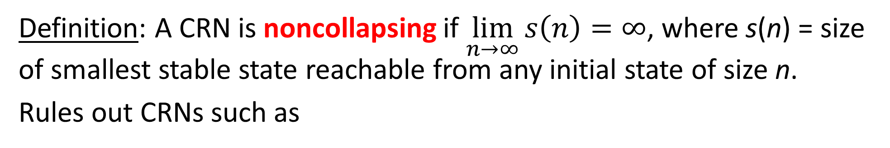
Noncollapsing CRNs
Definition: A CRN is noncollapsing if $\lim_{n→∞}{s\left(n\right)=∞}$, where s(n) = size of smallest stable state reachable from any initial state of size n.
Rules out CRNs such as
A_{e}
A_{o}+A_{o}→ A_{e}
A_{e}+A_{e} → A_{e}
A_{o}+A_{e} → A_{o}
A_{o}
A_{o}
A_{o}
A_{e}
A_{o}
which computes parity but always ends up with a single voter.

Slide 29
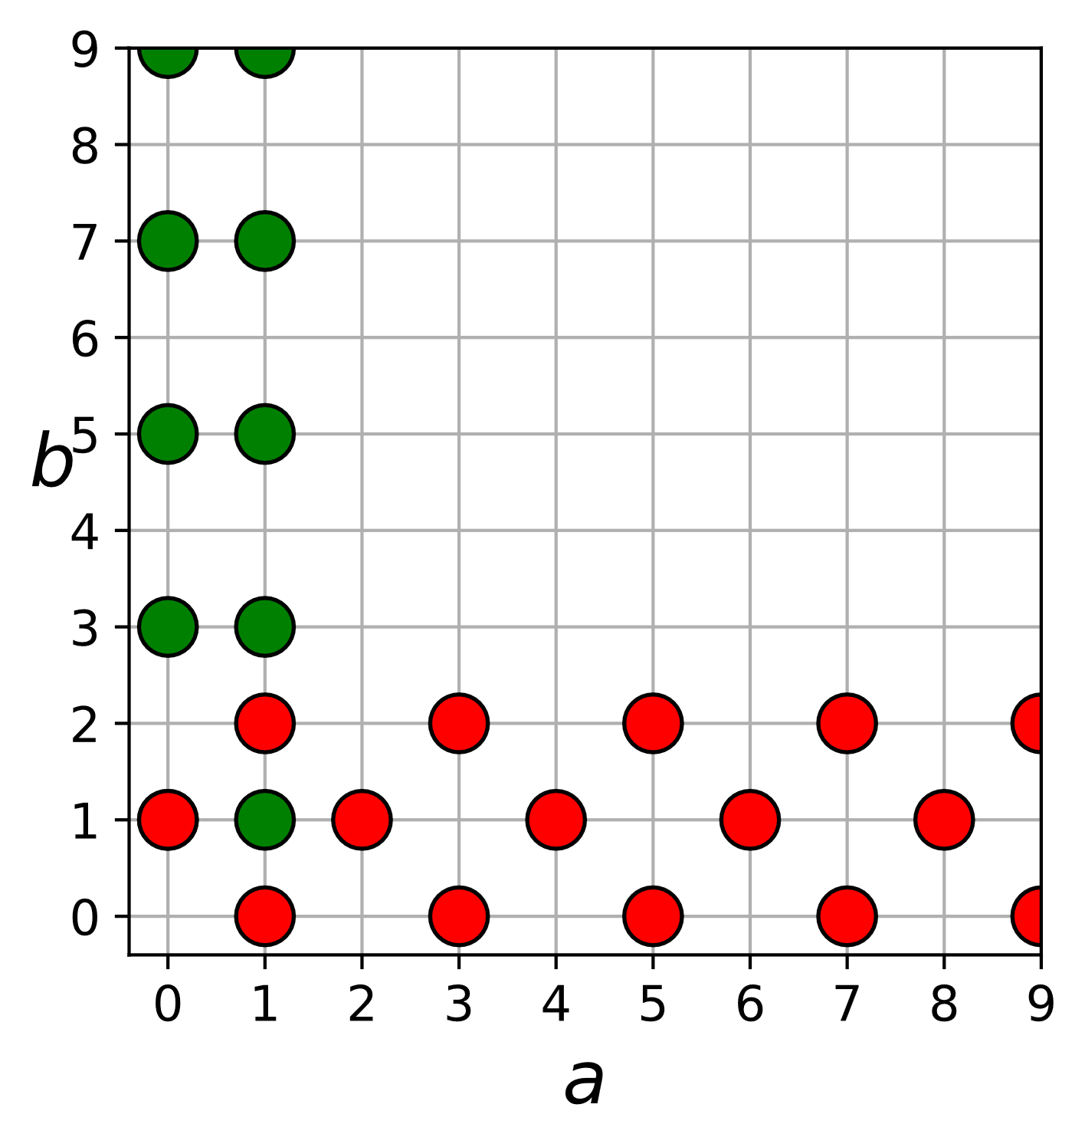
Eventually constant predicates
Definition: A predicate φ: ℕ^{k}→{Y,N} is eventually constant if, for some c ∈ ℕ, φ(x) is constant on all inputs x ≧ (c,c,…,c).
Example of eventually constant predicate:
a < 2 and b is odd, or b < 3 and a+b is odd
Non-eventually constant predicates:
majority (a≥b?)
parity (a is odd?)
equality (a=b?)
and most anything interesting.
inputs ≧ (3,3)
all have output “no”

Slide 30
Limitations of execution bounded CRNs
Theorem: If a CRN stably computing φ is noncollapsing and execution bounded from every input state, then φ is eventually constant.
Proof: complex.
Proof that such CRNs cannot compute parity (a is odd?):
Start with {A}, CRN can reach to stable YES state s₁.
Add 1 A. The state s₁+{A} is reachable from {2A}, so the CRN can reach from there to a stable NO state s₂.
Add 1 A. The state s₂+{A} is reachable from {3A}, so the CRN can reach from there to a stable YES state s₃.
…
⟹
Y₁
Y₂
⟹
N₁
N₂
N₁
Y₁
Y₂
…
A
A
⟹
A
A
A
A
Y₃
Y₂
{A}
+ {A}
s₁
+ {A}
s₂
+ {A}
s₃
+ {A}
+ {A}

Slide 31
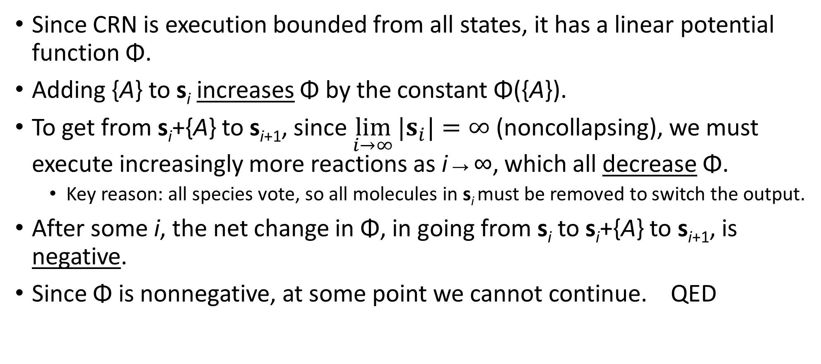
Limitations of execution bounded CRNs
Since CRN is execution bounded from all states, it has a linear potential function Φ.
Adding {A} to s_{i} increases Φ by the constant Φ({A}).
To get from s_{i}+{A} to s_{i+1}, since $\lim_{i→∞}{|s_{i}|=∞}$ (noncollapsing), we must execute increasingly more reactions as i→∞, which all decrease Φ.
  Key reason: all species vote, so all molecules in s_{i} must be removed to switch the output.
After some i, the net change in Φ, in going from s_{i} to s_{i}+{A} to s_{i+1}, is negative.
Since Φ is nonnegative, at some point we cannot continue. QED

Slide 32
Outline
Formal definition of chemical reaction networks
Execution bounded chemical reaction networks and linear potential functions
What is “computation” with chemical reactions?
Limitations of computation with execution bounded chemical reaction networks
Possibilities of computation with execution bounded chemical reaction networks

Slide 33
Are execution bounded CRNs good for any computation?
Yes! Execution bounded CRNs can stably compute all semilinear predicates if the CRN is leader-driven: it starts with an “initial leader”, e.g., to compute majority (a≥b?), start in initial state {1 L, a A, b B}… these are execution bounded from such states, but not from states with multiple leaders.
We also relax the voting requirement and allow only the leader to vote. (though this requirement can be relaxed; not shown in slides)

Slide 34
Single-voting CRNs
Definition: A CRN computing a predicate φ: ℕ^{k}→{Y,N} is single-voting if all states reachable from the input have a single voter.
Such CRNs are leader-driven: valid initial configurations have a single leader/voter molecule, and only the leader votes.

Slide 35
Semilinear predicates are Boolean combinations of threshold and mod predicates
Recall: Theorem: φ: ℕ^{k}→{Y,N} is stably computable by a CRN if and only if φ is semilinear. (= Boolean combination of threshold and mod predicates)
To show execution bounded CRNs can compute all semilinear predicates, it suffices to show:
They can compute all threshold predicates.
They can compute all mod predicates.
They can be composed to compute AND, OR, and NOT of other CRNs.

Slide 36
Execution bounded CRNs can compute threshold predicates
Theorem: Every threshold predicate [w₁x₁ + … + w_{k}x_{k} ≤ c?] can be stably computed by a single-voting execution bounded CRN.
Proof by example: To compute [2x₁ + 3x₂ – 5x₃ ≤ 4?], in addition to inputs X₁, X₂, X₃, start with 1 L_{Y} (yes voter/leader) and 4 N, and have reactions:
Now we compute majority [P ≤ N?]
X₁→2P
X₂→3P
X₃→5N
P will have count = weighted sum of inputs with positive weights
L_{Y}+P→ L_{N}
L_{N}+N→ L_{Y}
N will have count = weighted sum of inputs with negative weights (including constant –4)

Slide 37
Execution bounded CRNs can compute mod predicates
Theorem: Every mod predicate [w₁x₁ + … + w_{k}x_{k} ≡ c mod m?] can be stably computed by a single-voting execution bounded CRN.
Proof by example: To compute [2x₁ + 3x₂ ≡ 4 mod 5?], in addition to inputs X₁, X₂, start with 1 L₀, and have reactions:
L_{i} + X₁→L_{i+2 mod 5}
L_{i} + X₂→L_{i+3 mod 5}
for i = 0,1,2,3,4
L₄ votes yes, L₀, L₁, L₂, L₃ vote no

Slide 38
Composing CRNs to compute Boolean combinations of predicates
Theorem: If single-voting, execution bounded CRNs C₁ and C₂ stably compute predicates φ₁: ℕ^{k}→{Y,N} and φ₂: ℕ^{k}→{Y,N}, then there are single-voting, execution bounded CRNs stably computing [φ₁ and φ₂], [φ₁ or φ₂], and [not φ₁].
Proof : To compute [not φ₁], swap votes of voting species.
To compute [φ₁ and φ₂] and [φ₁ or φ₂], “split” each input X via reaction X→X₁ + X₂, so C₁ operates on X₁ and C₂ operates on X₂.
“global” voters of composed CRN:
V_{NN}, V_{NY}, V_{YN}, V_{YY}; start with 1 V_{NN}
Voters of C₁ and C₂ influence global voters:
S_{Y} + V_{NN}→ S_{Y} + V_{YN}
S_{Y} + V_{NY}→ S_{Y} + V_{YY}
T_{Y} + V_{NN}→ T_{Y} + V_{NY}
T_{Y} + V_{YN}→ T_{Y} + V_{YY}
Let S_{Y}, S_{N} be yes and no voters of C₁
Let T_{Y}, T_{N} be yes and no voters of C₂
S_{N} + V_{YN}→ S_{N} + V_{NN}
S_{N} + V_{YY}→ S_{N} + V_{NY}
T_{N} + V_{NY}→ T_{N} + V_{NN}
T_{N} + V_{YY}→ T_{N} + V_{YN}
C₁ is execution bounded, so can only switch between S_{Y} and S_{N} a finite number of times, limiting how many times we can flip between V_{N?} and V_{Y?}, so full CRN is execution bounded.

Slide 39
Open question
Using standard stochastic model of chemical kinetics (not shown), the execution bounded CRNs stably computing semilinear predicates can be shown to take expected time O(n log n) to converge.
Without the execution bounded constraint, it is known they can be computed exponentially faster: polylog(n). [Angluin, Aspnes, Eisenstat, Fast computation by population protocols with a leader, DISC 2006]
Conjecture: Execution bounded CRNs require Ω(n) time to stably compute any non-eventually constant predicate (e.g., majority or parity).

Slide 40
Thank you!
Questions?

