Slide 1

Design of geometric molecular bonds, à la Reed-Solomon
Workshop on coding techniques for synthetic biology
University of Illinois, Urbana-Champaign
David Doty
Department of Computer Science
University of California, Davis

Slide 2


Experimental background:
Structural DNA nanotechnology
a.k.a. DNA carpentry

Slide 3
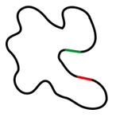


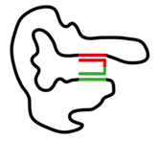
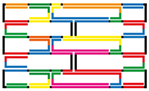

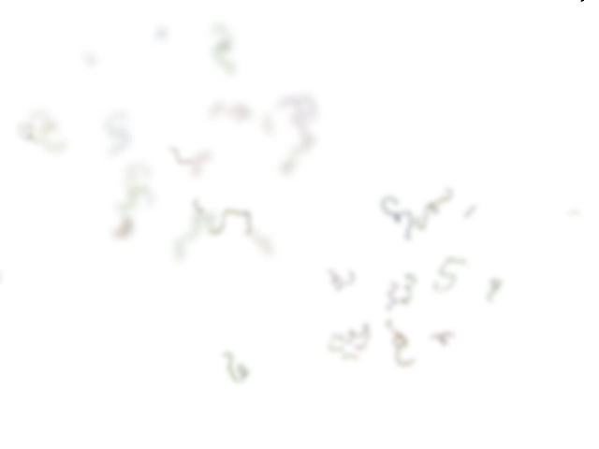
DNA origami
Paul Rothemund
Folding DNA to create nanoscale shapes and patterns
Nature 2006
staple DNA strands
folded DNA origami
heat to 90C, cool to 20C over an hour
scaffold DNA strand
(M13mp18 bacteriophage virus)
© http://openwetware.org/wiki/Biomod/2014/Design
© Shawn Douglas

Slide 4
DNA origami
Paul Rothemund
Folding DNA to create nanoscale shapes and patterns
Nature 2006
Atomic force microscope images
100 nm

Slide 5
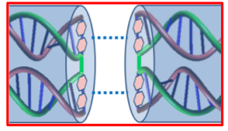
DNA stacking interactions between blunt ends
nonspecific attractive interactions
© http://openwetware.org/wiki/Biomod/2014/Kansai/Experiment

Slide 6
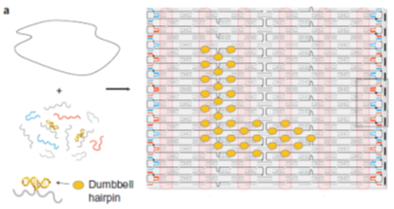
Stacking at edges of DNA origami
…
blunt ends
scale bars: 100nm
Sungwook Woo, Paul Rothemund
Programmable molecular recognition based on the geometry of DNA nanostructures
Nature Chemistry 2011

Slide 7
Programming specific macrobonds through geometric arrangement of nonspecific bonds (“patches”)
staple left out to “deactivate” patch
unintended translations can result in overlap between large subset of patches
Sungwook Woo, Paul Rothemund
Programmable molecular recognition based on the geometry of DNA nanostructures
Nature Chemistry 2011

Slide 8
Extending from 1D to 2D bonds
3D DNA origamis
stacking interactions
20nm
negative stain TEM images
Thomas Gerling, Klaus F. Wagenbauer, Andrea M. Neuner, Hendrik Dietz
Dynamic DNA devices and assemblies formed by shape-complementary, non–base pairing 3D components
Science 2015

Slide 9
Design of geometric molecular bonds, à la Reed-Solomon
How to engineer large sets of specific molecular bonds that do not bind (strongly) in unintended ways

Slide 10
Mathematical model
macrobond: subset of
n x n square
10
9
8
“patches”
7
6
5
4
3
2
1
0
0
1
2
3
4
5
6
7
8
9
10

Slide 11
Desired outcomes
any nonzero translation of macrobond has “small” overlap with untranslated original
any translation of macrobond has “small” overlap with other macrobonds
lots of macrobonds!
macrobond 1
macrobond 2

Slide 12
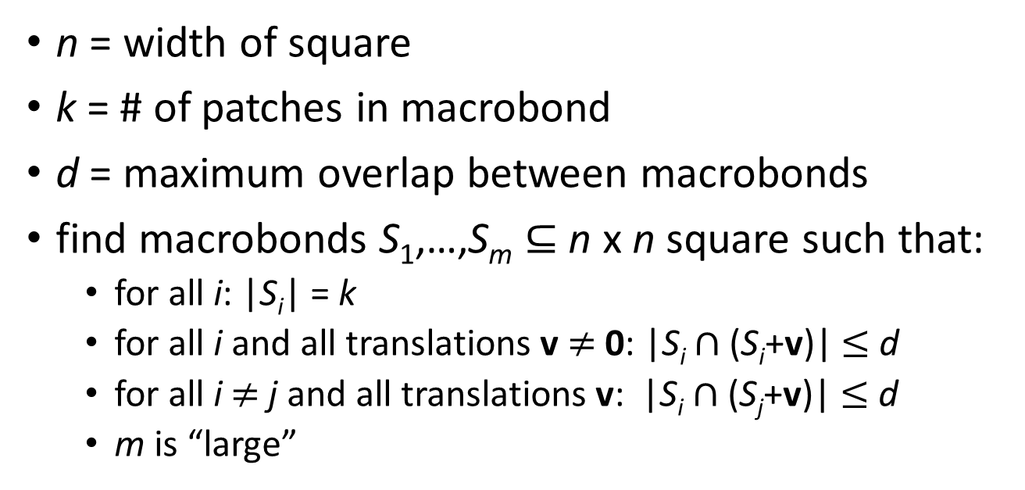
Orthogonal macrobond design problem
10
9
8
n = 11
7
k = 8
6
5
d = 2
4
3
2
n = width of square
k = # of patches in macrobond
d = maximum overlap between macrobonds
find macrobonds S₁,…,S_{m} $⊆$ n x n square such that:
  for all i: |S_{i}| = k
  for all i and all translations v$≠$0: |S_{i} $∩$ (S_{i}+v)| $≤$ d
  for all i$≠$j and all translations v: |S_{i} $∩$ (S_{j}+v)| $≤$ d
  m is “large”
1
0
0
1
2
3
4
5
6
7
8
9
10

Slide 13
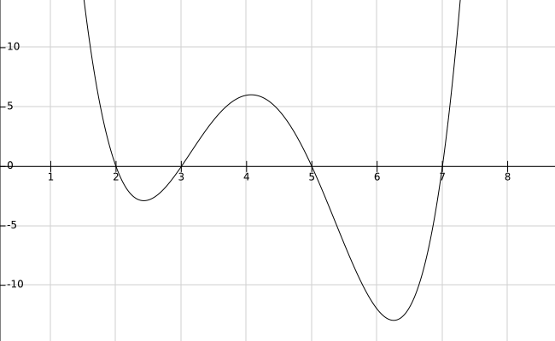
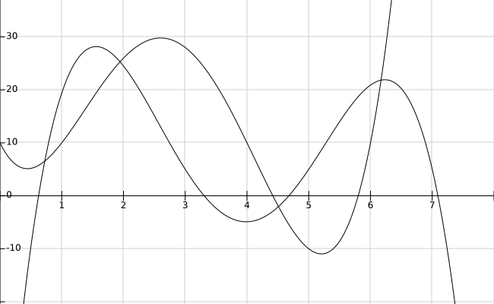
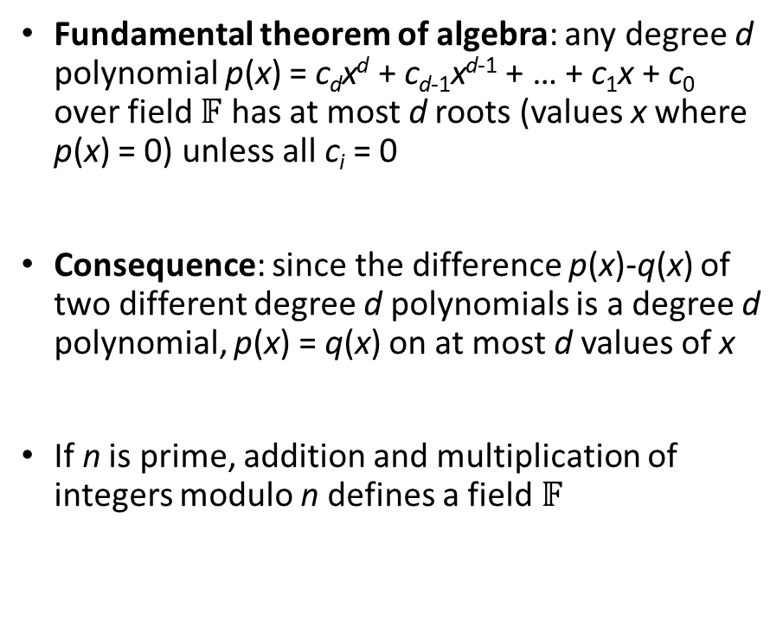
… à la Reed-Solomon
Fundamental theorem of algebra: any degree d polynomial p(x) = c_{d}x^{d} + c_{d-1}x^{d-1} + … + c₁x + c₀ over field $𝔽$ has at most d roots (values x where p(x) = 0) unless all c_{i} = 0
Consequence: since the difference p(x)-q(x) of two different degree d polynomials is a degree d polynomial, p(x) = q(x) on at most d values of x
If n is prime, addition and multiplication of integers modulo n defines a field $𝔽$
d = 4

Slide 14
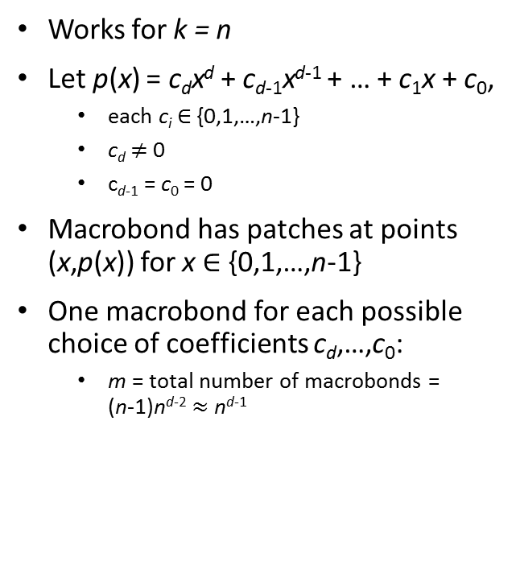
Algorithm for generating macrobonds
n = k = 11
d = 3
Works for k = n
Let p(x) = c_{d}x^{d} + c_{d-1}x^{d-1} + … + c₁x + c₀,
  each c_{i} $∈$ {0,1,…,n-1}
  c_{d} $≠$0
  c_{d-1} = c₀ = 0
Macrobond has patches at points (x,p(x)) for x $∈$ {0,1,…,n-1}
One macrobond for each possible choice of coefficients c_{d},…,c₀:
  m = total number of macrobonds = (n-1)n^{d-2} $≈$ n^{d-1}
example macrobond:
10
9
8
7
6
x³ + 5x + 8 (mod 11)
5
4
3
2
1
0
0
1
2
3
4
5
6
7
8
9
10
x

Slide 15

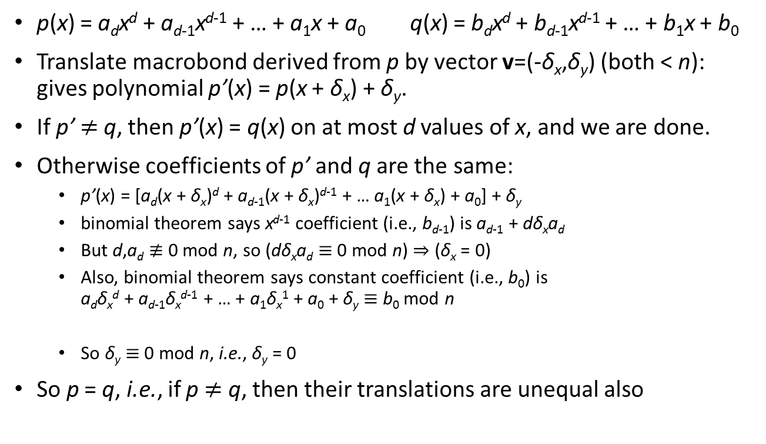


Why is overlap at most d?
$≠$ 0
= 0
$≠$ 0
= 0
p(x) = a_{d}x^{d} + a_{d-1}x^{d-1} + … + a₁x + a₀ q(x) = b_{d}x^{d} + b_{d-1}x^{d-1} + … + b₁x + b₀
Translate macrobond derived from p by vector v=(-δ_{x},δ_{y}) (both < n): gives polynomial p’(x) = p(x + δ_{x}) + δ_{y}.
If p’ $≠$q, then p’(x) = q(x) on at most d values of x, and we are done.
Otherwise coefficients of p’ and q are the same:
  p’(x) = [a_{d}(x + δ_{x})^{d} + a_{d-1}(x + δ_{x})^{d-1} + … a₁(x + δ_{x}) + a₀] + δ_{y}
  binomial theorem says x^{d-1} coefficient (i.e., b_{d-1}) is a_{d-1} + dδ_{x}a_{d}
  But d,a_{d} $≢$ 0 mod n, so (dδ_{x}a_{d} $≡$ 0 mod n) $⇒$ (δ_{x} = 0)
  Also, binomial theorem says constant coefficient (i.e., b₀) is a_{d}δ_{x}^{d} + a_{d-1}δ_{x}^{d-1} + … + a₁δ_{x}¹ + a₀ + δ_{y} $≡$ b₀ mod n
  So δ_{y} $≡$ 0 mod n, i.e., δ_{y} = 0
So p = q, i.e., if p $≠$ q, then their translations are unequal also
$≡$ b_{d-1} mod n
= 0
…
= 0
= 0

Slide 16
Possible next steps
Extend to macrobonds in n x n square (or n x n’ rectangle) that aren’t functions (i.e., exactly one y value per x value)
Rotations
  may be moot with particular DNA origami examples
Allow smooth transition from initial misaligned binding to intended alignment
Lower bounds

Slide 17

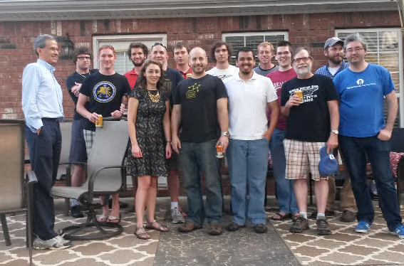


Acknowledgements
Andrew Winslow
2015 Arkansas self-assembly workshop

