Slide 1
Collaborative Data Sharing with Mappings and Provenance
Todd J. Green
University of Pennsylvania
Spring 2009

Slide 2
The Case for a Collaborative Data Sharing System (CDSS)
Scientists build data repositories, need to share with collaborators
Goal: import, transform, modify (curate) each other’s data
A central challenge in science today!
e.g., Genomics Unified Schema @ Penn Center for Bioinformatics, Assembling the Tree of Life, ...
Data from different sources is mostly complementary, but there may be disagreements/conflicts
Not all data is reliable, not everyone agrees on what’s right
Where the data came from may help assess its value

Slide 3
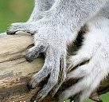

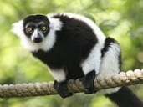

Example: Sharing Morphological Data
Alice’s field observations: A
ID | Species | Image | Character | State
34 | Lemur catta |  | hand color | white
47 | Lemur catta |  | hand color | white
Carol wants to gather information from Alice, Bob, uBio, and put into own data repository:
Bob’s field observations: B, C
Carol’s Guide to Primate Hand Colors
SID | Char | State
61 | hand color | black
Common Name | Hand Color
schema mappings
SID | Species | Picture
61 | Lemur catta
Can do this using
schema mappings
Standard species names: D
Species | Common Name
Lemur catta | Ring-Tailed Lemur
Notes:
make clear in this slide: in this talk “queries” = “update exchange”, i.e., queries carry out update exchange

Slide 4
What is a Schema Mapping and How is it Used?
Schema mappings relate databases with different schemas
Informally, think of correspondences between schema elements:
To actually transform data according to these mappings, need something analogous to a program or script – mappings in Datalog notation:
They are both specification
And executable database queries
Update exchange: the process of executing these queries in order to propagate data/updates (and satisfy the mappings)
ID | Species | Image | Character | State
SID | Species | Picture
SID | Char | State

Slide 5
Example: Sharing Morphological Data (2)
Alice’s field observations: A
Datalog mappings relating databases
ID | Species | Image | Character | State
34 | Lemur catta |  | hand color | white
47 | Lemur catta |  | hand color | white
E(name, color) :–
B(id, “hand color”, color),
C(id, species,_), D(species, name)
E(name, color) :–
A(id, species,_, “hand color”, color),
D(species, name)
Bob’s field observations: B, C
SID | Char | State
61 | hand color | black
Carol’s Guide to Primate Hand Colors: E
Common Name | Hand Color
Ring-Tailed Lemur | white
Common Name | Hand Color
SID | Species | Picture
61 | Lemur catta
Standard species names: D
Species | Common Name
Lemur catta | Ring-Tailed Lemur

Slide 6
Example: Sharing Morphological Data (2)
Alice’s field observations: A
Datalog mappings relating databases
ID | Species | Image | Character | State
34 | Lemur catta |  | hand color | white
47 | Lemur catta |  | hand color | white
E(name, color) :–
B(id, “hand color”, color),
C(id, species,_), D(species, name)
E(name, color) :–
A(id, species,_, “hand color”, color),
D(species, name)
Bob’s field observations: B, C
SID | Char | State
61 | hand color | black
Carol’s Guide to Primate Hand Colors: E
Common Name | Hand Color
Ring-Tailed Lemur | white
Common Name | Hand Color
Ring-Tailed Lemur | black
SID | Species | Picture
61 | Lemur catta
join
Standard species names: D
Species | Common Name
Lemur catta | Ring-Tailed Lemur

Slide 7
Example: Sharing Morphological Data (2)
Alice’s field observations: A
Datalog mappings relating databases
ID | Species | Image | Character | State
34 | Lemur catta |  | hand color | white
47 | Lemur catta |  | hand color | white
E(name, color) :–
B(id, “hand color”, color),
C(id, species,_), D(species, name)
E(name, color) :–
A(id, species,_, “hand color”, color),
D(species, name)
Bob’s field observations: B, C
SID | Char | State
61 | hand color | black
Carol’s Guide to Primate Hand Colors: E
Common Name | Hand Color
Ring-Tailed Lemur | white
Ring-Tailed Lemur | white
Common Name | Hand Color
Ring-Tailed Lemur | black
join
SID | Species | Picture
61 | Lemur catta
Standard species names: D
Species | Common Name
Lemur catta | Ring-Tailed Lemur

Slide 8
Example: Sharing Morphological Data (2)
Alice’s field observations: A
Datalog mappings relating databases
ID | Species | Image | Character | State
34 | Lemur catta |  | hand color | white
47 | Lemur catta |  | hand color | white
E(name, color) :–
B(id, “hand color”, color),
C(id, species,_), D(species, name)
E(name, color) :–
A(id, species,_, “hand color”, color),
D(species, name)
Bob’s field observations: B, C
SID | Char | State
61 | hand color | black
Carol’s Guide to Primate Hand Colors: E
Integrity constraint:
“Morphological characteristics should be unique”
from Bob, specimen 61
Common Name | Hand Color
Ring-Tailed Lemur | white
Ring-Tailed Lemur | white
Common Name | Hand Color
Ring-Tailed Lemur | black
SID | Species | Picture
61 | Lemur catta
conflict!
from Alice, specimens
34 or 47
Standard species names: D
NEED DATA PROVENANCE!
Species | Common Name
Lemur catta | Ring-Tailed Lemur
“Carol trusts Alice more than Bob”

Slide 9
Challenges in CDSS [Ives+05]
Finding the “right” notion of provenance
Many proposed formalisms in database and scientific data management communities, but no clear winner
Existing notions not informative enough
Supporting data sharing without global agreement
Varied schemas, conflicting data, distinct viewpoints
Efficient propagation of updates to data
Existing work assumes static databases
Handling changes to mappings and schemas
Existing work assumes these are fixed; real-world experience suggests they are dynamic
Wide open problem!

Slide 10
Contributions
The first set of comprehensive solutions for CDSS:
Incorporate a powerful new notion of data provenance
“Most informative” in a precise sense
Supports trust and dissemination policies, ranking, ..,
Allow participants to import/refresh one another’s data, across schema mappings, filtered by trust policies
Principled, uniform approach to handling updates to data, mappings, and schemas
Theoretical analysis: soundness and completeness
Implement and validate contributions in Orchestra, the first CDSS realization
A platform for supporting real bioinformatics applications

Slide 11
Orchestra From One Participant’s Perspective
Changes from other participants
Data: transformed to peer’s local schema using mappings
Provenance: reflects how data is combined and transformed by the mappings; is propagated along mappings together with the data
Handle incremental changes to data, and also mappings and schemas
Optimize update plan
Consistent with peer’s own curation, trust, and dissemination policies
4
+, −
Transform (map) with provenance
Filter by trust policies
Reconcile conflicts
Apply local curation / modification
Update DBMS instance
[TaylorIves06]
1
2
3
Contributions of my thesis
Focus of today’s talk

Slide 12
Roadmap
Provenance and its uses in CDSS
Formal foundations
Practical implementation
Evolution in CDSS
Changes to data, mappings, schemas
A unifying paradigm
Related Work
Conclusions and Future Work

Slide 13
Provenance in CDSS [Green+ PODS 07]
Basic idea: annotate source tuples with tuple ids, combine and propagate during query processing
Abstract “+” records alternative use of data (union, projection)
Abstract “¢” records joint use of data (join)
Yields space of annotations K
K-relation: a relation whose tuples are annotated with elements from K

Slide 14


Combining Annotations in Queries
ID | Species | Img | Character | State
34 | L.catta |  | hand color | white | p
47 | L.catta |  | hand color | white | q
ID | Character | State
61 | hand color | black | r
source tuples
annotated with tuple ids from K
ID | Species | Img
61 | Lemur catta |  | s
Species | Comm. Name
Lemur catta | Ring-tailed Lemur | u

Slide 15
Combining Annotations in Queries
Datalog mappings
ID | Species | Img | Character | State
34 | L.catta |  | hand color | white | p
47 | L.catta |  | hand color | white | q
E(name, color) :–
B(id, “hand color”, color),
C(id, species,_), D(species, name)
ID | Character | State
61 | hand color | black | r
r
join
ID | Species | Img
61 | Lemur catta |  | s
Comm. Name | Hand Color
Ring-tailed Lemur | black
s
r¢s¢u
Species | Comm. Name
Lemur catta | Ring-tailed Lemur | u
u
Operation x¢y means joint use of data annotated by x and data annotated by y

Slide 16
Combining Annotations in Queries
Datalog mappings
ID | Species | Img | Character | State
34 | L.catta |  | hand color | white | p
47 | L.catta |  | hand color | white | q
E(name, color) :–
B(id, “hand color”, color),
C(id, species,_), D(species, name)
p
q
E(name, color) :–
A(id, species,_, “hand color”, color),
D(species, name)
ID | Character | State
61 | hand color | black | r
ID | Species | Img
61 | Lemur catta |  | s
Comm. Name | Hand Color
Ring-tailed Lemur | black | r¢s¢u
Ring-tailed Lemur | white
Ring-tailed Lemur | white
p¢u
p¢u
Species | Comm. Name
Lemur catta | Ring-tailed Lemur | u
q¢u
u
Operation x¢y means joint use of data annotated by x and data annotated by y

Slide 17
Combining Annotations in Queries
Datalog mappings
ID | Species | Img | Character | State
34 | L.catta |  | hand color | white | p
47 | L.catta |  | hand color | white | q
E(name, color) :–
B(id, “hand color”, color),
C(id, species,_), D(species, name)
E(name, color) :–
A(id, species,_, “hand color”, color),
D(species, name)
ID | Character | State
61 | hand color | black | r
Comm. Name | Hand Color
Ring-tailed Lemur | black | r¢s¢u
Ring-tailed Lemur | white
Ring-tailed Lemur | white
ID | Species | Img
61 | Lemur catta |  | s
Comm. Name | Hand Color
Ring-tailed Lemur | black | r¢s¢u
Ring-tailed Lemur | white
p¢u + q¢u
p¢u
Species | Comm. Name
Lemur catta | Ring-tailed Lemur | u
q¢u
Operation x+y means alternate use of data annotated by x and data annotated by y

Slide 18
What Properties Do K-Relations Need?
DBMS query optimizers choose from among many plans, assuming certain identities:
union is associative, commutative
join associative, commutative, distributive over union
projections and selections commute with each other and with union and join (when applicable)
Equivalent queries should produce same provenance!
Proposition. Above identities hold for queries on K-relations iff (K, +, ¢, 0, 1) is a commutative semiring

Slide 19
What is a Commutative Semiring?
An algebraic structure (K, +, ¢, 0, 1) where:
K is the domain
+ is associative, commutative with 0 identity
¢ is associative, commutative with 1 identity
¢ is distributive over +
8 a 2 K, a ¢ 0 = 0 ¢ a = 0
(unlike ring, no requirement for additive inverses)
Big benefit of semiring-based framework: one framework unifies many database semantics

Slide 20
Semirings Explain Relationship Among Commonly-Used Database Semantics
Standard database models:
(B, Æ, Ç, >, ?) | Set semantics
(ℕ, +, ∙, 0, 1) | Bag semantics (SQL duplicates)
Ranked or uncertain data:
(P(Ω), [, Å, ;, Ω) | Probabilistic event tables [Fuhr&Rölleke 97]
(PosBool(X), Æ, Ç, >, ?) | Conditional tables [Imielinski&Lipski 84]
(N¹, min, +, 1, 0) | Tropical semiring (costs)
Data access:
(C, min, max, 0, All) C is set of access levels | Dissemination policies [Foster+ PODS 08]

Slide 21
Semirings Unify Existing Provenance Models
X a set of indeterminates, can be thought of as tuple ids
Orchestra provenance model:
(N[X], +, ¢, 0, 1) “most informative” | Provenance polynomials
Other models:
(Lin(X), [, [*, ;, ;*) sets of contributing tuples | Data warehousing lineage [Cui+ 00]
(Why(X), [, d, ;, {;}) sets of sets of contributing tuples | Why-provenance [Buneman+ 01]
(Trio(X), +, ¢, 0, 1) bags of sets of contributing tuples | Trio-style lineage [Das Sarma+ 08]
(B[X], +, ¢, 0, 1) | Boolean prov. polynomials

Slide 22
A Hierarchy of Provenance
Example: 2p²r + pr + 5r² + s
most informative
Orchestra’s provenance polynomials
N[X]
drop coefficients
p²r + pr + r² + s
drop exponents
3pr + 5r + s
B[X]
Trio(X)
drop both exp. and coeff.
pr + r + s
Why(X)
apply absorption
(pr + r ´ r)
r + s
collapse terms
prs
least informative
Lin(X)
PosBool(X)
A path downward from K₁ to K₂ indicates that there exists a surjective semiring homomorphism h : K₁ → K₂

Slide 23
Boolean Trust Policies in Orchestra
“Carol trusts Alice and uBio, but distrusts Bob for Lemur catta”
ID
... | p
... | q
SID | ...
61 | ... | r
Comm. Name | Hand Color
Ring-Tailed Lemur | white | pu + qu
Ring-Tailed Lemur | black | rsu
Spc
... | u
... | v
map
SID | ...
61 | ... | s
evaluate with r, s = false,
p, q, u, v = true
evaluate with r, s = false,
p, q, u, v = true
This path represents Orchestra’s approach
ID
... | true
... | true
Comm. Name | Hand Color
Ring-Tailed Lemur | white | true
Ring-Tailed Lemur | black | false
SID | ...
61 | ... | false
map
SID | ...
61 | ... | false
Spc
... | true
... | true
Notes:
Make clear what Orchestra does

Slide 24
Ranked (Dis)Trust Policies in Orchestra
“Carol fully trusts uBio (0), trusts Alice somewhat (1), trusts Bob a little less (2)”
use the Tropical semiring (N¹, min, +, 1, 0)
ID
... | p
... | q
SID | ...
61 | ... | r
Comm. Name | Hand Color
Ring-Tailed Lemur | white | pu + qu
Ring-Tailed Lemur | black | rsu
SID | ...
61 | ... | s
Spc
... | u
... | v
map
eval with u,v = 0,
p,q = 1, and r,s = 2
Same table as before
eval with u,v = 0,
p,q = 1, and r,s = 2
ID
... | 1
... | 1
Comm. Name | Hand Color
Ring-Tailed Lemur | white | 1
Ring-Tailed Lemur | black | 4
ID | ...
61 | ... | 2
map
ID | ...
61 | ... | 2
Spc
... | 0
... | 0
conflict!
Resolve conflict using distrust scores
Notes:
Emphasize that Top-right box is same as previous slide (flexibility of provenance)

Slide 25
Provenance for Recursive Mappings: Systems of Equations
Recursive mappings can yield infinite provenance expressions
Can always represent finitely as a system of equations
T
S
Name | Synonym
Fruit fly | Vinegar fly | t₁ = u + u ¢ t₉
Frit fly | Vinegar fly | t₂ = w ¢ t₁
... | ... | ...
Vinegar fly | Vinegar fly | t₉ = v ¢ t₂
Name | Synonym
Fruit fly | Vinegar fly | u + u²vw + u³v²w² + ...
Frit fly | Vinegar fly | uvw + u²v²w² + ...
... | ... | ...
Vinegar fly | Vinegar fly | uvw + u²v²w² + ...
Name | Synonym
Fruit fly | Vinegar fly | u
Vinegar fly | Frit fly | v
Frit fly | Fruit fly | w
map
transitive closure of S
T(n₁,n₂) :– S(n₁,n₂)
T(n₁,n₃) :– S(n₁,n₂), T(n₂,n₃)
provenance of a tuple is an infinite formal power series
prov. for this tuple
how derived as immediate consequence from other tuples
e.g., solving for t₁ we find t₁ = u + u²vw + u³v²w² + ...

Slide 26
An Equivalent Way of Thinking of Systems of Equations: As Graph
Name | Synonym
Fruit fly | Vinegar fly
Frit fly | Vinegar fly
... | ...
Vinegar fly | Vinegar fly
Name | Synonym
Fruit fly | Vinegar fly
Vinegar fly | Frit fly
Frit fly | Fruit fly
¢
this graph represents an
equation from last slide:
t₁ = u + u ¢ t₉
Graph-based viewpoint useful for practical implementation (we’ll revisit this)

Slide 27
Summary: Provenance Versatility
In Orchestra, one kind of annotation (provenance polynomials) can support many kinds of trust models, ranking, ...
Compute propagation of annotations just once
Extends to recursive mappings
Analysis of previous provenance models:
All special cases of framework
None suffices for Orchestra’s needs
Wider applications:
XML/nested relational data [Foster+ PODS 08]
Incomplete/probabilistic DBs [Green Dagstuhl 08]

Slide 28
Roadmap
Provenance and trust in CDSS
Formal foundations
Practical implementation
Evolution in CDSS
Changes to data, mappings, schemas
A unifying paradigm
Related Work
Conclusions and Future Work

Slide 29
Update Exchange in Orchestra: a Prototype CDSS [Green+ VLDB 07, Green+ SIGMOD 07]
1
2
3
Create provenance tables, rules to compute them
Compute incremental propagation (delta) rules
Generate SQL queries
Run SQL queries to fixpoint
(2nd part of talk)
Data
Prov

Slide 30
Creating Provenance Tables
Ideal world: DBMS supports provenance “natively”
Until then: need practical encoding scheme, storing provenance in tables
Can’t rely on user-defined functions to combine annotations (not portable, interfere with optimization)
As much as possible, do it in SQL
Keep storage overhead reasonable
We use a relational encoding scheme based on viewpoint of provenance as a graph

Slide 31
Encoding Provenance Graph in Tables
Datalog mappings:
ID | Species | Character | State
34 | L.catta | hand color | white
47 | L.catta | hand color | white
m₁: E(name, color) :–
A(id, species, “hand color”, color),
D(species, name)
¢
Comm. Name | Hand Color
Ring-tailed Lemur | white
Species | Comm. Name
L. catta | Ring-Tailed Lemur
¢
Provenance table for m₁:
= A.Species
= D.Comm. Name
= A.Character
ID | Species | Character | State
34 | L.catta | hand color | white
47 | L.catta | hand color | white
Species | Comm. Name
L. catta | Ring-Tailed L.
L. catta | Ring-Tailed L.
Comm. Name | Hand Color
Ring-tailed L. | white
Ring-tailed L. | white
Compress table using mapping’s correspondences
Rewrite mappings to fill provenance table (from Alice, Bob, uBio), and Carol’s DB (from provenance table)

Slide 32
Generating and Executing SQL Queries
For each rule in (rewritten) mappings, produce a SQL select-from-where query
Semi-naive Datalog evaluation using SQL queries
Logic in Java controls iteration
Optimizations
Keep processing and data within DBMS
Exploit indexing, keys
Encoding scheme for missing values
May have attributes in output relation that don’t have corresponding values in sources (not discussed in talk)
Need more than SQL’s NULL values: sometimes several missing values are known to be the same

Slide 33
Experimental Evaluation
Goal: establish feasibility for workloads typical of bioinformatics settings
10s to low 100s of participants (“peers”), GBs of data
Target operational mode: update exchange as overnight batch job
100K lines of Java, running over DB2 v9.5
Synthetic update workload sampled from SWISS-PROT biological data set
Real update loads aren’t directly available to us
Randomly-generated schemas and mappings
Dual Xeon 5150 server, 8 GB RAM (2 GB for DB)
Key questions:
Storage overhead of provenance acceptable (say, < DB size)?
Scalability to large numbers of peers, mappings?
Notes:
Mention CLOB

Slide 34
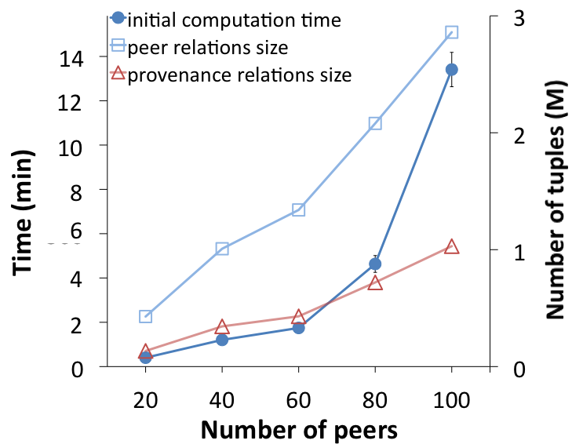
Update Exchange Scales to at Least 100 Peers
2 relations per peer, ~1 incoming and 1 outgoing mapping / peer (avg)

Slide 35
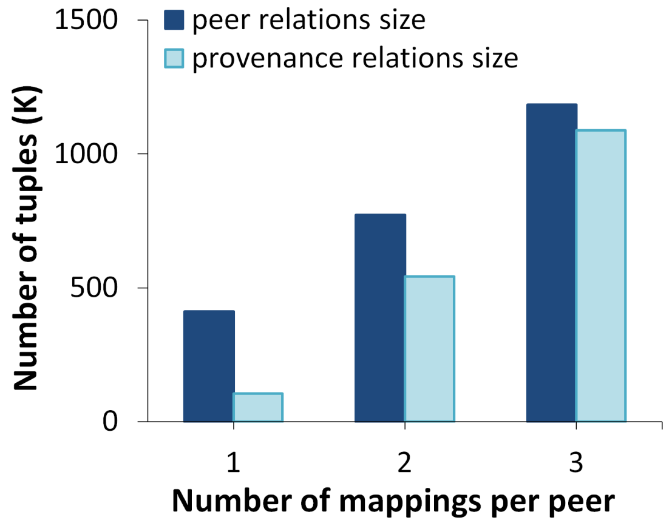
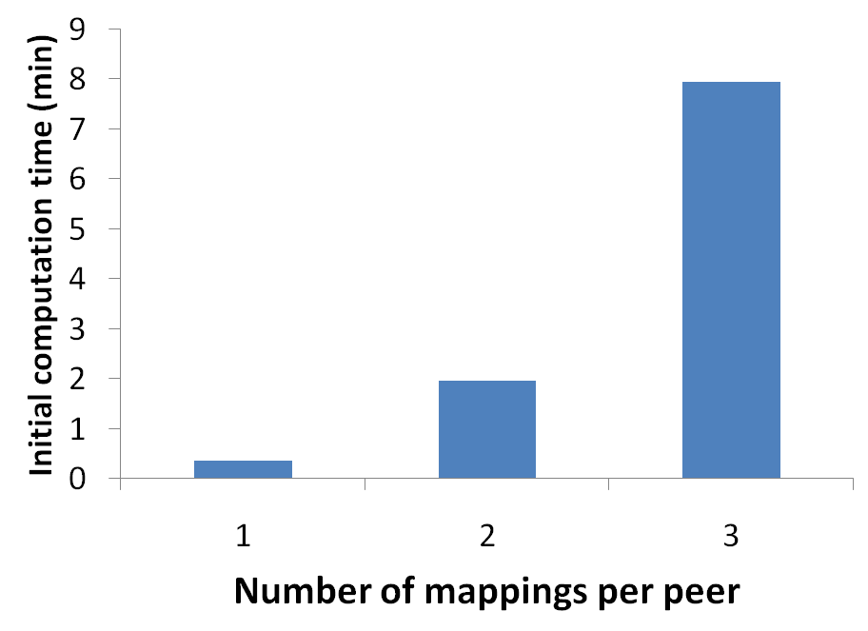
Provenance Storage Overhead and Computation Time Acceptable for Dense Networks of Schema Mappings
Space
Time
Initial compution time (min)
2 relations per peer, 20 peers, 80K source tuples total

Slide 36
Experimental Highlights and Takeaways
Provenance overhead small for typical numbers of mappings
Update exchange scales to 100+ peers, 10K+ base tuples per peer
Other key results
Different tuple sizes, larger data sets: scalability approximately linear in the increased sizes
Incremental recomputation produces significant benefits (often >10x)
Conclusion: Orchestra prototype shows CDSS is practical for target domains (100s of peers, batched updates)
Leverages off-the-shelf DBMS for provenance storage, update exchange

Slide 37
Roadmap
Provenance and trust in CDSS
Formal foundations
Practical implementation
Evolution in CDSS
Changes to data, mappings, schemas
A unifying paradigm
Related Work
Conclusions and Future Work

Slide 38
Change is a Constant
Even in ordinary DBMS, often need to change schemas, data layouts, handle data updates, …
Existing solutions are quite narrow and limited!
CDSS likely to exacerbate this, evolving continually:
Data is inserted, deleted, modified (update exchange)
Schemas and/or mappings change (schema evolution, mapping evolution)
More rarely; but often in young systems
Need efficient, incremental approach to propagating these various changes

Slide 39
Change Propagation: A Problem of Computing Differences
Incremental update exchange (cf. view maintenance)
Given:
mappings
Source data
R
V
Derived instance (view)
Change to source data
(difference)
Compute:
Change to
derived instance
(difference)
R¢
V¢
Mapping evolution (cf. view adaptation [Gupta+ 95])
Given:
mappings
Source data
R
V
Derived instance (view)
Change to mappings (another kind of difference)
Compute:
V¢
Change to
derived instance

Slide 40
How are Differences Represented? [Green+ ICDT 09]
Can think of changes to data as a kind of annotated relation
To track provenance in combination with updates, we allow negative coefficients in provenance polynomials:
use (Z[X], +, ¢, 0, 1) instead of (N[X], +, ¢, 0, 1) !
Uniform representation for both data and updates
Update application = union (a query!)
Correctness for query reformulations: Z[X]-equivalence
Inserted tuple | +
Deleted tuple | –
R¢
R’ = R [ R¢

Slide 41
How are Differences Computed? [Green+ ICDT 09]
Key insight. Incremental update exchange, schema/mapping evolution really just special cases of a more general problem:
answering queries using views [Levy+ 95, Chaudhuri+ 95]
Given: a relational algebra query Q (e.g. V¢ = V’ – V)
and set V of materialized relational views (e.g. R¢ = R’ – R)
Goal: find (optimize) efficient plan for answering Q,
possibly using views in V (“reformulation”) (e.g., V¢ = ... R¢ ...)
Well-studied problem for set/bag semantics, conjunctive queries; crucial new issues here:
How does provenance affect query reformulation (query equivalence)?
Does the difference operator cause problems?

Slide 42
Query Equivalence for K-Relations [Green ICDT 09]
strongest notion of equivalence
most informative
N[X]
B[X]
Trio(X)
any K
(positive K)
Why(X)
N
Lin(X)
PosBool(X)
weakest notion of equivalence
least informative
B
A path downward from K₁ to K₂ also indicates that for UCQs Q₁, Q₂ if Q₁ is K₁-equivalent to Q₂, then Q₁ is K₂-equivalent to Q₂

Slide 43
Complexity of Containment/Equivalence of Positive Queries on K-Relations [Green ICDT 09]
 |  | B | PosBool(X) | Lin(X) | Why(X) | Trio(X) | B[X] | N[X] | N
CQs | cont | NP | NP | NP | NP | NP | NP | NP | ? (Π₂^{p}- hard)
 | equiv | NP | NP | NP | GI | GI | GI | GI | GI
UCQs | cont | NP | NP | NP | NP | ? | NP | in PSPACE | undec
 | equiv | NP | NP | NP | NP | GI | NP | GI | GI
equivalence = isomorphism
(same as for bag semantics)
Bold type indicates results of [Green ICDT 09]
“NP” indicates NP-complete, “GI” indicates GI-complete
(GI is class of problems polynomial-time reducible to graph isomorphism)
NP-complete/GI-complete considered “tractable” here
Complexity in size of query; queries small in practice

Slide 44
Equivalence of Relational Algebra Queries on Z[X]-Relations is Decidable [Green+ ICDT 09]
Key Fact. Every relational algebra query Q can be rewritten as a single difference A – B where A and B are positive
Corollary. Equivalence of relational algebra queries on Z[X]-relations is decidable
Same problem undecidable for set, bag semantics!
Alternative representation of relational algebra queries justified by above: differences of UCQs
e.g.,
Decidability of equivalence enables sound and complete solution to answering queries using views...
E’ :– E
E’ :– ... A’ ...
– E’ :– ... A ...

Slide 45
A Sound and Complete Algorithm for Answering Queries Using Views [Green+ ICDT 09]
Given: query Q and set V of materialized views, expressed as differences of UCQs
Goal: enumerate all Z[X]-equivalent rewritings of Q (w.r.t. V)
Approach: term rewrite system with two rewrite rules
By repeatedly applying rewrite rules – both forwards and backwards (folding and augmentation) – we reach all (and only) Z[X]-equivalent rewritings
unfolding | replace view predicate with its definition
cancellation | e.g., (A [ B) – (A [ C) becomes B – C

Slide 46
Summary: Change Propagation in CDSS
A novel, uniform approach to handling changes to data, mappings, and schemas based on answering queries using views with Z[X]-provenance
Complete reformulation algorithm (non-recursive mappings)
Enabled by surprising decidability of Z[X]-equivalence of RA
Wider impact, for applications not needing provenance:
Techniques also work for Z-relations [Green+ ICDT 09]: bag relations with negative tuple multiplicities allowed
Generalizes delta rules of [Gupta&Mumick 95]
Finally enables optimization of incremental change propagation...

Slide 47
Ongoing Work: Optimizing Evolution in Orchestra
Approach: pair reformulation algorithm with DBMS cost estimator, cost-based search strategies
Heuristics, search strategies
Changes to mappings,
schemas,
data
Orchestra
Reformulation
Engine
EFFICIENT UPDATE PLAN
execute!
plans
costs
DBMS Cost Estimator
D
P
D’
P’
old data, provenance
new data, provenance
DBMS
Statistics, indices, etc
Main challenge: find effective heuristics and strategies to guide search
Huge search space, want to find a good (not perfect) plan quickly

Slide 48
Related work
Peer data management systems Piazza [Halevy+03, 04], Hyperion [Kementsietsidis+04], [Bernstein+02], [Calvanese+04], ...
Data exchange [Haas+99, Miller+00, Popa+02, Fagin+03], peer data exchange [Fuxman+05]
Provenance / lineage [CuiWidom01], [Buneman+01], Trio [Widom+05], Spider [ChiticariuTan06], ...
Incremental maintenance [GuptaMumick95], …
Containment/equivalence with where-provenance [Tan 03]
Answering queries using views [Levy+ 95], [Chaudhuri+ 95], [Cohen+ 99], [Afrati+ 99], ...
View adaptation [Gupta+ 95], mapping adaptation [Velegrakis+ 03]

Slide 49
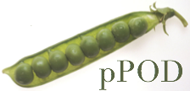
Contributions and Impact
We studied an important practical problem – collaborative data sharing – and developed the first comprehensive, principled solution: Orchestra
Formal provenance model: “most informative” in a precise sense; supports trust policies, ranking, ...
Uniform approach to propagating changes efficiently
Prototype implementation establishes feasibility of ideas
Orchestra currently being deployed in context of “Assembling the Tree of Life” (AToL) project
pPOD (“processing PhylOData”): joint project
between Penn, UC Davis, and Yale to
develop data management tools for AToL
Open source release of Orchestra also planned

Slide 50
Future Work
Incorporate uncertain information
Record linkage, imprecise queries, misaligned schemas, ... scientific data is full of these!
Provenance crucial here too, e.g., to assess information extraction quality
Relax the need for precise schema mappings
A daunting barrier to adoption!
Smoothly blend in “unstructured” modes of querying? Imprecise/uncertain mappings?
cf. Dataspaces [Franklin+ 05], best-effort data integration [Doan06], data integration with uncertainty [Dong+ 07]

Slide 51
Bibliography
T.J. Green, G. Karvounarakis, and V. Tannen. Provenance Semirings. PODS, June 2007.
T.J. Green, G. Karvounarakis, N.E. Taylor, O. Biton, Z.G. Ives, and V. Tannen. Orchestra: Facilitating Collaborative Data Sharing. SIGMOD (demo), June 2007.
T.J. Green, G. Karvounarakis, Z.G. Ives, and V. Tannen. Update Exchange with Mappings and Provenance. VLDB, September 2007.
J.N. Foster, T.J. Green, and V. Tannen. Annotated XML: Queries and Provenance. PODS, June 2008.
T.J. Green. Containment of Conjunctive Queries on Annotated Relations. ICDT, March 2009 (Best Student Paper Award).
T.J. Green, Z.G. Ives, and V. Tannen. Reconcilable Differences. ICDT, March 2009.
T.J. Green and Z.G. Ives. Evolution in Collaborative Data Sharing. In preparation, 2009.

Slide 53
Positive Relational Algebra (RA⁺) on K-Relations
natural join [ R₁ ⋈ R₂ ](t) := R₁(t₁) ∙ R₂(t₂)
where t on atts(R₁) = t₁, t on atts(R₂) = t₂
union [ R₁ ⋃ R₂ ](t) := R₁(t) + R₂(t)
projection [ π_{V}(R) ](t) := ∑_{t´=t on V and R(t´) ≠ 0} R(t´)
selection [ σ_{P}(R) ](t) := P(t) ∙ R(t)
where P is a predicate returning 0 or 1

Slide 54
Logical Implications of Containment and Equivalence [Green ICDT 09]
B[X]
N[X]
N
N[X]
Why(X)
Trio(X)
B[X]
N[X]
B[X]
N[X]
B[X]
Trio(X)
N
Why(X)
Trio(X)
Why(X)
Trio(X)
Why(X)
Lin(X)
Lin(X)
N
Lin(X)
N
Lin(X)
PosBool(X)
B
PosBool(X)
B
PosBool(X)
B
PosBool(X)
B
CQ containment
CQ equivalence
UCQ containment
UCQ equivalence
Arrow from K₁ to K₂ indicates K₁ containment (equivalence) implies K₂ cont. (equiv.)
All implications not marked $ are strict

Slide 55
Provenance is Universal
Theorem (factoring). The semantics of RA⁺ query answering on
K-relations for any commutative semiring K factors through
evaluation using provenance polynomials.
bag relation
a | c | 8
a | e | 10
d | c | 10
d | e | 55
f | e | 7
a | b | c | 2
d | b | e | 5
f | g | e | 1
q
q(R)
R
tag abstractly
evaluate polynomials
N[X]-relation
a | c | 2p²
a | e | pr
d | c | pr
d | e | 2r² + rs
f | e | 2s² + rs
a | b | c | p
d | b | e | r
f | g | e | s
q(R’)
q
R’

Slide 56
Provenance Tables and Mappings
Mappings converted to operate on provenance tables explicitly
ID | Species | Character | State
34 | L.catta | hand color | white
47 | L.catta | hand color | white
Species | Comm. Name
Lemur catta | Ring-Tailed L.
Mappings from A, D to provenance table
ID | Species | Character | State
34 | L.catta | hand color | white
47 | L.catta | hand color | white
Comm. Name
Ring-Tailed L.
Ring-Tailed L.
Provenance table for m₁
Mappings from provenance table to E
Comm. Name | Hand Color
Ring-tailed Lemur | white

Slide 57
Computing Differences for
Incremental Update Exchange
Given:
Goal:
Carol’s DB computed by a query over Bob’s DB
Recompute query that gives Carol’s DB
Bob’s DB changes
E :– … B …
B → B’
E’ :– … B’ …
Reformulation of E’
using E, B¢, B’!
Approach:
Compute Carol’s updated DB, using:
Carol’s old DB
Bob’s updates
Separate Bob’s updates
E’ :– E
E’ :– … B¢ ...
B’ = B with B¢
This is often more efficient than total recomputation
(cf. delta rules [Gupta&Mumick 93])

Slide 58
Computing Differences when Schemas and Mappings Change
Alice reorganizes database, splits A into two tables:
ID | Species | Img | Character | State
34 | L.catta |  | hand color | white | p
47 | L.catta |  | hand color | white | q
A:
ID | Img
34 |  | a
47 |  | b
ID | Species | Character | State
34 | L.catta | hand color | white | c
47 | L.catta | hand color | white | d
G:
H:
Carol updates mappings to reflect change (“mapping evolution”):
Old mapping
New mapping
E :– … A …
E’ :– … H …

Slide 59
Mapping Evolution as Query Reformulation
Goal: update Carol’s database instance incrementally, using Carol’s old DB, E
A reformulated plan to compute Carol’s new DB:
“insert data derived using updated rule”
E’ = E [ E₁ – E₂
E₁ :– … H …
E₂ :– … A …
“take everything that was in Carol’s DB already”
“delete data derived using old version of rule”
Note that plan introduces difference operator
(and is equivalent under Z[X]-semantics to original plan)
KEY QUESTIONS:
Is this the only reformulation?
For update exchange, is delta rules reformulation the only one?
If there are several reformulations, how to choose between them?

