Slide 1
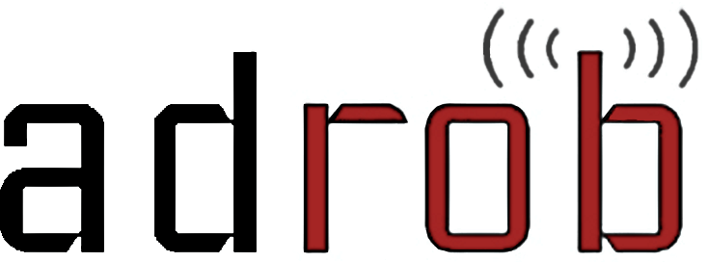
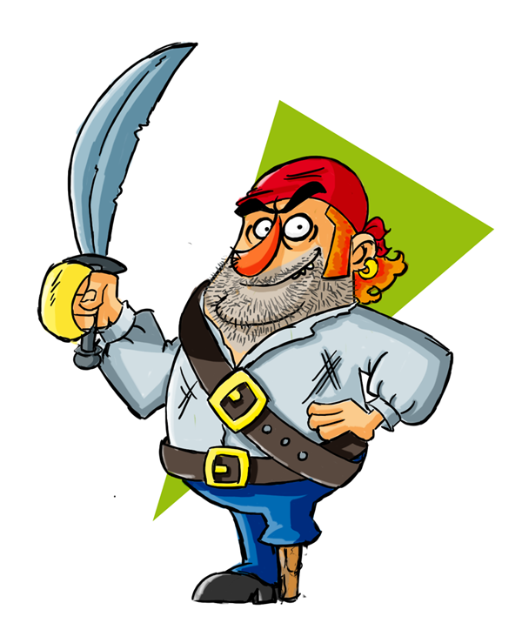


Examining the Landscape and Impact of Android App Plagiarism
Hao Chen
Clint Gibler
Ryan Stevens
Jonathan Crussell
Hui Zang
Heesook Choi

Slide 2





Smartphones Abound

Slide 3
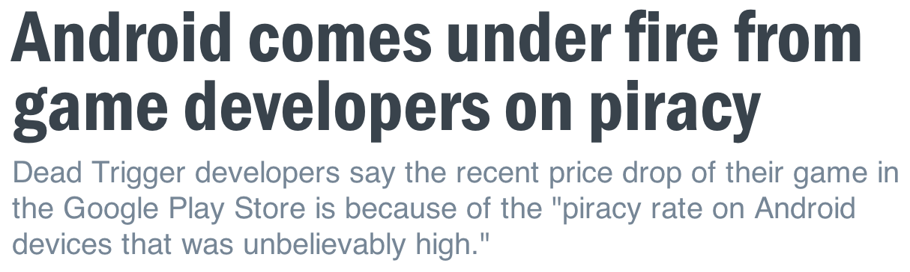
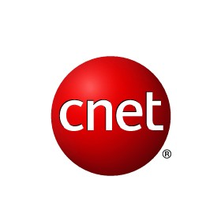

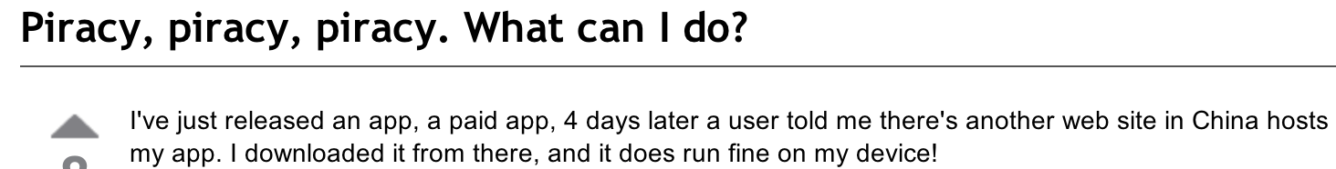

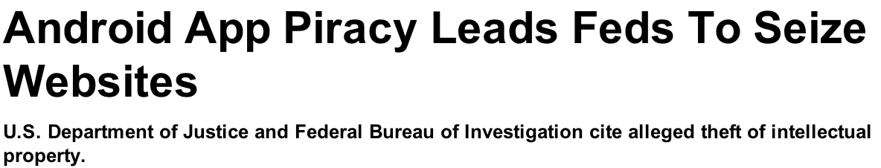

Slide 4
Plagiarism Harms the App Ecosystem
Developers
  Lose revenue and incentive to make apps
Markets
  Polluted search results
Users
  Difficult to find useful, high-quality apps

Slide 5



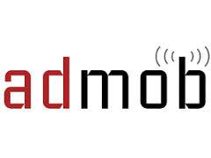

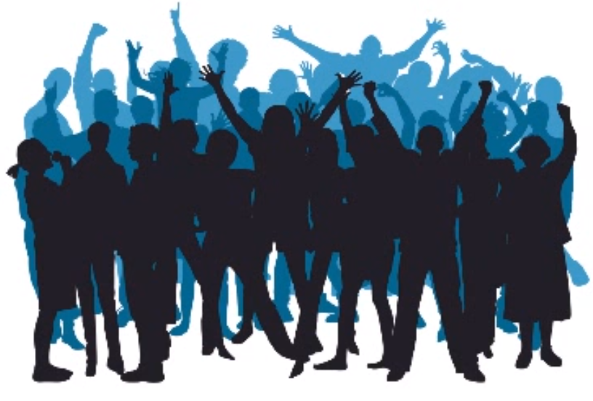
Investigation Goals
Characteristics of cloned apps
  Market
  App category
  Ad provider
Impact on developers
  Ad revenue
  User base
Notes:
We choose to focus on ad revenue because we found in previous work that a primary incentive for plagiarism is economic benefit and that this is often accomplished via ad revenue.
TODO: potentially have sub-bullets and images appear one by one onclick.

Slide 6
Definitions
Cloning
  Apps with significant code sharing
Plagiarism
  Cloned apps by different authors
Owner
  Signed and uploaded a given app
Notes:
Ideally we would like to determine the author of each app but there are several challenges to this in practice we’ll discuss later.
The issues include that owners may have multiple dev accounts.

Slide 7


Dataset – Android Apps
265,000 apps from 17 markets

Slide 8
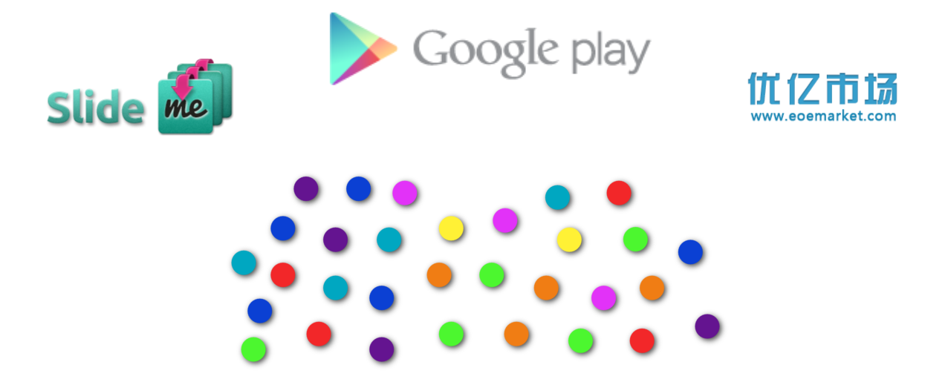
Dataset – Clone Clusters
265,000 apps from 17 markets

Slide 9
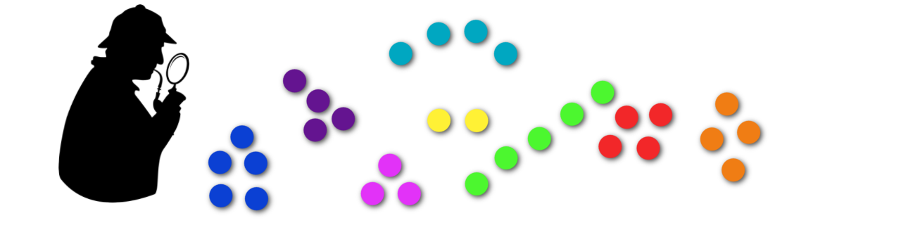
Dataset – Clone Clusters
[Crussell ESORICS 2013]
>5,000 clusters of similar apps
>44,000 unique apps

Slide 10
Dataset – Clone Clusters
[Crussell ESORICS 2013]
>5,000 clusters of similar apps
>44,000 unique apps
Likely clones

Slide 11
Characteristics of Cloned Apps
Notes:
We cover a number of further aspects in the video and in the paper.

Slide 12
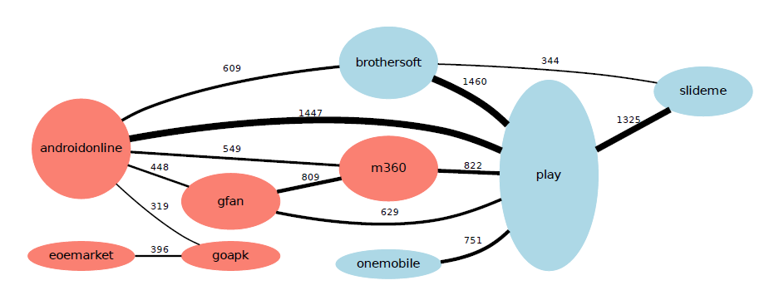
Cloning between Markets
androidonline
play
Notes:
This graph demonstrates the importance of cross market clone detection.
In this graph, each node represents a market and each edge between markets signifies the clone clusters that contains apps on both market.
Blue markets use English as their language while red ones use Chinese.
We omit edges/nodes below a certain threshold.
- Mention Play and AndroidOnline being cloning hubs.
If you assume there is only intramarket cloning you can use the developer accounts to signify the owner, but as we see cloning across markets, it’s not trivial to determine ownership across markets.
I’ll discuss how we do this later in the talk.
- Note that the edges in the graph or undirected- that is, it does not say apps tend to be copied from market A to market B.
At this point we’re not trying to determine the original app in each cluster.
The thickness of an edge is proportional to the MarketSim value between the markets, and the height of a node is proportional to the sum of the edge weights for a given market.
We have more in-depth breakdown by market, app category, and ad provider in the paper.
Presentation notes:
First, mention all vars= what are nodes/edges, then size of node/edges and color. Pause and let them absorb
Can spend a decent amount of time on this slide as it’s the only part of the characteristics presented in the talk.
Punchline: this shows that cloning happens across markets and thus inter-market clone detection is important.
Furthermore, ownership calculations across markets is more complicated than simply using developer account, thus we must do better. We discuss this later in the talk.

Slide 13
How do Plagiarized Apps Impact Developers?

Slide 14
Determining Impact
X
Naïve approach
  How many times has this app been cloned?
Our approach
  How many use plagiarized apps instead of the original?
Notes:
TODO: change to series of clock apps that then go to crowds of people like the video

Slide 15
Determining Impact
Measuring users running a given app
Determining app ownership
Identifying original app from plagiarized
Notes:
At the end of this slide: “So how do we determine how many users have installed a given app?”

Slide 16
(we’re not Google)
Notes:
Well, we don’t have code running on everyone’s phones…

Slide 17

So… what apps are you running?
Notes:
And we can’t just ask many users, so we found another way.
To measure app usage we leverage advertising on the Android platform.

Slide 18


Advertising Background
Ad Server
Ad request
Client ID = “bob”
Ad library
Ad URL
Notes:
When an application displays an ad it’s called an “impression.” I’ll discuss later how we use the impressions we observe to infer the economic impact of cloning on developers.

Slide 19
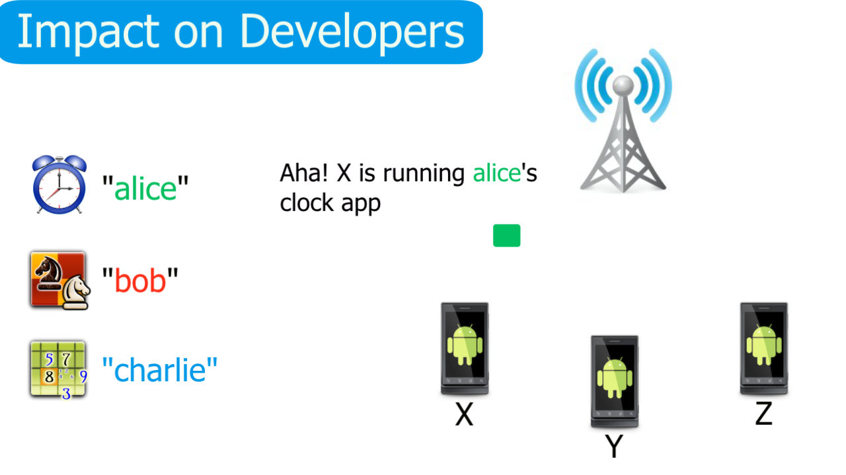
Number of Users Running an App
“bob”
Aha! Bob’s app is being run.
Notes:
We built tools to extract client IDs from popular ad libraries and ran them on our dataset.
Now, when we see a given client ID in network traffic we know that app is being run.

Slide 20
Dataset – Network Traffic
Major U.S. Cellular Provider
2.6 billion packets in 12 days
All user-identifying info removed

Slide 21
Determine Ownership of Apps
Owners may have multiple dev accounts
  Within one or on multiple markets
Apps that share an owner should not be considered plagiarized
Notes:
If we incorrectly determine ownership, our calculated impact may be much higher than its real value.
This is more complicated than if we just looked at one market, as the same developer could post to multiple markets and we don’t want to consider those other apps as clones.
We take the following steps to calculate app ownership

Slide 22







Determine Ownership of Apps
Phase 1 – Market/Dev Account
Notes:
2 apps from same dev account on same market
- Gets merged with app with same sig from a different market
- Gets merged with another app with same client ID
- 1 app with same dev account name but on a different market, don’t share sig – conservatively don’t merge
1 app with multiple sigs – were going to merge these but found in practice sometimes didn’t make sense
market/dev account, signature, client ID

Slide 23
Determine Ownership of Apps
Phase 1 – Market/Dev Account
Notes:
2 apps from same dev account on same market
- Gets merged with app with same sig from a different market
- Gets merged with another app with same client ID
- 1 app with same dev account name but on a different market, don’t share sig – conservatively don’t merge
1 app with multiple sigs – were going to merge these but found in practice sometimes didn’t make sense
market/dev account, signature, client ID

Slide 24
Determine Ownership of Apps
Phase 2 - Signature
Notes:
2 apps from same dev account on same market
- Gets merged with app with same sig from a different market
- Gets merged with another app with same client ID
- 1 app with same dev account name but on a different market, don’t share sig – conservatively don’t merge
1 app with multiple sigs – were going to merge these but found in practice sometimes didn’t make sense
market/dev account, signature, client ID

Slide 25



Determine Ownership of Apps
Phase 2 - Signature
Notes:
2 apps from same dev account on same market
- Gets merged with app with same sig from a different market
- Gets merged with another app with same client ID
- 1 app with same dev account name but on a different market, don’t share sig – conservatively don’t merge
1 app with multiple sigs – were going to merge these but found in practice sometimes didn’t make sense
market/dev account, signature, client ID

Slide 26
Determine Ownership of Apps
Phase 2 - Signature
Notes:
2 apps from same dev account on same market
- Gets merged with app with same sig from a different market
- Gets merged with another app with same client ID
- 1 app with same dev account name but on a different market, don’t share sig – conservatively don’t merge
1 app with multiple sigs – were going to merge these but found in practice sometimes didn’t make sense
market/dev account, signature, client ID

Slide 27
Determine Ownership of Apps
Phase 3 – Client IDs
Notes:
For the prevouis 2 merging steps we are certain they are correct.
However, it is possible that the plagiarist will not change the client ID.
We are curious about if plagirists do not share client IDs, how this will change our results.

Slide 28
Determine Ownership of Apps
Phase 3 – Client IDs
Notes:
2 apps from same dev account on same market
- Gets merged with app with same sig from a different market
- Gets merged with another app with same client ID
- 1 app with same dev account name but on a different market, don’t share sig – conservatively don’t merge
1 app with multiple sigs – were going to merge these but found in practice sometimes didn’t make sense
market/dev account, signature, client ID

Slide 29
Determine Ownership of Apps
Phase 3 – Client IDs
Notes:
2 apps from same dev account on same market
- Gets merged with app with same sig from a different market
- Gets merged with another app with same client ID
- 1 app with same dev account name but on a different market, don’t share sig – conservatively don’t merge
1 app with multiple sigs – were going to merge these but found in practice sometimes didn’t make sense
market/dev account, signature, client ID

Slide 30
Determine Ownership of Apps
Phase 3 – Client IDs
Notes:
2 apps from same dev account on same market
- Gets merged with app with same sig from a different market
- Gets merged with another app with same client ID
- 1 app with same dev account name but on a different market, don’t share sig – conservatively don’t merge
1 app with multiple sigs – were going to merge these but found in practice sometimes didn’t make sense
market/dev account, signature, client ID

Slide 31
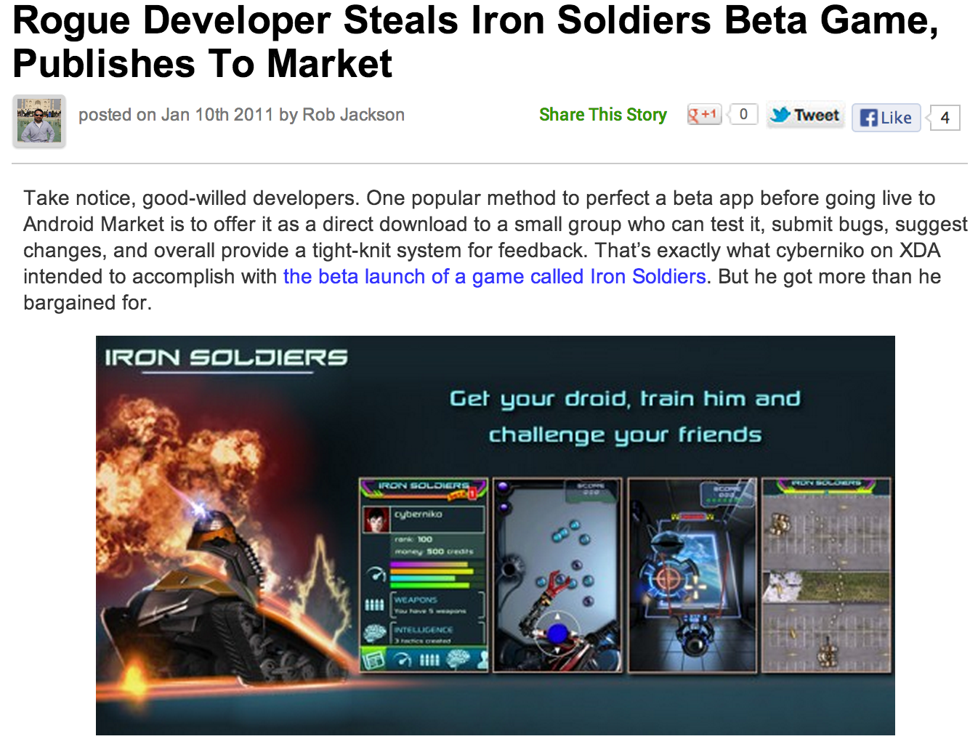
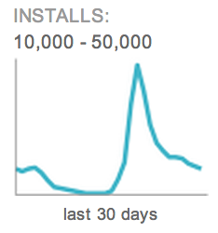

Identifying Original Apps:
Naïve Approaches
Date first uploaded to the market
Popularity
  Installs
  Rating
Code size
Notes:
Usually markets just show the upload date of the most recent version of an app. To know when the first version of an app was uploaded would require continuous crawling of all markets from the beginning. Even if you had crawled all markets continuously there are known cases of people taking beta versions of apps posted to developer forums and uploading them to markets, claiming them as their own.
For less popular apps, the number of downloads between the original and the clone may not be so different. Also vulnerable to Sybil attacks.
Code size may be easily changed by the plagiarist to be larger or smaller than the original app.
http://phandroid.com/2011/01/10/rogue-developer-steals-iron-soldiers-beta-game-publishes-to-market/

Slide 32
Determining Original vs Clones
Goal: give lower bound
An Example Cluster
Impressions
Alice
20 impressions
20%
Bob
30 impressions
50%
Charlie
50 impressions
30%
Notes:
Hard dollar amounts are difficult to calculate for the following reasons:
- TODO
Thus we give a ratio of the percent lost rather than hard dollar amounts.
Admob, airpush, inmobi, millennial, mobclix

Slide 33
Determining Original vs Clones
Goal: give lower bound
Estimated Loss
Impressions
20%
50%
50%
30%
50%
Notes:
Hard dollar amounts are difficult to calculate for the following reasons:
- TODO
Thus we give a ratio of the percent lost rather than hard dollar amounts.
Admob, airpush, inmobi, millennial, mobclix

Slide 34
Determining Original vs Clones
Goal: give lower bound
Estimated Loss
Real Loss
20%
50%
50%
30%
50%
Notes:
Hard dollar amounts are difficult to calculate for the following reasons:
- TODO
Thus we give a ratio of the percent lost rather than hard dollar amounts.
Admob, airpush, inmobi, millennial, mobclix

Slide 35
Determining Original vs Clones
Goal: give lower bound
Estimated Loss
Real Loss
50%
70%
30%
50%
Notes:
Hard dollar amounts are difficult to calculate for the following reasons:
- TODO
Thus we give a ratio of the percent lost rather than hard dollar amounts.
Admob, airpush, inmobi, millennial, mobclix

Slide 36
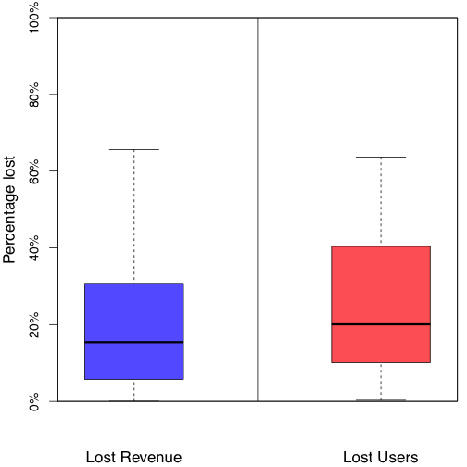
Percent Revenue/Users Lost
Notes:
On average, a victim developer loses …
Overall, collectively all developers lose 14% of their ad revenue and 10% of their user base. In the video we discuss this total loss due to plagiarism.
-----------
The median values in the plots represent the average lost revenue and users when looking at apps individually.
However we report on the lower aggregate figures in the video in order to avoid potential criticism or confusion as a result of giving equal weight to clusters with very few apps and impressions.

Slide 37
Suggestions for Reducing Cloning
Developers
  Proguard, License Verification Library (LVL)
Markets
  Use tools to detect cloned apps
  Adjust market registration fee
Ad providers
  Vet developers
Notes:
Proguard and LVL do not solve the problem but they raise the effort required of plagiarists.
Markets would ideally coordinate with eachother in the search for clones as the copied apps may not be on the same market as the original.
Note: don’t need to spend as much time on this slide. Skip if running out of time

Slide 38
Conclusion
First large scale study on impact of Android application plagiarism
Combine
  Static analysis for clone detection
  Network analysis for revenue loss measurement
  Use client IDs to link both analyses
Coming soon: sherlockdroid.com

Slide 39
