Slide 1
Secure Pairing of Wireless Devices by Multiple Antenna Diversity
Liang Cai
University of California, Davis
Joint work with Kai Zeng, Hao Chen, Prasant Mohapatra

Slide 2


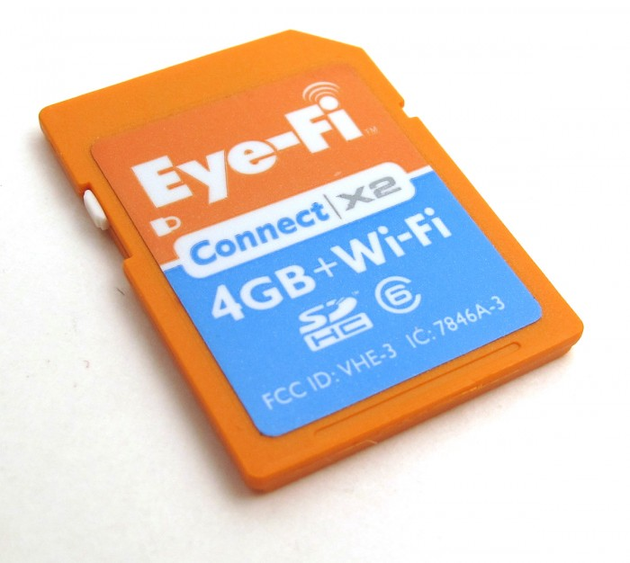
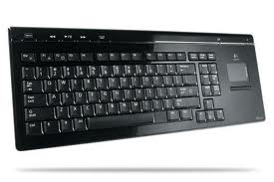

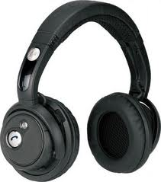



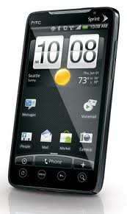
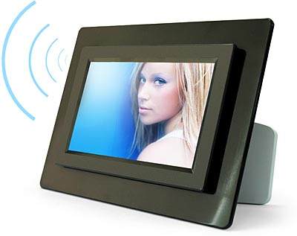
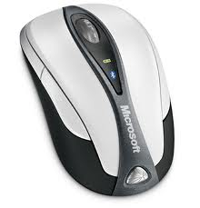

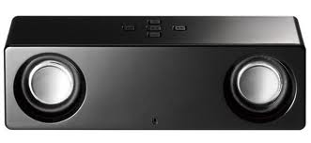
Ubiquitous Wireless Devices
Most of these devices require ad-hoc connections!

Slide 3

Wi-Fi Direct
Allows peer-to-peer Wi-Fi connection (without AP)
Requires no new hardware
Specification and certified devices are coming soon

Slide 4
Secure Device Pairing
Bootstrap secure communication between two devices.
Common approach: shared PIN code
Problems
  Many devices have no keyboard (so they hardcode secrets)
  Potential user error and vulnerability
Solution: using out-of-band (OOB) channels
Notes:
OOB approaches and Proximity based approaches has an obvious overlap.

Slide 5
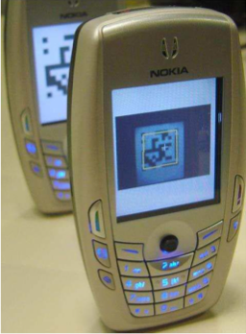
Visual Channel (Seeing is Believing)
Notes:
Refer wiki and the paper (Serial Hook-ups: A Comparative Usability Study of Secure Device Pairing Methods) for a brief description of the above schemes.

Slide 6
Acoustic Channel (Loud and Clear)

Slide 7
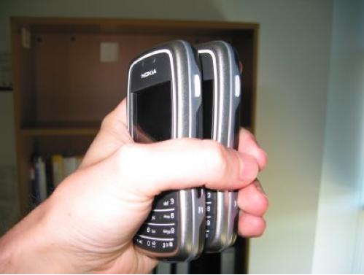
Motion Channel (Shake well before use)

Slide 8

Limitations of OOB Channels
OOB channels are not ubiquitous on all devices
Some OOB channels are vulnerable to attacks (Halevi etc. CCS ’10)
Notes:
OOB approaches and Proximity based approaches has an obvious overlap.

Slide 9
Desirable Device Pairing Scheme
Use no out-of-band channel
Does NOT require the user to
  Enter secrets (simplify user tasks), or
  Verify secrets (avoid user mistakes)

Slide 10
Our scheme: Good Neighbor
Use the wireless channel
Securely pair devices based on proximity

Slide 11
Why not using Distance-bounding Protocols
Cryptographic protocol that allows verifier V to establish an upper bound on physical distance to a prover P.
Based on the fact that electro-magnetic waves travel nearly at the speed of light, but cannot travel faster
Rely on a rapid bit exchange and require precise clocks to measure light-speed messages

Slide 12
Threat model
Attackers can
  Have powerful antennas
  Have exact copies of the pairing devices
  Know the exact location of the pairing devices
Attackers can NOT
  Come in close proximity of the receiver (Eg. less than 1m).
  Compromise the pairing devices.
  Jam the channel

Slide 13

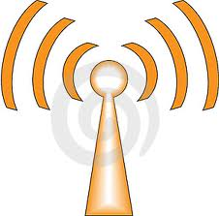
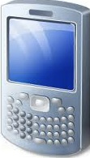

Naïve Approach: Inferring proximity by RSS
d = d₁
d = d₂
Receiver
Sender
Changing P₀

Slide 14



Improvement: Inferring proximity by RSS ratio
L
d₁
d₂
Ratio:
>>0
d’₁
d’₂
Ratio:
≈0

Slide 15
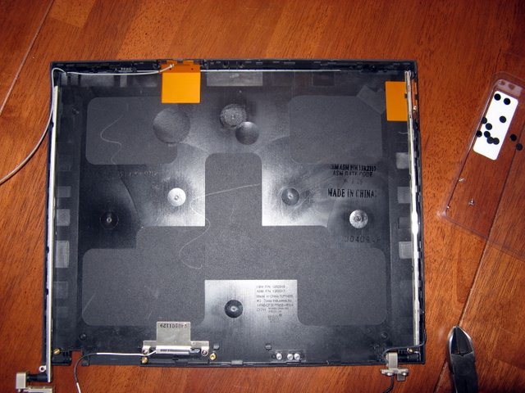
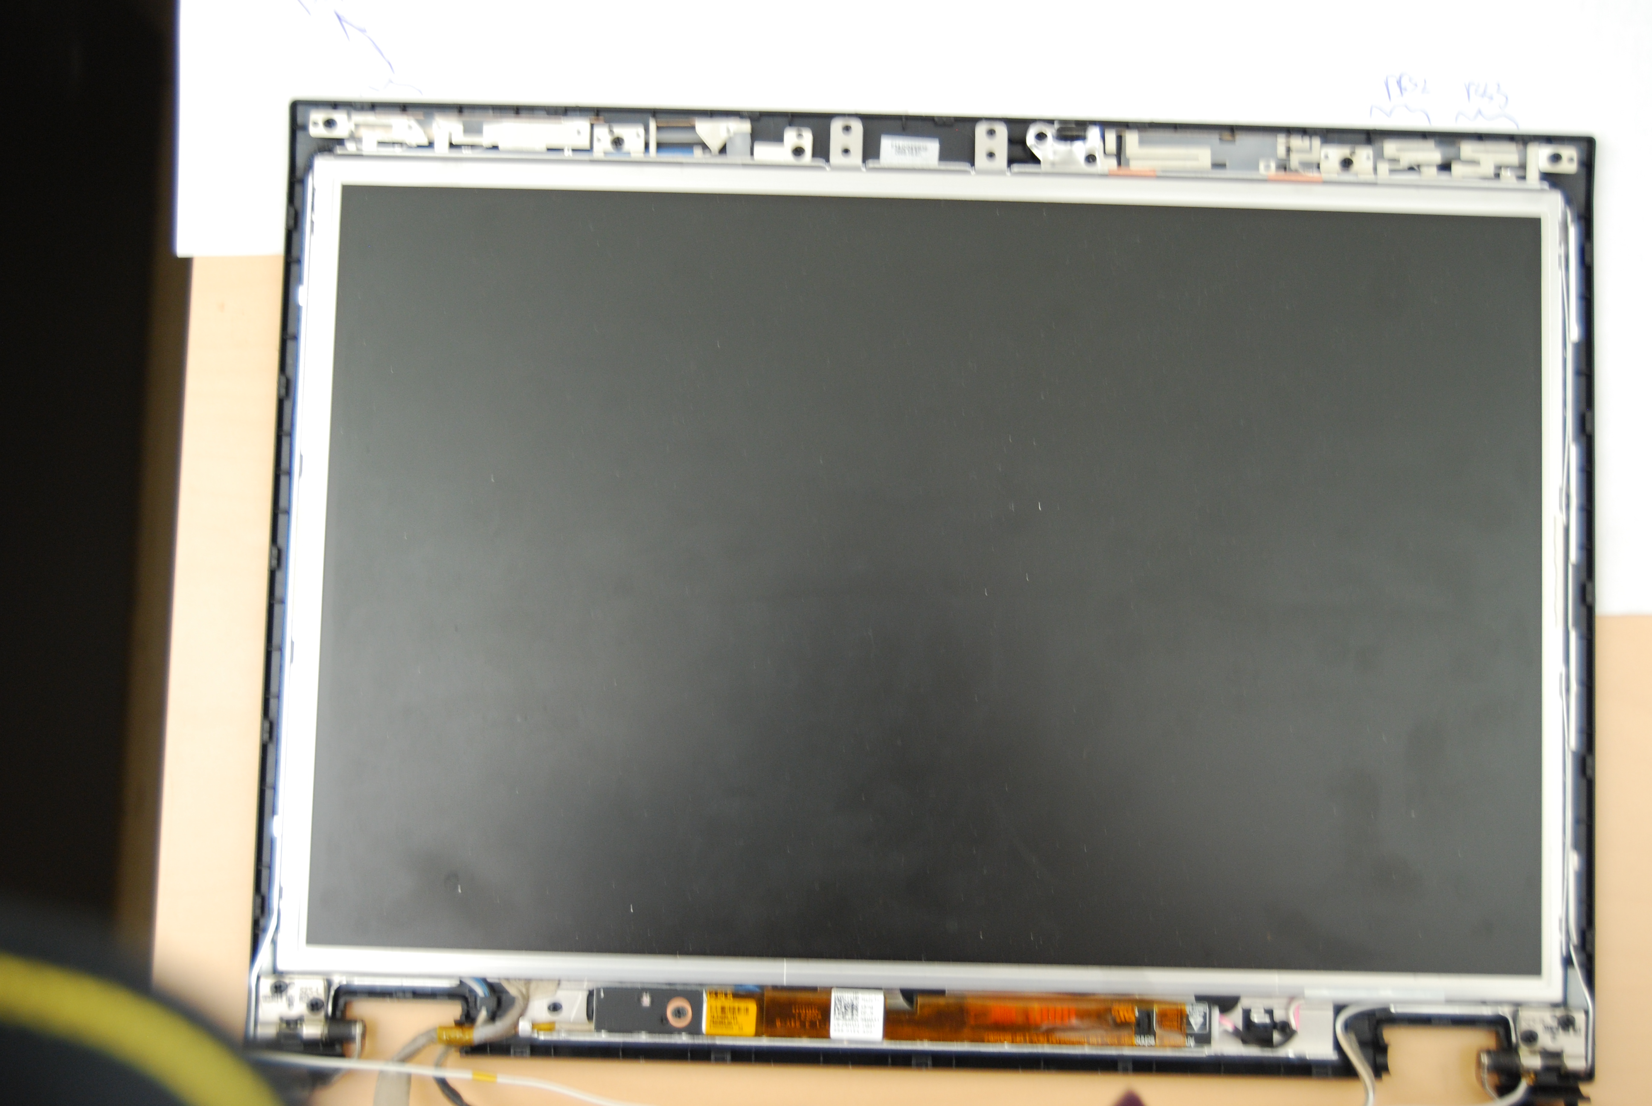
Antenna Diversity and IEEE 802.11n MIMO
IBM T42P (Antennas diversity)
Dell e5400 (MIMO antennas)
Spatial diversity: to improve the quality and reliability of a wireless link
Spatial diversity
Spatial multiplexing (From 54Mbps to 600 Mbps)

Slide 16
Practical Problem: Unstable RSS Values
Problem:
  RSS values may fluctuate
Solution:
  Sender (S) sends a series of packets
  Receiver (R) calculates the mean and deviation of the RSS values

Slide 17
Practical Problem: RSS saturation
Problem:
  RSS value saturates when the signal is too strong or too weak.
Solution: (power probing)
  S sends probing packets with different transmission power levels
  R chooses the optimal power level that results in the largest RSS ratio

Slide 18
Practical Problem: Automatic Rate Adaptation
Problem:
  Inconsistent RSS values if the Automatic Rate Adaptation feature is enabled.
Solution:
  Disable Automatic Rate Adaptation.

Slide 19

Final scheme
S
R
A₂
Move S close
to A₁ of R
A₁
R
AuthRequest()
AuthResponse(K_{R})
PowerQuery(I,n)
PowerResponse(l)
RSSMeasure(E_{KR}(k))
S
Move S close
to A₂ of R
RSSMeasure(E_{KR}(k))
Success()

Slide 20
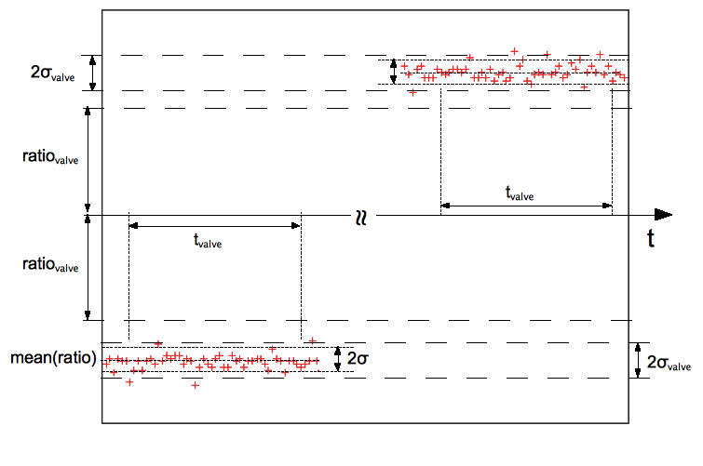
Typical RSS ratio of successful device pairing
RSS ratio

Slide 21
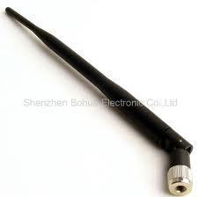
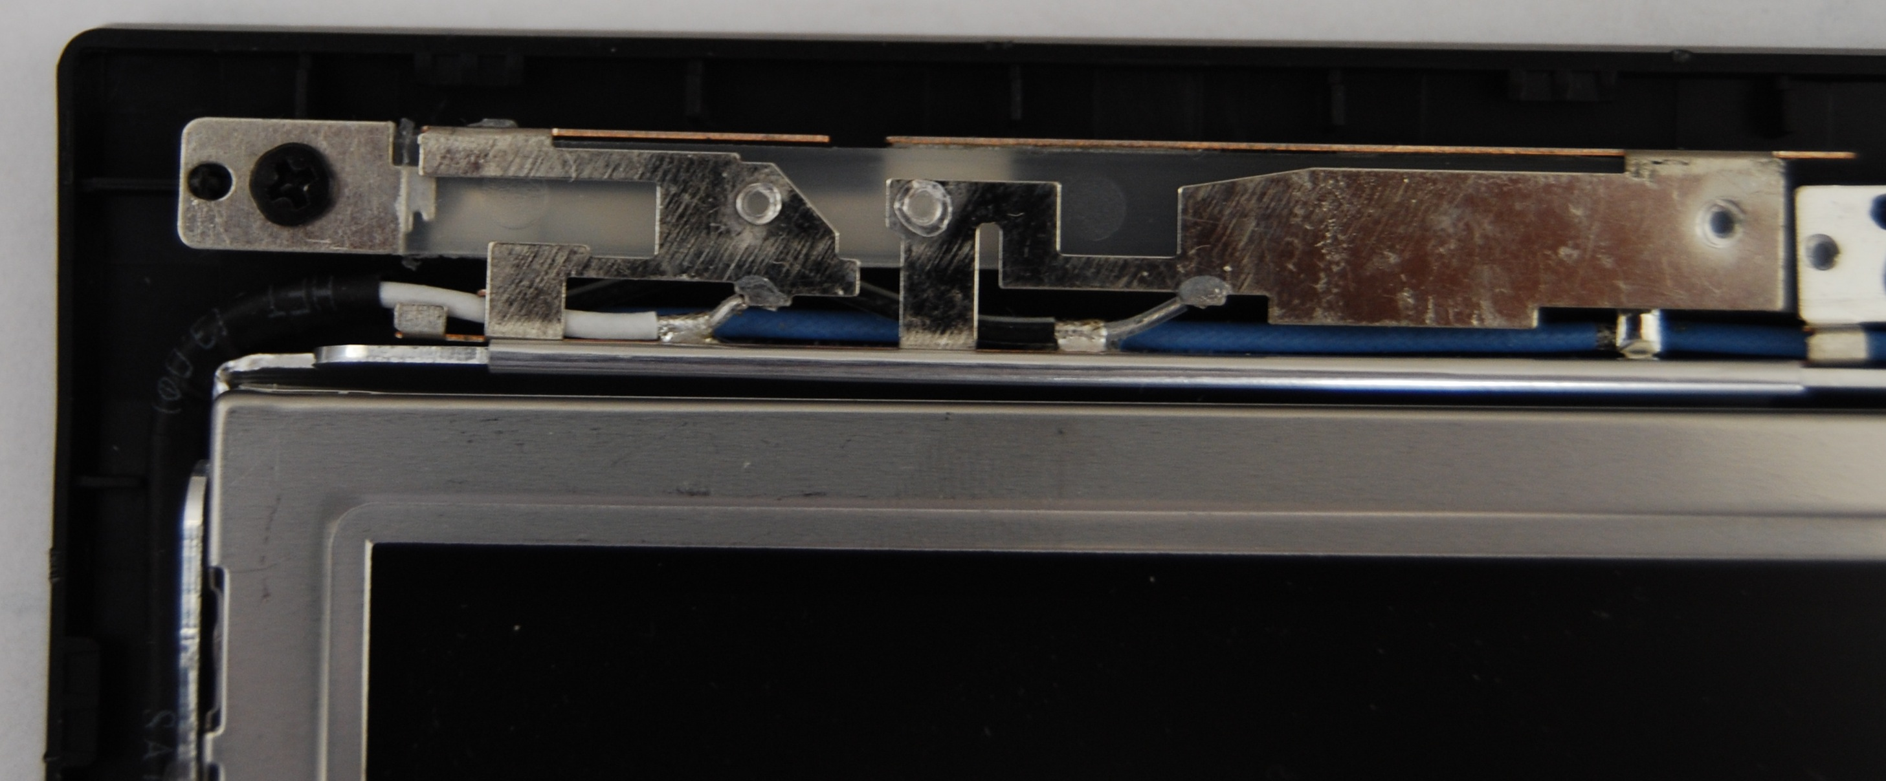
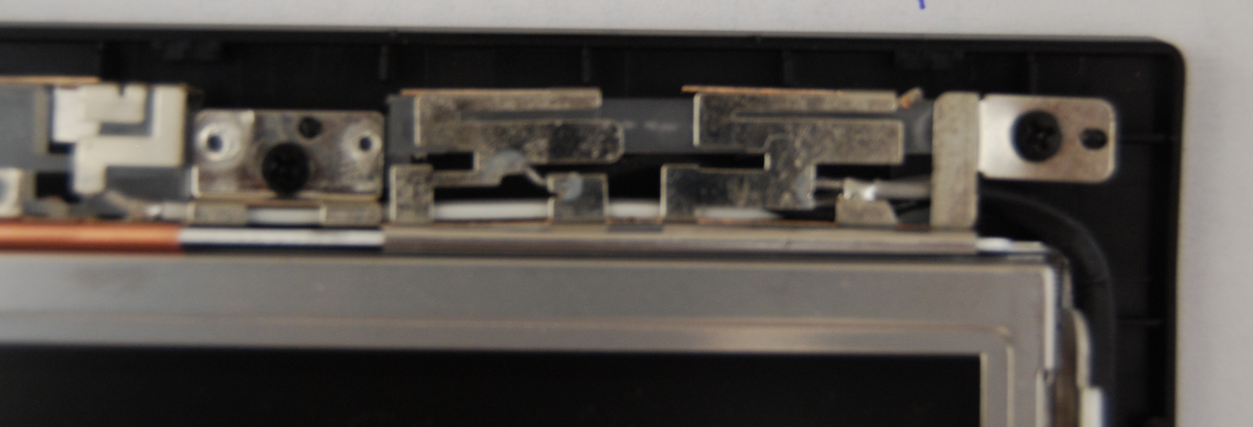
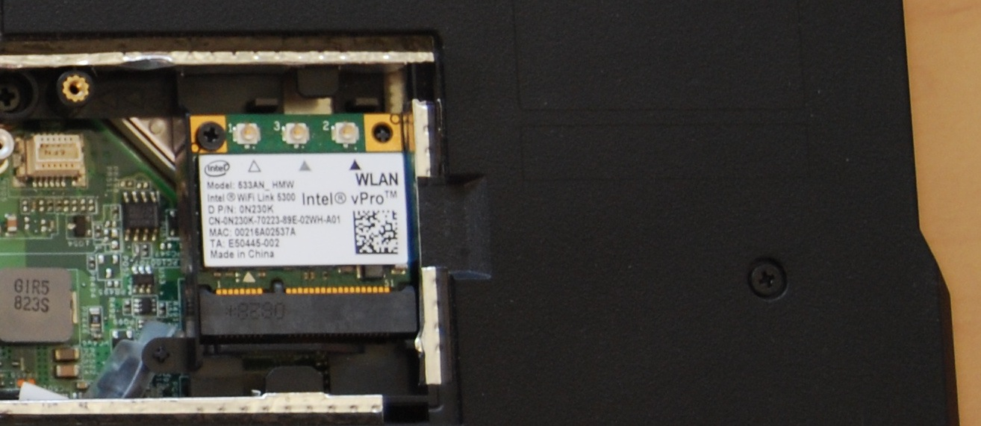
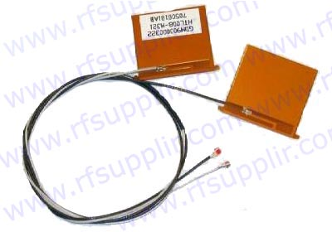
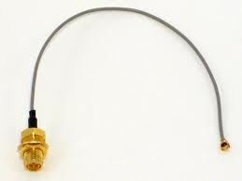
Antennas used in our experiments
Type 1: internal antennas for
Dell E5400 laptop
Type 4: Dipole antenna
Type 2: antennas for laptop mini PCI cards
Type 3: RP-SMA (f) socket

Slide 22
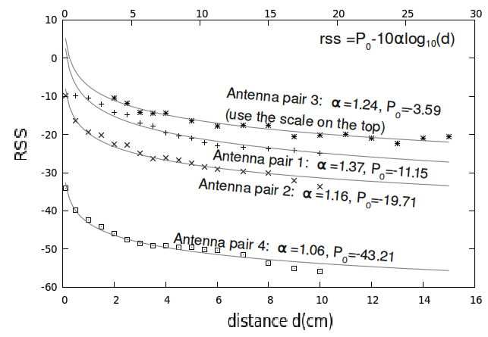
Logarithmic relationship between
RSS value and the sender-receiver distance

Slide 23
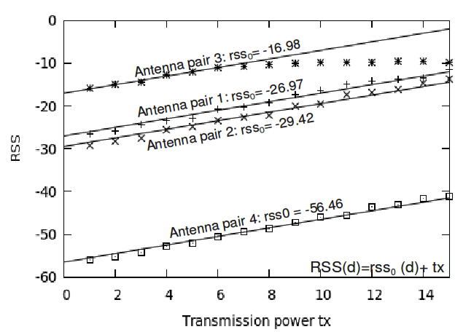
Linear relationship between RSS value and the transmission power

Slide 24
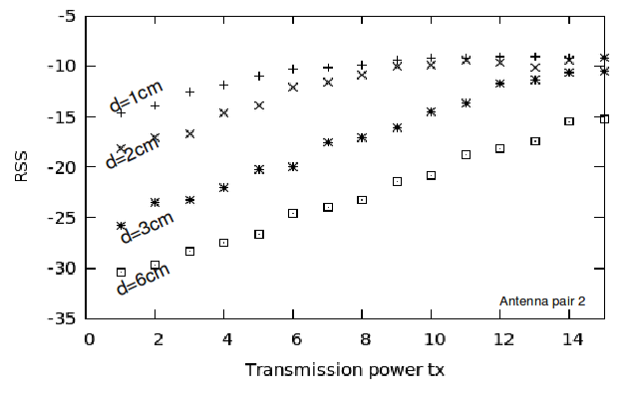
RSS saturation is observed when the distance decreases

Slide 25
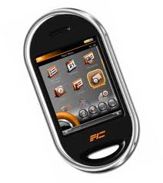

Prototype
26cm
Receiver
Sender
Modify the driver to export RSS values seperately
Threshold setting:
  r_{H} = -r_{L} = 11
  σ_{valve} =0.6
  T_{valve} = 1s

Slide 26
Video

Slide 27
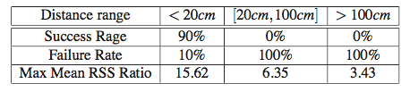
Prototype
r<20cm
20cm<r<1m
r>1m

Slide 28
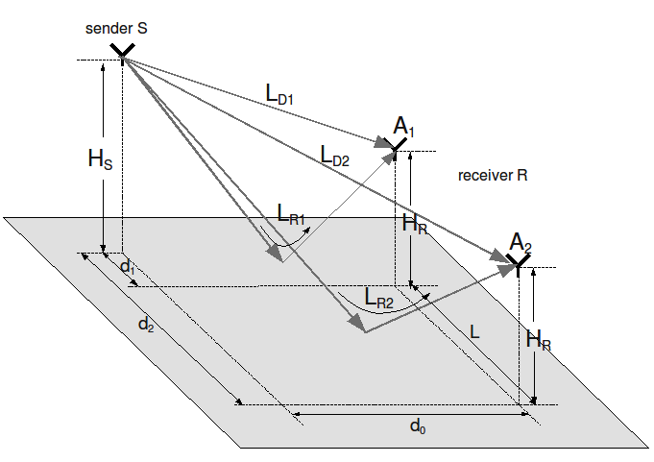
Potential Attack using Multipath Effect
Attacker may exploit multipath effect to find faraway locations that cause large RSS ratios

Slide 29
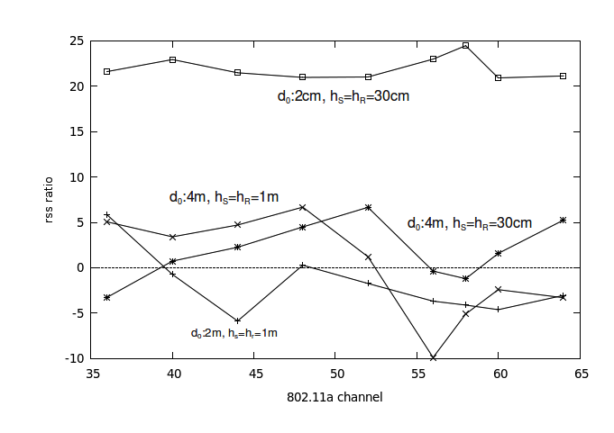
Mitigating with Frequency hopping

Slide 30
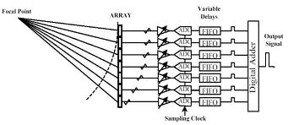
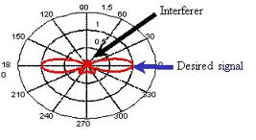
Potential Attack using Beam Forming
Risk: Attackers may form a beam of signal with an antenna array
Attackers need a very large antenna array (size of hundreds of meters when L=20cm, d>10m)

Slide 31
Future works
Mutual authentication
Apply our scheme to Bluetooth
Applications that requires Near Field Communication

Slide 32
Conclusion
A novel device-pairing scheme
  Based on proximity
  Requires no Out-of-Band Channel
  Requires no user input or verification

