Slide 1
Supervised Learning:
k-Nearest Neighbors
Patrice Koehl

Slide 2
Predicting
Let’s imagine a scenario where we would like to predict the value of one variable using another (or a set of other) variables.
Examples:
Predicting the effect of a medication based on symptoms experienced by the patient (temperature, pain, some blood results,…)
Predicting which movies a Netflix user will rate highly based on their previous movie ratings, demographic data, etc.

Slide 3
Example
The Advertising data set consists of the sales of a particular product in 200 different markets, and advertising budgets for the product in each of those markets for three different media: TV, radio, and newspaper. Everything is given in units of $1000.
TV | Radio | Newspaper | Sales
230.1 | 37.8 | 69.2 | 22.1
44.5 | 39.3 | 45.1 | 10.4
17.2 | 45.9 | 69.3 | 9.3
151.5 | 41.3 | 58.5 | 18.5

Slide 4
Response vs Predictor Variables
There is an asymmetry in many of these problems:
The variable we would like to predict may be more difficult to measure, may be more important than the other(s), or are probably directly or indirectly influenced by the other variable(s).
Thus, we'd like to define two categories of variables:
variables whose values we want to predict
variables whose values we use to make our prediction

Slide 5
Response vs Predictor Variables
X
predictors
features
covariates
Y
outcome
response variable
dependent variable
TV | Radio | Newspaper | Sales
230.1 | 37.8 | 69.2 | 22.1
44.5 | 39.3 | 45.1 | 10.4
17.2 | 45.9 | 69.3 | 9.3
151.5 | 41.3 | 58.5 | 18.5
n observations
p predictors

Slide 6
Response vs Predictor Variables
X1, X2,…, Xp
predictors
features
covariates
Y1, Y2, …, Ym
outcome
response variable
dependent variable
TV | Radio | Newspaper | Sales
230.1 | 37.8 | 69.2 | 22.1
44.5 | 39.3 | 45.1 | 10.4
17.2 | 45.9 | 69.3 | 9.3
151.5 | 41.3 | 58.5 | 18.5
n observations
p predictors

Slide 7
Statistical Model
We assume that the response variable, $Y$, relates to the predictors, $X$, through some unknown function expressed generally as:
$$Y=f\left(X\right)+ε$$
Here, $f$ is the unknown function expressing an underlying rule for relating $Y$ to $X$, $ε$is the amount (unrelated to $X$) that $Y$ differs from the rule $f\left(X\right).$
A statistical model is any algorithm that estimates $f$. We denote the estimated function as $\overset{^}{f.}$

Slide 8
Prediction vs Estimation
For some problems, what's important is obtaining $\overset{^}{f}$, the estimate of $f$. These are called inference problems.
When we use a set of measurements, $(x_{i,1},…,x_{i,p})$ to predict a value for the response variable, we denote the predicted value by:
${\overset{^}{y}}_{i}=$ $\overset{^}{f}(x_{i,1},…,x_{i,p})$.
For some problems, we do not care about the specific expression of $\overset{^}{f}$, we just want to make our predictions $\overset{^}{y}$’s as close to the observed values $y$’s as possible. These are called prediction problems.

Slide 9
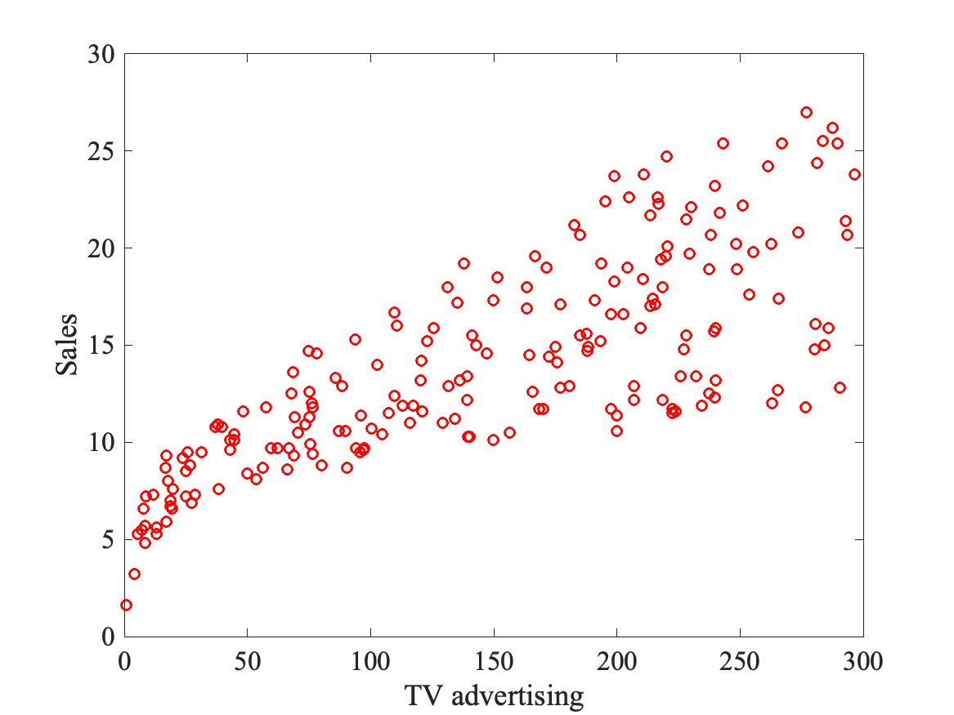
Prediction Model
Build a model to predict sales based on TV budget
The response, y, is the sales
The predictor, x, is TV budget

Slide 10
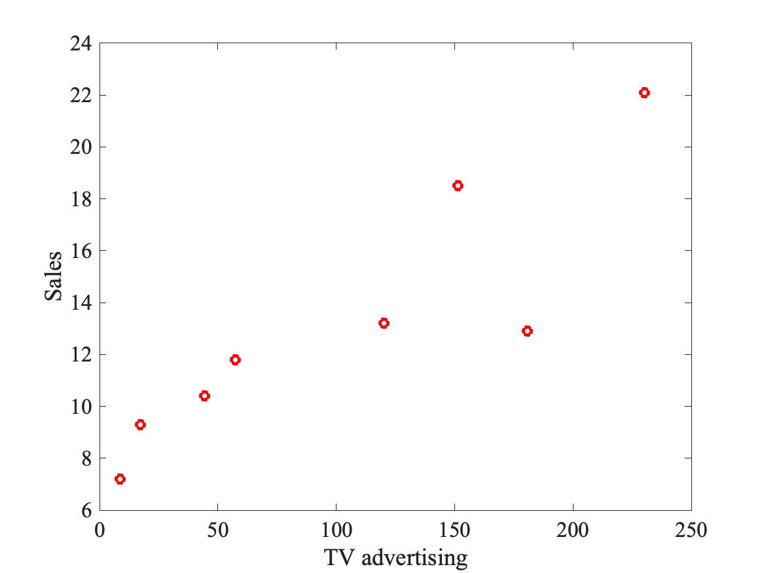
Prediction Model
y
x

Slide 11
Prediction Model
How do we predict the sales value (y) for a given TV advertising value (x)?
What is the value of y at this $x$?

Slide 12
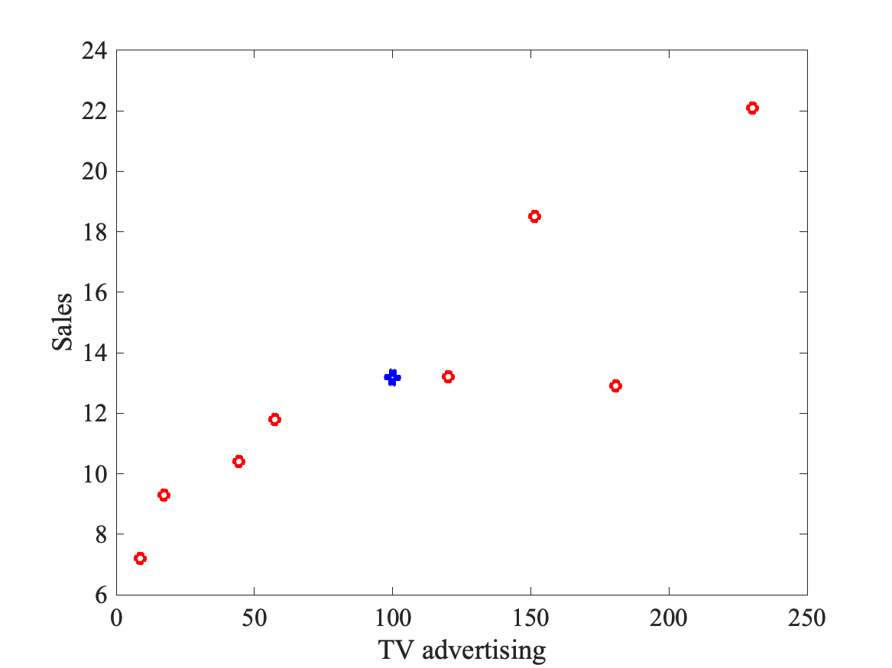
Prediction Model: Average
Simplest idea: table the mean of the existing values: $\overset{̂}{y}=\frac{1}{n}\overset{n}{\underset{i=1}{∑}}y_{i}$
$$\overset{̂}{y}$$
What is the value of y at this $x$?

Slide 13
Statistical Model

Slide 14
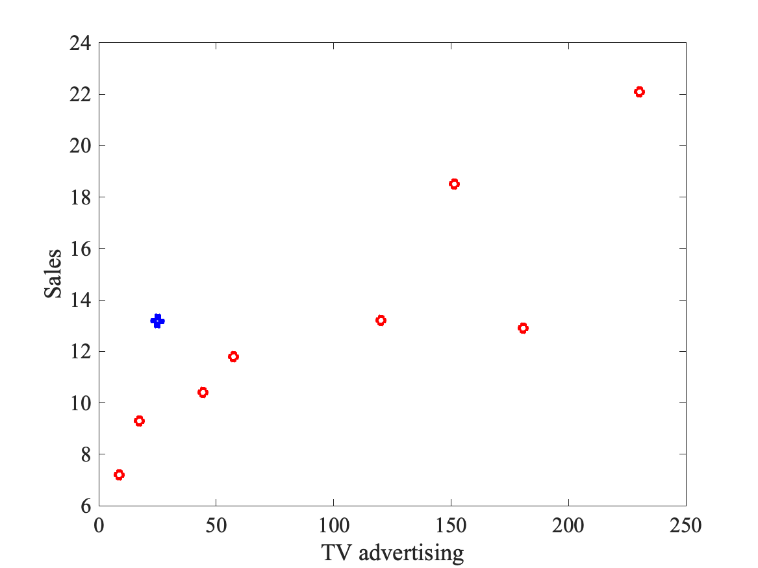
Prediction Model: Average
Simplest idea: table the mean of the existing values: $\overset{̂}{y}=\frac{1}{n}\overset{n}{\underset{i=1}{∑}}y_{i}$
Not always the “best” solution!
$$\overset{̂}{y}$$
What is the value of y at this $x$?

Slide 15
Prediction Model: 1-Neighbour
What is the value of y at this $x$?
What is the value of y at this $x$?

Slide 16
Prediction Model: 1-Neighbour
Find distance D(x,x_i) to all
other points
What is the value of y at this $x$?
What is the value of y at this $x$?

Slide 17
Prediction Model: 1-Neighbour
Find distance D(x,x_i) to all
other points
2. Find closest xc
$$x_{c}$$
What is the value of y at this $x$?
What is the value of y at this $x$?

Slide 18
Prediction Model: 1-Neighbour
Find distance D(x,x_i) to all
other points
2. Find closest xc
3. Define $\overset{̂}{y}(x)=y(x_{c})$
$$\overset{̂}{y}$$
$$x_{c}$$
What is the value of y at this $x$?
What is the value of y at this $x$?

Slide 19
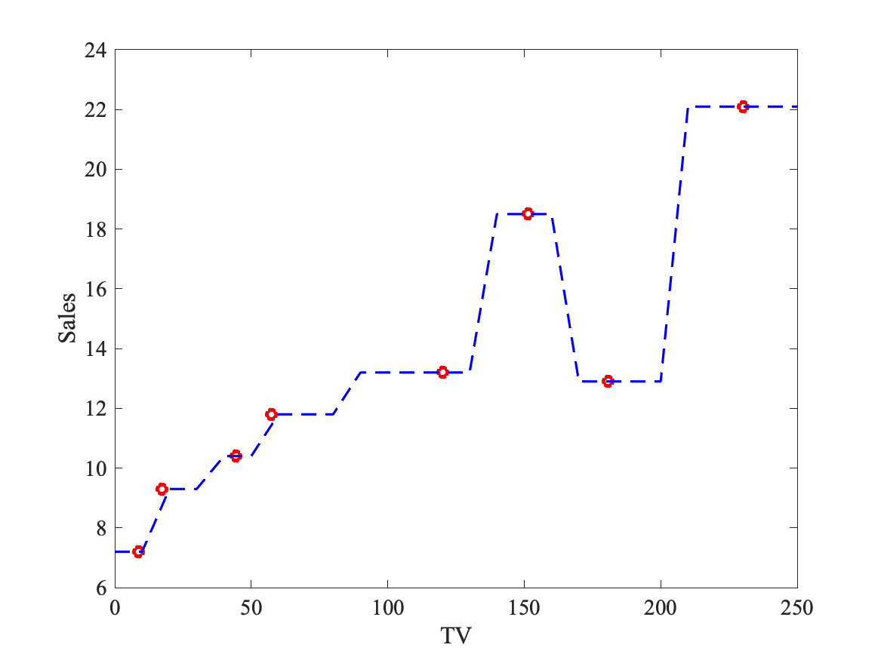
Prediction Model: 1-Neighbour
Repeat for all values of x in the range of “TV”: this builds a model for y!

Slide 20
Prediction Model: k-Nearest Neighbours
What is the value of y at this $x$?
What is the value of y at this $x$?

Slide 21
Prediction Model: k-Nearest Neighbours
Find distance D(x,x_i) to all
other points
What is the value of y at this $x$?
What is the value of y at this $x$?

Slide 22
Prediction Model: k-Nearest Neighbours
Find distance D(x,x_i) to all
other points
2. Find k closest xc1, xc2, xc3, xc4 …
(here k = 4)
$$x_{c3}$$
$$x_{c1}$$
$$x_{c2}$$
$$x_{c4}$$
What is the value of y at this $x$?
What is the value of y at this $x$?

Slide 23
Prediction Model: k-Nearest Neighbours
Find distance D(x,x_i) to all
other points
2. Find k closest xc1, xc2, xc3, xc4 …
(here k = 4)
3. Average y over k-nearest
Neighbors
$\overset{̂}{y}=\frac{1}{k}\overset{k}{\underset{j=1}{∑}}y(x_{cj})$
$$x_{c3}$$
$$\overset{̂}{y}$$
$$x_{c1}$$
$$x_{c2}$$
$$x_{c4}$$
What is the value of y at this $x$?
What is the value of y at this $x$?

Slide 24
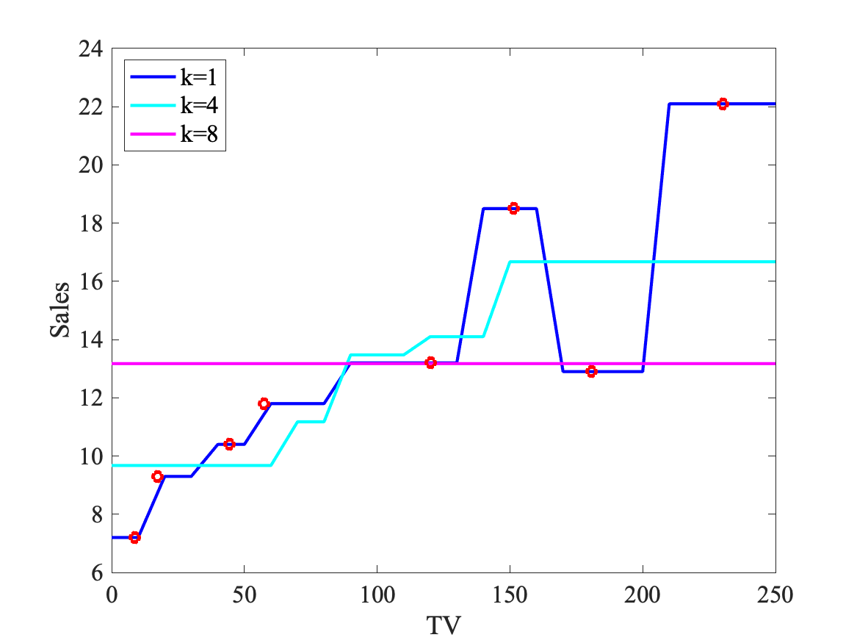
Prediction Model: k-Nearest Neighbours
Repeat for all values of x in the range of “TV” for different k values: this builds different models for y!

Slide 25
Prediction Model: k-Nearest Neighbours
The k-Nearest Neighbor (kNN) model is an intuitive way to predict a quantitative response variable:
to predict a response for a set of observed predictor values, we use the responses of other observations most similar to it
kNN is a non-parametric learning algorithm. When we say a technique is non parametric , it means that it does not make any assumptions on the underlying data distribution.
Note: this strategy can also be applied to classification problems to predict a categorical variable. We will encounter kNN in the lab.

Slide 26
Prediction Model: k-Nearest Neighbours
The k-Nearest Neighbor Algorithm:
Given a dataset $D=\{{(x}^{\left(1\right)},$ $y^{\left(1\right)}),…,{(x}^{\left(N\right)},$ $y^{\left(N\right)}$)}. For every new $X:$
Find the k-number of observations in $D$most similar to $X:$
$\{{(x}^{\left(n_{1}\right)},$ $y^{\left(n_{1}\right)}),…,{(x}^{\left(n_{k}\right)},$ $y^{\left(n_{k}\right)}$)}
These are called the k-nearest neighbors of $x$
Average the output of the k-nearest neighbors of $x$
$$\overset{̂}{y}=\frac{1}{k}\overset{k}{\underset{i=1}{∑}}y^{n_{i}}$$

Slide 27
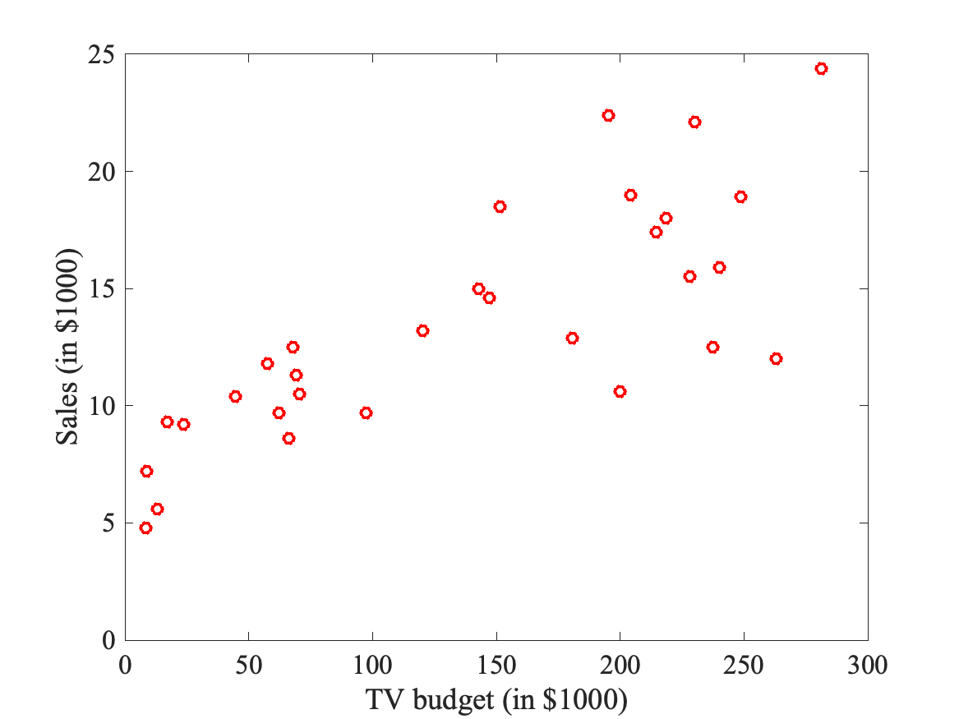
Evaluating a Model
Start with some data (x,y):

Slide 28
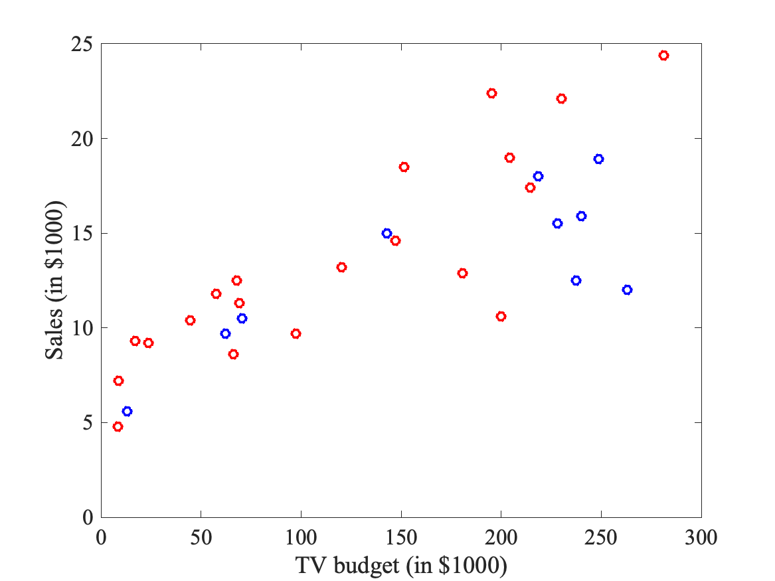
Evaluating a Model
Divide data into a training set (red) and a test set (blue):

Slide 29
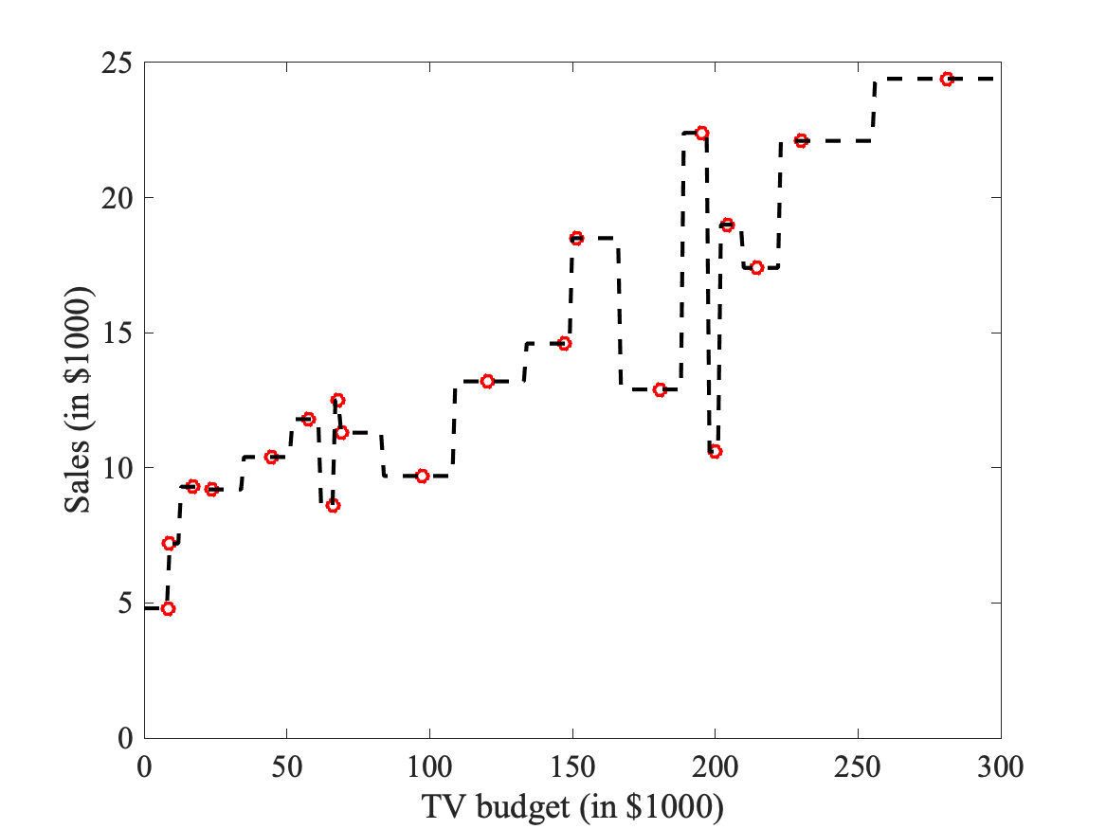
Evaluating a Model
1. Build a model based on training set
(here a 1-Neighbor model):

Slide 30
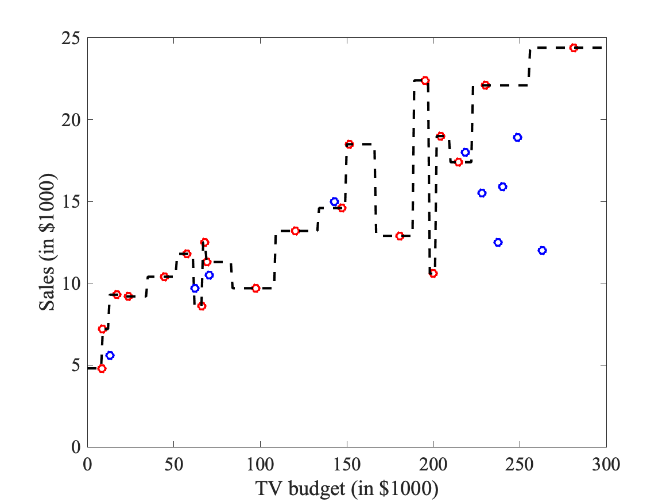
Evaluating a Model
1. Build a model based on training set
(here a 1-Neighbor model)
2. Add test data

Slide 31
Evaluating a Model
1. Build a model based on training set
(here a 1-Neighbor model)
2. Add test data
3. Compute residuals for the N test data
$(\overset{̂}{y}(i)-y(i))$
$$\overset{̂}{y}(i)-y(i)$$

Slide 32
Evaluating a Model
1. Build a model based on training set
(here a 1-Neighbor model)
2. Add test data
3. Compute residuals for the N test data
$(\overset{̂}{y}(i)-y(i))$
4. Compute the mean square error,
also called loss function
$$\text{MSE}=\frac{1}{N}\overset{N}{\underset{i=1}{∑}}(\overset{̂}{y}(i)-y(i))^{2}$$
$$\overset{̂}{y}(i)-y(i)$$

Slide 33
Evaluating a Model
Note: the mean square error is not the only possible loss function! Other possibilities:
Mean square error
Root mean square error
Maximum absolute error
Average absolute error
$$\text{MSE}=\frac{1}{N}\overset{N}{\underset{i=1}{∑}}(\overset{̂}{y}(i)-y(i))^{2}$$
$$\text{RMSE}=\sqrt{\frac{1}{N}\overset{N}{\underset{i=1}{∑}}(\overset{̂}{y}(i)-y(i))^{2}}$$
$$\text{MAE}=\max_{i∈[1,N]}|\overset{̂}{y}(i)-y(i)|$$
$$\text{AAE}=\frac{1}{N}\overset{N}{\underset{i=1}{∑}}|\overset{̂}{y}(i)-y(i)|$$

Slide 34
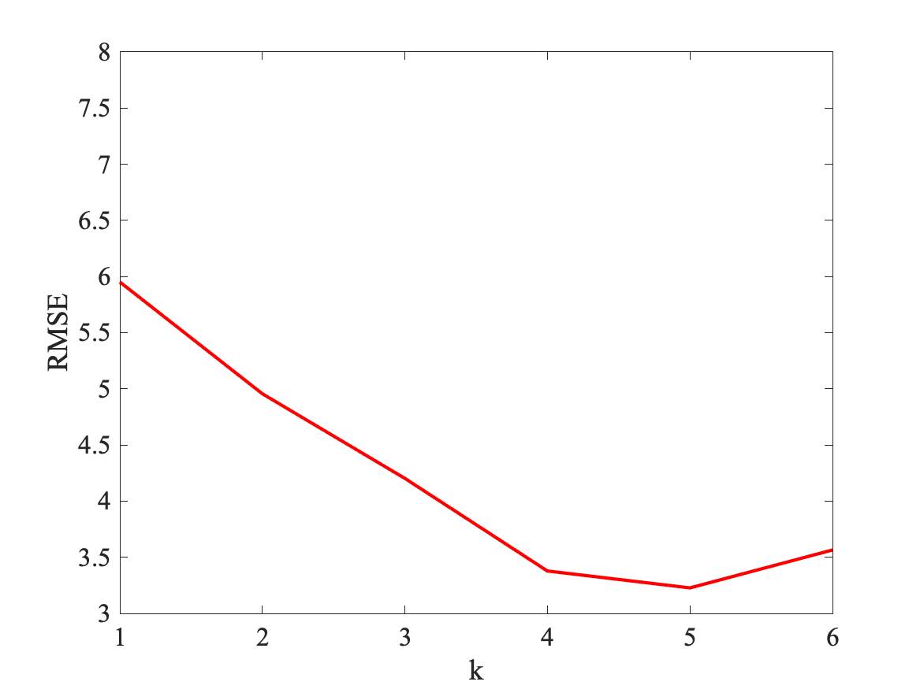
Comparing models
Compute RMSE for multiple models and plot as a function of k:
k=5 seems to be the best model

Slide 35
Model Fitness
Recall that for a given model,
we compute the mean square
Error
RMSE=5.95
$$\text{RMSE}=\sqrt{\frac{1}{N}\overset{N}{\underset{i=1}{∑}}(\overset{̂}{y}(i)-y(i))^{2}}$$
$$\overset{̂}{y}(i)-y(i)$$

Slide 36
Model Fitness
Recall that for a given model,
we compute the mean square
Error
RMSE=5.95
$$\text{RMSE}=\sqrt{\frac{1}{N}\overset{N}{\underset{i=1}{∑}}(\overset{̂}{y}(i)-y(i))^{2}}$$
$$\overset{̂}{y}(i)-y(i)$$
However, RMSE depends on the scale of the values y!
Here y are expressed in units of “1000 dollars”;
If instead we had used dollars,
RMSE=5950

Slide 37
Model Fitness
To normalize the “fitness” score:
Consider the test set with values $(x_{i}^{t},y_{i}^{t})$ for $i∈[1,N]$
We consider three models:
The simplest model where each value are predicted as the average of the test set values:
The “best” model where each value is exact
The current model M that we want to evaluate
$$\overset{̂}{y^{s}}(i)=\frac{1}{N}\overset{N}{\underset{i=1}{∑}}y^{t}(i)$$
$$\overset{̂}{y^{b}}(i)=y^{t}(i)$$
$$\overset{̂}{y^{M}}(i)$$

Slide 38
Model Fitness
To normalize the “fitness” score:
$$R^{2}=1-\frac{∑_{i=1}^{N}(\overset{̂}{y^{M}}(i)-\overset{̂}{y^{B}}(i))^{2}}{∑_{i=1}^{N}(\overset{̂}{y^{S}}(i)-\overset{̂}{y^{B}}(i))^{2}}$$
If our model is as good as the simple model, based on the average, then $R^{2}=0$
If our model is perfect then $R^{2}=1$
$R^{2}$ can be negative if the model is worst than the simple model (average). This can happen !

Slide 39
Model Fitness

Slide 40
RMSE or R²?
Both RMSE and R² quantify how well a model fits a dataset.
The RMSE tells us how well a regression model can predict the value of the response variable in absolute terms while R² tells us how well a model can predict the value of the response variable in percentage terms.
It is useful to calculate both the RMSE and R² for a given model because each metric gives us useful information.

