Slide 1
Supervised Learning:
Linear Regression
Patrice Koehl

Slide 2
Predicting
We get back to the scenario where we would like to predict the value of one variable using another (or a set of other) variables.
Examples:
Predicting the value of stocks based on its current market
Predicting the weather next fall based on previous years
Previously, we have seen that we can use k-Nearest Neighbor to do such predictions…
but not always! k-NN will work best when the variable we want to predict
is within the range of the training set…It means that kNN most likely will not work well for prediction outside that range, such as the prediction mentioned above.

Slide 3
Prediction vs Estimation
When we use a set of measurements, $(x_{i,1},…,x_{i,p})$ to predict a value for the response variable, we denote the predicted value by:
${\overset{^}{y}}_{i}=$ $\overset{^}{f}(x_{i,1},…,x_{i,p})$.
For some problems, we do not care about the specific expression of $\overset{^}{f}$, we just want to make our predictions $\overset{^}{y}$’s as close to the observed values $y$’s as possible. These are called prediction problems.
For some problems, what's important is obtaining $\overset{^}{f}$, the estimate of $f$. These are called inference problems.
Example: kNN
Example: Linear regression

Slide 4
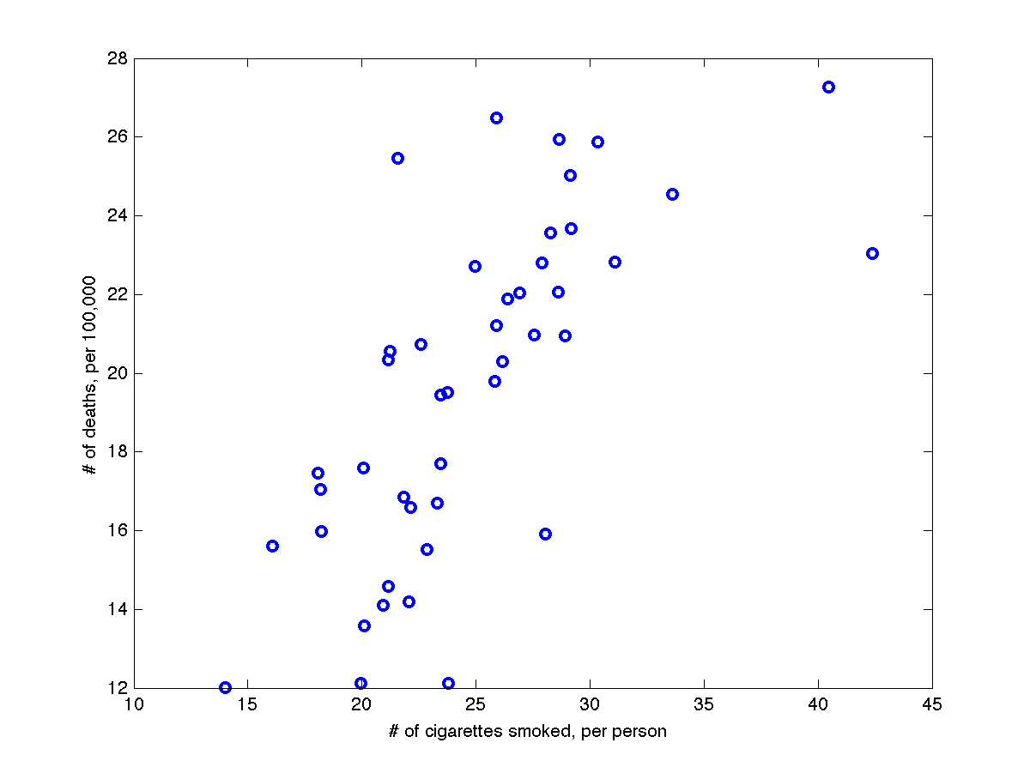
Linear Regression
Example: let us consider the dataset that gives the number of death observed in a population of smokers

Slide 5
Linear Regression
Example: let us consider the dataset that gives the number of death observed in a population of smokers
We assume that these data can be represented with a linear model
Which line is good:
Maybe this one (blue)

Slide 6
Linear Regression
Example: let us consider the dataset that gives the number of death observed in a population of smokers
We assume that these data can be represented with a linear model
Which line is good:
Maybe this one (blue)
Or this one (red)

Slide 7
Linear Regression
Example: let us consider the dataset that gives the number of death observed in a population of smokers
We assume that these data can be represented with a linear model
Which line is good:
Maybe this one (blue)
Or this one (red)
Or this one (green)

Slide 8
The normal distribution
In everyday life many variables such as height, weight, shoe size and exam marks all tend to be normally distributed, that is, they all tend to look like:
It is bell-shaped and symmetrical about the mean
The mean, median and mode are equal

Slide 9
The normal distribution
$$P(x)=\frac{1}{σ\sqrt{2π}}e^{-\frac{1}{2}\frac{(x-m)^{2}}{σ^{2}}}$$
Mean = 50
Std Dev = 15
2%
34%
34%
2%
14%
14%
5
20
35
50
65
80
95
-3
-2
-1
0
+1
+2
+3

Slide 10
Linear Regression
Let us suppose that:
The data points are independent of each other
Each data point has a measurement error that is random, distributed as a
Normal distribution around the “true” value Y(x_{i}):
The likelihood function is:

Slide 11
Linear Regression
Let us suppose that:
The data points are independent of each other
Each data point has a measurement error that is random, distributed as a
Normal distribution around the “true” value Y(x_{i}):
The probability of the data points, given the model Y is then:

Slide 12
Bayes’ theorem
where A and B are events and $P(B)≠0$.
P(A | B) is a conditional probability: it is the probability of event A occurring given that B is true. It is also called the posterior probability of A given B.
P(B | A) is also a conditional probability: the probability of event B occurring given that A is true.
P(A) and P(B) are the probabilities of observing A and B respectively without any given conditions; they are known as the marginal probability or prior probability.
A and B must be different events.

Slide 13
Bayes’ theorem
User new evidence to update beliefs
Likelihood
function
Prior
probability
Posterior
probability
Model evidence
(Independent of
Model)

Slide 14
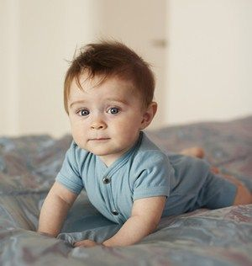
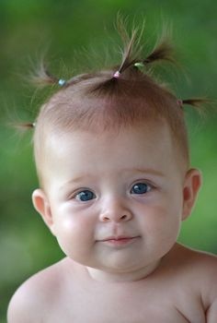
Bayes’ Theorem
Hypothesis (model) on your friend’s new baby:
H1: brown hair baby boy
H2: blond hair baby girl
H3: cute baby cat

Slide 15
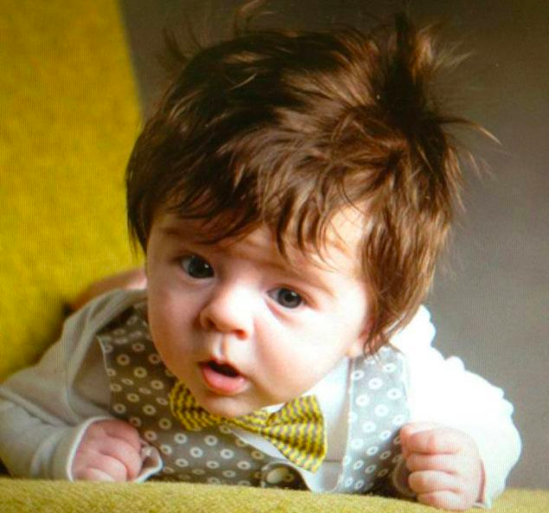
Bayes’ Theorem
Hypothesis (model) on your friend’s new baby:
Evidence
H1: brown hair baby boy
H2: blond hair baby girl
H3: cute baby cat

Slide 16
Bayes’ Theorem
Hypothesis (model) on your friend’s new baby:
Evidence
H1: brown hair baby boy
H2: blond hair baby girl
H3: cute baby cat

Slide 17
Bayes’ Theorem
Example: suppose a drug test is 99% sensitive and 99% specific.
(Namely, P(+|User) = 0.99 and P(+|Non user) = 0.01)
Suppose that 0.5% of people are users of the drug. If a random individual
tests positive, what is the probability she is a user?

Slide 18
Bayes’ Theorem
Example: suppose a drug test is 99% sensitive and 99% specific.
(Namely, P(+|User) = 0.99 and P(+|Non user) = 0.01)
Suppose that 0.5% of people are users of the drug. If a random individual
tests positive, what is the probability she is a user?

Slide 19
Linear Regression
The probability of the data points, given the model Y is then:

Slide 20
Linear Regression
The probability of the data points, given the model Y is then:
Application of Bayes ‘s theorem:

Slide 21
Linear Regression
The probability of the data points, given the model Y is then:
Application of Bayes ‘s theorem:
With no information on the models, we can assume that the prior probability
P(Model) is constant.

Slide 22
Linear Regression
The probability of the data points, given the model Y is then:
Application of Bayes ‘s theorem:
With no information on the models, we can assume that the prior probability
P(Model) is constant.
Finding the model that maximizes P(Model/Data) is then
equivalent to finding the model that maximizes P(Data/Model).

Slide 23
Linear Regression
The probability of the data points, given the model Y is then:
Application of Bayes ‘s theorem:
With no information on the models, we can assume that the prior probability
P(Model) is constant.
Finding the model that maximizes P(Model/Data) is then
equivalent to finding the model that maximizes P(Data/Model).
This is equivalent to maximizing its logarithm, or minimizing the negative of its
logarithm, namely:
$$χ_{2}=\overset{N}{\underset{i=1}{∑}}\frac{1}{2}{\left(\frac{y_{i}-Y(x_{i})}{σ_{i}}\right)}^{2}$$

Slide 24
Linear Regression
Fitting to a straight line:
$$Y(x)=ax+b$$
Then:
$$χ_{2}=\overset{N}{\underset{i=1}{∑}}{\left(\frac{y_{i}-ax_{i}-b}{σ_{i}}\right)}^{2}$$
The parameters a and b are obtained from the two equations:
$$\frac{δχ_{2}}{δa}=-2\overset{N}{\underset{i=1}{∑}}\frac{x_{i}(y_{i}-ax_{i}-b)}{σ_{i}^{2}}=0$$
$$\frac{δχ_{2}}{δb}=-2\overset{N}{\underset{i=1}{∑}}\frac{y_{i}-ax_{i}-b}{σ_{i}^{2}}=0$$

Slide 25
Linear Regression
Let us define:
$$S=\overset{N}{\underset{i=1}{∑}}\frac{1}{σ_{i}^{2}}S_{x}=\overset{N}{\underset{i=1}{∑}}\frac{x_{i}}{σ_{i}^{2}}S_{y}=\overset{N}{\underset{i=1}{∑}}\frac{y_{i}}{σ_{i}^{2}}S_{xx}=\overset{N}{\underset{i=1}{∑}}\frac{x_{i}^{2}}{σ_{i}^{2}}S_{xy}=\overset{N}{\underset{i=1}{∑}}\frac{x_{i}y_{i}}{σ_{i}^{2}}$$
Then:
$$aS_{xx}+bS_{x}=S_{xy}$$
$$aS_{x}+bS=S_{y}$$
From which we find a and b:
$$a=\frac{S_{xy}S-S_{x}S_{y}}{S_{xx}S-S_{x}^{2}}$$
$$b=\frac{S_{xx}S_{y}-S_{x}S_{xy}}{S_{xx}S-S_{x}^{2}}$$

Slide 26
Linear Regression
We are not done!
Uncertainty on the values of a and b:
$$σ_{a}^{2}=\frac{S}{S_{xx}S-S_{x}^{2}}$$
$$σ_{b}^{2}=\frac{S_{x}}{S_{xx}S-S_{x}^{2}}$$
Evaluate goodness of fit:
Compute residual error on each data point: Y(x_{i})-y_{i}
Compute correlation coefficient R²

Slide 27
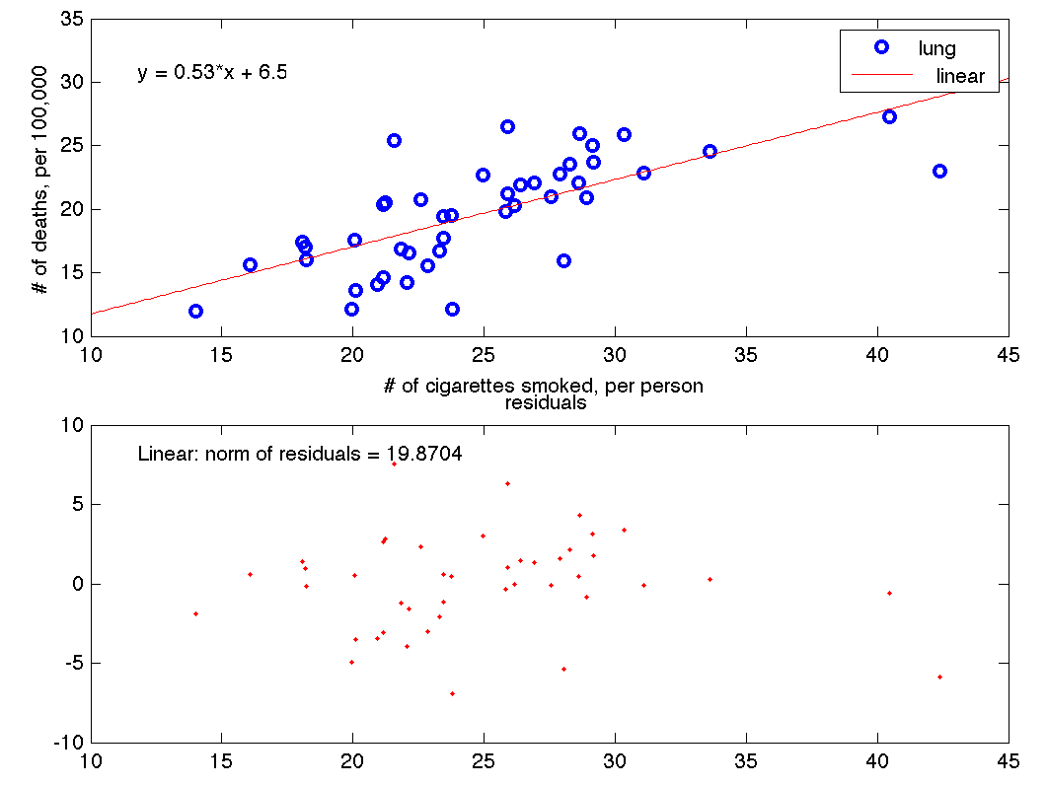
Linear Regression

Slide 28
Linear Regression
More general linear model:
$$Y(x)=a_{1}X_{1}(x)+a_{2}X_{2}(x)+…+a_{M}X_{M}(x)$$
Then:
$$χ_{2}=\overset{N}{\underset{i=1}{∑}}{\left(\frac{y_{i}-a_{1}X_{1}(x)-a_{2}X_{2}(x)-…-a_{M}X_{M}(x)}{σ_{i}}\right)}^{2}$$
The parameters a and b are obtained from the two equations:
$$\frac{δχ_{2}}{δa_{k}}=-2\overset{N}{\underset{i=1}{∑}}\frac{X_{k}(x_{i})(y_{i}-a_{1}X_{1}(x)-a_{2}X_{2}(x)-…-a_{M}X_{M}(x))}{σ_{i}^{2}}=0$$

Slide 29
Model fitting
Let us work out a simple example. Let us consider we have N students, S₁,…,S_{N}
and let us “evaluate” a variable x_{i} for each student such that:
x_{i}= 1 if student S_{i} owns a Ferrari, and x_{i}= 0 otherwise.
We want an estimator of the probability p that a student owns a Ferrari.
The probability of observing x_{i} for student S_{i} is given by:
$$f(x_{i},p)=p^{x_{i}}(1-p)^{1-x_{i}}$$
The likelihood of observing the values x_{i} for all N students is:
$$L(p)=f(x_{1},x_{2},…,x_{N};p)≈f(x_{1},p)f(x_{2},p)…f(x_{N},p)$$

Slide 30
Model Fitting
$$L(p)=p^{∑x_{i}}(1-p)^{N-∑x_{i}}$$
The maximum likelihood estimator of p is the value pm that maximizes L(p):
$$p_{m}=\text{argmax}L(p)$$
This is equivalent to maximizing the logarithm of L(p) (log-likelihood):
$$log(L(p))=log(p)\overset{N}{\underset{i=1}{∑}}x_{i}+log(1-p)\left(N-\overset{N}{\underset{i=1}{∑}}x_{i}\right)$$

Slide 31
Model Fitting
$$\frac{δlog(L(p))}{δp}=\frac{1}{p}\overset{N}{\underset{i=1}{∑}}x_{i}-\frac{1}{1-p}\left(N-\overset{N}{\underset{i=1}{∑}}x_{i}\right)=0$$
$$p_{m}=\frac{1}{N}\underset{i=1}{∑}x_{i}$$
This is the most intuitive value…. And it matches with the
maximum likelihood estimator

