Slide 1
Clustering
Unsupervised Learning

Slide 2
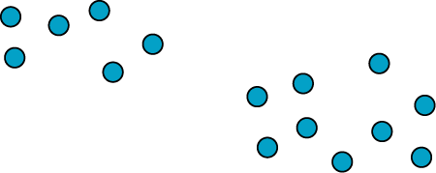
Clustering is a hard problem
Many possibilities; What is best clustering ?

Slide 3
Clustering is a hard problem
2 clusters: easy

Slide 4
Clustering is a hard problem
4 clusters: difficult
?
?
Many possibilities; What is best clustering ?

Slide 5
Clustering
Hierarchical clustering
K-means clustering
How many clusters?

Slide 6
Clustering
Hierarchical clustering
K-means clustering
How many clusters?

Slide 7
Hierarchical Clustering
To cluster a set of data D={P₁, P₂, …,P_{N}}, hierarchical clustering proceeds
through a series of partitions that runs from a single cluster containing all
data points, to N clusters, each containing 1 data points.
Two forms of hierarchical clustering:
Agglomerative
a, b, c, d, e
c, d, e
a, b
d, e
a
b
c
d
e
Divisive

Slide 8
Hierarchical Clustering
Methods differ in their definition of inter-cluster distance (or similarity)

Slide 9
Hierarchical Clustering
1) Single linkage clustering
Cluster A
Distance between closest pairs of points:
$$d(A,B)=min\{d(P_{i},P_{j}),P_{i}∈A,P_{j}∈B\}$$
Cluster B
2) Complete linkage clustering
Cluster A
Distance between farthest pairs of points:
$$d(A,B)=max\{d(P_{i},P_{j}),P_{i}∈A,P_{j}∈B\}$$
Cluster B

Slide 10
Hierarchical Clustering
3) Average linkage clustering
Cluster A
Mean distance of all mixed pairs of points:
$$d(A,B)=\frac{∑_{i=1}^{N_{A}}∑_{j=1}^{N_{B}}d(P_{i},P_{j})}{N_{A}N_{B}}$$
Cluster B
4) Average group linkage clustering
Cluster A
Mean distance of all pairs of points:
Cluster T
$$d(A,B)=\frac{∑_{i=1}^{N_{T}}∑_{j=1}^{N_{T}}d(P_{i},P_{j})}{N_{T}^{2}}$$
Cluster B

Slide 11
Clustering
Hierarchical clustering
K-means clustering
How many clusters?

Slide 12
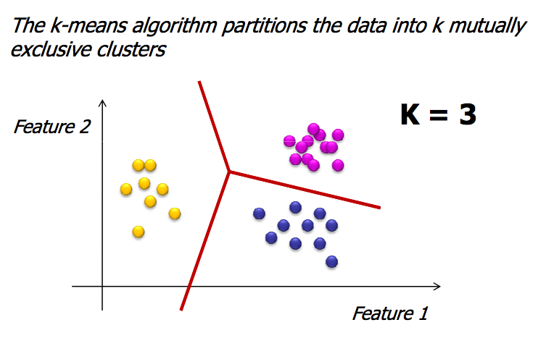
K-means clustering
(http://www.weizmann.ac.il/midrasha/courses/)

Slide 13
K-means clustering
(http://www.weizmann.ac.il/midrasha/courses/)

Slide 14
K-means clustering
(http://www.weizmann.ac.il/midrasha/courses/)

Slide 15
K-means clustering
(http://www.weizmann.ac.il/midrasha/courses/)

Slide 16
K-means clustering
(http://www.weizmann.ac.il/midrasha/courses/)

Slide 17
Clustering
Hierarchical clustering
K-means clustering
How many clusters?

Slide 18
Cluster Validation
Clustering is hard: it is an unsupervised learning technique. Once a
Clustering has been obtained, it is important to assess its validity!
The questions to answer:
Did we choose the right number of clusters?
Are the clusters compact?
Are the clusters well separated?
To answer these questions, we need a quantitative measure
of the cluster sizes:
intra-cluster size
Inter-cluster distances

Slide 19
Cluster Validation

Slide 20
Inter cluster size
Computing $δ(A,B)$:
Several options:
Single linkage
Complete linkage
Average linkage
Average group linkage
Cluster A
$$δ(A,B)$$
Cluster B

Slide 21
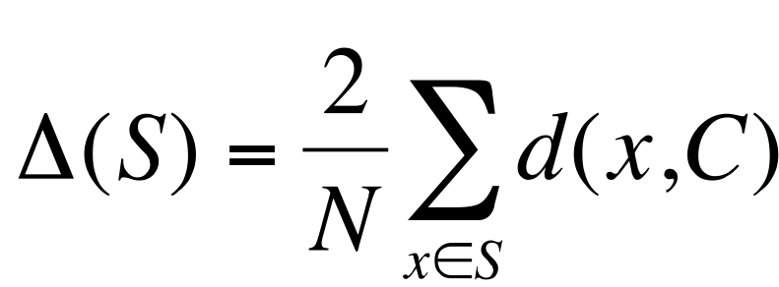
Intra cluster size
Several options:
Complete diameter:
Average diameter:
Centroid diameter:
For a cluster S, with N members and center C:

Slide 22
Clustering Quality
For a clustering with K clusters:
1) Dunn’s index
-> Large values of D correspond to good clusters
2) Davies-Bouldin’s index
-> Low values of DB correspond to good clusters

Slide 23
Cluster Quality: Silhouette index
Define a quality index for each point in the original dataset:
For the ith object di, calculate its average distance to all other
objects in its cluster. Call this value a(di).
For the ith object and any cluster not containing the object,
calculate the object’s average distance to all the objects in the
given cluster.
Find the minimum such value with respect to all clusters;
call this value b(di).
For the ith object, the silhouette coefficient is
$$S(di)=\frac{b(di)-a(di)}{max(a(di),b(di))}$$

Slide 24
Cluster Quality: Silhouette index

Slide 25
Cluster Quality: Silhouette Index
Note that:
$$-1≤s(di)≤1$$
s(i) = 1, i is likely to be well classified
s(i) = -1, i is likely to be incorrectly classified
s(i) = 0, indifferent

Slide 26
Cluster Quality: Silhouette Index
Cluster silhouette index:
$$S(X_{i})=\frac{1}{N}\overset{N}{\underset{i=1}{∑}}s(i)$$
Global silhouette index:
$$GS=\frac{1}{K}\overset{K}{\underset{i=1}{∑}}S(X_{i})$$
Large values of GS correspond to good clusters

Slide 27
Comparing two clustering
Given a set of n elements $S=\{a_{1},a_{2},…,a_{n}\}$ and two partitions of S to compare, $X=\{X_{1},…,X_{r}\}$, a partition of S into r subsets, and , $Y=\{Y_{1},…,Y_{s}\}$
a partition of S into s subsets, define the following:
a, the number of pairs of elements in that are in the same subset in and in the same subset in S
b, the number of pairs of elements in that are in different subsets in and in different subsets in S
c, the number of pairs of elements in that are in the same subset in and in different subsets in S
d, the number of pairs of elements in that are in different subsets in and in the same subset in S
The Rand index, R, is:
$$R=\frac{a+b}{a+b+c+d}=2\frac{a+b}{n(n-1)}$$

Slide 28
Comparing two clustering
$$R=2\frac{a+b}{n(n-1)}$$
n=9

Slide 29
Comparing two clustering
$$R=2\frac{a+b}{n(n-1)}$$
n=9
Pairs in same cluster is A:
(2,3) (4,5) (1,6) (1,7) (1,8) (1,9)
(6,7) (6,8) (6,9) (7,8) (7,9) (8,9)

Slide 30
Comparing two clustering
$$R=2\frac{a+b}{n(n-1)}$$
n=9
Pairs in same cluster is A and B:
(2,3) (4,5) (1,6) (1,7) (1,8) (1,9)
(6,7) (6,8) (6,9) (7,8) (7,9) (8,9)

Slide 31
Comparing two clustering
$$R=2\frac{a+b}{n(n-1)}$$
n=9
Pairs in same cluster is A and B:
(2,3) (4,5) (1,6) (1,7) (1,8) (1,9)
(6,7) (6,8) (6,9) (7,8) (7,9) (8,9)
a =5

Slide 32
Comparing two clustering
$$R=2\frac{a+b}{n(n-1)}$$
n=9
Pairs in same cluster is A and B:
(2,3) (4,5) (1,6) (1,7) (1,8) (1,9)
(6,7) (6,8) (6,9) (7,8) (7,9) (8,9)
Pairs in different clusters in A:
(1,2) (1,3) (1,4) (1,5) (2,4) (2,5)
(2,6) (2,7) (2,8) (2,9) (3,4) (3,5)
(3,6) (3,7) (3,8) (3,9) (4,6) (4,7)
(4,8) (4,9) (5,6) (5,7) (5,8) (5,9)
a =5

Slide 33
Comparing two clustering
$$R=2\frac{a+b}{n(n-1)}$$
n=9
Pairs in same cluster is A and B:
(2,3) (4,5) (1,6) (1,7) (1,8) (1,9)
(6,7) (6,8) (6,9) (7,8) (7,9) (8,9)
Pairs in different clusters in A and B:
(1,2) (1,3) (1,4) (1,5) (2,4) (2,5)
(2,6) (2,7) (2,8) (2,9) (3,4) (3,5)
(3,6) (3,7) (3,8) (3,9) (4,6) (4,7)
(4,8) (4,9) (5,6) (5,7) (5,8) (5,9)
a =5

Slide 34
Comparing two clustering
$$R=2\frac{a+b}{n(n-1)}$$
n=9
Pairs in same cluster is A and B:
(2,3) (4,5) (1,6) (1,7) (1,8) (1,9)
(6,7) (6,8) (6,9) (7,8) (7,9) (8,9)
Pairs in different clusters in A and B:
(1,2) (1,3) (1,4) (1,5) (2,4) (2,5)
(2,6) (2,7) (2,8) (2,9) (3,4) (3,5)
(3,6) (3,7) (3,8) (3,9) (4,6) (4,7)
(4,8) (4,9) (5,6) (5,7) (5,8) (5,9)
a =5
b =20

Slide 35
Comparing two clustering
$$R=2\frac{a+b}{n(n-1)}$$
n=9
Pairs in same cluster is A and B:
(2,3) (4,5) (1,6) (1,7) (1,8) (1,9)
(6,7) (6,8) (6,9) (7,8) (7,9) (8,9)
Pairs in different clusters in A and B:
(1,2) (1,3) (1,4) (1,5) (2,4) (2,5)
(2,6) (2,7) (2,8) (2,9) (3,4) (3,5)
(3,6) (3,7) (3,8) (3,9) (4,6) (4,7)
(4,8) (4,9) (5,6) (5,7) (5,8) (5,9)
a =5
$$R=2\frac{20+5}{9×8}=\frac{25}{36}=0.69$$
b =20

Slide 36
Comparing two clustering
$$R=2\frac{a+b}{n(n-1)}$$
n=9
Pairs in same cluster is A and B:
(1,2) (1,3) (4,5) (4,6) (7,8) (7,9)
(8,9)
Pairs in different clusters in A and B:
(1,4) (1,5) (1,6) (1,7) (1,8) (1,9) (2,4)
(2,5) (2,6) (2,7) (2,8) (2,9) (3,4) (3,5)
(3,6) (3,7) (3,8) (3,9) (4,7) (4,8) (4,9)
(5,7) (5,8) (5,9) (6,7) (5,8) (6,9)
a =7
$$R=2\frac{20+5}{9×8}=\frac{25}{36}=0.69$$
$$R=2\frac{7+0}{9×8}=0.19$$
b=0

