Slide 1
RNA Structure Prediction

Slide 2
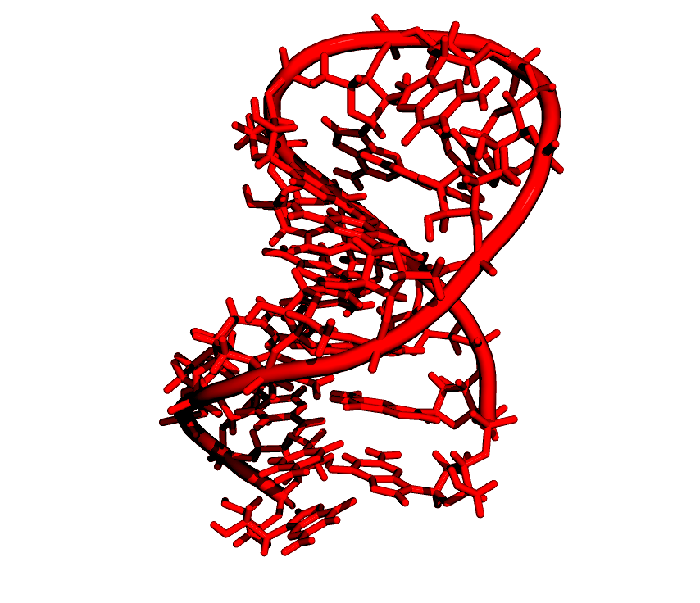
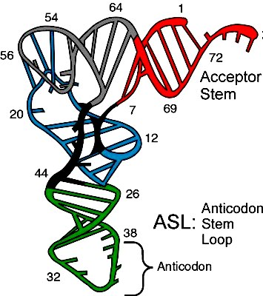
Hierarchical organization of RNA molecules
Primary structure:
5’ ACCACCUGCUGA 3’
Secondary Structure
Tertiary structure:

Slide 3
Hierarchical organization of RNA molecules
Primary structure:
5’ to 3’ list of covalently linked nucleotides, named by the attached base
Secondary Structure
List of base pairs, denoted by i•j for a pairing between the i-th and j-th
Nucleotides, r_{i} and r_{j}, where i<j by convention.
Pairing mostly occur as A•U and G•C (Watson Crick), and G •U (wobble)
By definition, base pairs in secondary structure are nested: if i is paired with j,
Then i+1 can only be paired with k such that i+2<k<j.
Helices are inferred when two or more base pairs occur adjacent to one another
Tertiary structure:
List of interactions between secondary structures

Slide 4
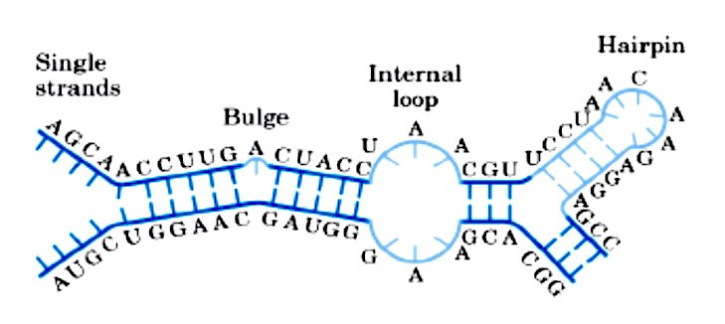
RNA secondary structures
Single stranded bases within a stem are called a bulge of bulge loop if
the single stranded bases are on only one side of the stem.
If single stranded bases interrupt both sides of a stem, they are called an
internal (interior) loop.

Slide 5
RNA “tertiary interactions”
In addition to secondary structural interactions in RNA, there are also tertiary interactions, including: (A) pseudoknots, (B) kissing hairpins and (C) hairpin-bulge contact.
Pseudoknot
Kissing hairpins
Hairpin-bulge

Slide 6
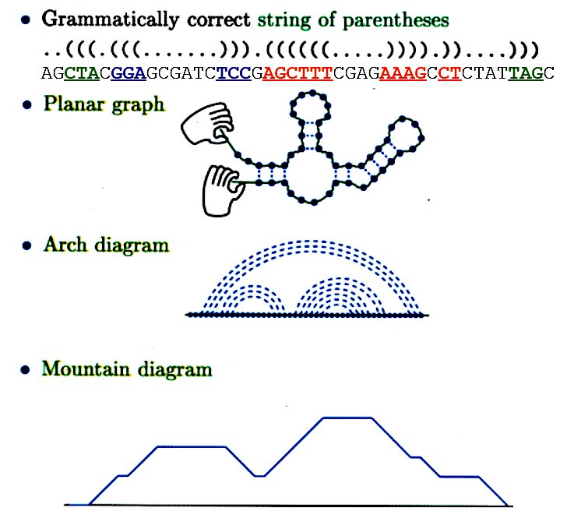
RNA secondary structure representation
..(((.(((......))).((((((....)))).))....)))
AGCUACGGAGCGAUCUCCGAGCUUUCGAGAAAGCCUCUAUUAGC

Slide 7
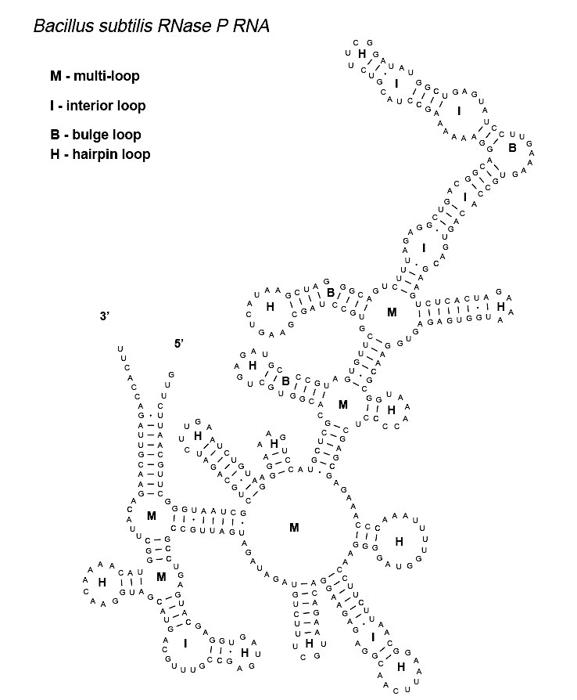
Predicted secondary
structure for Bacillus
Subtilis RNase P RNA
(from Zuker)

Slide 9
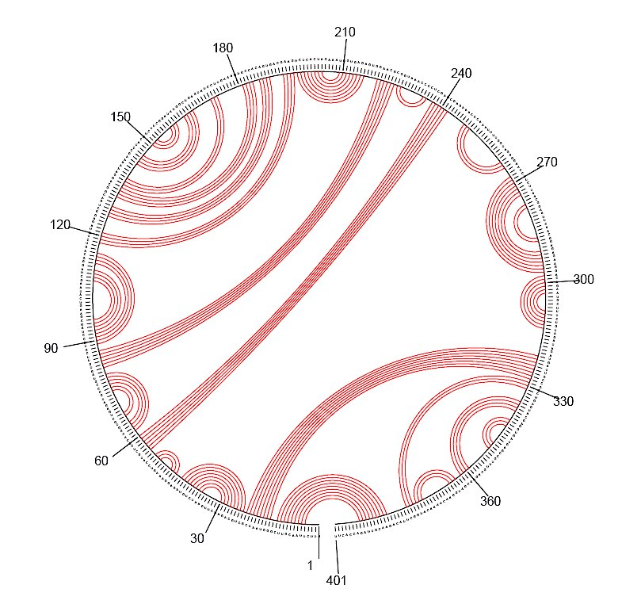
RNA secondary structure representation
Circular representation:
Bacillus Subtilis RNase P RNA

Slide 10
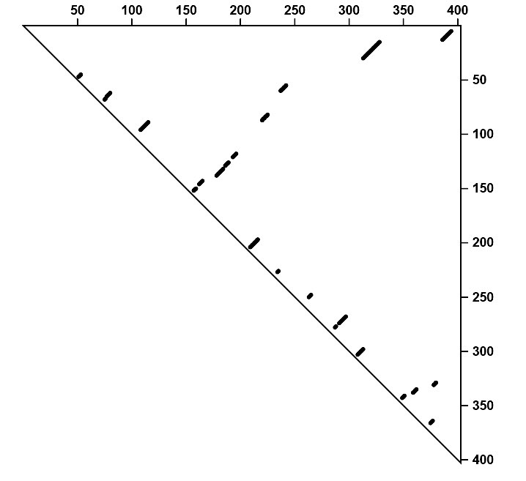
RNA secondary structure representation
DotPlot representation
of the same Bacillus
Subtilis RNA folding:
A dot is placed to represent
a base pair

Slide 11
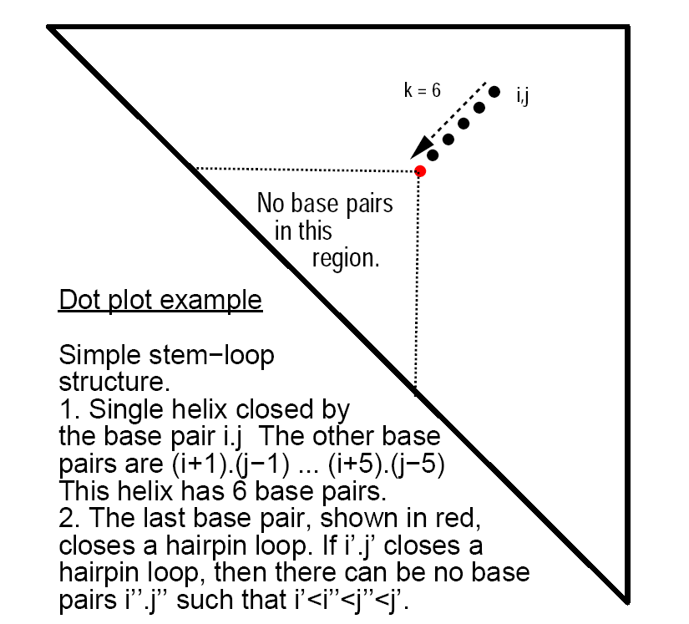
Understanding RNA structure dot plot
Simple stem loop:
Single helix closed by the base
pair i•j.
The other base pairs are (i+1) •(j-1) …
(i+5) •(j-5) (6 total)
The last base pair, shown in red,
closes a hairpin loop.
If k •l closes a hairpin loop, there can be
no base pair k’ •l’ such that k<k’<l’<l

Slide 12
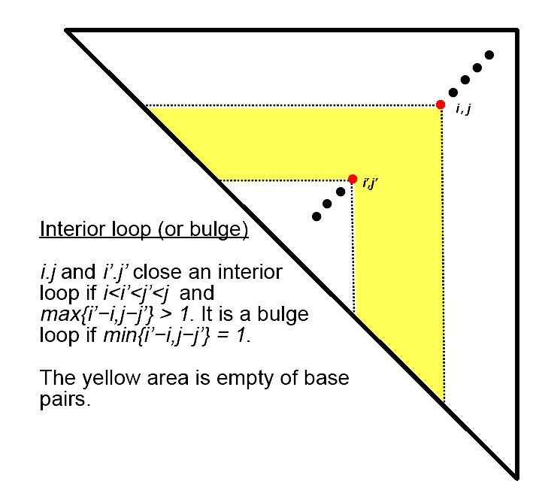
Understanding RNA structure dot plot
Interior loop (or bulge):
i•j and i’ •j’ close an interior
loop if i<i’<j’<j and max{i’-i, j-j’}>1.
It is a bulge loop if min{i’-i,j-j’}=1.
The yellow area is empty of base pair.

Slide 13
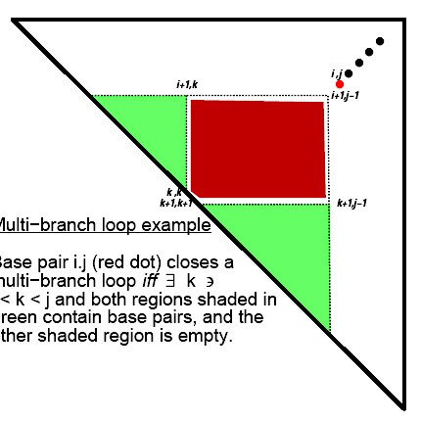
Understanding RNA structure dot plot
Multi-branch loop:
Base pair i•j closes a multi-branch
if and only if there is a k, i<k<j
such that both regions shaded
In green contain base pairs, and the
other shaded region is empty

Slide 14
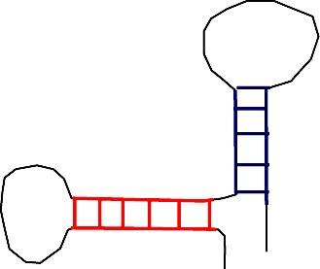
Only three ways to pair four segments…
3
2
1
2
3
4
4
1
1
2
3
4
2
1
3
4

Slide 15
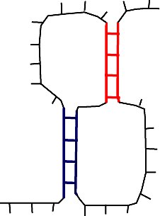
Only three ways to pair four segments…
1
2
3
4
2
4
Pseudo-knot : usually
not considered a secondary
structure…as it is difficult to
predict !!
1
3

Slide 16
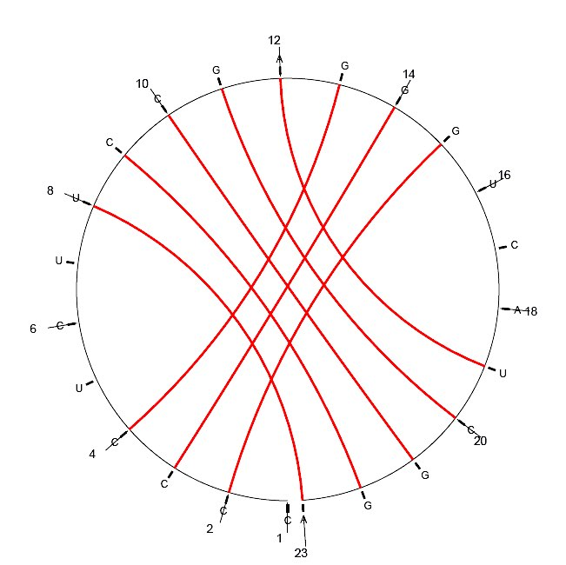
Circular representation of a pseudo-knot

Slide 17
RNA secondary structure definition
An RNA sequence is represented as:
R = r₁, r₂, r₃, …, r_{n} (r_{i} is the i-th nucleotide).
Each r_{i} belongs to the set {A, C, G, U}.
A secondary structure on R is a set S of ordered pairs, written as i•j,
1≤i<j≤n, satisfying:
1. j – i > 3 (exclude “close” base pairs)
2. if i •j and k •l are 2 base pairs, with i≤k, then either:
(a) i = k and j = l (same base pair)
(b) i < j < k < l (i •j precedes k •l)
(c) i < k < l < j (i •j includes k •l)

Slide 18
RNA Secondary Structure Prediction
Two primary methods for RNA secondary structure prediction:
Co-variation analysis (comparative sequence analysis)
Takes into account conserved patterns of basepairs during
evolution (2 or more sequences)
Minimum free-energy method
Determines structure of complementary regions that are
energetically stable

Slide 19
Comparative Sequence Analysis
Molecules with similar functions and different nucleotide sequences will form similar structures
Correctly identifies high percentage of secondary structure pairings and a smaller number of tertiary interactions
Primarily a manual method

Slide 20
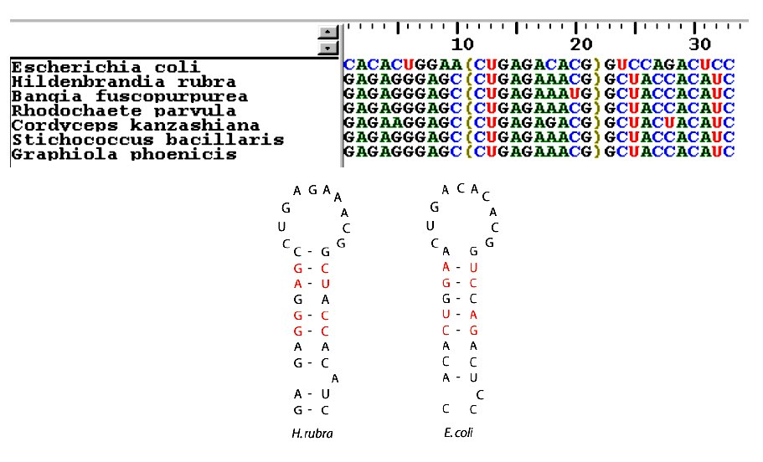
Co-variation

Slide 21
Quantitative Measure of Co-variation
Mutual Information Content:
$$H(i,j)=\underset{N_{1},N_{2}∈\{A,C,G,U\}}{∑}f_{i,j}(N_{1},N_{2})\log_{2}\frac{f_{i,j}(N_{1},N_{2})}{f_{i}(N_{1})f_{j}(N_{2})}$$
fij(N1,N2) : joint frequency of the 2 nucleotides, N1 from the i-th column,
and N2 from the j-th column
fi(N) : frequency in the i-th column of the nucleic acid N

Slide 22
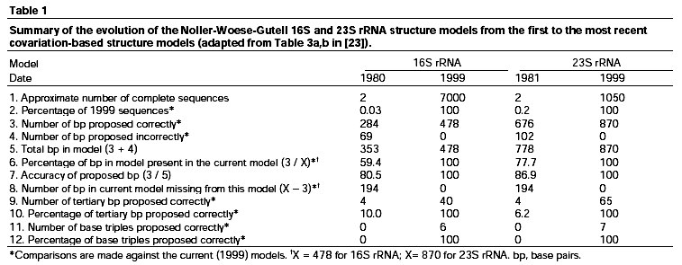
How well does it work ?
Gutell, Lee, Cannone, COSB, 2002, 12:301

Slide 23
Computing RNA secondary structure
Working hypothesis:
The native secondary structure of a RNA molecule is the one with the minimum free energy
Restrictions:
No knots
No close base pairs
Base pairs: A-U, C-G and G-U

Slide 24
Computing RNA secondary structure
Tinoco-Uhlenbeck postulate:
Assumption: the free energy of each base pair is independent of all the other pairs and the loop structures
Consequence: the total free energy of an RNA is the sum of all of the base pair free energies

Slide 25
Independent Base Pairs Approach
Use solution for smaller strings to find solutions for larger strings
This is precisely the basic principle behind dynamic programming algorithms!

Slide 26
RNA folding: Dynamic Programming
Notation:
e(r_{i},r_{j}) : free energy of a base pair joining r_{i} and r_{j}
B_{ij} : secondary structure of the RNA strand from base r_{i} to base r_{j}. Its energy is E(B_{ij})
S(i,j) : optimal free energy associated with segment r_{i}…r_{j}
S(i,j) = max E(B_{ij})

Slide 27
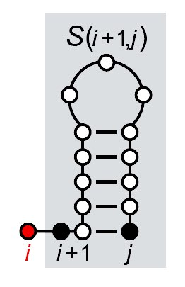
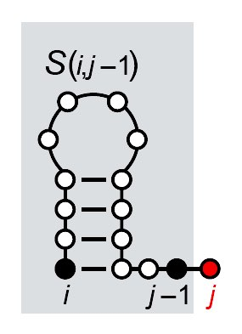
RNA folding: Dynamic Programming
There are only four possible ways that a secondary structure of
nested base pair can be constructed on a RNA strand from position i to j:
i is unpaired, added on to
a structure for i+1…j
S(i,j) = S(i+1,j)
j is unpaired, added on to
a structure for i…j-1
S(i,j) = S(i,j-1)

Slide 28
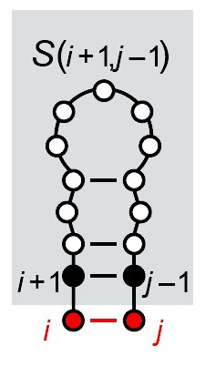
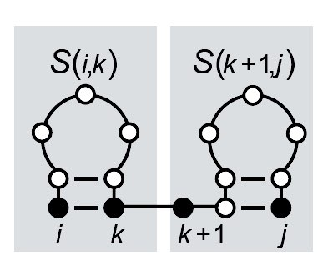
RNA folding: Dynamic Programming
i j paired, but not to each other;
the structure for i…j adds together
structures for 2 sub regions,
i…k and k+1…j
S(i,j) = max {S(i,k)+S(k+1,j)}
i j paired, added on to
a structure for i+1…j-1
S(i,j) = S(i+1,j-1)+e(r_{i},r_{j})

Slide 29
RNA folding: Dynamic Programming
Since there are only four cases, the optimal score S(i,j) is just the
maximum of the four possibilities:
To compute this efficiently, we need to make sure that the scores for
the smaller sub-regions have already been calculated
Dynamic Programming !!

Slide 30
RNA folding: Dynamic Programming
Notes:
S(i,j) = 0 if j-i < 4: do not allow “close” base pairs
Reasonable values of e are -3, -2, and -1 kcal/mole
for GC, AU and GU, respectively. In the DP procedure,
we use 3, 2, 1 (or replace max with min)
Build upper triangular part of DP matrix:
- start with diagonal – all 0
- works outward on larger and larger regions
- ends with S(1,n)
Traceback starts with S(1,n), and finds optimal path that
lead there.

Slide 31
j
Initialisation:
No close basepairs
 | A | U | A | C | C | C | U | G | U | G | G | U | A | U
A | 0 | 0 | 0 | 0
U |  | 0 | 0 | 0 | 0
A |  |  | 0 | 0 | 0 | 0
C |  |  |  | 0 | 0 | 0 | 0
C |  |  |  |  | 0 | 0 | 0 | 0
C |  |  |  |  |  | 0 | 0 | 0 | 0
U |  |  |  |  |  |  | 0 | 0 | 0 | 0
G |  |  |  |  |  |  |  | 0 | 0 | 0 | 0
U |  |  |  |  |  |  |  |  | 0 | 0 | 0 | 0
G |  |  |  |  |  |  |  |  |  | 0 | 0 | 0 | 0
G |  |  |  |  |  |  |  |  |  |  | 0 | 0 | 0 | 0
U |  |  |  |  |  |  |  |  |  |  |  | 0 | 0 | 0
A |  |  |  |  |  |  |  |  |  |  |  |  | 0 | 0
U |  |  |  |  |  |  |  |  |  |  |  |  |  | 0
i

Slide 32
j
 | A | U | A | C | C | C | U | G | U | G | G | U | A | U
A | 0 | 0 | 0 | 0 | 0
U |  | 0 | 0 | 0 | 0 | 0
A |  |  | 0 | 0 | 0 | 0 | 2
C |  |  |  | 0 | 0 | 0 | 0 | 3
C |  |  |  |  | 0 | 0 | 0 | 0 | 0
C |  |  |  |  |  | 0 | 0 | 0 | 0 | 3
U |  |  |  |  |  |  | 0 | 0 | 0 | 0 | 1
G |  |  |  |  |  |  |  | 0 | 0 | 0 | 0 | 1
U |  |  |  |  |  |  |  |  | 0 | 0 | 0 | 0 | 2
G |  |  |  |  |  |  |  |  |  | 0 | 0 | 0 | 0 | 1
G |  |  |  |  |  |  |  |  |  |  | 0 | 0 | 0 | 0
U |  |  |  |  |  |  |  |  |  |  |  | 0 | 0 | 0
A |  |  |  |  |  |  |  |  |  |  |  |  | 0 | 0
U |  |  |  |  |  |  |  |  |  |  |  |  |  | 0
Propagation:
C5….U9 :
C5 unpaired:
S(6,9) = 0
U9 unpaired:
S(5,8)=0
C5-U9 paired
S(6,8) +e(C,U)=0
C5 paired, U9 paired:
S(5,6)+S(7,9)=0
S(5,7)+S(8,9)=0

Slide 33
j
 | A | U | A | C | C | C | U | G | U | G | G | U | A | U
A | 0 | 0 | 0 | 0 | 0 | 0 | 2
U |  | 0 | 0 | 0 | 0 | 0 | 2 | 3
A |  |  | 0 | 0 | 0 | 0 | 2 | 3 | 5
C |  |  |  | 0 | 0 | 0 | 0 | 3 | 3 | 3
C |  |  |  |  | 0 | 0 | 0 | 0 | 0 | 3 | 6
C |  |  |  |  |  | 0 | 0 | 0 | 0 | 3 | 3
U |  |  |  |  |  |  | 0 | 0 | 0 | 0 | 1 | 1
G |  |  |  |  |  |  |  | 0 | 0 | 0 | 0 | 1 | 2
U |  |  |  |  |  |  |  |  | 0 | 0 | 0 | 0 | 2 | 2
G |  |  |  |  |  |  |  |  |  | 0 | 0 | 0 | 0 | 1
G |  |  |  |  |  |  |  |  |  |  | 0 | 0 | 0 | 0
U |  |  |  |  |  |  |  |  |  |  |  | 0 | 0 | 0
A |  |  |  |  |  |  |  |  |  |  |  |  | 0 | 0
U |  |  |  |  |  |  |  |  |  |  |  |  |  | 0
Propagation:
C5….G11 :
C5 unpaired:
S(6,11) = 3
G11 unpaired:
S(5,10)=3
C5-G11 paired
S(6,10)+e(C,G)=6
C5 paired, G11 paired
S(5,6)+S(7,11)=1
S(5,7)+S(8,11)=0
S(5,8)+S(9,11)=0
S(5,9)+S(10,11)=0

Slide 34
j
 | A | U | A | C | C | C | U | G | U | G | G | U | A | U
A | 0 | 0 | 0 | 0 | 0 | 0 | 2 | 3 | 5 | 6 | 6 | 8 | 10 | 12
U |  | 0 | 0 | 0 | 0 | 0 | 2 | 3 | 5 | 6 | 6 | 8 | 10 | 10
A |  |  | 0 | 0 | 0 | 0 | 2 | 3 | 5 | 5 | 6 | 8 | 8 | 8
C |  |  |  | 0 | 0 | 0 | 0 | 3 | 3 | 3 | 6 | 6 | 6 | 6
C |  |  |  |  | 0 | 0 | 0 | 0 | 0 | 3 | 6 | 6 | 6 | 6
C |  |  |  |  |  | 0 | 0 | 0 | 0 | 3 | 3 | 3 | 3 | 3
U |  |  |  |  |  |  | 0 | 0 | 0 | 0 | 1 | 1 | 3 | 3
G |  |  |  |  |  |  |  | 0 | 0 | 0 | 0 | 1 | 2 | 2
U |  |  |  |  |  |  |  |  | 0 | 0 | 0 | 0 | 2 | 2
G |  |  |  |  |  |  |  |  |  | 0 | 0 | 0 | 0 | 1
G |  |  |  |  |  |  |  |  |  |  | 0 | 0 | 0 | 0
U |  |  |  |  |  |  |  |  |  |  |  | 0 | 0 | 0
A |  |  |  |  |  |  |  |  |  |  |  |  | 0 | 0
U |  |  |  |  |  |  |  |  |  |  |  |  |  | 0
Propagation:
i

Slide 35
j
 | A | U | A | C | C | C | U | G | U | G | G | U | A | U
A | 0 | 0 | 0 | 0 | 0 | 0 | 2 | 3 | 5 | 6 | 6 | 8 | 10 | 12
U |  | 0 | 0 | 0 | 0 | 0 | 2 | 3 | 5 | 6 | 6 | 8 | 10 | 10
A |  |  | 0 | 0 | 0 | 0 | 2 | 3 | 5 | 5 | 6 | 8 | 8 | 8
C |  |  |  | 0 | 0 | 0 | 0 | 3 | 3 | 3 | 6 | 6 | 6 | 6
C |  |  |  |  | 0 | 0 | 0 | 0 | 0 | 3 | 6 | 6 | 6 | 6
C |  |  |  |  |  | 0 | 0 | 0 | 0 | 3 | 3 | 3 | 3 | 3
U |  |  |  |  |  |  | 0 | 0 | 0 | 0 | 1 | 1 | 3 | 3
G |  |  |  |  |  |  |  | 0 | 0 | 0 | 0 | 1 | 2 | 2
U |  |  |  |  |  |  |  |  | 0 | 0 | 0 | 0 | 2 | 2
G |  |  |  |  |  |  |  |  |  | 0 | 0 | 0 | 0 | 1
G |  |  |  |  |  |  |  |  |  |  | 0 | 0 | 0 | 0
U |  |  |  |  |  |  |  |  |  |  |  | 0 | 0 | 0
A |  |  |  |  |  |  |  |  |  |  |  |  | 0 | 0
U |  |  |  |  |  |  |  |  |  |  |  |  |  | 0
Traceback:
i

Slide 36
FINAL PREDICTION
U G
C U
AUACCCUGUGGUAU
C G
C G
A U
U A
A U
Total free energy: -12 kcal/mol

Slide 37
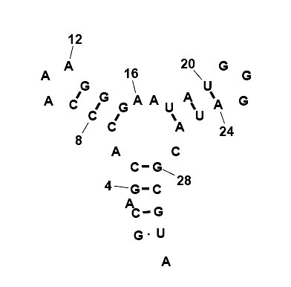
Try it yourself!!
Sequence:
GCAGCACCCAAAGGGAAUAUGGGAUACGCGUA
One possible solution:

Slide 38
Some notes
Computational complexity: N³
Does not work with pseudo-knot (would invalidate DP algorithm)
Methods that include pseudo knots:
Rivas and Eddy, JMB 285, 2053 (1999)
Orland and Zee, Nucl. Phys. B 620, 456 (2002)
These methods are at least N⁶

Slide 39
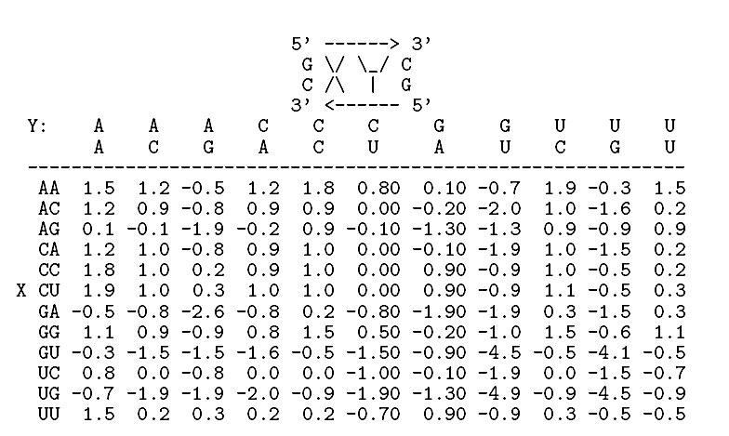
Some notes (2)
The scoring scheme is too simplistic!
Needs to take into account the cost of loops (both internal and in hairpins), of bulges, ….
Example: 2x2 interior loops in RNA closed by a GC and a CG base pair:

Slide 40
Destabilizing energies of loops
Size | Internal | Bulge | Hairpin
1 | NA | 3.8 | NA
2 | NA | 2.8 | NA
3 | NA | 3.2 | 5.6
4 | 1.7 | 3.6 | 5.5
5 | 1.8 | 4.0 | 5.6
6 | 2.0 | 4.4 | 5.3
7 | 2.2 | 4.6 | 5.8
8 | 2.3 | 4.7 | 5.4
30 | 3.7 | 6.1 | 7.7

Slide 41
Prediction Programs
MFOLD (Zuker) (web server)
http://www.unafold.org/mfold/applications/rna-folding-form.php
Genebee (both comparative + energy model) (web server)
http://www.genebee.msu.su/services/rna2_reduced.html
Vienna RNA package
http://www.tbi.univie.ac.at/~ivo/RNA/
Mc-Sym (Computer Science approach)
https://major.iric.ca/MC-Sym/
RNAFold
http://rna.tbi.univie.ac.at/cgi-bin/RNAWebSuite/RNAfold.cgi

Slide 42
How well do they perform?
Current RNA folding programs get about 60% of base pairs correct, on average: useful, but not yet good.
The problem is the scoring system: thermodynamic model is accurate within 5-10%, and many alternative structures are within 10%.
Possible solution: combination of thermodynamic score with comparative sequence information

Slide 43
Useful web sites on RNA
Comparative RNA web site
https://crw-site.chemistry.gatech.edu
RNA structure database
http://ndbserver.rutgers.edu/ (nucleic acid database)
RNA structure classification
http://scor.berkeley.edu/
RNA visualisation
http://ndbserver.rutgers.edu/ndbmodule/services/download/rnaview.html
http://x3dna.org

