Slide 1
Ab Initio Protein Structure Prediction: AlphaFold

Slide 2

Ab initio Protein Structure Prediction
Ab initio prediction before AlphaFold
Ab initio prediction: Predicting Contacts
AlphaFold 1
AlphaFold 2

Slide 3
Ab initio Protein Structure Prediction
Ab initio prediction before AlphaFold
Ab initio prediction: Predicting Contacts
AlphaFold 1
AlphaFold 2

Slide 4
3
4

Slide 5
Fragment based methods

Slide 8
Ab initio Protein Structure Prediction
Ab initio prediction before AlphaFold
Ab initio prediction: Predicting Contacts
AlphaFold 1
AlphaFold 2

Slide 9
Predicting residue contacts

Slide 10
Predicting residue contacts
1. Given a multiple sequence alignment (MSA):
2. Compute “mean” sequence and covariance matrix:
$$X_{1}$$
$$\overline{\text{X}}=\frac{1}{N}\overset{N}{\underset{n=1}{∑}}{\text{X}}_{n}$$
$$X_{N}$$
$$\overline{C}=C(MSA,\overline{\text{X}})=\frac{1}{N}\overset{N}{\underset{n=1}{∑}}({\text{X}}_{n}-\overline{\text{X}})^{T}({\text{X}}_{n}-\overline{\text{X}})$$
3. Compute contact J(i,j)
$$J(i,j)=C(i,j)?$$

Slide 11
Predicting residue contacts
No! We need to pay attention to indirect effects:

Slide 12
Predicting residue contacts
No! We need to pay attention to indirect effects:
Gaussian model:
Each sequence $X_{i}$ in the MSA is drawn from a multivariate Gaussian distribution
characterized by a mean vector $μ$ and a covariance matrix $Σ$, with the probability:
$$P({\text{X}}_{n}|μ,Σ)=(2π)^{-\frac{Ls}{2}}|Σ|^{-\frac{1}{2}}exp\left[-\frac{1}{2}({\text{X}}_{n}-μ)^{T}Σ^{-1}({\text{X}}_{n}-μ)\right]$$

Slide 13
Predicting residue contacts
No! We need to pay attention to indirect effects:
Gaussian model:
Each sequence $X_{i}$ in the MSA is drawn from a multivariate Gaussian distribution
characterized by a mean vector $μ$ and a covariance matrix $Σ$, with the probability:
$$P({\text{X}}_{n}|μ,Σ)=(2π)^{-\frac{Ls}{2}}|Σ|^{-\frac{1}{2}}exp\left[-\frac{1}{2}({\text{X}}_{n}-μ)^{T}Σ^{-1}({\text{X}}_{n}-μ)\right]$$
Assuming that the $N$ sequences in the MSA are statistical independent,
the probability, or likelihood of the data under this model is given by
$$P(MSA|μ,Σ)=\overset{N}{\underset{n=1}{∏}}P({\text{X}}_{n}|μ,Σ)$$

Slide 14
Predicting residue contacts
No! We need to pay attention to indirect effects:
Gaussian model:
Each sequence $X_{i}$ in the MSA is drawn from a multivariate Gaussian distribution
characterized by a mean vector $μ$ and a covariance matrix $Σ$, with the probability:
$$P({\text{X}}_{n}|μ,Σ)=(2π)^{-\frac{Ls}{2}}|Σ|^{-\frac{1}{2}}exp\left[-\frac{1}{2}({\text{X}}_{n}-μ)^{T}Σ^{-1}({\text{X}}_{n}-μ)\right]$$
Assuming that the $N$ sequences in the MSA are statistical independent,
the probability, or likelihood of the data under this model is given by
$$P(MSA|μ,Σ)=\overset{N}{\underset{n=1}{∏}}P({\text{X}}_{n}|μ,Σ)$$
Using the maximum likelihood estimator for this probability
$$μ=\overline{\text{X}}$$
$$Σ=\overline{C}=C(MSA,\overline{\text{X}})$$

Slide 15
Predicting residue contacts
No! We need to pay attention to indirect effects:
Gaussian model:
$$P({\text{X}}_{n}|μ,Σ)=(2π)^{-\frac{Ls}{2}}|Σ|^{-\frac{1}{2}}exp\left[-\frac{1}{2}({\text{X}}_{n}-μ)^{T}Σ^{-1}({\text{X}}_{n}-μ)\right]$$
$$μ=\overline{\text{X}}$$
$$Σ=\overline{C}=C(MSA,\overline{\text{X}})$$
Note that:
$$({\text{X}}_{n}-μ)^{T}Σ^{-1}({\text{X}}_{n}-μ)=\overset{N}{\underset{k=1}{∑}}\overset{N}{\underset{l=1}{∑}}(X_{k}-μ_{k})(Σ^{-1})(k,l)(X_{l}-μ_{l})$$
This shows that $(Σ^{-1})(k,l)$ serves as a coupling between positions $k$ and $l$
in the MSA.
Therefore:
$$J=Σ=(C(MSA,\overline{X}))^{-1}$$

Slide 16
Predicting residue contacts

Slide 17
Predicting residue contacts: How well does it work?
Actual contacts
Predicted distances to residue 29
Proximity to residue 29
Predicted contacts
CASP target T0995

Slide 18
Ab initio Protein Structure Prediction
Ab initio prediction before AlphaFold
Ab initio prediction: Predicting Contacts
AlphaFold 1
AlphaFold 2

Slide 19
AlphaFold 1
AlphaFold1

Slide 20
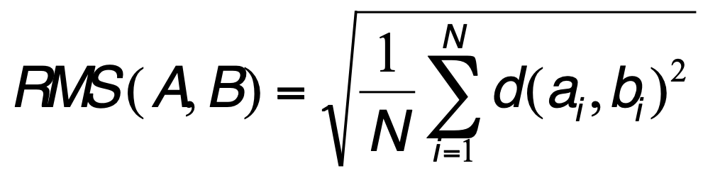
AlphaFold 1
Reminder:
To compare two sets of points (atoms) A={a₁, a₂, …a_{N}} and B={b₁, b₂, …,b_{N}}:
Define a 1-to-1 correspondence between A and B
for example, a_{i} corresponds to b_{i}, for all i in [1,N]
Compute RMS as:
Compute TM score:
$$TM(A,B)=\frac{1}{N}\overset{N}{\underset{i=1}{∑}}\frac{1}{1+{\left(\frac{d(a_{i},b_{i})}{d_{0}(N)}\right)}^{2}}$$
$$\text{with}d_{0}(N)=1.24\sqrt[3]{N-15}-1.8$$
d(a_{i},b_{i}) is the Euclidian distance between a_{i} and b_{i} after optimal alignment of B onto A
RMS: the lower, the better
TM: between [0,1]; the higher the better

Slide 21
AlphaFold 1

Slide 22
AlphaFold 1
Helix in blue, strand in red

Slide 23
AlphaFold 1: Success

Slide 24
Ab initio Protein Structure Prediction
Ab initio prediction before AlphaFold
Ab initio prediction: Predicting Contacts
AlphaFold 1
AlphaFold 2

Slide 25
AlphaFold 2

Slide 26
AlphaFold 2: some intuition

Slide 27
AlphaFold 2: the structure module
Predicting backbone:
the residues form a gas soup of triangles whose relative positions are characterized by affine transformation
Predicting side chains:

Slide 28
Successes at CASP14
TBM: template-based modeling
FM: free modeling

Slide 29
Successes at CASP14

Slide 30
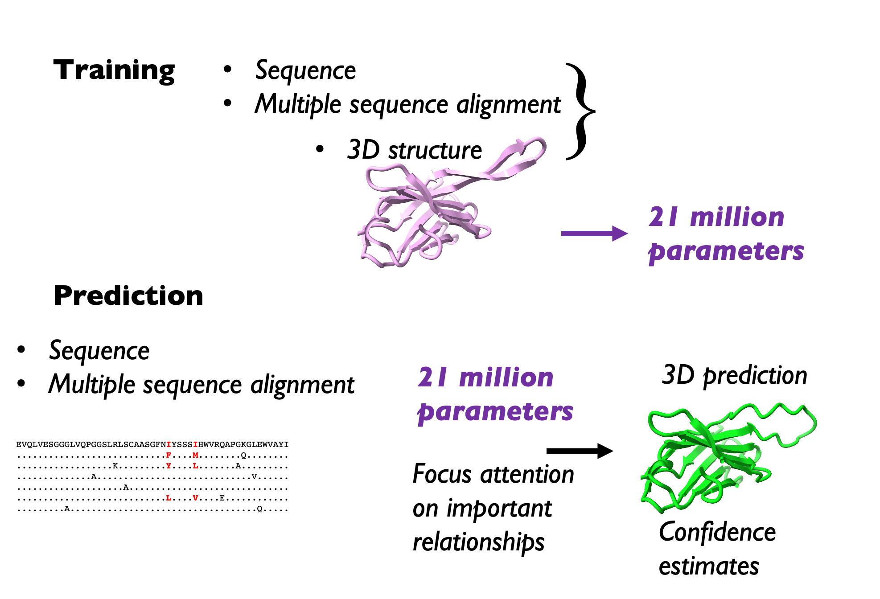
Credit: Tom Terwilliger, Los Alamos NL

Slide 31
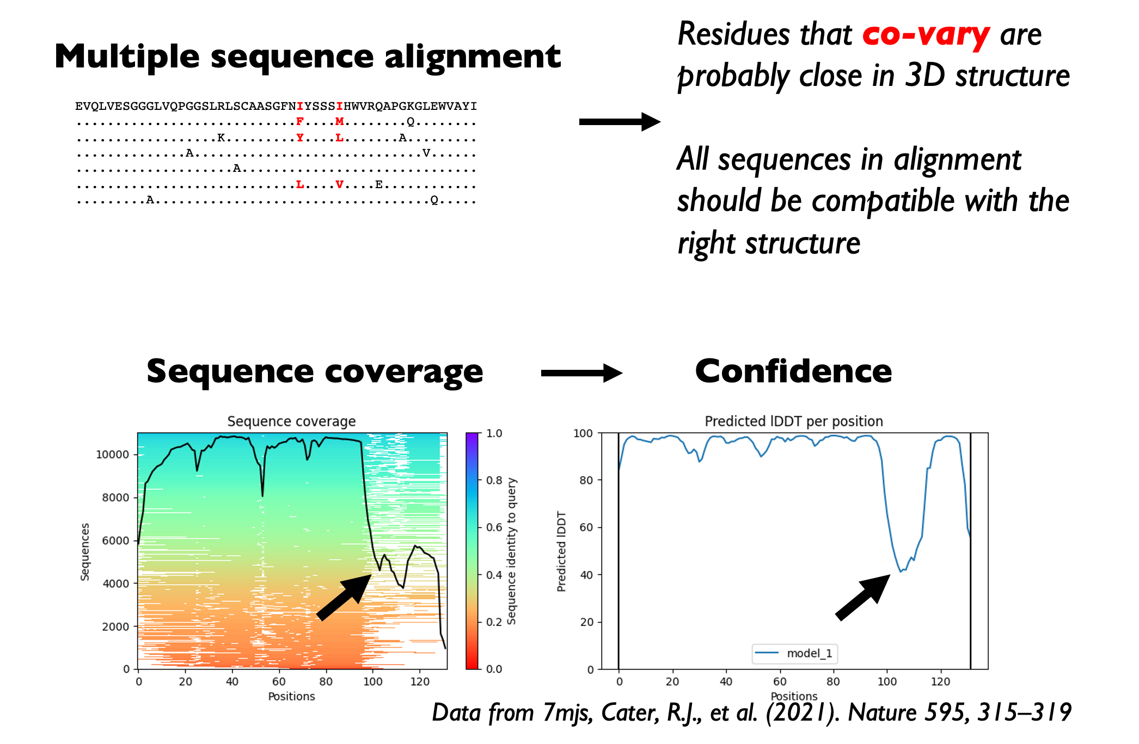
Credit: Tom Terwilliger, Los Alamos NL

Slide 32
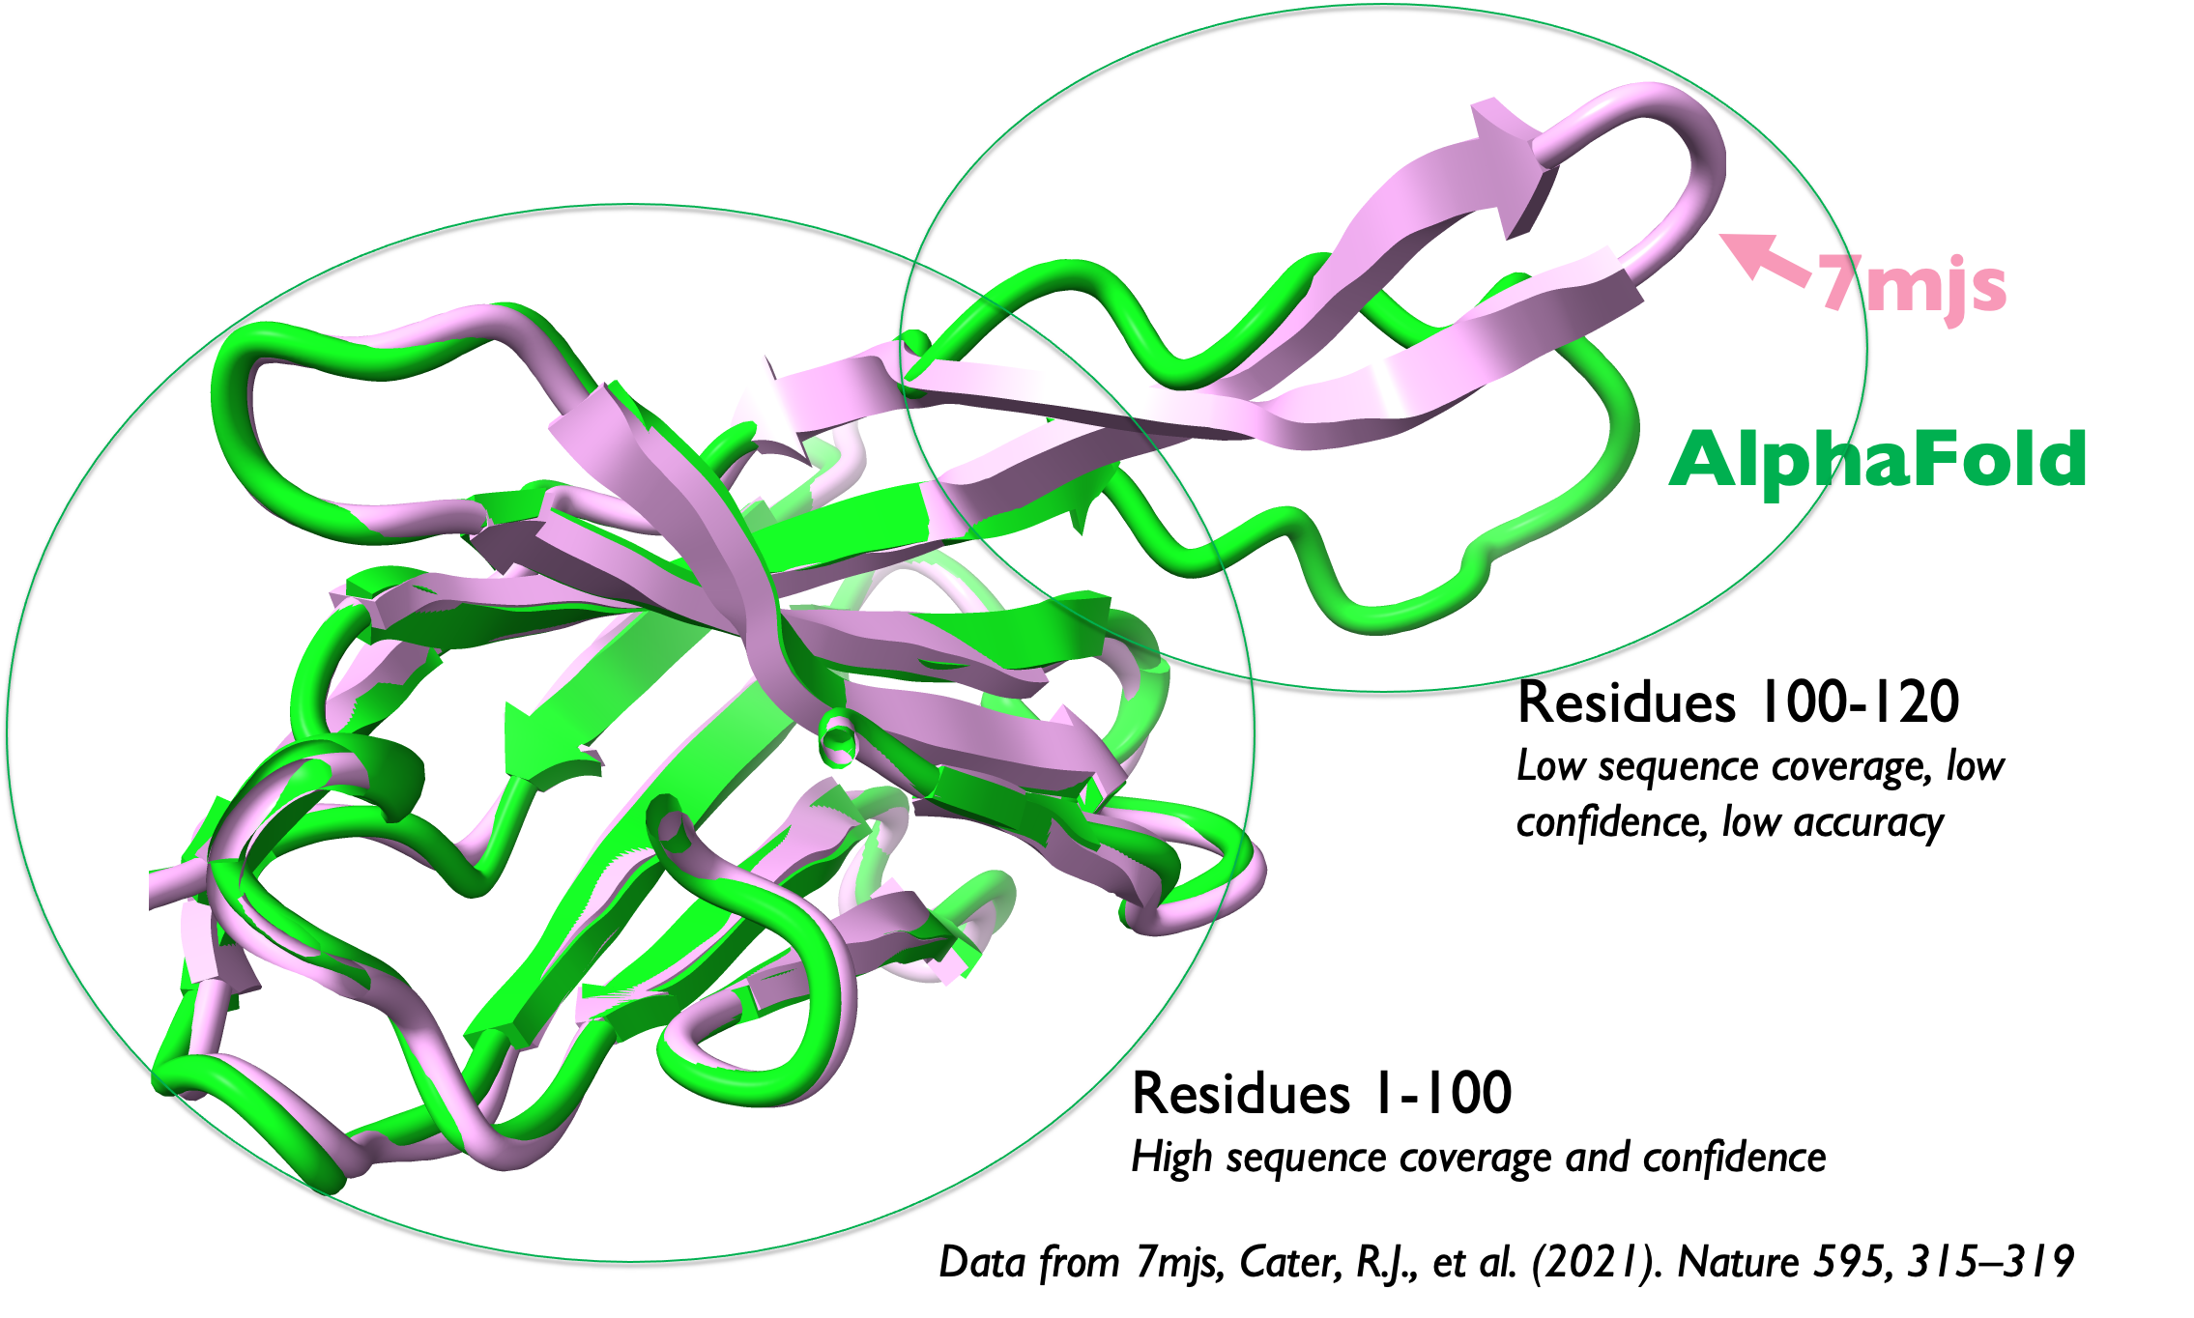
Credit: Tom Terwilliger, Los Alamos NL

Slide 33
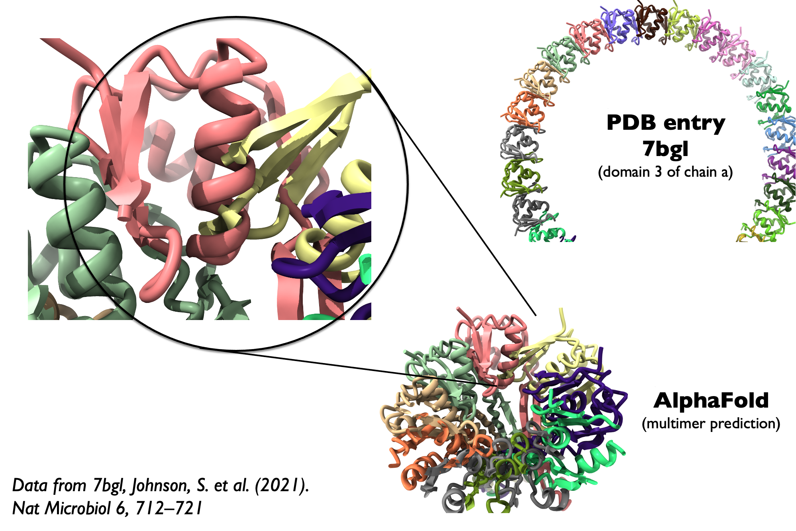
Multimeric proteins
Credit: Tom Terwilliger, Los Alamos NL

Slide 34
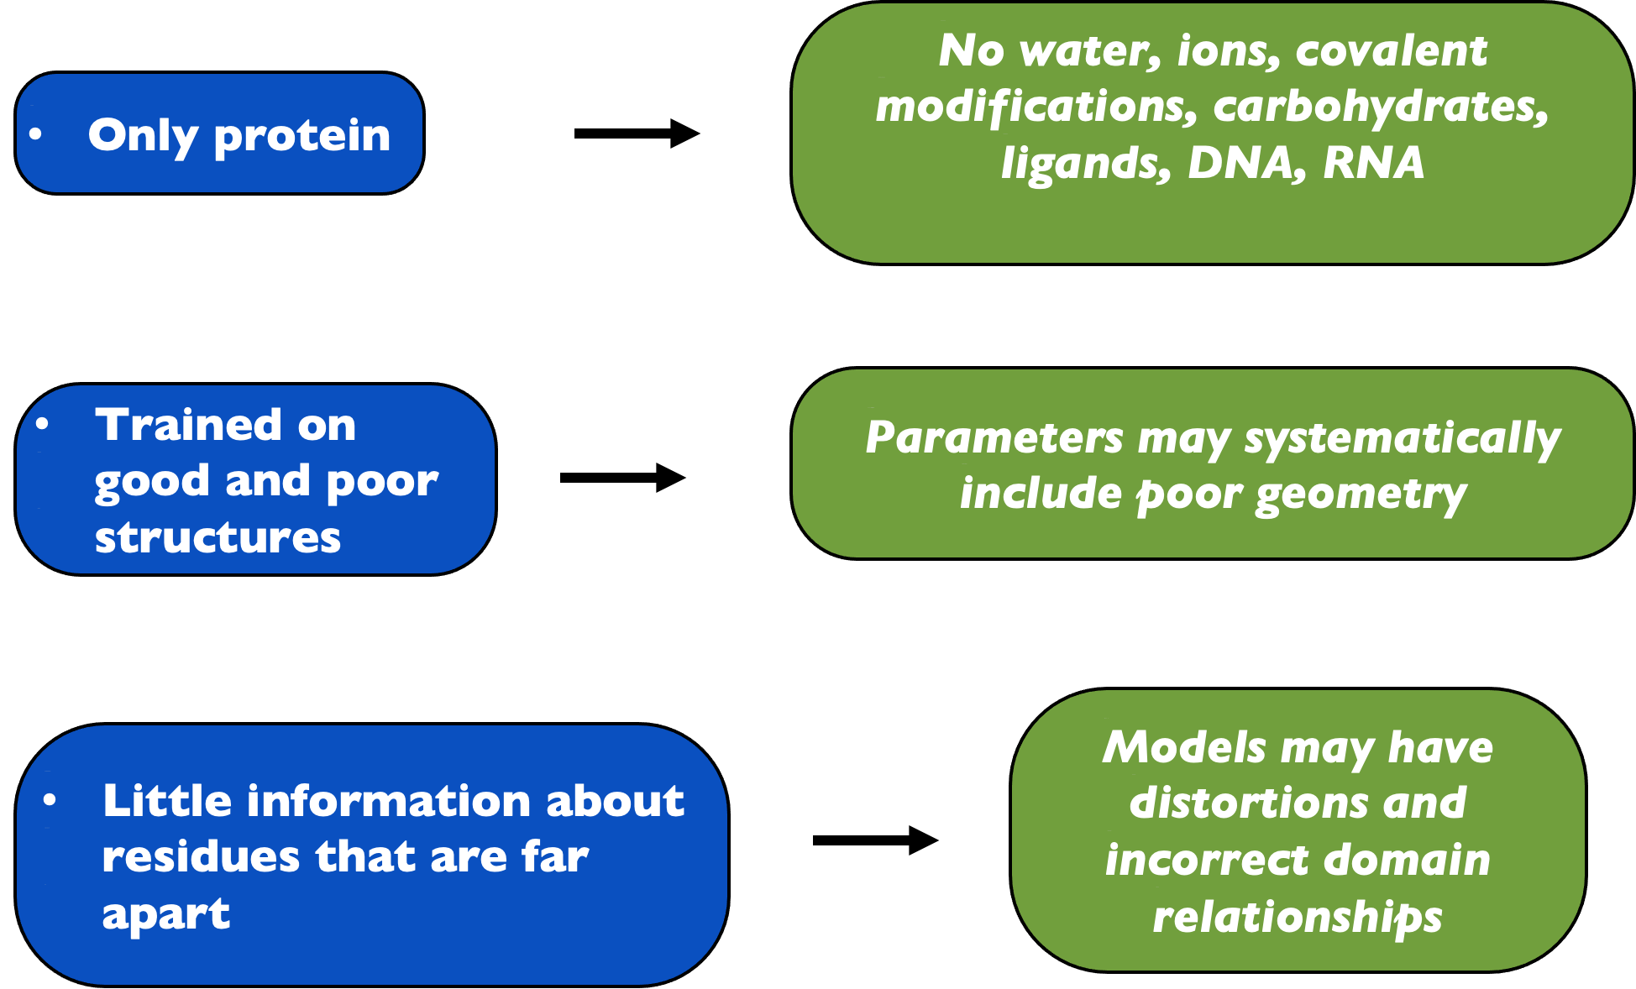
Credit: Tom Terwilliger, Los Alamos NL

