Slide 1
Biomolecular simulations
Patrice Koehl

Slide 2







Hierarchical Simulations
Multi-scale
Years
Yards
Cancer
Research
Fossil Energy
Fuel Cells
Nanotechnology
Genetic
Engineering
Polymers
Organelle
Modeling
Electronic
& Optical
Materials
Ceramics
Design
Seconds
Inches
Specialty
Chemicals
& Catalysts
Receptor
Modeling
Metal
Alloys
Pharmaceuticals
Materials
Biochemistry
Material Science
Microseconds
Microns
Chemistry
Molecular
Self-Assembly
Equilibrium
& Rate
Constants
Meso-scale
Modeling
Picoseconds
Nanometers
Molecules
F=ma
Molecular Mechanics
Force Fields
Femtoseconds
Angstroms
H Ψ= E Ψ
QUANTUM
MECHANICS
Atoms
Electrons
© W.A. Goddard III, M. Blanco, 1998

Slide 3
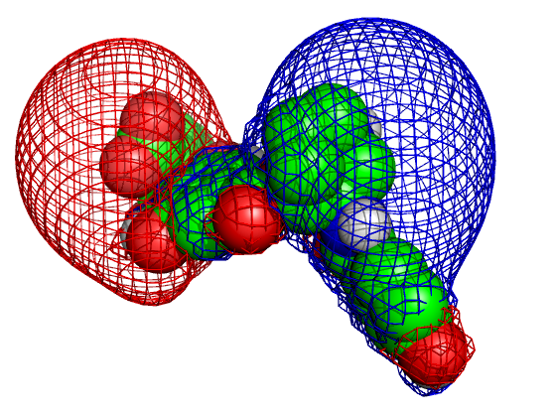
Biomolecular Simulations
Molecular Mechanics force fields
Energy Minimization
Molecular dynamics
Monte Carlo methods

Slide 4
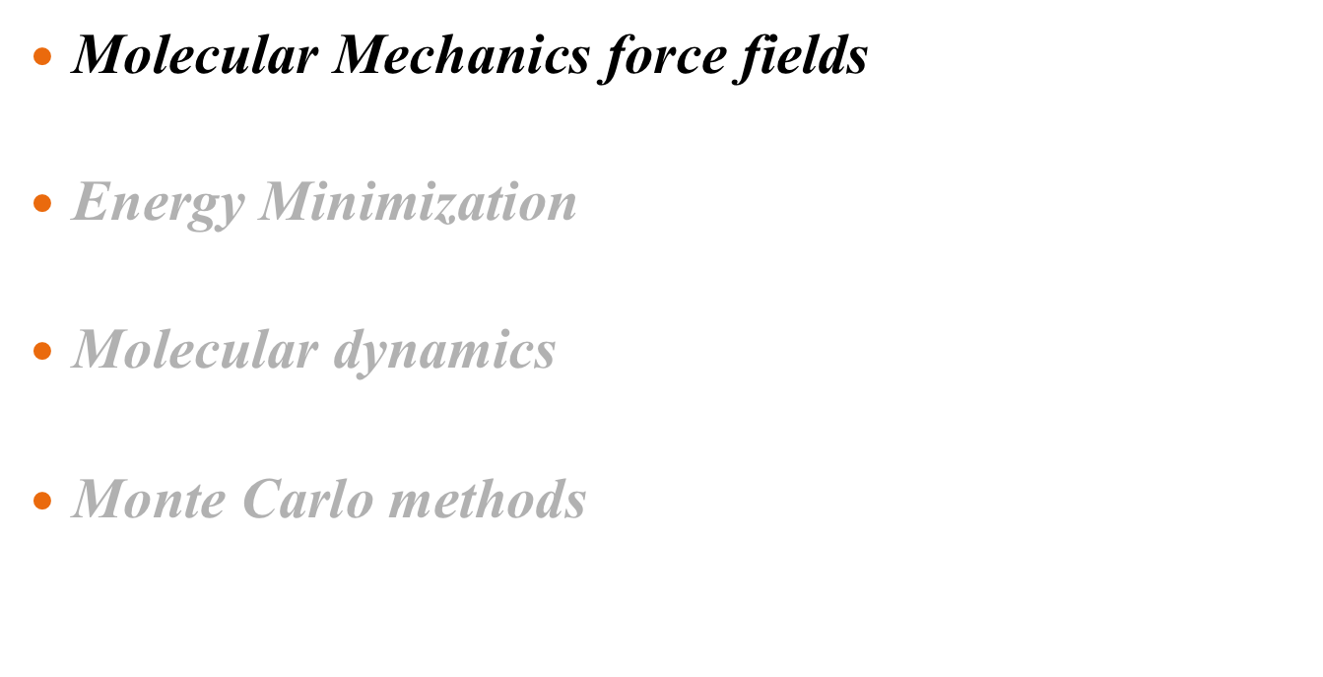
Biomolecular Simulations

Slide 5
The two major assumptions in molecular simulations
Born-Oppenheimer approximation
  “the dynamics of electrons is so fast that they can be
  considered to react instantaneously to the motion of
  their nuclei”
Classical mechanics
  “The nuclei are treated as point particles that follow
  the classical laws of mechanics.”

Slide 6
What is an atom?
Classical mechanics: a point particle
Defined by its position (x,y,z) and its mass
May carry an electric charge (positive or negative), usually partial (less than an electron)

Slide 7
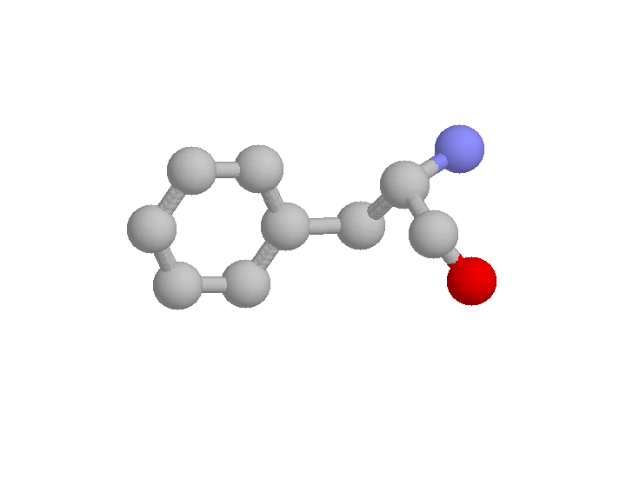
Atomic interactions
Torsion angles
Are 4-body
Non-bonded
pair
Angles
Are 3-body
Bonds
Are 2-body

Slide 8



Atomic interactions
Strong valence energies
b
All chemical bonds
q
Angle between chemical bonds
Preferred conformations for
torsion angles:
- ω angle of the main chain
- χ angles of the sidechains
(aromatic, …)
f

Slide 9
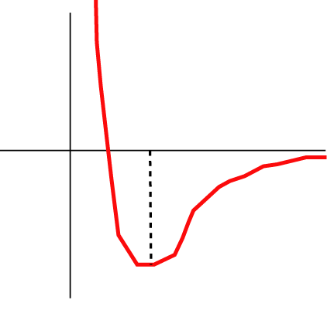
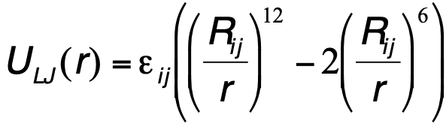
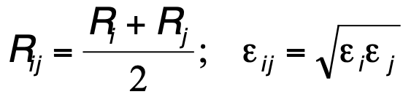
vdW interactions
r
1/r¹²
Lennard-Jones potential
R_{ij}
1/r⁶

Slide 10
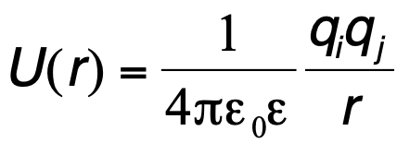
Electrostatics interactions
r
Coulomb potential
q_{i}
q_{j}

Slide 11
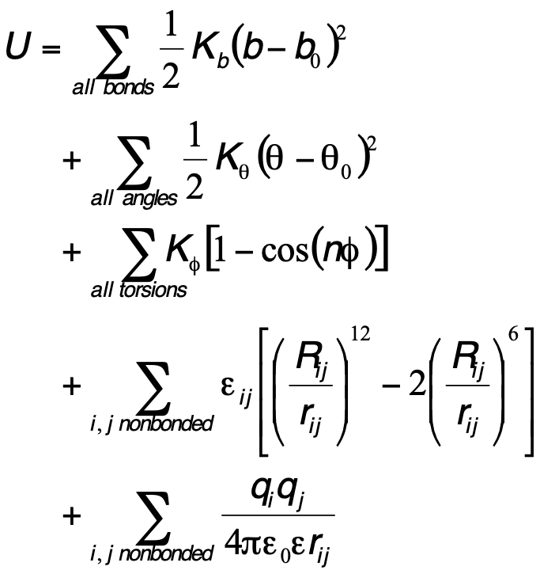
Computing energy
Torsion angles
Are 4-body
Non-bonded
pair
Angles
Are 3-body
Bonds
Are 2-body

Slide 12
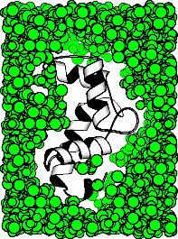
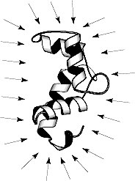
Solvent
Explicit or Implicit ?

Slide 13
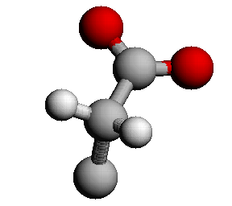
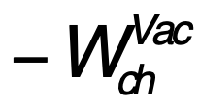

Solvation Free Energy
W_{sol}
+
+
W_{np}

Slide 14
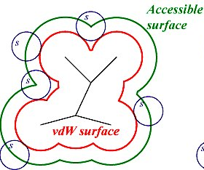
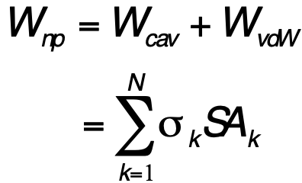
The SA model
Surface area potential
Eisenberg and McLachlan, (1986) Nature, 319, 199-203

Slide 15
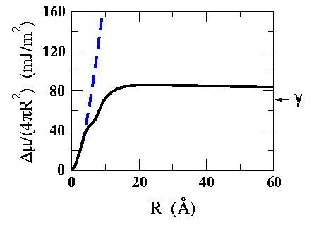
Hydrophobic potential: Surface Area, or Volume?
Surface effect
(Adapted from Lum, Chandler, Weeks,
J. Phys. Chem. B, 1999, 103, 4570.)
Volume effect
“Radius of the molecule”
For proteins and other large bio-molecules, use surface

Slide 16
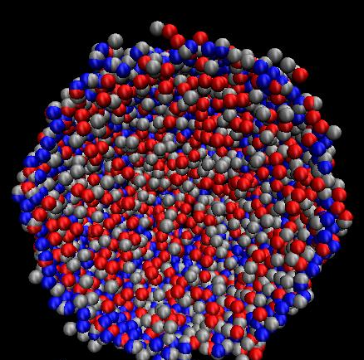
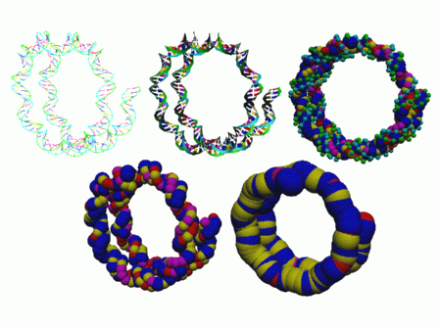
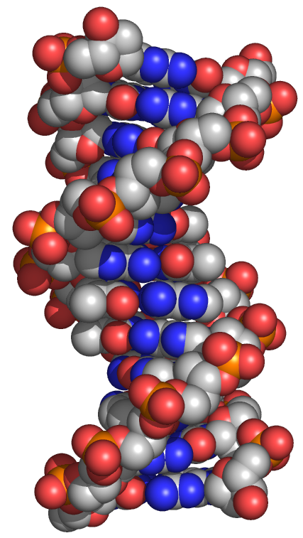
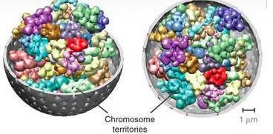
Sphere Representations in Biology
Viral DNA
DNA
Nucleosome
Chromosome arrangements

Slide 17
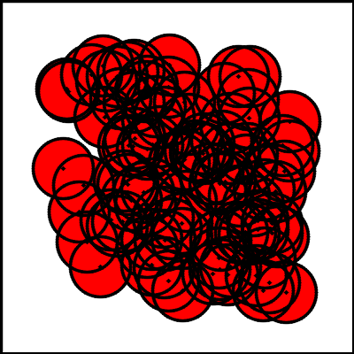
Measuring a Union of Balls

Slide 18
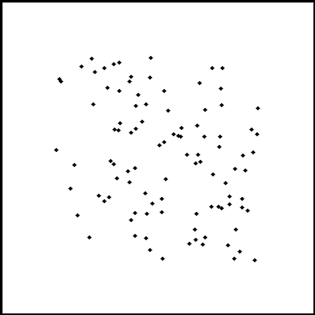
Measuring a Union of Balls

Slide 19

Measuring a Union of Balls
Algorithm for computing
Delaunay triangulation:
Input: N: number of points
Ci: position of point I
Randomize points
2) For i = 1:N
- Location: find tetrehedra
that contains Ci
- Addition: Divide t into 4
tetrahedra
- Correct: flip non local tetrahedra
Output: list of tetrahedra

Slide 20
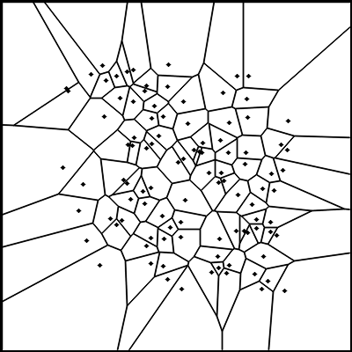
Measuring a Union of Balls
Compute Voronoi diagram from
Delaaunay complex: dual

Slide 21
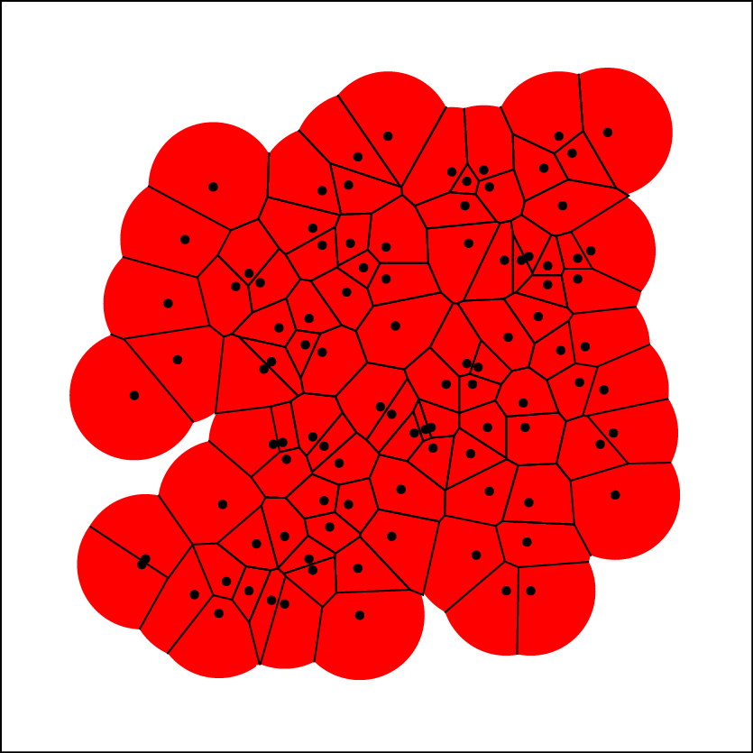
Measuring a Union of Balls
Restrict Voronoi diagram to
the Union of Balls:
Power diagram

Slide 22
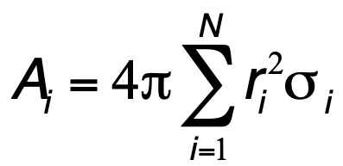
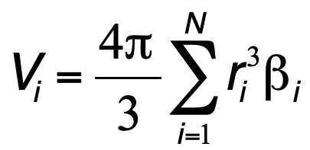
Measuring a Union of Balls
r_{i}
Atom i:
Fraction in Voronoi cell:
s_{i} and b_{i}

Slide 23
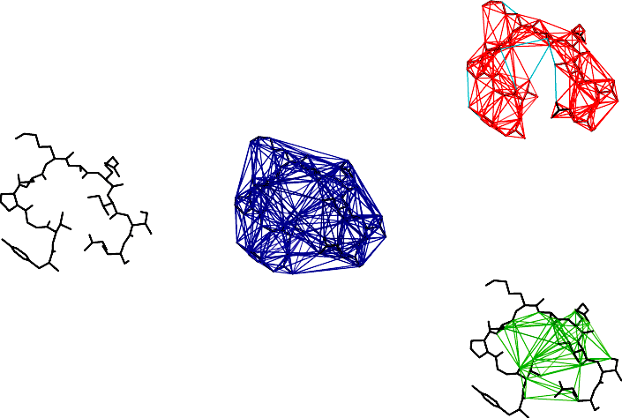
Measuring a Union of Balls
K complex
Protein
Delaunay Complex
Pocket

Slide 24
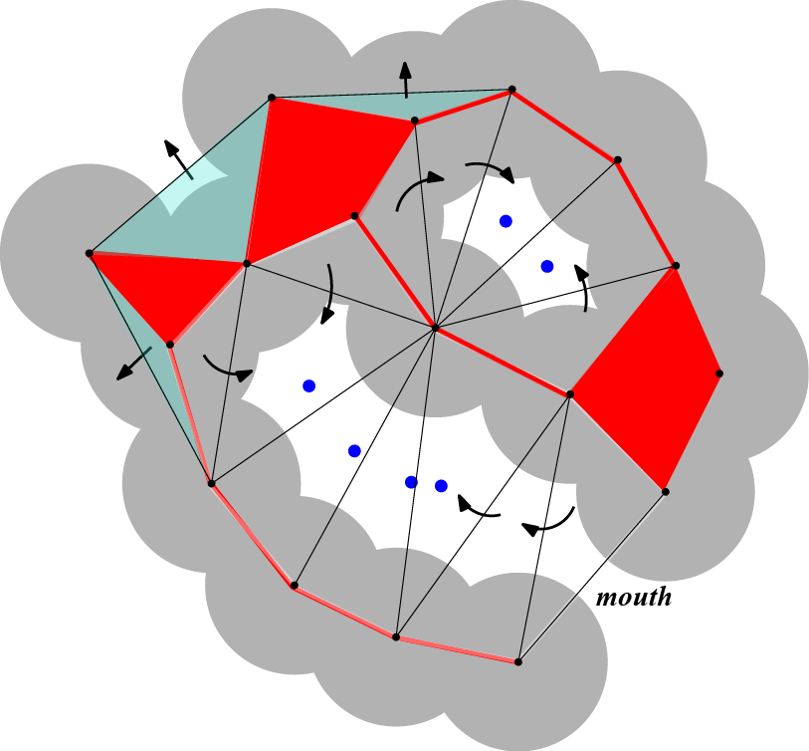
Measuring Union of Balls
Cavity
Pocket

Slide 25
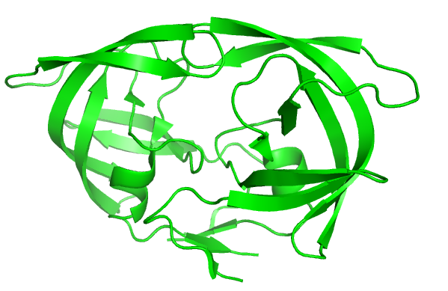
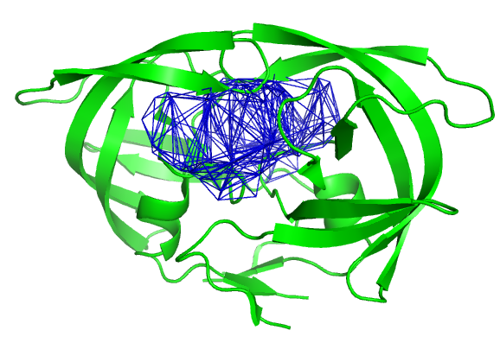
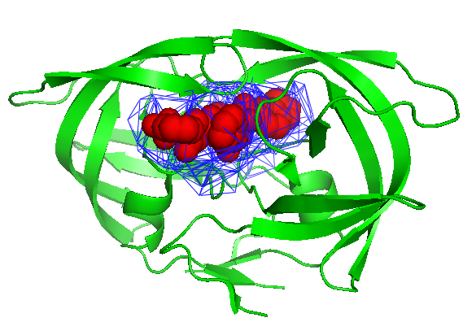
Applications to drug design
HIV protease (3MXE)
Main cavity
Actual position of K54
(inhibitor)

Slide 26
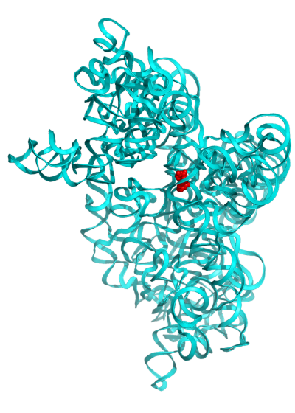
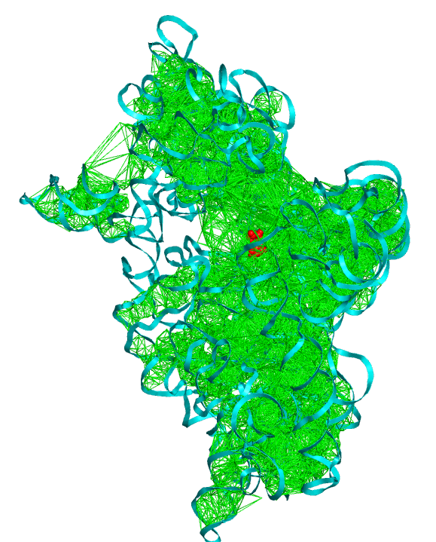
BINDING POCKETS IN 16S RIBOSOMAL RNA
Hygromycin B
PDB structure: 1HZN

Slide 27
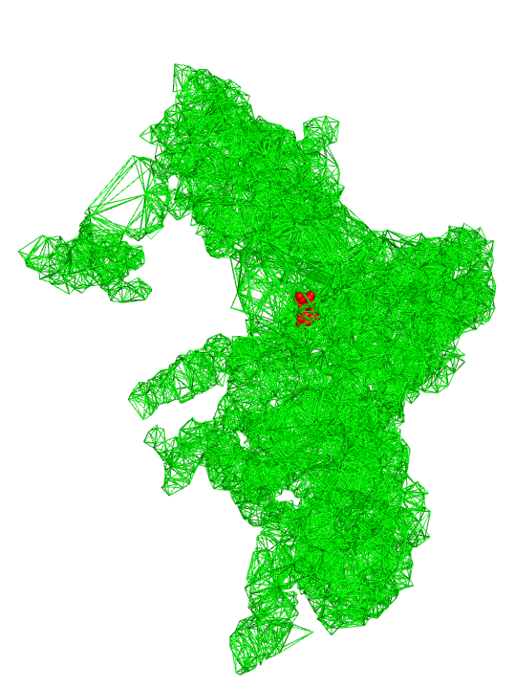
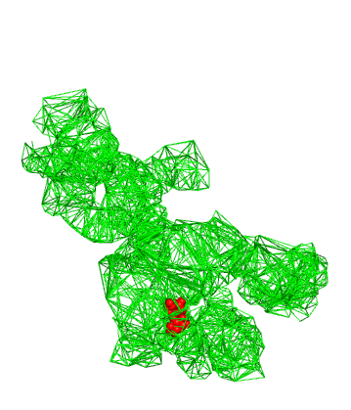
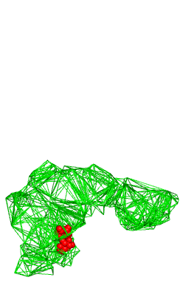
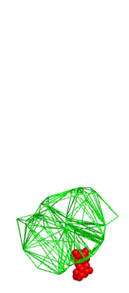
BINDING POCKETS IN 16S RIBOSOMAL RNA
8 Å
Probe Size
1.4 Å

Slide 28
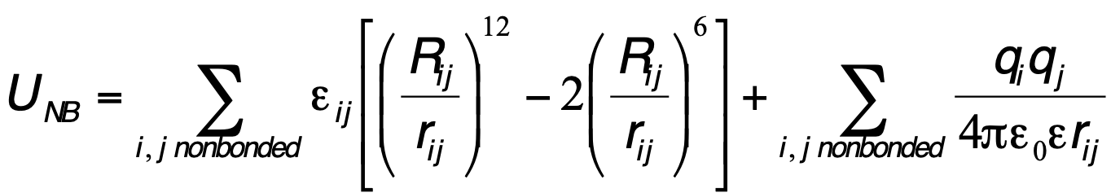
Computing energy
Bonded interactions are local, and therefore their computation has a linear
computational complexity (O(N), where N is the number of atoms in the
molecule considered.
The direct computation of the non bonded interactions involve all pairs of
atoms and has a quadratic complexity (O(N2)).
This can be prohibitive for large molecules.

Slide 29
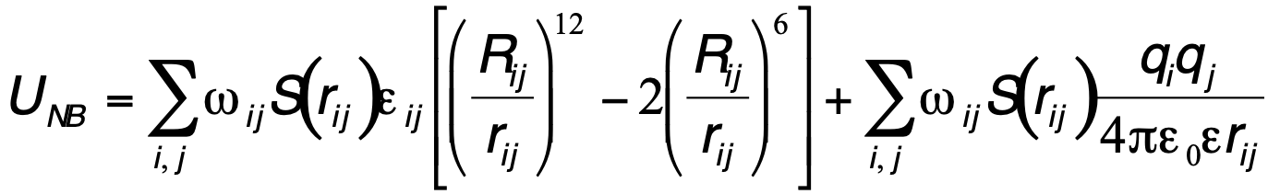
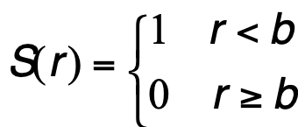
Cutoff schemes for faster energy computation
w_{ij} : weights (0< w_{ij} <1). Can be used to exclude bonded terms,
or to scale some interactions (usually 1-4)
S(r) : cutoff function.
Three types:
1) Truncation:
b

Slide 30
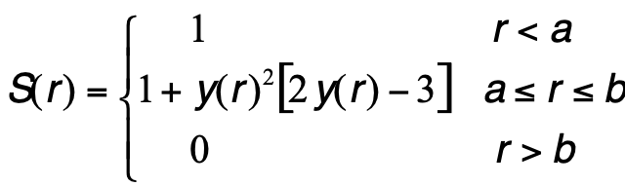
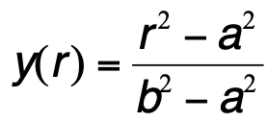
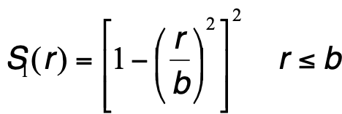
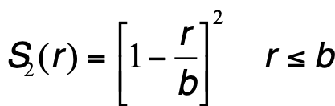
Cutoff schemes for faster energy computation
2. Switching
a
b
with
3. Shifting
or
b

Slide 31
Units in Molecular Simulations
Most force fields use the AKMA (Angstrom – Kcal – Mol – Atomic Mass Unit) unit
system:
Quantity | AKMA unit | Equivalent SI
Energy | 1 Kcal/Mol | 4184 Joules
Length | 1 Angstrom | 10⁻¹⁰ meter
Mass | 1 amu (H=1amu) | 1.6605655 10⁻²⁷ Kg
Charge | 1 e | 1.6021892 10⁻¹⁹ C
Time | 1 unit | 4.88882 10⁻¹⁴ second
Frequency | 1 cm-1 | 18.836 10¹⁰ rd/s

Slide 32
Some Common force fields in Computational Biology
ENCAD (Michael Levitt, Stanford)
AMBER (Peter Kollman, UCSF; David Case, Scripps)
CHARMM (Martin Karplus, Harvard)
OPLS (Bill Jorgensen, Yale)
MM2/MM3/MM4 (Norman Allinger, U. Georgia)
ECEPP (Harold Scheraga, Cornell)
GROMOS (Van Gunsteren, ETH, Zurich)
Michael Levitt. The birth of computational structural biology. Nature Structural Biology, 8, 392-393 (2001)

Slide 33
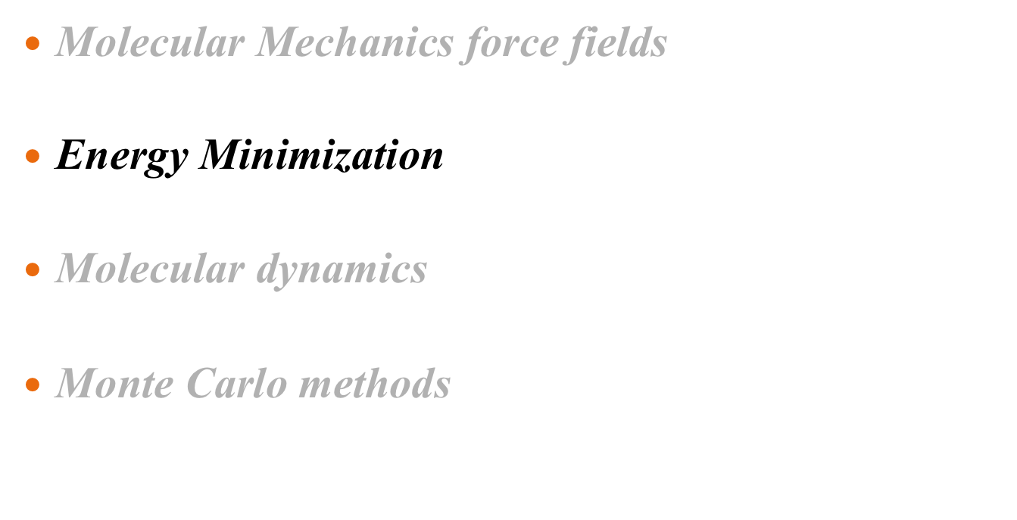
Biomolecular Simulations

Slide 34
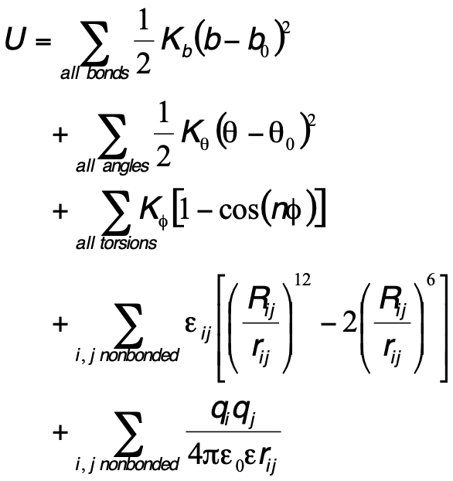
Computing energy
Torsion angles
Are 4-body
Non-bonded
pair
Angles
Are 3-body
Bonds
Are 2-body
U is a function of the conformation C of the protein.
The problem of “minimizing U” can be stated as finding C
such that U(C) is minimum.

Slide 35
The minimizers
Minimization of a multi-variable function is usually an iterative process, in which
updates of the state variable x are computed using the gradient, and in some
(favorable) cases the Hessian.
Iterations are stopped either when the maximum number of steps (user’s input)
is reached, or when the gradient norm is below a given threshold.

Slide 36
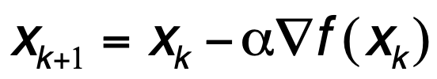
Steepest descent (SD):
The simplest iteration scheme consists of following the “steepest
descent” direction:
Usually, SD methods leads to improvement quickly, but then exhibit
slow progress toward a solution.
They are commonly recommended for initial minimization iterations,
when the starting function and gradient-norm values are very large.
(α sets the minimum
along the line defined
by the gradient)

Slide 37

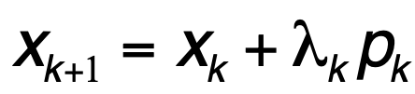
The minimizers
Conjugate gradients (CG):
In each step of conjugate gradient methods, a search vector p_{k} is
defined by a recursive formula:
The corresponding new position is found by line minimization along p_{k}:
the CG methods differ in their definition of β.

Slide 38
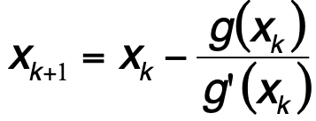
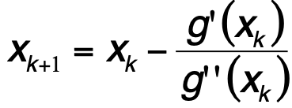
The minimizers
Newton’s methods:
Newton’s method is a popular iterative method for finding the 0 of a
one-dimensional function:
x₃
x₂
x₁
x₀
It can be adapted to the minimization of a one –dimensional function, in which
case the iteration formula is:
Several implementations of Newton’s method exist: quasi-Newton,
truncated Newton, “adopted-basis Newton-Raphson” (ABNR),…

Slide 39
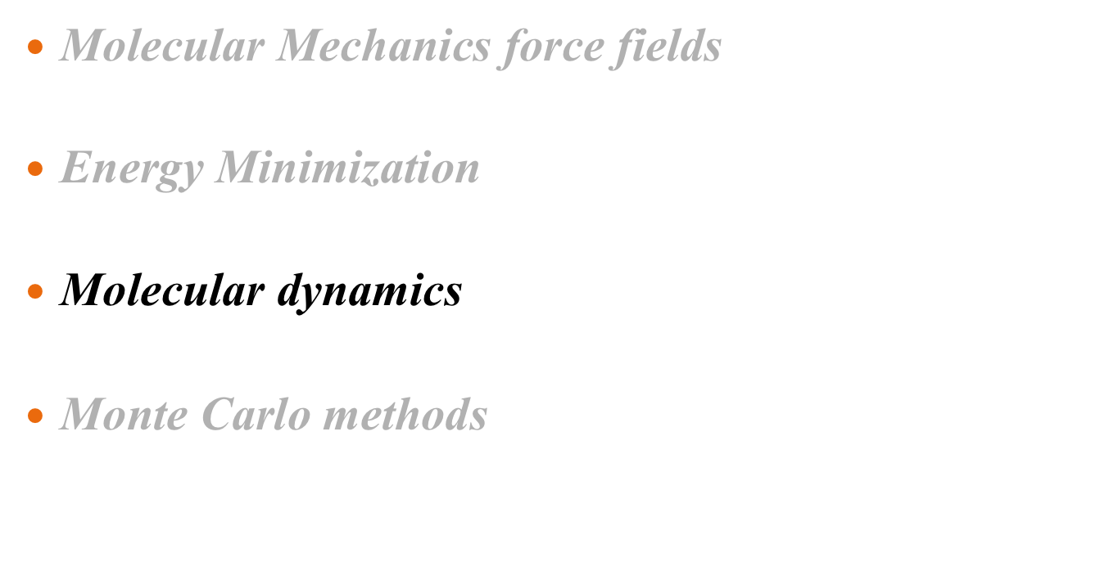
Biomolecular Simulations

Slide 40
What is a molecular dynamics simulation?
Simulation that shows how the atoms in the system move with time
Typically on the nanosecond timescale
Atoms are treated like hard balls, and their motions are described by Newton’s laws.

Slide 41
Characteristic protein motions
Type of motion | Timescale | Amplitude
Local: bond stretching angle bending methyl rotation | 0.01 ps 0.1 ps 1 ps | < 1 Å
Medium scale loop motions SSE formation | ns – μs | 1-5 Å
Global protein tumbling (water tumbling) protein folding | 20 ns (20 ps) ms – hrs | > 5 Å
Periodic (harmonic)
Random (stochastic)

Slide 42
Why MD simulations?
Link physics, chemistry and biology
Model phenomena that cannot be observed experimentally
Understand protein folding…
Access to thermodynamics quantities (free energies, binding energies,…)

Slide 43


How do we run a MD simulation?
Get the initial configuration
  From x-ray crystallography or NMR spectroscopy (PDB)
Assign initial velocities
At thermal equilibrium, the expected value of the kinetic energy of the system at temperature T is:
This can be obtained by assigning the velocity components vi from a random Gaussian distribution with mean 0 and standard deviation (k_{B}T/m_{i}):

Slide 44


How do we run a MD simulation?
For each time step:
Compute the force on each atom:
Solve Newton’s 2nd law of motion for each atom,
to get new coordinates and velocities
Store coordinates
Stop
X: cartesian vector
of the system
M diagonal mass matrix
.. means second order
differentiation with
respect to time
Newton’s equation cannot be solved analytically:
Use stepwise numerical integration

Slide 45

MD as a tool for minimization
Energy
Molecular dynamics
uses thermal energy
to explore the energy
surface
State A
State B
Energy minimization
stops at local minima
position

Slide 46

Crossing energy barriers
State B
Energy
I
Position
DG
State A
A
B
Position
time
The actual transition time from A to B is very quick (a few pico seconds).
What takes time is waiting. The average waiting time for going from A to B
can be expressed as:

Slide 47

Biomolecular Simulations

Slide 48


Monte Carlo: random sampling
A simple example:
  Evaluate numerically the one-dimensional integral:
  Instead of using classical quadrature, the integral can be rewritten as
<f(x)> denotes the unweighted average of f(x) over [a,b], and can be
determined by evaluating f(x) at a large number of x values randomly
distributed over [a,b]
Monte Carlo method!

Slide 49



A famous example: Buffon’s needle problem
The probability that a needle of length
L overlaps with one of the lines, distant
from each other by D, with L≤D is:
D
For L = D
Method to estimate π numerically:
“Throw” N needles on the floor, find needles that cross one of the line
(say C of them). An estimate of π is:
Buffon, G. Editor's note concerning a lecture given by Mr. Le Clerc de Buffon to the Royal Academy of
Sciences in Paris. Histoire de l'Acad. Roy. des Sci., pp. 43-45, 1733.
Buffon, G. "Essai d'arithmétique morale." Histoire naturelle, générale er particulière, Supplément 4,
46-123, 1777

Slide 50


Monte Carlo Sampling for protein structure
The probability of finding a protein (biomolecule) with a total energy
E(X) is:
Partition function
Estimates of any average quantity of the form:
using uniform sampling would therefore be extremely inefficient.
Metropolis and coll. developed a method for directly sampling
according to the actual distribution.
Metropolis et al. Equation of state calculations by fast computing machines. J. Chem. Phys. 21:1087-1092 (1953)

Slide 51

Monte Carlo for sampling conformations
The Metropolis Monte Carlo algorithm:
Select a conformation X at random. Compute its energy E(X)
Generate a new trial conformation Y. Compute its energy E(Y)
Accept the move from X to Y with probability:
Repeat 2 and 3.
Pick a random number
RN, uniform in [0,1].
If RN < P, accept the
move.

