Slide 1
Protein Structure Comparison
ECS129
Patrice Koehl

Slide 2
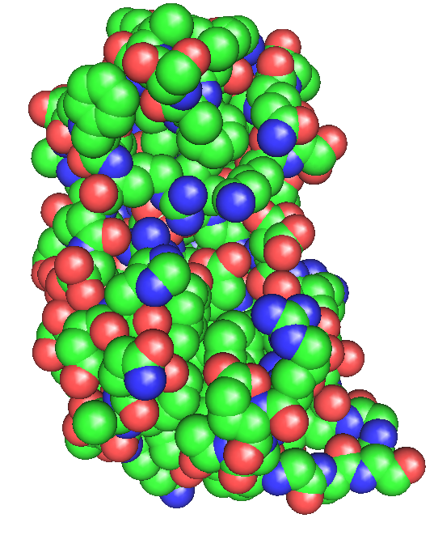
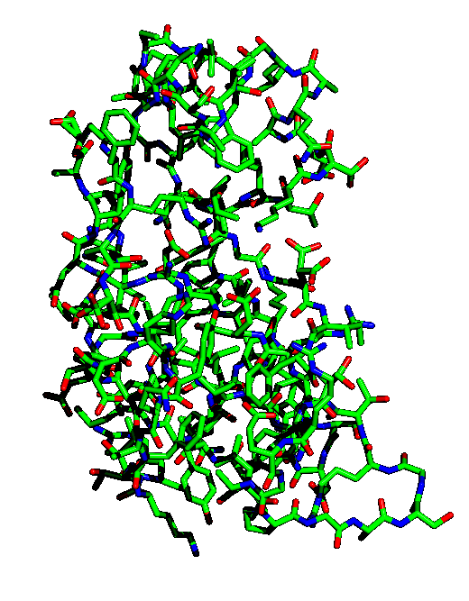
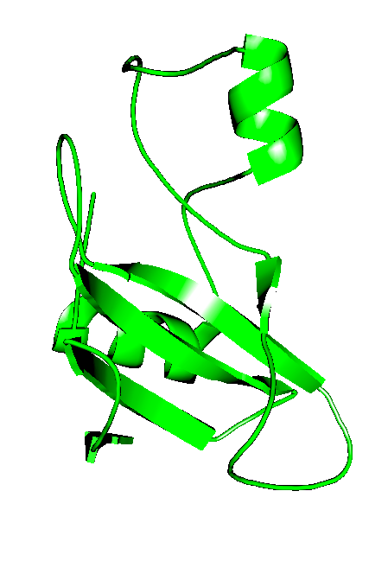
Protein Structure Representation
CPK: hard sphere model
Ball-and-stick
Cartoon

Slide 3
Degrees of Freedom in Proteins
Bond length
Bond angle
Dihedral angle
1
2
1
3
4
2
+

Slide 4
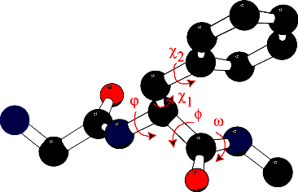
Protein Structure: Variables
Backbone: 3 angles per residue : ϕ, φ and ω
Sidechain: 1 to 7 angles, χ; each χ has 3 favored values: 60º, -60º, 180º.

Slide 5
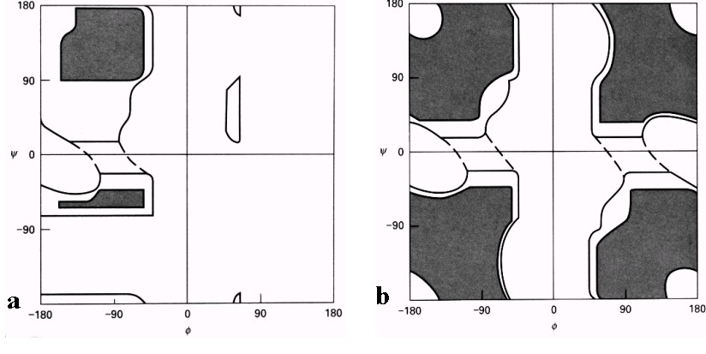
Ramachandran Plots
y
y
f
f
All residues, but glycine
Glycine
Acta Cryst. (2002). D58, 768-776

Slide 6
Sequence versus Structure
The protein sequence is a string of letters: there is an optimal solution (DP) to the problem of string matching, given a scoring scheme
The protein structure is a 3D shape: the goal is to find algorithms similar to DP that finds the optimal match between two shapes.

Slide 7
Protein Structure Comparison
Global versus local alignment
Measuring protein shape similarity
Protein structure superposition
Protein structure alignment

Slide 8
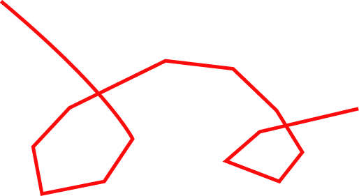
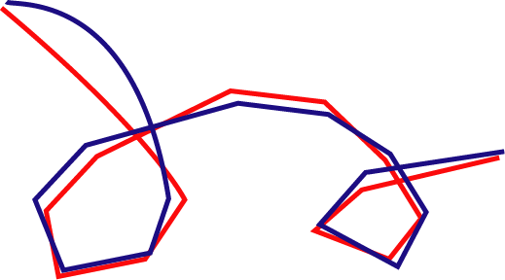
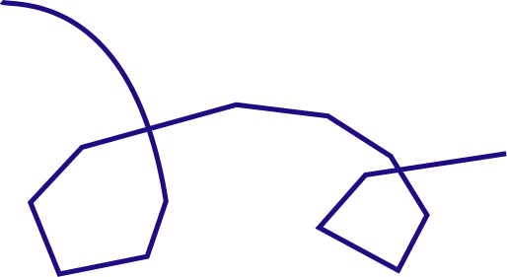
Global versus Local
Global alignment

Slide 9
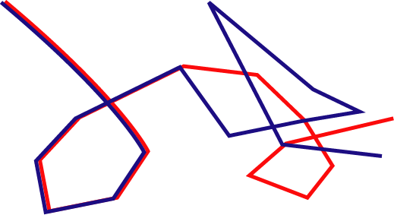
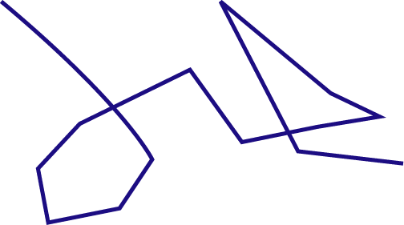
Global versus Local (2)
motif
Local alignment

Slide 10
Measuring protein structure similarity
Given two “shapes” or structures A and B, we are interested
in defining a distance, or similarity measure between
A and B.
Visual comparison
Dihedral angle comparison
Distance matrix
RMSD (root mean square distance)
Is the resulting distance (similarity measure) D a metric?
D(A,B) ≤ D(A,C) + D(C,B)

Slide 11
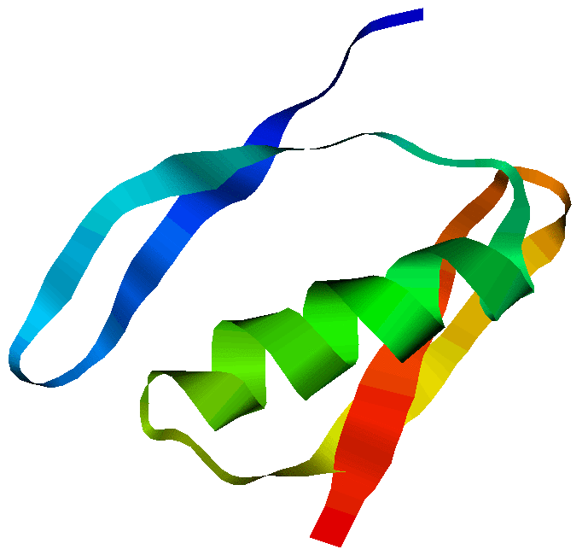
Comparing dihedral angles
Torsion angles (φ,ψ) are:
- local by nature
- invariant upon rotation and translation of the molecule
- compact (O(n) angles for a protein of n residues)
But…
Add 1 degree
To all φ, ψ

Slide 12
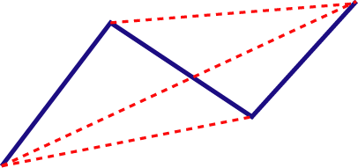
Distance matrix
 | 1 | 2 | 3 | 4
1 | 0 | 3.8 | 6.0 | 8.1
2 | 3.8 | 0 | 3.8 | 5.9
3 | 6.0 | 3.8 | 0 | 3.8
4 | 8.1 | 5.9 | 3.8 | 0
2
5.9
4
8.1
3
6.0
1

Slide 13
Distance matrix (2)
Advantages
- invariant with respect to rotation and translation
- can be used to compare proteins of different sizes
Disadvantages
- the distance matrix is O(n2) for a protein with n residues
- comparing distance matrix is a hard problem
- insensitive to chirality

Slide 14
Root Mean Square Distance (RMSD)
To compare two sets of points (atoms) A={a₁, a₂, …a_{N}} and B={b₁, b₂, …,b_{N}}:
Define a 1-to-1 correspondence between A and B
for example, a_{i} corresponds to b_{i}, for all i in [1,N]
Compute RMS as:
d(A_{i},B_{i}) is the Euclidian distance between a_{i} and b_{i}.

Slide 15
Protein Structure Superposition
Simplified problem: we know the correspondence between set A and set B
We wish to compute the rigid transformation T that best align a₁ with b₁, a₂ with b₂, …, a_{N} with b_{N}
The error to minimize is defined as:
Old problem, solved in Statistics,
Robotics, Medical Image Analysis,
…

Slide 16
Protein Structure Superposition
A rigid-body transformation T is a combination of a translation t and a rotation R: T(x) = Rx+t
The quantity to be minimized is:

Slide 17
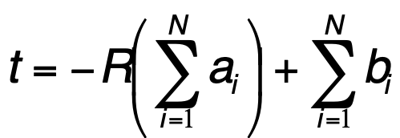
The translation part
E is minimum with respect
to t when:
Then:
If both data sets A and B have been centered on 0, then t = 0 !
Step 1: Translate point sets A and B such that their centroids coincide
at the origin of the framework

Slide 18
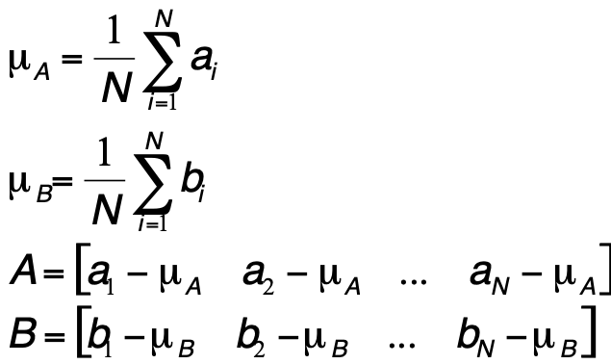
The rotation part (1)
Let μ_{A} and μ_{B} be then barycenters of A and B, and A’ and B’ the
matrices containing the coordinates of the points of A and B centered
on O:
Build covariance matrix:
Nx3
3xN
x
=
3x3

Slide 19
The rotation part (2)
Compute SVD (Singular Value Decomposition) of C:
U and V are orthogonal matrices, and D is a diagonal matrix containing the singular values.
U, V and D are 3x3 matrices
Define S by:
Then

Slide 20
The algorithm
1. Center the two point sets A and B
4. Define S:
2. Build covariance matrix:
3. Compute SVD (Singular Value
Decomposition) of C:
5. Compute rotation matrix
6. Compute RMSD:
O(N) in time!

Slide 21
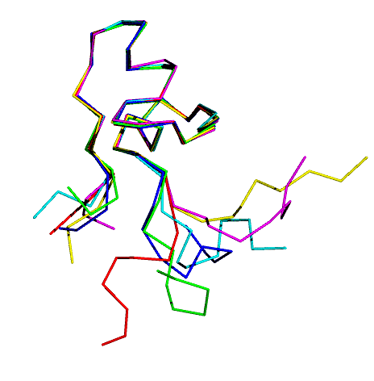
Example 1: NMR structures
Superposition of NMR
Models
1AW6

Slide 22
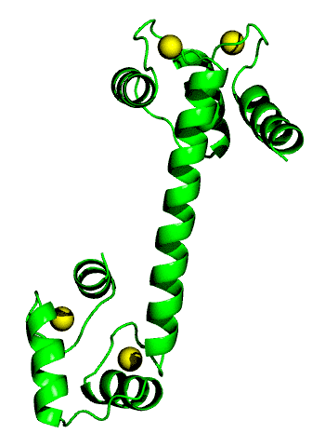
Example 2: Calmodulin
Two forms of
calcium-bound
Calmodulin:
Ligand free
Complexed
with
trifluoperazine

Slide 23
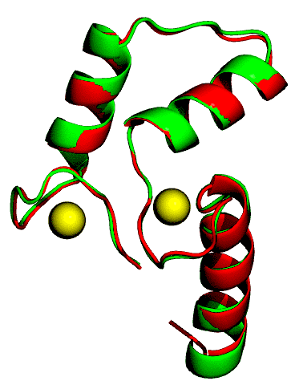
Example 2: Calmodulin
Global alignment:
RMSD =15 Å /143 residues
Local alignment:
RMSD = 0.9 Å/ 62 residues

Slide 24
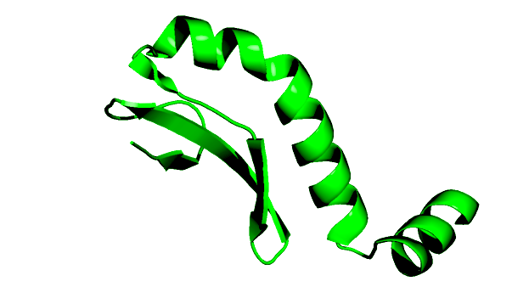
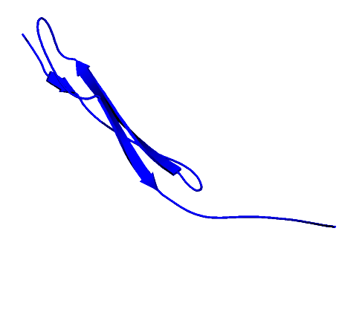
RMSD is not a Metric
cRMS = 2.8 Ǻ
cRMS = 2.85 Ǻ

Slide 25
Protein Structure Alignment
Protein Structure Superposition Problem:
Given two sets of points A=(a1, a2, …, an) and B=(b1,b2,…bm) in
3D space, find the optimal subsets A(P) and B(Q) with |A(P)|=|B(Q)|,
and find the optimal rigid body transformation Gopt between the two
subsets A(P) and B(Q) that minimizes a given distance metric D over
all possible rigid body transformation G, i.e.
The two subsets A(P) and B(Q) define a “correspondence”, and
p = |A(P)|=|B(Q)| is called the correspondence length.

Slide 26
Two Subproblems
Find correspondence set
Find alignment transform
(protein superposition problem)

Slide 27
Existing Software
DALI (Holm and Sander, 1993)
SSAP (Orengo and Taylor, 1989)
STRUCTAL (Levitt et al, 1993)
VAST [Gibrat et al., 1996]
LOCK [Singh and Brutlag, 1996]
CE [Shindyalov and Bourne, 1998]
SSM [Krissinel and Henrik, 2004]
…

Slide 28
Trial-and-Error Approach to Protein Structure Alignment
Iterate N times:
Set Correspondence C to a seed correspondence set (small set sufficient to generate an alignment transform)
Compute the alignment transform G for C and apply G to the second protein B
Update C to include all pairs of features that are close apart
If C has changed, then return to Step 2

Slide 29
Protein Structure Classification

Slide 30
Why Classifying ?
Standard in biology:
Aristotle: Plants and Animal
Linnaeus: binomial system
Darwin: systematic classification that reveals phylogeny
It is easier to think about a representative than to embrace the information of all individuals

Slide 31
Protein Structure Classification
Domain Definition
3 Major classifications
- SCOP
- CATH
- DDD

Slide 32
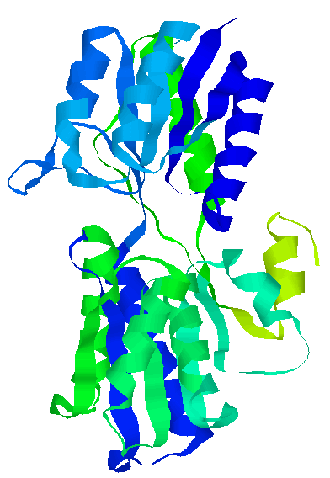
Protein Structural Domains

Slide 33
Protein Domain: Definitions
Regions that display significant levels of sequence similarity
The minimal part of a gene that is capable of performing a function
A region of a protein with an experimentally assigned function
Region of a protein structure that recurs in different contexts and proteins
A compact, spatially distinct region of a protein

Slide 34
Web services for domain identification
Program | Web access
DIAL | http://www.ncbs.res.in/~faculty/mini/ddbase/dial.html
DomainParser | http://compbio.ornl.gov/structure/domainparser
DOMAK | http://www.compbio.dundee.ac.uk/Software/Domak/domak.html
PDP | http://123d.ncifcrf.gov/pdp.html

Slide 35
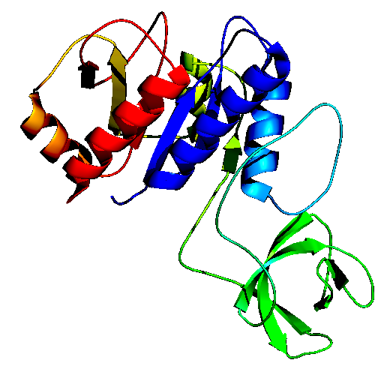
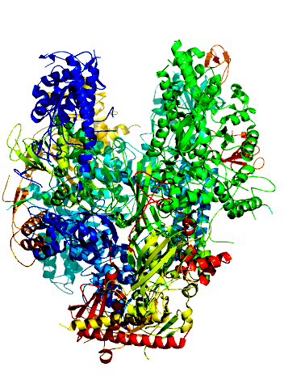
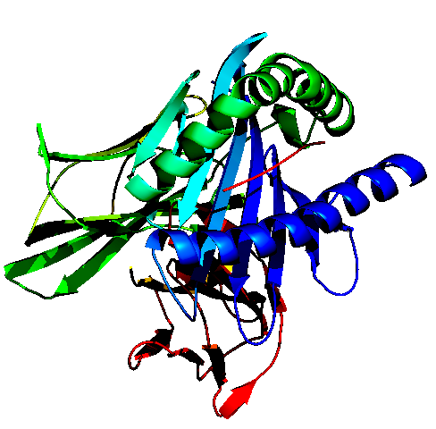
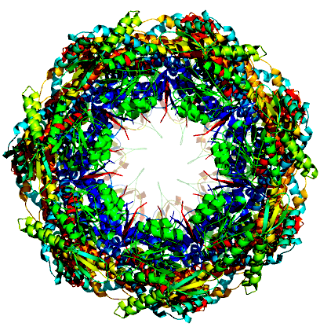
Protein Structure Space
1CTF
1TIM
1K3R
68 AA
247 AA
268 AA
1A1O
1NIK
1AON
384 AA
4504 AA
8337 AA

Slide 36
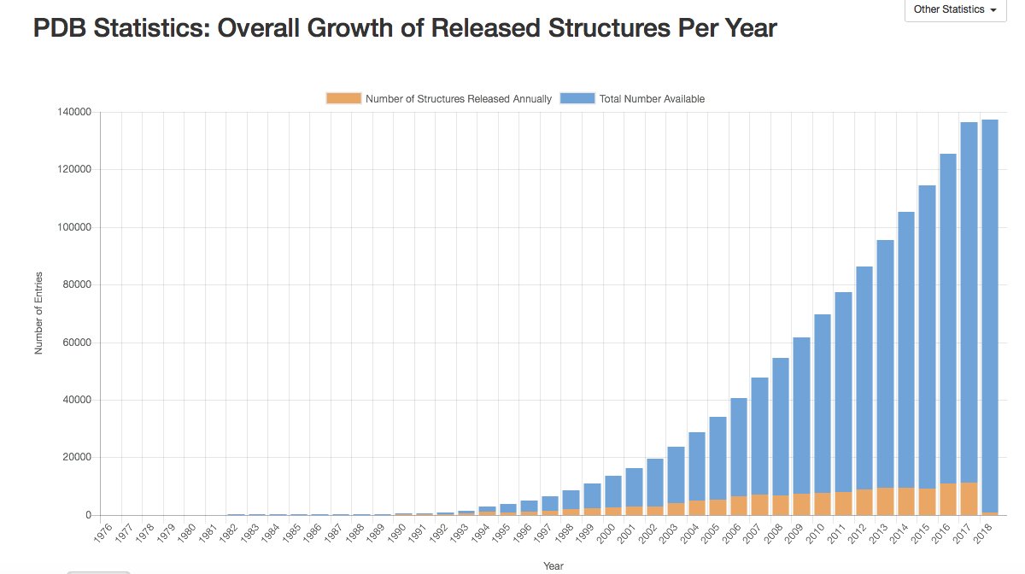

Slide 37
Current state of the PDB

Slide 38
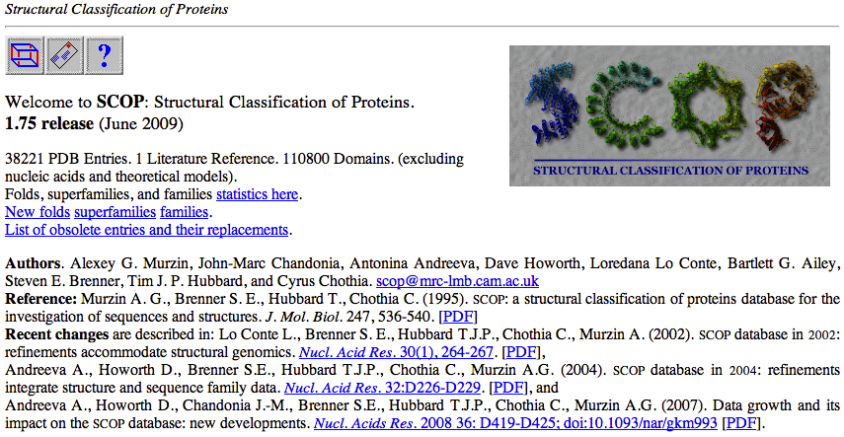
Classification of Protein Structure: SCOP
http://scop.mrc-lmb.cam.ac.uk/scop/
http://scop.berkeley.edu/

Slide 39
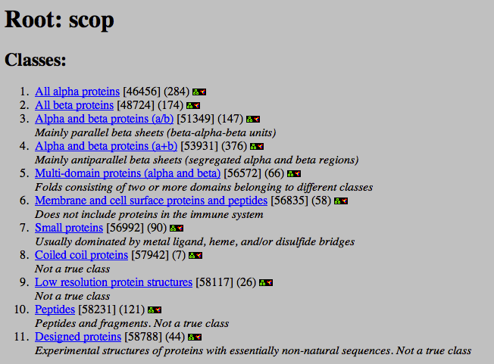
Classification of Protein Structure: SCOP
SCOP is organized into 4 hierarchical layers:
(1) Classes:

Slide 40
Classification of Protein Structure: SCOP
(2) Folds: Major structural similarity
Proteins are defined as having a common fold if they have the
same major secondary structures in the same arrangement and
with the same topological connections
3) Superfamily: Probable common evolutionary origin Proteins that have low sequence identities, but whose structural and
functional features suggest that a common evolutionary origin is probable
are placed together in superfamilies
4) Family: Clear evolutionarily relationship Proteins clustered together into families are clearly evolutionarily related.
Generally, this means that pairwise residue identities between the proteins
are 30% and greater

Slide 41
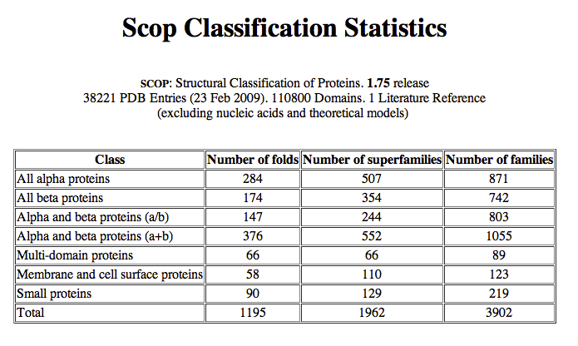
Classification of Protein Structure: SCOP

Slide 42
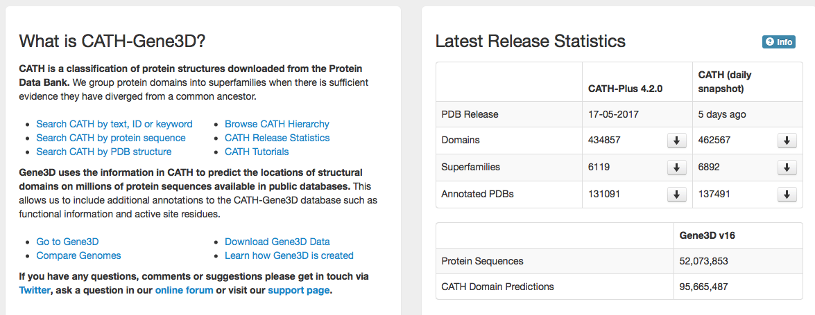
Classification of Protein Structure: CATH
http://www.cathdb.info

Slide 43
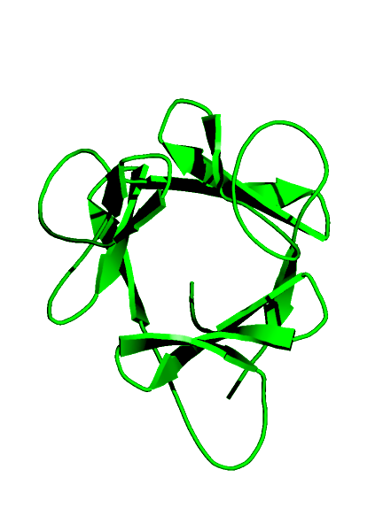
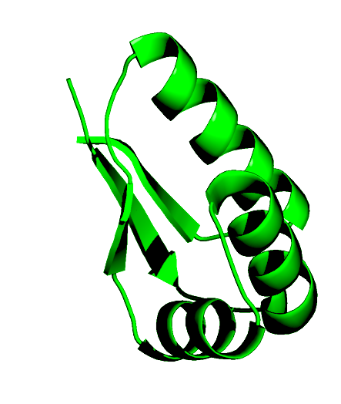
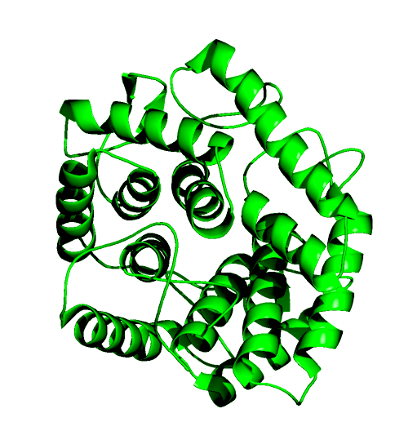
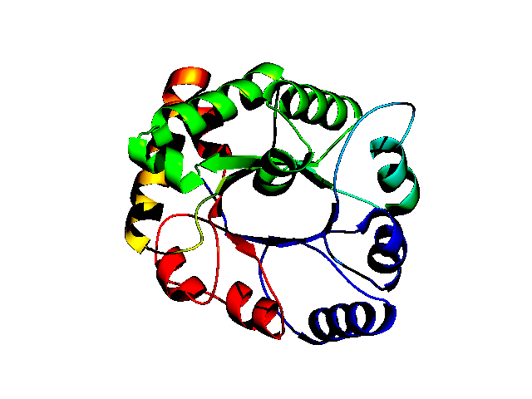
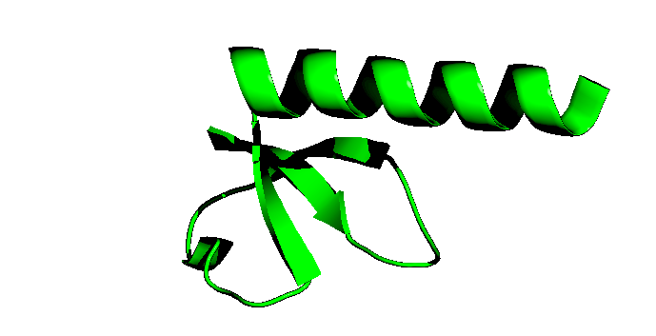
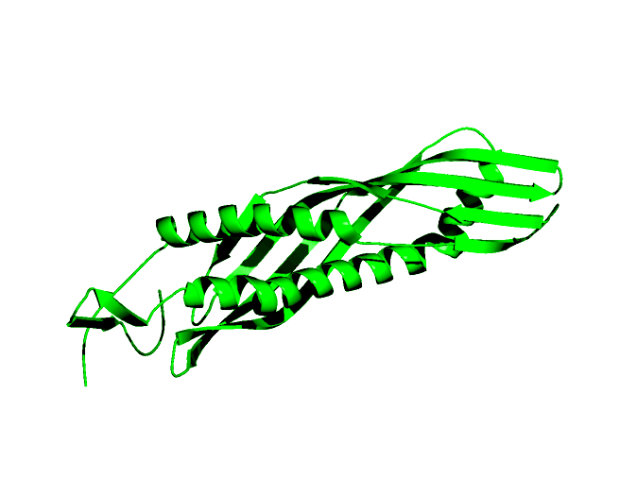
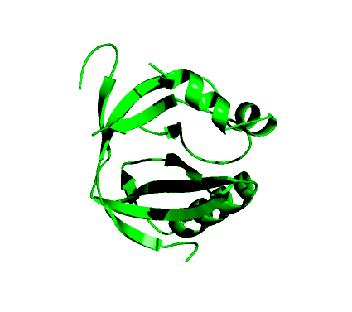
Classification of Protein Structure: CATH
Mixed Alpha
Beta
Alpha
Beta
C
Barrel
Super Roll
Sandwich
A
Tim Barrel
Other Barrel
T

Slide 44
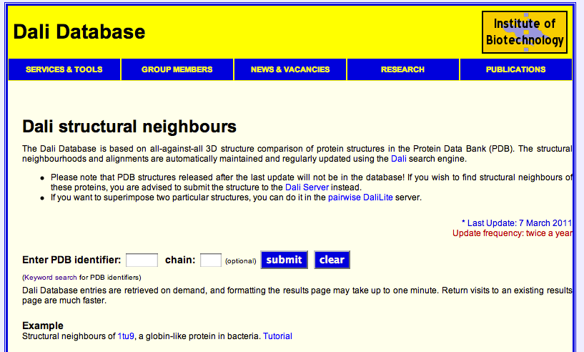
The DALI Database
http://ekhidna.biocenter.helsinki.fi/dali/start

Slide 45
The DALI Domain Dictionary
All-against-all comparison of PDB90 using DALI
Define score of each pair as a Z-score
Regroup proteins based on pair-wise score:
Z-score > 2: “Folds”
Z-score >4, 6, 8, 10 : sub-groups of “folds”
(different from Families, and sub-families!)

Slide 46
Summary
Classification is an important part of biology; protein structures are not exempt
Prior to being classified, proteins are cut into domains
While all structural biologists agree that proteins are usually a collection of domains, there is no consensus on how to delineate the domains
There are three main protein structure classification:
- SCOP (manual)
source of evolutionary information
- CATH (semi-automatic)
source of geometric information
- Dali (automatic)
source of raw data

