Slide 1
Digital Data
Patrice Koehl
Computer Science
UC Davis

Slide 2
Digital Data
Binary and hexadecimal representations
Different types of numbers: natural numbers, integers, real numbers
ASCII code and UNICODE
Sound: Sampling, and Quantitizing
Images

Slide 3
Digital Data
Binary and hexadecimal representations
Different types of numbers: natural numbers, integers, real numbers
ASCII code and UNICODE
Sound: Sampling, and Quantitizing
Images

Slide 4
Number representation
We are used to counting in base 10:
1000
100
10
1
10³ 10² 10¹ 10⁰
….. thousands hundreds tens units
Example:
1
7
3
2
digits
1000
100
10
1
1x1000+7x100+3x10+2x1 = 1732

Slide 5
Number representation
Computers use a different system: base 2:
1024 512 256 128 64 32 16 8 4 2 1
2¹⁰ 2⁹ 2⁸ 2⁷ 2⁶ 2⁵ 2⁴ 2³ 2² 2¹ 2⁰
Example:
bits
1 1 0 1 1 0 0 0 1 0 0
1024 512 256 128 64 32 16 8 4 2 1
1x1024+1x512+0x256+1x128+1x64+0x32+ 0x16+ 0x8 + 1x4 + 0x2 + 0x1 = 1732

Slide 6
Number representation
Base 10 | Base 2
0 | 0
1 | 1
2 | 10
3 | 11
4 | 100
5 | 101
6 | 110
… | …
253 | 11111101
254 | 11111110
255 | 11111111
… | …

Slide 7
Conversion
From base 2 to base 10:
1 1 1 0 1 0 1 0 1 0 0
1024 512 256 128 64 32 16 8 4 2 1
1x1024+1x512+1x256+0x128+1x64+0x32+ 1x16+ 0x8 + 1x4 + 0x2 + 0x1 = 1876
From base 10 to base 2:
1877 %2 = 938 Remainder 1
938 %2 = 469 Remainder 0
469 %2 = 234 Remainder 1
234 %2 = 117 Remainder 0
117 %2 = 58 Remainder 1
58 %2 = 29 Remainder 0
29 %2 = 14 Remainder 1
14 %2 = 7 Remainder 0
7 %2 = 3 Remainder 1
3 %2 = 1 Remainder 1
1 %2 = 0 Remainder 1
1877 (base10) = 11101010101 (base 2)

Slide 8
Facts about Binary Numbers
Each “digit” of a binary number (each 0 or 1) is called a bit
1 byte = 8 bits
1 KB = 1 kilobyte = 2¹⁰ bytes = 1024 bytes (≈1 thousand bytes)
1 MB = 1 Megabyte = 2²⁰ bytes = 1,048,580 bytes (≈ 1 million bytes)
1 GB = 1 Gigabyte = 2³⁰ bytes = 1,073,741,824 bytes (≈1 billion bytes)
1 TB = 1 Tetabyte = 2⁴⁰ bytes = 1,099,511,627,776 bytes (≈ 1 trillion bytes)
A byte can represent numbers up to 255: 11111111 (base 2) = 255 (base 10)
The largest number represented by a binary number of size N is 2^{N} - 1

Slide 9
Big Data: Volume
Byte Kilobyte Megabyte Gigabyte Terabyte Petabyte Exabyte Zettabyte Yottabyte
KB MB GB TB PB EB ZB YB
1000 bytes 1000 KB 1000 MB 1000 GB 1000 TB 1000 PB 1000 ZB 1000YB

Slide 10

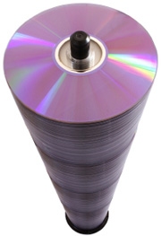






Big Data: Volume
One page
of text
6 million
books
55 storeys
of DVD
Data
up to
2003
Data
in 2011
NSA
data center
One song
One movie
30KB
5 MB
5 GB
1 TB
1 PB
5 EB
1.8 ZB
1 YB
Byte Kilobyte Megabyte Gigabyte Terabyte Petabyte Exabyte Zettabyte Yottabyte
KB MB GB TB PB EB ZB YB
1000 bytes 1000 KB 1000 MB 1000 GB 1000 TB 1000 PB 1000 ZB 1000YB

Slide 11
Big Data: Volume
One page
of text
6 million
books
55 storeys
of DVD
Data
up to
2003
Data
in 2011
NSA
data center
One song
One movie
30KB
5 MB
5 GB
1 TB
1 PB
5 EB
1.8 ZB
1 YB
Byte Kilobyte Megabyte Gigabyte Terabyte Petabyte Exabyte Zettabyte Yottabyte
KB MB GB TB PB EB ZB YB
1000 bytes 1000 KB 1000 MB 1000 GB 1000 TB 1000 PB 1000 ZB 1000YB
1s 20 mins 11 days 30 years 300 30 million 30 billion ….
centuries years years

Slide 12
Hexadecimal numbers
While base 10 and base 2 are the most common bases used
to represent numbers, others are also possible:
base 16 is another popular one, corresponding to
hexadecimal numbers
256 16 1
16² 16¹ 16⁰
The “digits” are: 0 1 2 3 4 5 6 7 8 9 A B C D E F
2 A F
Example:
256 16 1
2x256 + 10*16 + 15x1 = 687

Slide 13
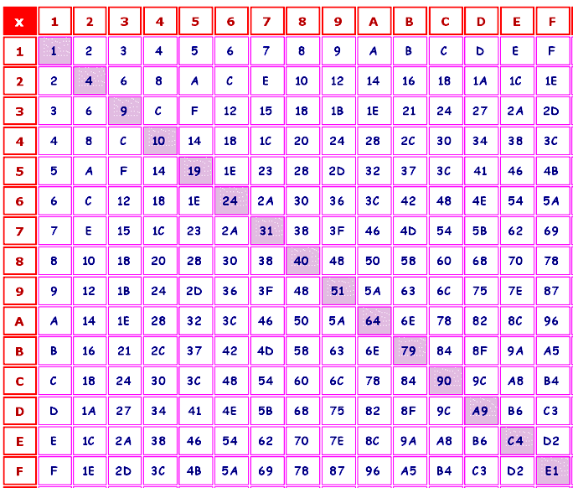
Hexadecimal numbers
Everything we have learned in base 10 should be studied
again in other bases !!
Example: multiplication table in base 16:

Slide 14
Hexadecimal numbers
Base 10 | Base 2 | Base 16
0 | 0000 | 0
1 | 0001 | 1
2 | 0010 | 2
3 | 0011 | 3
4 | 0100 | 4
5 | 0101 | 5
6 | 0110 | 6
7 | 0111 | 7
8 | 1000 | 8
9 | 1001 | 9
10 | 1010 | A
11 | 1011 | B
12 | 1100 | C
13 | 1101 | D
14 | 1110 | E
15 | 1111 | F

Slide 15
Conversion: From base 2 to base 16, and back
This is in fact easy!!
From base 2 to base 16:
Example: 11011000100
Step 1: break into groups of 4 (starting from the right):
110 1100 0100
Step 2: pad with 0, if needed:
0110 1100 0100
Step 3: convert each group of 4, using table:
6 C 4
Step 4: regroup:
6C4
11011000100 (base 2) = 6C4 (base 16)

Slide 16
Conversion: From base 2 to base 16, and back
From base 16 to base 2:
Example: 4FD
Step 1: split:
4 F D
Step 2: convert each “digit”, using table:
0100 1111 1101
Step 3: Remove leading 0, if needed
100 1111 1101
Step 4: regroup:
10011111101
4FD (base 16) = 10011111101 (base 2)

Slide 17
Digital Data
Binary and hexadecimal representations
Different types of numbers: natural numbers, integers, real numbers
ASCII code and UNICODE
Sound: Sampling, and Quantitizing
Images

Slide 18
The different set of numbers

Slide 19
Representing Integers
Unsigned integers (natural numbers):
Num
Sizes
  Char: 1 bit
  Unsigned short: 16 bits (2 bytes)
  Unsigned int: 32 bits (4 bytes)

Slide 20
Representing Integers
Signed integers
s
Num
S:
sign bit: 0 means positive, 1 means negative
Num:
If s = 0, direct representation of the number in binary form
If s = 1, two’s complement of the number
Sizes
  Char: 1 bit
  Short: 16 bits (2 bytes)
  int: 32 bits (4 bytes)

Slide 21
Representing Integers: two’s complement
The two's complement of an N-bit number is defined as its complement with respect to 2^{N}
The sum of a number and its two's complement is 2^{N}.
For instance, for the three-bit number 010, the two's complement is 110, because
010 + 110 = 1000 (= 2³ = 8).
The two's complement is calculated by inverting the bits and adding one.

Slide 23
IEEE Floating Point Representation
IEEE Standard 754
  Established in 1985 as uniform standard for floating point arithmetic
    Before that, many idiosyncratic formats
  Supported by all major CPUs
Driven by Numerical Concerns
  Nice standards for rounding, overflow, underflow
  Hard to make go fast
    Numerical analysts predominated over hardware types in defining standard

Slide 24
IEEE Floating Point Representation
Numerical Form
  (–1)^{s} M 2E
    Sign bit s determines whether number is negative or positive
    Significand M normally a fractional value in range [1.0,2.0).
    Exponent E weights value by power of two
Encoding
  MSB is sign bit
  exp field encodes E
  frac field encodes M
s
exp
frac

Slide 25
IEEE Floating Point Representation
s
exp
frac
Encoding
  MSB is sign bit
  exp field encodes E
  frac field encodes M
Sizes
  Single precision: 8 exp bits, 23 frac bits
    (32 bits total)
  Double precision: 11 exp bits, 52 frac bits
    (64 bits total)
  Extended precision: 15 exp bits, 63 frac bits
    Only found in Intel-compatible machines
    Stored in 80 bits (1 bit wasted)

Slide 26
IEEE Floating Point Representation
Special value:
  exp = 111…1
  exp = 111…1, frac = 000…0
    Represents value ∞ (infinity)
    Operation that overflows
    Both positive and negative
    E.g., 1.0/0.0 = −1.0/−0.0 = +∞, 1.0/−0.0 = −∞
  exp = 111…1, frac ≠ 000…0
    Not-a-Number (NaN)
    Represents case when no numeric value can be determined
    E.g., sqrt(–1), ∞ − ∞

Slide 27
Floating Point Operations
Conceptual View
  First compute exact result
  Make it fit into desired precision
    Possibly overflow if exponent too large
    Possibly round to fit into frac
Rounding Modes (illustrate with $ rounding)
$1.40 $1.60 $1.50 $2.50 –$1.50
  Round down (-∞) $1 $1 $1 $2 –$2
  Round up (+∞) $2 $2 $2 $3 –$1
  Nearest Even $1 $2 $2 $2 –$2
Note:
1. Round down: rounded result is close to but no greater than true result.
2. Round up: rounded result is close to but no less than true result.

Slide 28
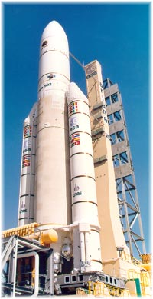
Unwanted noise
Computers encounter noise!
The Ariane 5 tragedy: On June 1996,
the first Ariane 5 was launched…
and exploded after 37 seconds
The failure of the Ariane 501 was
caused by the complete loss of
guidance and altitude information
37 seconds after start….due to a
numerical error.
https://www.wired.com/2005/11/historys-worst-software-bugs/

Slide 29
Digital Data
Binary and hexadecimal representations
Different types of numbers: natural numbers, integers, real numbers
ASCII code and UNICODE
Sound: Sampling, and Quantitizing
Images

Slide 30
ASCII
American Standard Code for Information Interchange
So far, we have seen how computers can handle numbers.
What about letters / characters?
The ASCII code was designed for that: it assigns a number to
each character:
    A-Z: 65- 90
    a-z: 97-122
    0-9: 48- 57

Slide 31
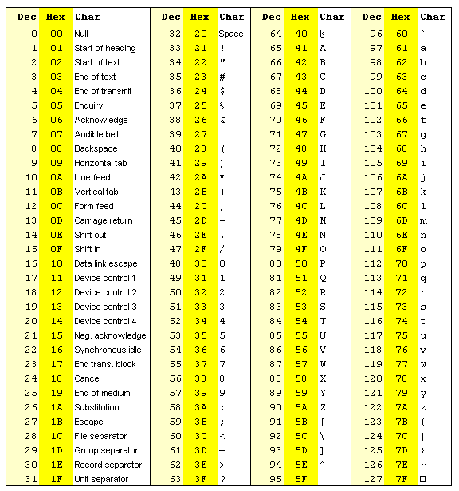
ASCII
American Standard Code for Information Interchange

Slide 32
UNICODE
ASCII only contains 127 characters (though an extended version exists with 257 characters).
This is by far not enough as it is too restrictive to the English language.
UNICODE was developed to alleviate this problem: the latest version, UNICODE 14.0 (September 2021) contains more than 140,000 characters, covering most existing languages.
For more information, see:
http://www.unicode.org/versions/Unicode14.0.0/

Slide 33
Digital Data
Binary and hexadecimal representations
Different types of numbers: natural numbers, integers, real numbers
ASCII code and UNICODE
Sound: Sampling, and Quantitizing
Images

Slide 34
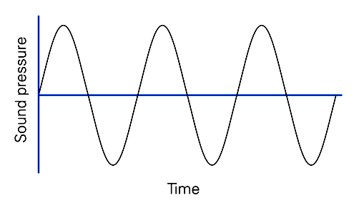
Sound is produced by the vibration of a media like air or water. Audio refers to the sound within the range of human hearing.
Naturally, a sound signal is analog, i.e. continuous in both time and amplitude.
To store and process sound information in a computer or to transmit it through a computer network, we must first convert the analog signal to digital form using an analog-to-digital converter ( ADC ); the conversion involves two steps:
(1) sampling, and
(2) quantization.
Digital Sound

Slide 35
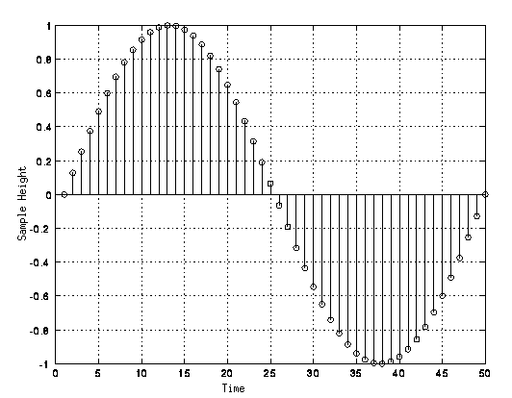
Sampling
Sampling is the process of examining the value of a continuous function
at regular intervals.
Sampling usually occurs at uniform intervals, which are referred to as sampling intervals. The reciprocal of sampling interval is referred to as the sampling frequency or sampling rate.
If the sampling is done in time domain, the unit of sampling interval is second and the unit of sampling rate is Hz, which means cycles per second.

Slide 36
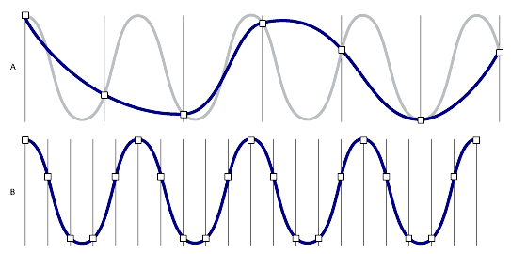
Sampling
Note that choosing the sampling rate is not innocent:
A higher sampling rate usually allows for a better representation of the original sound
wave. However, when the sampling rate is set to be strictly greater than twice the highest frequency in the
signal, the original sound wave can be reconstructed without loss from the samples.
This is known as the Nyquist theorem.

Slide 37
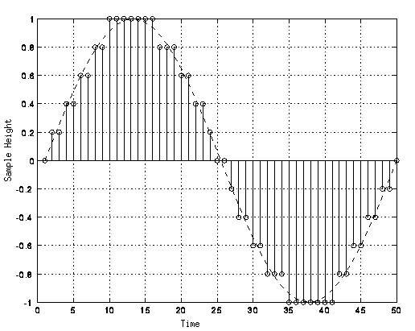
Quantization
Quantization is the process of limiting the value of a sample of a continuous
function to one of a predetermined number of allowed values,
which can then be represented by a finite number of bits.

Slide 38
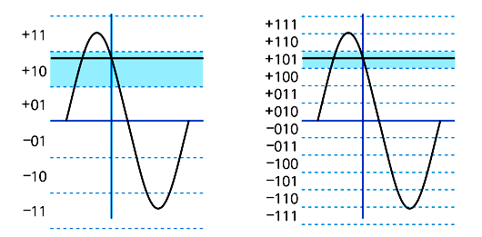
Quantization
The number of bits used to store each intensity defines the accuracy of
the digital sound:
Adding one bit makes the sample twice as accurate

Slide 39
Audio Sound
Sampling:
The human ear can hear sound up to 20,000 Hz: a sampling rate of
40,000 Hz is therefore sufficient. The standard for digital audio is
44,100 Hz.
Quantization:
The current standard for the digital representation of audio sound is to use
16 bits (i.e 65536 levels, half positive and half negative)

Slide 40
Audio Sound
How much space do we need to store one minute of music?
60 seconds
44,100 samples
16 bits (2 bytes) per sample
2 channels (stereo)
S = 60x44100x2x2 = 10,534,000 bytes ≈ 10 MB !!
1 hour of music would be more than 600 MB !

Slide 41
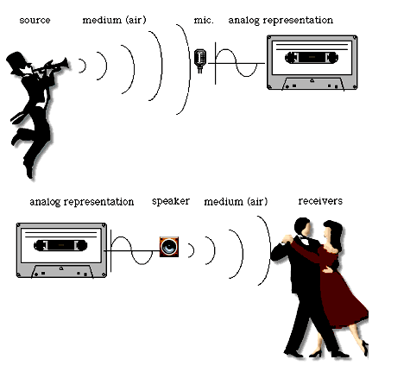
Analog Recording
www.atpm.com/6.02/digitalaudio.shtml

Slide 42
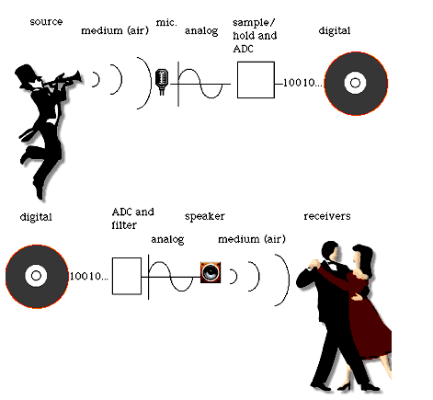
DIGITAL RECORDING
www.atpm.com/6.02/digitalaudio.shtml

Slide 43
DIGITAL RECORDING
Advantages of digital recording:
Faithful
  can make multiple identical copies
Can be processed
  compression (MP3)
www.atpm.com/6.02/digitalaudio.shtml

Slide 44
Digital Data
Binary and hexadecimal representations
Different types of numbers: natural numbers, integers, real numbers
ASCII code and UNICODE
Sound: Sampling, and Quantitizing
Images

Slide 45

Digital Images

Slide 46
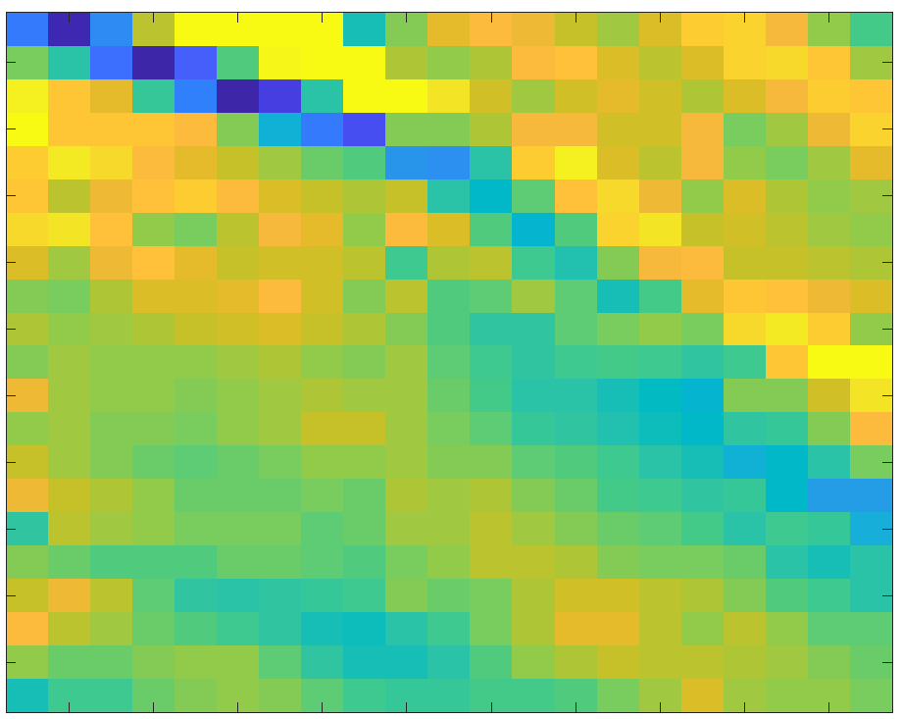
Digital Images

Slide 47
Digital Images
Sampling:
Images are broken down into little squares: pixels
Resolution: Number of squares along each direction
Quantization:
Each pixel is characterized either as
A binary number (0 or 1) to indicate black or white
A natural number between 0 and 255, to indicate a gray scale
- A set of three numbers, each between 0 and 255, to indicate the amount of Red (R), Green (G), and Blue (B)
“True Color”: a pixel is represented by 24 bits, corresponding to 16,777,216 possible colors

Slide 48
Digital Images
The RGB color model (used for most digital representations of images)
Mixing colors:

Slide 49
Digital Images
The CMYK color model (used by color printers)

