Slide 1

Computers
Logic and CPU
Patrice Koehl
Computer Science
UC Davis

Slide 2
Computers
Logic: acting on information
The Central Processing Unit (CPU)
Elements of a Computer

Slide 3
Computers
Logic: acting on information
The Central Processing Unit (CPU)
Elements of a Computer

Slide 4
The concept of pressure
When we remove the block, what is the effect on pressure?

Slide 5
The concept of pressure
Decreases
When we remove the block, what is the effect on pressure?

Slide 6
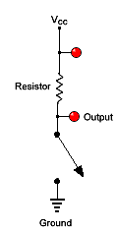
Electrical pressure: voltage
If switch is off (0) (equivalent to
the presence of the block)
V_{output}=V_{cc} high (i.e. 1)
If switch is on (1) (equivalent to
the absence of the block)
Switch
V_{output}<<V_{cc} low (i.e. 0)
“Inverter”

Slide 7
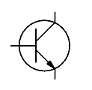
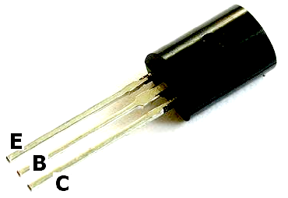
The transistor
A transistor can be used as an
electronic switch:
if V_{base} is high, the current
“flows” between the emitter and
the collector
(switch is on)
If V_{base} is low, the current
does not pass
(switch is off)
Collector
Base
Emitter

Slide 8
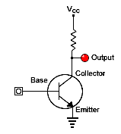
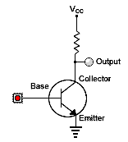
The not gate
1
0
Input: 0
Input: 1
Input | Output
0 | 1
1 | 0

Slide 9
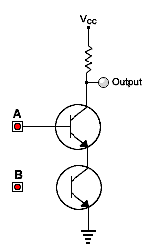
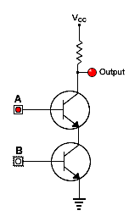
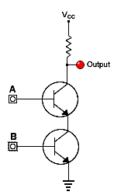
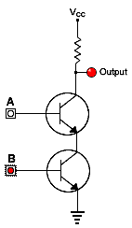
The not-and (NAND) gate
Input A | Input B | Output
1 | 1 | 0
1 | 0 | 1
0 | 1 | 1
0 | 0 | 1

Slide 10
The AND gate
Input A | Input B | Output
1 | 1 | 1
1 | 0 | 0
0 | 1 | 0
0 | 0 | 0

Slide 11
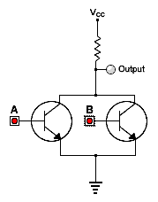
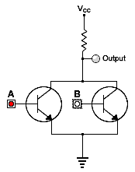
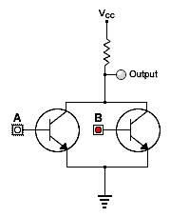
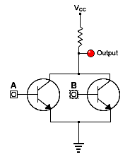
The not-or (NOR) gate
Input A | Input B | Output
1 | 1 | 0
1 | 0 | 0
0 | 1 | 0
0 | 0 | 1

Slide 12

The OR gate
Input A | Input B | Output
1 | 1 | 1
1 | 0 | 1
0 | 1 | 1
0 | 0 | 0

Slide 13
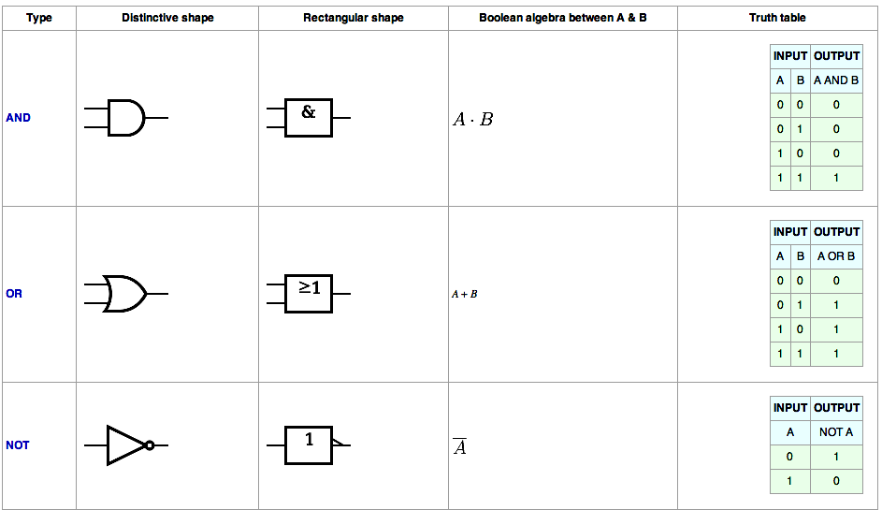
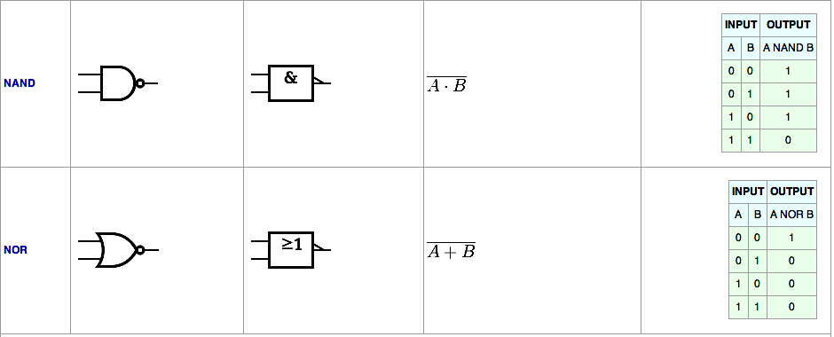
http://en.wikipedia.org/wiki/Logic_gate

Slide 14
Computers
Logic: acting on information
The Central Processing Unit (CPU)
Elements of a Computer

Slide 15
The Central Process Unit (CPU)
CPU
ALU
Control
Input
Memory
Output
The CPU consists of three parts:
the Arithmetic Logic Unit (ALU)
The Control Unit
Memory

Slide 16
The Fetch/Execute Cycle
The CPU cycles through a series of operations or instructions,
organized in a cycle, the Fetch/Execute cycle:
Instruction Fetch (IF)
Instruction Decode (DP)
Data Fetch (DF)
Instruction Execute (IE)
Result Return

Slide 17
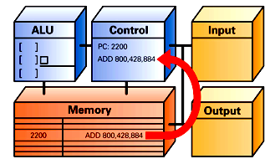
Step 1: Instruction Fetch
Fetch instruction from memory position 2200:
Add numbers in memory positions 884 and 428, and
store results at position 800

Slide 18
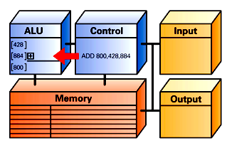
Step 2: Instruction Decode
Decode instruction:
Defines operation (+), and set memory pointers in ALU

Slide 19
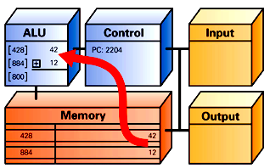
Step 3: Data Fetch
PC: 2200
Fetch data:
Get numbers at memory positions 428 and 884: 42 and 12
and put in ALU

Slide 20
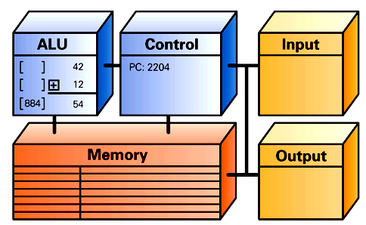
Step 4: Instruction Execution
PC: 2200
[800]
Execute:
Add numbers 42 and 12 in ALU: 54

Slide 21
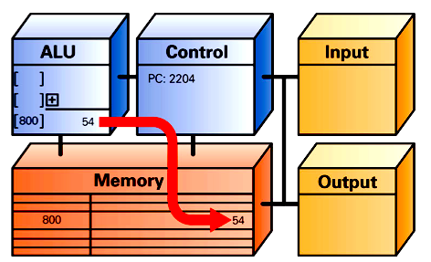
Step 5: Return Result
PC: 2200
Return:
Put results (54) in position 800 in memory

Slide 22
Possible operations
Computers can only perform about 100 different types of operations; all other operations must be broken down into simpler operations among these 100.
Some of these operations:
Add, Mult, Div
AND, OR, NAND, NOR, …
Bit shifts
Test if a bit is 0 or 1
Move information in memory
…

Slide 23
Repeating the F/E cycle
Computers get their impressive capabilities by performing
many of these F/E cycles per second.
The computer clock determines the rate of F/E cycles per
second; it is now expressed in GHz, i.e. in billions of cycles
per seconds!
Note that the rate given is not an exact measurement.

Slide 26
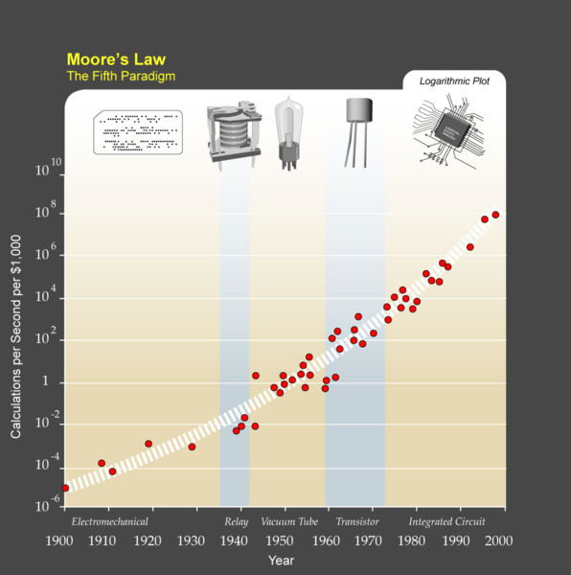
(http://en.wikipedia.org/wiki/Accelerating_change)

Slide 27
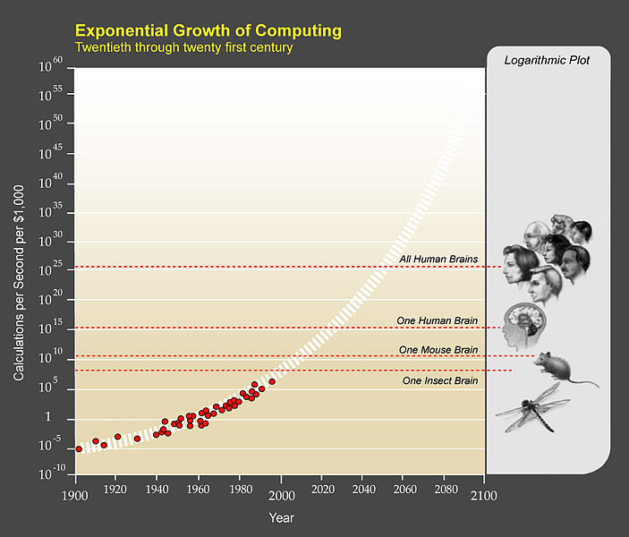
(http://en.wikipedia.org/wiki/Accelerating_change)

Slide 28
Computers
Logic: acting on information
The Central Processing Unit (CPU)
Elements of a Computer

Slide 29
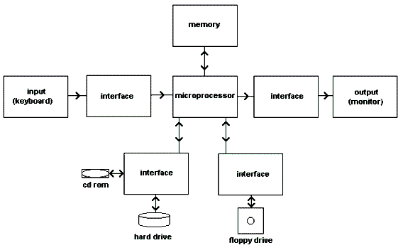
Computer: basic scheme
Input devices
CPU
Output devices
Storage

Slide 30
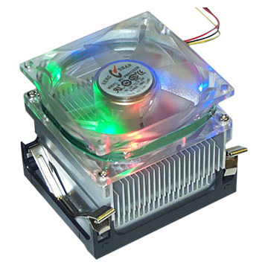
The Central Process Unit (CPU)
CPUs are getting smaller, and can include more than one “core” (or processors).
CPUs get hot, as their internal components dissipate heat: it is important to add a heat sink and fans to keep them cool.

Slide 31
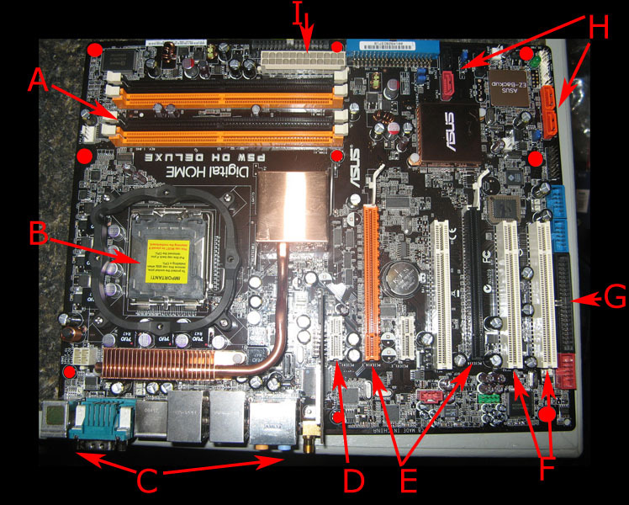
The motherboard:
backbone of the computer
Power supply connector
Slot for memory:
RAM
Hard drive connectors
Slot for CPU
Input/Output: Keyboard, Mouse,…
Extension cards: Video, sound, internet…

Slide 32
Communications on the mother board

